Slide 1

Why #ChoosePsychiatry for Academics
Prof Subodh Dave
Dean, Royal College of Psychiatrists

Slide 2

This Photo by Unknown Author is licensed under CC BY-NC-ND
Notes:
So I’m going to start with a thought (and feeling experiment) – take a moment to notice how you are feeling – right now.. Focus on that feeling and if you feel up to it – write down that feeling in the chat..

Slide 3
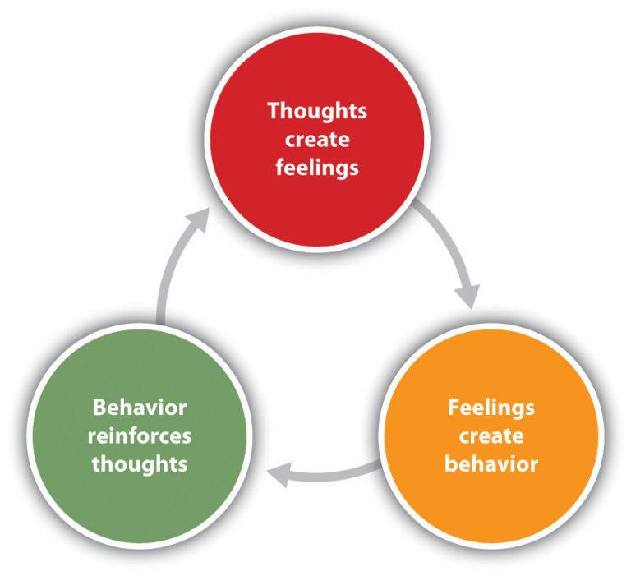

What are the limits of human physiology?
This Photo by Unknown Author is licensed under CC BY-NC
This Photo by Unknown Author is licensed under CC BY-SA-NC
Notes:
Why are feelings important? Brain is a super complex organ – and guess which branch of medicine gets to study it and to study the complex connections between feelings and behaviour? Yup – Psychiatry – THE science that actually invented and now explores PsychoBioSocial

Slide 4
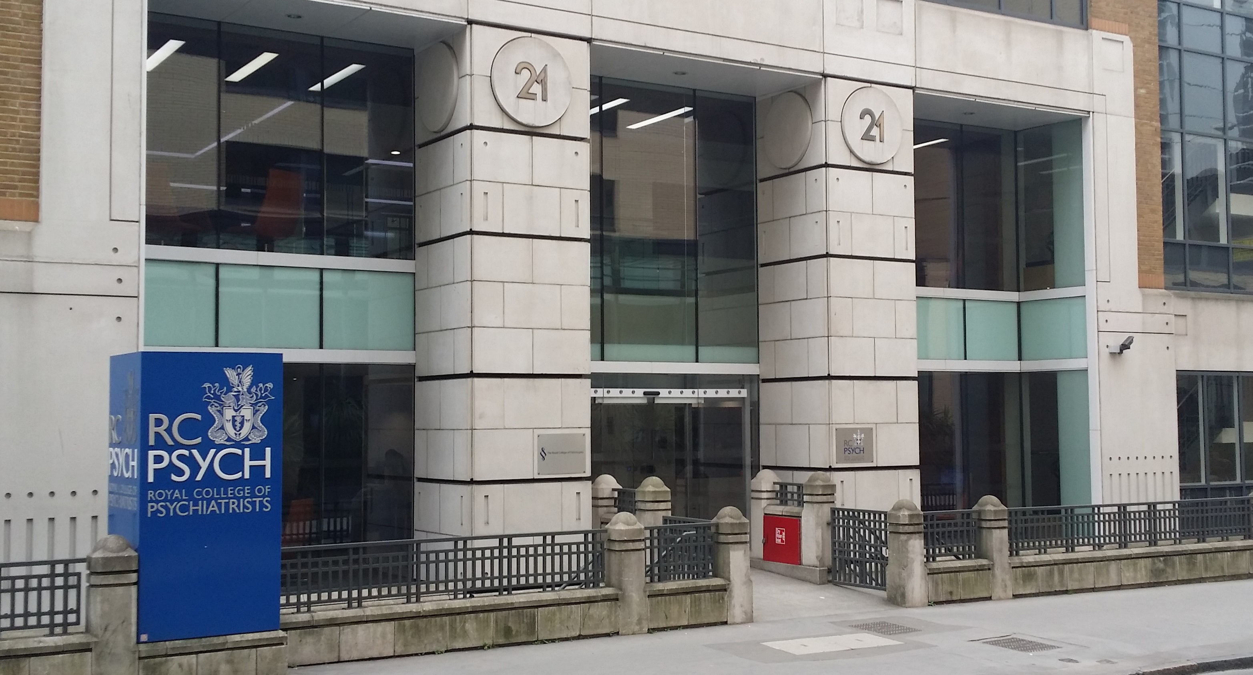
This Photo by Unknown Author is licensed under CC BY-SA
Notes:
Now that we’ve got in touch with our feelings – I can formally welcome you to RCPsych – and you’ve heard from other speakers today – about the exciting things happening in Psychiatry. I wanted to share my personal pathway – and give you an insight on why Psychiatry is THE branch to go into if you are a bright academic looking to solve mysteries in science..

Slide 5
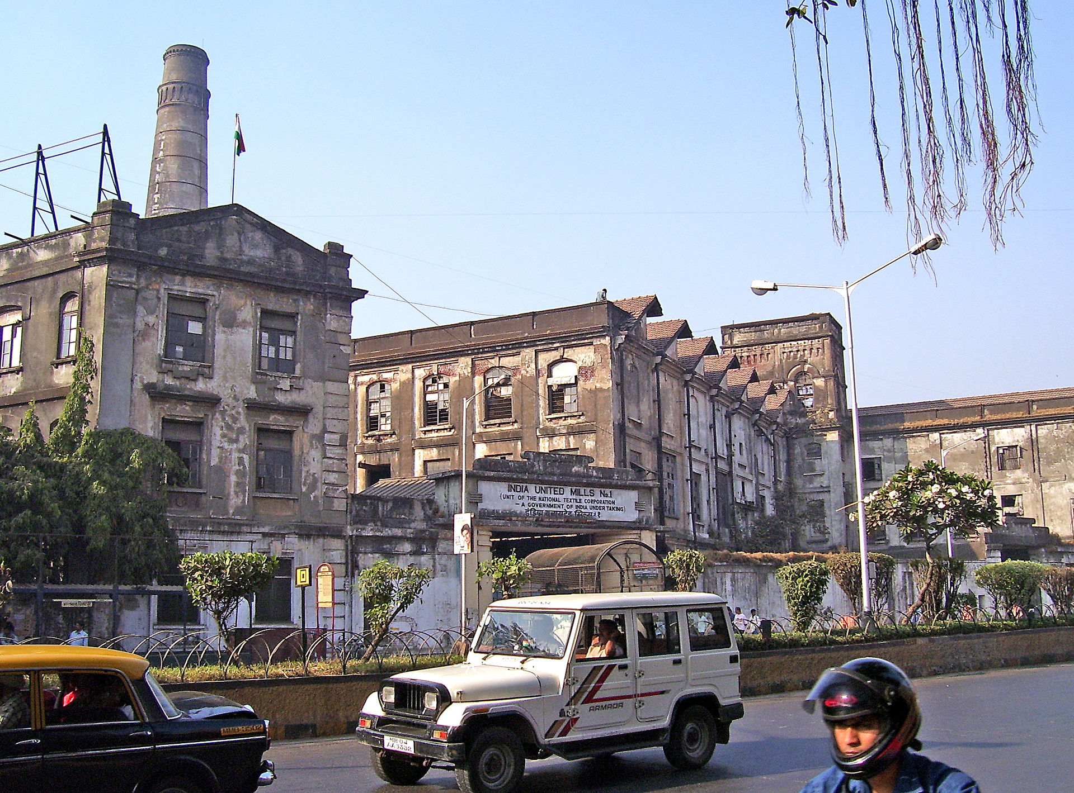
This Photo by Unknown Author is licensed under CC BY-SA
Notes:
I grew up in Mumbai a few minutes from this mill – what’s a textile mill go to to with psychiatry? Well it does and it doesn’t – I grew up at the times of closure of these mills – umemployment and poverty were on the rise – and so was mental illness

Slide 6
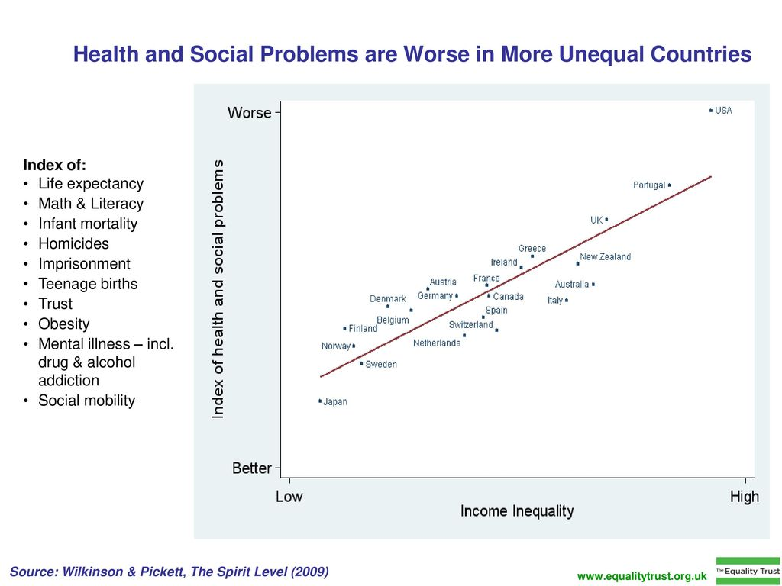
Notes:
In Mumbai even if you are a billionaire you are likely to die earlier..

Slide 7
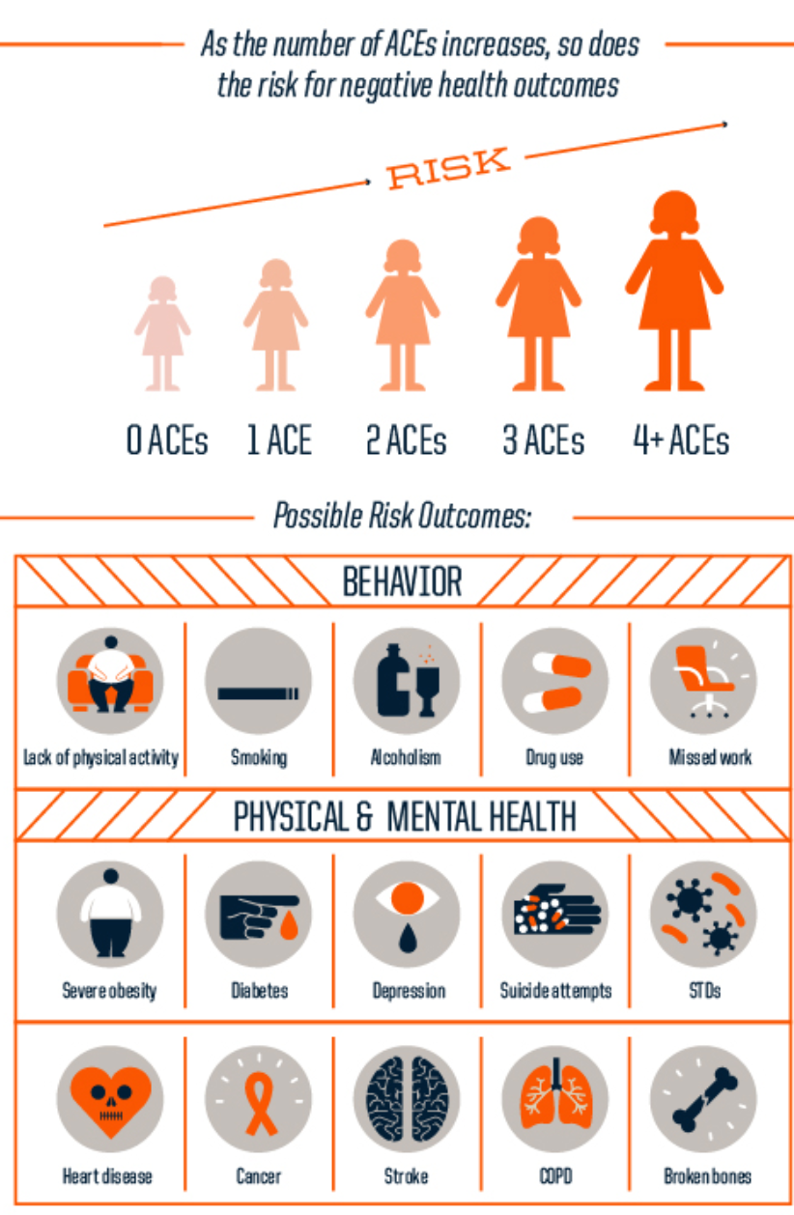
Adverse Childhood Experiences
Notes:
The science around ACEs has been building up – CAMHS has adapted this but I still feel that this knowledge is not reflected in our clinics – in history taking or in shaping trauma-informed careHughes et al5 demonstrate increased
relative risks in adults with four or more ACEs: doubled
risks of heart disease (95% CI 1.66–2.59), alcohol misuse
(1.74–2.78), and cancer (1.82–2.95); tripled rates of chest dis-
eases (2.47–3.77) and anxiety (2.62–5.22); a four-fold
increase in ‘low life satisfaction’ (3.72–5.10) and depression
(3.54–5.46); and a 30-fold increased risk of a suicide attempt
(14.73–61.67).

Slide 8
Why did I #ChoosePsychiatry?
Notes:
Not linked to either poverty and its impact on health outcomes or on the mind body connection – but mainly because I saw it as a very human and humane science- Since then I have had a very satisfying career that combines- academic, clinical, educational and leadership roles but what gives me most pleasure is directly influencing theoutcomes for my patients sometimes simply by talking to them!And to have the inteelectual stimulation of being in a branch of science – not just medicine but science that is looking the big Questions

Slide 9
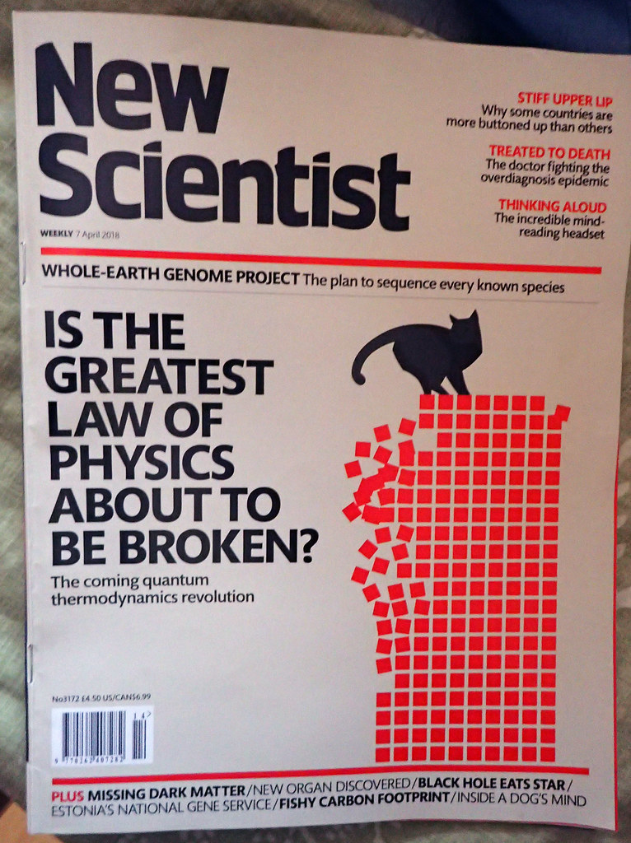
The Big Questions
What is Consciousness?
What is it to be human?
What are the limits of physiology? What is normal/abnormal/hypernormal?
What is nature? What is nurture?
Will we ever cure diseases like cancer? Will we ever have personalised medicine?
This Photo by Unknown Author is licensed under CC BY

Slide 10


Addressing Health Inequalities
Public Mental Health
Person-centred care
This Photo by Unknown Author is licensed under CC BY

Slide 11
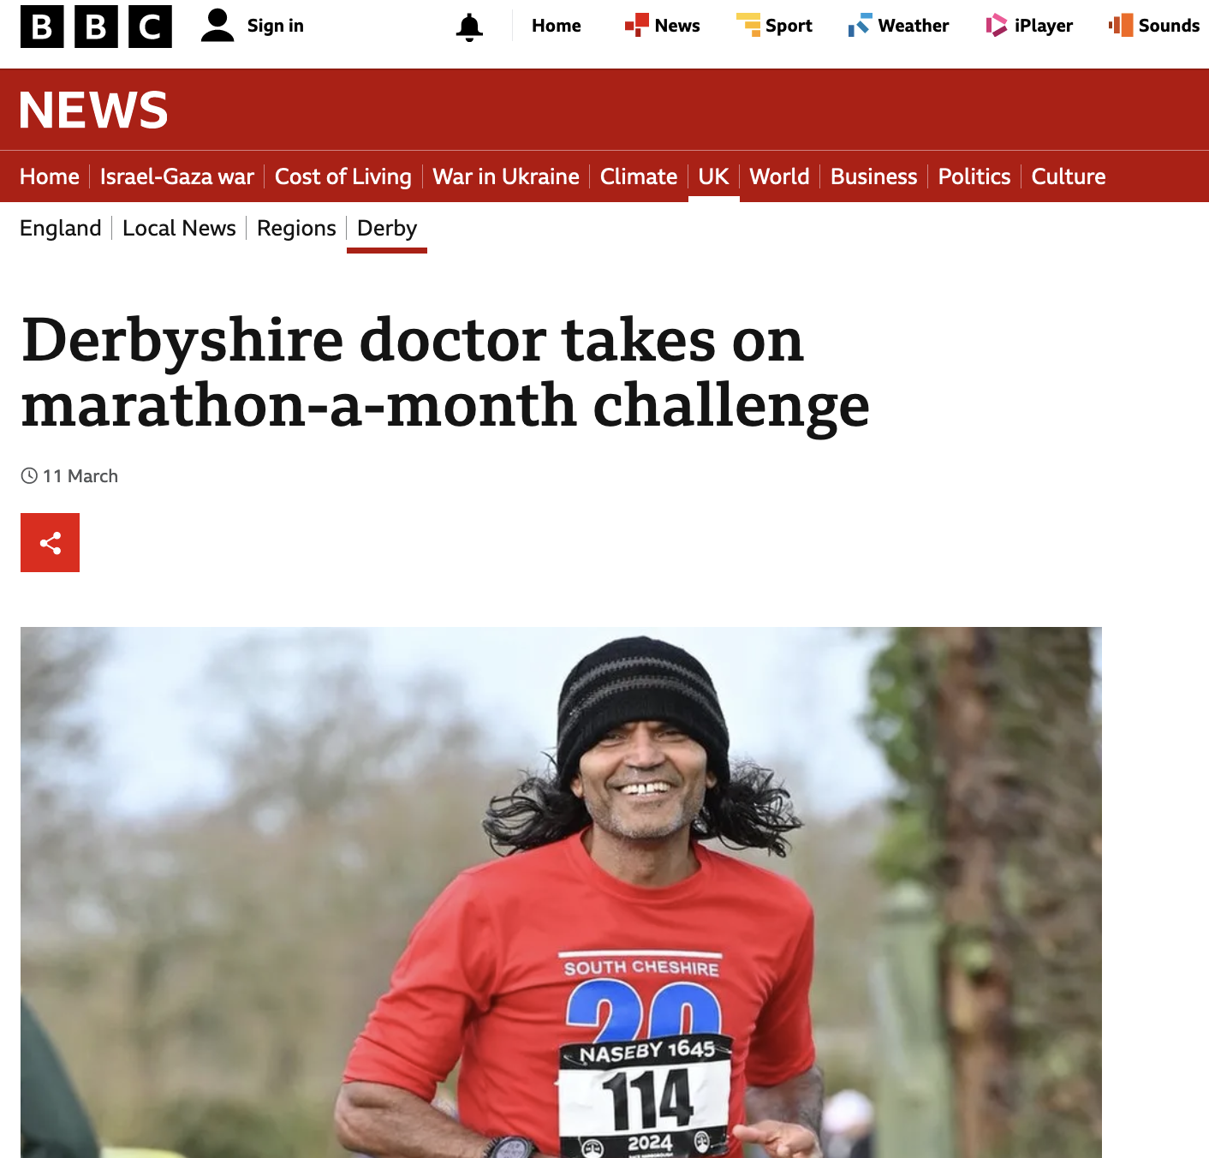
Get in touch
#IdeasToAction
#CanDoWillDo
@subodhdave1
dean@rcpsych.ac.uk
@DoctorsDistress

