Slide 1

How to start in research
Kate Saunders/Shruti Garg
Training co-leads NIHR MH-TRC

Slide 2
“The very first step towards success in any occupation is to become interested in it.”
William Osler

Slide 3
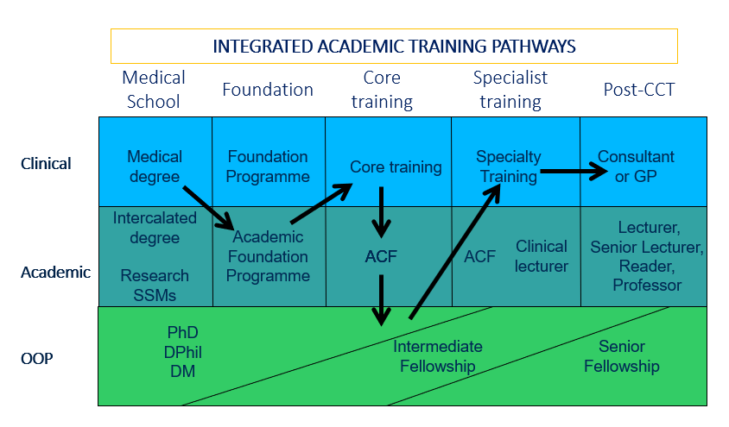

Slide 4
How can you best prepare yourself to start in research?
Make sure you are good clinically
Network with academics at all levels
Build an academic portfolio
Develop self-sufficiency
Find ways around 'obstructions‘
Have a longitudinal plan – avoid short-termism
Trajectory rather than position

Slide 5

www.mentalhealthresearch.org.uk

Slide 6
How can you best prepare yourself to start in research?
Make sure you are good clinically
Network with academics at all levels
Build an academic portfolio
Develop self-sufficiency
Find ways around 'obstructions‘
Have a longitudinal plan – avoid short-termism
Trajectory rather than position

Slide 7
Building an academic portfolio
There is scope for opportunism
Clinical problems
The unusual patient
Chance encounters
The arrival of a new technique
The profitable use of spare time
Fortune favours the prepared mind
– think lots
- read lots
- question lots

Slide 8
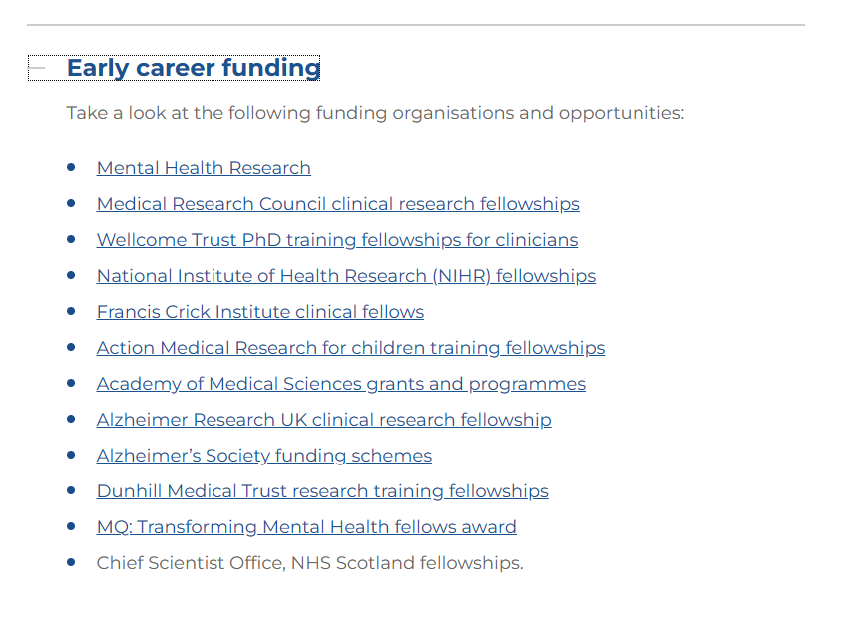
Building an academic portfolio
Approach your local R&D department
Consider further training in research methodology
Get familiar with funding schemes
Explore publicly available data
Academic psychiatry research | Royal College of Psychiatrists (rcpsych.ac.uk)

Slide 9


Slide 10
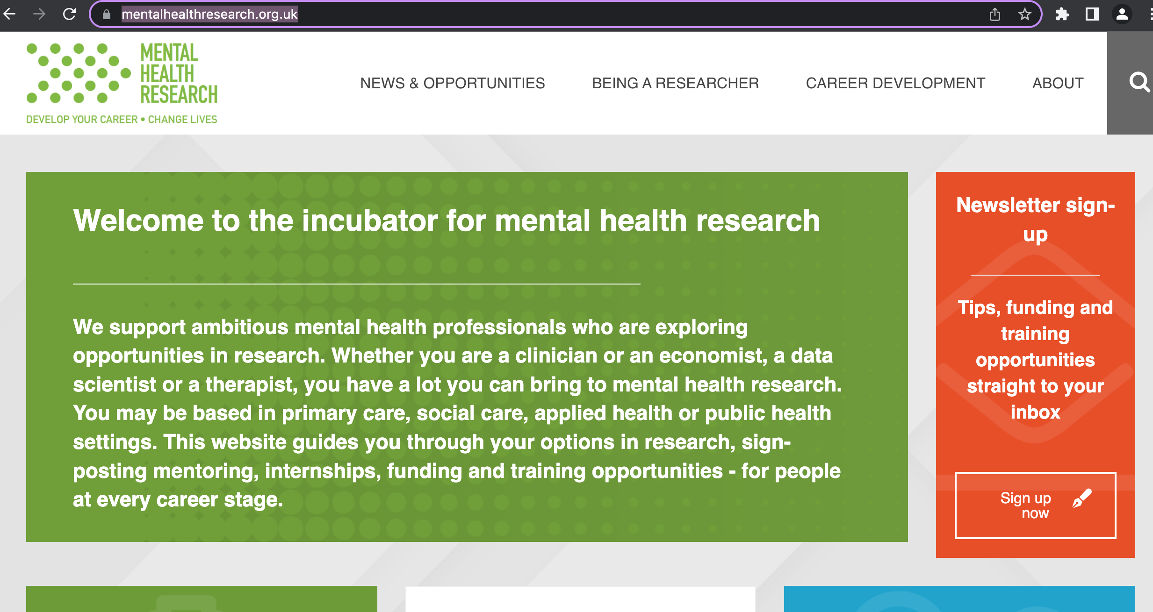
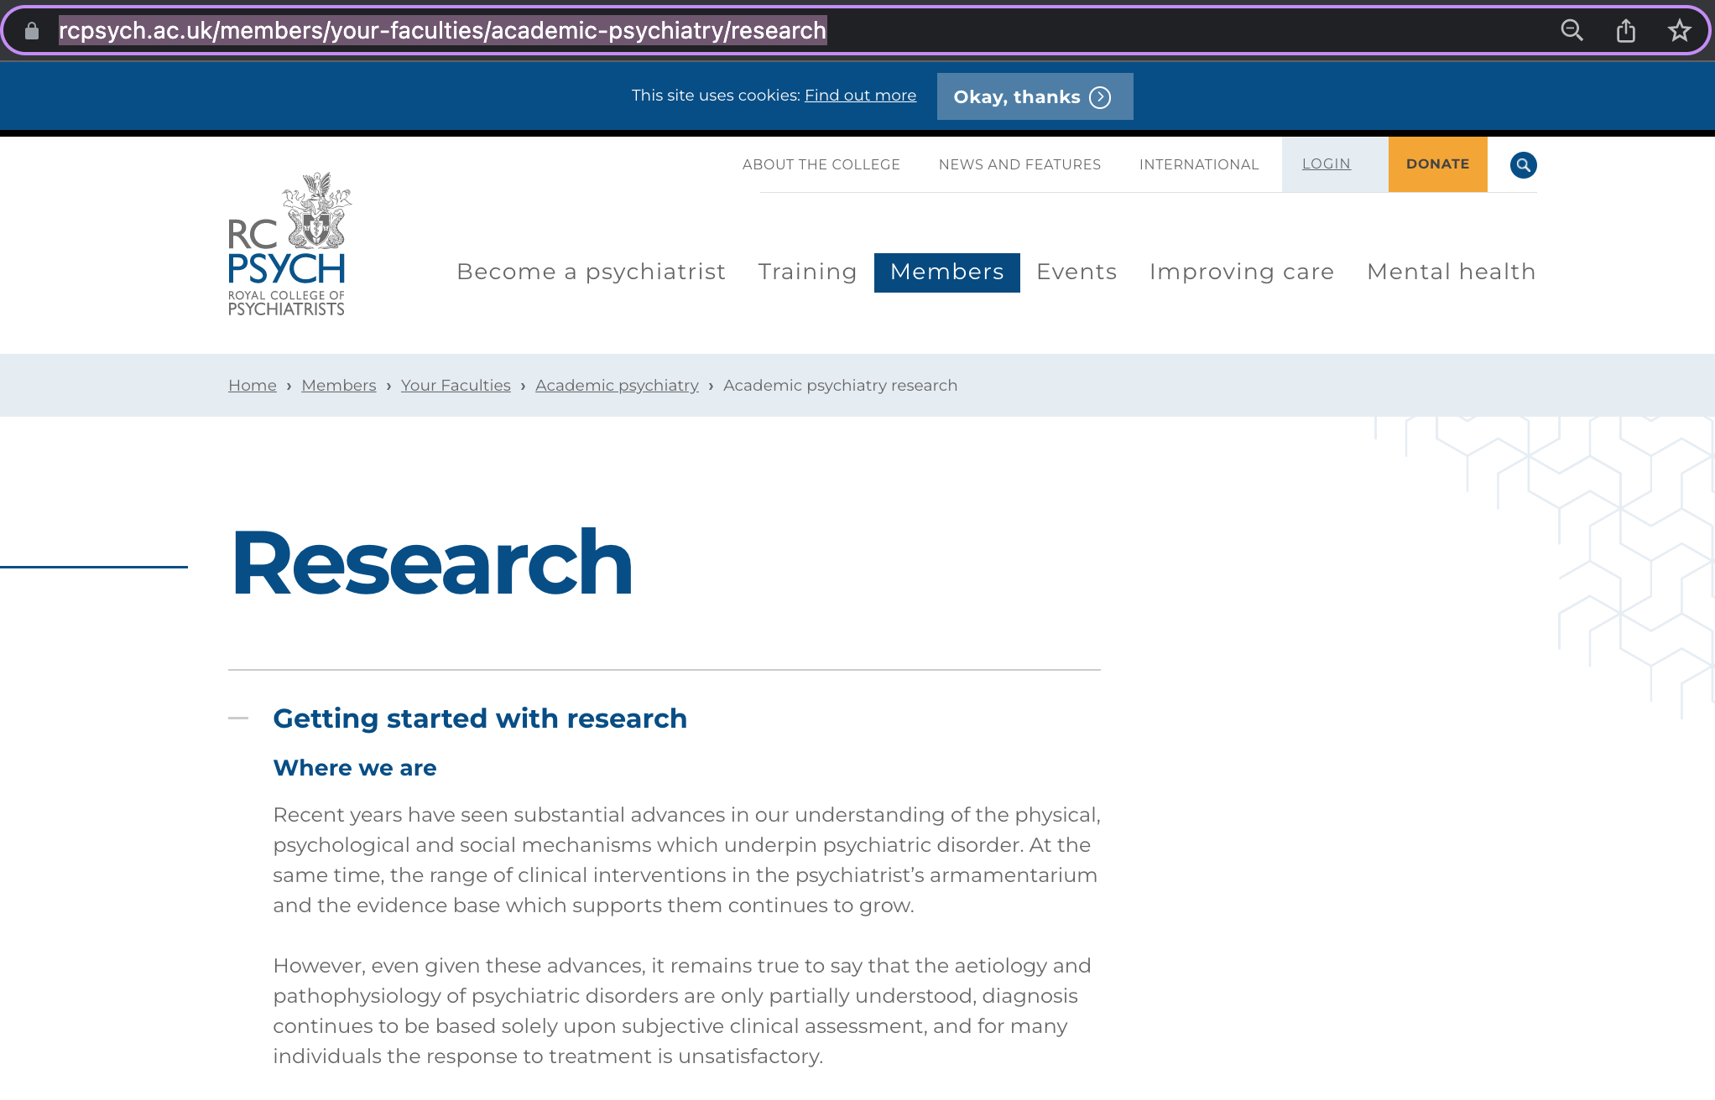


Slide 11
Questions

