Slide 1


Guidance for medical schools
[Your name]
[Title of event and date]

Slide 2
Today’s presentation
Background information
Overview of project aim and methods
Key findings & recommendations
Next steps
Discussion

Slide 3

About the RCPsych
Professional medical body
Aims to improve the outcomes of people with mental illness and the mental health of individuals, their families and communities
Supports psychiatrists throughout their careers
Sets and raises standards of psychiatry in the UK

Slide 4
Key challenges in psychiatry
Recruitment
Retention
Reliance on international medical graduates
Training the wider workforce
Notes:
Suggested text:
Over the past few years, there has been an unprecedented focus on mental health across the UK. Yet a lack of suitably trained staff is widely recognised as one of the biggest risks to achieving parity of esteem between mental and physical health.
Psychiatry faces recruitment & retention challenges – with one in 10 consultant psychiatric roles unfilled according to the College’s latest census. There is also an increasing reliance on recruiting locums and doctors from abroad.
Finally, the Government’s ambitious plans for mental health and the high prevalence of mental illness mean that all future health professionals – including doctors in all specialties - will need to be equipped to provide appropriate support to people with mental illness.

Slide 5
Examples of RCPsych ongoing projects
Highlighting
The positive difference psychiatrists make through our #ChoosePsychiatry campaign
Promoting
Careers in psychiatry in schools, colleges, universities and postgraduate environments
Informing
Workforce policy through gathering intelligence from College networks and census
Supporting
Psychiatrists throughout their careers. Understanding and influencing factors affecting retention
Influencing
Access to the international labour markets
Developing
Other roles - to support people with mental health problems
Notes:
Suggested text:
RCPsych works hard to help address those challenges – here are just a few examples of what the College does.

Slide 6
Aim of this project
#ChoosePsychiatry recruitment campaign focused on foundation doctors and ‘external influencers’ (e.g. peers, the media, etc.)
The College felt it needed a more detailed analysis of students’ experiences at medical school and the factors impacting on their views of the specialty.
Through various discussions with external stakeholders, they realised this project could be particularly helpful and timely for medical schools too.
  The GMC Outcomes for Graduates
  The bidding process for allocating these new places
  They decided to develop a practical guidance with 4 key areas for actions and checklists of suggested actions, to make implementation as easy as possible.
Notes:
Notes for 1. and 2.:
As we said before, the high prevalence of mental illness means that all doctors in all specialties will need to be equipped to provide appropriate support to people with mental illness. This has been recognised by the General Medical Council in its ‘Outcomes for graduates’ document, which include a range of practical skills and procedures related to mental health. One of the project’s objectives is to help medical schools meet those mental health related standards.
In England, you may be aware that when the Government announced new medical school places in 2018, it said that those places would be allocated to areas with a relative shortage of doctors overall and in certain specialties – and psychiatry was one of them. Now the NHS Long Term Plan sets out a proposal for a further expansion of the number of medical schools and once again, the plan is to prioritise schools that can demonstrate a clear plan to encourage more doctors to choose to work in shortage specialities, including psychiatry.
Our findings provide timely insights into some of the key factors that could be considered by medical schools in England, should they want to increase their chances to be allocated those new places.

Slide 7
Methods
A questionnaire to medical schools across the UK
A questionnaire to medical students across the UK (792 respondents)
Six focus groups (26 participants)
Engagement with key stakeholders
Notes:
Stakeholders we worked with: medical school’s education leads, UG education leads in psychiatry, College Officers, College’s workforce leads, members of the CP Committee, the PTC, the MSC…

Slide 8

4 key areas for action
Notes:
Suggested text:
RCPsych has identified 4 key areas for action. You can find the detailed checklists of actions in the guidance itself.

Slide 9
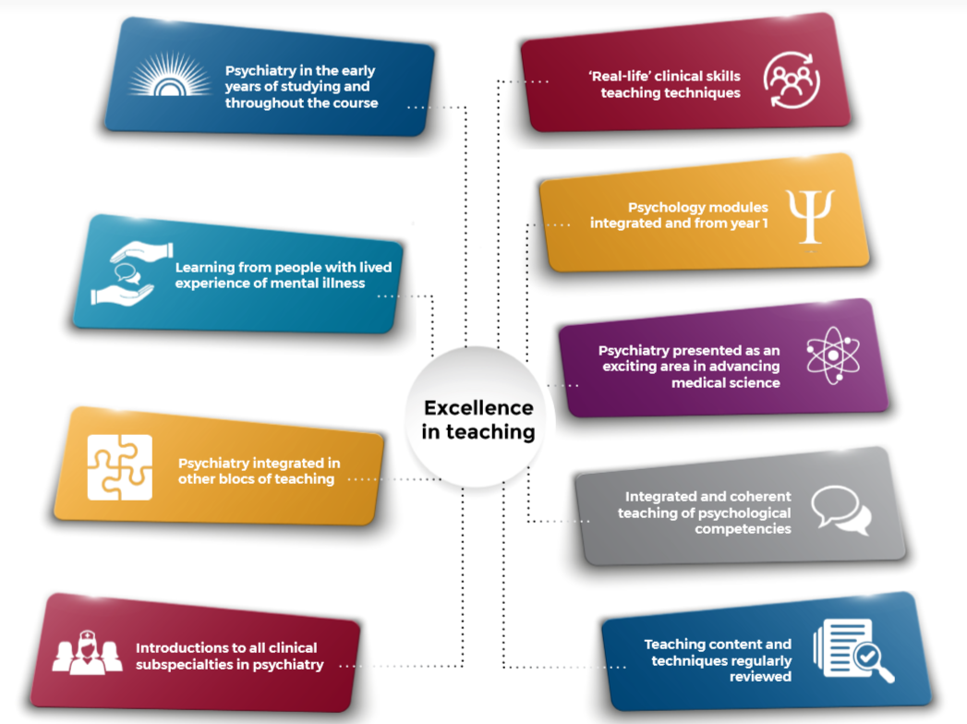
Notes:
Suggested text:
RCPsych examined several aspects of different learning opportunities and how they may affect students’ interest in psychiatry, and suggest a range of initiatives that medical schools could put in place to enhance students’ experiences of psychiatry teaching.
They encourage all medical schools to consider reviewing their undergraduate curriculum in psychiatry to ensure it reflects what we can learn from medical students’ experiences and integrate psychiatry courses into the curriculum as widely and as early as possible.

Slide 10
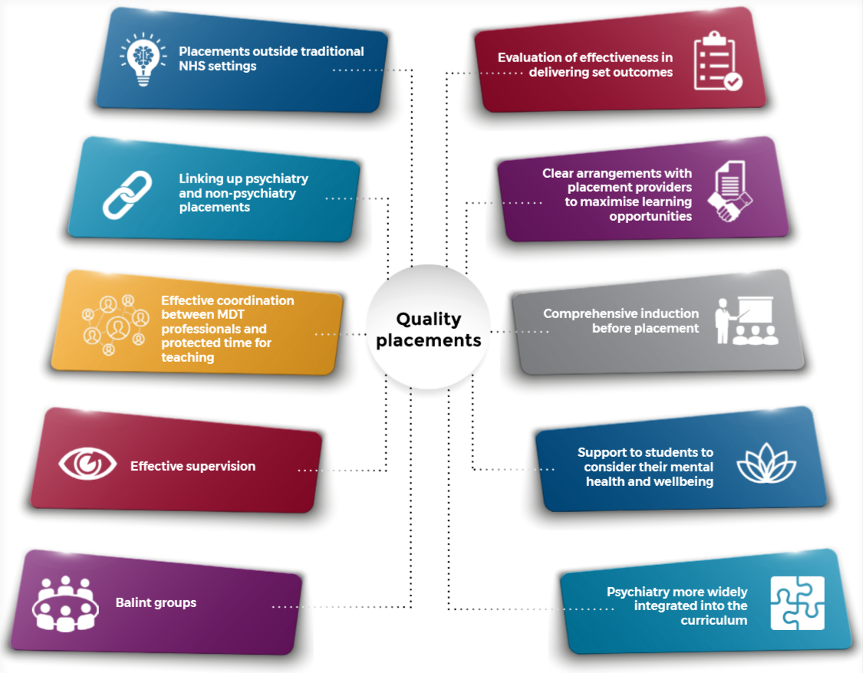
Notes:
Suggested text:
Ensuring that clinical placements have genuine educational value can be difficult for medical schools, as relationships with placement providers can be challenging at a time when budgets for all services are under pressure. In this context, RCPsych explored what medical schools could do to ensure medical students get the best out of their placement in psychiatry.
They encourage all medical schools to work with placement providers to organise high-quality undergraduate placements in psychiatry based on what we can learn from medical students’ experiences.

Slide 11
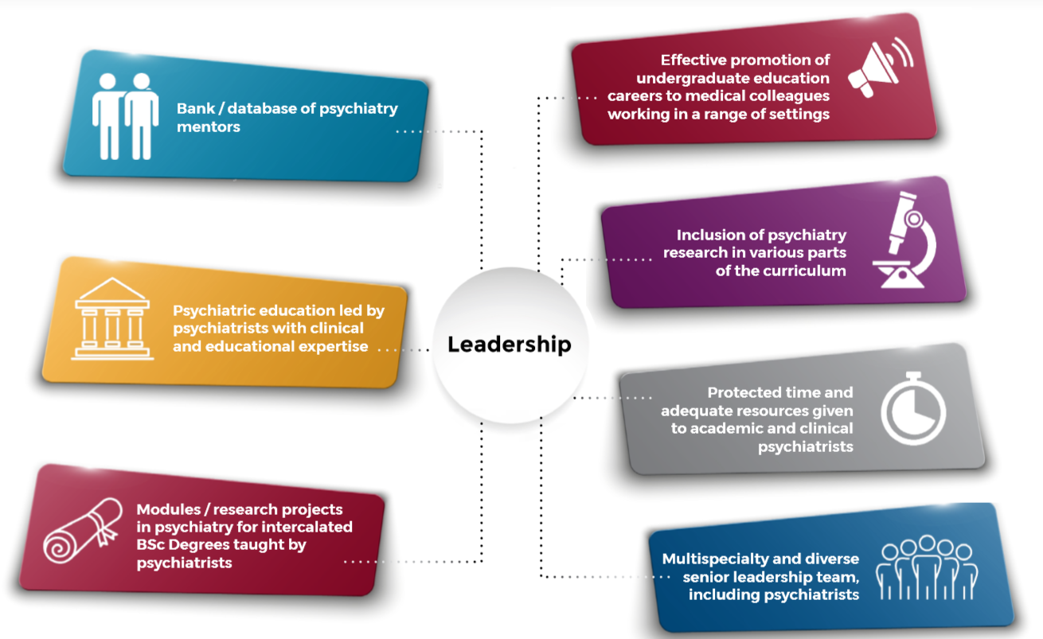
Notes:
Suggested text:
The medical students RCPsych spoke to highlighted the importance of seeing and talking to inspiring consultant psychiatrists during their time at medical school. They explored what actions medical schools could take to raise the profile of psychiatrists in undergraduate education.

Slide 12
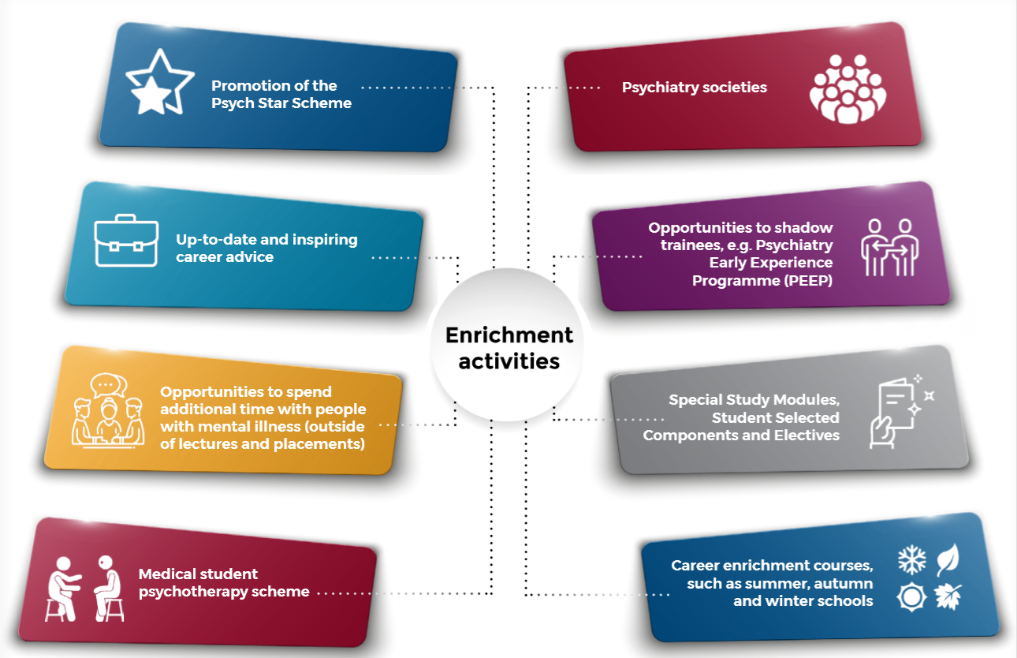
Notes:
Suggested text:
Medical students told RCPsych that they would like more extracurricular events and activities focused on mental health at their university – incorporating talks from people who work in psychiatry, including those in senior positions.
Students said that participating to such events and activities furthered their knowledge and understanding of mental health and psychiatry, which they felt enhanced their view of the specialty.
RCPsych therefore encourage all medical schools to design and implement a range of enrichment activities to enhance students’ exposure to, and experience of, psychiatry.

Slide 13
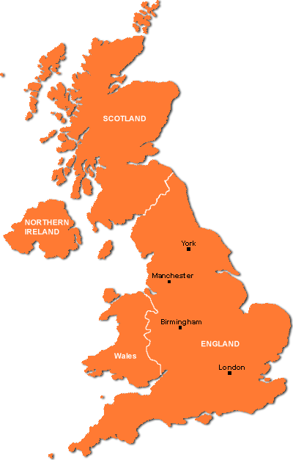
The Online ‘Hub’
Hub gathering the materials we publish for med schools and students. This could be either tied to the UEF webpage or the Choose Psychiatry webpage (or both).
Would include UK map of initiatives by medical schools.
Email zoe.mulliez@rcpsych.ac.uk to showcase your work.
Case study showcasing great initiative from Birmingham Medical School
Notes:
Suggested text:
To support the development of enrichment activities, RCPsych are creating an online hub showcasing case studies and examples of good practice across the UK. A number of these case studies have already been collected for the Choose Psychiatry Guidance or by the Undergraduate Education Forum chaired by Professor Ania Korszun, but we know there are many other ongoing initiatives that could be included.
If you would like us to showcase the work that you are doing, please email zoe.mulliez@rcpsych.ac.uk

Slide 14
Other activities the College consider doing
Expand the #ChoosePsychiatry campaign to reach other audiences
Work with the MSC to involve more psychiatrists in interview panels
Work with providers of mental health services to understand challenges to offer work experience to secondary school students
Develop a toolkit to give PsychSocs information & advice on funding available, how to host successful events, how to widen the scope of their events, etc.
Work with other Royal Colleges to develop materials for medical schools to integrate teaching of psychiatry into all aspects of the UG curriculum
Work with the MSC to develop psychiatry materials for medical schools running summer/autumn/winter school events
Organise an event on 'Psychiatry & mental health in all specialties’ for both medical schools’ staff and students
Any other ideas? Please email zoe.mulliez@rcpsych.ac.uk

Slide 15
Before we move on to the discussion…
https://www.youtube.com/watch?v=wW8GNnI1oO4
Please help us ensure that as many students as possible see this!

Slide 16

Discussion
How would you like to be involved and implement the Guidance?
Is there anything else RCPsych could help you with?

Slide 17

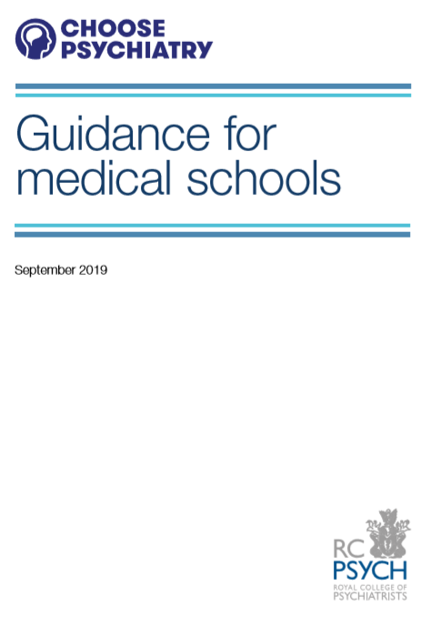
Thank you
The College is keen to hear from you
Please contact Zoé Mulliez, RCPsych Policy and Campaigns Manager
zoe.mulliez@rcpsych.ac.uk
**The Guidance is on the RCPsych website**
Notes:
Suggested text:
There is no doubt that doctors for the future will need to have a good grounding in psychiatry in order to deliver excellent patient care no matter the specialty they choose.
Now increasing our workforce’s ability to treat people with mental illness will require significant investment from governments and the full support of a wide range of stakeholders.
With limited resources available, it represents a challenge to everyone involved, and we are extremely grateful for your consideration and help to achieve this goal.

