Slide 1
Virtual Cognitive Stimulation Therapy (vCST):
The FaceCog project
Aimee Spector
Professor of Old Age Psychology
University College London

Slide 2
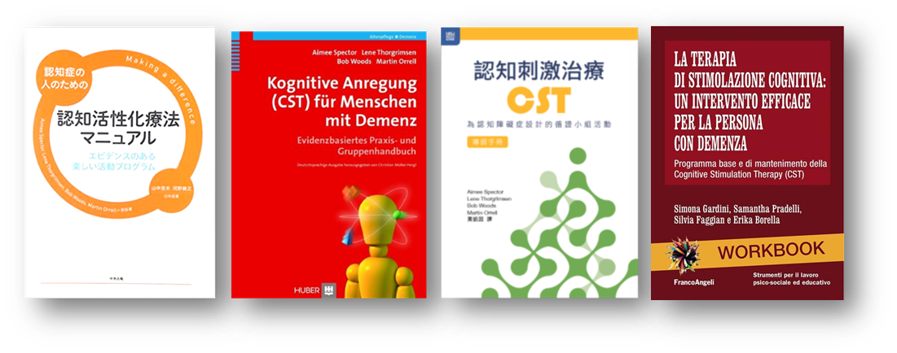
What is CST?
“CST should routinely be given to people with early stage dementia”
Only non-drug therapy endorsed by NICE guidelines to improve cognition, independence and well-being.
*Global trials consistently demonstrate improvements to cognition, with many showing benefits to QoL, mood and carer well-being. Cost-effective.
Group CST, maintenance CST (MCST) and individual CST (iCST)
*Lobbia, A., Carbone, E., Faggian, S., Gardini, S., Piras, F., Spector, A., & Borella, E. (2019). The efficacy of cognitive stimulation therapy (CST) for people with mild-to-moderate dementia: A review. European Psychologist, 24(3),
“Offer group cognitive stimulation therapy to people living with mild
to moderate dementia”
International development
https://www.ucl.ac.uk/international-cognitive-stimulation-therapy

Slide 3
Key Principles & Themes
Session Themes
1 Physical games
2 Sound
3 Childhood
4 Food
5 Current affairs
6 Faces / scenes
7 Word associations
8 Being creative
9 Categorizing objects
10 Orientation
11 Using money
12 Number game
13 Word game
14 Team game
1 | Mental Stimulation
2 | New ideas, thought and associations
3 | Using orientation, but sensitively and implicitly
4 | Opinions, rather than facts
5 | Using reminiscence, and as an aid to the here-and-now
6 | Physical movement
7 | Providing triggers to aid recall
8 | Continuity & consistency between sessions
9 | Implicit (rather than explicit) learning
10 | Stimulating language
11 | Stimulating executive functioning
12 | Person-centred
13 | Respect
14 | Involvement & Inclusion
15 | Choice
16 | Fun
17 | Maximising potential
18 | Building / strengthening relationships

Slide 4
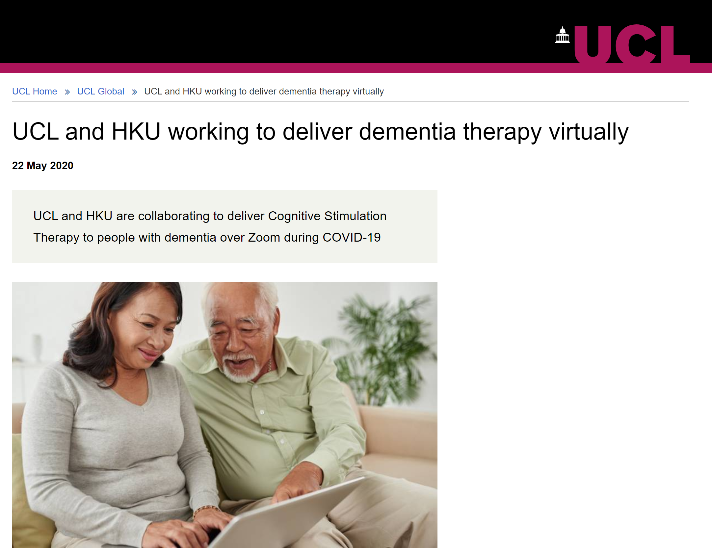
Hong Kong Project Background
Planned before COVID-19 outbreak
To cater for PwD who cannot join CST groups physically (e.g. mobility, logistical challenges)
To connect those with similar cultural background, language, interest beyond geographical boundaries
Pilot stage: feasibility, acceptability and modification of CST groups through Zoom
RCT (n=200) to end in Dec 2021
https://www.ucl.ac.uk/global/news/2020/may/ucl-and-hku-working-deliver-dementia-therapy-virtually

Slide 5
UCL Project
Group CST, following standard 14 session manual (2 x week, 7 weeks) via Zoom or similar online platform.
Stage 1: Focus groups with professionals who have tried it (10th July), seeking to understand barriers, facilitators and potential modifications required. We will also hold a focus group for PwD and caregivers, asking about their use of technology and perceived barriers and facilitators from their perspective. Feedback will input into final design of virtual CST programme.
Stage 2: Aug-Dec 2020. Small pre-post feasibility / proof of concept study (n= appx 20) led by 2 trainee Clinical psychologists. Will examine whether people can engage in new CST groups online, follow sessions, work the technology, benefit from the content, which people are more suited, etc.
Will look at simple outcomes (e.g. cognition, quality of life, mood), use observational data and conduct qualitative interviews to understand experience from the perspective of PwD and facilitators.
Applying for funding to enable this to be a more substantial, feasibility RCT where we will investigate implementation and cost-effectiveness and would recruit through NHS.

Slide 6
Observations from New Zealand
(Dr Gary Cheung and Dr Kathy Peri, University of Auckland)
Technology and online environment related
Roughly half have access to Zoom
Optimal number per v-CST group: 3-5
People who live alone can be coached to join Zoom via mobile phone
1:1 pre-training with supporter / caregiver
The role of a vCST co-facilitator
Manage Zoom connection and technology use, leaving main facilitator free.
Phone a participant/caregiver and coach them to join a session if necessary
Monitor the video and audio functions
Check that names of participants and facilitators are correct on screen
Notes:
婆婆 (92 years old, mild Dementia) and carer (daughter, mid 50's) were new to the 視像 concept but willing to try
- 婆婆 expressed 30 minutes is good, not too tired for her both physically or the "eyes"
- 婆婆 expressed overall she could hear and see me clearly through 視像

Slide 7
Observations from New Zealand
Adaptation of session structure and content
Check participants can see and hear from their device
Icebreaker activity at the beginning of a vCST session e.g. virtual background, wigs.
Using a PowerPoint presentation and the share screening function
Contactless method to deliver activity resources bags, encourage people to bring resources to sessions.
Benefits: Participants can recognize each other online and re-connect virtually, can follow activities and have fun
Notes:
婆婆 (92 years old, mild Dementia) and carer (daughter, mid 50's) were new to the 視像 concept but willing to try
- 婆婆 expressed 30 minutes is good, not too tired for her both physically or the "eyes"
- 婆婆 expressed overall she could hear and see me clearly through 視像

Slide 8
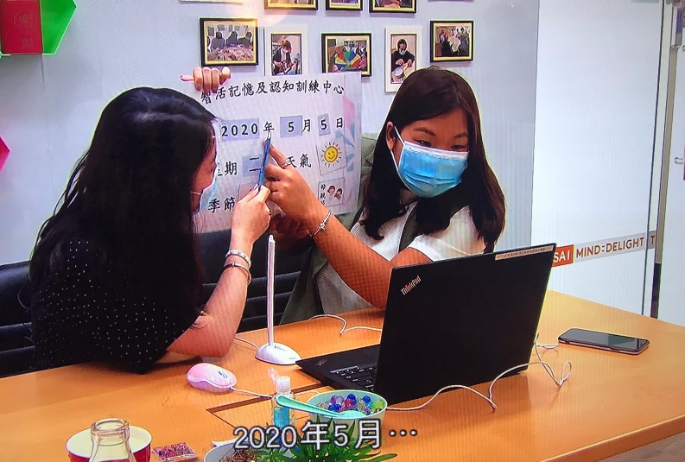
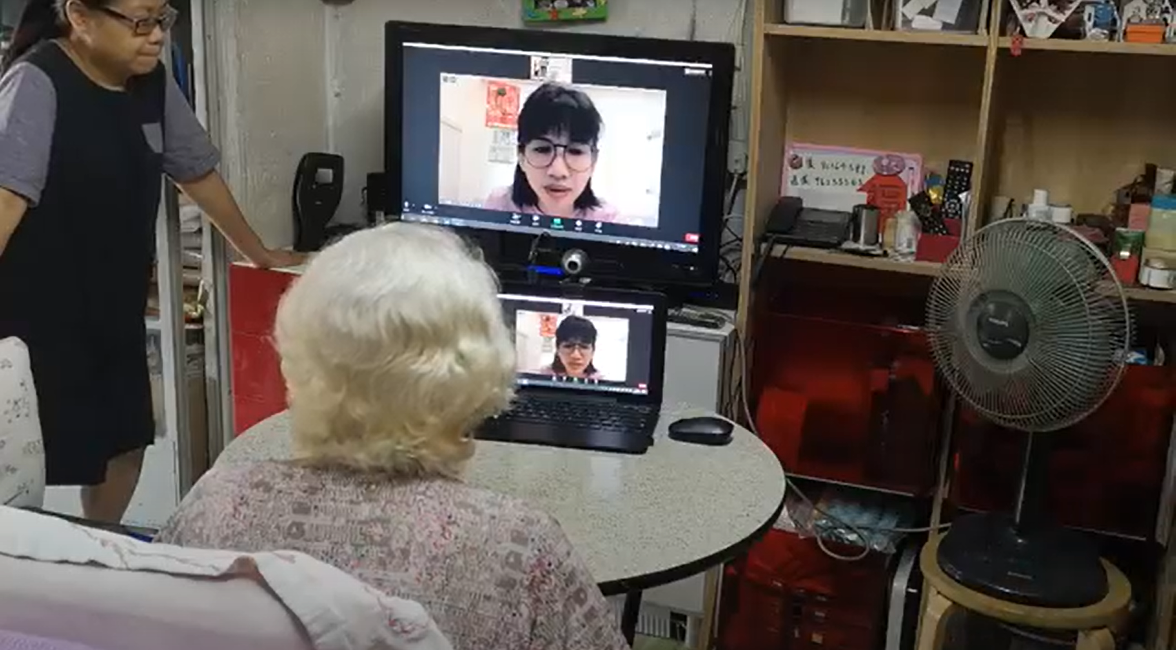
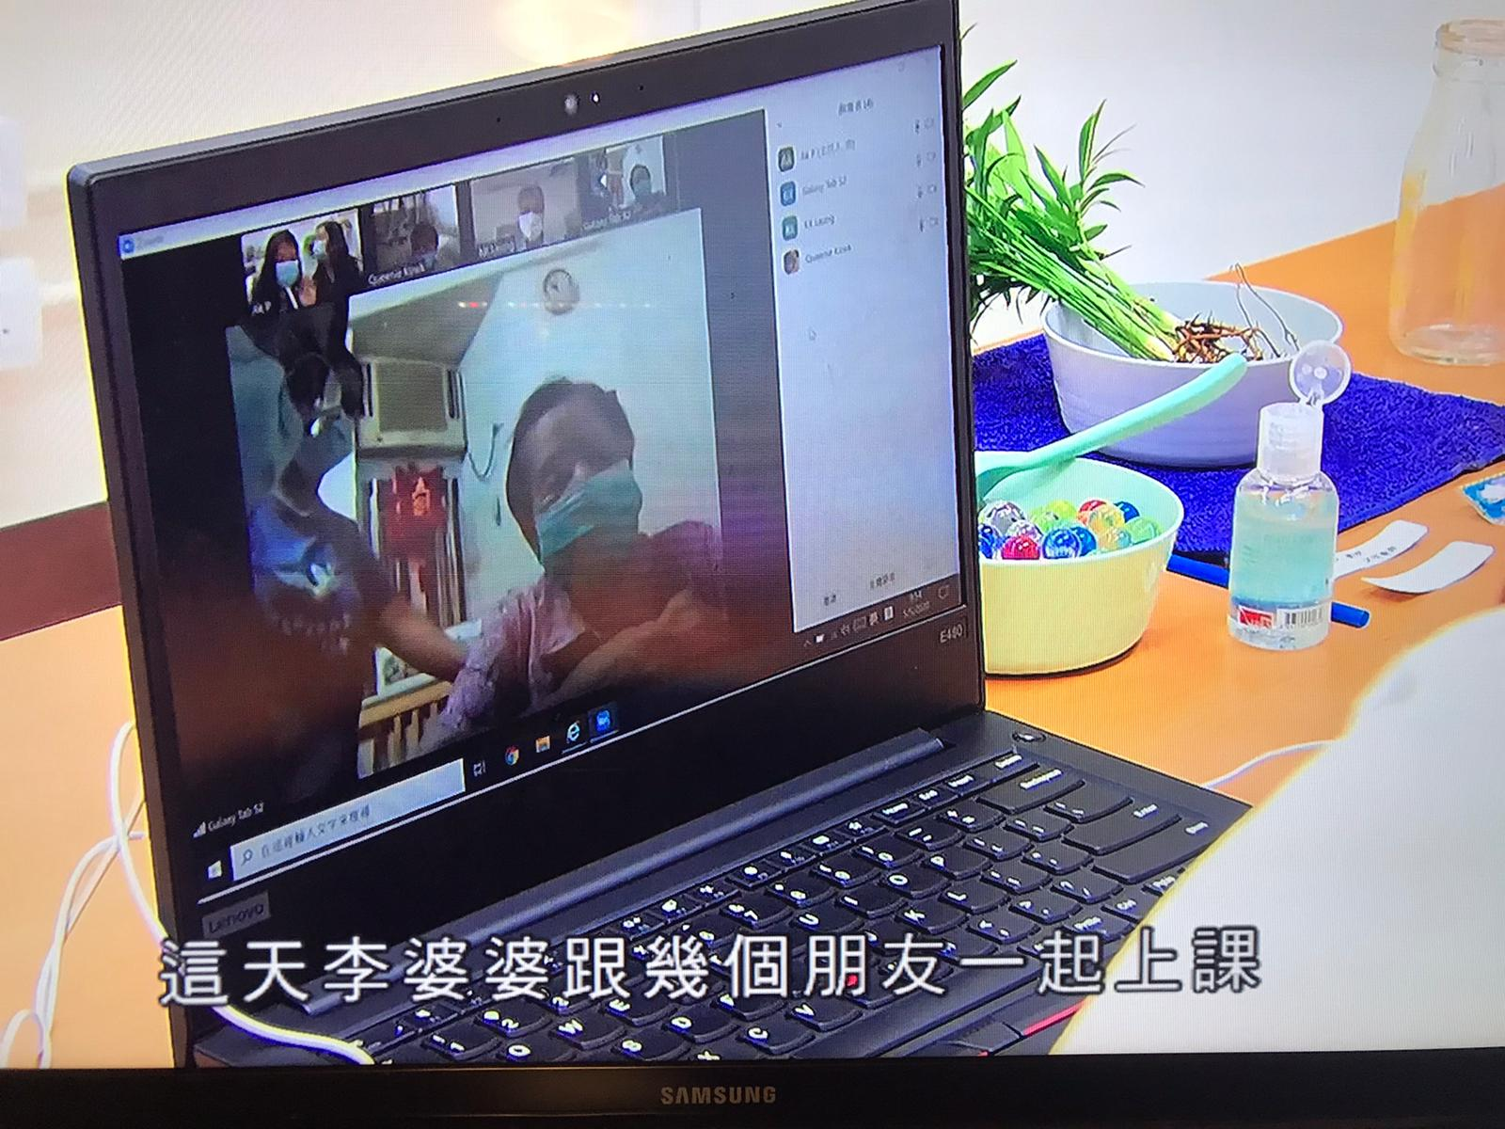
Observations from Hong Kong (Dr Gloria Wong)
Manageable in some people with mild to moderate dementia
Most without any ICT experience (e.g. a 92yo lady new to Zoom)
Positive feedback from carers: improved mood
Positive feedback from PwD:
“I feel like a celebrity!”
Novel and empowering to master new technology
Notes:
婆婆 (92 years old, mild Dementia) and carer (daughter, mid 50's) were new to the 視像 concept but willing to try
- 婆婆 expressed 30 minutes is good, not too tired for her both physically or the "eyes"
- 婆婆 expressed overall she could hear and see me clearly through 視像

Slide 9

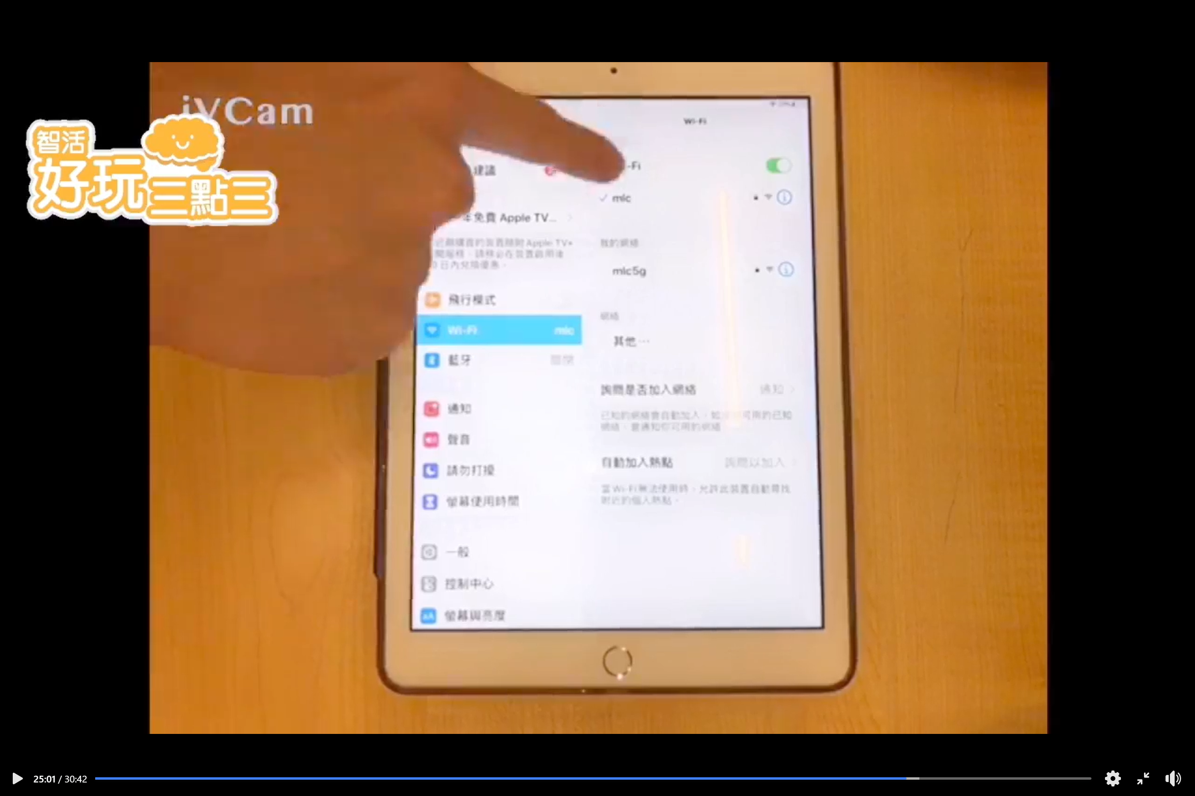
Observations from Hong Kong
Device set-up: carers need technical support and training
Network requirement
Hearing: mic set-up
Attention/engagement level
Shorter session,
tiring for the eyes
Facilitators: more challenging in managing online groups
Notes:
Daughter expressed it is lucky to have Mr. Tsoi help set up the "system" at her home, she said she will need some training before she can "operate" it herself
- "收音" clearly is very important as if the facilitator cannot hear properly, it is not easy to respond to participant or facilitate the conversation
- I used the power point (with pictures and words) to share screen in zoom, 婆婆 expressed she could see it quite clearly but would be even better if the pictures can be larger.
- Mr. Tsoi expressed if the process can be more "interactive", such as 婆婆 can have a pen to circle / select the picture on the screen, it would be more fun.

Slide 10
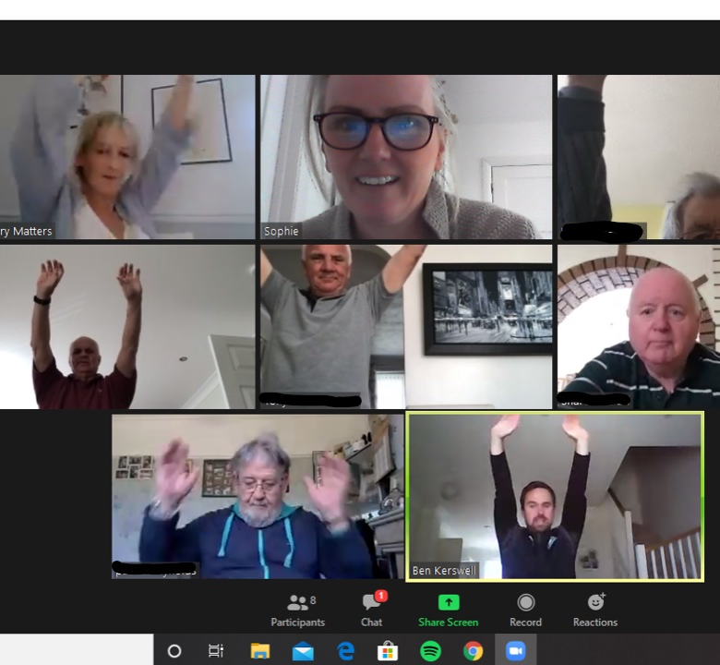
Memory Matters South West (Laura Walker and Sophie Hester): Group song with seated exercise
Notes:
In the main part of the session the possibilities are endless and we have found ourselves getting more experimental as we learn.
We now use google slides to create sessions, adding images, embedding you tube clips etc so its ready to use for all facilitators on the team
We have a session run through with the whole team on Mondays so all facilitators and co-facilitators are prepared for the current weeks session.
10

Slide 11
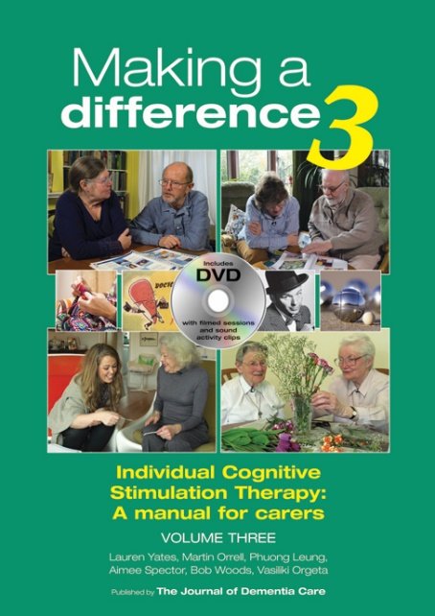
Role of iCST during COVID-19
Initial trial (n=356) showed benefits to caregiver QoL and person-caregiver relationship when iCST delivered by family caregivers.
Pilot study (n=32) found that iCST, delivered by trainee clinical psychologists, led to significant improvements in cognition.
Second study ruled out issues of adherence, attendance and sessions delivered by trained therapist. Role of iCST remotely not yet investigated.
Thinkability app - https://thinkability.eu/ based on the iCST manual, available from the Apple store. Preliminary evaluation confirmed benefits to caregiver QoL.
Orrell, M., Yates, L., Leung, P., Kang, S., Hoare, Z., Whitaker, C., ... & Pearson, S. (2017). The impact of individual Cognitive Stimulation Therapy (iCST) on cognition, quality of life, caregiver health, and family relationships in dementia: A randomised controlled trial. PLoS Medicine, 14(3), e1002269.
Gibbor, L., Forde, L., Yates, L., Orfanos, S., Komodromos, C., Page, H., ... & Spector, A. (2020). A feasibility randomised control trial of individual cognitive stimulation therapy for dementia: impact on cognition, quality of life and positive psychology. Aging & Mental Health, 1-9.
Notes:
婆婆 (92 years old, mild Dementia) and carer (daughter, mid 50's) were new to the 視像 concept but willing to try
- 婆婆 expressed 30 minutes is good, not too tired for her both physically or the "eyes"
- 婆婆 expressed overall she could hear and see me clearly through 視像

Slide 12
Concluding thoughts
Good anecdotal evidence for vCST.
Need clearer research to show feasibility and acceptability, resulting in guidelines on implementation including who is eligible and might benefit, how the programme should be adapted, IT considerations.
Could provide an important long-term option for people who cannot access group CST due to transport, frailty, health problems, etc.
Notes:
婆婆 (92 years old, mild Dementia) and carer (daughter, mid 50's) were new to the 視像 concept but willing to try
- 婆婆 expressed 30 minutes is good, not too tired for her both physically or the "eyes"
- 婆婆 expressed overall she could hear and see me clearly through 視像

Slide 13
How to get involved
1) Register interest in being a recruitment site by emailing Michelle (w.leung.19@ucl.ac.uk) or Diyaneh (nur.Wahab.19@ucl.ac.uk)
.2) Register for focus group / discussion on 10th July (if you have already tried virtual group CST) by emailing Cerne (Cerne.Felstead.18@ucl.ac.uk) or Luke (luke.perkins.15@ucl.ac.uk)
3) Keep an eye out for updates on: www.ucl.ac.uk/international-cognitive-stimulation-therapy
Watch clip courtesy of Memory Matters South West:
https://www.youtube.com/watch?v=OuASky-rIcM&feature=youtu.be
Notes:
婆婆 (92 years old, mild Dementia) and carer (daughter, mid 50's) were new to the 視像 concept but willing to try
- 婆婆 expressed 30 minutes is good, not too tired for her both physically or the "eyes"
- 婆婆 expressed overall she could hear and see me clearly through 視像

