Slide 1

New research developments relevant to YOD
The Angela Project – Improving diagnosis
and support for YPD and families
Translating evidence into practice
Can it inform day to day practice and new ways of working?
MSNAP Webinar Dr Janet Carter, UCL and NELFT

Slide 2
Main questions from the study – improving diagnosis and support
Can we identify quality indicators/standards to improve diagnosis?
Can we improve patient experience – understand what matters most?
Can we assess how well we currently perform? – case note audit
Can we understand what works best for support after diagnosis?

Slide 3

https://www.youngdementiauk.org/angela-project
Recommendations for service design and development,
care planning

Slide 4
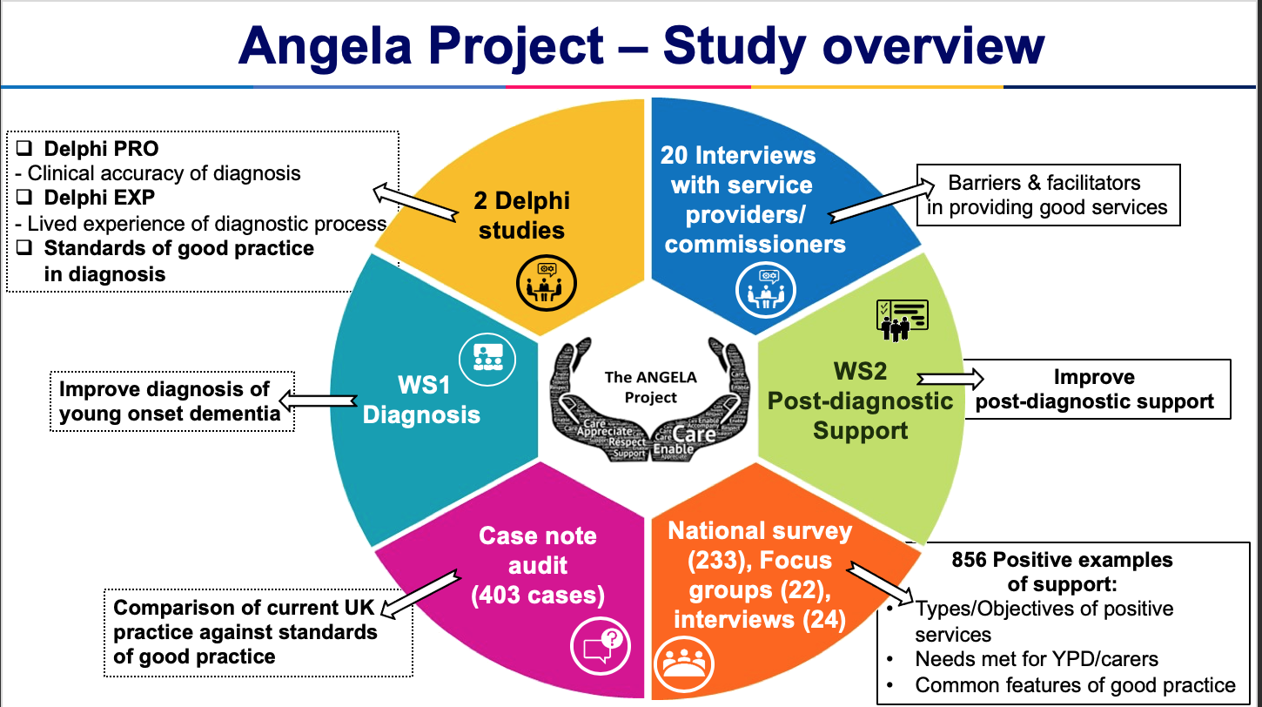
Issues –psychosocial and clinical differences to LOD
delay to diagnosis
misdiagnosis
under-investigation
poor patient experience
Routine assessments
tailored to older patients
are insufficient to identify
the complex presentations of YOD

Slide 5
Delphi Study
Method
-iterative questionnaire
-translates professional experience into clinical decision making
- forces consensus
Delphi-PRO(fessional)
23 international clinical experts
Identify ‘quality indicators’ for
making an accurate diagnosis of YOD?
48 Delphi-PRO - clinical indicators
33 indicators for the Gold Standard (80% consensus)
11 for Minimum Standard (100% consensus)
Notes:
Diagnosis group: There were 18 different ICD-10 codes that were identified through the query and 14 different dementia diagnoses (See appendix XX for the breakdown). For the purpose of the analysis, diagnoses were group into one of four broad categories: Alzheimer’s disease, Vascular dementia, Dementia in Pick’s disease and ‘Other’.

Slide 6
Examples of quality indicators
reaching 80% consensus in grey
CATEGORY Psychiatric History and symptom enquiry | STATEMENT
 | 6.1. Take a thorough psychiatric history
 | 7.1. Exclude Symptoms of mood disorder
 | 7.3. Exclude psychotic symptoms
 | 7.7. Include a mental state examination
Physical examination | 3.4. A Physical Examination should be conducted

Slide 7
Examples of quality indicators
Imaging Only 4/23 thought CT preferable | 12.1. Do baseline structural neuroimaging (22/23)
 | 12.6. Do an MRI dementia protocol incorporating T1, T2 and Flair images (19/23)
 | 12.5. Assess Medial Temporal Lobe atrophy on MRI – volumetric analysis
--------------------------------------------------------------------------------------------------------------------------------------------------------------------
A basic/routine dementia blood screen
A chest x-ray
An ECG
A screen for autoimmune disorders
To enquire if there are any swallowing difficulties
Use a mood inventory such as GDS, BDI, HADS
To assess for previous head injuries
To ask about stressful life events
CSF analysis for biomarkers i.e. TAU and AB42 markers
AMYLOID-PET if available
CT
Volumetric analysis of MRI
Use a mood inventory such as GDS, BDI, HADS
Use an inventory for neuropsychiatric symptoms such as NPI
Examples of
Statements not reaching consensus

Slide 8
Statements rated by 100% of experts as essential – MINIMUM STANDARD
Diagnosis of YOD is a clinical judgement and has a profound impact on the future, so it important to convey this to patient and their family and remain open to the need to review and potentially modify opinion
Establishing rapport to enable open reporting of symptoms
To ask an informant (e.g. wife/husband) for a collateral history
To understand the symptom type and the mode of onset
Enquire about loss of sympathy/empathy towards others, disinhibited behaviour, change in food preferences and changes in personality
To enquire about changes in physical health
If there have been any changes in activities of daily living
To ask about changes in behaviour
To ask if a first degree relative has had young onset dementia
To have a full medical history (including cardiovascular history)
A thorough neurological assessment should be conducted

Slide 9
Example of gold standard indicators
Pre-assessment and communication | The assessment should start with counselling to ascertain what patient and supporters require
Pre-assessment and communication | Ensuring the patient has capacity
Neuroimaging include | Visual assessment of MTL atrophy on MRI
Neuropsychological assessment | An ACE* -3 is useful to understand the cognitive profile
Neuropsychological assessment | Patterns of cognitive deficits provide clues to disease aetiology on the ACE-3
Neuropsychological assessment | Detailed neuropsychology testing should be considered if there is under-performance on screening measures
Neurological examination: examine for | Eye movements
 | Cerebellar signs
 | Tongue or limb fasciculation
 | Frontal signs
 | Extrapyramidal features
 | Motor Skills

Slide 10
Delphi-EXP(erience)
What matters most to YPD and families/supporters
Two Round Process. Round 1 participants answered open-ended questions (relating to referral, assessment and diagnosis).
Round 2 participants rated the derived statements.
Delphi participants were 18 people living with young onset dementia, and 18 supporters. Recruited from across England (NHS & third sector)
relating to the referral, assessment and diagnosis process.
27 statements were rated on average absolutely essential or very important.
Notes:
Diagnosis group: There were 18 different ICD-10 codes that were identified through the query and 14 different dementia diagnoses (See appendix XX for the breakdown). For the purpose of the analysis, diagnoses were group into one of four broad categories: Alzheimer’s disease, Vascular dementia, Dementia in Pick’s disease and ‘Other’.

Slide 11
Functional factors – the process
Appointment - Ensure there is enough notice between letters being issued and appointment | Convenience - Making appointments convenient for working adults
Follow-up letter – Providing the person with dementia and their supporters with a letter which details the diagnosis | Contact family supporters as well - Healthcare professionals should make contact with family supporters if unable to get through to the person with dementia directly regarding appointments
Single point of contact - Having an identified key person as a single point of contact throughout the whole diagnostic process | Quick Referral - The referral process from GP to first assessment needs to be shorter
Referrals to specialist services - Referrals should ideally be made to specialist YOD clinicians and services | Home visits – Patients should be seen at home for assessments and post-diagnostic support where appropriate
Multi-disciplinary team – There should be a multi-disciplinary team involved in diagnosis to provide appropriate support | Enhanced awareness of YOD - More awareness and training on rarer dementia types as well as the issues faced by young people with dementia in Mental Health Trusts.
GP to be able to identify dementia in younger people | Pleasant MRI experience - The MRI experience should provide blankets, ear protectors to reduce noise and allow supporters to be in the room if the person wishes
Results issued more quickly - Results need to be given in clinic more quickly | Shorter time to diagnosis - The time taken to achieve a formal diagnosis needs to be shortened if possible
 | Assessments should be conducted in a quiet and private room

Slide 12
Relational aspects of care – feeling informed, listened to, clinician communication style
Private discussions – Clinicians should offer opportunities for the person with dementia and their supporters to speak separately about any issue they wish to discuss | Reaction to diagnosis - Remember that receiving the diagnosis is a lot to take in for the person with dementia and supporter
Explanation of assessments - Having more information about investigations (for example on what the SPECT scanning was all about) | Understanding all forms of dementia - Being understanding during the assessments, especially visual tests for people with PCA
Being involved - Being kept in the loop and feeling involved in the assessment | Meeting in person- Communication with clinicians should ideally be in person
Avoid repetition - Avoid the same questions being asked by the separate clinicians where possible | Considerate use of language - Clinicians should be compassionate, empathic and respectful and particularly sensitive when providing information about a diagnosis
Time to ask questions - Give the person with dementia and their family enough opportunities to ask questions | Calm approach – The Clinician’s manner should be calm, approachable and easy to talk to
Using lay terms - Clinicians should explain medical terms, and what they mean in a simplified manner.

Slide 13
Experiences of support after diagnosis
findings from a National survey, focus groups and individual interviews
Continuity
60% of those diagnosed in neurology services received no follow-up in the first 6/52
16% had no-one managing their ongoing care
39% had seen no health professional in the previous three months
Specialist services input
Only 20% had ongoing management from young onset dementia specialists
Costs of care
Family (median £8320 over three months) v statutory services (median £394)
57% of family carers provided support for five hours or more every day,
69% of carers reported there was no service that provided care for their relative to allow them to take a break

Slide 14
Positive experience of care - Satisfaction with services
associated with
Knowing who to contact – named person
being managed in a specialist YOD service
living in the South-East of England (all positively associated with satisfaction)
reporting nobody or a GP alone managed care on a regular basis (associated with lower satisfaction)
Specialist young onset dementia services performed better than other types of service on several quality indicators, including regularity of appointments, continuity of services, having a care plan and satisfaction with services.

Slide 15
What next
Use indicators to devise proformas/templates /educational/audit tools/care plans
Working with YDN to convert this evidence into usable tools
THANK-YOU - j.carter@ucl.ac.uk
1. Living with Young Onset Dementia and actively shaping dementia research through PPI - The Angela Project
Keith Oliver, Dr Mary O’Malley, Prof Jacqueline Parkes, Dr Vasileios Stamou, Dr Jenny LaFontaine, Prof Jan Oyebode & Dr Janet Carter. (Dementia, 2020, 19 (1): 41-48) doi.org/10.1177/1471301219876414
2. Young-onset dementia: scoping review of key pointers to diagnostic accuracy.
O'Malley M, Parkes J, Stamou V, LaFontaine J, Oyebode J, Carter J. BJPsych Open. 2019 Jun 4;5(3):e48. doi: 10.1192/bjo.2019.36.
3. Receiving a diagnosis of young onset dementia: a scoping review of lived experiences.
O'Malley M, Stamou V, LaFontaine J, Oyebode J, Carter J, Parkes J. (Aging Ment Health). 2019 Oct 24:1-12. doi: 10.1080/13607863.2019.1673699.
4. The nature of positive post-diagnostic support as experienced by people with young onset dementia.
Stamou V, La Fontaine J, O’Malley M, Jones B, Gage H, Parkes J, Carter J, Oyebode J. (2020). Aging and Mental Health . 2020 Feb 18:1-9. doi: 10.1080/13607863.2020.1727854.
5. International consensus on quality indicators for clinical diagnosis of young onset dementia using a modified e-Delphi approach (Int. J. Geriatric Psychiatry 2020 in press) O’Malley M, Stamou V, LaFontaine J, Oyebode J, Parkes J, Carter J

