Slide 1


A practical guide to providing neuropsychological assessment
#MSNAP
15 July 2020
Notes:
Welcome and thank you for coming.
Introductions.

Slide 2
Dr Sarah Ghani (Chair)
Chair of MSNAP Advisory Group
Notes:
Welcome and thank you for coming.
Introductions.

Slide 3


Q&A
Please type your questions and who you are directing your question to in the question and answer box. We will read them out and answer them live.
If we are unable to answer every question during the webinar then we will ensure that we answer them afterwards.
Notes:
For anyone who is not a member.
MSNAP is part of the CCQI which aims to raise the standard of care that people with emotional or mental health needs receive by helping providers, users and commissioners of services to assess and increase the quality of care they provide.
More than 90% of Trusts in the UK who provide mental health services participate in the work of the CCQI and we currently have 24 accreditation projects, of which MSNAP is one.
We publish standards and use a peer review model to measure services against the standards.
MSNAP has now been running for 10 years.

Slide 4
Discussion
You can contribute to the discussion by 'raising your hand'. We will unmute you so that you can speak. You will need to confirm that you want to be unmuted.
If you are joining by telephone, please press * followed by 9 to raise your hand. You will be informed when the host has unmuted you.
Notes:
For anyone who is not a member.
MSNAP is part of the CCQI which aims to raise the standard of care that people with emotional or mental health needs receive by helping providers, users and commissioners of services to assess and increase the quality of care they provide.
More than 90% of Trusts in the UK who provide mental health services participate in the work of the CCQI and we currently have 24 accreditation projects, of which MSNAP is one.
We publish standards and use a peer review model to measure services against the standards.
MSNAP has now been running for 10 years.

Slide 5

A practical guide to providing neuropsychological assessment & intervention using telehealth
Royal College of Psychiatrists, Memory Services National Accreditation Programme (MSNAP)
Dr Rebecca Poz
Clinical Psychologist & Clinical Neuropsychologist
Older People’s Service & Memory Assessment and Therapy Service
Norfolk & Suffolk NHS Foundation Trust
Email: rebecca.poz@nsft.nhs.uk
Twitter: @rebeccapoz
Dr Wendy Kelso, DPsych (Clin Neuro)
Senior Clinical Neuropsychologist, Neuropsychiatry
Royal Melbourne Hospital, Parkville, Australia
Email: wendy.kelso@mh.org.au
Twitter: @kelsowm
Dr Julia Cook
Clinical Psychologist
Early Intervention in Dementia Service & Complex Dementia Care
Worcestershire Health & Care NHS Trust
Email: julia.cook@nhs.net
Twitter: @julia_c_psych
Associate Prof. Rene Stolwyk, DPsych (Clin.Neuro)
Senior Lecturer & Clinical Neuropsychologist
Monash University, Melbourne, Australia
Email: rene.stolwyk@monash.edu
Twitter: @rene_stolwyk
Notes:
Dana, welcome and acknowledgment of country
Everyone introduces themselves

Slide 6
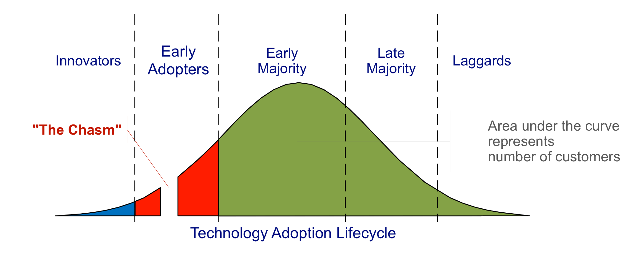
Setting Expectations!
Much of our work to date has focused on addressing rural unmet needs, addressing COVID-19 is a work in progress
Transitioning to telehealth will take time. This may be just the start of your telehealth journey…
Notes:
Aimed at neuropsychologists
Will be covering high level assessment and intervention
Need to be competent and experienced in scope of practice
Webinar is aims at two groups. Those who with no experience. No need until now. Concerned
Also those early rein back some practices to ensure valid and ethical practice.
Sensible centre
Four year journey. Developing skills and confidence takes time.

Slide 7

Learning Objectives
By the end of this webinar, attendees will be able to:
  Understand different models of teleneuropsychology implementation
  Understand when teleneuropsychology may/not be appropriate to your clinical practice
  Appraise current evidence and ethical guidelines relating to teleneuropsychology assessment and intervention
  Apply procedures on how to conduct teleneuropsychology assessment and intervention sessions

Slide 8
Webinar Schedule
Time | Content and Presenter
9.00am | Introduction
9.15am-9.35am | What is Teleneuropsychology? Models of TeleNeuropsychology Evidenced Based Practice Rene Stolwyk
9.35am-9.55am | General Principles of TeleNeuropsychology Practice Risks and Benefits Special Considerations Wendy Kelso
9.55am-10am | The Australian Experience Rene Stolwyk and Wendy Kelso
10am-10.20am | Local experience – Julia Cook and Rebecca Poz
10.20am – 10:50am | Discussion Julia Cook and Rebecca Poz
10.50am | Conclusions and Future Directions Session Close

Slide 9
Background
Memory Service Assessments: A New Way of Working (NHSe/NHSi)
Guidance on remote working for memory services during COVID-19 (London Clinical Networks)
Inter Organisational Practice Committee (IOPC) guidance, Division of Neuropsychology (DON, BPS) guidance
Pearson – letter of no objection

Slide 10
Survey results – potential strengths and opportunities
  Timely assessments and reduced waits
  Patient and clinician safety
  Less travel; convenience and more comfortable for patients
  May reach clients who would normally struggle to access the service/clinic,
  Continuity of service provision
  Reduce waiting lists; increase clinician capacity due to reduced travel. Cross cover between teams – enhanced use of expertise.

Slide 11
Survey results – potential weaknesses, threats and challenges
  Reduced accuracy/validity/standardisation
  Access to technology
  Engagement with technology (anxiety, attention)
  Reduced ability for qualitative observation, difficulties establishing rapport
  Environmental control
  Reduced ability to provide help where needed
  Limited tests suitable for remote administration
  Client fatigue – maximum recommended session length

Slide 12
Survey results – biggest concerns
  Inaccurate diagnoses/validity of outcomes
  Technology failing
  Would Trusts invest money in this approach
  Lack of training, confidence, familiarity
  Clinical governance
  Fear re legal challenge
  Sensory difficulties prohibiting access
  Lack of best practice national guidance/consensus

Slide 13
What is TeleNeuropsychology?
Provision of neuropsychology services using telecommunication technologies.
  Assessment (History taking, interview, close other report, behavioural observation, psychometric assessment)
  Intervention (Feedback, psychoeducation, cognitive rehabilitation, psychological therapy, behavioural management)
Examples: telephone, mobile devices, interactive videoconferencing, email, chat, text, and internet (e.g., self-help websites, online psychoeducational materials or bulletin boards, blogs, and social media).
May be synchronous (videoconferencing) or asynchronous (email, sharing video)
Technologies may augment traditional in-person services or be used as stand-alone services.
Different technologies may be used in various combinations and for different purposes during the provision of teleneuropsychology services.

Slide 14
Models of TeleNeuropsychology
Notes:
Before getting into the nitty gritty of telehealth practice, important to understand the three key models of telehealth that we are presenting to day
Because specific practices will change across these models.

Slide 15
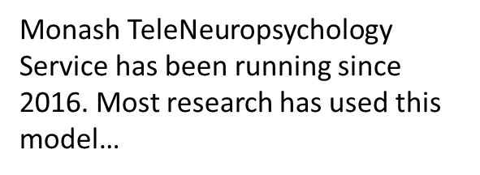
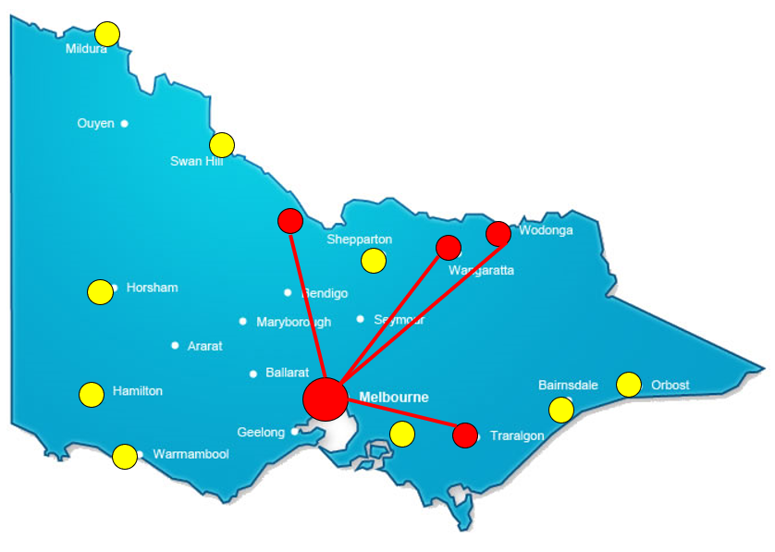
Remote Clinic Model
Location | Clinician and Client in separate clinics/hospitals. E.g. Monash Psychology Clinic to Echuca Regional Health
Trained Assistant Required? | Yes
Restrictions to Test Selections | Minimal
Cognitive/Sensory/Motor requirements of Client | Minimal
Travel Requirements | None
Meeting Social Distancing Requirements? | No

Slide 16
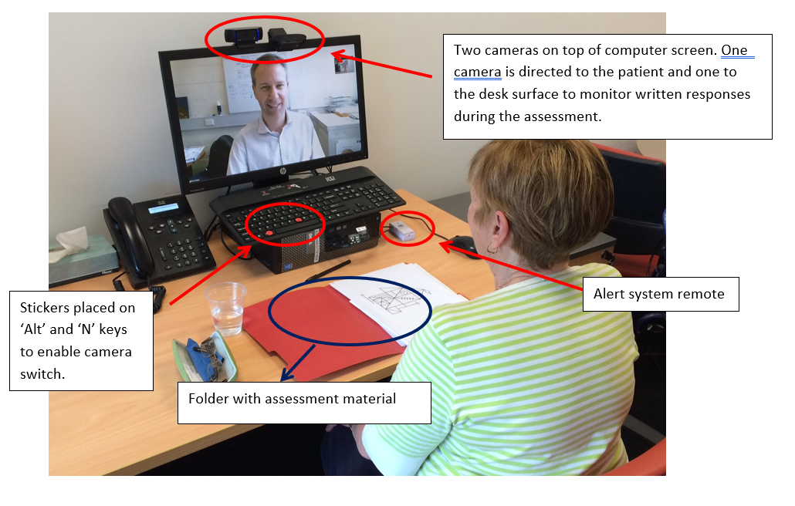
Remote Clinic Model
Zoom videoconferencing software, existing PC and tablet hardware
  Screen sharing
  Multiple cameras for assessment
  Session recording
Virtual Private Networks to share documents
Web-based encrypted email
Private rooms on both ends
Trained assistants available
Notes:
We used a desktop computer. Initial trials with a videoconference cart were unsuccessful. The desktop has proved to be very reliable for the lengthy assessment sessions.
You can see two cameras attached to the screen which enables the neuropsychologist to switch from the patient to the desk areas during written or desk based assessments
TNSR Technology
Zoom videoconferencing
Data security
VPN access to ERH servers and web-based ERH email

Slide 17
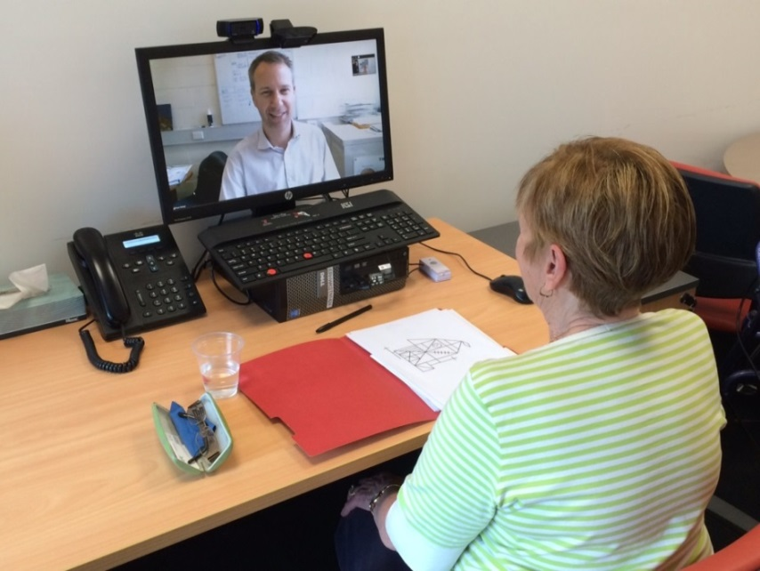
Remote Clinical Model
No Modification Required | Stimulus Materials and Forms in Coloured Folders | Assistant Required
WAIS-IV Digit Span WAIS – IV Similarities HVLT-R Semantic Fluency (Animals) Letter Fluency (FAS) | MoCA TOPF Stroop Test (Victoria Version) SDMT (WrittenOral) WAIS-IV Vocabulary BNT-2 Trail Making Test | WAIS-IV Block Design WMS-IV Visual Reproduction WAIS-IV Matrix Reasoning RCFT
* Level of assistant input depends on client motor/sensory abilities, level of cognitive/ behavioural function etc.

Slide 18
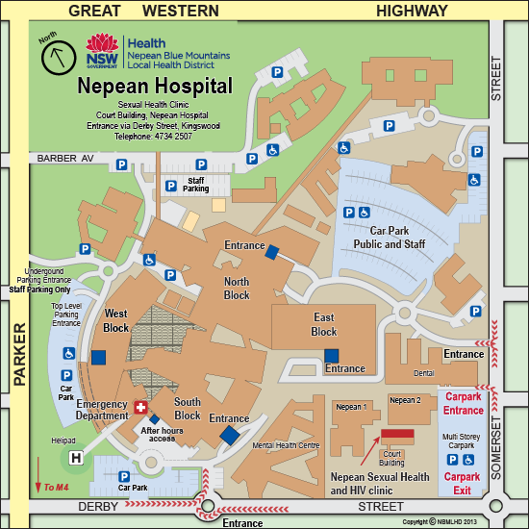
Within Clinic Model
Location | Clinician and Client in adjacent rooms, or at least at social distance
Trained Assistant Required? | No
Restrictions to Test Selections | Some
Cognitive/Sensory/Motor requirements of Client | Some
Travel Requirements | Both clinician and client need to travel
Meeting Social Distancing Requirements? | Yes
NEW for COVID-19!!!

Slide 19
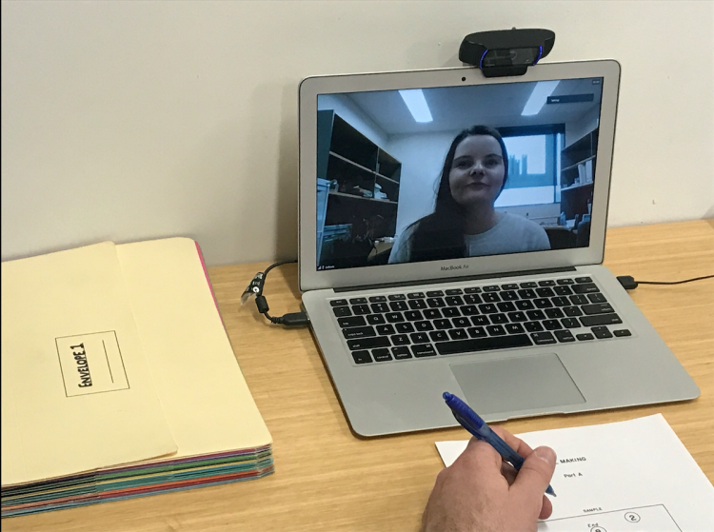
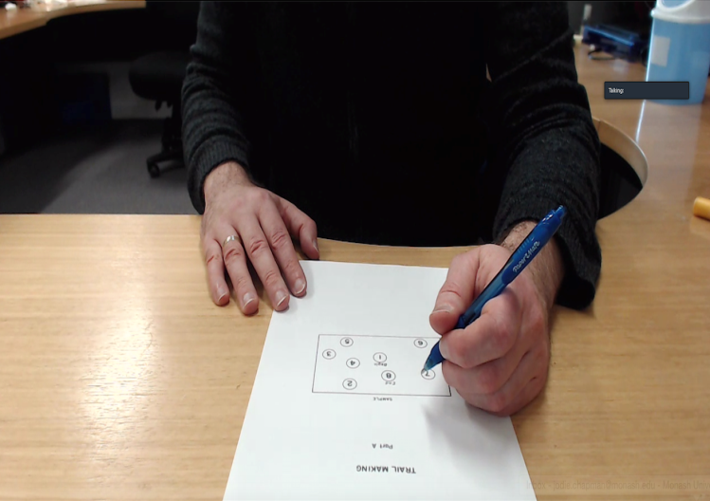
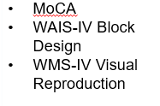
Within Clinic Model
Client Site
Camera B
Camera A
No Modification Required | Screen Share Stimulus Materials | Forms in Coloured Folders Materials on hand
WAIS-IV Digit Span WAIS – IV Similarities HVLT-R Semantic Fluency (Animals) Letter Fluency (FAS) | TOPF WAIS-IV Vocabulary WAIS-IV Matrix Reasoning BNT-2 Stroop Test (Victoria Version) | Trail Making Test SDMT (Written/Oral)
Online Admin of MoCA has been released
Check publisher permissions
Clinician View (Camera B)
RCFT

Slide 20
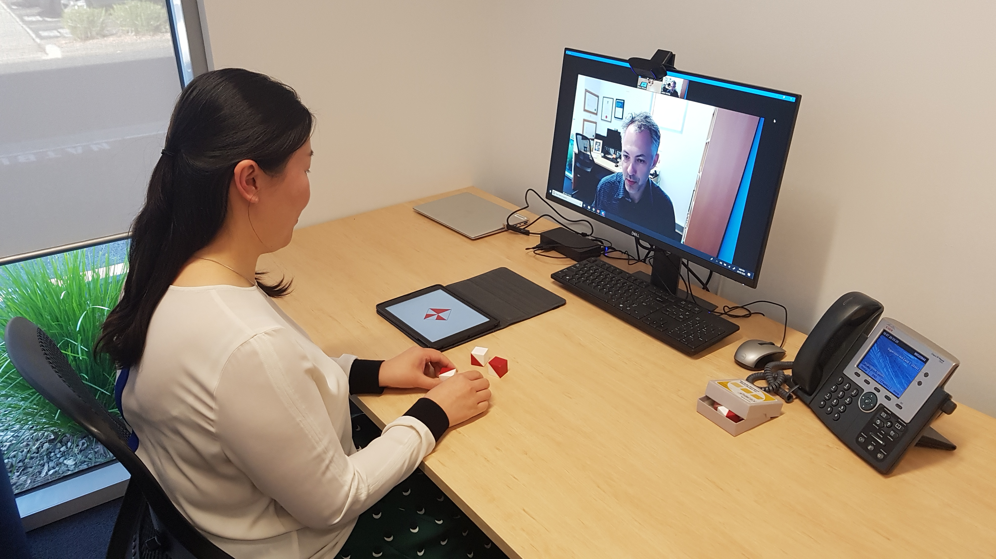
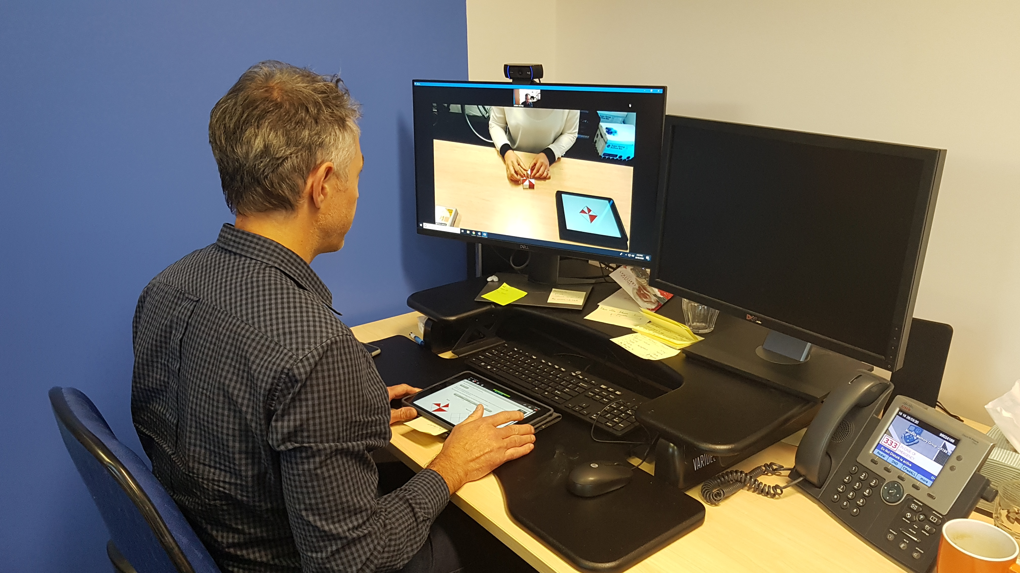
Within Clinic Test Administration
Q-interactive

Slide 21

Home Model
Location | Clinician in clinic/home, Client at home
Trained Assistant Required? | No
Restrictions to Test Selections | Most
Cognitive/Sensory/Motor requirements of Client | Significant
Travel Requirements | None (provided adequate home office set up)
Meeting Social Distancing Requirements | Yes
The New Frontier !?

Slide 22
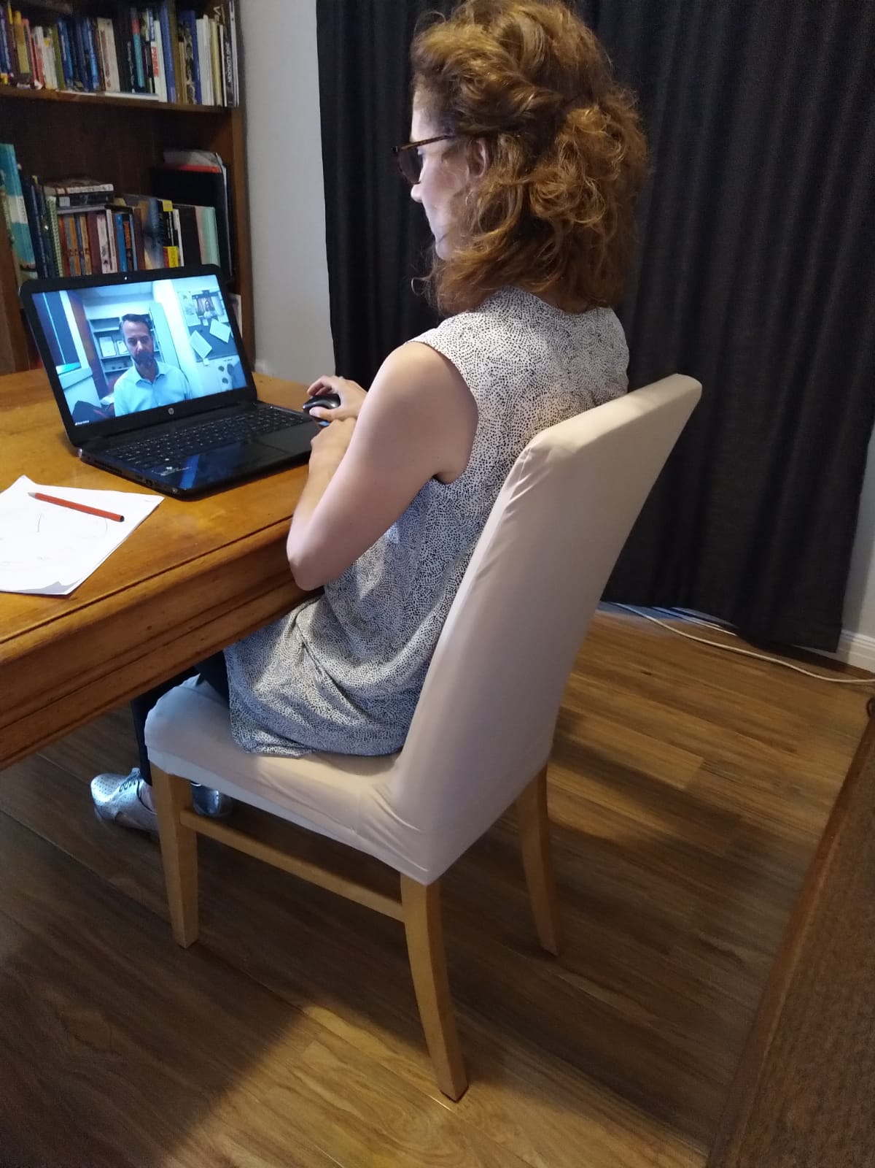
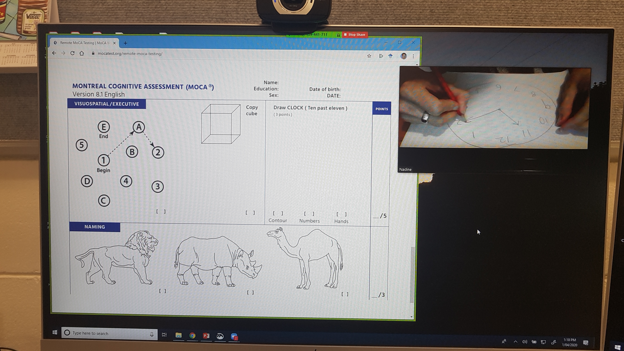
Home Assessment Model
Client Site
No Modification Required | Screen Share Stimulus Materials | Stimulus Materials and Forms in Coloured Folders | Not possible?
WAIS-IV Digit Span WAIS – IV Similarities HVLT-R Semantic Fluency (Animals) Letter Fluency (FAS) | TOPF WAIS-IV Vocabulary WAIS-IV Matrix Reasoning & VP MoCA BNT-2 Stroop Test (Victoria Version)? Oral SDMT? WMS-IV - VR RCFT |  | WAIS-IV Block Design Trail Making Test
Clinician View
Online Admin of MoCA has been released
Check publisher permissions

Slide 23
TeleNeuropsychology
Evidence-Base
Notes:
DW redesigned

Slide 24
Appraising the Evidence of Test Administration via Telehealth
Most studies which aim to validate remote administration of tests compare a face-to-face condition with a telehealth condition.
When evaluating this evidence, consider:
  Are you using the same procedure for the telehealth administration (i.e., are their findings translatable to your approach)?
  Are the statistical techniques used to establish equivalence/agreement appropriate?
    Less appropriate: t-tests, Spearman’s/Pearson’s correlations.
    More appropriate: Intraclass Correlation Coefficients (ICCs), non-inferiority/equivalence testing, Bland-Altman procedures.
Notes:
Point 1 – Are you using the same procedure? If the study has used a remove administration procedure that requires a remote assistant and you are using a document camera…this might mean that the evidence they have established is not translatable to the context in which you are using it. (Although, the closer related the techniques you use are, the more confidence you could have).
Point 2 – Statistical techniques:
Whilst we are used to looking for difference, statistically difference and equivalence/agreement are different concepts. As such, some studies have used inadequate statistical techniques to assess for agreement between conditions. In particular, the use of paired-samples t-tests is largely uninformative about the agreement between conditions because (a) finding no statistical difference doesn’t imply equivalence, and (b) the level of agreement between conditions is not considered. Therefore t-tests are not appropriate when done in isolation. Further, Pearson’s and Spearman’s correlations are not appropriate to assess for agreement because two variables that covary to not necessarily agree. For example, if a sample of participants consistently scored 10 points lower in one condition, compared to the other, a perfect correlation would be obtained (because they perfectly covary) despite the fact that the condition lead to substantially different results.
More appropriate statistical techniques in this instance include ICCs, non-inferiority/equivalence testing, Bland-Altman procedure/plots to name a few.

Slide 25
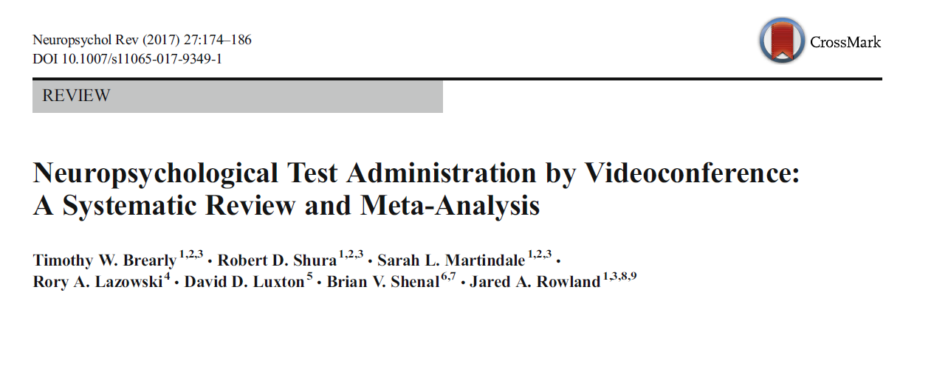
What Does Meta-Analytic Evidence Suggest?

Slide 26
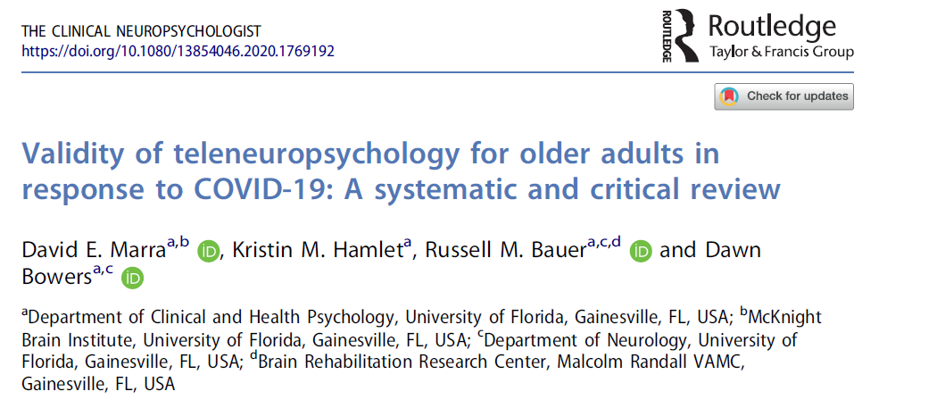
An additional 10 studies…

Slide 27
Evidence Signposting - What Populations Have Been Evaluated?
Healthy | Cullum et al. (2006); Cullum et al. (2014); Galusha-Glasscock et al. (2015); Hildebrand et al. (2004); Jacobsen et al. (2003); Rebchuk et al. (2019); Stead & Vinson (2019)
MCI and AD | Cullum et al. (2006); Cullum et al. (2014); Galusha-Glasscock et al.(2015); Vestel et al. (2006); Wadsworth et al. (2016, American Indians); Loh et al., (2007); Carotenuto et al., (2018); Yoshida et al. (2019); Vestal et al. (2006); Lindauer et al. (2017)
Movement Disorders | Abdolhi (PD/HD 2016); Stillerova et al. (2016)
Substance Abuse | Kirkwood et al. (2000)
Adults Developmental Disorders | Temple et al. (2010)
Psychiatric | Stain et al. (2011); Grosch et al. (2014); Vahia et al. (2015)
MS | Settle et al. (2015)
Stroke | Park et al. ( 2017); Chapman et al. (2019)
Mixed Rehabilitation | Montani et al. (1997)
Notes:
These are studies that have done face-to-face/VC comparisons specifically.
I have also not included studies here that look exclusively at screening measures (although Brearly does).

Slide 28
Evidence Signposting - What Tests Have Been Evaluated?
Screening | MoCA (Abdolahi et al., 2016; Chapman et al., 2019; Stillerova et al., 2016; Lindauer et al., 2017) MMSE (Cullum et al., 2006, 2014; Grosch et al., 2015; Loh et al., 2004, 2007; McEachern et al., 2008; Montani et al., 1996, 1997; Salgari et al., 2002; Wadsworth et al., 2016) CAMCOG (Ball & Puffett, 1998) RUDAS (Wong et al., 2012)
Batteries | WASI (Temple et al., 2010) RBANS (Galusha-Glasscock et al., 2015) NIH Toolbox Cognitive Battery (Rebchuk et al., 2019)

Slide 29
Evidence Signposting - What Tests Have Been Evaluated?
Premorbid Ability | NART (Kirkwood et al., 2000) WTAR (Stain et al., 2011) TOPF (Chapman et al., under review)
Attention and Information Processing | Digit Span (Chapman et al., under review; Cullum et al., 2006, 2014; Jacobsen et al., 2003; Stain et al., 2011; Stead & Vinson, 2019; Wadsworth et al., 2016) Symbol Digit Modalities Test (Chapman et al., under review; Jacobsen et al., 2003; Settle et al., 2015), Brief Test of Attention (Hildebrand et al., 2004) Seashore Rhythm Test (Jacobsen et al., 2003) Adult Memory and Information Processing Battery (Kirkwood et al., 2000)

Slide 30
Evidence Signposting - What Tests Have Been Evaluated?
Language | Letter and Category Fluency (Chapman et al., under review; Cullum et al., 2006, 2014; Hildebrand et al., 2004; Stain et al., 2011; Vestal et al., 2006; Wadsworth et al., 2016) Boston Naming Test (Chapman et al., under review; Cullum et al., 2006, 2014; Stead & Vinson, 2019; Vestal et al., 2006; Wadsworth et al., 2016) WAIS-3 Vocabulary (Hildebrand et al., 2004; Jacobsen et al., 2003) MAE Aural Comprehension (Vestal et al., 2006)
Visuospatial Function | Clock Drawing (Cullum et al., 2006, 2014; Hildebrand et al., 2004; Montani et al., 1997; Wadsworth et al., 2016) WAIS-3 Matrix Reasoning (Hildebrand et al., 2004) Beery VMI (Temple et al., 2010) VOSP (Jacobsen et al., 2003) WAIS-IV Block Design (Chapman et al., under review)

Slide 31
Evidence Signposting - What Tests Have Been Evaluated?
Learning and Memory | HVLT-R (Chapman et al., under review; Cullum et al., 2006, 2014; Stead & Vinson, 2019; Wadsworth et al., 2016) RAVLT (Hildebrand et al., 2004) RCFT (Chapman et al., under review) WMS-IV Visual Reproduction (Chapman et al., under review) WMS-R Logical Memory (Jacobsen et al., 2003; Stain et al., 2011) Benton Visual Retention Test (Jacobsen et al., 2003) Adult Memory Information Processing (Kirkwood et al., 2000)
Executive Function | Trail Making Test (Chapman et al., under review; Wadsworth et al., 2016) WAIS-IV Similarities (Chapman et al., under review) Stroop Test (Victoria Modification; Chapman et al., under review)
Psychomotor Function | Grooved Pegboard (Jacobsen et al., 2003)

Slide 32
What Does Meta-Analytic Evidence Suggest?
Aim: to assess the effect of videoconference administration on adult neurocognitive tests. To examine whether scores acquired during videoconference administration were different from those acquired during on site administration.
Included studies (see next slide):
  n of studies = 12
  Healthy populations, psychiatric populations and neurocognitive populations.
  Participant age range from 34 – 88.

Slide 33
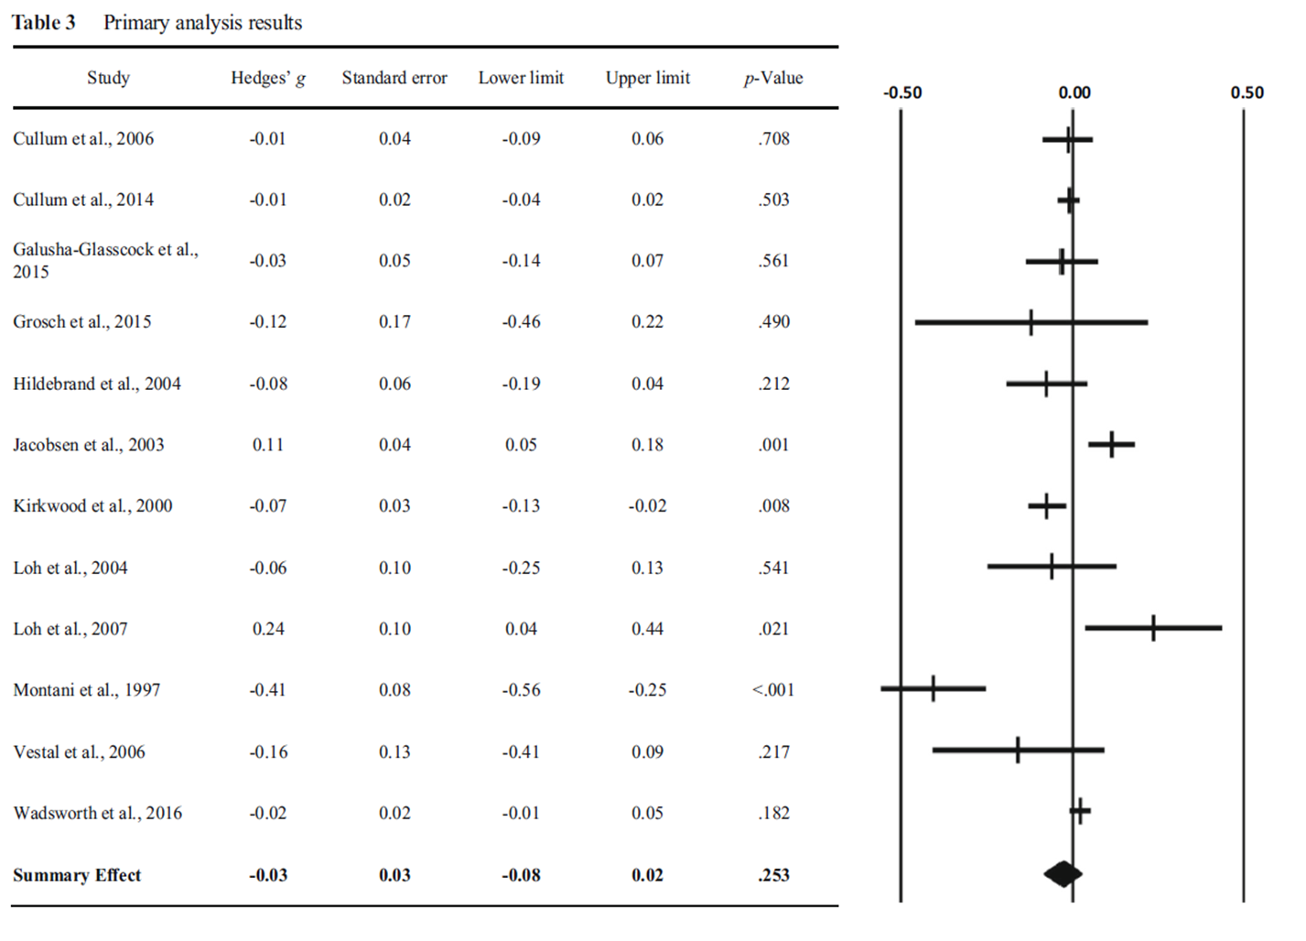

Slide 34
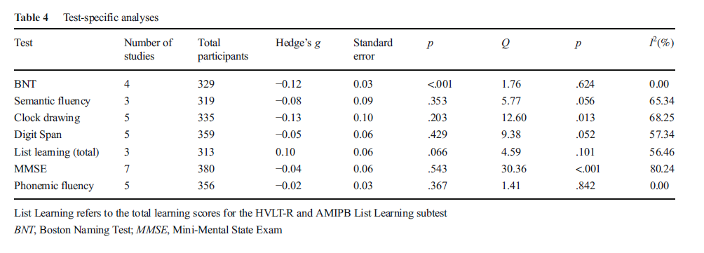
Notes:
Authors of a recent meta-analysis demonstrated that for non-timed tests that allow for repetition, videoconference scores were one tenth of a standard deviation below face-to-face scores (Brearly et al., 2017). In contrast, face-to-face and videoconference scores were equivalent for verbally-mediated, timed tests that proscribe repetition (e.g., list learning tasks; Brearly et al., 2017).

Slide 35
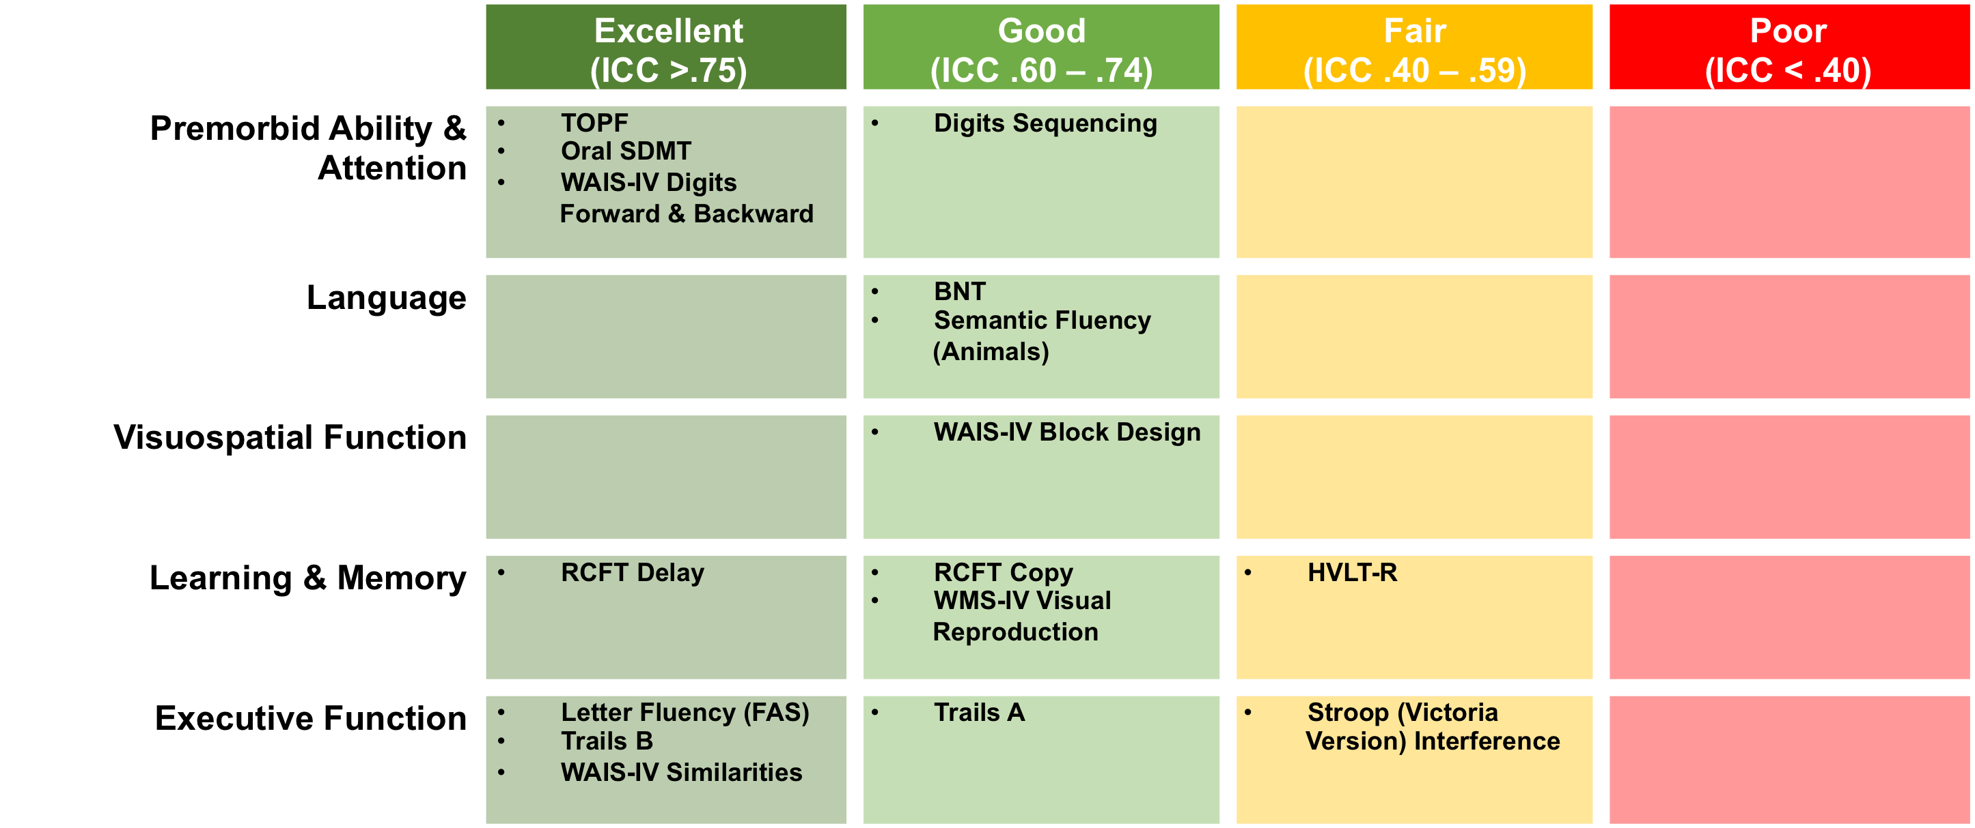
Chapman et al. Under Review

Slide 36
Interim Summary
Emerging evidence supports the feasibility, reliability and validity of teleneuropsychology assessment. Evidence building across clinical populations and tests.
Importantly, no specific test to date has been shown to be invalid.
Evidence is particularly limited for:
  Home assessment model
  Executive Functions and Psychomotor Speed
  Those with profound cognitive/communication impairments
  Cross cultural teleneuropsychology assessment
Need to accommodate these limitations into test interpretation and clinical formulation.

Slide 37

TeleNeuropsychology Practice
Notes:
DW redesigned

Slide 38
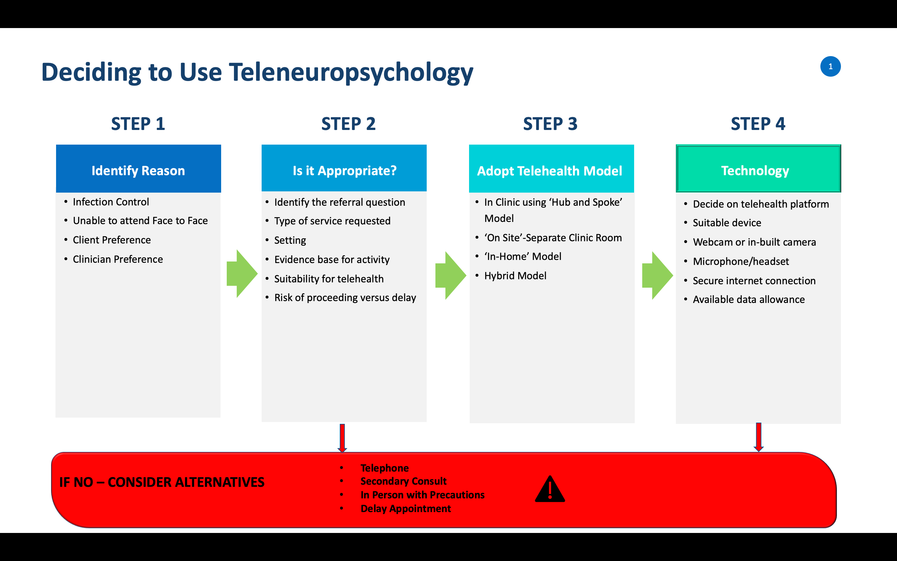

Slide 39
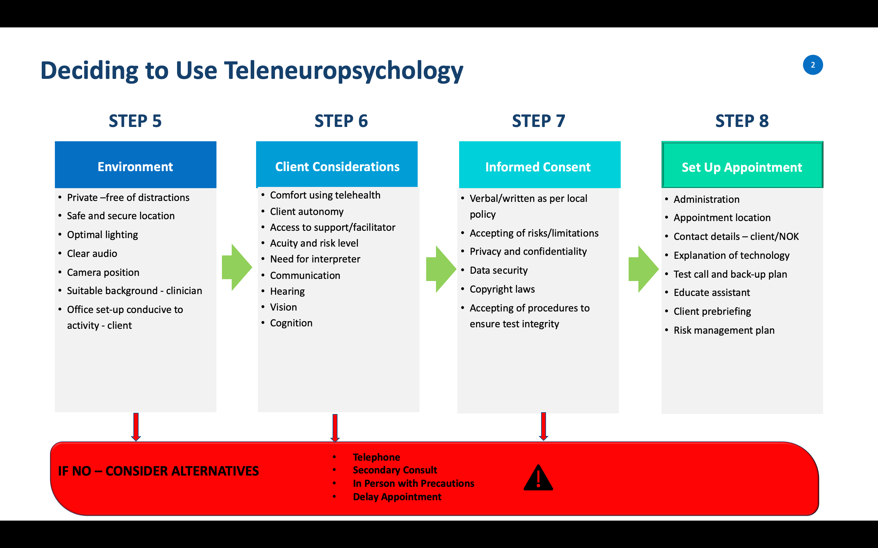

Slide 40
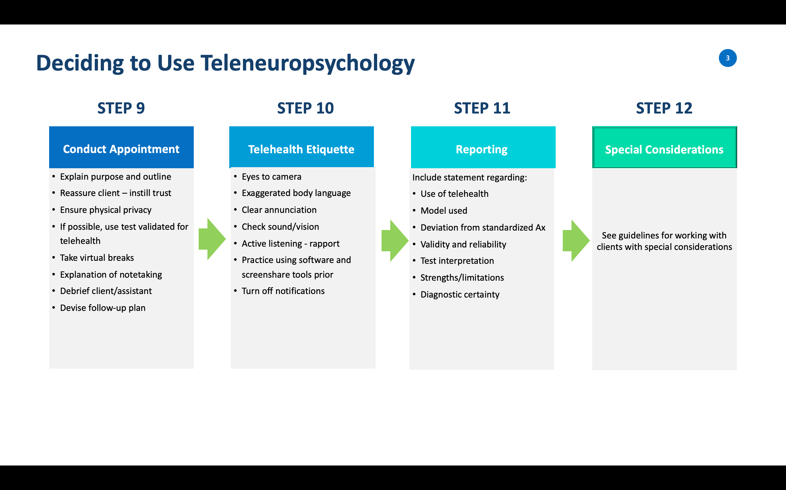

Slide 41
Clinical Priorities during COVID19 pandemic
Ultimate goal: keeping people safe and well
  Physical/mental/cognitive/spiritual
Prevent admission to hospital/care facilities
Prevent delirium
Manage significant BPSD
Assist ‘At Risk’ families – abuse/neglect/unstable accom/employment
Support clients and caregivers mental health
Continue to provide a useful service - YOD

Slide 42
When Telehealth is Not an Option
Some clients:
  Cannot come to hospital
  Need help
  Cannot manage telehealth or would prefer not to try
Phone is your only option
What can you still do? Quite a lot…
  Triage urgent issues, problem solve, manage crises, provide support, demonstrate compassion, prevent future problems, refer on, check in
  Cognitive screening – verbal tasks
  If concerned – GP/medical/crisis support lines
  Run telephone/online support groups
  Contain and reassure

Slide 43

Getting Ready for the Assessment

Slide 44
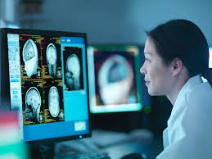
Technology
Screen Size
  iPad/tablet is a minimum standard
  Laptop/Desktop with <13" screen - best practice
  Dual screens - clinician
Connection/Speed
  www.speedtest.net
  Cabled if possible or stable WiFi - if an emergency – use phone 4G/5G
Platform
  Secure and HIPAA/Privacy compliant
  Familiarise with platform and functions
  Screenshare/Chat/PDF Share/Camera/Whiteboard
Background noise – consider lapel microphone or headphones

Slide 45

Telehealth 101 – Prior to Appointment
Where the person will be seen?
Call the client prior to obtain verbal/written consent to proceed
Explain what will happen and check access to technology and support
Support person at the other end - educate this person on what you may need them to do
Test call prior to the appointment with the client or healthcare service

Slide 46
Consent Procedures
Written and verbal consent, as per local policy
See BPS DON guidelines for sample consent form
No screen recording, screenshots, photocopying, reproducing etc.
Copyright laws/confidentiality of test material
Tests used may be different from ‘In-Clinic’ Ax
Evidence base
May affect diagnostic certainty/conclusions
Medicolegal – person must be able to use technology independently

Slide 47

Setting Up Your Workspace Environment
Sign on your door advising of video call
Minimise external distractions in environment
Open applications/disable notifications/alerts
Contact number beside you/phone on
Once video call is working – phone on silent or vibrate
Lighting/sound
Confidential information should be out of view

Slide 48

The Appointment
Explain the back-up plan if the technology breaks down
Obtain phone contact details, email, DOB, address/NOK
The location of where the patient is at the time of Ax
Check sound and vision
Adjust image quality if poor by reducing the bandwidth.
The client may look ‘grainy’ but the sound and picture will be more stable
Position the camera so you are looking at it
Continue with the appointment just like you would with any other

Slide 49
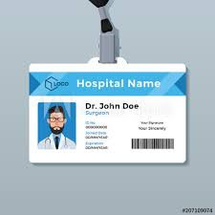
The Appointment
Introductions – name, position, location
Who is in the room? Out of view?
Confidentiality - session is private, adheres privacy laws F2F
Identification is visible
Explain purpose and structure of appointment
Set expectations – duration/medium/breaks/assistance
Check what their understanding of purpose is?
Person-Centered Care/Goals

Slide 50
Introductions - Example
‘Thank you very much for coming in today to see me. My name is Julia and I am a Clinical Psychologist based in Kidderminster’s Dementia Assessment Service. While I would normally see you face to face, today we will be conducting the appointment via a videocall
This is new technology. It will require some changes to the way we work together. Please be patient while we adjust to a different way of working. We will do our best together to ensure this is a useful service for you. If at any time you have questions or concerns, please let me know…’

Slide 51

Telehealth Etiquette

Slide 52
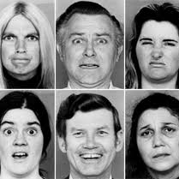
Adapting Your Therapeutic Skills
Frame face - head and shoulders in view
Animation
  Facial expression – smiles/frowns
  Voice – clear, animated, not monotone
Make body language mirror what you are trying to express
Empathy – lean forward and look into camera
Requires a higher level of attention – both clinician and client
Minimise your on-screen image once used to platform
Set up room so you can alter your posture
Notes:
Watch yourself in the mirror

Slide 53

Building Rapport
Reassurance of physical privacy
Importance of small talk – get to know your client
Familiarity with platform – anxiety impacts rapport
Be explicit – ask if you cannot 'read' body language
Clients reveal more detailed personal information than F2F
More informal medium – be mindful of boundaries
Summarise information to enhance comprehension

Slide 54
Checking In with
Check in With the Client
This type of assessment is also new for your client
They may be anxious or uncertain
The client may not tell you if..
  They cannot hear you
  They cannot see you
  They didn't understand what you said
  Grooming/self-care

Slide 55

Special Considerations

Slide 56
‘In-Home’ Assessment: Tests to Consider
Premorbid: TOPF/NART/Vocab/Info
Attention & Working Memory: Digit Span, Arithmetic, Mental Control, Oral Trails A
Verbal Memory: Word Lists/Stories/PAL
Visual Memory: Rey Delay, VR I & II, L’hermitte Board, Benton Visual Retention Test
Language: Cookie Theft, BNT, SydBat, Category Fluency, Reading, Writing, Spelling
Visuospatial: Simple Copy, Rey Figure Copy, Clock Drawing, Line Bisection, Neglect, Praxis, MR, VOSP
Speed of Processing: Symbol Digit Modalities Test (Oral), Motor speed
Executive Functioning: Oral Trails B, VP, Phonemic Fluency, Haylings Sentence Completion Test, Similarities, Practical problem solving, ‘Go-No Go’ paradigms
Social Cognition: Hinting Test, Faux Pas Test

Slide 57
Clients with Hearing Impairment
Determine the presence/degree - test call
Ensure client is wearing hearing aids
Turn up speaker volume
Consider use of a headset to minimise feedback
Speak loudly and clearly - annunciate
Look at the camera when speaking – this enables lip reading
Ask the person to repeat back what they have heard

Slide 58
Clients with Low Vision
Assistant or family member to facilitate assessment
Orientate client to work desk set-up, technology, stimuli, etc.
Often visual stimuli can be magnified or simplified
Completely blind? - May need to rely on verbal assessment, some visual Ax, OT Ax and informant history – ‘visual’ still useful
Visual environment - uncluttered, with good lighting and good surface definition between the stimuli and the desk
Examiner should wear solid colours - avoid patterns
Think about modifications if seeing ‘in-person’

Slide 59
Communication Difficulties
  Allow extra time
  Reduce distractions - quiet environment
  Pause before and after IMPORTANT information
  What makes things easier to communicate effectively?
  Establish context - e.g. Are you talking about this or that?
  Ask Yes/No questions
  Use the chat, whiteboard and screenshare tools were necessary
  Simplifying, rephrase and repeat where test allow this
  Add gesture, written key words, drawing, pictures

Slide 60
Interpreters
If possible, employ a neuropsychologist that speaks the dialect
Options: phone interpreting, teleinterpreting (3-way call) or interpreter on-site
Provide TH information in dialect of client, prior to session
Explain to interpreter how Ax will be conducted and tasks delivered via TH. Allow enough time for translation
Seeking direct interpretation of what client says in both conversation directions
Ask interpreter for impression of client’s expressive & receptive language in native tongue (i.e. speech intelligibility, word-finding, thought form)
Debrief the interpreter after the consult

Slide 61
Clients with Cognitive Impairment
Check prior performance on cognitive screening - is Ax feasible?
Support person/facilitator to assist the client
Allow more time and ‘virtual breaks’
Clients - highly anxious, longer to develop rapport
Provide reassurance, clear explanations, containment – normalise
Simplify and repeat instructions where possible – reduce information overload

Slide 62
Clients with Behavioural Change
Informant history is critical – family/support person/staff
Assess acuity and risks carefully – pre and post
Ideally, client can be seen ‘in-person’ initially for behavioural observation, then subsequent sessions can be delivered via telehealth
Involve support people/staff when developing recommendations
Use telehealth medium to view environmental set-up and complete visual ‘walk around’
Easier to schedule monitoring sessions

Slide 63
Pros Cons
Convenient (for both), enables greater access
Infection control
Sessions ‘in-home’ – content more generalisable to everyday life
Greater family engagement - opportunity to use family members to enhance use of behavioural/rehabilitation strategies
Able to build a strong therapeutic relationship
Less control over environment
Limited validated tests
Minimal research for ‘in-home’ model
Data and test security – copyright
Technology breaks down
Tech inaccessible – economic/access
Confusing for some clients
Requires greater administration and set-up time
Less diagnostic certainty

Slide 64

Reporting
‘Thankyou for referring Mrs Smith for neuropsychological assessment. Mrs Smith was seen via telehealth using the Attend Anywhere platform at her home in Suffolk. The examiner was based in Bury St Edmunds’ Memory Assessment Service. Mrs Smith viewed a 15” desktop computer for the consultation.
Mr and Mrs Smith were present for the interview. Mrs Smith was seen by herself when completing formal cognitive assessment tasks.
There was one instance of loss of sound during the interview, which was resolved after refreshing the screen. The sound and vision quality were otherwise excellent.
The assessment was thought to be valid, with good effort displayed. Every effort was made to simulate standardised assessment practices.
However, as this assessment was conducted via telehealth, special consideration must be made with test interpretation/conclusions, due to deviation from non-standardised administration of test materials’

Slide 65
IOPC Guidelines for TeleNP…
“Due to circumstances that prevent in-person clinical visits, this assessment was conducted using telehealth methods (including remote audiovisual presentation of test instructions and test stimuli, and remote observation of performance via audiovisual technologies). The standard administration of these procedures involves in-person, face-to-face methods. The impact of applying non-standard administration methods has been evaluated only in part by scientific research. While every effort was made to simulate standard assessment practices, the diagnostic conclusions and recommendations for treatment provided in this report are being advanced with these reservations.”

Slide 66
Medicolegal Assessment via Telehealth?
Vigorous debate since COVID19 pandemic
Main Concerns:
  Test Integrity/copyright
  Reliability and validity
  Cheating
  Effort Testing
  Lack of controlled environment
  Reports being scrutinised in court
Laws different across jurisdictions
Require permission from both parties for TH Ax before proceeding
Outline risks – written consent
Client must be able to manage technology independently – no undue influence

Slide 67
Risk Management
If telehealth requested – triage, and appropriateness
Consider
  Reason
  Appropriateness
  Risk
  Alternatives
Decisions and responsibility lie with the clinician
Insurance and liability
Doing a telehealth assessment is remarkably similar to doing a face to face assessment. You are not assessing with a blindfold on!
Managing patient risk

Slide 68

What Clinical Skills Do You Need?
Patient and calm demeanor – ‘unflappable’
Well-developed social skills/able to read non-verbal cues
Ability to develop rapport quickly
Communication and collaboration skills – Team Player
Trust and respect
Problem solver and solution focused
Flexible thinker and open minded
Aware of cultural and social issues in communities

Slide 69

Take Home Messages
The evidence for teleneuropsychology is developing. Studies to date support the feasibility, acceptability, validity and efficacy of teleneuropsychology assessment and intervention.
TeleNP may not be appropriate for every situation. May be more challenging for those with significant sensory, cognitive, language or behavioural presentations. Or limited access to technology.
Significant clinician training, practice and supervision is recommended before jumping into assessment. This will take time…
Need to be flexible, adaptive and creative to the situation in hand…

Slide 70
Resources
General TelePsychology Practice
  APA Telehealth 101 Webinar https://apa.content.online/catalog/product.xhtml?eid=15132&eid=1921
  APS Telehealth Webinar - Adjusting your practice for COVID-19: Telehealth tips you can use now.
  APS Ethical Guidelines
    Ethical guidelines for providing psychological services and products using the internet and telecommunications
    Ethical guidelines for psychological assessment and the use of psychological tests
  http://www.aths.org.au/resources/guidelines/

Slide 71

Resources
TeleNeuropsychology
  Inter Organizational Practice Committee – Teleneuropsychology guidelines https://iopc.online/teleneuropsychology
https://www.pearsonclinical.com.au/covid19support
https://www.pearsonassessments.com/professional-assessments/digital-solutions/telepractice/about.html
Communities of Practice
  NPinOZ
  BrainSPaN
CCN Resource coming soon

Slide 72
















Acknowledgements
Jodie Chapman
David Lawson
Simone Mangelsdorf
April Philpott
Upeka Embuldeniya
Lauren Arthurson
Dennis Velakoulis
Stefanie Colella
Melinda Sorraghan
Karen and Kerin
Rebecca Sutherland
Amy Scholes
Warwick Brewer
Liz Mullaly
APS

Slide 73

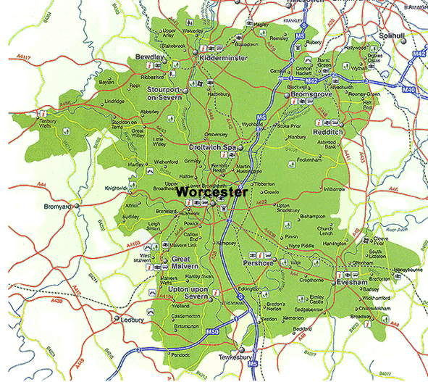
Local experiences
Model and process in Worcestershire
Telephone initial assessment for brief clinical interview and update; assess remote assessment suitability and eligibility with crib sheet to guide, and discussion regarding:
Benefits, risks and options for proceeding with assessment currently
Purpose of assessment inc. support mechanisms if distress caused
Device, feelings toward technology, internet connection
Environment
Individual factors and support needs
Informed consent
Currently:
Remote as default but hybrid being introduced where necessary
Face to face only where clinical need balanced against risk
Working towards: one session for face to face work per clinician per week from 1st August
Supported by a shift in assessment practice, training on remote ACE and team managers enabling staff to observe administration. OTs, Psychology and support workers running CST, Living Well and Carers Information groups virtually or individual provision by telephone. Where appropriate Consultant Psychiatrist delivering diagnoses remotely.

Slide 74
Example in practice
Remote assessment of person in early 60’s - inpatient
Reason for referral: query DLB/vascular dementia, psychological cause or other known neurological cause (epilepsy, migraines) – presentation: progressive cognitive decline, hallucinations.
Reduced occupational/educational attainment
Questionnaire measures – IQCode, DASS-21
Assessment supported by ward OT – he had also been through neuropsych 2 years prior
Tests used via webex + Q global, document camera
Visuospatial – VOSP, CDT free + copy, Picture Completion
Executive - DKEFS Verbal Fluency, Key Search*, Hayling, Similarities
Language – Picture Naming
Memory – CVLT, RCFT*
Information processing and attention – Symbol Search*, Cancellation*, Digit Span
Visual abstract reasoning – Matrix Reasoning, Visual Puzzles
Feedback from patient – “I was nervous about using the new devices at first, but I enjoyed it. It gave me something to do, and if you can help to find out what’s causing this problem in my head, it will have been very helpful indeed!”
*Only possible due to environment/help from OT
Practicalities discussion
Clinical interview separately with patient + wife (with informed consent)
No prior familiarity whatsoever with videotech

Slide 75
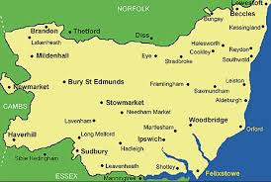
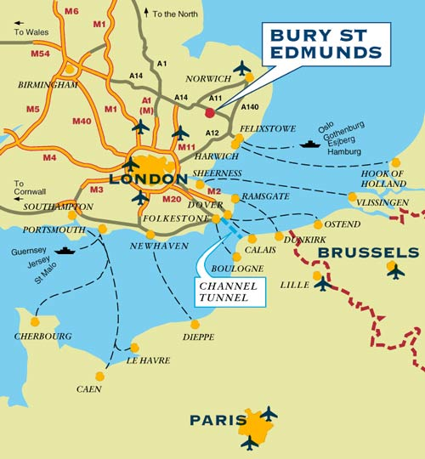
Local experiences
Suffolk: East and West different models
Neuropsychology offer
  Remote
  F2F Home visit
  F2F Clinic (West only)
Pros and Cons crib-sheet

Slide 76
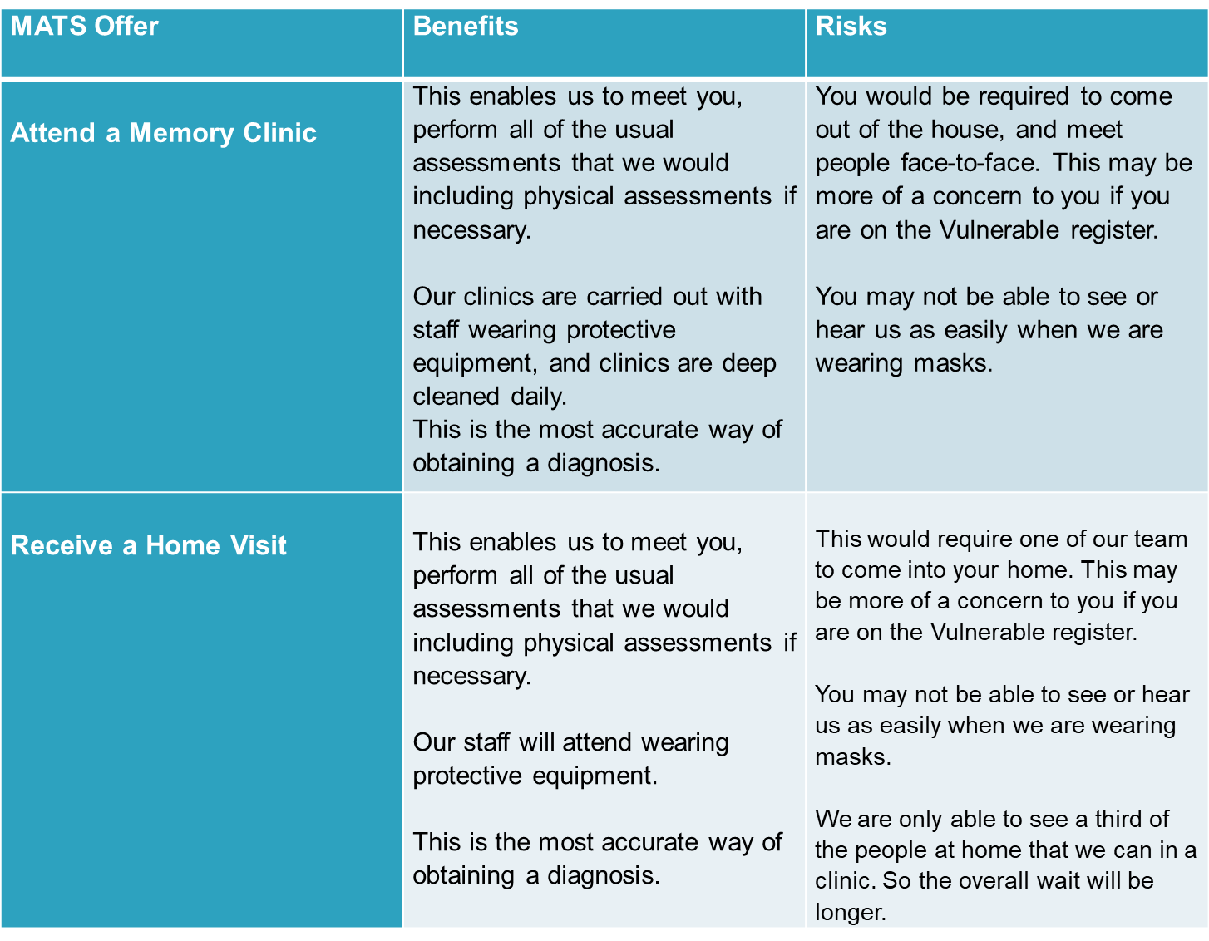

Slide 77
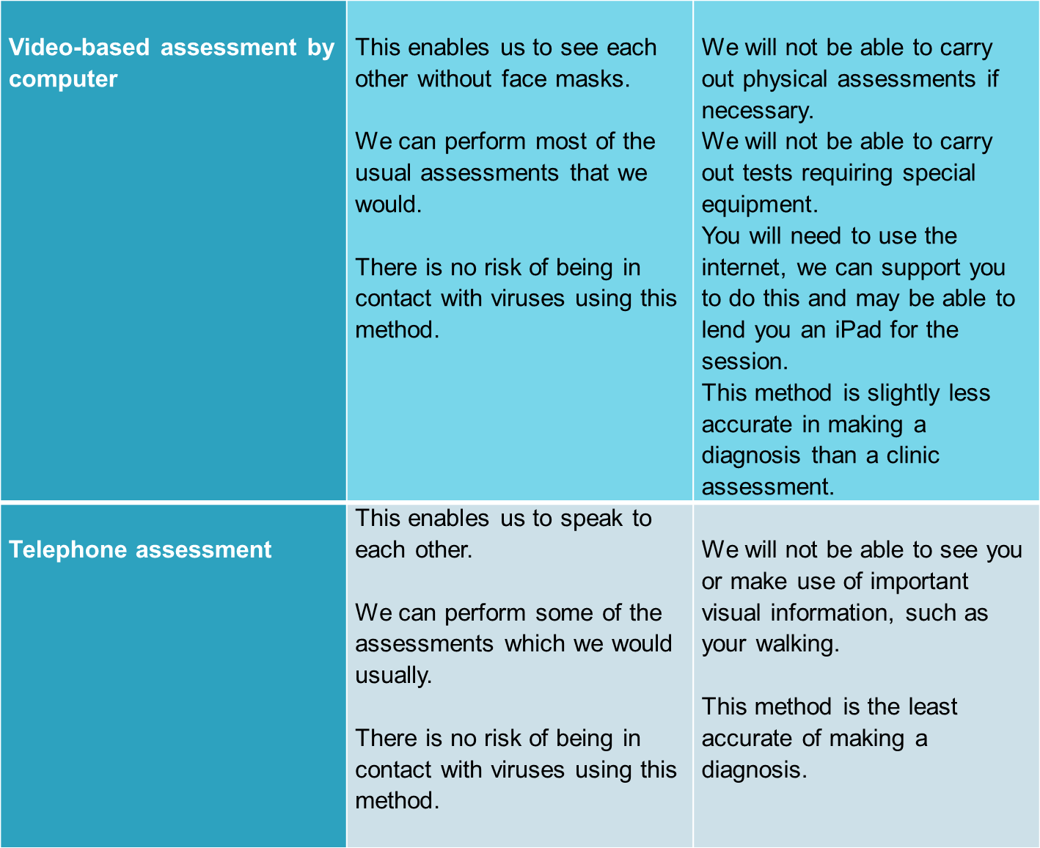

Slide 78

Staff experiences
  PPE: test manipulation & audibility (F2F)
  Screen sharing not matching paper (eg ACE-III)
  “Lots of preparation to work up to the assessment”
  eg start with an interview video, then an ACE-III, then neuro
  “It’s exhausting”
  Can’t ‘control’ session: screen used, prompts etc
  Not being physically present to keep someone on track and motivated led to some giving up more quickly
  Value of a knowledgeable manager & a good team for triage, discussion and practicing testing remotely

Slide 79
Patient experiences
Some have declined a video appointment, preferring to wait for a F2F.
“Definitely preferred computer” reduced performance anxiety & travel (3 hours)
“it felt like she was in the room rather than online… (clinician) helped her to feel at ease”
“very,very good, very nice… informative…knew what she was talking about”
felt that face-to-face might be easier for clinicians to pick up on emotions, body language and for there to be more discussion
Had to use the mobile “not ideal we couldn’t see each other fully”
How will you deliver bad news online?

Slide 80

‘Memory Patients’ and Legal issues?
Court of Protection: “litigants in the CoP are right in the vanguard of this awful pandemic”
https://www.judiciary.uk/wp-content/uploads/2020/03/13-March-2020-Court-of-Protection-Guidance-from-the-Hon-Mr-Justice-Hayden.pdf
“I think it is prudent to indicate that visits should only be made to P where that it is assessed as absolutely necessary. Alternative arrangements should always be considered first, such as telephone, facetime and skype conferencing” The Hon Mr Justice Hayden, 2020
The importance of maintaining the Rule of Law in the Civil Courts during COVID-19

Slide 81
“We are always assessing, but don’t always test” (Cullum et al 2020 – “Risk Management for TeleNP” presentation)
What is the clinical question and how can it be answered
Is testing going to help?
Example referral: a man with Parkinson’s disease for neuropsychological assessment to establish whether dementia or MCI
Chronic alcohol use
Anticholinergic medication (Oxybutynin)
Insomnia
untreated sleep apnoea
significant untreated comorbid mental health problems
Would test scores add to any differential diagnosis without addressing comorbidities first?
What can be done besides diagnostic assessment?
1. psychoeducation
2. onwards referral for therapy/physical investigations
3. discuss anticholinergics with prescriber
4. re-referral at a later date

Slide 82
Practicalities
Clinical interview can often be conducted remotely regardless of testing possibilities
Questionnaires to aid process where helpful
Cautious interpretation
Value of repeat/extended assessment – compare individual’s performance across time
Value of practice (!!)
Definitely not a ‘one size fits all’ approach e.g. more moderate/severe presentations
Acknowledging environmental limitations
  Can’t direct eye gaze
  Disconnect from patient & relative – direction of attention
  Risk of distraction despite best efforts of all
  May not be aware of e.g. patient pointing to stimuli, help from relative, writing things down, looking at items to provide assistance
  Need to be more obvious in terms of what you want the person to do; fewer cues from body language
  Camera angle if patient only using one camera –challenge for visuospatial tasks
  Platform interacts with dual document camera and webcam possibilities (e.g. Webex)

Slide 83

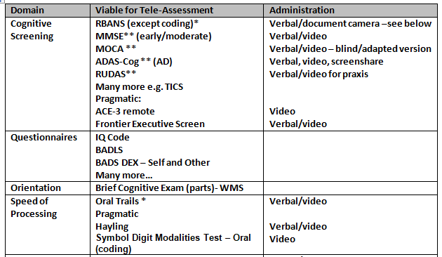
Potential tests
Disclaimer: some, but not all of these have an evidence base
Based on own clinical experience, Australian Dementia Network (2020), Brearly et al (2017), Marra et al., (2020)

Slide 84
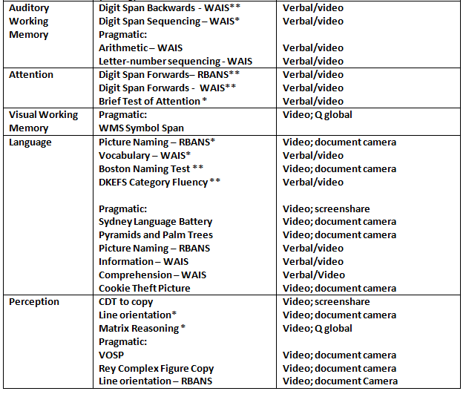

Slide 85
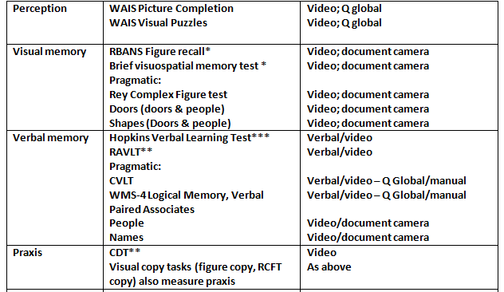

Slide 86
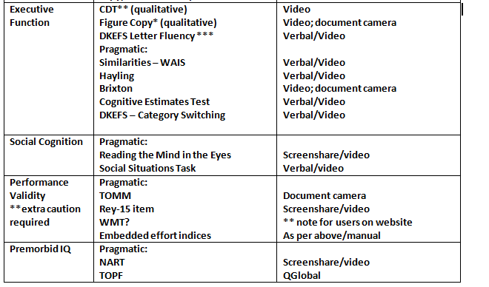

Slide 87
Possibilities
Is there potential to devise local clinical governance and guidance?
Proposal for access to Q Global/document camera
Evaluation – e.g. surveymonkey to establish patient experience

Slide 88
Video

Slide 89
Useful links/information
Australian Dementia Network: Managing Memory Clinics during the COVID-19 pandemic: initial perspectives from the Australian Dementia Network Memory Clinics network. April 2020
Division of Neuropsychology Guidance
NHS E&I – Memory Service Assessments: a new way of working
London Clinical Networks - Guidance on remote working for memory services during COVID-19
Risk Management for Teleneuropsychology: https://ce.nationalregister.org/wp-content/uploads/2020/04/Risk-Management-for-Teleneuropsychology.pdf
Dementia Academy https://dementiaacademy.co/resources/webinars-covid-19/ (inc remote cognitive screening – sensory impairment)
Brearly et al., 2017 https://link.springer.com/article/10.1007/s11065-017-9349-1?shared-article-renderer
Mazza et al 2020 https://pubmed.ncbi.nlm.nih.gov/32519594/
Wadsworth et al., 2018 https://academic.oup.com/acn/article/33/8/1040/4797076
Phillips et al., 2020 (MOCA) https://onlinelibrary.wiley.com/doi/full/10.1111/jgs.16469

Slide 90

Thank you!
Questions?

