Slide 1

MSNAP Webinar
Adapting memory services and working flexibly during Covid-19
3 June 2020
Notes:
Welcome and thank you for coming.
Introductions.

Slide 2

Housekeeping
This is a live event, therefore unless you’re a designated speaker you are on mute
Please use the Q&A function to ask any questions and vote for the ones you want answered
This will be recorded and the link will be shared after the event
If you have requests or suggestions for future webinars please let us know
Notes:
For anyone who is not a member.
MSNAP is part of the CCQI which aims to raise the standard of care that people with emotional or mental health needs receive by helping providers, users and commissioners of services to assess and increase the quality of care they provide.
More than 90% of Trusts in the UK who provide mental health services participate in the work of the CCQI and we currently have 24 accreditation projects, of which MSNAP is one.
We publish standards and use a peer review model to measure services against the standards.
MSNAP has now been running for 10 years.

Slide 3
Dr Sarah Ghani
Chair of MSNAP Advisory Group & Consultant Clinical Psychologist
West London Trust
Notes:
Welcome and thank you for coming.
Introductions.

Slide 4
Dr Chris Jagus
Consultant in Old Age Psychiatry
Isle of Man
Notes:
Welcome and thank you for coming.
Introductions.

Slide 5
Dr Sabrina Leigh-Hunt
Consultant Psychiatrist
Margaret Cooper
Memory Service Nurse Prescriber
Tees Esk & Wear Valleys NHS Foundation Trust
Notes:
Welcome and thank you for coming.
Introductions.

Slide 6
Delivering Memory Services during COVID Crisis at Hambleton and Richmondshire Memory Clinic
Dr S Leigh-Hunt, Consultant In Old Age Psychiatry and Margaret Cooper, Memory Service Nurse Prescriber

Slide 7
Pros and Cons of Business as usual
Pros
Cons
Avoiding waiting times for patients.
Reducing anxiety for patients and relatives
Identifying and addressing risks
Developing safe and effective new ways of working ( retrospect)
Risk of reducing quality of the diagnostic process
Developing two tier system – not everyone will be suitable for remote assessment
Physical observations (pulse, BP, ECG)
Missing aspects of risk through remote working
Notes:
The working group discussed the pros and cons of conducting assessments and delivering diagnosis through telephone and video conferencing options( Appendix A). We collected opinion from healthcare professionals across the Trust on this subject.

Slide 8
What we did?
Reviewed Trust Dementia Care Pathway and added modifications to support continued delivery of assessments and treatment.
Reviewed IT equipment / software early on and identified and ensured staff had appropriate IT requirement laptops, mobile telephones, headphones.
Staff resources – number of staff at base and working remotely reduced to ensure social distancing was possible- team meeting.
Established huddles via Microsoft teams
Notes:
WE CHANGED FROM MODEL ONE STOP SHOP/ FLOATING CONSULTANT MODEL TO ADAPT TO COVID
We followed guidance from SDG working group who commenced work 19th march 2020
2) Huddles – 7 members of staff involved MT – recorded under mdt / clinical decisions

Slide 9
Prior to appointment…
Patients are screened to ensure that they can either participate in attend anywhere or telephone assessment. Consent is obtained to talk to carers/relatives. This streamlines the assessment
Information about this service and the third sector is sent out to the patient via post. This includes any services that have been set up in their area in response to Covid 19.
Notes:
Any assessments that we cannot do remotely a waiting list has been created.
All referrals are contacted and suitability for remote assessment is considered, and contact for informant history .

Slide 10
Assessment
Live recording
Patient and collateral history is the key- consistent team approach for obtaining history. Conscious of obtaining informed consent at every stage of process.
Assessment Tools
Prior to MDT: any results bloods/ CT/ physical hx and relevant information already checked by medic ready for discussion.
MDT discussion- facilitated by remote working. Once assessment completed time slot has been pre-arranged via Microsoft teams with the consultant and another clinician to discuss the assessment and generate a working diagnosis
Notes:
Assessments start on time, member of staff works with headset and live records the interview
Feedback from patients and carers has been positive, they are given time afterwards in private if needed to discuss any matters further
Ham/Rich staff have over 120 years of experience between them which probably helped with considering new ways of working and having the confidence to work differently.
Agreed team patient flow means that all team members follow a standard process of assessment, care planning and treatment
Once assessment completed time slot has been prearranged via Microsoft teams with the consultant and another clinician to discuss the assessment and generate a working diagnosis
One of the clinicians (mostly nurses), will the contact the patient and deliver the diagnosis. If the patient has stated that they wish to have it delivered this way
Patients that need further psychometric assessment are on a waiting list, the trust is considering ways in which that can be addressed
elements of the ACE 11 ( which staff are confident in using). Recognised this is not a validated tool but possibly can be helpful.
Working diagnosis- face to face appointments are being planned to confirm diagnosis.
Using ICD codes: continue to be used.
Neuropsychometryrecognise the difficulties in completing . There is a working group investigating ways forward.

Slide 11
Diagnostic Feedback
Always by a senior clinician with careful attention to consent and emotional reaction.
We encourage family members to be present if possible and if not to contact patient straight after.
Our clinical psychologist is available for post diagnostic support.
We continue to refer to appropriate services – both secondary MH services and local support agencies.
Appropriate information pack is sent following Diagnostic Discussion.
Notes:
To include feedback continues by consultant but more and more nurse led

Slide 12
Commencing Treatment
Non–Medical Prescriber primarily commences treatment
Working closely with primary care to obtain physical observations, and health concerns.
Working closely with pharmacies to ensure safe delivery of prescriptions.
Review appointments by telephone.
Involving patients and carers in self monitoring – Home BP machines, pulse monitors- but recognising clinical limitations.
Cautious titration .
Notes:
Titration: donepezil up to 5 mg –

Slide 13
Cont…
Weekly NMP supervision with Consultant.

Slide 14
Following Diagnosis
Educational session (Living well with memory loss). 1:1 basis instead of group with senior OT . Which includes those who may have struggled to attend the group. Applicable written information sent in the post / email.
Carers group – OT liaising with 3rd sector service to develop small carers group via Microsoft team.
CST / MCI –follow a similar pattern to the Living Well Group.

Slide 15
Feedback from Professionals
we realised that face to face appointments would be impossible….our everyday work needed to continue in some format or we would increase risks further for our patients……Although phone appointments have not been suitable for all patients…in particular hearing impairment or severe disorientation can rule it out…in most cases we have been able to achieve some level of assessment………..MEMORY CLINIC NURSE
lucky to have some retired senior nurses back …….. and this has allowed us to increase the number of initial assessments and working diagnoses have been made by close working with our consultant…… that the provisional diagnosis can be disclosed to the patient……………see all these patients face to face to confirm the diagnosis………... TEAM MANAGER
Keeping an expert admin eye on appointments and follow ups…….Attending Huddles…..........
everyone is at a safe distance……..
Not travelling to other departments/wards unnecessarily….Sending the majority of post to GP’s via email (this is much quicker than royal mail at the present time)………TEAM SECRETARY
·
As a nurse prescriber I have continued titration appointments……Excellent and frequent clinical supervision for prescribing has aided this…..

Slide 16
Staff Reflections
“ Overall a very effective, efficient and ‘win win situation for everyone.’
“It was very beneficial to then be part of the diagnostic feedback given by … all on the same day”.
“ I think the patient and carer were very reassured to hear our feedback in a timely way”.

Slide 17
Clinical Psychology
As yet we have not completed any new assessment/ repeat neuropsychometry
For those patients assessed joint diagnostic feedback with consultant via attend anywhere
Psychologist role in CLS has been maintained weekly
Psychologist has been present throughout lockdown to support staff as needed assist with other roles if appropriate.
Notes:
Fullen continues to liaise with neuropsychology colleagues across the trust to consider a way forward- as it stands holding a waiting list

Slide 18
Constraints and Challenges
Training requirements for Professionals
Patients who were not assessed remotely- waiting lists
Titrations
Those who require neurology opinion/other
Certainty of Diagnosis
Assessing risk accurately – relying on information given by patient/ carers.
Staff / patients anxiety re: length of time this situation will continue. “ this present situation will become endemic so we will continue to work differently whilst maintaining standards”
Notes:
Constraints= limitations
Training requirements= tools to be used
Example: those need a referral to neurology/ cardioloogu- remote

Slide 19
Positives
Staff ability to adapt and continue to put patient at the centre of everything we do.
Staff are feeling less isolated when working at home and continue to be involved in operational decision making.
Embracing technology. Using Microsoft Teams for Huddles, Staff support, CLS – complex patient care, diagnostic discussions.
More staff are able to attend Webinars- good practice being disseminated more efficiently.

Slide 20
Thank you
Sharon Airey, Team Manager
Dr Venkatesh Muthukrishnan , Clinical Director MHSOP York & North Yorkshire, TEWV
Dr. Mani Krishnan Senior Clinical Director MHSOP, TEWV

Slide 21
Dr M Santhana Krishnan
Consultant in Old Age Psychiatry/Liaison Psychiatry, Senior Clinical Director MHSOP Trust-wide
Tees Esk & Wear Valleys NHS Foundation Trust
Notes:
Welcome and thank you for coming.
Introductions.

Slide 22
Memory clinics during COVID19 Pandemic
Challenges and Opportunities
Dr M Santhana Krishnan
Consultant in old age psychiatry
Chair Elect FACULTY of old age psychiatry @rcpsych

Slide 23
Our Dilemma
COVID 19 posed a challenge to our ‘routine’ memory clinic work
Business as usual is not possible neither we can close for business
We used NEED and RISK as a mantra to challenge whatever we did
Patients and families were clearly keen to engage in the new way

Slide 24
Memory clinics in COVID Times
Enhanced Screening – Need & Risk
Assessment – Remote vs F2F
Diagnosis – Remote vs F2F
Future Planning – OT assessment etc
Discussion with patients and Family

Slide 25
Memory Clinic Referral
SCREENING
ASSESSMENT
DIAGNOSIS
+
POST DIAGNOSIS

Slide 26
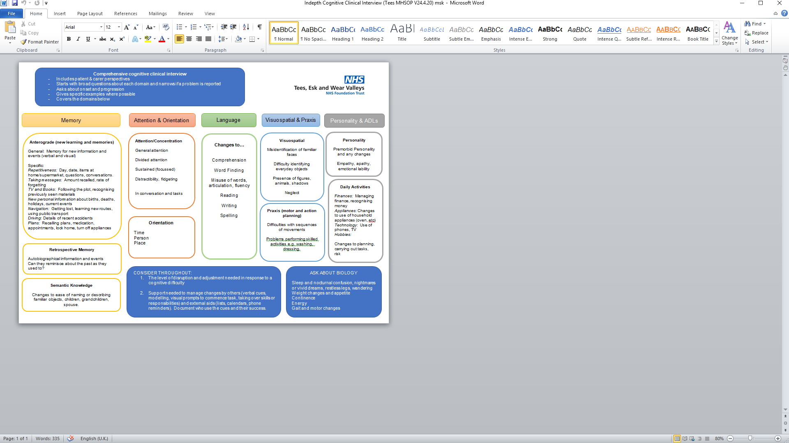
History
A thorough and well informed history is key
The IQ code (https://www.cochrane.org/CD011333/DEMENTIA_using-structured-questionnaire-iqcode-detect-individuals-who-may-go-develop-dementia) is a helpful instrument of proven validity

Slide 27
Assessment
Cognitive Assessment
Neuro-imaging
Depression & anxiety assessments
OT Assessment

Slide 28
Treatment
Pulse/ ECG
Prescribing memantine should be straightforward if there is a recent e-GFR.
Other treatments options remain possible eg treatment of depression, reviewing medications etc
carers could be offered a psychoeducation and skills training programme. StrAtegies for Relatives Intervention (START) can be delivered via a telephone or video – CST Groups

Slide 29
Brain Scanning and Blood Tests
A discussion with the patient and the family about the risks of having a scan and the likelihood that the results would change the management plan should be undertaken.
Protocols have been developed which suggest the clinical situations where a scan may or may not be necessary. For example:
http://www.londonscn.nhs.uk/wp-content/uploads/2018/10/dem-imaging-oct18.pdf
http://www.yhscn.nhs.uk/media/PDFs/mhdn/Dementia/Dementia%20Diagnosis/Neuroimaging%20guidance/Yorkshire%20and%20Humber%20Neuroimaging%20Guidance%20in%20Dementia%202018.pdf
Blood tests
There should be flexibility in the time between the blood test and the assessment
Unless there is a clinical indication, waiting for blood test should not hold up the diagnostic process.

Slide 30
CT Scan reports
There is no evidence of an underlying intracranial mass lesion, no midline shift and no hydrocephalus.
There are small vessel ischaemic changes within the periventricular and centrum semi-ovale regions bilaterally.
Global involutional cerebral atrophic changes which are more pronounced centrally, with prominence of the temporal horns of the lateral ventricles bilaterally and minor associated temporal lobe volume loss. Unremarkable skull vault.
ACE 54/100
Mildly dilated cerebral cortical sulci, more marked in both frontal and in the left parietal regions -- more than to be expected at this age.
The MTLs show mild atrophy, but more marked on the left and on the left too much for patient’s age.
The hippocampus regions shows moderate atrophy - too much for patient’s age.
Early small vessel ischaemic disease noted.
No significant interval changes compared to August 2019.
Conclusion:
Moderate cerebral bi-frontal and left parietal cortical atrophy - more than to be expected at this age.

Slide 31
Perfection is the enemy of Progress
Winston Churchill
Thank you

Slide 32
Thank you msnap@rcpsych.ac.uk
Notes:
Welcome and thank you for coming.
Introductions.

