Slide 1



The new extendable audit
Information Webinar – National Audit of Dementia Round 5
8 July 2022

Slide 2
Agenda
Welcome and Housekeeping 11.00
National Audit of Dementia R5 – pilot/ casenote audit 11.05
Pilot site perspectives 11.35
Q and A/ discussion 11.40
ADS, patient and carer feedback, timeline 11.55
Q and A 12.05
Close 12.15

Slide 3
Housekeeping
Please use the Chat function to comment and ask questions throughout the presentation, we will be monitoring this throughout
If you are not speaking please mute your microphone
During the question sessions please use the raise hand function (Participants > raise hand)
We will note any questions not answered today and get back to you via email – please identify yourself and hospital in the Chat so we can do this.
This session will be recorded to capture discussions and feedback. Presentations will be shared

Slide 4
Next Round of Audit in general hospitals:
Content summary
Prospective identification of patients with dementia (total sample)
New patient-level audit measures (reduced data set focussing on key measures)
Annual Dementia Statement (key organisational information building into a series of statements about the hospital’s approach to care)
Patient feedback (collected using a newly developed flexible tool, based on feedback from people with dementia about care experience and question format)
Carer questionnaire
As in previous rounds, this is not a one person job
The Dementia Lead/ Team will need high level support from Chief Nurse/ MO and from colleagues to assist: Informatics department, administrative staff, junior doctors, ward managers, Patient and Public Engagement leads

Slide 5
Piloting changes to the audit
In 4 previous rounds of NAD, patient notes sampling was done using ICD10 codes
  These are applied post discharge, which can take 1-3 months, and sometimes longer
  Leads to significant time lag between patient admission and receiving any reporting
Key aim for next round of audit is a greater QI focus
  More frequent and timely reporting
  Rapid feedback of performance to identify and address issues outside of formal reporting
  Better integration with QI techniques and ability to evaluate their effectiveness throughout the audit
2-part pilot:
  Prospective ID – is this possible? Multiple methods are in use. What sort of sample do you get?
  Curtailed and focused data set, new data platform
  Working with 20 sites

Slide 6
Pilot sites for main data collection phase
Given NAD many hours of their time to pilot and provide feedback

Slide 7
How did they get on?
2 groups of volunteers
2 debriefing webinars
Aggregation of anonymous feedback
1 webinar to discuss recommendations

Slide 8
The challenges
The timing
Identifying eligible patients
Record keeping systems
Data items
Specialist input
Sample size
‘Real-time’ measurement

Slide 9
Identifying eligible patients
People with dementia are not immediately identified as such on their admission to hospital. Case finding therefore has additional requirements to those in many other audits, where the diagnosis or the treatment pathway identifies patients for audit. These can include:
electronic flagging, based on known diagnosis/ previous admission;
history taken at admission;
referral to a team once admitted;
assessment criteria applied to all in a certain age group or designated “frail”;
review of records of medications or consultations with other services e.g. CMHTs, GPs, memory services;
discussions with families and carers.

Slide 10
Identifying eligible patients
Many dementia leads were limited in the patients they were able to include in audit by the capacity of their record keeping systems. Examples were:
Access to notes: patients with shorter admission (less than 72 hours) may already have been discharged and their records not accessible i.e. they may with them, or they may have been removed for data inputting, sometimes offsite.
Content of notes: some (but not all) systems had the capability to also identify patients with cognitive impairment (possible dementia, delirium);
Access to lists: some systems produced a daily record from admissions of patients known to have dementia, but these are not retained to the next day.

Slide 11
1. Identifying eligible patients: quotes from pilot participants
Timeliness
“Sometimes the nurses weren't screening in a timely manner... and sometimes the information provided to them from the care homes wasn't always correct.”
“Is this an underline dementia or a delirium? ... It is not really possible to establish until end of the stay as to what is their cognition.”
Systemic issues
“Problems inputting the data mainly because we have a completely new IT system and all our notes have now gone electronic from completely paper based... hard to identify patients … we are going through the exercise as a trust of marking patients with dementia”.

Slide 12
1. Identifying eligible patients: quotes from pilot participants
Accuracy of lists
19 patients were coded... we found 39”.
“I'd say 70% were correct and then I found the other 30%.”
But … on the ‘plus’ side…
“The problem for me is the actual IT system from this end. I think once it is up and running we can identify patients with dementia quicker and hopefully patients with delirium or confusion stop. I think it'll be quite a straightforward process with system you have given us. It is just everybody’s systems are so different and that's what makes it difficult at the moment. So hopefully we all go electronic, it will be a smoother process. It's not all negative!”
“We’ve gone away and worked with our teams to say how we can develop our reports so they are more sophisticated and it is less burdensome... one of the benefits of taking part in this pilot.”

Slide 13
Record keeping systems
Electronic systems can support and facilitate identification but not all hospitals have a system with this capability in place or are close to developing one. Electronic records may not always contain the ability to flag patients with dementia for identification.
Of the participating sites, 5 had fully (or almost) electronic records, 2 were paper based and the rest mixed.

Slide 14
Data items
As patients with dementia will be found across adult wards and treatment pathways, their records may be in different parts of the system and presented differently. e.g. one department may use NEWS2, incorporating 4AT delirium screen, where another may use 4AT alone or a different screening. This means clinical judgement must be involved in checking the audit criteria for each patient.
As length of stay is a key metric, additional time was required in order to complete each record after discharge. The majority of sites could not access consistent administrative support to assist with this.
Time taken to find patients and enter the data was generally sizeable.

Slide 15
Data items
Case finding (minutes per pt)
all pilots | Range 5-45
Electronic records | Range 5-40
Mixed | Range 10-40
Dementia information on system | Range 5-25
Dementia information not on system | Range 20-40
Paper | 45
Data collection following case finding varied - shortest time with electronic system/ flagging and or the support of the informatics department.
Extra time could be taken to find missing data and cross check eligibility

Slide 16
Record keeping systems and data items: quotes from pilot participants
Timeliness
“If we had had to track paper notes, that would have been impossible... Week 1, I requested the notes of the 10 patients we had identified. I received one set of notes last week … luckily we've got enough information electronically, so we were able to do it.”
“We got what we could, and left we couldn't... it took too long to get data... our coders are working from home which causes a massive delay.”
“I was using hard copies and I was following patients as they went from the admitting ward … (I spent) around 10 hours of my time every week going from ward to ward, chasing information, updating information... it was quite time consuming.”

Slide 17
Specialist input
Input from a lead nurse or consultant was required to check data items and also inclusion/exclusion criteria. This was necessary even where a site was supported by an electronic records system for identification.
“Some of the questions are a bit subjective and require a bit more of a clinical input, whereas the 4AT is a ‘yes’ or’ no’ answer.”
“As a nurse consultant (the only one in the hospital who covers patients with dementia) I am covering a lot of the clinical aspects of care and service development, having the time to input this data... it's almost at the bottom of my list and I don't want it to be... I felt I was doing a role I didn't need to do.”
“It took me away from my own work quite a bit... and I would work overtime.”

Slide 18
Sample size
For all the reasons already discussed, the size of the task being asked of hospitals will relate to the sample required. Some quotes from the pilot sites
“I always made sure I sent him 20 patients per week... I couldn't have done anymore because I wouldn't have had the time. I was doing that as well as doing my ordinary job.”
“It didn't feel as if it were onerous as long as I was only doing 10 [per week]. Doing the whole lot (50) the first week nearly killed me!”
“We managed to do all the patients... I had junior doctors who helped.”
“(We sampled) around the 300 mark for patients over 70. If we done for 18 plus, I can't imagine how many people that would have taken”.

Slide 19
Sample size: reflections and suggestions
“We were ambitious and tried to input everyone, but we ended up doing a quarter - 51 out of 206”.
“If you want good compliance with any audit going forward, it's better to keep the sample size down. ‘All’ would be too time consuming: data would be missed; people would cut corners. If it was just a snapshot, you'd get the same qualitative data, but people would be more likely to do it properly. So maybe 25 to 30%, maybe more?”

Slide 20
Real-time measurement
There was consistent support for the added value of screening all patients as a way of ensuring that all eligible patients were identified and then offered appropriate care and supports.
Participants expressed mixed feelings about the benefits of real-time measurement as a driver for improving quality:
  some spoke enthusiastically about the opportunities to take forward immediate plans for improvements;
  others argued that they had previously used their local data in the same way;
  some commented on the fact that this way of working had generated more reliable and timely data.

Slide 21
Summary
Identifying eligible patients
Many different systems are in use to identify people with dementia admitted to the hospital, no one method of identification can be recommended
Some but not all systems can identify: people with possible dementia, people under 65
In most cases, prospective ID picks up people with dementia not identified by ICD10 coding
Allowing a time lag between admission and identification does not necessarily mean that more patients are identified
Supports
Support will be required from audit or informatics departments
The proportion of people with dementia admitted does not correlate to the size of the hospital and cannot be predicted

Slide 22
Summary
But …
Finding a total sample creates awareness of systems and where people are missed
Entering data on a sub sample is sufficient for comparable data and benchmarking
Therefore …
Flexibility should be provided but distinct data collection periods identified for comparability and to allow resource allocation
Data collection closer in time to admission supports quicker identification of any issues

Slide 23
The ‘new look’ audit: extendable with flexibility
Has a period of identification of a sample of ALL patients followed by entry of key metrics on a sub sample
The yearly sample (80) can be split between 2 data entry periods
More patient data can be submitted by larger sites
Data can be viewed/ downloaded as submitted
Split data set increases case finding and minimises clinical input

Slide 24
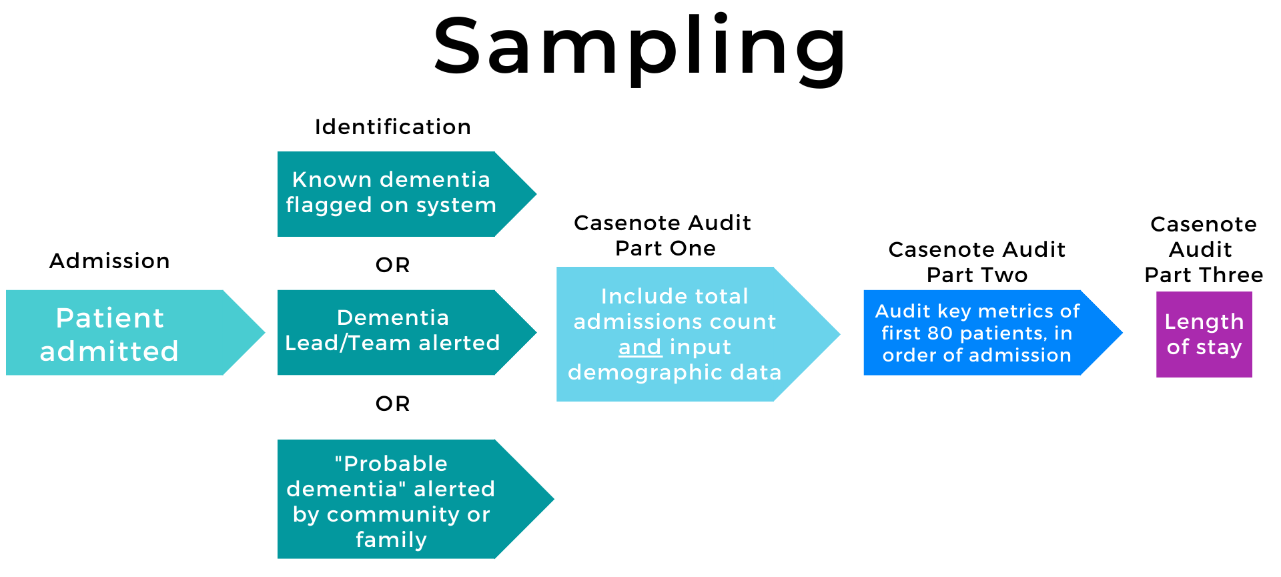
Prospective ID will provide us with local and national information about the number of patients with dementia being admitted in a month and will pick up patients missed by coding.
Notes:
Patient admitted. Known dementia flagged on system OR alerted to the Dementia Lead/ Team via other system or from admitting ward OR “probable dementia” alerted eg from community input or family. These patients are eligible for the TOTAL count and demographics. (Part One)
In order of admission, the first 80 of these will be audited against the key metrics (part 2) and discharge information (part 3)

Slide 25
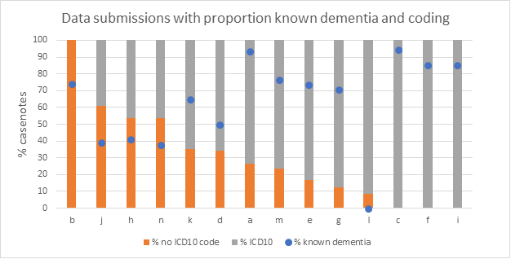

Slide 26
4 weeks allows hospitals with lower admissions to identify requisite number of patients
Casenote audit
Sampling :
Identify all patients admitted with dementia over a 4 week period
Inclusion of patients with probable/ suspected dementia
No age limit but we know that this will affect some samples
Demographic information
Dataset:
Over the next 8 weeks, enter data on a sample of patients
Delirium screening and assessment, pain assessment and repeat, discharge planning
Discharge information including length of stay entered after a lag of one month
One data entry period is mandatory and one voluntary
Autumn phase is mandatory for all sites
Sites choosing to do so can split their sample between Autumn and Spring
First reporting point will be based on Autumn data
To be included if possible
This will allow for the key metric LOS to be completed for nearly all patients.

Slide 27
Casenote dataset
The dataset has been split into the three parts
Part one :
Demographics, admitting condition, dementia status/ subtype, admitting ward, place of residence prior.
Patients with a confirmed or working diagnosis or with known/ suspected cognitive impairment are eligible
Part two:
Delirium screening, assessment, management/ care plan
Pain assessment and follow up pain assessment
Initiation of discharge planning
Sequence of questions relating to pain assessment changed so easier to answer/ analyse if a non-standard assessment
Part three
Date of discharge (or death)
Place discharged/ transferred
Was the patient on the right ward for responsible consultant specialty
Was the patient receiving end of life care
Can be input by non-clinical staff
Can be submitted by non clinical staff

Slide 28
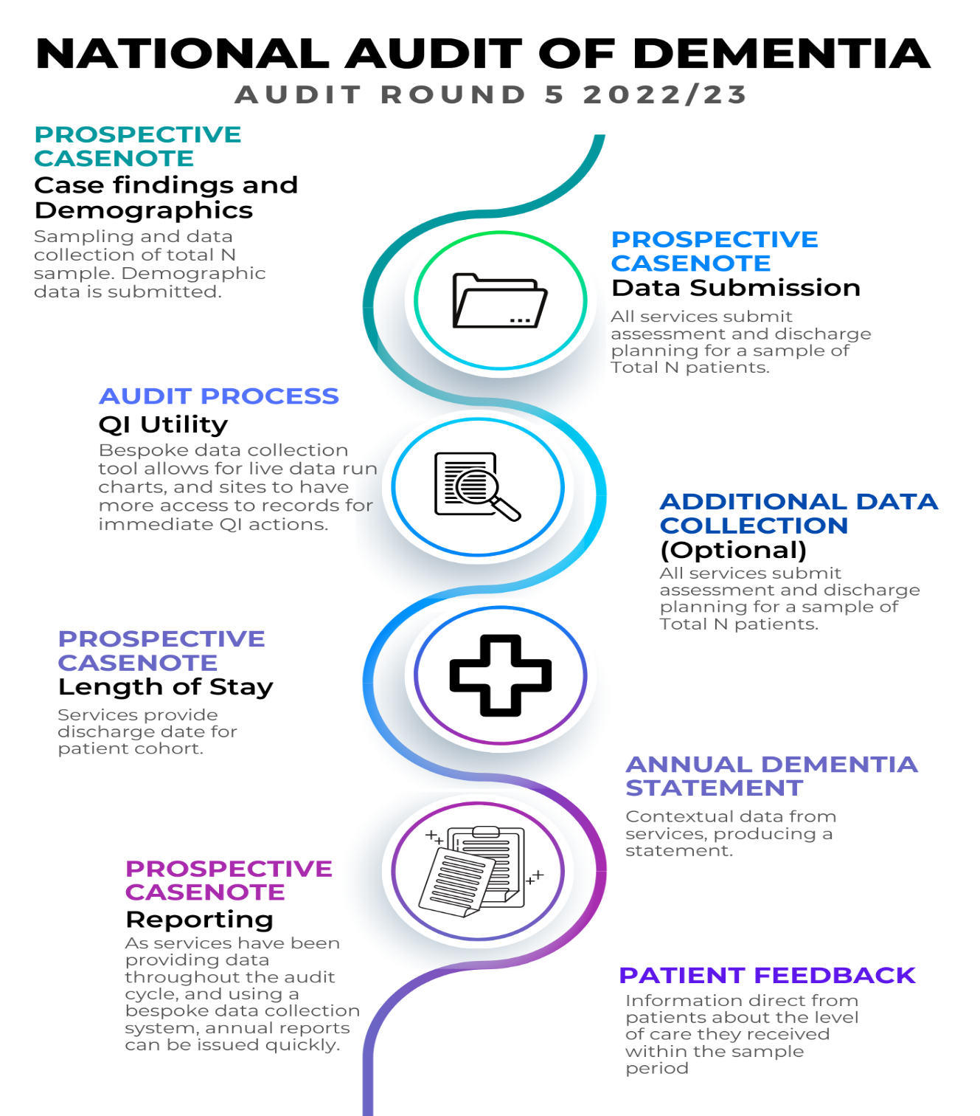

Slide 29
pilot site feedback

Slide 30

This Photo by Unknown Author is licensed under CC BY-SA

Slide 31
Annual Dementia Statement
This is information collected at hospital level
The tool is in the form of simple questions which will produce a series of statements which illustrate the approach to the provision of dementia care.
Eg – “In our hospital, 100% of staff working on adult wards have received training in dementia awareness.” “The hospital is signed up to John’s Campaign”.
Results from the casenote audit will feed in eg: “78% of patients with dementia were screened for delirium”. “82% patients with dementia received an assessment for pain”.
Results from the carer questionnaire will also be added e.g. “Carers rated the care delivered highly at 83/100”.
The output will be a poster PDF which can be displayed on the website and will be updated yearly

Slide 32
Patient feedback tool
We asked people living with dementia about their priorities for good quality hospital care
We developed a short questionnaire together with our patient and carer representatives
The questions cover
  Staff understanding dementia
  Communication
  Being kept informed
  Getting help when you needed it
  Pain relief
  Being treated with dignity and respect
Additional questions were added following consultation relating to food and seeing family/visitors
Available in plain text and emoji versions. Will be made available in other languages
Can be used as a questionnaire or a semi structured interview
Hospitals will be asked to collect 3-5 per month/ at least 30 per year

Slide 33
Carer questionnaire
Rounds 3 and 4 of audit used a carer questionnaire which produced quantitative and qualitative data on
The questionnaire also produces hospital level scores for the overall rating of care and for the carer rating of communication
Hospitals will be asked to collect at least 25 responses
The tool will be the same version as in Round 4 and the data directly comparable.
We assume that we will need to offer a paper version as responses are lower when surveys are web based only.

Slide 34
Audit component | Data collection | Reporting
Mandatory casenote audit | September-December 2022 | Data available to download on completion of entry, National Report (cleaned data) June 2023
Optional second casenote audit | March-June 2023 | Data available to download on completion of entry, National Report (cleaned data) February 2024 (tbc)
Annual Dementia Statement | September-December 2022 | March 2023
Patient questionnaire | Ongoing beginning September 2022 | 2 annual reporting points beginning March 2023
Carer questionnaire | September 2022-January 2023 | Scores included in Annual Dementia Statement

Slide 35
Feedback
We recognise that there are expected and unexpected challenges facing hospitals
We aim to keep an open dialogue with participants about the process and any further flexibility that can be incorporated in future rounds
We aim to provide you with greatly improved access to information about care provision and your own systems for supporting care
We also aim to work with you on using the information to improve care in hospitals. We will be holding QI webinars on identifying and measuring improvement using your data – the first this autumn, as the data is collected and any problems begin to be identified

Slide 36

This Photo by Unknown Author is licensed under CC BY-SA

Slide 37


