Slide 1
National Audit of Eating Disorders: Service Mapping Report 2025
Slide Deck
This slide deck includes data presented in the NAED Service Mapping Report 2025 and Appendices

Slide 2
Audit Background
The National Audit of Eating Disorders (NAED) is a new audit commissioned in August 2024 by the Healthcare Quality Improvement Partnerships (HQIP) as part of the National Clinical Audit and Patient Outcomes Programme (NCAPOP) on behalf of NHS England.
Aim: to drive improvement of the identification and appropriate management of eating disorders and the quality and consistency of services for children and young people (CYP), adults of working age and older adults.

Slide 3
Eligibility Criteria
Inclusion Criteria
Eating Disorder (ED) services in England that are:
NHS commissioned services, including those commissioned by specialised commissioning and ICBs/ICSs and Provider Collaboratives
Services delivered in partnership with and by the voluntary, community and social enterprise (VCSE) sector that are commissioned by the NHS
Inpatient and community eating disorder services
All general adolescents units where eating disorders are not explicitly excluded
Exclusion Criteria
NHS funded non-eating disorder services that provide eating disorder treatments
Services treating co-morbid conditions other than eating disorders
Services that provide primary care and acute care

Slide 4
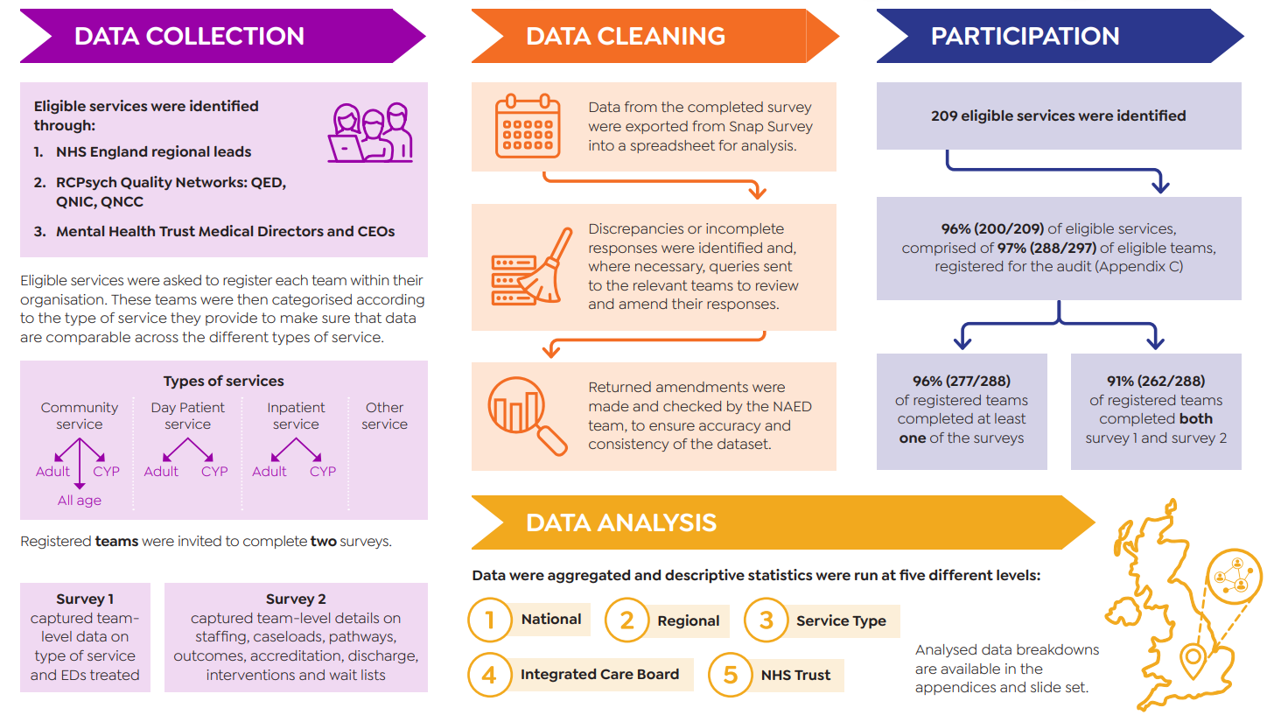
Methodology
Data collection took place between January and May 2025.

Slide 5
Eating Disorder Service Type and Structure

Slide 6
Overview of Eating Disorders Provision in England

Slide 7
Eating Disorder Services Provided, by Region
Service Type | East of England (n = 34) | London (n = 39) | Midlands (n = 49) | North East and Yorkshire (n = 51) | North West (n = 36) | South East (n = 34) | South West (n = 33) | National (n = 276)
Outreach Service | 20.6% (7/34) | 10.3% (4/39) | 16.3% (8/49) | 25.5% (13/51) | 2.8% (1/36) | 11.8% (4/34) | 24.2% (8/33) | 16.3% (45/276)
Community Service | 50.0% (17/34) | 46.2% (18/39) | 61.2% (30/49) | 58.8% (30/51) | 72.2% (26/36) | 55.9% (19/34) | 63.6% (21/33) | 58.3% (161/276)
Intensive Community Service | 23.5% (8/34) | 25.6% (10/39) | 44.9% (22/49) | 52.9% (27/51) | 19.4% (7/36) | 35.3% (12/34) | 48.5% (16/33) | 37.0% (102/276)
Day Patient Service | 23.5% (8/34) | 28.2% (11/39) | 16.3% (8/49) | 17.6% (9/51) | 2.8% (1/36) | 23.5% (8/34) | 18.2% (6/33) | 18.5% (51/276)
Inpatient Service | 29.4% (10/34) | 35.9% (14/39) | 28.6% (14/49) | 25.5% (13/51) | 27.8% (10/36) | 29.4% (10/34) | 24.2% (8/33) | 28.6% (79/276)
Other Service | 20.6% (7/34) | 12.8% (5/39) | 24.5% (12/49) | 17.6% (9/51) | 22.2% (8/36) | 23.5% (8/34) | 21.2% (7/33) | 20.3% (56/276)
NB: This table shows the percentage of each type of service offered out of all teams in each region. For example, 20.6% of all eating disorder teams in the East of England offer an outreach service.

Slide 8
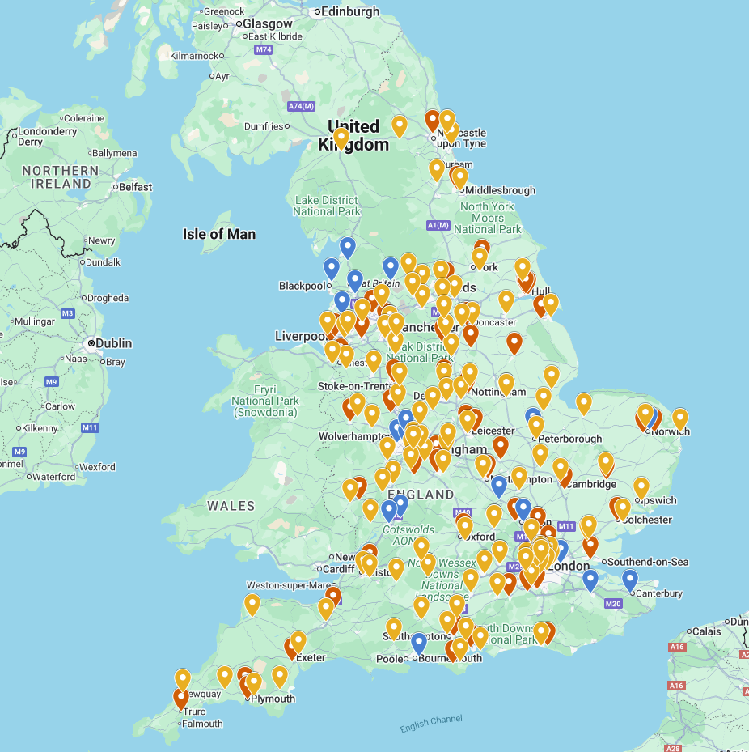
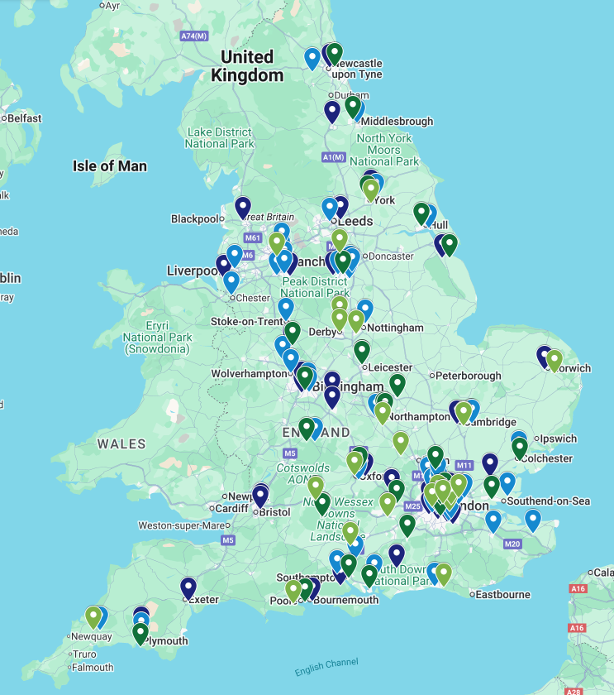



Map of the Distribution of Eating Disorder Day Patient, Inpatient and Community Provision Across England
Community services
Day Patient and Inpatient services
Community All Age
Day Patient Adult
Community Adult
Day Patient CYP
Community CYP
Inpatient Adult
Inpatient CYP

Slide 9
Structure of Eating Disorder Service Provision

Slide 10
Structure of Eating Disorder Service Provision

Slide 11
Structure of Eating Disorder Service Provision

Slide 12
Eating Disorder Service Providers

Slide 13
Overview of Eating Disorder Service Providers

Slide 14
Eating Disorder Service Providers, by Region

Slide 15
Eating Disorder Service Providers, by Service Type

Slide 16
Eating Disorders Treated

Slide 17
Eating Disorders Treated Across ICBs
* All age teams are included in both the adult and CYP categories

Slide 18
Eating Disorders Treated Across Teams
* All age teams are included in both the adult and CYP categories

Slide 19
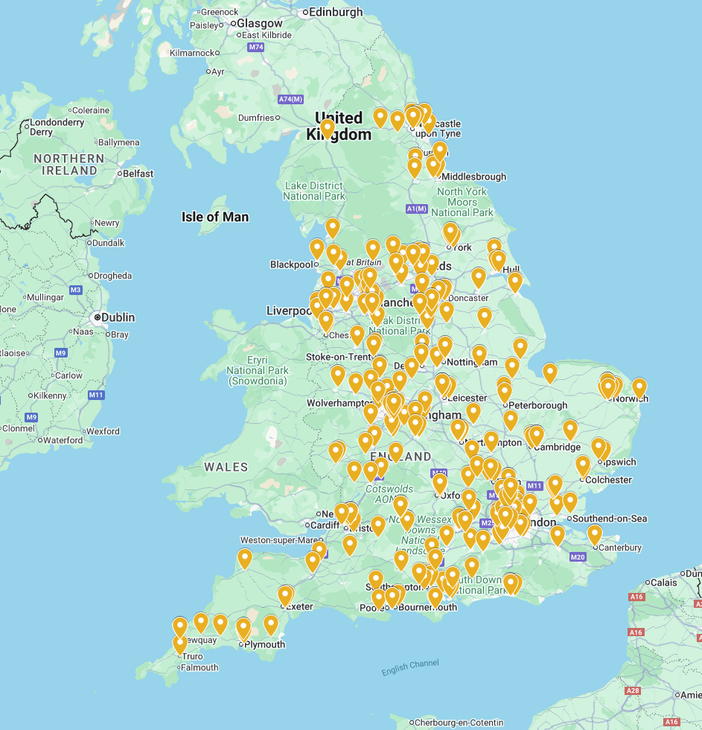
Eating Disorders Treated, by Region
Map of eating disorder services that treat Anorexia Nervosa

Slide 20
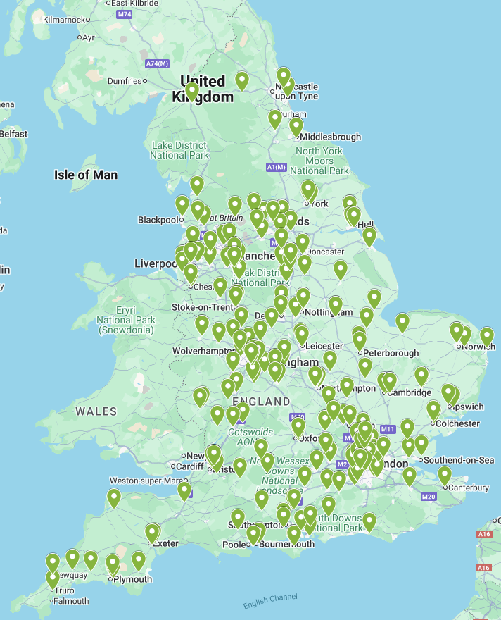
Eating Disorders Treated, by Region
Map of eating disorder services that treat Atypical Anorexia Nervosa

Slide 21
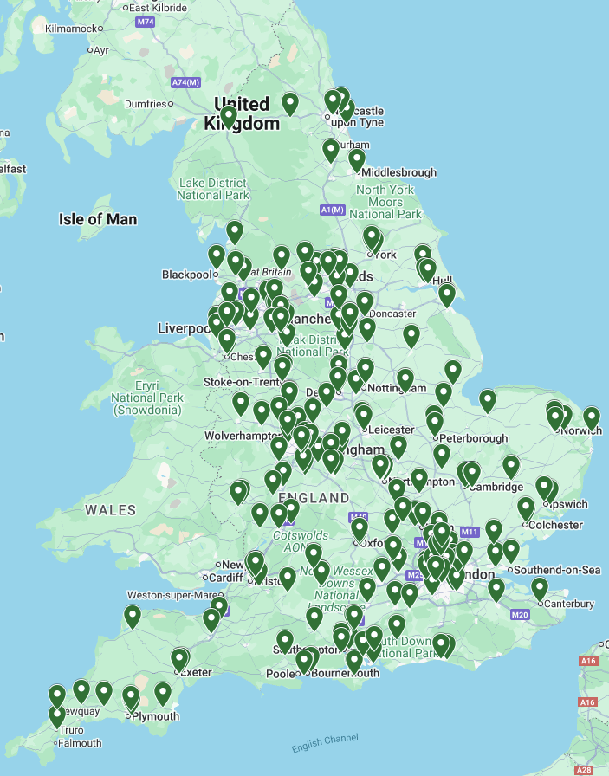
Eating Disorders Treated, by Region
Map of eating disorder services that treat Bulimia Nervosa

Slide 22
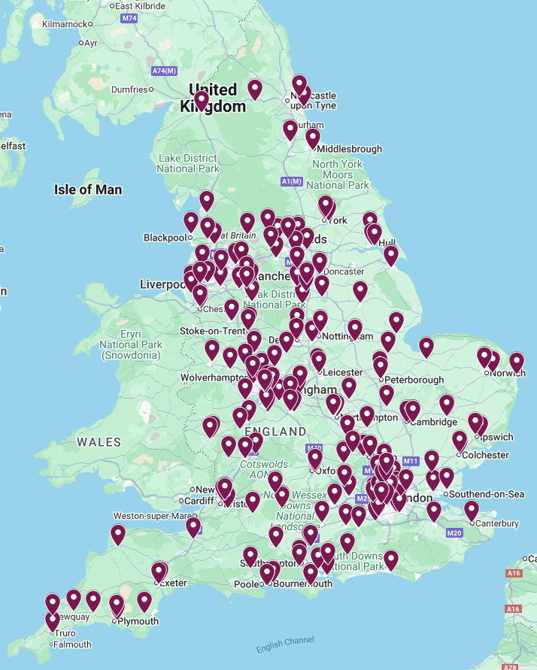
Eating Disorders Treated, by Region
Map of eating disorder services that treat Atypical Bulimia Nervosa

Slide 23
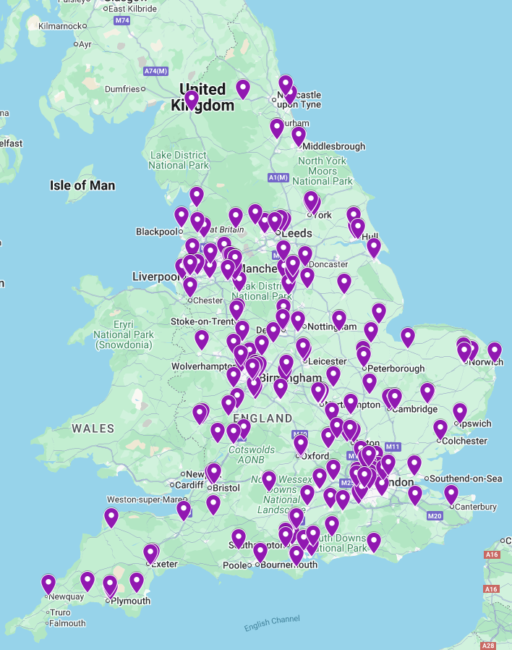
Eating Disorders Treated, by Region
Map of eating disorder services that treat Binge Eating Disorder

Slide 24
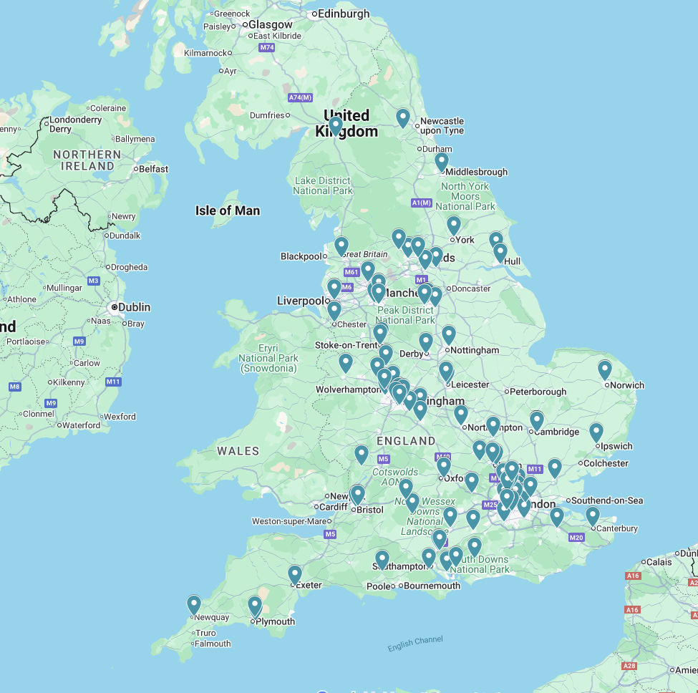
Eating Disorders Treated, by Region
Map of eating disorder services that treat ARFID

Slide 25


Why this matters
My son has ARFID. We were only referred because we ended up in their local hospital… Even when you get into a service there is no particular pathway. In the past 5 years we have been in three different teaching hospitals in London which have all taken a very different approach.
- Carer

Slide 26
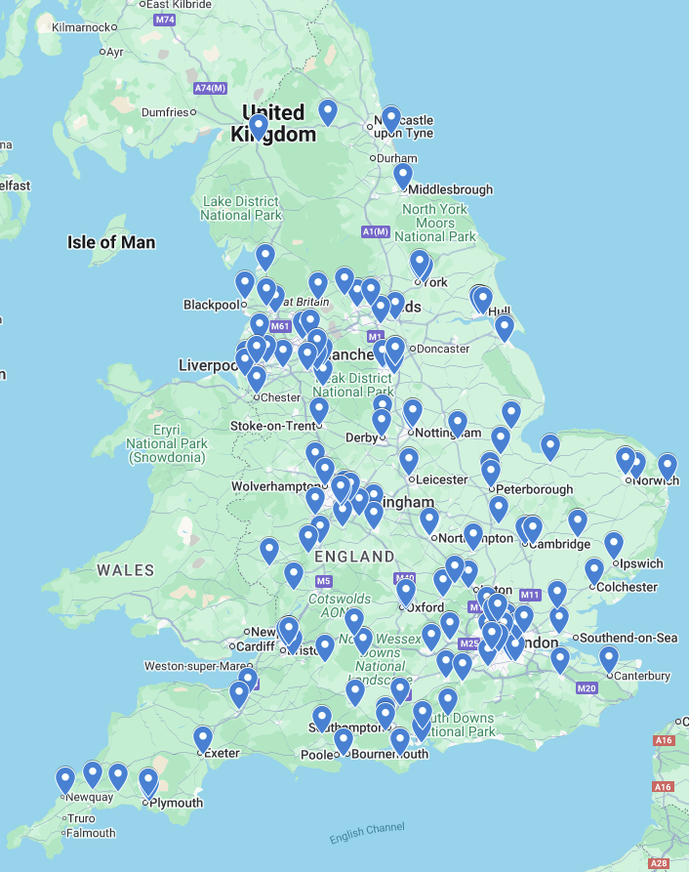
Eating Disorders Treated, by Region
Map of eating disorder services that treat Purging Disorder

Slide 27
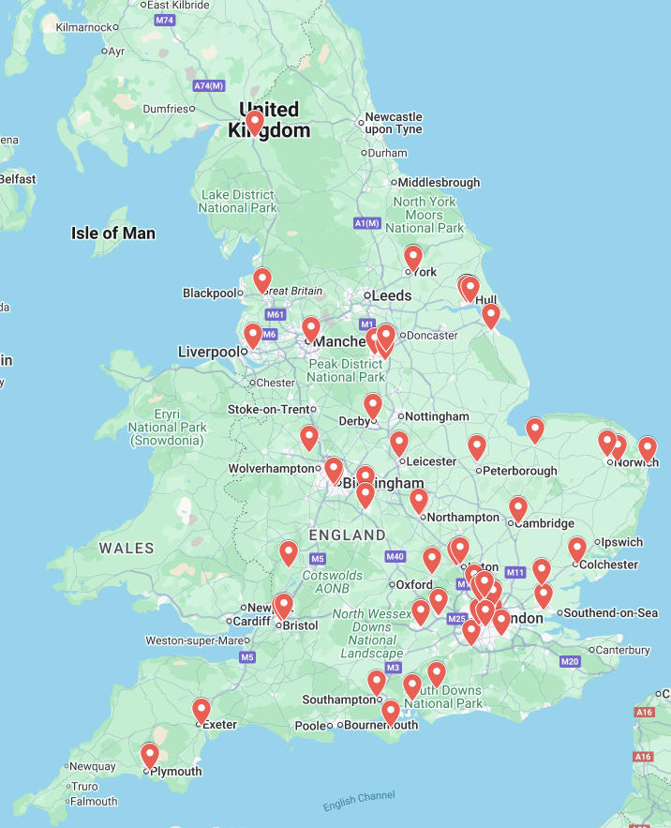
Eating Disorders Treated, by Region
Map of eating disorder services that treat Night Eating Syndrome

Slide 28
Eating Disorders Treated, by Service Type

Slide 29
Eating Disorders Treated, by Service Type

Slide 30
Eating Disorders Treated, by Service Type

Slide 31
Eating Disorders Treated, by Service Type

Slide 32
Referral Pathways

Slide 33
Eating Disorder Services Accepting Self Referrals

Slide 34
Referral Pathways, by Region
Region | East of England (n = 31) | London (n = 37) | Midlands (n = 48) | North East and Yorkshire (n = 51) | North West (n = 34) | South East (n = 31) | South West (n = 31) | National (n = 263)
GP | 54.8% (17/31) | 48.6% (18/37) | 60.4% (29/48) | 60.8% (31/51) | 67.6% (23/34) | 58.1% (18/31) | 61.3% (19/31) | 58.9% (155/263)
Social Care | 38.7% (12/31) | 40.5% (15/37) | 52.1% (25/48) | 45.1% (23/51) | 50.0% (17/34) | 38.7% (12/31) | 54.8% (17/31) | 46.0% (121/263)
Self-Referral | 32.3% (10/31) | 16.2% (6/37) | 18.8% (9/48) | 37.3% (19/51) | 29.4% (10/34) | 35.5% (11/31) | 45.2% (14/31) | 30.0% (79/263)
Parent or Carer | 29.0% (9/31) | 13.5% (5/37) | 18.8% (9/48) | 35.3% (18/51) | 32.4% (11/34) | 29.0% (9/31) | 45.2% (14/31) | 28.5% (75/263)
Community Mental Health Service (e.g. CAMHS, CMHT) | 61.3% (19/31) | 73.0% (27/37) | 79.2% (38/48) | 84.3% (43/51) | 82.4% (28/34) | 67.7% (21/31) | 83.9% (26/31) | 76.8% (202/263)
CEDS | 87.1% (27/31) | 86.5% (32/37) | 85.4% (41/48) | 74.5% (38/51) | 85.3% (29/34) | 67.7% (21/31) | 74.2% (23/31) | 80.2% (211/263)
Medical Ward | 48.4% (15/31) | 45.9% (17/37) | 68.8% (33/48) | 62.7% (32/51) | 70.6% (24/34) | 61.3% (19/31) | 67.7% (21/31) | 61.2% (161/263)
Inpatient Psychiatric Unit | 58.1% (18/31) | 54.1% (20/37) | 66.7% (32/48) | 56.9% (29/51) | 61.8% (21/34) | 48.4% (15/31) | 71.0% (22/31) | 59.7% (157/263)
Educational Institution | 35.5% (11/31) | 24.3% (9/37) | 43.8% (21/48) | 33.3% (17/51) | 44.1% (15/34) | 38.7% (12/31) | 51.6% (16/31) | 38.4% (101/263)
Other | 16.1% (5/31) | 24.3% (9/37) | 25.0% (12/48) | 15.7% (8/51) | 20.6% (7/34) | 16.1% (5/31) | 16.1% (5/31) | 19.4% (51/263)

Slide 35
Referral Pathways, by Service Type
Service Type | Community Adult (n=61) | Community All Age (n=15) | Community CYP (n=84) | Day Patient Adult (n=15) | Day Patient CYP (n=8) | Inpatient Adult (n=30) | Inpatient CYP (n=43) | Other (n=7)
GP | 82.0% (50/61) | 100.0% (15/15) | 88.1% (74/84) | 6.7% (1/15) | 0.0% (0/8) | 20.0% (6/30) | 7.0% (3/43) | 85.7% (6/7)
Social Care | 45.9% (28/61) | 93.3% (14/15) | 78.6% (66/84) | 6.7% (1/15) | 0.0% (0/8) | 13.3% (4/30) | 4.7% (2/43) | 85.7% (6/7)
Self Referral | 14.8% (9/61) | 53.3% (8/15) | 61.9% (52/84) | 0.0% (0/15) | 0.0% (0/8) | 3.3% (1/30) | 7.0% (3/43) | 85.7% (6/7)
Parent or carer | 6.6% (4/61) | 73.3% (11/15) | 60.7% (51/84) | 0.0% (0/15) | 0.0% (0/8) | 3.3% (1/30) | 7% (3/43) | 71.4% (5/7)
Community Mental Health Service (e.g. CAMHS, CMHT) | 90.2% (55/61) | 100.0% (15/15) | 95.2% (80/84) | 13.3% (2/15) | 25.0% (2/8) | 33.3% (10/30) | 76.7% (33/43) | 71.4% (5/7)
CEDS | 77.0% (47/61) | 86.7% (13/15) | 81.0% (68/84) | 80.0% (12/15) | 100.0% (8/8) | 70.0% (21/30) | 81.4% (35/43) | 100.0% (7/7)
Medical ward | 83.6% (51/61) | 80.0% (12/15) | 88.1% (74/84) | 6.7% (1/15) | 12.5% (1/8) | 26.7% (8/30) | 27.9% (12/43) | 28.6% (2/7)
Inpatient psychiatric unit | 73.8% (45/61) | 73.3% (11/15) | 75.0% (63/84) | 20.0% (3/15) | 25.0% (2/8) | 23.3% (7/30) | 55.8% (24/43) | 28.6% (2/7)
Educational institution | 27.9% (17/61) | 93.3% (14/15) | 77.4% (65/84) | 0.0% (0/15) | 0.0% (0/8) | 0.0% (0/30) | 0.0% (0/43) | 71.4% (5/7)
Other | 23.0% (14/61) | 6.7% (1/15) | 14.3% (12/84) | 33.3% (5/15) | 0.0% (0/8) | 33.3% (10/30) | 20.9% (9/43) | 0.0% (0/7)

Slide 36
Why this matters
I self referred to CAMHS on the Monday back to school after Christmas and we were seen on Friday – that was great but equally a function of how ill my son was.
- Carer

Slide 37
Exclusion Criteria

Slide 38
Exclusion Criteria, by Service Type

Slide 39
Access and Waiting Times

Slide 40
Waitlist Reasons in Community Services

Slide 41
Waiting Lists in Community Services

Slide 42
Waiting Lists, by Service Type

Slide 43
Waiting Times in Community Services - Median

Slide 44
Waiting Times, by Service Type - Median

Slide 45
Why this matters
Waiting lists can be difficult in terms of where you are at with your recovery. Being referred and feeling ready but if there is a long wait, struggling physically with anorexia, being too unwell to access the therapy and ending up in inpatient care.
- Service User

Slide 46
Why this matters
This huge pressure was created on us to work through the waiting list. We managed to do it, but at what cost… The moral injury and the burnout and everything to work on that waiting list.
- Clinician

Slide 47
Staffing

Slide 48
Staff Within Each Profession in All Services

Slide 49
Staff Within Each Profession in Community Adult Teams

Slide 50
Staff Within Each Profession in Community CYP Teams

Slide 51
Staff Within Each Profession in Community All Age Teams

Slide 52
Staff Within Each Profession in Day Patient Adult Teams

Slide 53
Staff Within Each Profession in Day Patient CYP Teams

Slide 54
Staff Within Each Profession in Inpatient Adult Teams

Slide 55
Staff Within Each Profession in Inpatient CYP Teams

Slide 56
Staff Within Each Profession in Other Teams

Slide 57
Staff Vacancies, by Region

Slide 58
Staff Vacancies, by Service Type

Slide 59
Reasons for Staff Vacancies, by Region

Slide 60
Reasons for Staff Vacancies, by Service Type

Slide 61
Therapist Caseload, by Region

Slide 62
Therapist Caseload, by Service Type

Slide 63
Team Caseload, by Region

Slide 64
Team Caseload, by Service Type

Slide 65
Why this matters
One thing I feel like my experience lacked was dietetic support. Rest of team were great, had psych for therapy, nurse as care-co (weekly visits) and support worker.
- Service user

Slide 66
Why this matters
….the morale of the team… has gotten so much better, and we got a load of new staff… we had over a year’s waiting time. And now I think it’s more like 6 to 8 months, and that is because of the increase in staff.
- Clinician

Slide 67
Psychological Interventions

Slide 68
Psychological Interventions in Community Teams

Slide 69
Psychological Interventions in Adult Community Teams, by Region

Slide 70
Psychological Interventions in Adult Community Teams, by Region

Slide 71
Psychological Interventions in Adult Community Teams, by Region

Slide 72
Psychological Interventions in CYP Community Teams, by Region

Slide 73
Psychological Interventions in CYP Community Teams, by Region
Note: these are NICE-recommended adult interventions and would not be expected to be delivered within CYP teams unless considered appropriate for someone with a longstanding disorder

Slide 74
Psychological Interventions in CYP Community Teams, by Region

Slide 75
Psychological Interventions in All Age Community Teams, by Region

Slide 76
Psychological Interventions in All Age Community Teams, by Region

Slide 77
Psychological Interventions in All Age Community Teams, by Region

Slide 78
Psychological Interventions, by Service Type

Slide 79
Psychological Interventions, by Service Type

Slide 80
Psychological Interventions, by Service Type

Slide 81
Discussion of Psychological Treatment Options

Slide 82
Discussion of Psychological Treatment Options, by Region

Slide 83
Discussion of Psychological Treatment Options, by Service Type

Slide 84
Joint Working Arrangements

Slide 85
Joint Working Arrangements

Slide 86
Shared Care Protocols for Psychiatric Comorbidities, by Service Type

Slide 87
Shared Care Protocols for Physical Comorbidities, by Service Type

Slide 88
Shared Care Protocols for Neurodivergence, by Service Type

Slide 89
Shared Care Protocols for Perinatal Women, by Service Type

Slide 90
Shared Care Protocols, by Region

Slide 91
Why this matters
FBT was offered as the only intervention, and his autism and ADHD were looked at as adjuncts – however they are intensely important to viewing him holistically.
- Carer

Slide 92
Routinely Collected Outcomes

Slide 93
Outcomes Measured, by Region

Slide 94
Outcomes Measured, by Region

Slide 95
Outcomes Measured, by Region

Slide 96
Outcomes Measured, by Service Type

Slide 97
Outcomes Measured, by Service Type

Slide 98
Outcomes Measured, by Service Type

Slide 99
Discharge Readiness

Slide 100
Discharge Readiness, by Region

Slide 101
Discharge Readiness, by Region

Slide 102
Discharge Readiness, by Service Type

Slide 103
Discharge Readiness, by Service Type

Slide 104
Why this matters
Then the actual therapy started which was 18 weeks… but because it was an 18-week therapy programme, on the last day, it was see you later.
- Service user

