Slide 1

Welcome to the first National Audit of Eating Disorders Quality Improvement Webinar
Theme 1: Overcoming barriers to doing improvement work
QI coaches
Sadhbh Fitzgerald & Maureen McGeorge

Slide 2
We’re going to open with a quick poll which should be coming up on your screens now.
Q. What best describes your relationship with Quality Improvement right now?
Options:
I’m actively involved in QI work
I want to do QI but I’m not sure where to start
I’ve tried QI before and found it hard to sustain
QI feels important but unrealistic in current pressures
I’m not sure if improvement is the priority right now

Slide 3
The 5 stages of Improvement
1. What’s your problem and what are you going to do about it? Understand what you need to improve and why.
2. How will you know whether you are improving? Agree one or more ‘measures’ so you can track your progress.
3. What are the ideas that you can test to show whether you are improving? Develop effective change ideas or interventions that will result in improvement.
4. Test changes before implementing. Try them out on a small scale to find out whether that change will lead to improvement on a larger scale.
5. Implement/embed: make any effective changes permanent.

Slide 4
An example of a QI Project
What’s your problem? Young people’s dissatisfaction with meals and snacks in CAMHS services.
What are you going to do about it? Reduce dissatisfaction.
How will you know whether you are improving? Levels of dissatisfaction will decrease.
What are the ideas that you can test to show whether you are improving? We are not sure … yet …

Slide 5
Context
QNIC Accreditation
Mealtimes were “A nightmare”.
Senior support
Great team
12-week programme (4 other teams)

Slide 6
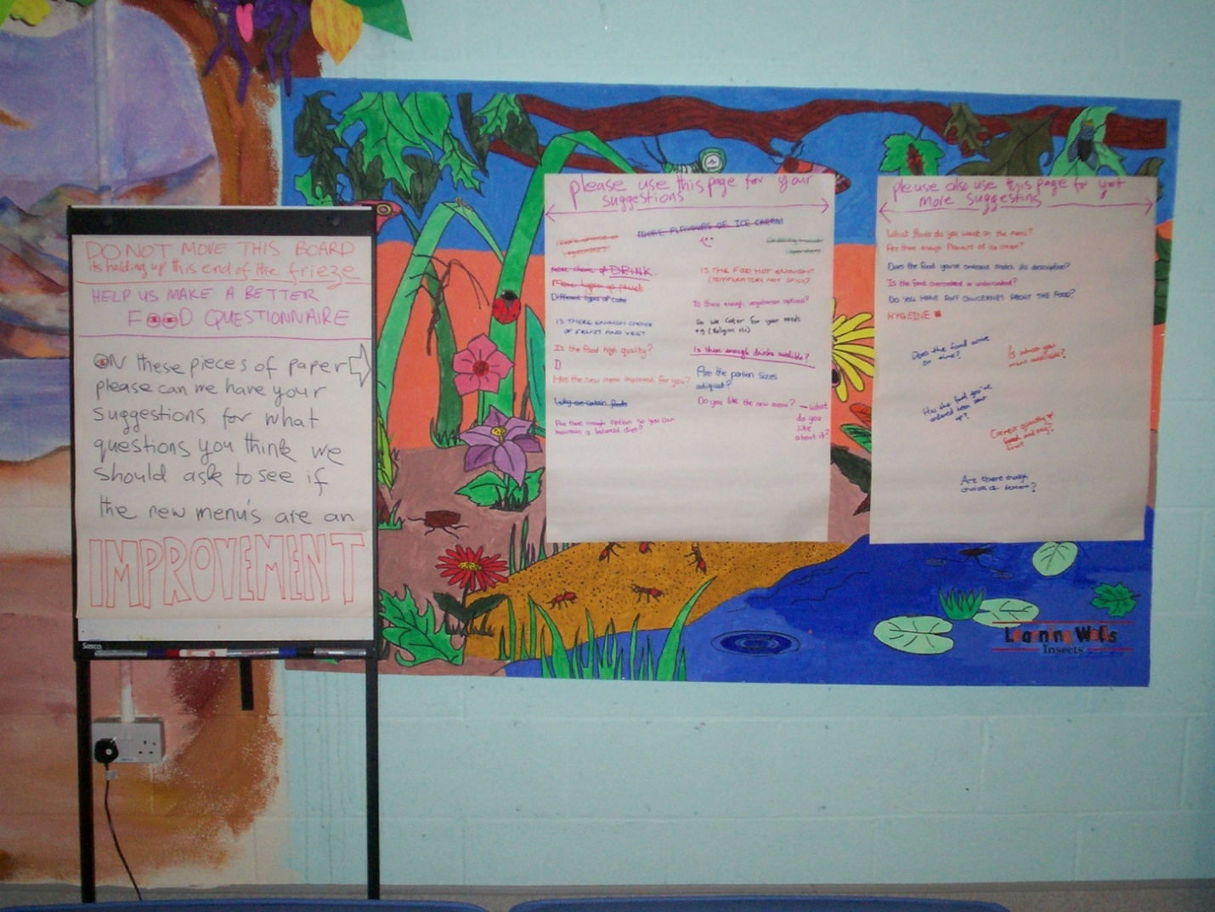
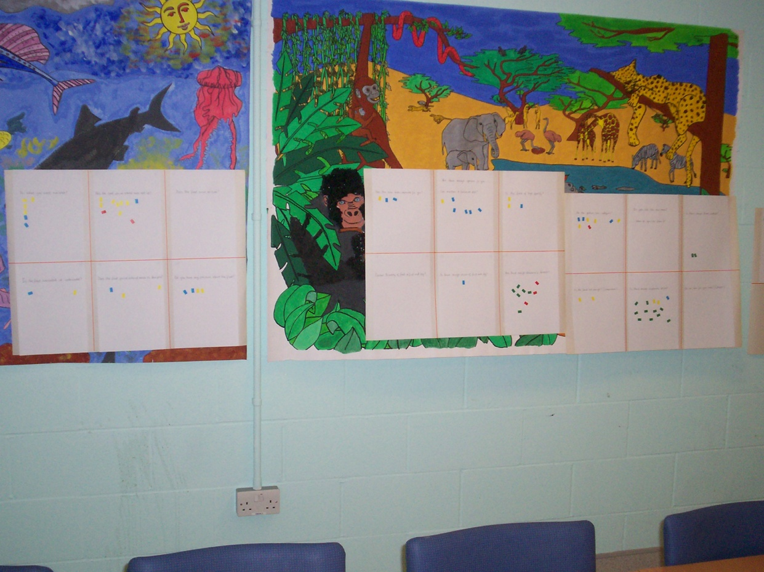
One week later …

Slide 7
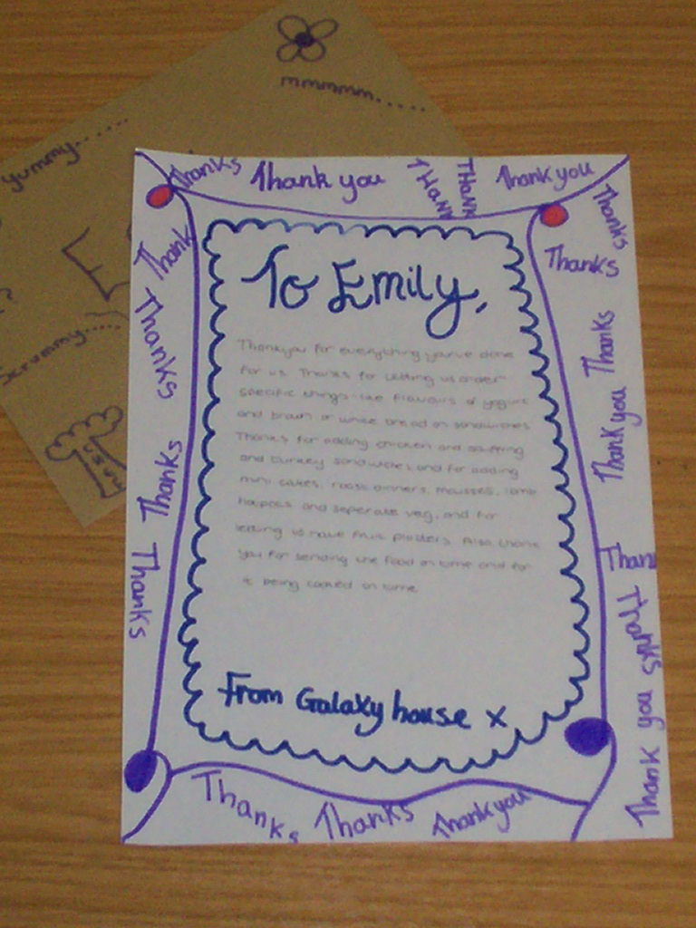
Within 4 weeks …
Measure: design competition
Change ideas: new presentation (veg, fruit, toppings); better choices (yoghurts); taster sessions.

Slide 8
Observation by one of the Team
“The problem can be with improvement that it can be too management led – but this is kids-led and engaged the Ward Manager, involved the private firm domestic service supervisor and the dietician.”

Slide 9
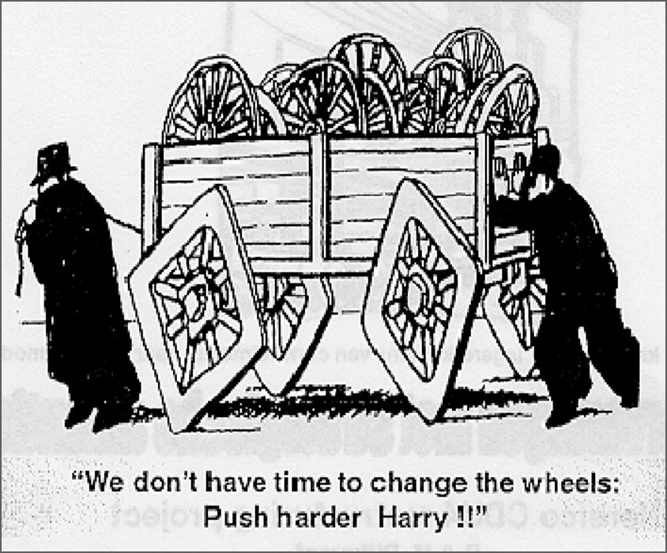
Why can improvement feel so hard?
Improvement isn’t challenging because staff don’t care.
It can be hard because:
  We have to rely on others
  We don’t always have time to reflect on how easier things could be and consider how we could do things differently.
  There’s always the temptation to jump to solutions without really understanding what is causing the problem

Slide 10
Myth | Reality
“We’ve always done it this way; there's no other solution”. | Most teams struggle because they don’t yet understand their problem well enough.
“The problem is too big to fix.” | Improvement usually starts with one small step, not fixing everything at once
“We need a brilliant idea.” | Useful ideas tend to come from understanding what’s getting in the way, not from re-inventing the wheel !
“Measurement feels like an inspection” | Measurement is vital for showing us if what we’re testing is leading to improvement
“If this doesn’t work, it’ll reflect badly on us” | Small tests are meant to be low‑risk — they help teams learn quickly, even when they don’t go to plan
“We’re too busy to take on QI right now” | Done well, QI can reduce repeated frustrations and make day‑to‑day work easier

Slide 11
Common barriers to doing QI and how to overcome them
Barrier 1: We don’t really understand the problem- How to view problems in a new way.
Barrier 2: We don’t know what to change - How to choose you change ideas
Barrier 3: Fear of measurement -What measurement in
QI is and why it's less complicated than we think.

Slide 12

Barrier 1: We don’t really understand the problem- How to view problems in a new way.
“Here is Edward Bear, coming downstairs now, bump, bump, bump on the back of his head, behind Christopher Robin.
It is, as far as he knows, the only way of coming downstairs, but sometimes he feels that there really is another way, if only he could stop bumping for a moment and think of it”.
AA Milne – Winnie the Pooh
Sometimes we keep solving problems the same way, even when it isn’t working. QI encourages us to pause, look again, and find a better way.

Slide 13

Two common approaches to tackling complex problems
When facing complex problems, teams often fall into one of two traps
1. Too much action (Chaos)
2. Analysis Paralysis
Trial and error?
Detailed prior study?
Too much action, not enough thinking
Too much thinking, not enough action
‘Trial and Learning’ approach
Let’s try lots of things at once!
“we can’t do anything until we know exactly what to do….”
Jeremy Heimens, Henry Timms New Power: How its changing the 21st century and why you need to know (2018)

Slide 14
  Most barriers to improvement are system barriers, not people problems
 | Person approach | Systems approach
Focus | Blames, punishes, or rewards individuals (e.g., "blame the last person in contact with the patient"). | Examines organisational factors, environment, and equipment design.
Philosophy | Human error is the root cause of accidents. | Humans are a part of a system; errors are consequences, not causes.
Action | “Fixes” people through training, stricter policies, or disciplinary action. | Redesigns processes, tools, and environments to prevent errors or mitigate their effects.
The Model for Improvement helps teams test small, manageable changes in the system, focusing on learning rather than perfection

Slide 15
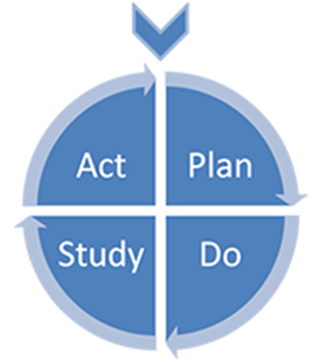
The Model for Improvement
DO WE ALL AGREE WE HAVE A PROBLEM?
NO
STOP
YES
1. What are you trying to accomplish?
2. How will you know that a change is an improvement?
3. What change can you make that will result in improvement?
Langley G, Nolan K, Nolan T, Norman C, Provost L, (1996), The improvement guide: a practical approach to enhancing organisational performance,
Jossey Bass Publishers, San Francisco

Slide 16
Question 1: The Model for Improvement
1. What are you trying to accomplish?
Understanding the problem and why it’s happening. Knowing what you’re trying to do – a clear and desirable aim.
2. How will you know that a change is an improvement?
3. What change can you make that will result in improvement?
Langley G, Nolan K, Nolan T, Norman C, Provost L, (1996), The improvement guide: a practical approach to enhancing organisational performance,
Jossey Bass Publishers, San Francisco

Slide 17
An example of the early stage of the QI journey
But what’s going on ?
Problem: Delays in starting the right intervention

Slide 18
Using the example of delays in starting the right intervention, what do you think might be causing the problem ?
Limited clinician availability delays allocation
Urgent risk management takes priority over planned treatment starts
Delays in starting the right intervention
Training opportunities aren’t always accessible or timely
Referral and triage processes are unclear or vary between teams
Staff are not confident in explaining what certain interventions consist of
Service users and families aren’t always clear about what different interventions involve

Slide 19
What is your problem?
Diagnosis/analysis
What are you going to do about it?
So now you REALLY understand your problem and what’s causing it….

Slide 20
Look at existing data
Numbers (quantitative) data that is already being collected:
E.g. the number of service users being offered interventions; the number declining; the number of referrals received and number accepted.
Information about people’s experiences (qualitative data): e.g. complaints; Compliments; service users surveys; local research.

Slide 21
Collect some new data
Sometimes existing data doesn’t give you the full picture. Collecting new information can help you understand what’s really causing the problem.
Examples of new data you can collect
Short survey e.g. ask staff to write down two factors that they believe contribute to delays in starting the right intervention.
Brief patient or carer feedback.
Team ‘Huddles’ or discussions.

Slide 22
Use ‘The 5 Whys’
Problem: Delays in starting the right intervention.
Why? Service users don’t understand how the intervention might benefit them.
Why? The intervention was not fully explained to them.
Why? Late or unclear referrals
Why? Training gaps
Why? The Team has been short staffed.
The 5 Whys
We often jump to either the symptom of the problem, OR the solution.

Slide 23
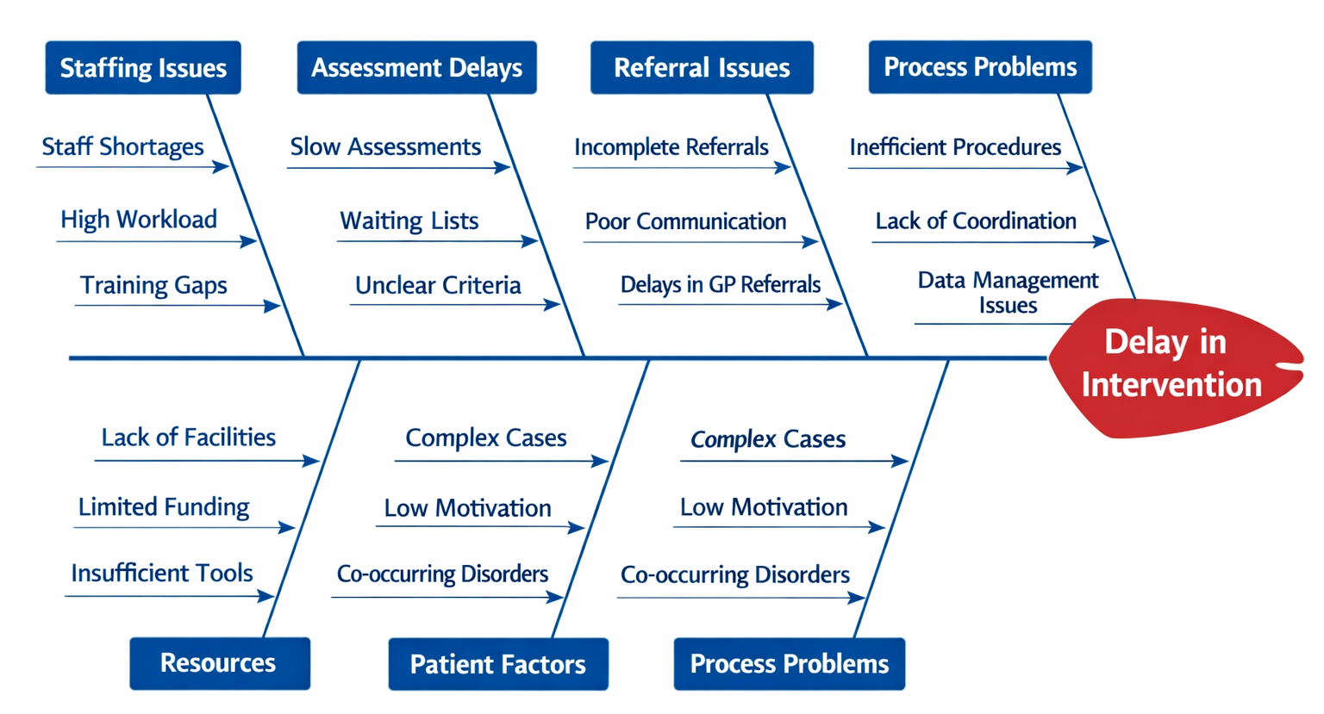
Fishbone diagram: map out all possible causes into themes.
These tools are designed to help us slow down just enough to understand what’s actually happening!

Slide 24
The importance of contributory factors in improving quality
A ‘contributory factor’ is something that helps cause a result.
An example: I cut my finger badly slicing a loaf of bread.
What were the contributory factors?
It was a new, sharp knife (equipment).
My cat jumped up on the table while I was cutting (distraction).
The bread was crusty and hard to cut (difficulty of task).
I’m not very good at cutting bread (skills).
Not all are amenable to improvement!

Slide 25
Poll two:
Please take a minute to look through the options coming up on your screen and choose the one that feels most applicable at the moment.
1. Lack of time
2. Staff shortages or high turnover
3. Competing priorities / constant crisis mode
4. I/we don't know where to start
5. We don't have any barriers we're QI ninjas !!
6. Other

Slide 26
Barrier 2: We don’t know what to change
A change idea is a specific idea for how you can do thing differently so that you will get the results that you want.
Change ideas are the ‘WHAT’ you want to test
Change ideas don’t need to be innovative
They just need to link clearly to what’s causing the problem
Good change ideas come from understanding causes — not from creativity alone.

Slide 27
Where do you get them?
The ‘evidence’
Other services/people’s experiences
Anyone can have a great idea
‘Steal shamelessly’ (remembering you may have to ‘adapt, not adopt’)
Things to think about:
Which are the team most excited about?
The level of effort required?
Do you need a ‘quick win’?

Slide 28
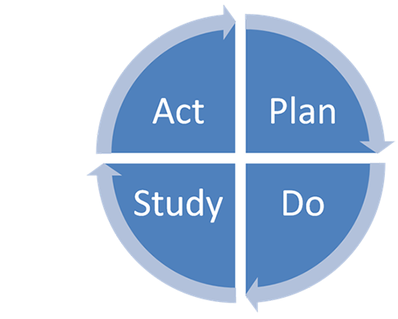
What happens when you agree on what you want to change ?
Agree your change ideas.
Then you test your ideas using the Plan Do Study act (PDSA) cycle.
What hunches do you have?
What should you test?
What can you learn as you go along?

Slide 29
Or to put it another way…

Slide 30
Why use PDSA cycles?
Small rapid tests of what does (or doesn’t) work:
  You get less resistance.
  You can find out whether the change will work in the actual environment.
  It’s safe and ‘low risk’ because you are testing and improving the way you do it before you ‘rollout’ on a broader scale (if at all).
  You keep increasing the rigor of the testing.

Slide 31

Barrier 3: Fear of measurement:
What measurement in QI is and why it's less complicated than we think.

Slide 32




Why measure for quality improvement?
To know where you are….
… where you are going
… and when you’ve arrived!

Slide 33



Why measure for quality improvement?
We use measurement all the time in our lives…
To weigh ingredients….
To manage household bills …
And even to countdown to Christmas!
But ‘measuring for improvement’ can feel intimidating

Slide 34
Uses of ‘measurement’ in the NHS
Aim
Sample Size
Confidentiality of the Data
Performance management
Comparison, choice, reassurance, spur for change
Obtain 100% of available, relevant data
Data available for public consumption and review
Research
New knowledge (What?)
“Just in case” data
Research subjects’ identities protected
Improvement
Improvement of care (How?)
“Just enough” data, small sequential samples
Owned by the teams

Slide 35
Types of Quality Improvement measures
Three of the different types of measures that can be used in Quality Improvement work:
Outcome- Did it work ?
Process- are we doing the right things?
Balancing- did it cause unintended problems elsewhere ?

Slide 36
In summary
Barrier 1: we don’t really understand the problem
It is important that you take time and involve the right people so you can focus on tackling the parts that are ‘broken’ and you can ‘fix’ them. There are loads of tools to help you.
Barrier 2: we don’t know what to change
Most organisations have been encouraged to be solution focused so there will always be loads of possible ideas to test. Make sure they are well-supported and remember that you can learn as much from doesn’t work as what does!
Barrier 3: fear of measurement
‘Measurement for improvement’ is new to most and it needs to be seen as a
A help not hindrance. It allows us to show ourselves and others
what we are achieving and remember – ownership of the QI data lies
with the team, until they are ready to share.

Slide 37
How the NAED QI programme will support you
Online resources: Bite size QI training videos will be available on the NAED webpage as well self-paced evaluation tools for teams to assess the impact of their QI activities.
Monthly drop in calls-beginning the week commencing the 25th May monthly drop-in calls will be available for teams to meet 1:1 with QI coaches.
Key dates for events this year:
1. Wednesday 3rd June from 3:30-4:30pm, Ask and Learn session- an open forum for all teams to share their questions/challenges
2. Thursday 17th September- (time tbc) Shared Learning Webinar 2- Sample QI case studies and impact stories. Theme 2: A deep dive into “diagnosing” your area of improvement.
3. November- Wednesday 11th (time tbc) Shared Learning Webinar 3-
Capturing learning from across teams. Theme 3: What does your audit data tell you ?

Slide 38
Thank you for joining
Recording and slides will be shared shortly.
If you would like to present at a future shared learning, events please email NAED@rcpsych.ac.uk

