Slide 1

NCAP QI collaborative round two shared learning session three
13 February 2025
2.30 – 4.30 pm
Team name: West Early intervention team
Team locality: Cornwall

Slide 2
1. Project aim
To increase the uptake of carer’s support by 40% to reach 50% of friends and family of newly confirmed clients on our caseload. We aim to do this by May 2025. To achieve this, we will be promoting and facilitating a mixture of 1-1 appointments and group opportunities to meet the expectations highlighted in the data from our carer survey.
We agreed on our aim statement by reviewing the data collected and working with staff and carers. We reviewed the requirements of the NCAP audit, and this helped us identify a percentage to work towards, to meet the criteria. In our last NCAP audit, we scored ‘needs improvement’ for our carer support, indicating that this is something we want to work on.

Slide 3
2. Overview of a successful change idea so far and its PDSA cycles
The main change idea that we have worked on so far is offering 1-1 appointments. This is because we are working to increase uptake of a carer support and education programme based off of our previous offer of groups last year that didn’t have an uptake.
PLAN- We conducted research questionnaires that concluded the majority of friends and family would prefer 1-1 appointments. We then discussed how we would do this and decided on days and times that worked best.
DO- We started offering and carrying out 1-1 carer appointments. We have protected time for the project on a Monday, therefore we offer the appointments on this day.
STUDY- We noticed that the uptake was a lot higher than when we were offering groups. However, on occasion we noticed that there were DNAs for the morning appointments. To combat this, we decided to send out reminders in the morning and also make 2 appointments in the day to cover a possible DNA.
ACT- Since sending out text reminders we have not had any DNAs. We are also able to work through the list of appointments more efficiently by offering 2 appointments in a day.

Slide 4
3. Updated Run chart(s)
If you are able to add in any annotation in the timeline that links to the test of change ideas and the associated improvements, that would be great!

Slide 5
4. Biggest learning points aka ‘surprises’ so far
We were initially surprised when receiving feedback from the questionnaires that people would prefer 1-1, face to face appointments. We thought that people would prefer to have peer support in a group setting and so learning the preferences of friends and family are to have individual space to talk was interesting for us and helped us to navigate the best way to work.
As well as that, we have been offering appointments in resource centres as opposed to people’s homes to give them some space to discuss openly. It also allows us to work more efficiently by cutting down travel time. However, we didn’t ask this within the questionnaire and so weren’t sure how people would respond to travelling. We noticed that people are very willing to travel to resource centres and appear to be valuing having their own space with us. We are able to make adjustments where necessary and so this hasn’t been a boundary so far, however we have only needed to make an adjustment on one occasion for an individual who needed to be seen at home.

Slide 6
5. Next steps
After having success with offering the 1-1 appointments to newly confirmed people on our caseload, we have decided to face-to-face to the rest of the caseload and are accepting referrals from other care co-ordinators within the team. We are asking that the care co’s have the conversation with carers first and gain their consent to refer, as this will hopefully prevent us having an influx of referrals that may not result in appointments. This is because we have noticed admin time is more than we expected, and so this will hopefully save time chasing people who may not actually want an appointment.
As well as that, we are in the process of deciding how a follow up appointment would look. We have spoken about doing a 6-month follow up phone call and seeing how people are doing, then offering another face-to-face appointment if we feel this would be helpful, with a rationale as to what the individual(s) would get from another appointment. This is because we know everyone’s recovery looks different, and so the carer’s might have different questions or concerns from their last appointment. Equally if things are going well, they may not find a face-to-face appointment beneficial, in which case we won’t book one in.

Slide 7
NCAP QI collaborative round two shared learning session three
13 February 2025
2.30 – 4.30 pm
Team name: Navigo, EIP
Team locality: North East Lincolnshire

Slide 8
1. Project aim
To increase the uptake of Family Intervention
Notes:
So, the overall project aim is to increase the uptake of Family Intervention as it had been neglected for some time due to covid issues and staffing changes.
In an attempt to move forward, four clinical members of staff embarked on the King’s college training programme for CBT FI – which is a yearlong post graduate course that came to an end in January 2025, and we are (anxiously) awaiting results.
Initially, the aim had been to increase uptake by of FI to 25% - from the previous figure of 0. As a team, we wanted to set an achievable goal but did not anticipate the level of success we have had.
To give context, Navigo’s EIP is a relatively small team that is made up of 7x clinicians (3x Social Workers, 1x Occupational Therapist and 3x Nurses (one of those being the teams manager), a CBT Therapist, A Consultant Psychiatrist, 1x Support worker and 1x peer support. The general number of individuals on the team’s caseload is around 11-15 per Clinician. Currently, the teams caseload is 61.
Prior to the King’s training, there had been four members of the team trained in BFT FI.

Slide 9

2. Overview of a successful change idea so far and its PDSA cycles
Notes:
For the last presentation, we spoke a lot about the methodology and how the figures indicate we are definitely heading in the right direction and this still continues to be the case.
We considered how to sell the intervention. We started by focusing on the service menu’s – looking at the individuals that have accepted FI. We then considered how many of the accepted families/support networks then went on to engage in the initial session of FI and those that had completed FI.
Through the QI programme process and supervision sessions with Maureen, we began to realise the importance of language and exactly how we measure the uptake and effectivity. In other words, we needed to breakdown the overall process – posing questions such as do we consider just the accepting cases, engagement with allocated family workers, how many sessions do we consider for formal measurement.
In making such considerations and breaking things down in this way, it has allowed us set more achievable goals and look at what the barriers are and what is actually working well – providing a detailed account for reflection.
This helps to implement change, such as more detailed service menu and a family work leaflet

Slide 10
3. Updated Run chart(s)
Notes:
This slide shows the results so far:
April 2024: -63x in total on the teams caseload – with 50x (79%) declining FI – 13x (21%) accepted and undergoing
Seven months later:
November 2024: -65x in total on the teams caseload – 46x (71%) declining FI – 19x (29%) accepted and undergoing
Just three months later:
February 2025-61x in total on the teams caseload – 35x (57%) declining FI – 23x (37%) accepted and undergoing and 3x (5%) undecided
It is important to note that the data is not fully accurate given how fluid the figures are – considering that people are being discharged, pending discharge, new care spells, extended assessments etc. Which is ever changing.
This data is based on the amount of people accepting family work and are on the waiting list, however, the final outcomes measures will be based on engagement and having at least one sessions of family work.

Slide 11

4. Biggest learning points aka ‘surprises’ so far
Notes:
The biggest surprise so far was how dynamic the peer supervision has become - it has grown and taken on a life of its own!!
We set aside protected time and implemented structured supervision sessions which take place on a monthly basis, during which we discuss current cases, any concerns, review the referrals list and allocate families.
The sessions were prioritised and we ensured that the teams other commitments fitted around them. Attendance is also compulsory and includes any staff members that delivers FI, it is led by the team’s manager and psychologist.
Another thing that we have found really useful during the sessions, was recording the FI sessions and taking time to listen to extracts. This had been an element of the King’s college training for assessment and was found to be particularly useful for guidance and reflection and something that we decided to continue during team supervision. Although it can be difficult and exposes staff vulnerabilities (cringing listening back to the recording), it does allow problem solving to take place which has been instrumental in a number of cases.
We utilise the supervision sessions to mirror the work we undertake within the family work
We are also supporting other teams (CMHT) in their training and inviting practitioners currently undergoing the BFT training to join our supervision, which again is proving to be really useful and has led to changes in the way that they deliver family intervention – working together instead of separately.
Overall there has been a really positive vibe and it’s clear that there has been a change in the team culture in terms of attitudes towards FI.

Slide 12

5. Next steps
Notes:
We have a few idea’s for what to aim for next – we would like to look at ways to evaluate the Family work from the family and service user perspectives and hope to obtain audio recordings for the next presentation from family members that have completed it.
We would also like to find out how the other two trainee’s are finding the sessions.
Moving forward, it would be positive to encourage peer engagement – this could include recording testimonies of people that have completed the FI or inviting them to attend the carers groups.
We would also like to continue to develop the direction of the supervisions and are looking at spotlighting different areas by having monthly themes.
Another goal is to reduce the amount of people that are still declining the intervention– this started at 50x in April 2024, it does not feel unachievable at this point to say by April 2025 this could be reduced further to 25 with the current figure being at 35.

Slide 13
NCAP QI collaborative round two shared learning session three
Thursday 13th February 2025
2.30pm-4.30pm
Team name: PATH
Team locality: Hertfordshire

Slide 14
1. Your Project Aim
To increase the take up of family intervention therapy from the current 8% delivery to 16% by May 2025.

Slide 15
2. Your Project Measures
Continue to measure from the EIP reporting dashboard:
- Take up %s and numbers of service users
- Waiting list sizes & longest waits
- Offers of FI to service users who aren’t on waiting lists
Staff surveys around experience of change of ideas & repeat confidence level surveys from training sessions
Change ideas – take baseline data & review after these are setup

Slide 16
3. List change ideas that you have tested or planned to test
Revisit service understanding of the effectiveness of FI, clinical outcomes and experience of service users and their families
Training for new staff and non FI qualified staff
Service user and carer survey around FI
Bank work for out of hours clinical sessions & additional sessions within office hours for interest from part time staff within HPFT
Moving to a dedicated clinic slot for FI pairings to protect time for FI delivery
Enhance the FI Tracker to include the rationale for sessions being extended beyond 15 sessions & detailed narrative on gaps in sessions taking place
FI reporting – needs to be updated to include FI specific sessions only
Job planning for FI workers – how to build in protected time & balance workload, identifying common times for pairings and balance of registered & unregistered staff are matched
Explore an alternative training model. Explore training 2nd clinician under Kings model in the future
Increase dedicated workforce for FI by changing budget skill mix
MDT – bring top 5 on waiting list for discussion
Looking at the back log waiting list and
Notes:
Refresher training session held to support clinicians who haven’t practiced for some time. Plan to bring in families for future training to share their experiences.
Include all members of the MDT - making it everyone’s business. Using the simulation hub, which would be free if participants were part of the role paly
decided to put on hold as not clear how much detailed feedback this would provide for this project. And how would we use the feedback generated from it? Agreed to take this forwards as business as usual after the project.
Using our current resource and recognising that some staff across the organisation are FI trained and work part time, so may be interested in completing some bank work as additional paid hours.

Slide 17
4. Thinking about one of the change ideas that you have tested, outline the first PDSA cycle, then any tweaks you made during subsequent cycles
MDT – Top 5 people on the waiting list – care coordinators to bring back information to MDT on a weekly basis to establish whether families are ready to start and want to proceed with the therapy. We weren’t receiving the feedback.
Assistant Psychologists – To directly contact families to discuss readiness for starting therapy – no capacity in this resource to be able to progress
Administrator: Created database of the waiting list, with the longest waiters prioritised. Contacting the service users, if they still want to proceed asking who they want to have sessions with and then contacting family to get everyone’s availability. A slow process, worthwhile continuing, but can be difficult to get responses – can take some chasing.
We have identified from the contacts that some service users do not want to proceed with the therapy. We go back to the mini team to discuss before they are closed to the waiting list and an opt in letter is sent- this has established a robust process for working though the waiting list quicker.

Slide 18
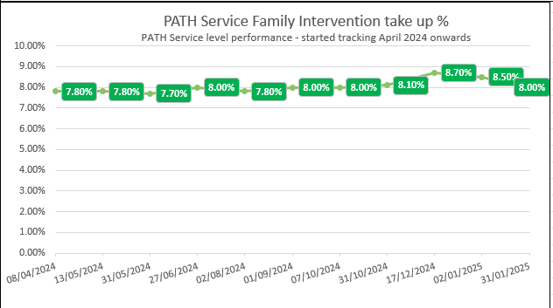
5. Results so far/Run chart(s)
Notes:
FI take up increased slightly in Dec & Jan but had decreased by end of Jan & is still at 8% as the first table shows from SPIKE today

Slide 19
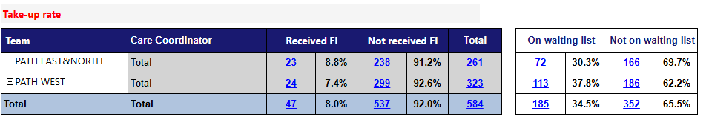
5. Results so far/Run chart(s)
Notes:
This shows the split of the 2 teams, how many service users & their families have received family intervention this year to date. Those who are on the waiting list and those who are not – this may be because they have been offered the therapy and declined it. However, the not on waiting list rate is high, and this indicates that the quality/ content of conversations with service users and family's needs to be developed to highlight the benefits of FI and increase acceptance.

Slide 20
6. What has been challenging about the process so far ?
Changing the culture within the service- making it everyone’s business
Having the dedicated time to focus on testing the change ideas and being able to properly review using the PDSA cycle
Long waiting list for Family Intervention therapy and limited resource to effect change, retention of staff that are trained, in particular registered staff.
Time taken for matching availability of families with staff pairings to get therapies started as soon as possible
Protected clinic slots difficult to currently implement due to shortage of resources. Practitioners & family to come together and agree a set day & time for the duration of the sessions at the start of the therapy.
Is the Kings model and training programme sustainable to effectively increase the delivery of FI given the limitations on training places and qualified staff
Notes:
The number of staff being able to be trained under the Kings model is limited to annual allocations, the course is very academic and this puts people off completing ( high drop out rates)– is this a sustainable model for us to continue using., expensive to keep putting staff through training who then leave. It also creates a separation between the staff team because not all staff can access the training, difficulty pairing as 1 has to be a registered qualified professional – challenge on agreeing to move to a different model whereby we could buy the training package and train all staff regardless of banding.
The back log is on average a 2 year wait, therefore service users receiving FI at the end of the pathway are subsequently discharged & don’t count as part of the audit. There are not enough FI trained staff to work through the back log to make an effective change – looking at how we can manage the waiting list differently and what percentage could be offered therapy within the next 6 months.
Trying to find families to match with staff pairing and availability – this should change in the future with change idea of developing a database with admin support
Specific members of the team that are delivering & the mini teams not feeling enthusiastic about FI and this projects into clinical conversations with service users and family– trying to bridge the gap

Slide 21
7. Next steps
Enhance the support for staff whilst on training and afterwards to protect time to deliver FI
Influencing the role of the mini teams being part of meetings, getting them more involved in discussions and finding different ways to translate the enthusiasm and benefits of FI therapy. Bring in a strong FI voice to MDTs.
Continue with testing change ideas and using PDSA cycle
Think about workforce that we have to deliver FI and is it fit for purpose – look at demand and whether the current caseload requires more resource to deliver FI, with dedicated posts.
Complete some workforce modelling to see the impact this would have on ability to increase pairings.
Explore how to manage the waiting list to deliver FI therapy within a shorter time frame – admin support
Exploring the introduction of peer support workers – developing co-production to deliver Family Intervention, think about how other EIP services are using peer support
Notes:
Selecting staff for training: We have done things slightly differently this year in being very clear about the course content, the expectations and what support we as a service will provide during the training and afterwards when staff are practising. This has meant the staff booked onto the training in 2025 have a clear understanding and are committed to the course and delivery of FI once qualified.
We have currently got a dedicated FI therapist out to advert and thinking about other staff we could train to be the 2nd person in a pairing, although we are short of registered practitioners.
Admin support contacting service users and families is helping with the allocations as knowing the preferences for locations, days & time of days really helps. But also checking the readiness for service users to start FI. There have been instances of service users declining FI or requesting to wait and this helps to work through & reduce the waiting list.

Slide 22
NCAP QI collaborative round two shared learning session two
13th February 2025
Team name: Early intervention team in psychosis
Team locality: Warrington & Halton

Slide 23

1. QI team membership
Team members:
Stephanie Smith, Clinical Team Manger.
Tracy Harrison, Clinical Lead.
Rachel Nolan, Research Assistant.
How are you involving people with lived experience in your QI work ?
Those that have been through the process of BFT are assisting the service with re-design of the leaflets, to help make the offer more appealing and hold greater meaning.
Carers, who have participated in Behavioural Family Therapy, to provide video/ audio recordings.
Notes:
Prompts- please list your QI team membership including lived experience representatives (don’t have not provide names if they do not consent)

Slide 24


2. What’s your problem area for improvement?
FI is needed to reduce relapse.
Data informed us that: not enough meaningful offers are being made.
Team is not delivering enough FI to patients & families.
Data not captured correctly due to codes used on Rio.
Staff’s enthusiasm towards FI.
Notes:
Prompts- what is the problem you are tackling ? E.g. improve our team's performance on the Fi standard- can add details about how and why you chose to focus on this standard.

Slide 25

3. What diagnostic tools/exercises did you use to better understand your problem?
Barriers
Change ideas
Themes: Time, Caseloads, Confidence, Engagement, Education.
“Completing the training a while ago, therefore not feeling comfortable with facilitating”
“Managing a big caseload and not working full time hours.”
“Not interested, don't feel it is relevant to their care”
“Complex relationships with family, engagement and motivation can be poor”
Themes: Staffing, Supervision, Training, Update materials
“Protected time for staff to deliver FI, Regular supervision. Newly trained doing FI with experienced staff. Top up training”
“Increase in number of care coordinators to free up time for staff to engage in BFT work with families”.
“Think leaflet for family members could have more about the research into BFT, and degree of success for people that engage with it”.
“I do feel that our team having a full time staff member to focus on FI would benefit us”.
Notes:
Prompt- what have done to better understand your problem ? Staff surveys’, team meetings, collected your baseline data (add in what this is)
Staff Survey:
Importance of FI: Scores range from 4-10 (average 9)
FI apart of your role: Scores range from 1-10 (average 6)
Confidence in explaining to families: 3-10 (average 8)
Confidence in delivering to families: 4-10 (average 7)

Slide 26



4. What was your key learning about the area you want to improve?
Time/ non protected time
Workload/ high caseloads
Confidence
Team not viewing FI as a part of their role
Education to patients & families
Feeling the family are to ‘blame’
Not interested/ feeling it is not important
This Photo by Unknown Author is licensed under CC BY
Notes:
Prompt- did anything come up you didn’t expect ? It would be helpful for teams to think about whether there was any difference between what you thought was the problem versus what actually came up via survey's, conversations with staff/service users, trends in baseline data etc.

Slide 27


5. Statement
To increase the uptake of BFT, for all eligible patients and their families. The aim is to have a 10% increase in the uptake by May 2025.
Notes:
Prompt- E.g to Improve the uptake of Fi for all eligible service users by 10% by May 2025. please add in some detail about how your team arrived/agreed on your aim statement.

Slide 28

6. What are you going to measure?
Change ideas
Measure
Regular supervision
Offering BFT earlier
Updating the BFT leaflet, provided to patients and families
Expert by experience to discuss with families on their experience of BFT.
Regular training/ refresher role plays.
Attendance sheet, feedback sheets.
Monitoring offers made in MDTs.
Survey to staff and patients/ families on their views of the current leaflet.
Uptake numbers of BFT from families.
Confidence scale, pre & post EIT away day.
Notes:
Prompt- thinking about your aim and change ideas what are you going to measure to understand the impact of your change ideas ? E.g. ongoing outcome measure will be how many families start FI per week/month or staff confidence levels before and after refresher training etc.

Slide 29


7. Next steps
1) Supervision: To ask facilitators to add role plays to supervision.
There has been a request that BFT supervisions incorporate opportunity for role play.
2) Offer BFT earlier: To discuss in MDT’s, organise carers group (once a month) for new patients on the First Episode Psychosis (FEP) pathway.
This is now ongoing within the EIP weekly MDT. This has also been moved to the first agenda of the MDT as it was noted that this may allow emphasis to the importance of its delivery.
3) Leaflet: Distribute survey to staff and patients/ families.
This has been actioned, there was not an initial great response from staff, so a further push has been made to gain further data.
4) Expert by experience: Ask families to provide video/ audio videos.
1 family to date has been approached.
5) Training/ role plays: Organise EIT Away Day.
During the recent away day on the 15th October, simulations were run for staff to gain an experience and exposure to the delivery of BFT. Staff were provided with opportunity to observe the delivery of a particular skill (example- problem solving).
Notes:
Prompt- this can include a list of the change ideas you have come up with (can be provisional ones and don’t have to be in the order you are going to test them in if that’s not been decided), reviewing your survey results, meeting with carers groups etc.

Slide 30

8. So how are things looking?
April May June July Aug Sept Oct Nov Dec Jan
Early Intervention - Number of service users with an open FEP pathway with activity of ‘EIP – Family intervention for psychosis’ |  | 30.0% |  | 10.8% | 9.5% | 10.0% | 9.9% | 9.7% | 9.2% | 9.4% | 9.5% | 10.5% | 11.9%
Notes:
Prompt- did anything come up you didn’t expect ? It would be helpful for teams to think about whether there was any difference between what you thought was the problem versus what actually came up via survey's, conversations with staff/service users, trends in baseline data etc.

Slide 31

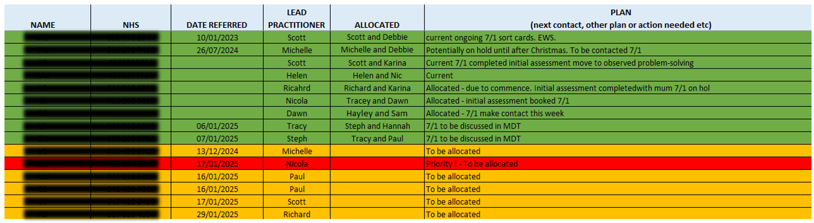
9. How are we keeping track?
Notes:
Prompts- please list your QI team membership including lived experience representatives (don’t have not provide names if they do not consent)

Slide 32
10. What’s next?
Expert by experience- gaining feedback from those currently engaging in BFT and identifying those that may wish to assist with promotion of BFT to others. Will be invited to participate in next scheduled carers group that is delivered by EIP. Due Feb 2025.
Notes:
Prompt- E.g to Improve the uptake of Fi for all eligible service users by 10% by May 2025. please add in some detail about how your team arrived/agreed on your aim statement.

Slide 33
NCAP Quality Improvement collaborative round two​
QI project training February 2025

Slide 34
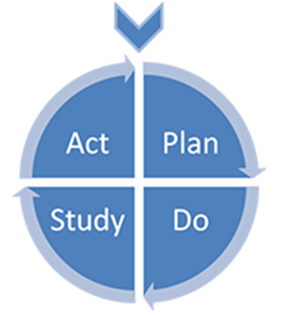
Q2: The Model for Improvement
1. What are you trying to accomplish?
2. How will you know that a change is an improvement?
Measuring processes and outcomes.
3. What change can you make that will result in improvement?
Langley G, Nolan K, Nolan T, Norman C, Provost L, (1996), The improvement guide: a practical approach to enhancing organisational performance,
Jossey Bass Publishers, San Francisco

Slide 35




Q2: Why should you measure for improvement?
To know where you are….
… where you are going
… and when you’ve arrived!

Slide 36
Q2: Why should you measure for improvement?
        All improvement involves change. But not all change is an improvement!
        AND
        Without measurement, it is impossible to know whether you have improved.

Slide 37
Q2: Why should you measure for Quality Improvement?
        “We treat patients using data. We wouldn‘t dream of not using full blood tests and other diagnostic tools. But, somehow, we seem able to intervene in an entire hospital system without data.”
        Prof. Charles Vincent

Slide 38
Q2: When should you measure for improvement?
At the beginning of the project (your baseline): what your current system can deliver.
Ongoing measurement (ideally): each case/each clinic/each incident/daily/weekly/monthly

Slide 39
Q.2 How should you measure for improvement ?
Using a run chart
Data over time
A simple and effective tool to depict the current performance of a process and to help you determine whether the changes you are making are leading to improvement.
All teams are expected to create run charts using the data you are collecting over the course of your project.

Slide 40
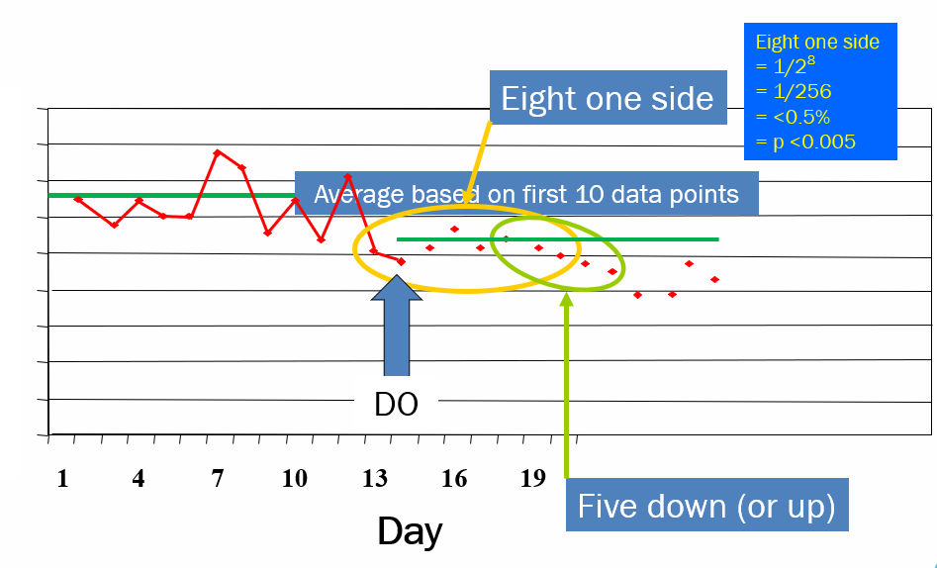
Q2: How will you measure for improvement?
The Run Chart rules
Baseline = average of 10 data points
Significant improvement = 8 data points one side of 10-day average
OR
5 data points that all go either up or down
http://qualitysafety.bmj.com/content/20/1/46.abstract

Slide 41
Q2: types of QI measures
Three of the different types of measures that can be used in quality improvement work:
Outcome
Process
Balancing
41

Slide 42
Q2: types of QI measures - outcome measure
This relates back to the aim:
Outcome measure = progress towards the aim.
The percentage of families that take up the offer of FI (per week/month)
Aim: To increase uptake of FI by 20% in 6 months
42

Slide 43
Q2: types of QI measures - outcome measure
Baseline outcome measure (before you test out any changes): the current percentage of families that take up the offer of FI.
Ongoing outcome measure: the percentage of families that take up the offer of FI (per week/month).
43

Slide 44
Q2: types of QI measures - process measure
A process measure looks at the parts or steps in a process that lead to the outcome:
Are the processes (parts/steps) in the system working as they should?
- Often ‘times between’
OR
- Whether ‘good practice is being followed
44

Slide 45
Q2: types of QI measures -process measure
Aim: To increase uptake of FI by 20% in 6 months.
One possible process that may be 'broken':
Problem: Families are failing to attend their first FI appointment
Process measure: % service users that fail to attend their first FI appointment
45

Slide 46
Q2: types of QI measures - balancing measure
Unintended consequences
Robbing Peter to pay Paul
What would you worry about?
Example:
YOU: “We want all new referrals allocated a Care co-Ordinator within the recommended 14-day period.”
CLINICIANS: “How will we manage our workload to allow us time to screen the referrals.”

Slide 47
Q2: types of data you can collect
Numbers (quantitative data) e.g. time taken; weight.
How often things happen e.g. number of complaints.
How you ‘rate’ something e.g. ‘How would you rate the helpfulness of the training session? (‘poor’, ‘fair’, ‘good’, ‘very good’, ‘excellent’).
47

Slide 48
Q.2: Choosing your measures
Do | Don’t
use data that is either being collected already OR is easy to collect. | choose too many measures.
choose measures that matter to your team. | choose data that is rare and not sensitive enough to show any improvement.
48

Slide 49
Q2: Key learning points
Try to understand and tackle any restrictions to you collecting the data, because:
if you don’t measure, it is impossible to know whether you have improved;
to understand what your current system is capable of you need a baseline of how you are doing before you test out any change ideas;
measures should be collected on an on-going basis so you can see your improvement.

Slide 50
Key learning points
Three types of measures that can be used in Quality Improvement work:
Outcome – relates back to the aim
Process – looks at the specific steps in a process that lead to the outcome
Balancing – unintended consequences
50

