Slide 1
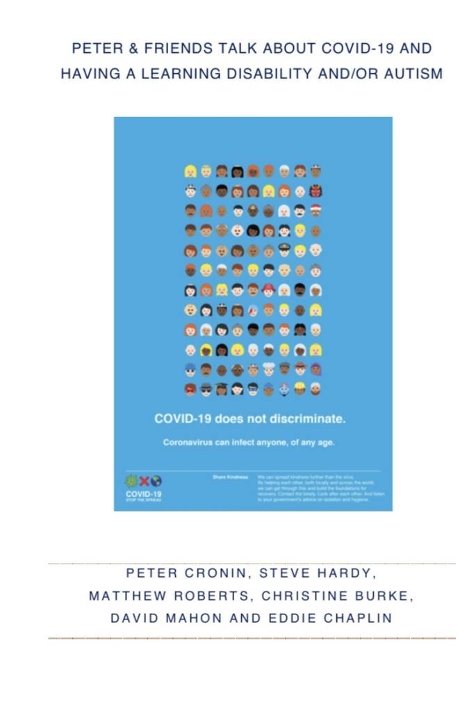
Peter and friends experience of covid-19
For people with intellectual or learning disabilities and/or autism

Slide 2
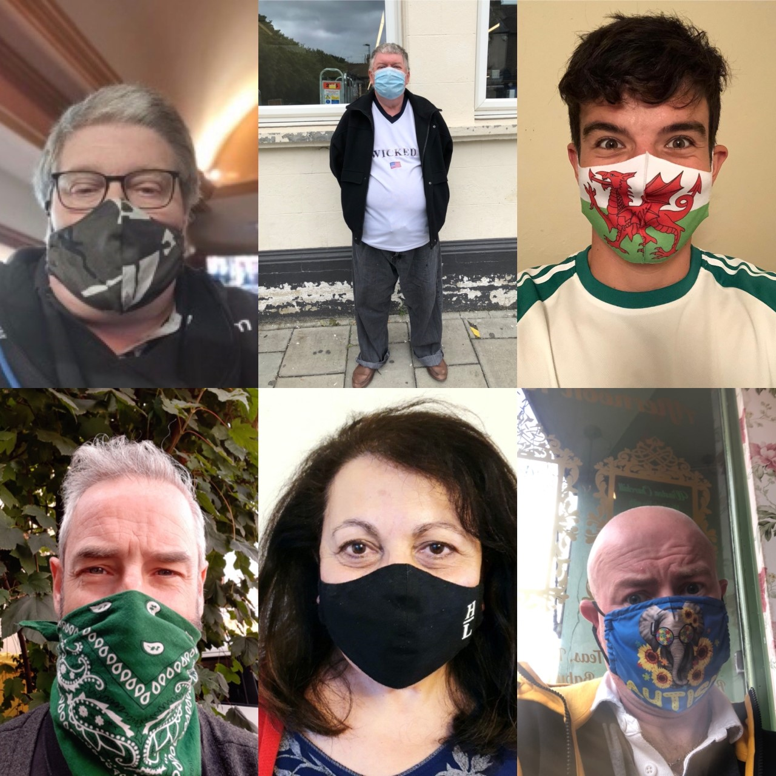

Slide 3
What we will be covering?
Introductions
The reasons why we produced this book
Some stories from experts by experience
Some stories from those who work in health and social care
What we will do if it happened again?
Questions

Slide 4
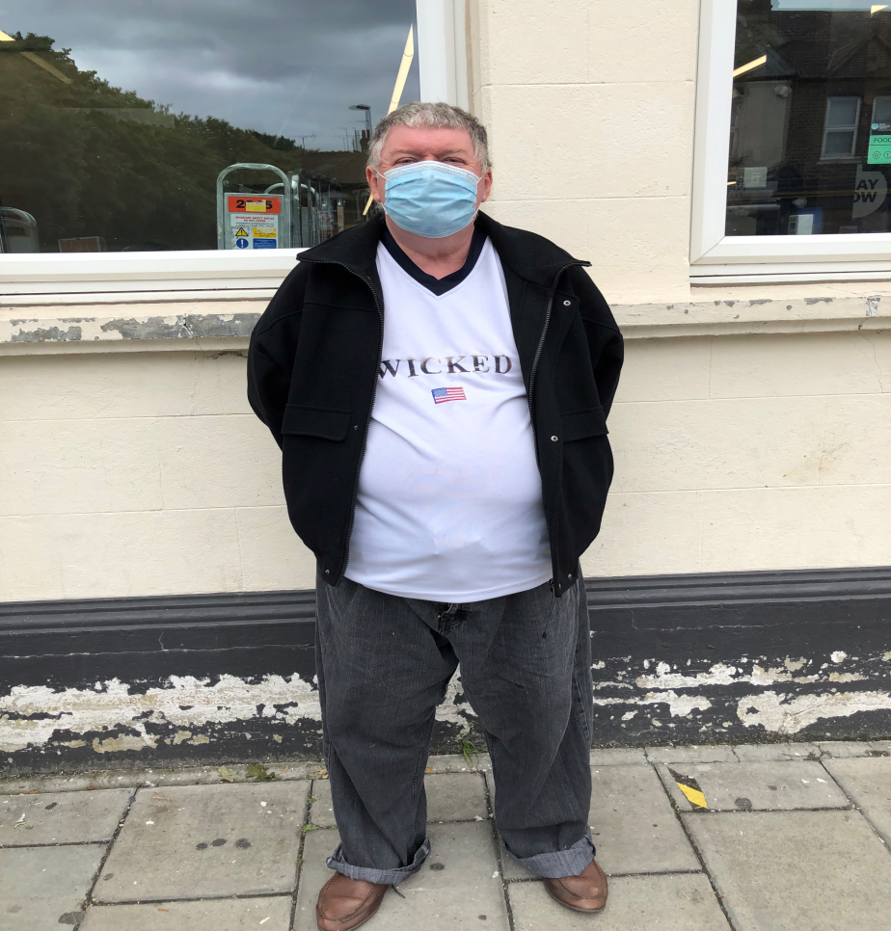
The reason why we produced this book
Worried and anxious
Sleepless nights
Kept coughing but unable to see the GP – only on telephone
Outreach was stopped
College was closed
Due to that I can’t read I couldn’t find out what you should do

Slide 5
What happened?
Pete and Steve had a discussion
We decided that people with learning disabilities needed a platform to be heard
Matthew joined us from Cardiff University
Eddie came on board from LSBU
Christine loved the idea
So we started a book!

Slide 6






Slide 7
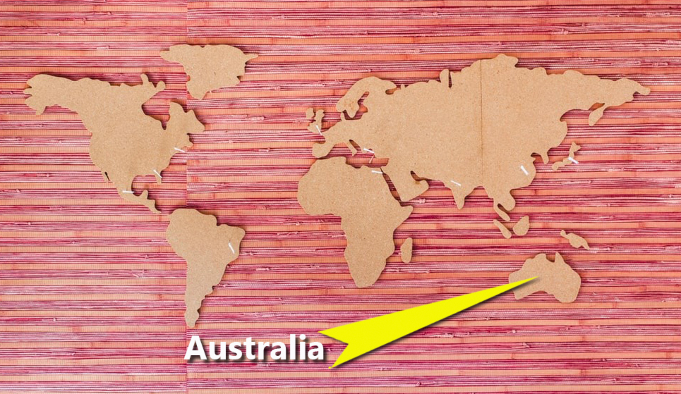
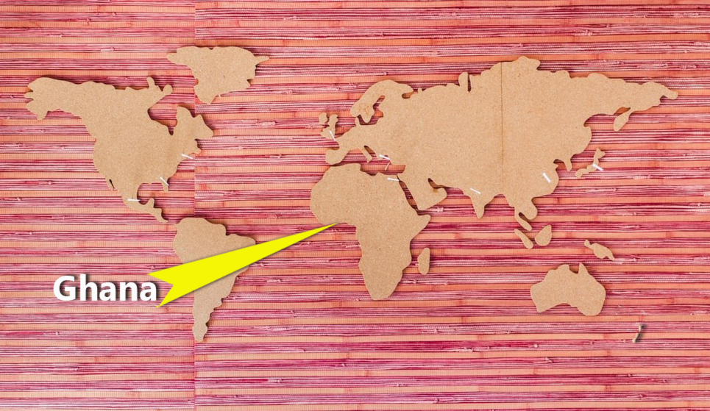

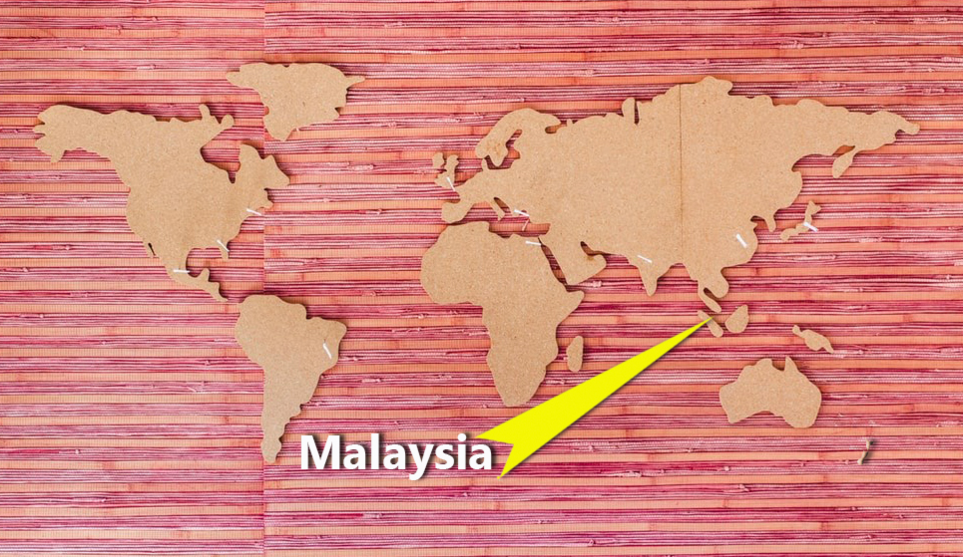

Slide 8

What does the book look like?
Introductions
Experts by experience
Families and carers
Organisations and those who work in them
Mental health and covid-19
What if it happened again?

Slide 9


Slide 10
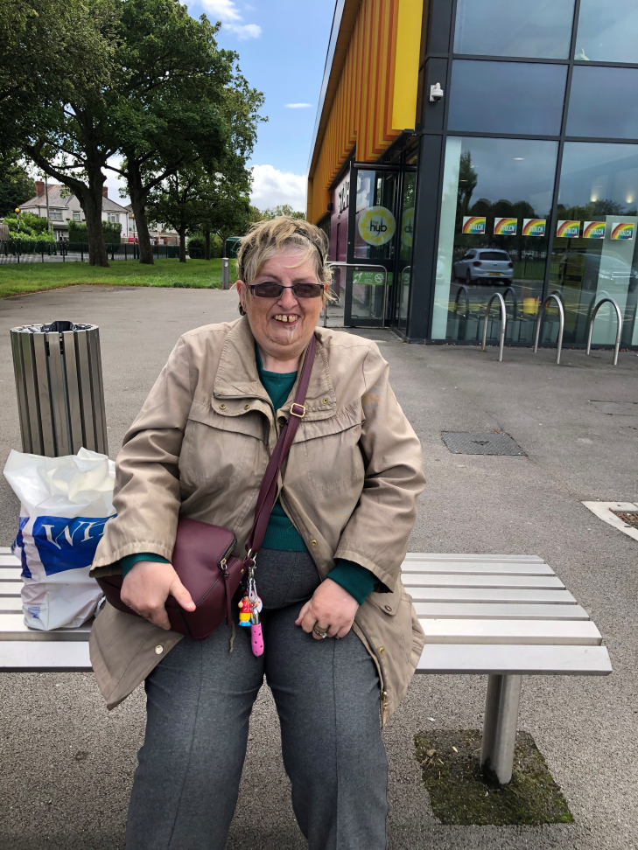
Experts by Experience - Janice
Positivity is her game!
Lives in Key Ring
Survived lockdown
Helping others with their shopping
One thing that upset her that the gym was closed
Looking forward to seeing friends and family

Slide 11


Slide 12
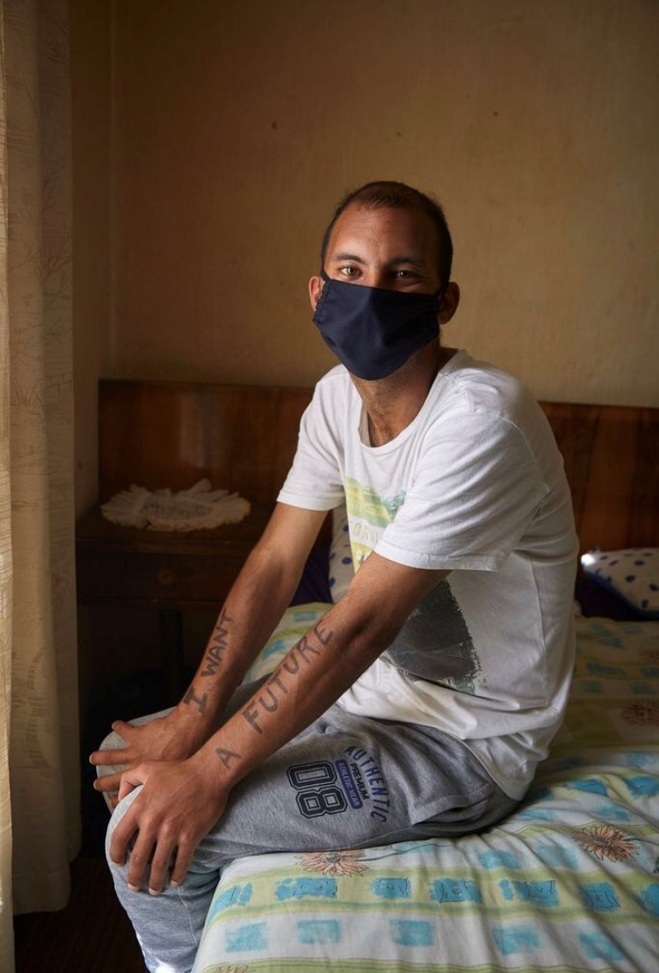
Expert by Experience - Michyle
Dreams and aspirations
So proud he has recently got a job
Then covid-19 came and everything changed
Worried of the gangsters
Must be reminded to wash hands, clothes and wear a mask

Slide 13


Slide 14

Expert by Experience - Greg
Depressed and suicidal
Watching news is upsetting
Counselling
Cricket, snooker, darts football
Family and friends
Seeability

Slide 15
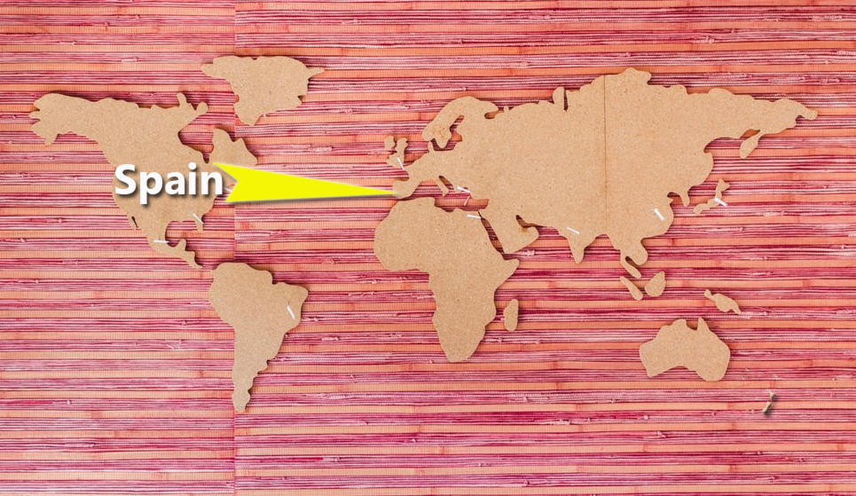

Slide 16
Organisation – Almudena
Spain is one of the countries which has been most shaken by the Coronavirus pandemic.
We are really worried and have suffered a lot.
Probably one of the worst moments was the beginning of the lockdown, not knowing what was going to happen, how contagious this was…
We were also very worried about the survival of our organisation.
Many of our activities were forced to close, and therefore many of our sheltered employment businesses.
But also some others could continue, because they were considered “essential”: basically our service of parcel delivery in the neighbourhood and our contract with the Spanish Postal Service for the cleaning and disinfection of their boxes.

Slide 17
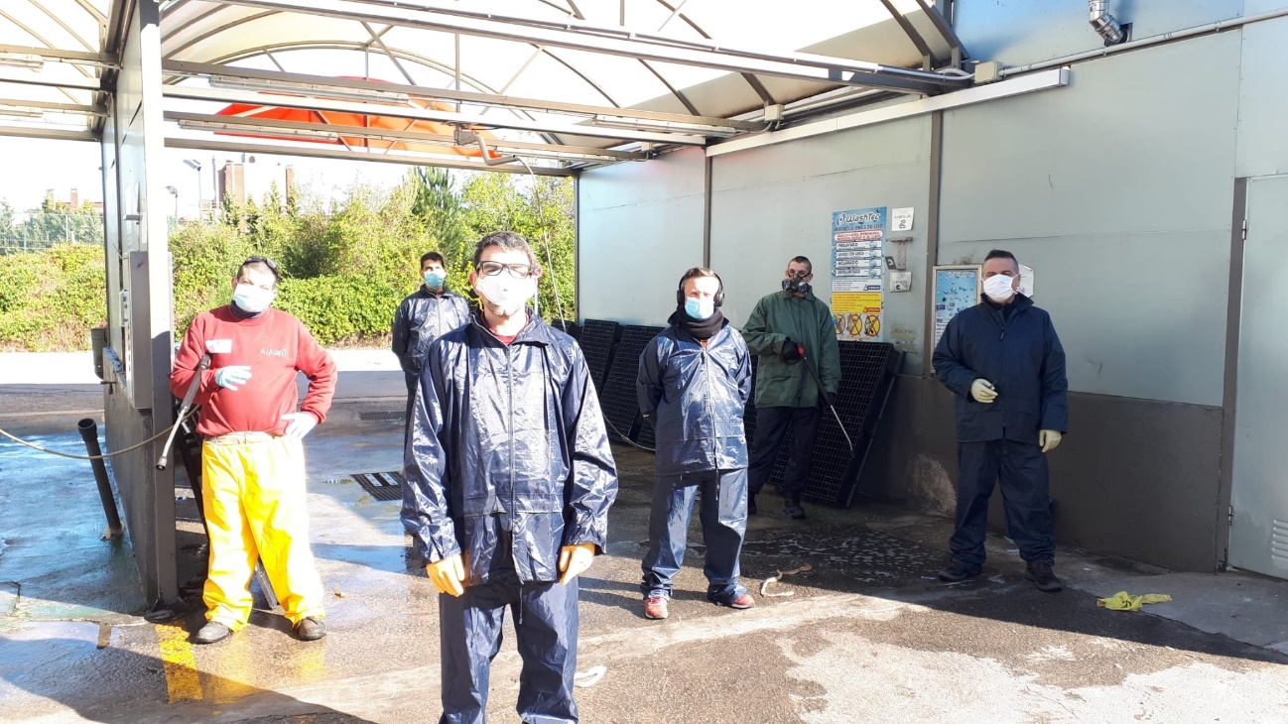
Almudena

Slide 18
Almudena
500 workers in the A LA PAR Foundation had to go to temporary unemployment because of the forced shutdown of our activities
We had to take a thoughtful decision: though the parcel delivery and box cleaning services had always been undertaken by workers with learning disabilities, maybe this time those had to be the workers who had to be protected, and therefore should stay at home

Slide 19
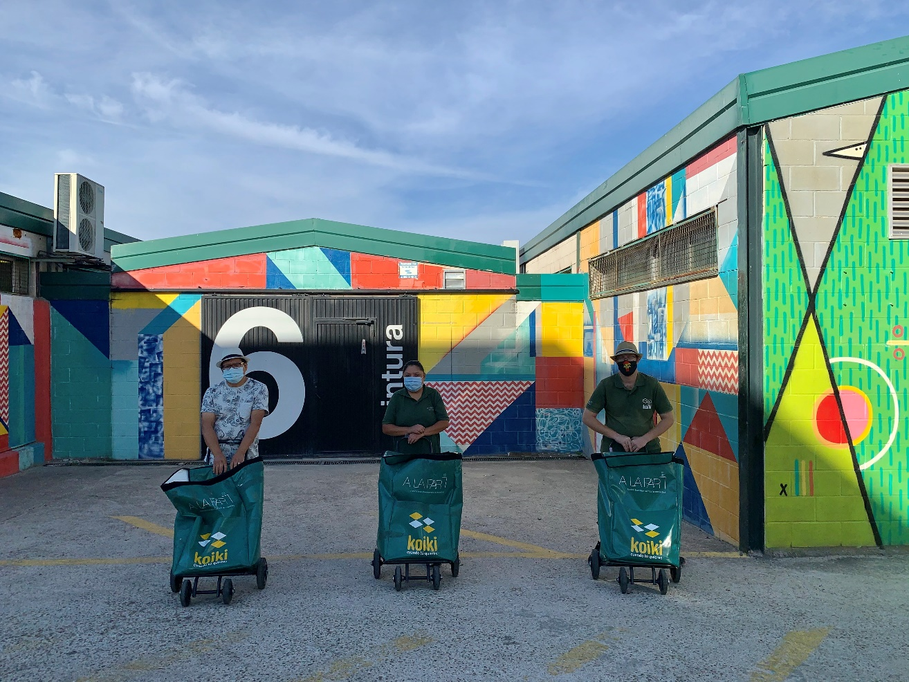

Slide 20
Almudena
We decided that we could not take any decision based on someone’s condition. This meaning thatthat we couldn’t decide saying “as this worker has a disability…”. If someone was at risk, or their families, or had to take care of someone who had to stay at home (kids, elderly….), those could be motives to decide who should not work during the lockdown. But those could be present either having or not having a disability. We also decided that as an organisation we had no authority to eliminate someone’s right to being useful and having the privilege to boar with others during such tough moments. And moreover, it was a very important moment to shine and break prejudices about the value of people with learning disabilities. It reminded me of women in World War II, and the images we all still remember of their value.

Slide 21
What if it happened again?
Do you think we have learnt lessons when it comes to people with learning disabilities and covid-19?

Slide 22


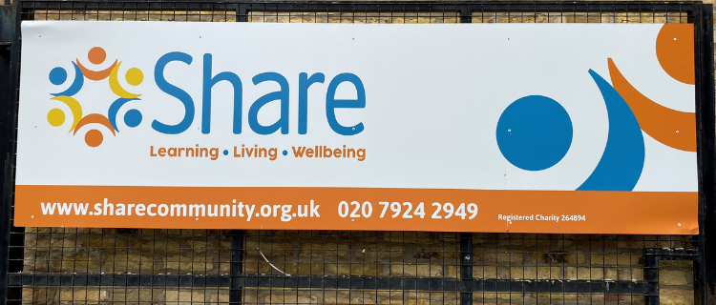

Slide 23
Some suggestions
Include people with learning disabilities in simulations
People with learning disabilities should be represented on LA, NHS and Government forums
All information should be in a varetry of accessibility – use videos!
More support
Make guidance clearer

Slide 24
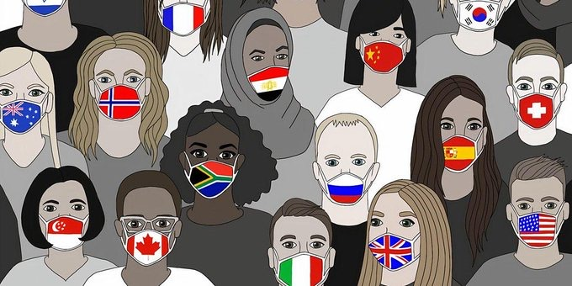
29th October 2020
Official Launch

Slide 25
What we did…
Fusion not coproduction
Intro by Peter and Eddie
Role play
Interview with Almudena in Madrid
Interview with experts by experience
Sir Norman Lamb and Hayley Newman
FPLD – staying mentally well
Song from Cardiff University Vox

Slide 26

Book is available at..
www.stevehardyldn.com

Slide 27
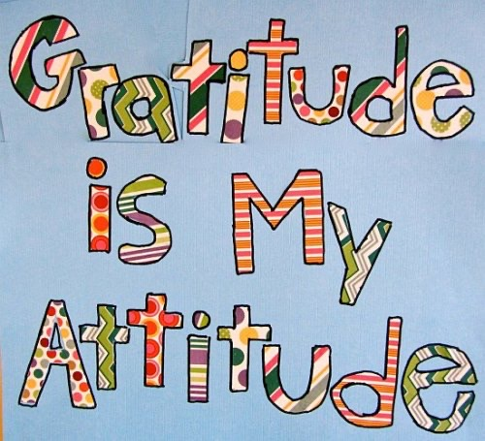
This has been a great experience!
We would like to thank all of those who submitted stories and all of those who supported this project!

Slide 28
Any questions?
Thank you for listening to us!

