Slide 1

Learning Disability and Dementia: Supporting a Timely Diagnosis
Jane Nickels – Learning Disabilities Admiral Nurse
Sarah Ormston – Health, Dementia and Wellbeing Manager
Notes:
Both introduce ourselves.

Slide 2
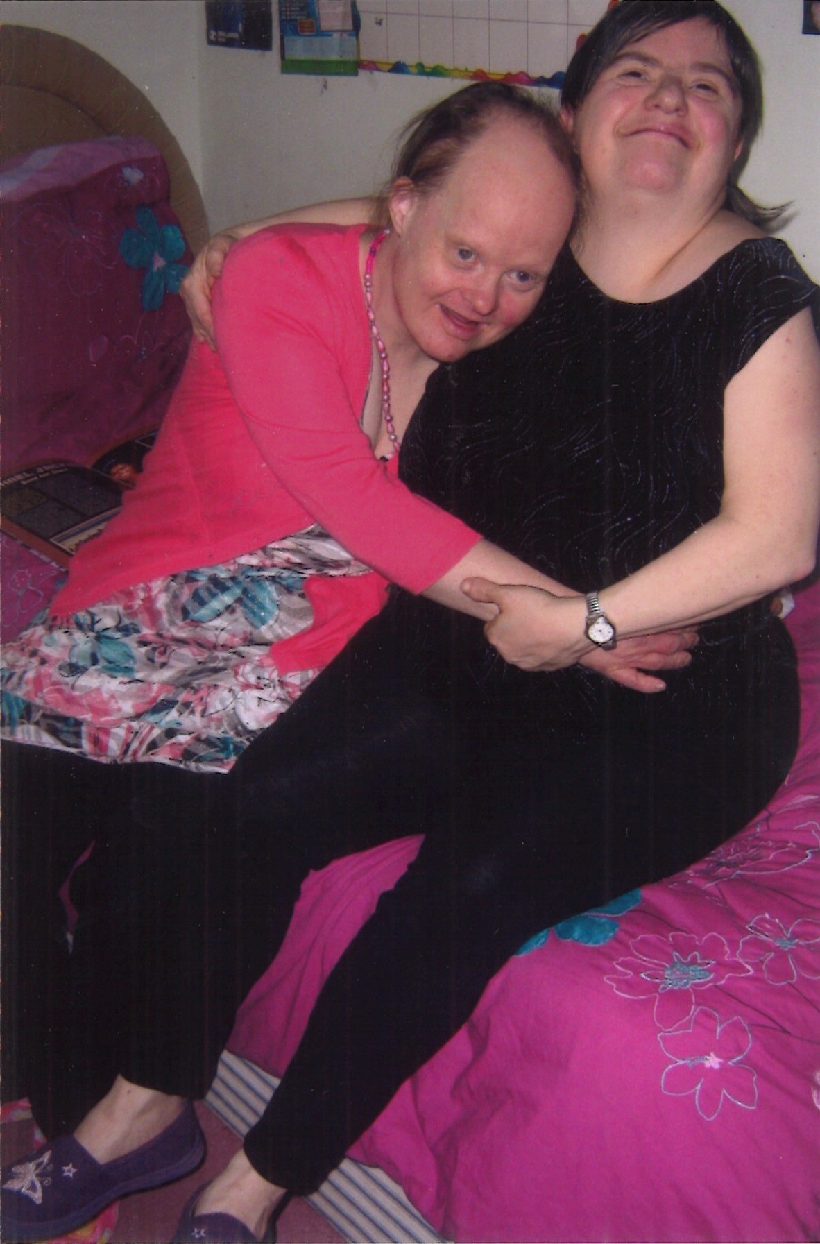
What we will talk about today
Brief introduction to MacIntyre
Whole organisation approach to improving health outcomes
Supporting a Timely Diagnosis of dementia for a person with a learning disability
Notes:
Jane

Slide 3
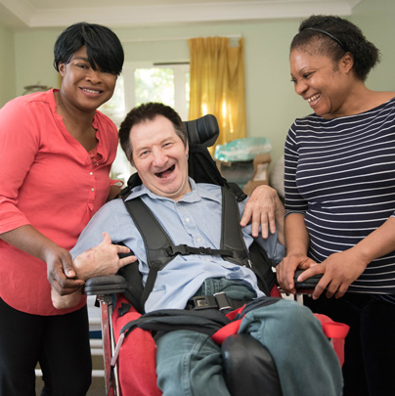

About MacIntyre
We provide education, learning, support and care for more than 1,500 children, young people and adults who have a learning disability and/or autism across England and Wales.
Notes:
Sarah

Slide 4
MacIntyre Dementia Project
In February 2016, MacIntyre was awarded a significant grant from the Department of health Innovation, Excellence and Strategic Development Fund.
Across the 3 year funded project, MacIntyre won 3 National awards including: the Dementia Care Award for their work and dedication to people with a learning disability and dementia.
The project ended in 2018 with a legacy of resources but this was far from the end of our commitment to people with dementia and learning disabiltiies.
In partnership with DementiaUK, we appointed the UK’s first Learning Disabilities Admiral Nurse
Notes:
Sarah
The application was made following the enormous success of MacIntyre’s Dementia Special Interest Group (DSIG).
The Department of Health grant enabled MacIntyre to create a range of learning and multi-media information resources to improve the support and care for people with learning disabilities who have dementia or are at risk of developing dementia.
The Aims of the 2 year project was to help raise awareness of dementia among people with a learning disability, their families and professionals to better understand the condition and future care. Also to, help people with a learning disability receive a timely diagnosis of dementia.
Info on slide In 2017
Info on slide
Hand over to Jane Following the project, MacIntyre now host the UK’s first Learning disabilities Admiral Nurse. Admiral Nurses are renowned for their expertise in Dementia and supporting families during times of crisis. My role within MacIntyre is to support people pre and post dementia diagnosis, ensuring they receive a timely diagnosis so support and environments are tailored to meet their individual needs.

Slide 5
What is a Learning Disability?
It is estimated that 1.5 million people in the UK have a learning disability.
A learning disability affects the way a person learns new things in any area of life, how they understand information and how they communicate.
This can mean they can have difficulty:
Understanding new or complex information
Learning new skills
Being independent
Notes:
Jane
MacIntyre's definition of a learning disability

Slide 6
Links Between Learning Disability and Dementia
Prevalence
Risk factors
Early onset
Key points
Notes:
Jane Numbers:
There have been significant improvements in the life expectancy of people with a learning disability over the years
It is believed that the number of people with a learning disability over the age of 65 has doubled in the past 5 years. However, as the learning disability population ages, so more people with a learning disability develop dementia.
Risk factors:
We know that people with a learning disability, particularly those with Down’s Syndrome, are at increased risk of developing dementia, in addition to the known risk factors of getting older. Thanks to advances in modern medicine and improved care and support, the life expectancy of a person with Down’s Syndrome has dramatically improved – however we still have a long journey to go. Reports such as LeDeR highlight stark inequalities to people with a learning disability and equity in life expectancy and access to healthcare.
People with a learning disability are also more likely to have additional health and social factors that are known to increase the risk of developing dementia.
For example, people with a learning disability are more likely to have existing physical health conditions, be overweight and eat unhealthily, do less physical exercise, have a limited social circle and more likely to be lonely, and are less likely to participate in games and activities that keep their brain active.
• Early onset: If a person with a learning disability develops dementia, it is often at a younger age than a person without a learning disability, and the person will face different and additional challenges to people who do not have a learning disability. MacIntyre's record people at risk based on NICE Guidance (meaning 30+ Down’s Syndrome, 40+ Learning Disability)
Key points:
Dementia is not a normal part of getting older, but one of the risks of developing dementia is ageing.
Dementia presents much in a similar way to people with a learning disability the differences may come in the way you share information with the person and the changes in the person may be slightly less obvious.
The families and circles of support (e.g.social care staff) know the person really well and it is important as Memory Clinic Managers that you listen and and take note of the changes being reported on and what this might mean.

Slide 7
Health Inequalities
There are over 11 million people with a limiting long-term illness, impairment or disability in the UK. Disabled people seek more health care than people without a disability and have more unmet health needs.
LeDeR shows men with a learning disability die 13 years sooner and women 20 years sooner
Over 80% of adults with learning disabilities engage in physical activity that is below official recommendations levels
Women receive less screening for breast and cervical screening. Adolescents and adults with disabilities are more like to be excluded from sex education programmes
Poor access to mainstream NHS Community Services
Lack of understanding by NHS staff, especially hospital staff and some GPs, of the difficulties accessing services faced by people with learning disabilities
Staff and people supported have low awareness about importance of a healthy lifestyle including eating a healthy diet and taking exercise.
Notes:
Both.
Sarah – Introduce - LeDeR, screening, lack of understanding NHS staff
Jane – 80%, poor access, and lifestyle changes

Slide 8
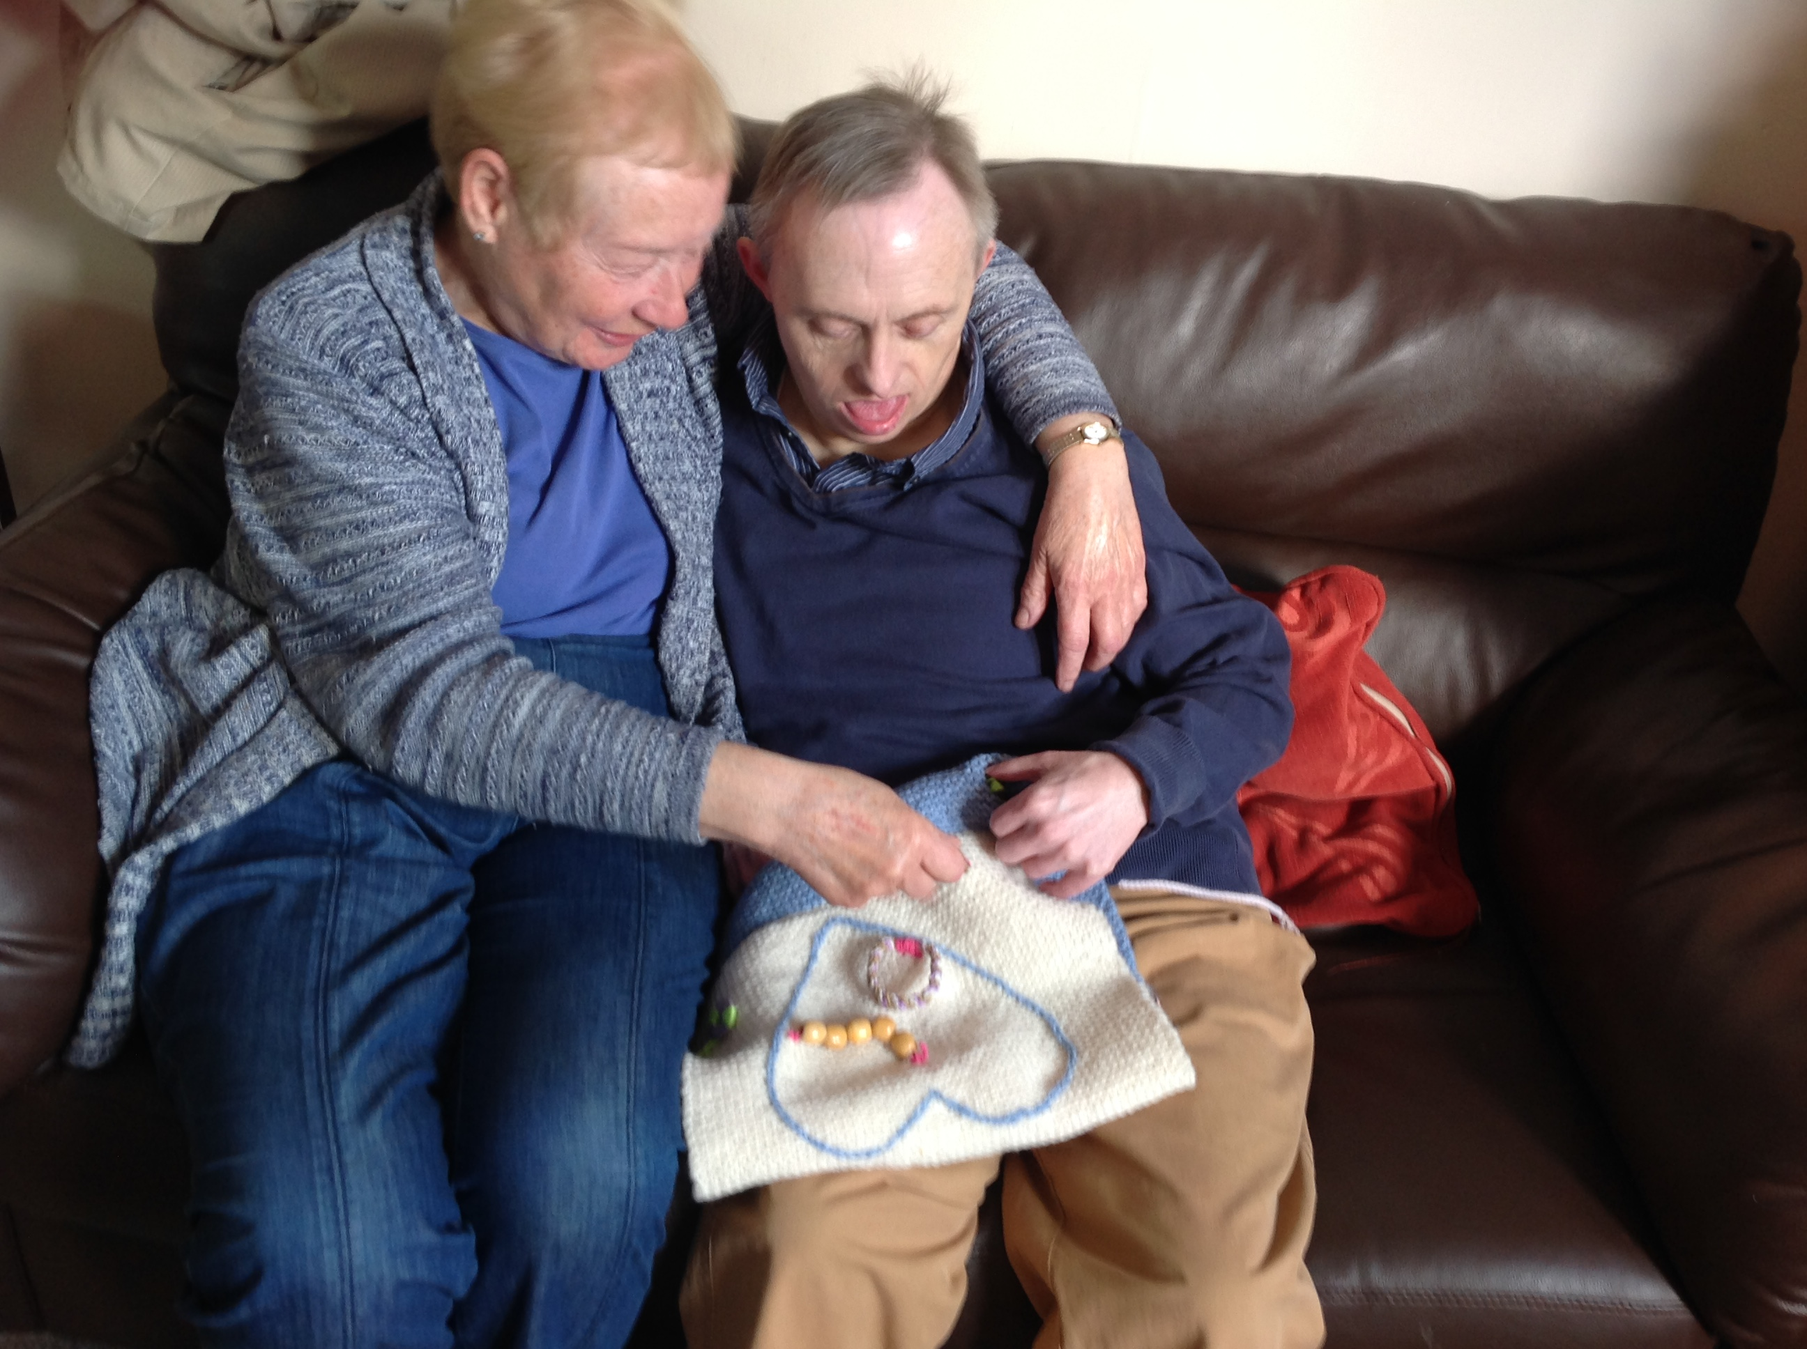
The MacIntyre way
Coproduction and Side by Side training
External partners and critical friends
Specialist champions and specialist interest groups
Funded through trading income, charitable funds and grants
Notes:
Sarah

Slide 9

What Works
Equipping Staff
Reasonable Adjustments
Delivering Good Support
Sharing Good Practice
Notes:
Jane

Slide 10
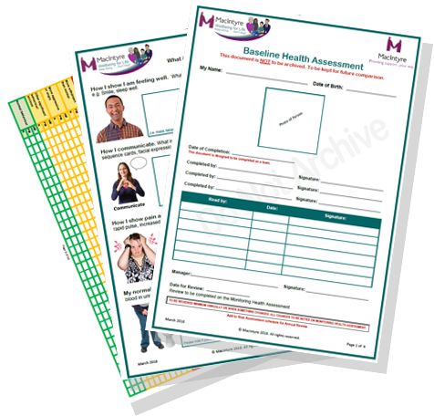
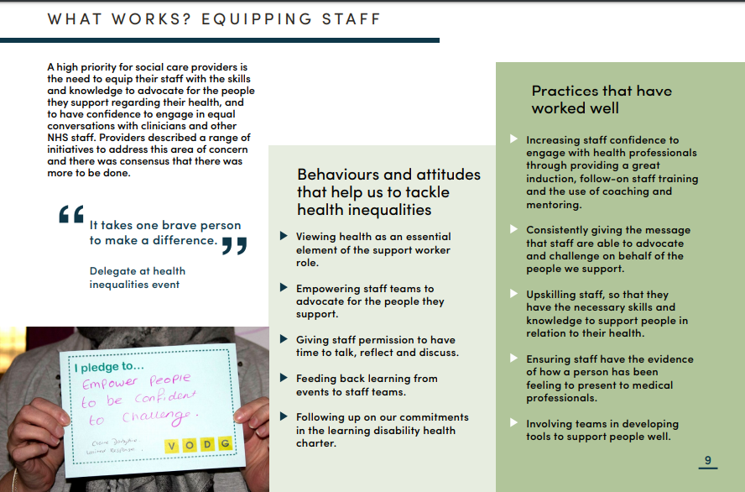
What Works – Equipping Staff
A high priority for social care providers is the need to equip their staff with the skills and knowledge to advocate for the people they support regarding their health, and so have confidence to engage in equal conversations with clinicians and other NHS Staff.

Slide 11
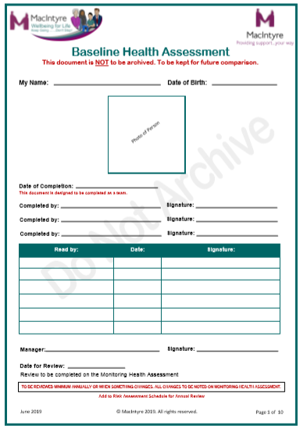
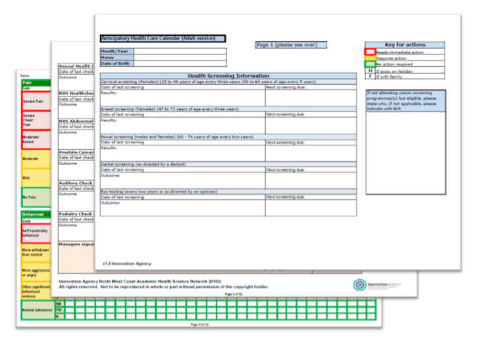
MacIntyre: What Works – Equipping Staff
Notes:
Sarah

Slide 12
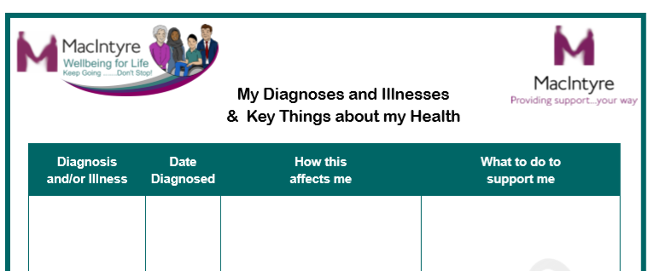
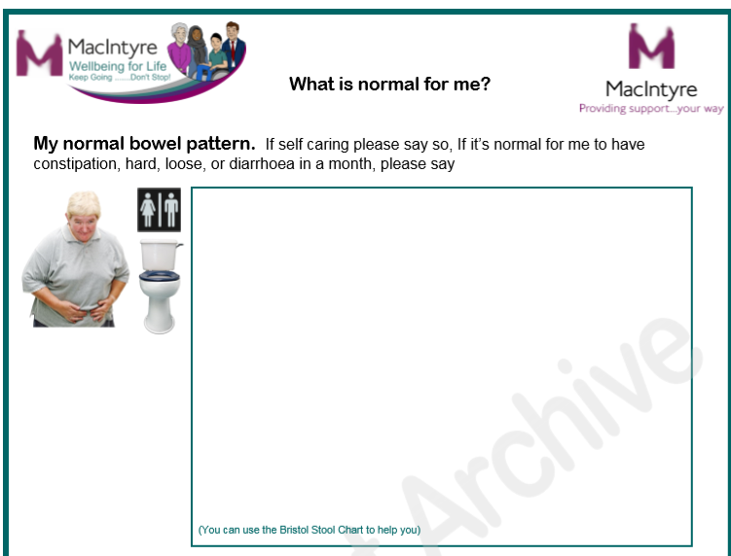
Baseline Health Assessments
Notes:
Sarah

Slide 13
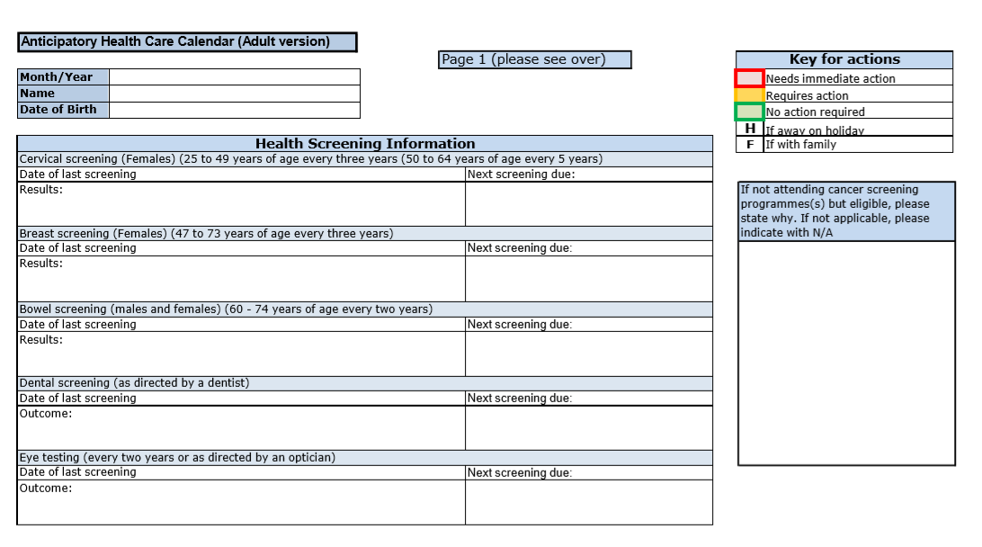
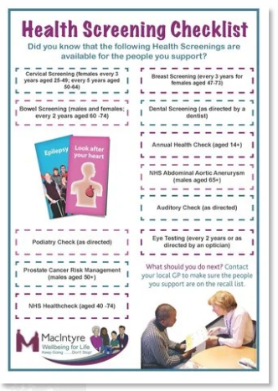
Anticipatory Care Calendar ©
(Health Calendar)
We are using the Anticipatory Care Calendar © with permission from the Innovation Agency, NHS.
Notes:
Sarah

Slide 14
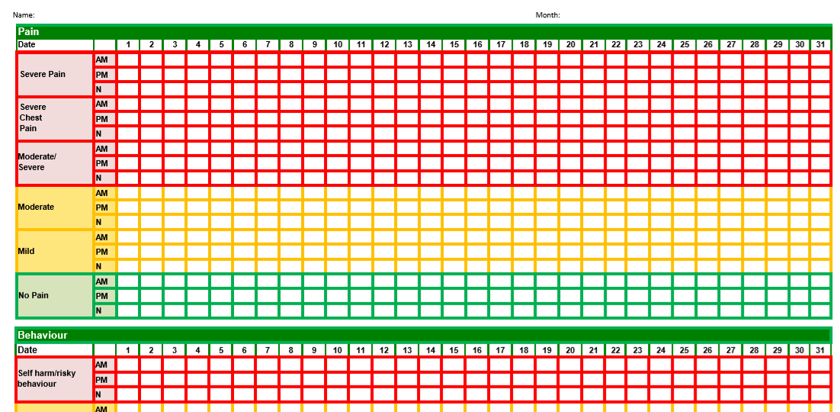
Anticipatory Care Calendar ©
(Health Calendar)
Notes:
Sarah

Slide 15
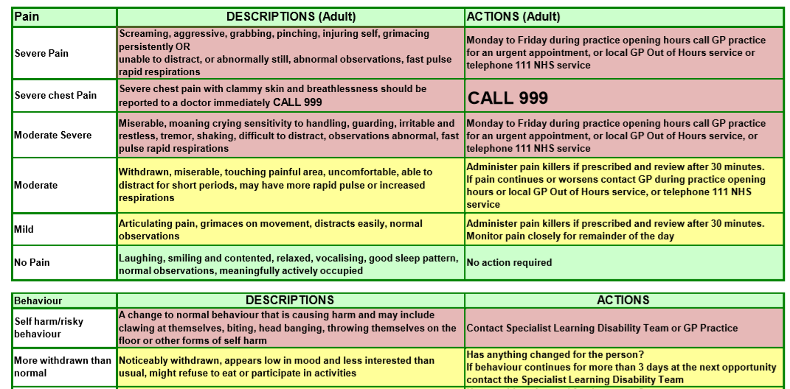
Descriptions and Actions Sheet ©
Notes:
Sarah

Slide 16
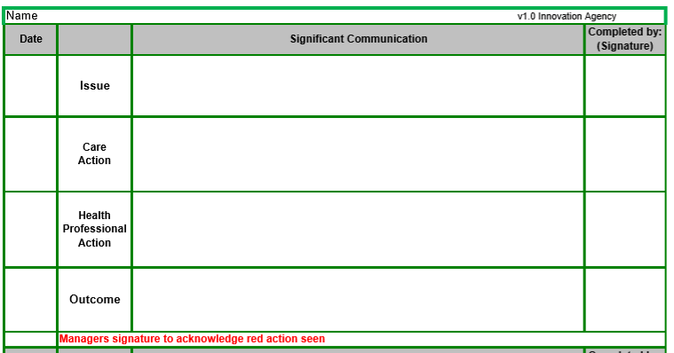
Significant Communication Sheet - ©
Notes:
Sarah

Slide 17
How the Anticipatory Care Calendar is helping to help us to support Timely Diagnosis
Viewing health as an essential element of the support worker role
Empowering staff teams to advocate for the people they support
Giving staff a tool to monitor deterioration of a person’s health and communicate this effectively to the relevant professionals.
Feeding back learning from events to staff teams – HSIG / DSIG
Following up on our commitments in the learning disability health charter
Providing us with an overview of patterns we are noticing and subtle changes to a person’s health.
Notes:
Jane

Slide 18
Other Way to Support Timely Diagnosis
Preparing the person
Sharing information
The assessment - NICE Pathways - Dementia Diagnosis and Assessment, 2016
Following a diagnosis of dementia
Notes:
Jane
Reiterate the importance of the Health Calendar & Baseline Health Assessments
Preparing the person:
Consider reasonable adjustments: double appointments, using the NICE guidance for the diagnosis process
Communication needs
Send out pre-assessment information so the person knows what to expect (& also the info the clinician wants) – in a format that makes sense to the person.
Explore letting the person visit the clinic prior to any formal assessment
Trust the people supporting the person and their circle of support and families and the information they are helping to provide to you.
Sharing information:
Clear record keeping and sharing information with others – including history taking from family and friends where possible
Request support from a local learning disability community nurse to support the assessment and treatment process
The assessment:
Rule out possible other health conditions for example UTI
Use simple sentences – no jargon
Allow the person time to process information and respond
Address the person being assessed and not the person supporting them
Consider what knowledge the person may have around a subject before asking questions? Who is the current Monarch? (What does Monarch mean?) Another good example is which have seen sadly – ‘tell me about an event you’ve been to in the last 3 weeks – during Covid19 height of pandemic. It is ok to off script”!!!!!!!!
NICE Pathways - Dementia Diagnosis and Assessment, 2016 advise: “Refer people with learning disabilities who have suspected dementia to a psychiatrist with expertise in assessing and treating mental health problems in people with learning disabilities” https://pathways.nice.org.uk/pathways/dementia#path=view%3A/pathways/dementia/dementia-diagnosis-andassessment.xml
Following a diagnosis of dementia:
Tell the person (give them the choice if they wish to know – same as it would be for you or me) health professionals should, unless the person with dementia clearly indicates to the contrary, provide them and their family with written information about: • The signs and symptoms of their type of dementia • The course and prognosis of the condition • Treatments • Support groups • Sources of financial and legal advice, and advocacy • Local care, support and information sources, including libraries and voluntary organisations.

Slide 19

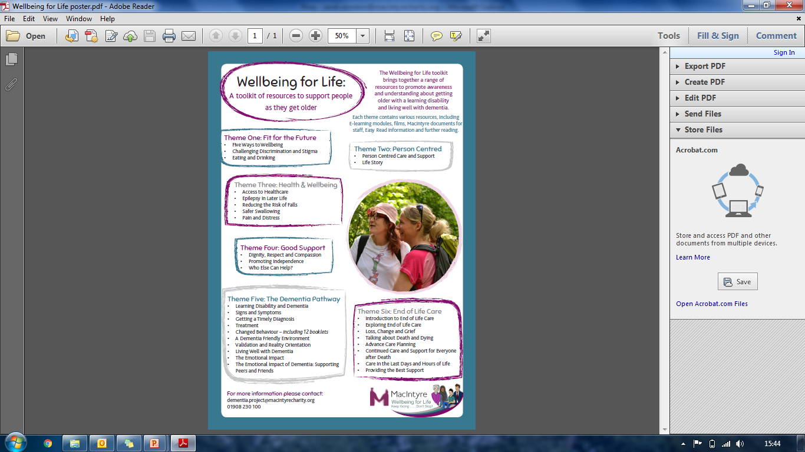
Sharing Good Practice
Module/eBook Titles:
Five Ways to Wellbeing
Challenging Discrimination and Stigma
Eating and Drinking
Person Centred Care and Support
Life Story
Access to Healthcare
Epilepsy in Later Life
Reducing the Risk of Falls
Safer Swallowing
Pain and Distress
Dignity and Respect
Promoting Independence and Safety
Who Else Can Help?
Learning Disability and Dementia
Signs and Symptoms
Getting a Timely Diagnosis
Treatments
Changed Behaviour – including 11 mini books
A Dementia Friendly Environment
Validation and Reality Orientation
Living Well with Dementia
The Emotional Impact of Dementia
The Emotional Impact of Dementia: Supporting Peers and Friends
An Introduction to End of Life Care
Exploring End of Life Care
Loss, Change and Grief
Talking about Death and Dying
Advance Care Planning
Continued Care and Support for Everyone After Death
Care in the Last Days and Hours of Life
Providing the Best Support
All free on our website! – www.mactinyrecharity.org
Notes:
Sarah

Slide 20
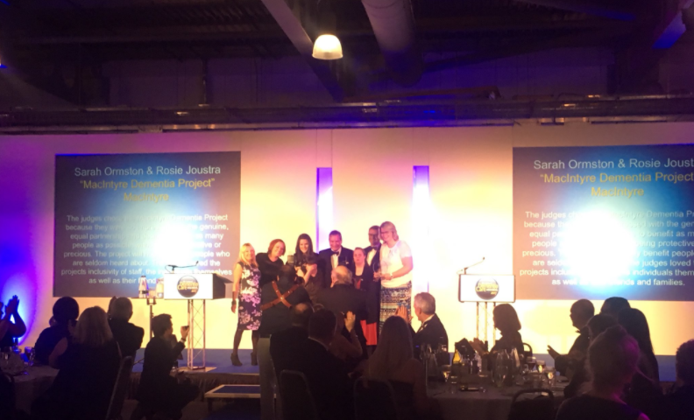
MacIntyre – this was the start of a journey!
Notes:
Sarah

Slide 21

Thank you – Any Questions?
Thank you - Any Questions?
?
?
Notes:
Jane

Slide 22
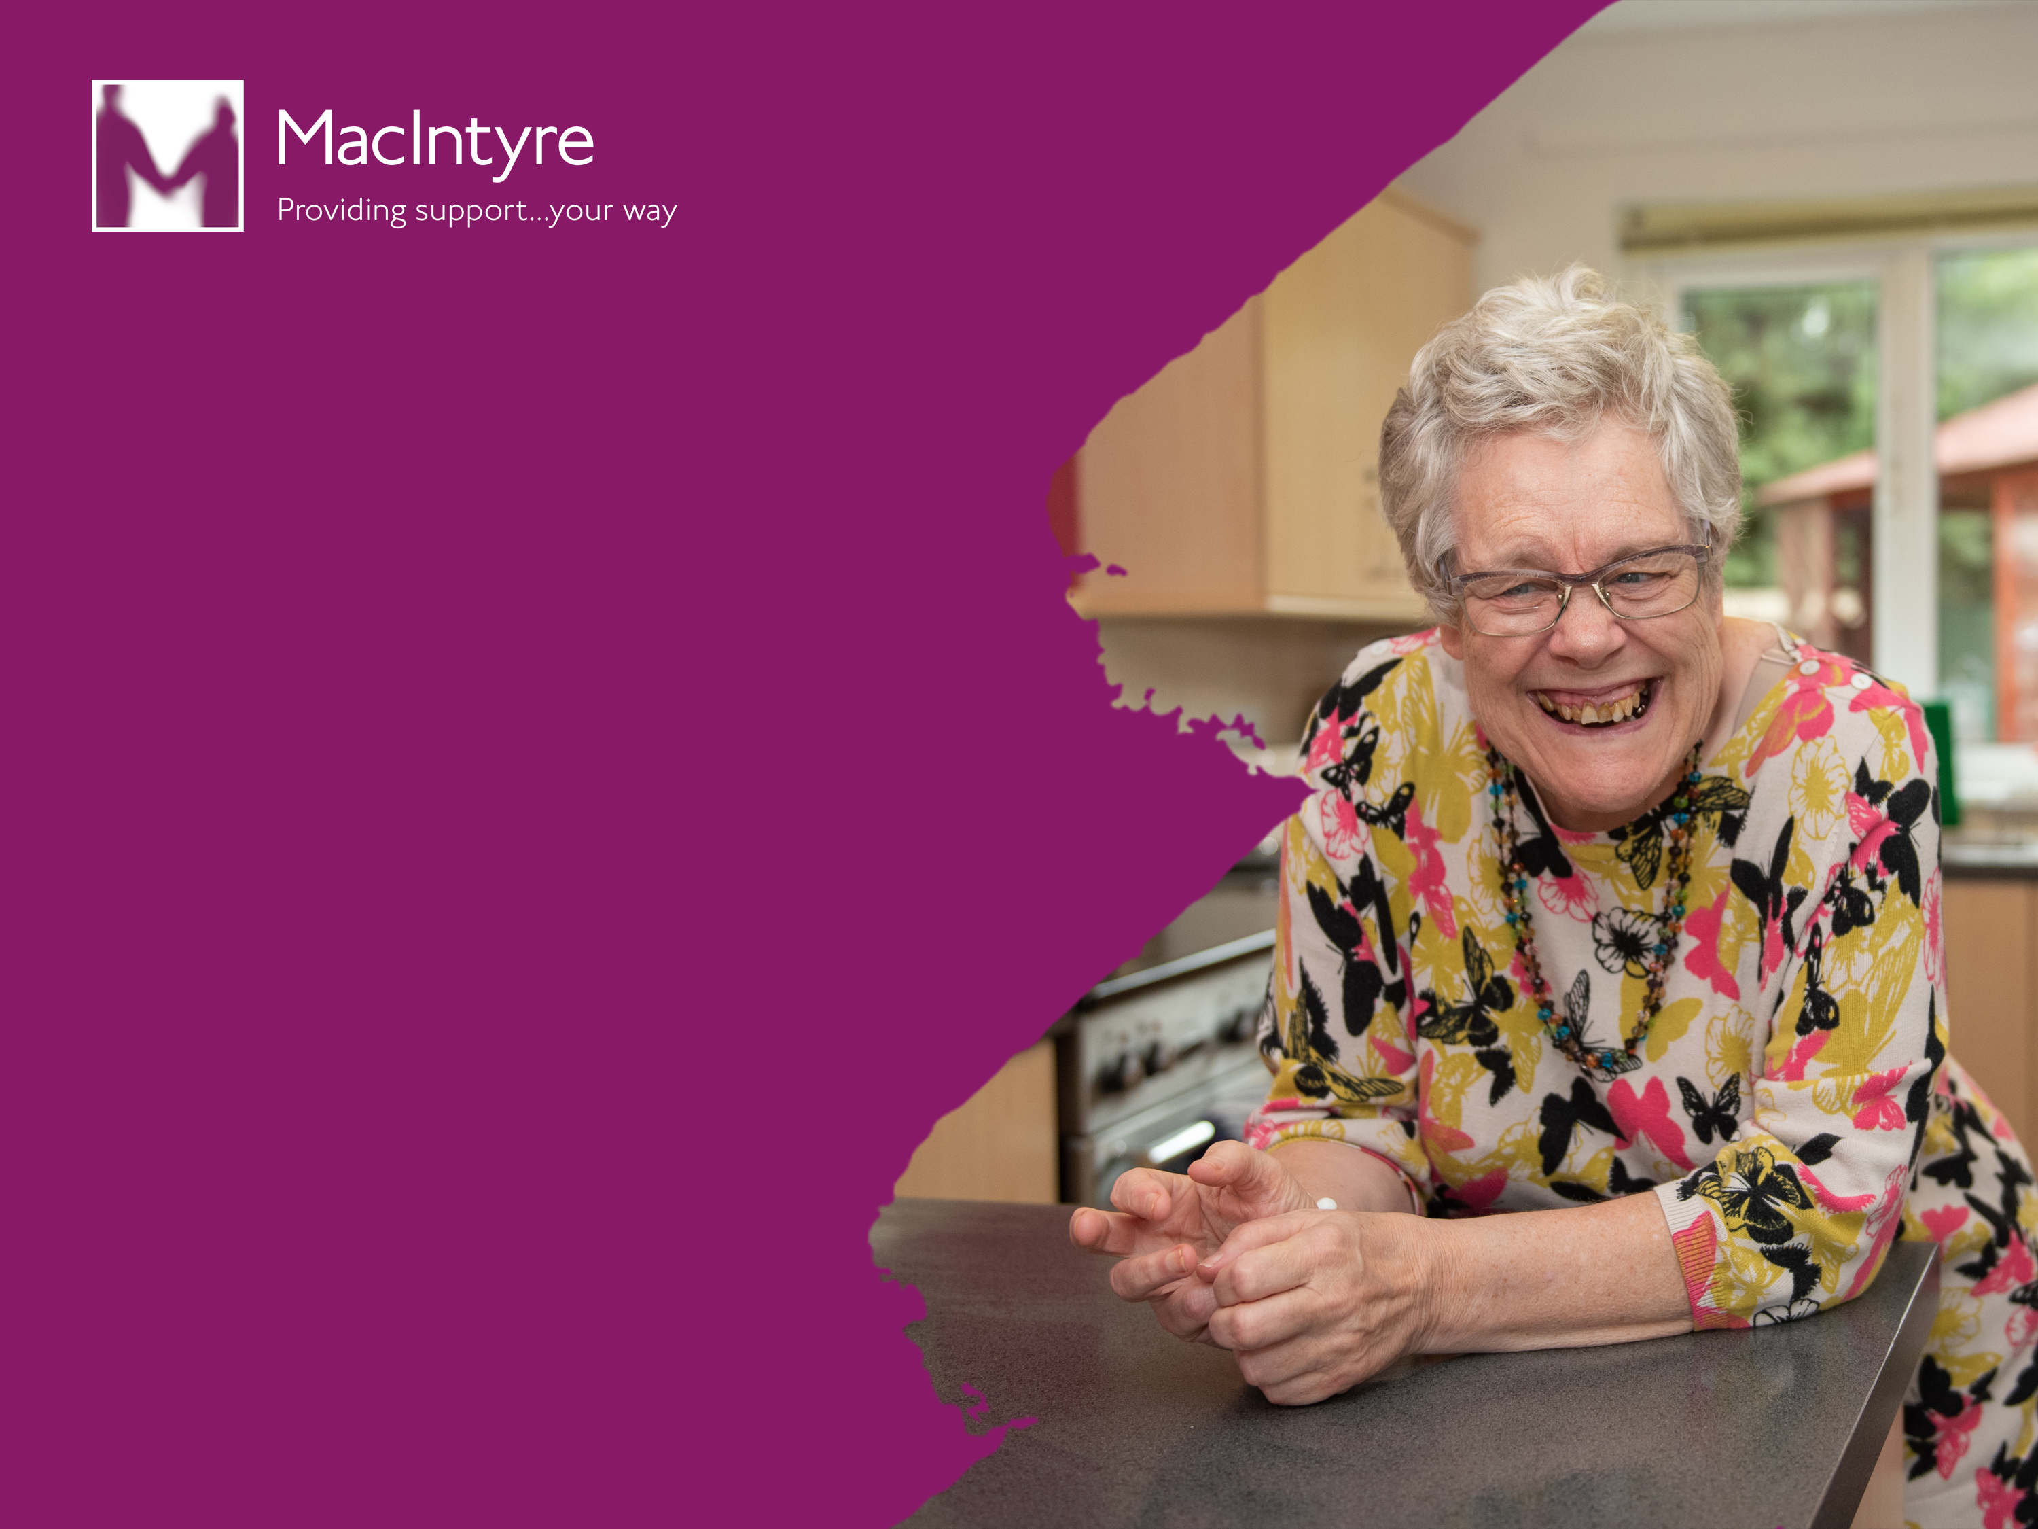
Jane Nickels – Learning Disabilities Admiral Nurse
Sarah Ormston - Health, Dementia and Wellbeing Manager
T: 01908 230100
E: health.team@macintyrecharity.org
@HealthLD, @DementiaLD @SarahOrms
www.macintyrecharity.org

