Slide 1
Telemedicine rollout for secure and detained settings
18th August 2020
Chantal Edge c.edge@ucl.ac.uk/Chantal.edge@nhs.net

Slide 2
All digital technology (hardware and software) deployed in prisons must be approved centrally by the national HMPPS Information Management and Cybersecurity teams
Local Governor approval is not sufficient alone…

Slide 3







Jan 2020 COVID-19 cases in England
Feb-Mar 2020 Community settings started shifting to digital delivery of healthcare
Mar 2020 NHSE H&J start working with HMPPS to assure a prison telemedicine model
Apr 2020
Agreement reached on secure software options for use in prisons
Policy changed to allow use of secure 4G tablets in prisons for telemedicine and access to medical notes
May-Aug 2020 Design, purchase and rollout of telemedicine and
tablets to 135 sites in England including prisons, IRCs and CYPSE
Notes:
The timeline/story so far of telemedicine rollout

Slide 4
Every English prison, IRC and CYPSE will receive:
Visionable software licences
4G tablet enabled for telemedicine and access to SystmOne
Webcams for PC based telemedicine
2 year pilot (June 20-22)

Slide 5
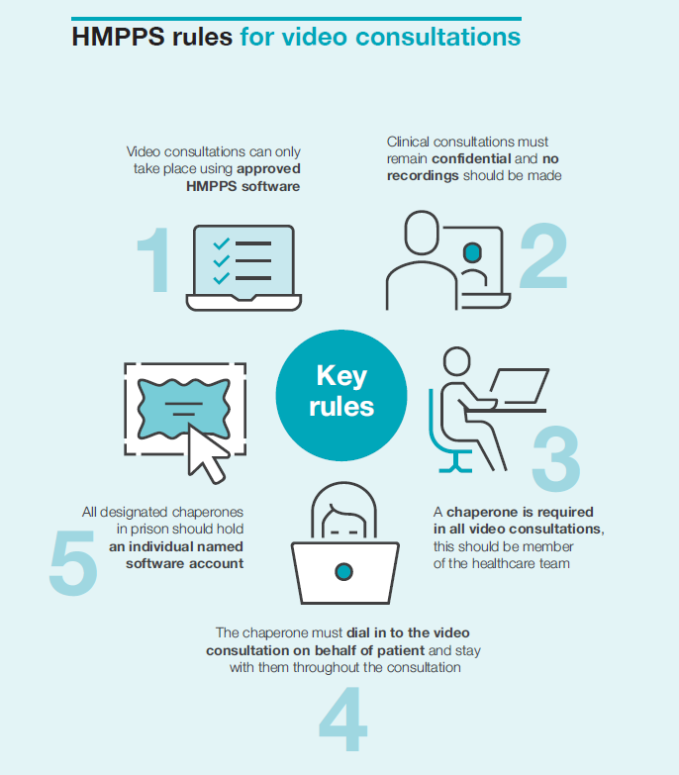

Slide 6
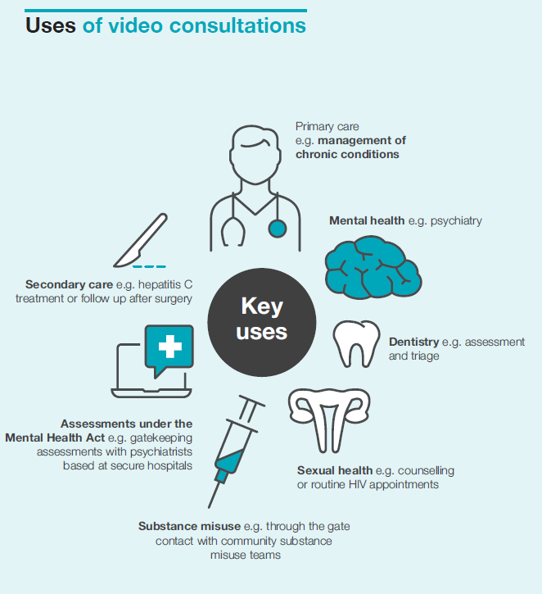

Slide 7





  Prison to remote clinician
  e.g. GP at home/hub
  Prison to psychiatrist at
  secure hospital
  Prison to hospital
  Prison to prison
  Two way- both the prison user and the remote clinician have their own Visionable licence (full client)
  One way – only the prison user has their own Visionable licence but they send a meeting invite to an NHS or approved contact who can join their meeting
Notes:
Types of call
Tablet and PC based calls in prison
Call types include prison to prison, prison to remote clinician, prison to hospital, prison to secure hospital etc
Two way- both the prison user and the remote clinician have their own Visionable licence (full client)
One way – only the prison user has their own Visionable licence but they send a meeting invite to an NHS or approved contact who can join their meeting
Community based ‘clinic’ licence

Slide 8
Audit – criteria for software use
HMPPS may audit…
User names
Call duration
Contacts dialled/invited to meetings
Approved contacts added to the telemedicine system
Accountability and misappropriation
Notes:
Security around software

Slide 9
Joining a meeting as a guest
Confirm with the secure setting healthcare team you would like to do a video assessment
Set a time/date for the assessment
Provide your email address (NHS)
Pre-warn the healthcare team if anyone else needs to take your place for the assessment
Join the meeting on the day!
Notes:
Webcams for pcs also permitted

Slide 10
National Evaluation 2021
- Access
- Quality
- Cost
Chantal Edge
c.edge@ucl.ac.uk / Chantal.edge@nhs.net
Notes:
Webcams for pcs also permitted

