Slide 1
AMHE Learning Set 8
Welcome!
Tuesday 20 June 2023
11:00 – 15:00

Slide 2
Housekeeping
Toilets are located to the right of the lifts on level 1 (men’s and women’s toilets) and the ground floor (gender neutral toilets and disabled toilets).
Lunch will be from 12:40-13:25 and will be served in Room 1.6
Room 1.2is available if anyone needs to take a break at any point to decompress or needs some quiet time
Room 1.1 is available for those who may need to take calls during the day
Female faith room is on the ground floor faith room, male faith room is lower ground floor faith room.

Slide 3

Twitter
We will be live tweeting this event so you may see the QI coaches on their phones or laptops during some sessions. Please also find and follow us @NCCMentalHealth or search for #AMHE.
We encourage use of Twitter and social media to share the work that you are doing throughout the collaborative.
However, we kindly ask you not to tweet people’s names, photographs of people’s faces or their talks without their permission.
Thank you!

Slide 4
Agenda
Time | Item | Speaker
11:00-11:10 | Welcome and introductions | Emily Cannon, Head of Quality Improvement, NCCMH
11:10-11:45 | Celebrating World Refugee Day | Joshua Bailey, Research Insight and Involvement Officer, Solent Mind Wayne Lawrence, Assistant Director, Northamptonshire Healthcare NHS Foundation Trust Dr Yasir Hameed, Consultant Psychiatrist, Norfolk and Suffolk NHS Foundation Trust
11:45-12:10 | Q&A panel | Tom Ayers, Director, NCCMH
12:10-12:40 | Reflecting on progress | All
12:40 – 13:25 | Lunch
13:25-13:55 | Advancing mental health equalities for people who require an interpreter | Jennie Lee Sims, John Macairt & Oisin McAuley , Southern Health and Social Care Trust
13:55 – 14:55 | Coproducing mental health services and support with refugees | Mark Farmer and Meera Burgess, Patient and Carer Representatives, NCCMH
14:55 – 15:00 | Feedback, next steps and close | Matt Milarski, Senior Quality Improvement Advisor, NCCMH

Slide 5
Celebrating World Refugee Day

Slide 6
Advancing Mental Health Equality Collaborative
Southampton Refugee Project
Joshua Bailey, Research, Insight and Involvement Officer
Solent Mind

Slide 7
Choosing this population
Limited local population data
Evidence of higher risk of mental heath problems
  Higher likelihood of poorer mental health than the local population including higher rates of depression, PTSD, and anxiety disorders
  5x more likely to have mental health needs than general population
  61% will experience severe mental distress
  Less likely to receive support than the general population
Southampton City of Sanctuary and close links with other local organisations
Existing mental health and wellbeing support limited

Slide 8
Progress and learning so far
Extensive outreach work with community members and grassroots organisations
    Southampton and Winchester Visitors Group
    CLEAR Project
    Two Saints
    Southampton Action
    Red Cross
Great need for specific trauma informed support
Language barriers and terminology
Cultural competence
Wellbeing of staff and volunteers in the refugee and asylum sector

Slide 9

Achievements so far and next steps
Pilot Wellbeing Support Group from our Mayfield Nurseries Wellbeing Centre
Offering free workplace wellbeing training to local organisations supporting refugees and asylum seekers
Community research
Closer collaboration with community members and local organisations to design more changes
Inviting community members and external staff to our EDI action group

Slide 10
Advancing Mental Health Equality Collaborative
Wayne Lawrence, Assistant Director
Project Lead AMHE in NHFT
Northamptonshire Healthcare Foundation Trust (NHFT)

Slide 11
John
Residing in a hotel for many months following evacuation from Afghanistan
Exhibiting symptoms of mental illness
Family and friends attempting to shield and protect John
Symptoms progressed
Risk profile increased
Family, friends, hotel staff did not know where to seek help
Assessed by mental health services
Reliance on family perspective, observed symptomatology
Referral to CMHT
Within 24 hours, incident – Section 2 – PICU admission – many months in hospital

Slide 12
AMHE – Core Project Group
Wayne Lawrence (Assistant Director NHFT)
Lenea Nyamapfeka (Project Manager/Equalities Lead ICS)
Kirsty Hart (Head of Inpatient Services)
Experts by Experience
Loreen Mawongera (Head of Learning Disability and Autism Services)
Dawn Rosen (Head of Older People’s Mental Health Services)
Kat Gaunt (Service Manager Community Services North)
Justina Bryan (Service Manager Community Services South)
Pauline Nyakatawa (Equality and Inclusion Compliance Manager)
Ifeoluwa Adeniran (CMHT Peer Support Worker)
Arlene Millar (Business Manager)
Aarti Gandesha (QI Coach Royal College)
Executive Sponsor Linda Chibuzor (Director of Nursing, Allied Health Professions and Quality)

Slide 13







WORKSHOPS – Dec 22, Jan 23
Identifying Populations
What local populations experience inequality in outcomes, experience and access to mental health care?
Who is not thriving?
What data is available (formal and informal)
Where is there will and urgency to do something different?
Is there any existing work

Slide 14
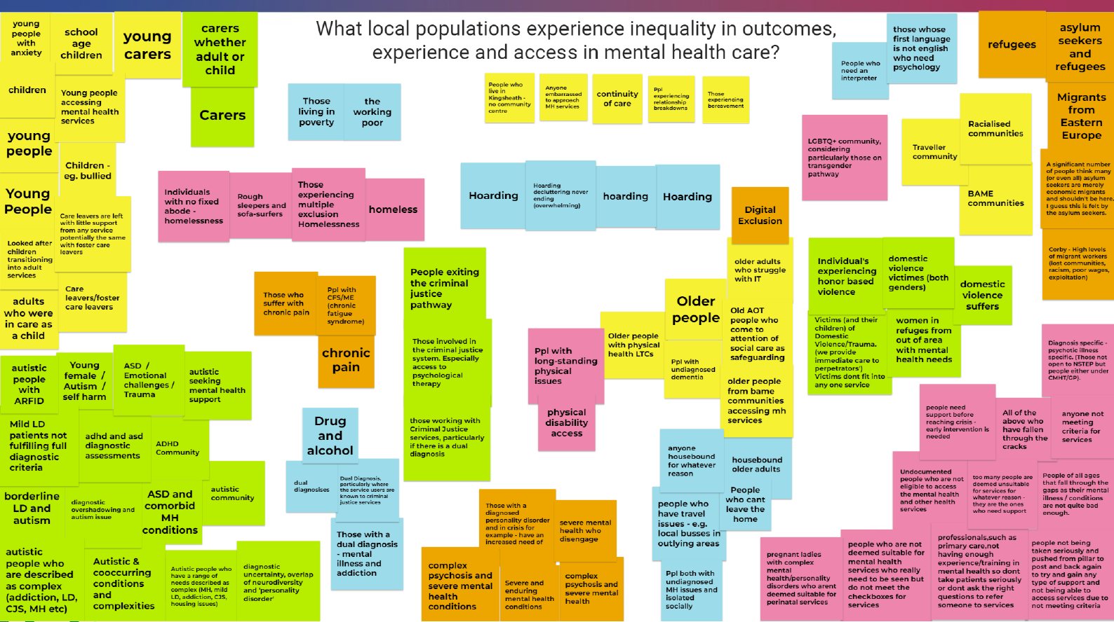

Slide 15
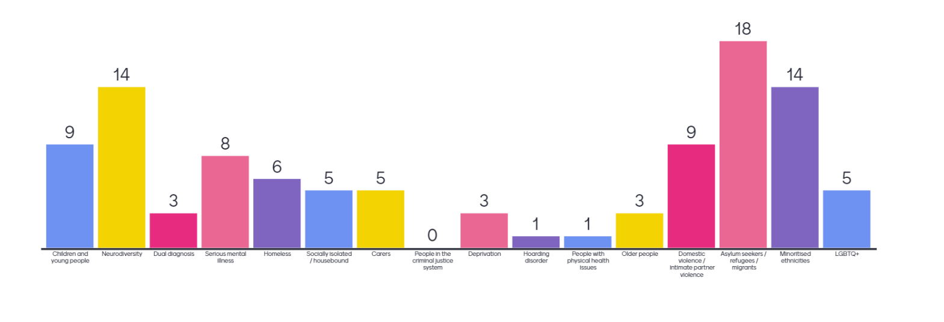

Slide 16
Population Groups for AMHE
Refugees, asylum seekers and migrants
Children and Young People
People who are neurodivergent

Slide 17
Sub group - Refugees, asylum seekers and migrants
NHFT
West Northamptonshire Council
Integrated Care System
Space 2 Talk

Slide 18
3 Part Data Review
Reviewing available data
  What data????????
  Asylum Seekers, Refugees and Resettled People
Engaging with care/support teams
  What services do you currently deliver to Asylum Seekers, Refugees and Resettled People in Northamptonshire? What unmet needs are you aware of?
  Thinking about the with this group (e.g. cultural, logistic), how confident do you feel to provide a service for this group?
  If you were to create or design a new system for this population, what would that be? What would be the key elements in that design?
  What do you think are the existing challenges to engage this group and to provide a service for them?
Engaging with service users/carers

Slide 19
Challenges
Time and space
Financial
Data
Government policy

Slide 20
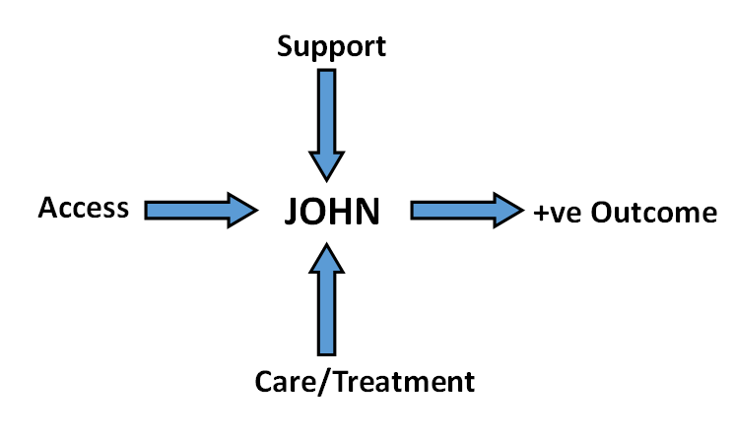
What do we want to achieve?

Slide 21
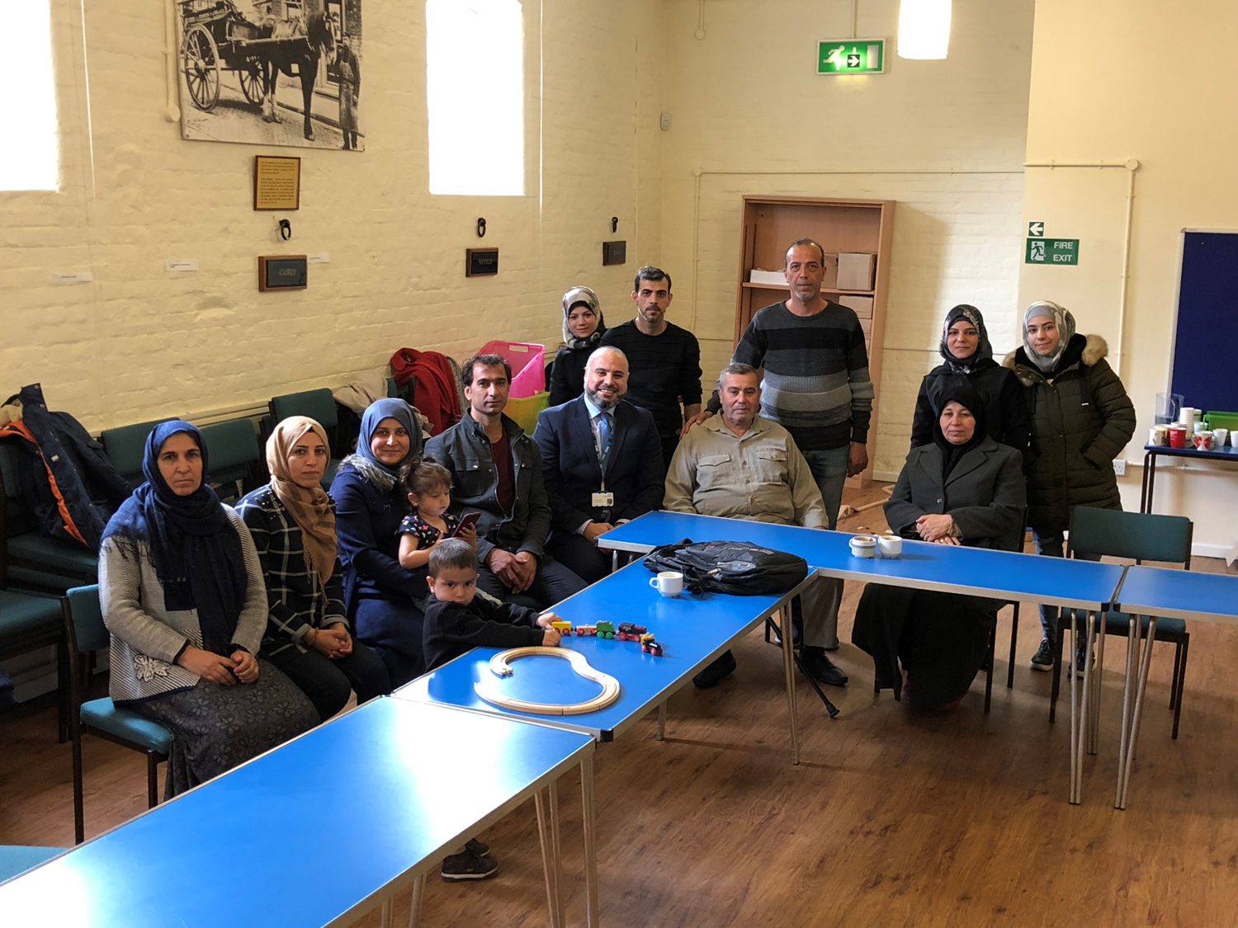
SHIFA: The Asylum Seekers and Refugees Clinic in Norwich, Norfolk:
Challenges and opportunities
Yasir Hameed
Consultant Psychiatrist
Norfolk and Suffolk NHS Foundation Trust

Slide 22
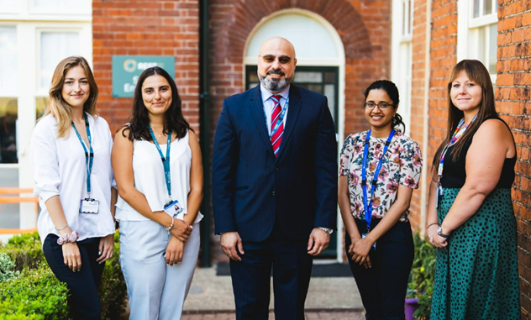
What is the SHIFA clinic?
SHIFA (Supporting Holistic and Integrated Assessment for Forced Migrants)
Part of the Advancing Mental Health Equalities QI Collaborative, which the Royal College of Psychiatrists launched to reduce barriers to accessing mental health services for disadvantaged populations.
Once monthly clinic based at the REST hub in Norwich (the venue is run by the MIND)
One Psychiatrist, one GP (Hannah Fox), two assistant psychologists (Izzy and Eirini) and psychiatric trainees.
Referrals received from primary care, social services (People from Abroad Team), charity organisations, Wellbeing service, inpatient and Community Mental Health Teams.
Referrals for all age groups are accepted

Slide 23

But how did we get there?

Slide 24
My personal experience
I was born in Baghdad, 1978.
Father was in army most of my childhood.
Lived under the Iraq Iranian war (1980-1988), first Gulf war (1991), economic sanctions (1990-2003) and second Gulf war (2003) and its aftermath (until 2005).
Grieved for many relatives and friends (cousin 2004, father 2005, older brother 2006) and many others.

Slide 25

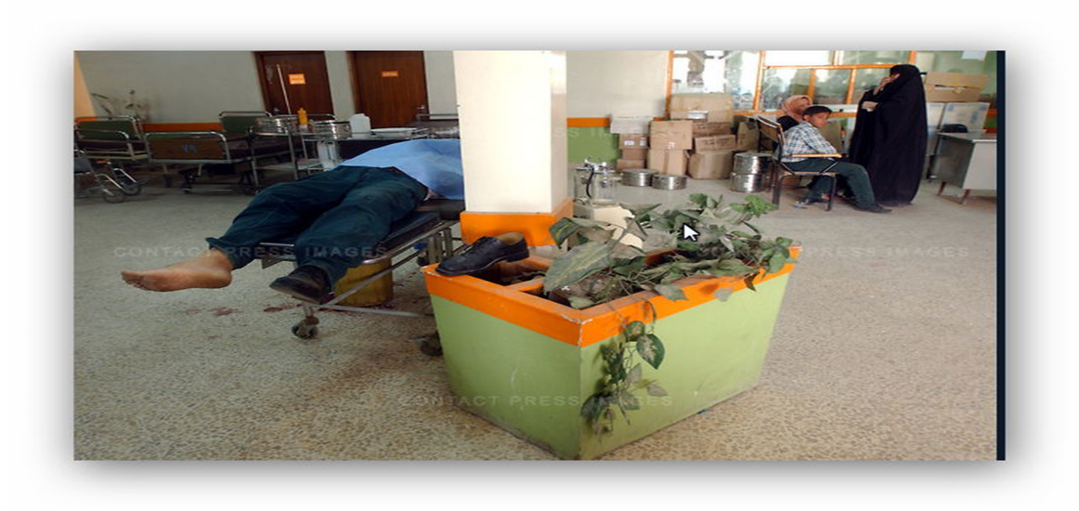
Al Wasiti Hospital, Baghdad: 9th April 2003
“Al Wasiti was a filthy, chaotic place, and, on this chaotic day, the best Baghdad had to offer. It was filled with patients, gun-shot, broken and deathly ill.”
“There was not enough of anything there, neither bandages nor antiseptic nor beds nor doctors.”

Slide 26
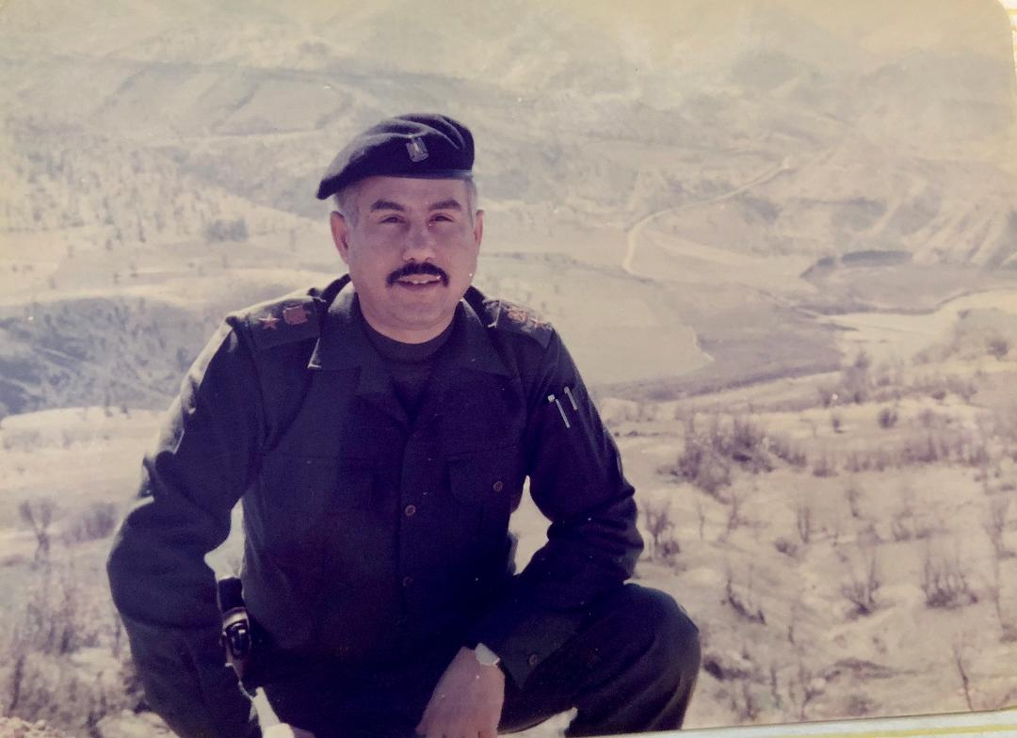
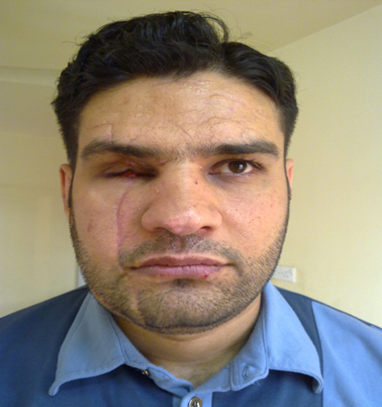
September 2005: My father was kidnapped and killed by Iran backed militia forced in Baghdad. We never found his body.
August 2009: My brother got severe injuries and lost his right eye & developed PTSD symptoms following a terrorist attack on his workplace.

Slide 27
2005-2018
2005: Moved to Yemen and became a refugees
2009: Moved to the UK
2010-2017: Moved to Norwich and completed my psychiatry training.
2018: volunteered at a local charity and started a once monthly clinic to see asylum seekers and refugee patients in partnership with primary care. No formal referral system. No outcomes recorded. No admin support.
2020-2022: Stopped due to COVID-19

Slide 28
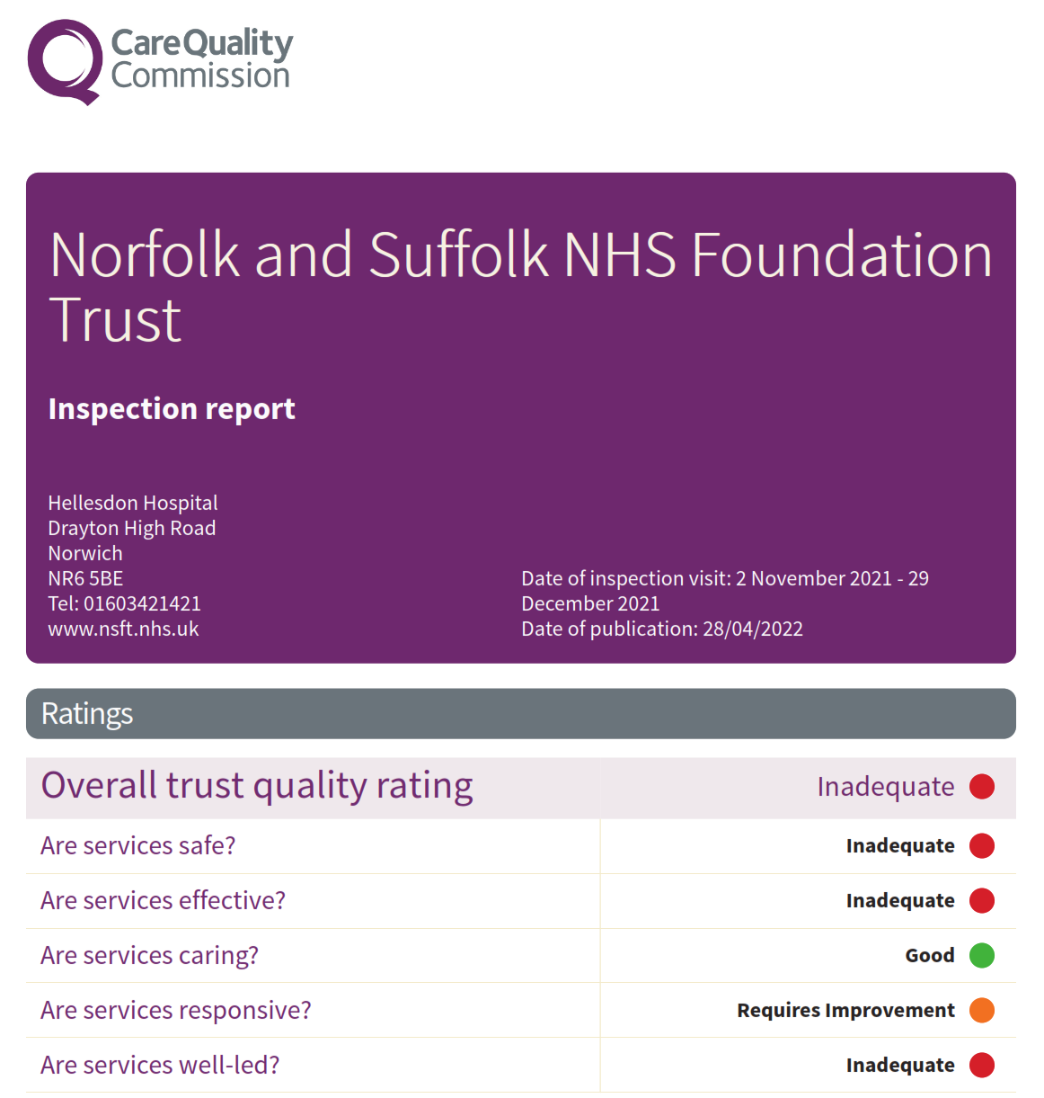
Challenges and opportunities
2021-2022: Many meetings with the Trust leads/primary care leads/charities/other organisations.
Concerns regarding referral pathways/risk assessments/limited resources vs demands
Although the Trust was very supportive, the care of these patients was not seen as a priority or part of the focus of the CQC reports or actions for the Trust to address in order to improve its rating.
No funding was possible, so where would the resources would come from?

Slide 29
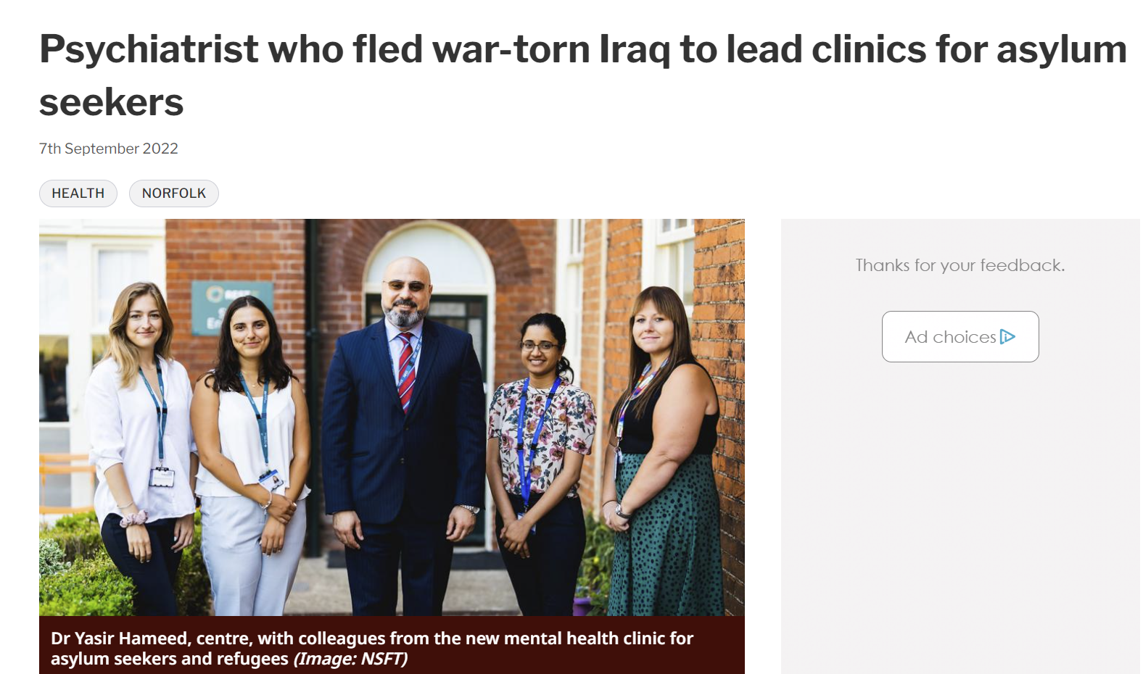
The clinic was eventually launched in April 2022
AMHE collaborative helped to generate a strong will and sustain the motivation to carry on the project.
The AMHE working group brought professionals and service user representatives from various services and backgrounds to support this work and achieve its aims.

Slide 30
Potential MH Specialist Clinic for Refugees and support pathway
Social Prescribing/Community Groups
GP
Community Partner MH Support
Community Partners
Mental Health Specialist Clinic
Wellbeing Services
NSFT teams (including MHLS) and Wellbeing
Secondary Community MH Services
(Self-Referral)

Slide 31
What do we offer?
Holistic: a person centred, trauma informed approach (creating a safe & empowering environment).
Integrated: Improving communication between services and continuity of care
Access to appropriate treatment
Drop in session in hotels where asylum seekers are housed.
Training opportunities.
Offer psychoeducation and awareness about mental health issues, available resources and coping strategies.

Slide 32
Referral criteria
Forced migration history
Any age
Any area in Norfolk
We can’t accept “urgent” referrals
Patients who are in crisis or requires Crisis Team input: we still offer co-working, advice and support.

Slide 33
Why we needed it? (1)
Many asylum seekers and refugees struggle to access mental health services due to various reasons (internal vs external factors).
Compared to local population, they experience higher prevalence of various mental disorders, such as depression and PTSD.
Mental illness can occur before, during or after their arrival to the host country.
Poor housing, separation from family, hostile environment, discrimination and racism are all factors that have major impact on their mental health.

Slide 34
Why we need it? (2)
Mental health services are under unprecedented pressures and find it difficult to clearly identify the needs of these patients.
The standard interventions that mainstream mental health services can be ineffective or even inappropriate for them.
Their difficulties could be seen as “situational”
Many similar initiatives around the world showed that such “specialist” services provide better quality of care and better service-user experience compared to usual mental health services (but more research is needed)

Slide 35
The situation in Norfolk
Over the last few years, Norfolk welcomed thousands of refugees and asylum seekers.
Recently, Norfolk saw increasing number of asylum seekers. Home Office opened three Initial Accommodation (IA) sites in Norwich and one in Great Yarmouth. The approximate number of people living in the hotels is 450.
Initial Accommodation should be offered for only three to four weeks before individuals are moved to dispersal housing. However, we have seen that they have to live there for months.
Asylum seekers in these hotels are given £8 weekly allowance.

Slide 36
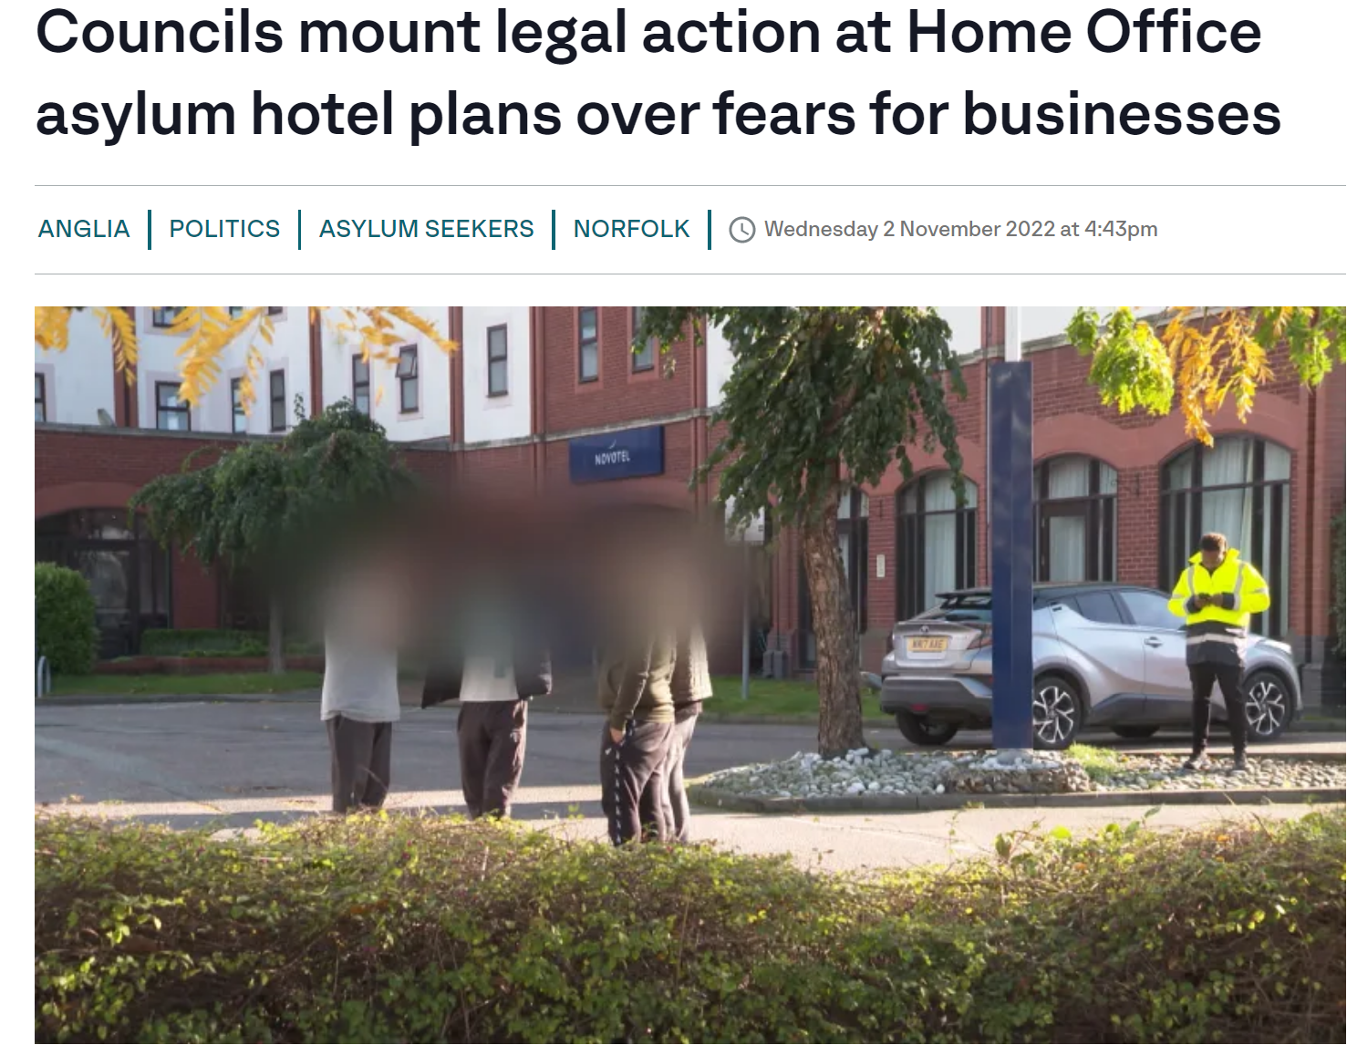
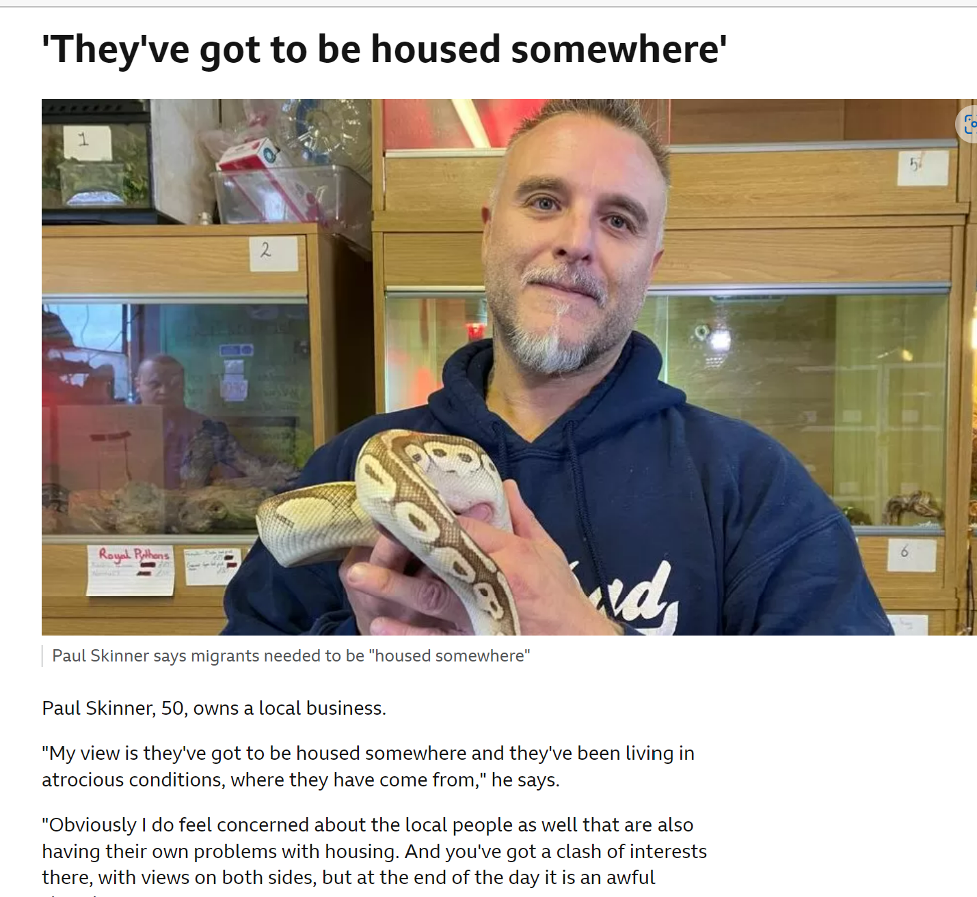

Slide 37
From April 2022-May 2023
Youngest patient was 10 years old, oldest was 59 years old.
We followed nearly half of these patients in the clinic in subsequent visits.
Only 10 patients out of 59 were referred to the CMHTs. None were referred to CRHT. 16 patients were referred to Wellbeing Services. Others were signposted to access support from charities or did not need further input.

Slide 38
From April 2022-May 2023
Feedback from professionals and patients was very positive.
Funding was finally approved for 6 months (June 2023-December 2023)
Recorded videos of consultation will be used in training.
Advocacy and raising awareness locally and also reaching out to politicians and stakeholders.

Slide 39
In critique of moral resilience: UK healthcare professionals’ experiences working with asylum applicants housed in contingency accommodation during the COVID- 19 pandemic. Tomkow L, Prager G,Worthing K, et al. J Med Ethics .11 May 2023. doi:10.1136/jme-2022-10863
Encountering the harms endured by people seeking asylum prior to arrival in the UK and through the UK’s ’Hostile Environment’ caused healthcare staff moral suffering.
They responded to this in several ways, including: (1) feeling grateful for their own fortunes; (2) defining the limitations of their professional obligations; (3) focusing on the rewards of work and (4) going above and beyond usual care.

Slide 40
“Although moral resilience is reflected in much of the data, some participants described how the work caused ideological transformations and motivated challenges to systems of oppression”.

Slide 41
May 2023: Voting for a new name for the service
SHIFA (Supporting Holistic and Integrated Assessment for Forced Migrants)
Shifa means “healing” in Arabic, Turkish, Persian, Urdu, Pashtu and other languages.
The voting included service users and experts by experience and co-production professionals.

Slide 42
Questions and aspirations
How do we build the competence and confidence of clinical and community teams to best support the mental health needs of forced migrants?
How do we ensure sustainability of such initiative?

Slide 43
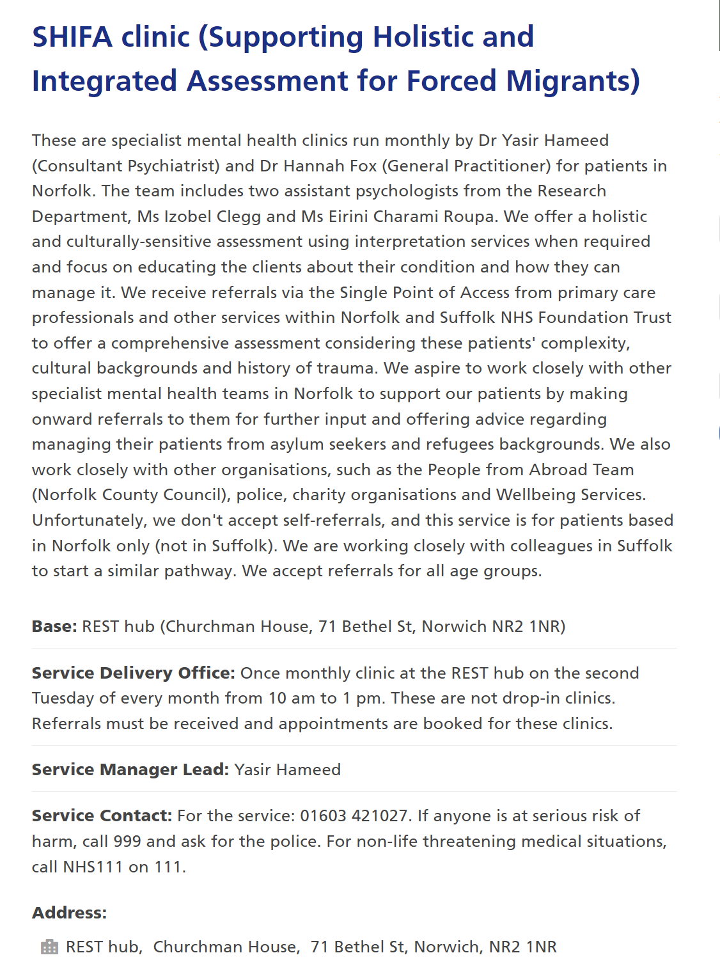
Contact us
https://www.nsft.nhs.uk/community-services/service/asylum-seekers-and-refugees-clinic-at-the-rest-hub-150/
asylumseekerandrefugeeclinic@nsft.nhs.uk
Yasir.Hameed@nsft.nhs.uk

Slide 44

Thank you
شكرا جزيلا

Slide 45
Q&A panel

Slide 46

Reflecting on your AMHE project…
What have been the key achievements of your AMHE project in the last few months?
5 minutes

Slide 47
Reflecting on your AMHE project…
Form groups of 3-4 people, from different teams
Share your achievements with colleagues
15 minutes

Slide 48
Reflecting on your AMHE project…
Go back to your tables and identify the key next steps/actions to take forward to continue to progress your AMHE project
10 minutes

Slide 49

Lunch
12:40 – 13:25

Slide 50


Advancing Mental Health Equalities for People Who Require An Interpreter
Notes:
Introductions
Project team – apologies – Gavin, Brigine
SHSCT – Bluestone mental health inpatient unit
96 bedded unit, adult mental health incl. dementia and learning disability
Our trust has a bigger population than Belfast Trust due to it’s large geographical spread

Slide 51
Aim
By June 2024, all patients admitted to the Bluestone Inpatient Unit who require an interpreting service, will be able to self-refer to Interpreting Services NI and have full access to this during their admission and post-discharge
Notes:
Aim has been modified and refined
Thinking too big initially – we were looking at primary drivers as
Decided it needs to be SMART (Specific, Measurable, Achievable, Relevant, and Time-Bound)
We wished to capture making service users empowered around self-referrals as well as having access for them regardless of where they are located

Slide 52
Background
High quality care is essential
Be more responsive
How people interact
Characteristics such as race/language
Referral rates
Regional “Learning Matters”
Medication error and communication issues
Notes:
High quality care is essential – we need to identify and reduce health inequalities in order to deliver high quality care
Be more responsive – our mental health services need to be more responsive to local population
How people interact – we need to be aware of how people interact with the system especially with access, experience and outcomes
Characteristics such as race/language – there are protected characteristics such as race where English is not the first language
Referral rates – Our Trust has a high referral rate compared to other NI Trusts – we will look at this in next few slides
Regional “Learning Matters” - A recent SAI revealed learning about the need for interpreting service whenever a family member accompanied a patient to hospital and surgery was performed incorrectly
Medication error and communication issues - where a patient who did not speak English was discharged and there was a medication error which was likely the result of patient not speaking English.

Slide 53
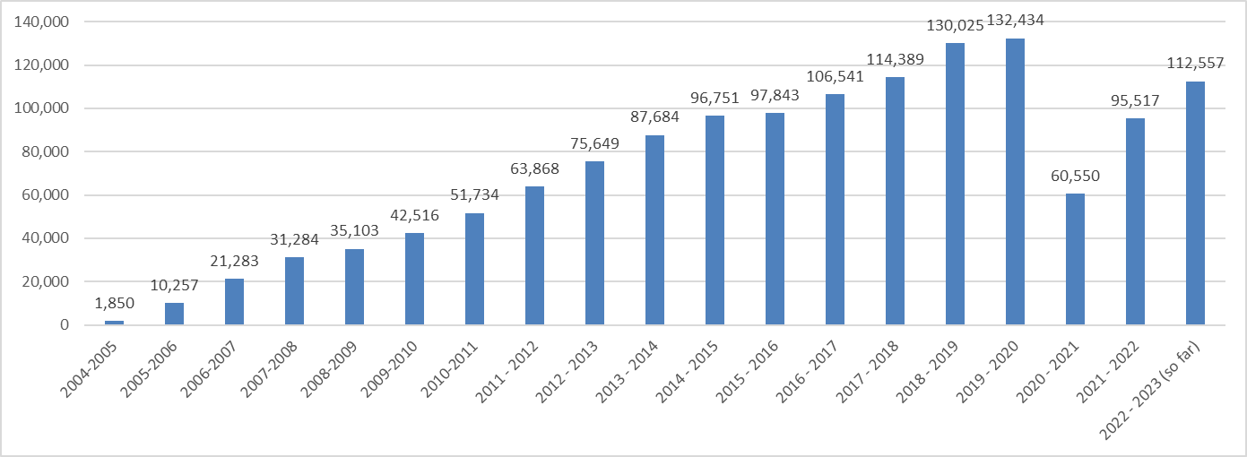
Interpreting Service Requests Per Year (N.I)
Notes:
We can see that referrals have risen steadily over the past 19 years
During the pandemic referrals dropped but are almost back to pre-pandemic levels

Slide 54
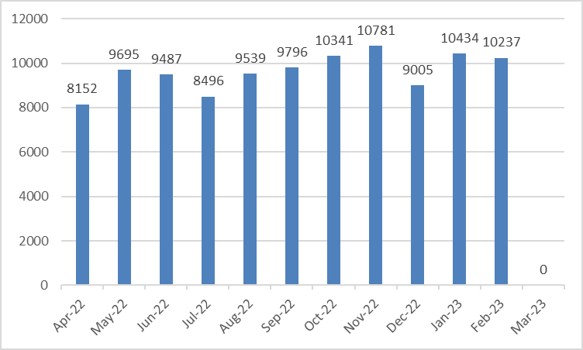
Interpreting Service Monthly Requests 22-23 (N.I)
Notes:
Over the past year referrals have remained steady at around 9-10,000 a month

Slide 55
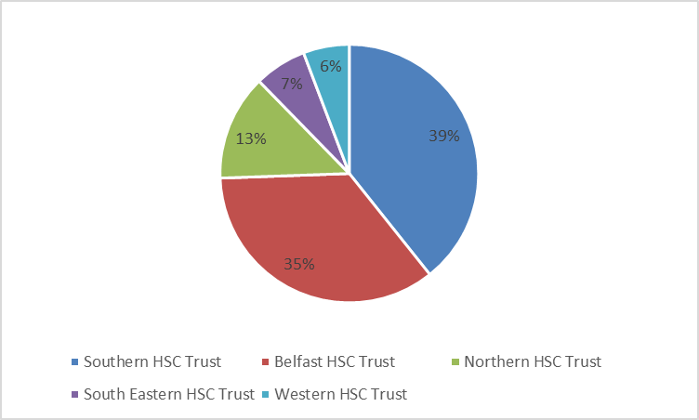
Interpreting Service Requests
April 22-Mar 23
Trust | Requests
Southern HSC Trust | 44219
Belfast HSC Trust | 39570
Northern HSC Trust | 14914
SouthEastern HSC Trust | 7367
Western HSC Trust | 6487
Notes:
Southern Trust is not as densely populated as Belfast Trust yet has a greater population
Our population is about 390,000
Belfast is approx. 360,000
It has the highest numbers of interpreting requests in NI at 39% of requests, more than Belfast at 35% and much more than the other Trusts
We think this is due to numerous ethnic minority populations within the Trust who live and work in our towns

Slide 56
A few Local stats!
Top 10 Languages in SHSCT | Top 10 Users SHSCT
1. Polish | 1. Outpatients
2. Lithuanian | 2. Health Visiting
3. Tetum | 3. Physiotherapy
4. Portugese | 4. Radiology
5. Romanian | 5. Family Intervention Team
6. Arabic | 6. Bluestone Unit
7. Russian | 7. Children & Young People
8. Latvian | 8. NINES B Floor STH
9. Ukranian | 9. Antenatal & Gynae Outpatient
10. Slovak | 10. Acute Services
Notes:
These are our top 10 languages within our Trust population
It would be interesting to hear what other Trust populations comprise as am sure they will vary across the country
The top 10 areas where interpreting services are requested are also listed – Bluestone mental health is 6th
Outpatients is the most common area – this is all outpatients not mental health

Slide 57
Aim
Primary drivers
Secondary drivers
Change ideas
Empower service users to self-refer
Realtime feedback from patient after sessions with interpreters
Patients
By June 2024, all patients admitted to the Bluestone Inpatient Unit who require an interpreting service, will be able to self-refer to Interpreting Services NI and have full access to this during their admission and post-discharge
Patient centred approach
During admission process offer patient choice/preference of interpreter
Patient experience
Promote patient choice
surveys
Staff
staff experience
Promoting interpreting service (poster)
Nursing huddles
Raising awareness/improving engagement
Promoting interpreter service
Interpreting service champions
Ward (Environment)
Communication re: interpreting service
Admin - change to letter
Learning from incidents
Interpreters having debrief with staff post-interpreting session
Safe and Effective Practice
Identifying risk during admission process
Handover during daily safety briefings
Interpreting service
Top 5 languages leaflet/slip
Early psychoeducation for interpreters
QR Code – service user self-booking
Interpreter experience
More interpreters out of hours
Pros/cons of same person– boundary issues
Clear messaging and communication on interpreting service for patients
Notes:
Future - publications

Slide 58
What Did We Do?
Outpatient/Discharge Letter Amendment –
Circulated proposed wording to appointment letter to service area governance groups for consultation
Letter amendment – Inserted ‘Interpreting Services are available, if required, please contact via Telephone No. on receipt of this letter.’
Leaflet/insertion slip – a one page leaflet/slip for wards to be given out upon Discharge at Ward level so a Patient knows that should they require/moving forward into Outpatients that an Interpreter, if required can be sourced. [not agreed/finalised yet until letter is tested]

Slide 59
What Did We Do?
Survey of service users –
Early feedback suggests –
Current communication is good
Times slot – mixed response
Patients unaware of booking process, high reliance on nursing staff
No process visible on ward
No issues with continuity
Example of interpreting service was for detention rights
There are 5 service users on the wards at present

Slide 60


Measures
Uptake of services
  Use ward clerk records to capture all referrals
  incl. referrals made by ward and self-referrals
  How training improves –
  Patient experience
  Interpreter Experience
  Care Opinion

Slide 61

Learning & Next Steps
Await feedback from outpatient letters – letter to be amended and uploaded to electronic notes system. We need to monitor the effectiveness of this. | Have admin staff tick a sheet to say how many patients have requested an interpreter. Review after 3 months?
Service User Experience Surveys – these are currently being distributed by ward staff – will take time to gather in responses | Keep promoting this and review after 3 months
How do we receive feedback from service users post-discharge from hospital? | Link in with community teams and key workers. Keep them on board?
QR Code | Have placed on wards for patients to easily access?

Slide 62

Pixel Buds
Pair of earbuds called Pixel Buds.
Work with its Pixel smartphones and Google Translate app to produce practically real-time translation.
Person talks into their phone and the service user can hear the translation through the earbud.

Slide 63
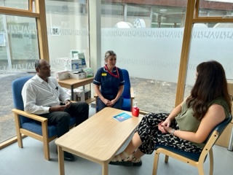
Questions?
Thank You For Listening!

Slide 64
Co-producing mental health services and support with refugees
Mark Farmer and Meera Burgess
Patient and Carer Representatives
NCCMH

Slide 65
Recap
In the last learning set we spoke about relationships within co-production
We reflected on taking risks in co-production and how taking risks can lead to positive change and innovation
We considered if you were enable to take risks in your AMHE work, what the barriers were and how to address them
In today’s sessions we are going to take a look at co-producing with refugees and people seeking asylum

Slide 66
Using the right language is an important starting place- From the UK Refugee Council
The definition of a refugee according to The 1951 United Nations Convention Relating to the Status of Refugees is:
“A person who owing to a well-founded fear of being persecuted for reasons of race, religion, nationality, membership of a particular social group or political opinion, is outside the country of his nationality and is unable or, owing to such fear, is unwilling to avail himself of the protection of that country; or who, not having a nationality and being outside the country of his former habitual residence as a result of such events, is unable or, owing to such fear, is unwilling to return to it.”
In the UK, a person becomes a refugee when government agrees that an individual who has applied for asylum meets the definition in the Refugee Convention they will ‘recognise’ that person as a refugee and issue them with refugee status documentation. Usually refugees in the UK are given five years’ leave to remain as a refugee. They must then must apply for further leave, although their status as a refugee is not limited to five years.
A person seeking asylum
A person who has left their country of origin and formally applied for asylum in another country but whose application has not yet been concluded. Wherever possible, we prefer to describe someone as a person seeking asylum as we feel that the term asylum seeker is dehumanising.

Slide 67


How many traumatic events has a refugee survived in their country of origin?
5 events | 8 events | 13 events
Move to the left | Move to the middle | Move to the right
Notes:
On average, refugees have survived 13 traumatic events in their countries of origin. In other words, only 7% experienced one traumatic event, while 80% experienced six or more traumatic events before they were forced to flee their homes

Slide 68
People seeking asylum are banned from working, how much money are they provided with to live on per day
£7 | £10 | £15
Move to the left | Move to the middle | Move to the right
Notes:
People seeking asylum are provided £7 day by the government to cover costs of basic nescessities

Slide 69
Which one is it?
How many more times likely are refugees to have mental health needs than the rest of the UK population?
Two times | Five times | Ten times
Move to the left | Move to the middle | Move to the right
Notes:
Refugee Council found that you are five times more likely- that’s 500 per cent.

Slide 70
What percentage of refugees seekers experience serious mental distress
20 percent | 44 percent | 61 per cent
Move to the left | Move to the middle | Move to the right
Notes:
2017 UN research 56.6 per cent

Slide 71
These stats are the stark realities of life as a refugee. Research has shown that these stats are where they are because the increased vulnerability to mental health problems that refugees and asylum seekers face is linked to pre-migration experiences (such as war trauma, sexual abuse or discrimination) and post-migration conditions (such as separation from family, difficulties with asylum procedures, financial problems and poor housing)

Slide 72
In groups discuss what the barriers to co-production with refugees are
15 minutes
Notes:
Some barriers:
Preconceived ideas can stop strong relationships from forming
Relationships should be openly explored in a safe space, this could involve a discussion on a person’s experience of using a service or for example, it could include exploring preconceived ideas around what it is to be LGBQT+ experiencing mental health inequality but, you will need to determine the right time to have that conversation
Suspions

Slide 73
In groups discuss what a good mental health support service look like?
20 minutes
Notes:
Some barriers:
Preconceived ideas can stop strong relationships from forming
Relationships should be openly explored in a safe space, this could involve a discussion on a person’s experience of using a service or for example, it could include exploring preconceived ideas around what it is to be LGBQT+ experiencing mental health inequality but, you will need to determine the right time to have that conversation
Suspions

Slide 74
Any reflections? Any questions?
Notes:
Five minutes
In summary
For co-production to be successful, it is essential to have strong relationships between the partners.
First, strong relationships are necessary for effective communication and collaboration. Partners need to be able to openly and honestly share information and ideas in order to make informed decisions and take collective action. Without good communication, misunderstandings and conflicts can arise, leading to delays and wasted resources.
Second, strong relationships foster trust and mutual understanding. Trust is essential for partners to feel comfortable sharing sensitive information and for taking risks together. Mutual understanding helps partners to appreciate each other's perspectives and to work towards a common goal.
Third, strong relationships can lead to increased motivation and engagement among partners. Partners who feel that their contributions are valued and that they have a stake in the success of the project will be more motivated to take an active role in the co-production process.
Finally, strong relationships can also increase the chances of the project being successful. Partners who have a good working relationship are more likely to be able to resolve conflicts quickly, to identify and address problems as they arise, and to adapt to changing circumstances.
In conclusion, co-production can be a powerful tool for creating effective and sustainable solutions, but it requires strong relationships between the partners. Investing time and effort in building strong relationships can lead to more effective communication and collaboration, greater trust and mutual understanding, increased motivation and engagement, and ultimately, more successful project outcomes.

Slide 75
Close
Matt Milarski
Senior Quality Improvement adviser
NCCMH
Notes:
Mention reflection space!

Slide 76
Optional drop-in sessions
Time | Optional drop-in sessions | Room
From 15:00 | AMHE teams Time to catch up with a coach, ask questions, think about your work or do some more planning | 1.7
 | Reflecting on the day An invitation to talk, share and reflect on the day itself or any of the topics explored | 1.1

