Slide 1
Good morning and welcome to today's National Learning Session.
We will give everyone a couple of minutes to join and start shortly.
Notes:
Ask people to introduce themselves in the chat

Slide 2
Culture of Care
National Learning Session
Monday 7 July, 10:00 – 13:00
Notes:
Ask people to introduce themselves in the chat

Slide 3

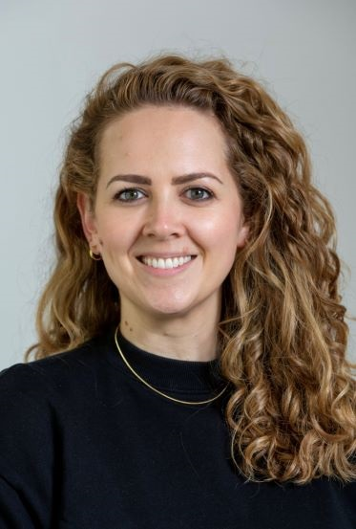
A warm welcome and housekeeping
Matt Milarski & Emily Cannon
Heads of Quality Improvement, NCCMH
Notes:
Acknowledge change of topic. Race equity session now 30th October.

Slide 4
Housekeeping
Please mute your microphone unless you are speaking.
We encourage you to have your cameras on.
We will be recording today's session.
If you would like to ask a question or leave a comment, please use the chat function. We will also ask for contributions via menti, details of which will be shared later.
If you experience any technical difficulties, please email: cultureofcare@rcpsych.ac.uk

Slide 5


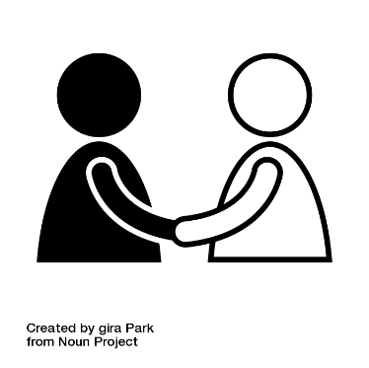



How we want to work together
Collaborative learning – Make the most out of the session, whatever that looks like for you.
Respect privacy – Protect carefully the privacy of the storyteller. Ask what parts, if any, you can share with others.
Approach with kindness and curiosity – We’ve all been through stuff so let’s look after each other in this space.​
Diversity of views – respecting different viewpoints and experiences and being okay with sometimes disagreeing.
Language is important – If you want to improve culture, the way you speak to and about the people around you needs to support the building of trusting relationships.
Be kind to yourself – take breaks if needed, use our support space.

Slide 6

Support Space
On-Call Support Space Facilitator: Ros Warby
Join at any time:
Join the meeting now
Meeting ID: 369 376 923 290 3
Passcode: Wc6L7FD2
The link to the support space will also be available in the chat.

Slide 7
Today
Time | Item
10:00 – 10:10 | Welcome & Housekeeping
10:10 – 10:50 | Culture of Care Programme Recap
10:50 – 11:20 | Applying CofC standards across all levels of your organisation (Standards 1 – 4)
11:20 – 11:30 | Break
11:30 – 12:00 | Applying CofC standards across all levels of your organisation (Standards 5 – 8)
12:00 – 12:30 | Applying CofC standards across all levels of your organisation (Standards 9 – 12)
12:30 – 12:40 | Support offer for organisation-level element
12:40 – 13:00 | Q&A
13:00 | Close

Slide 8
Culture of Care Programme Recap
Matt Milarski & Emily Cannon
Heads of Quality Improvement, NCCMH

Slide 9
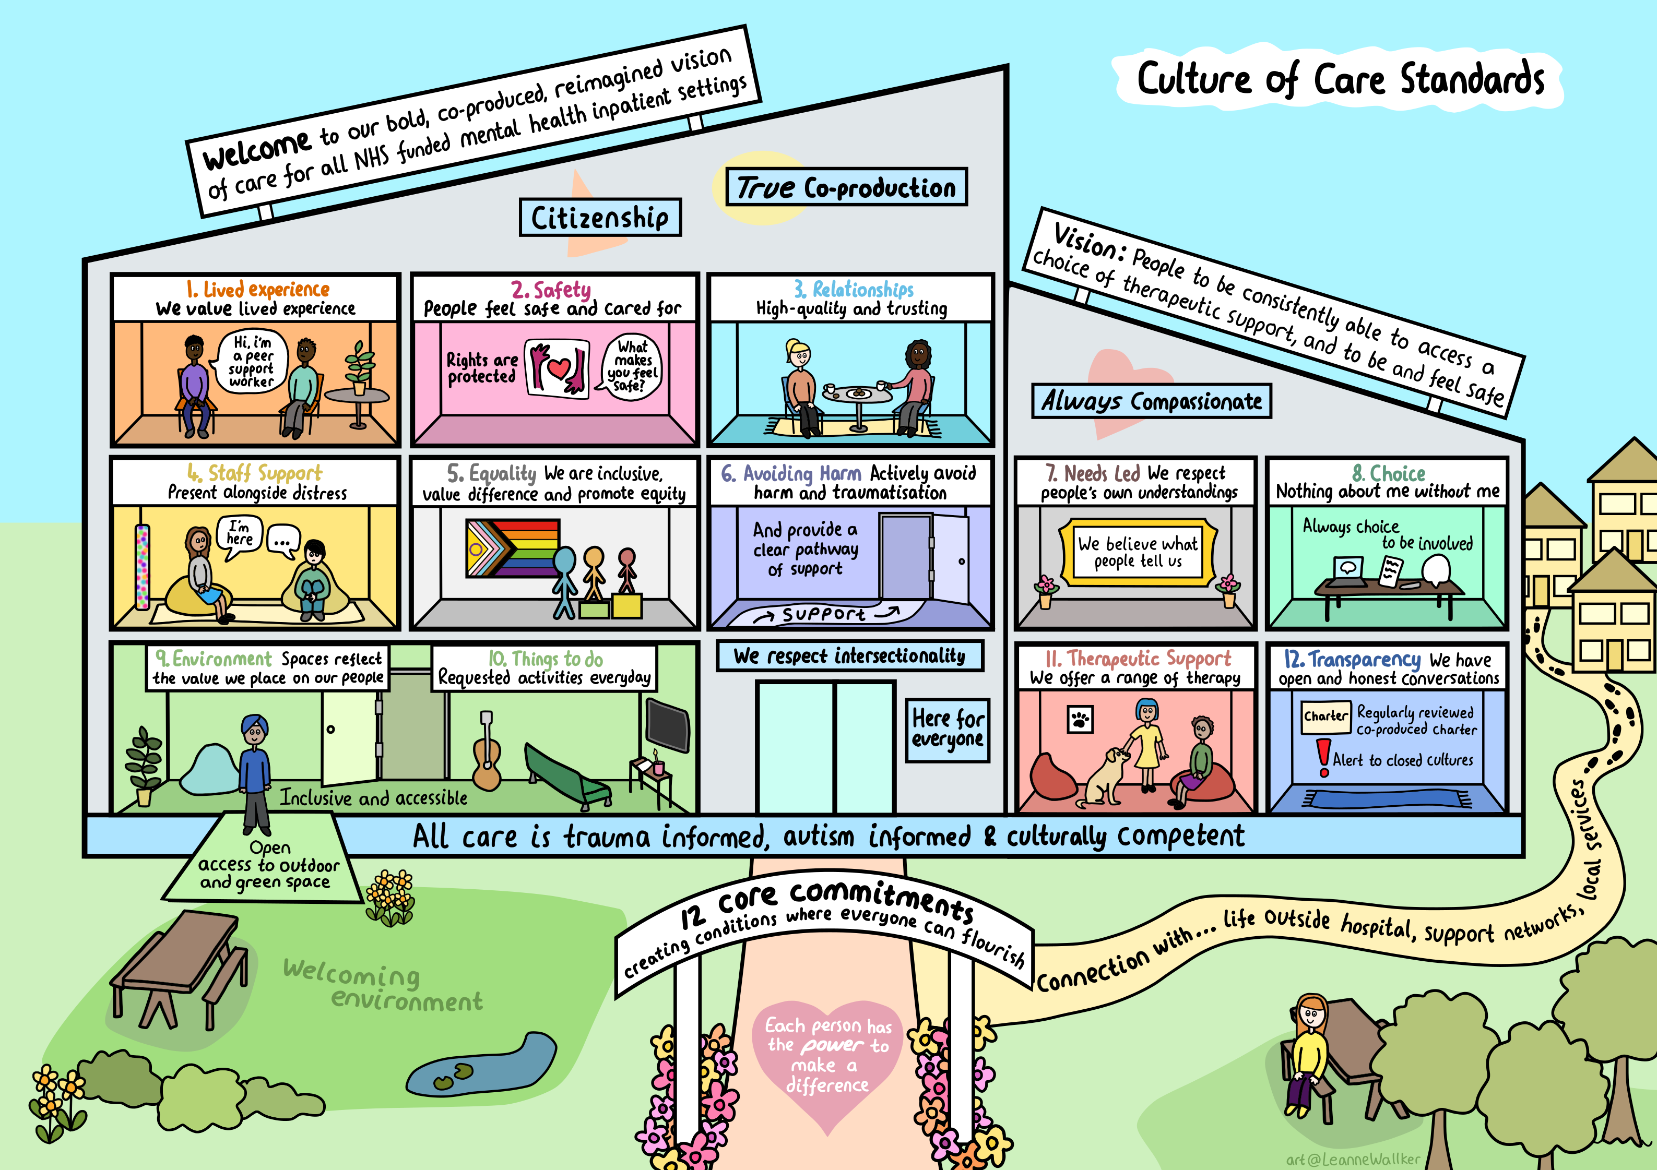
Culture of Care Standards
Illustration by Leanne Walker

Slide 10
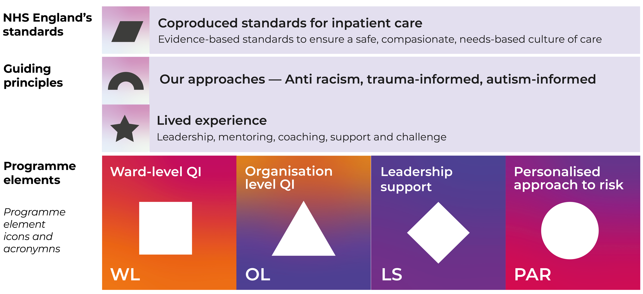
Culture of Care – programme overview

Slide 11
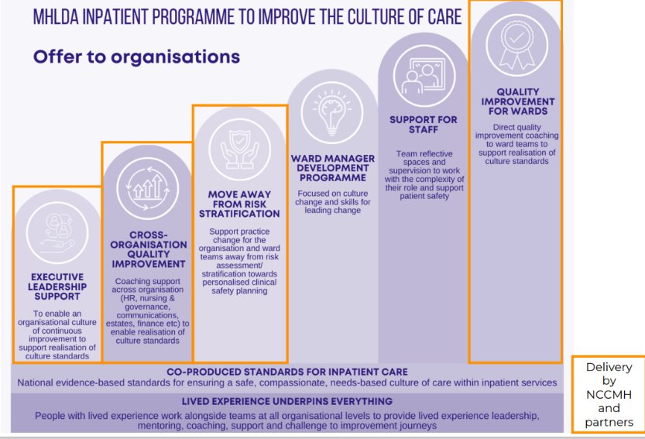
Culture of Care – offer to organisations

Slide 12
CofC Data Update

Slide 13
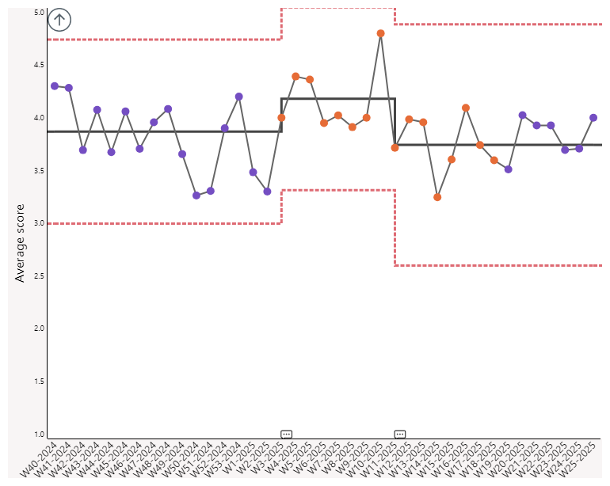
CARE measure over time

Slide 14
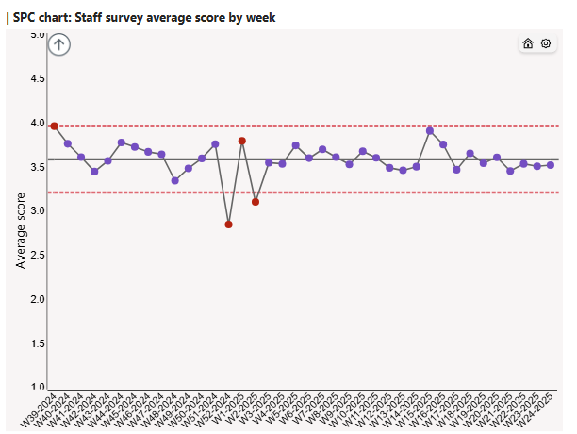
Staff survey over time

Slide 15
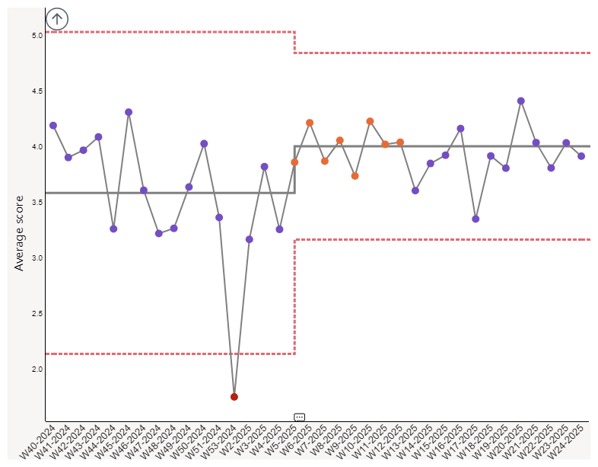
Patient experience over time
Open in Power BI CofC Dashboard Data as of 13/06/25, 13:24 Filtered by Average of Score (is not blank), Form_Name (is Patient Experience Survey)

Slide 16
Culture of Care Standards
Illustration by Leanne Walker

Slide 17
A few examples

Slide 18

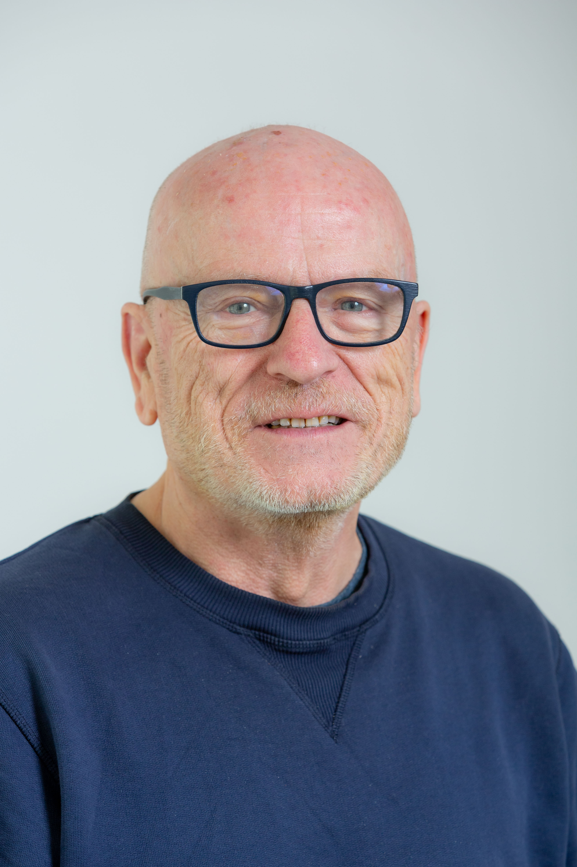

Exploring the CofC standards through an organisational lens
Sal Smith (Head of Lived Experience, NCCMH)
Brendan Stone (Leadership coach, NCCMH)

Slide 19
Organisational support
An element of CofC that perhaps has not been tested in other QI initiatives in MH.
An opportunity to embed the standards and equity principles in the structures that exist between ‘ward and board.’
Support sustainability of the changes and good work happening across wards.
Opportunity for corporate teams, clinical teams, leaders and managers, people and families to come together reflect and connect.

Slide 20
Challenges/barriers;
Things that we have heard make it difficult to embed the standard at ward level that perhaps sit outside the control of the ward team.
Organisational support for this standard
Suggestions for change ideas that might happen across an organisation or be led by a corporate team that might support the embedding of the standards. Food for thought...
These are just suggestions, would not work everywhere and not exhaustive lists. We also recognise that a lot of these suggestions take time.
Mentimeter
We will be asking for your thoughts about organisational support via menti after discussing 4 standards. Opportunity to start generating ideas ahead of the organisational intervention.

Slide 21
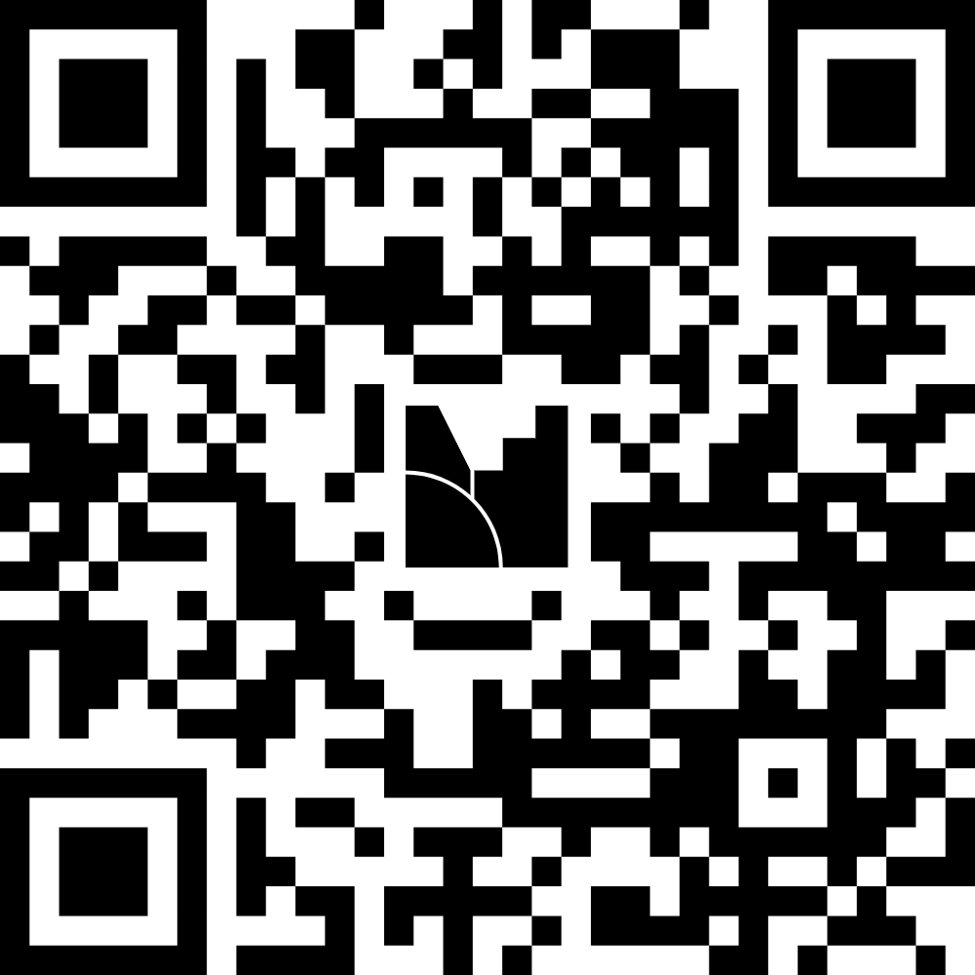
Q&A
What support do you need from your organisation to embed standards 1-4?
What does your organisation do well in relation to standards 1-4?
Standards
1.Lived Experience
2.Safety
3.Relationships
4. Staff Support
https://www.menti.com/alfcx2ghzcq9

Slide 22
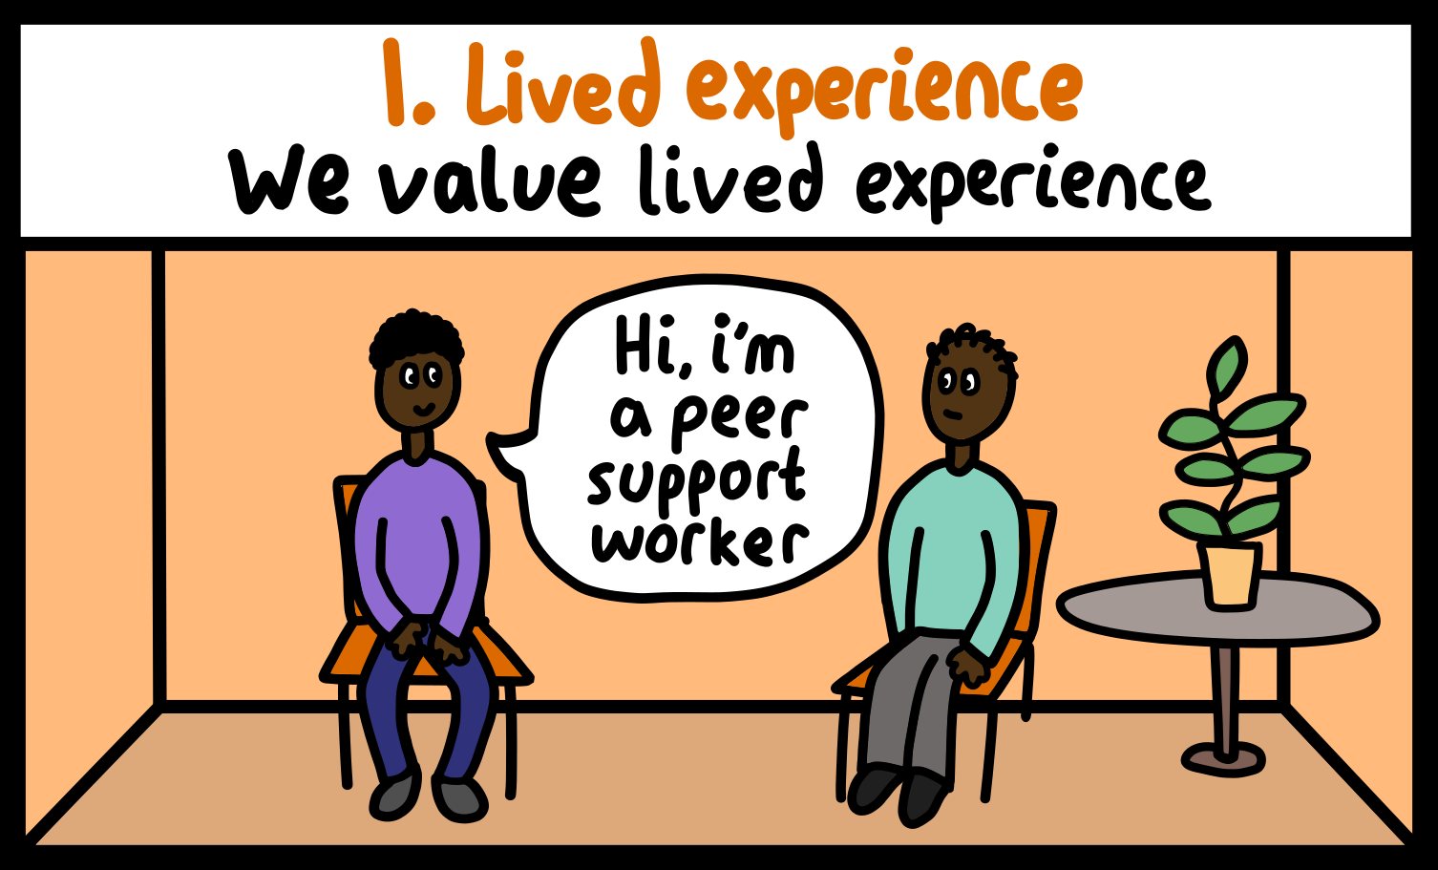
Lived Experience
All patients are supported to have a voice in their care
All patients’ experiences are systematically measured, valued and used to improve care
Paid peer workforce at all levels are an integral part of the multidisciplinary team (MDT)
Lived experience leadership roles are at all levels of the organisation
Lived experience representative of the service type and local community is embedded in service design, quality improvement, governance and oversight
Infrastructure is in place to support people with lived experience in these roles, and designed by people with lived experience

Slide 23
1. Lived Experience
Challenges/barriers
Not always understood or valued
Fear of sharing power and responsibility
No infrastructure to support paid lived experience roles.
Lack of investment in lived experience roles
Suggestions for organisational change....
Investment in lived experience/peer leadership roles at all levels including in corporate teams.
Investment in peer roles on every ward, peer leadership in every hospital.
Robust payment policy for coproduction activities.
Trauma informed HR policies to support LE roles to thrive (and benefit everyone)
Training for LE/peer roles
Meaningful support and supervision for LE/peer roles
Notes:
Lived experience not valued or understood
No infrastructure to support paid lived experience roles ( training, recruitment, payment, support, supervision, career progression etc)
Lack of investment in lived experience roles

Slide 24
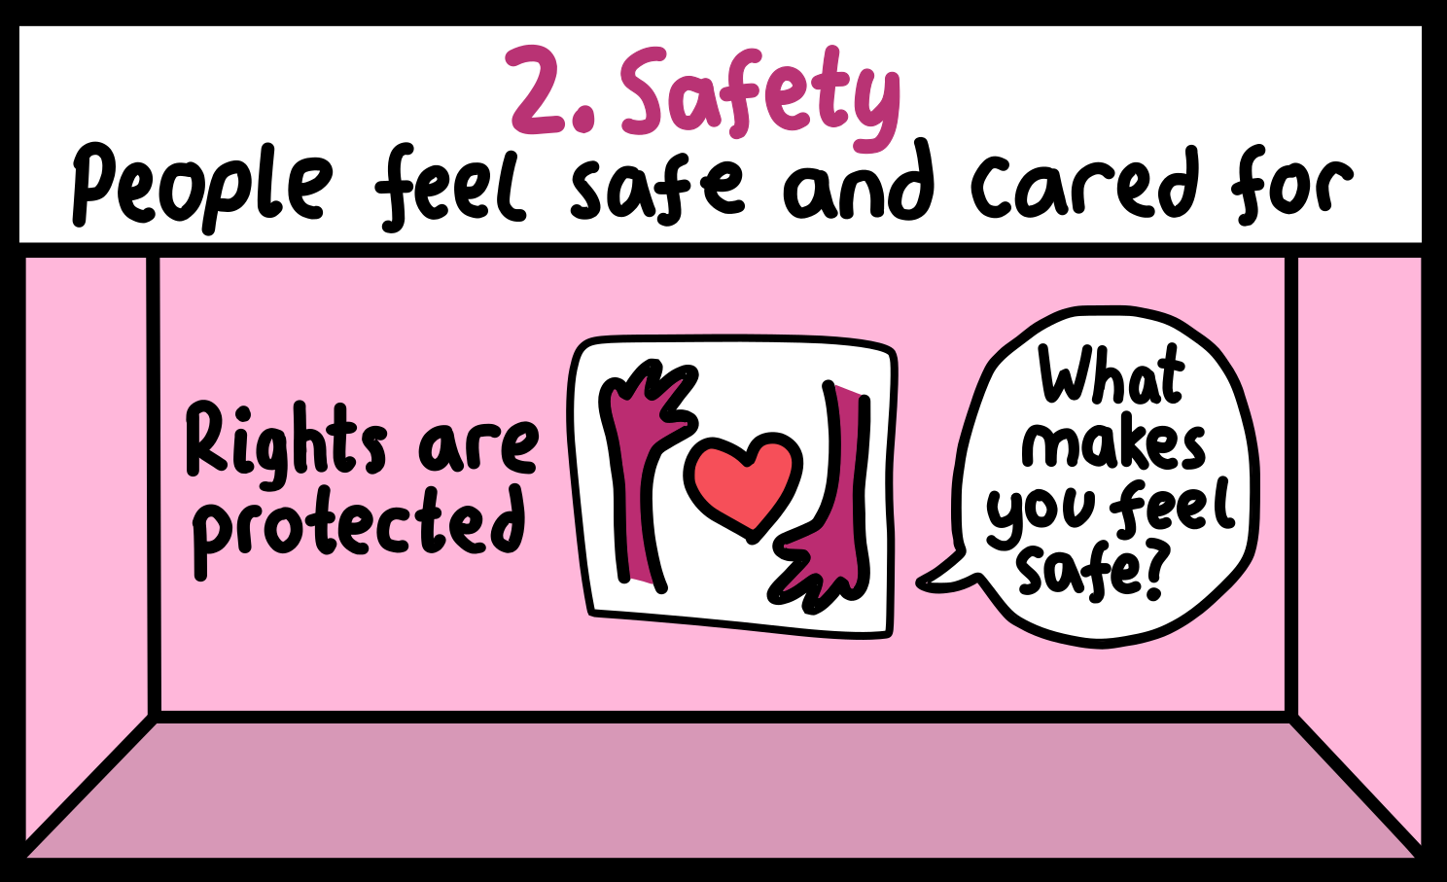
2. Safety
All people (patients, staff and visitors) feel safe on the ward
We respect and protect people’s civil and human rights
Staff prioritise building therapeutic relationships to support patient safety
People always receive a compassionate response when they feel unsafe
The approach to safety is relational
People’s mental health and physical health needs are understood and met

Slide 25
2. Safety
Challenges/barriers
Staffing levels
Fear of litigation, losing professional registration
Impact of coroners & regulatory bodies
Organisational approach to risk management and recording systems that mandate a RAG rating approach
Staff not feeling trained or supported to provide relational safety
Action planning culture
Suggestions for organisational change....
Risk assessment policy aligned to safety standard
Ward spaces designed to promote relational approaches not act as barriers.
Compassionate responses to distress prioritized in recruitment and staff training.
Aligned approaches to responding to incidents within nursing and governance and exec team.
Organisational leadership development to promote relentless positive regard to patients and curiosity about how to prioritise patients feeling safe.
Notes:
Fear of litigation, losing professional registration
Organisational approach to risk management including risk assessment policy
Staff not feeling trained or supported to provide relational safety
When something goes wrong there is a pressure to take action. This results in an action planning culture rather than a relational approach.
Impact of coroners, regulatory bodies etc
Staffing levels
Reporting and recording systems that mandate a RAG rating approach
Risk assessment policy that does not require stratification of risk to self but promotes a personalized approach to safety including a formulation or narrative approach.
Ward spaces designed to promote relational approaches not act as barriers.
Compassionate responses to distress prioritized in recruitment and staff training.
Changes to how incidents are responded to in nursing and governance, model prioritising how to support all people feel safe. Move away from tasks that offer false reassurance that things are safer.

Slide 26
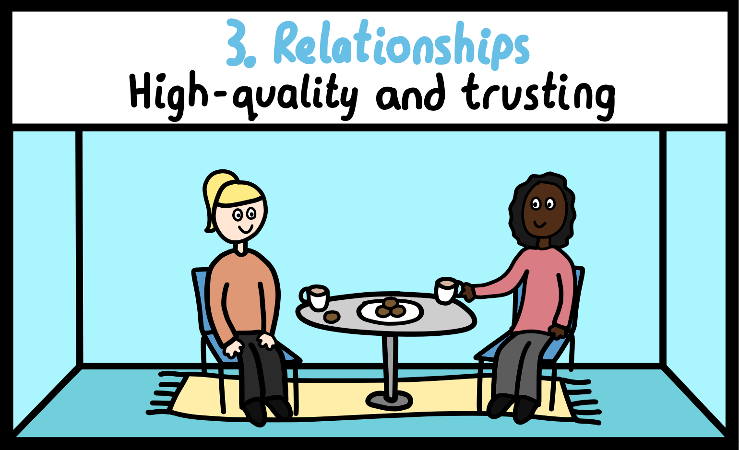
3. Relationships
Staff take the time to get to know the people on their wards and build a trusting relationship with them
Staff are competent in building relationships with different people and responding compassionately to extreme states of distress
Staff understand and respond to different individuals’ needs, for example with reasonable adjustments
The ward builds and maintains consistent relationships with people’s chosen support network
People and families feel care is culturally competent and meets people’s diverse needs
The organisation supports staff to protect and prioritise the therapeutic relationship
The organisation supports the development of healthy team dynamics that positively impact on patient care and patient experience

Slide 27
3. Relationships
Challenges/barriers
Staffing levels & mix
Staff training & support
Performance reporting/audits
Relationships through the management structure - what is modelled and expected
Focus on tasks, interventions and productivity
Suggestions for organisational change....
Measuring what matters.
Recognition of where staff do this well, accountability where its not done well.
Consider policies that get in the way of relationships
Stability of staff team
Staff trained in how to be alongside people in distress
Compassionate/relational leadership
Continuity of care; models that support in reach of community, who knows the person.
Review need for all ward paperwork, including audits and checks.
Consider ward sizes and whether number of beds impact on patient safety.
Notes:
Performance reporting/audit
Relationships through the management structure including exec- what is modelled and expected
Focus on tasks/interventions/productivity moves away from relational approach
Staffing levels vs ward size/acuity/no of tasks- staff do not have the time to be with patients
Staffing mix- peer workers/social workers/therapists/benefits and housing workers/vcse etc would give opportunity for more connections
Staff not trained in the importance of building relationships and ‘being with’ as the primary task or not trained in how to do that alongside people in acute distress/ traumatised/ neurodivergent people/ culturally competent way
Measuring what matters and reducing task based measurement. Performance data to prioritise patient and staff experience and time to care.
Recognition of where staff do this well, accountability where its not done well.
Consider policies that get in the way of connection and relationships eg Oxevision, body warm cameras, staff policing smoking etc
Stability of staff team- how do safe staffing approaches prioritise stability of teams.
Staff trained in how to be alongside people in distress eg Open Dialogue training. Staff trained in regulation/ co-regulation
Compassionate/relational leadership
Continuity of care-policies that support in reach of community, who knows the person. Peers across whole pathway and follow person.

Slide 28
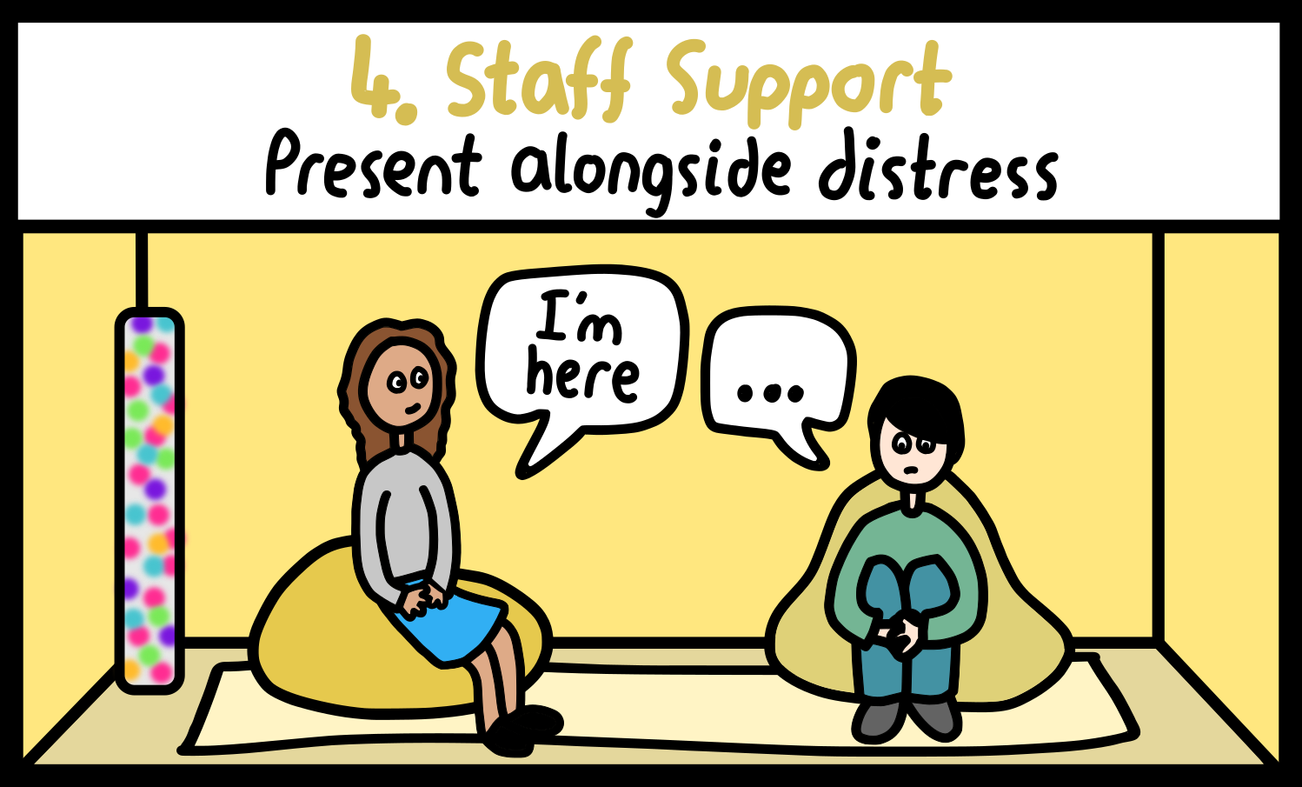
4. Staff support
Staff have the practical and emotional support they need to remain compassionate, understanding and emotionally available. This is evident at every level of the organisation and underpinned by HR policies
Ward leaders have the skills and training to foster a compassionate culture on the ward
Freedom to speak up systems are in place for staff to raise concerns and be heard
Staff experience is systematically measured and used to improve care
Reflective practice is mandatory for all staff providing care on the ward, regardless of role
We have enough skilled staff on the ward to deliver safe and therapeutic care
Staff know spending time with patients is a measurable priority, and that administrative tasks are never prioritised over providing compassionate care

Slide 29
4. Staff support
Challenges/barriers
Staffing levels
Shift patterns/ not having supernumerary time
Stigma about accessing support- being seen as weak and not able to job well
Staff not feeling safe enough to acknowledge negative feelings towards patients and for that to be held alongside prioritising care for patient
Suggestions for organisational change....
Reconsider 12-hour shifts.
Organisational modelling- how are staff responded to in a compassionate way.
How trauma informed, autism informed and culturally competent are staff well-being and sickness policies.
Rota planning to enable reflective spaces.
Separate management supervision and clinical/reflective supervision
Staff reward and recognition based on patient feedback.
Invest in staff having one paid for meal per shift with a policy that staff eat with patients

Slide 30
Q&A
What support do you need from your organisation to embed standards 1-4?
What does your organisation do well in relation to standards 1-4?
Standards
1.Lived Experience
2.Safety
3.Relationships
4. Staff Support
https://www.menti.com/alfcx2ghzcq9

Slide 31

Break
11:20 – 11:30

Slide 32
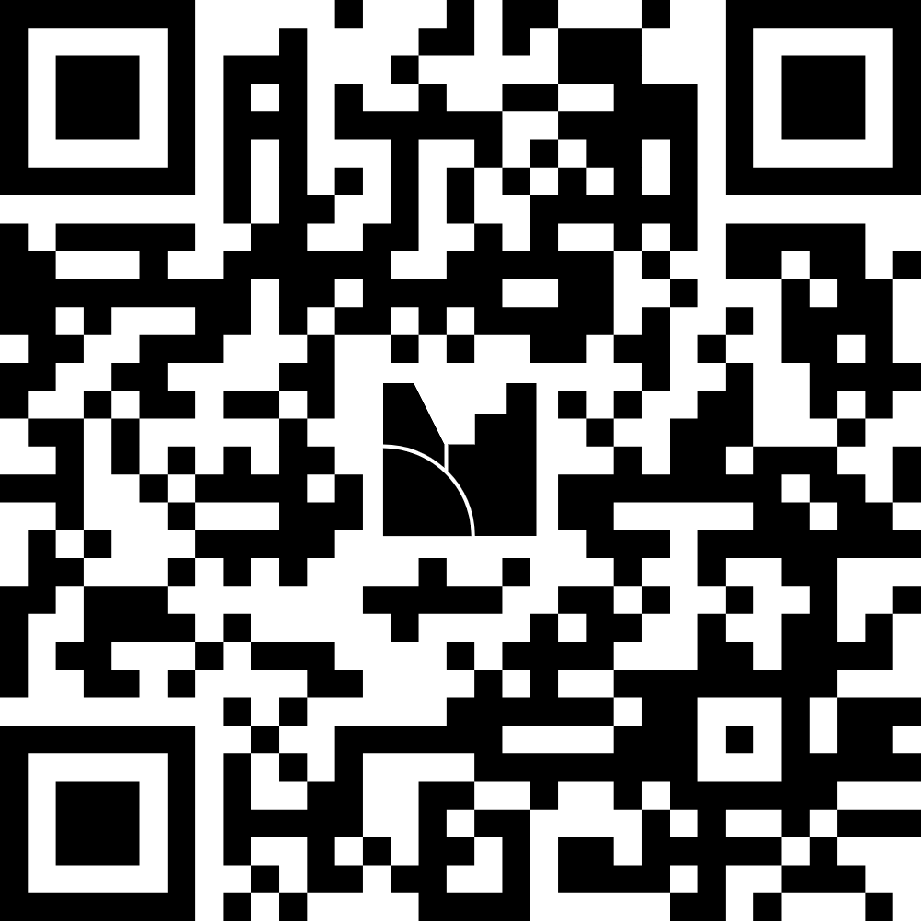
Q&A
What support do you need from your organisation to embed standards 5-8?
What does your organisation do well in relation to standards 5-8?
Standards
5.Equity
6.Avoiding harm
7.Needs led
8.Choice
https://www.menti.com/alh3gycmcseg

Slide 33
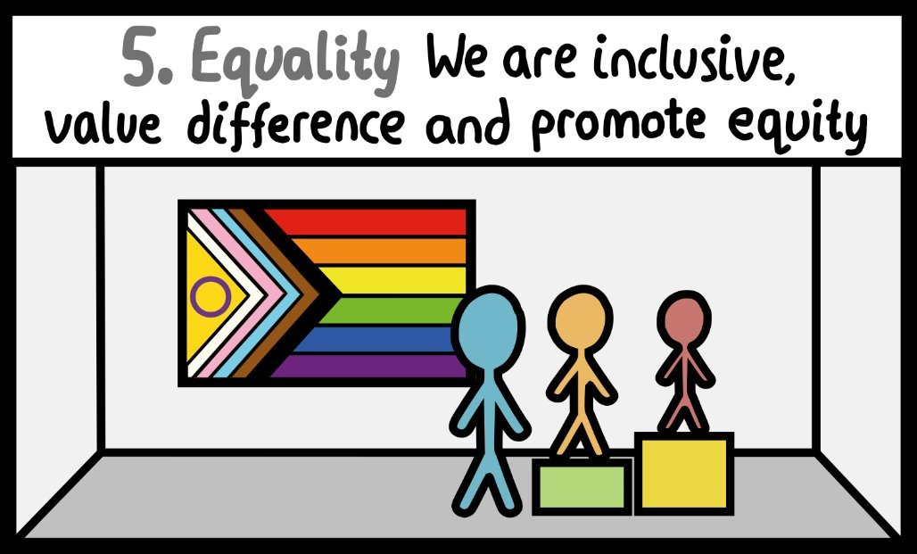
5. Equity
The organisation understands its local population and takes action where certain groups are over- or under-represented in services. And where outcomes for particular groups are poor, we take steps to mitigate these and share learning
Patient experience and outcome measures are captured and analysed by protected characteristics (including for levels of restrictive practice)
The organisation fosters connections with local community services, VCSE providers and other statutory organisations to take a collaborative approach in identifying and addressing health inequalities across the whole care pathway

Slide 34
5. Equity
Challenges/barriers
Inherent bias and own unexamined privilege
Having the time and capacity to understand different people and their needs and make equity a priority
Policies that have embedded systemic inequality
Poor quality data
Uncertainty about what changes to make to drive improvements
Suggestions for organisational change....
Diversity of workforce especially leadership posts
Resource and leadership to roll out and embed PCREF
Collection, understanding of and response to data.
Procurement and contracting to support investment in small local community groups and user led organisations.
Analyse inpatient pathway through equity lens
Comms team to reflect on how they engage with communities under-served

Slide 35
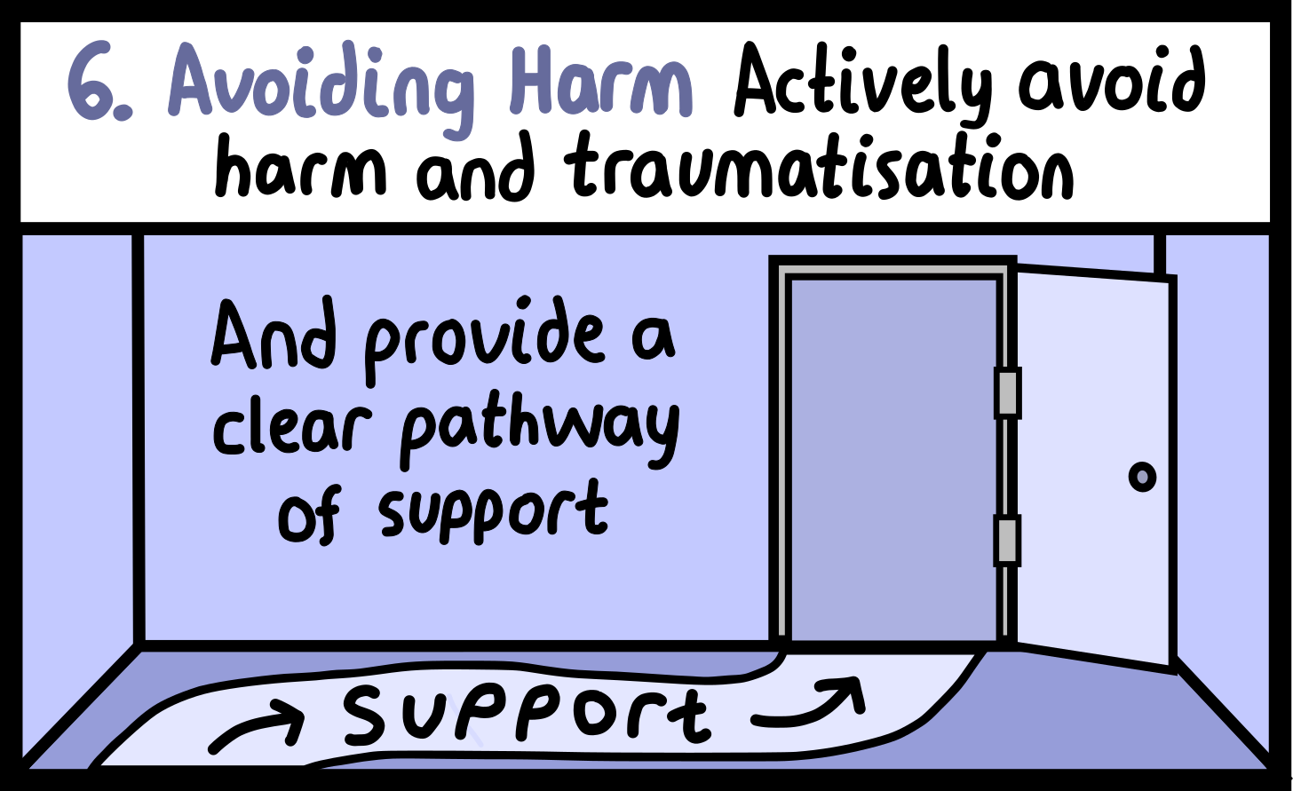
6. Avoiding harm
We acknowledge and avoid the harm and traumatisation that can occur when people are in hospital.
There is a clear pathway of support for patients who have experienced abuse/harm, including access to advocacy
We understand that restraint and coercion is harmful and we only use it as a last resort; that includes the use of blanket restrictions
We do not use mechanical restraint
Our inpatient services meet the needs of trauma survivors in crisis
We are trans*-accessible and inclusive

Slide 36
6. Avoiding harm
Challenges/barriers
Staffing skills/experience to respond to potential harm in a relational way
Zero tolerance type policies
Fear of creating a blame culture and wanting to protect staff can lead to closed culture.
Difficulty to engage with patients and families who are angry, hurt or who want justice.
Current impact of high court ruling for trans community.
Suggestions for organisational change....
Commission a harmed patient pathway
Freedom to speak up guardian for patients
Lived Experience role in complaints team
Patients can report their own incident- IT
Commission help from outside the organisation to help to build relationships with harmed patients and families.
Close inpatient services that are not in line with the commissioning framework.
Work with Local Authorities to ensure inpatients can access IDVA services - eg regular drop ins.

Slide 37
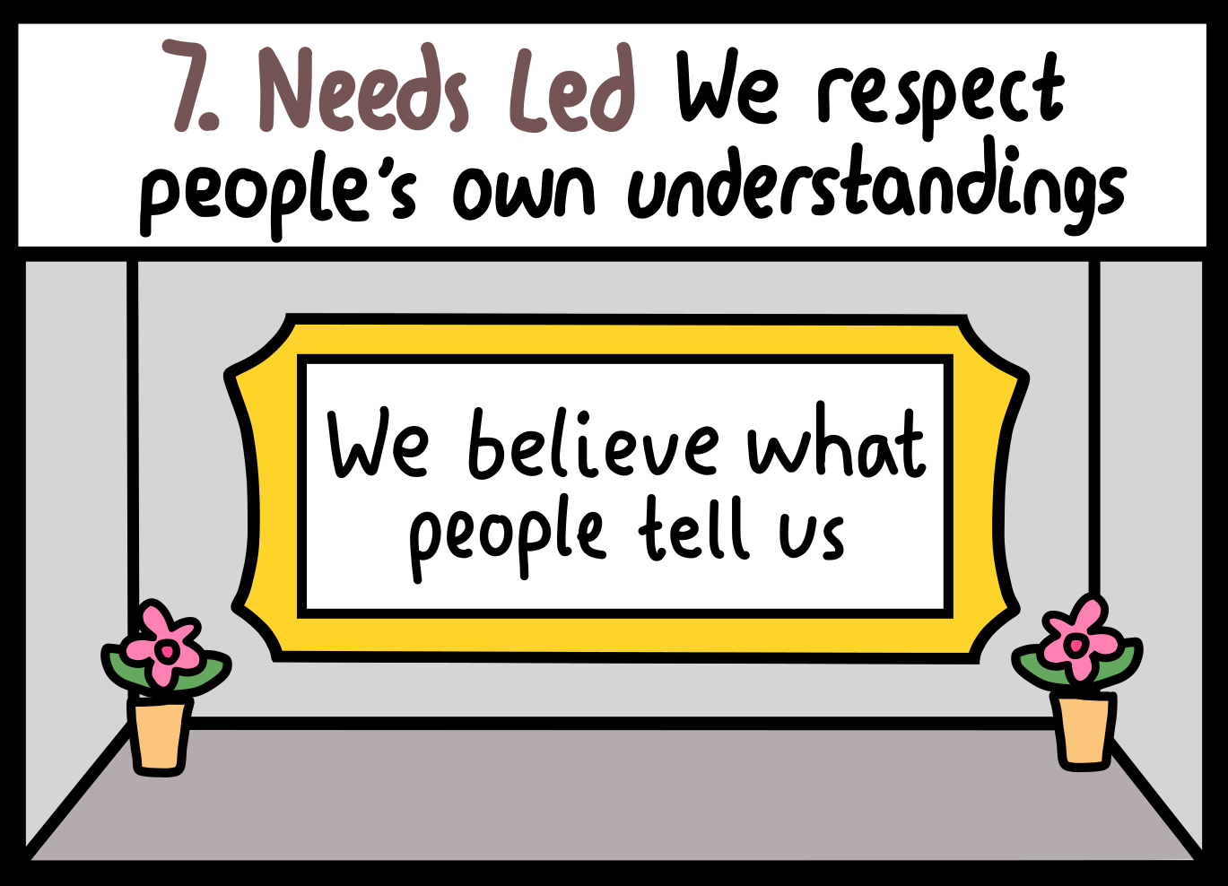
7. Needs led
We are needs-led, not diagnostically driven
People are supported and encouraged to define their needs
The MDT respects people’s individual understanding of their distress
We validate patients’ feelings, and respect their culture, values and beliefs
We take a capabilities approach and recognise that everyone has something to offer
We meet the needs of people’s chosen support network
Patients’ needs and wishes are listened to in the admission and discharge process

Slide 38
7. Needs led
Challenges/barriers
Diagnostic driven pathways
Staff training, competencies and mix
Division between community and inpatient
Lack of choice and involvement leading to needs being assumed
Suggestions for organisational change....
Therapies dept to understand the workforce implications are of providing therapeutic interventions.
Partnerships with primary care and other parts of acute care.
Re-consider functional split and management structures to improve continuity between community and inpatient.
Commission Hearing Voices Network training for all staff.
Commission VCSE organisations to work into ward to provide culturally specific support.
Catering contracts to support nutritious food and culturally competent food.

Slide 39
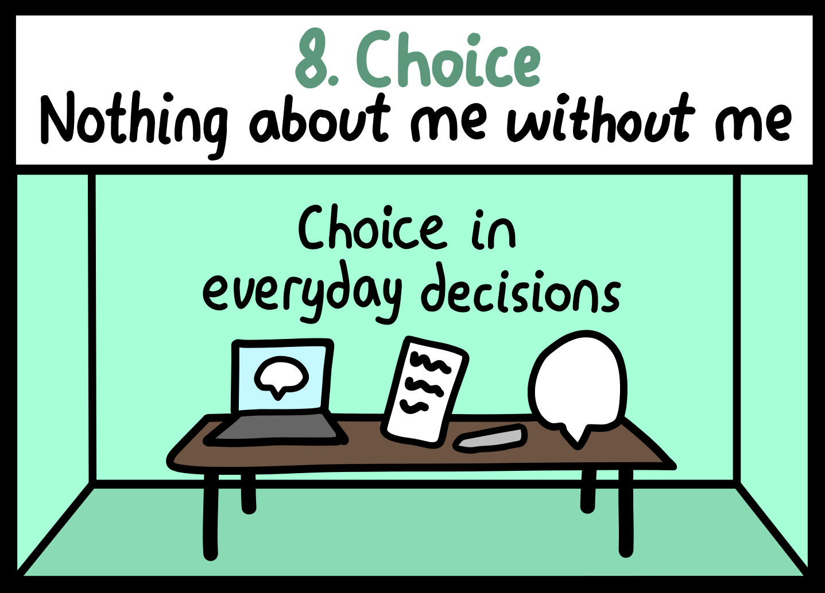
8. Choice
Patients always have the choice to be present at meetings about them
We adhere to the evidence-based approach of Open Dialogue and its key principles
Patients are supported to be involved in the decisions about them
Patients have choice in everyday decisions
Patients have the choice to collaborate in the writing of their notes and/or have access to their notes so that they know what has been recorded about them at any point during their inpatient stay
Patients have informed choice over their preferred treatment and who is involved in their care
Where legislation overrides personal choice, this is explained in a clear and transparent way
Patients have the choice to be supported by people who know them well, by an advocate or by a peer worker

Slide 40
8. Choice
Challenges/barriers
Staffing mix and availability limit menu of options
Staff skills and competencies
Diagnostic driven pathways
Fear patients will make unwise choices
Third party contracts for things like food not flexible enough to meet individual needs.
Funding constraints
Suggestions for organisational change....
Investment in therapeutic options for inpatients
Staffing mix that supports a range of treatment/support options.
Policy that requires 'nothing about me without me'
IT and data- patients having access to notes and care plan
Training and medical dept- staff trained in open dialogue or shared decision making
Commissioners- commissioning of advocates including culturally appropriate advocates

Slide 41
Q&A
What support do you need from your organisation to embed standards 5-8?
What does your organisation do well in relation to standards 5-8?
Standards
5.Equity
6.Avoiding harm
7.Needs led
8.Choice
https://www.menti.com/alh3gycmcseg

Slide 42
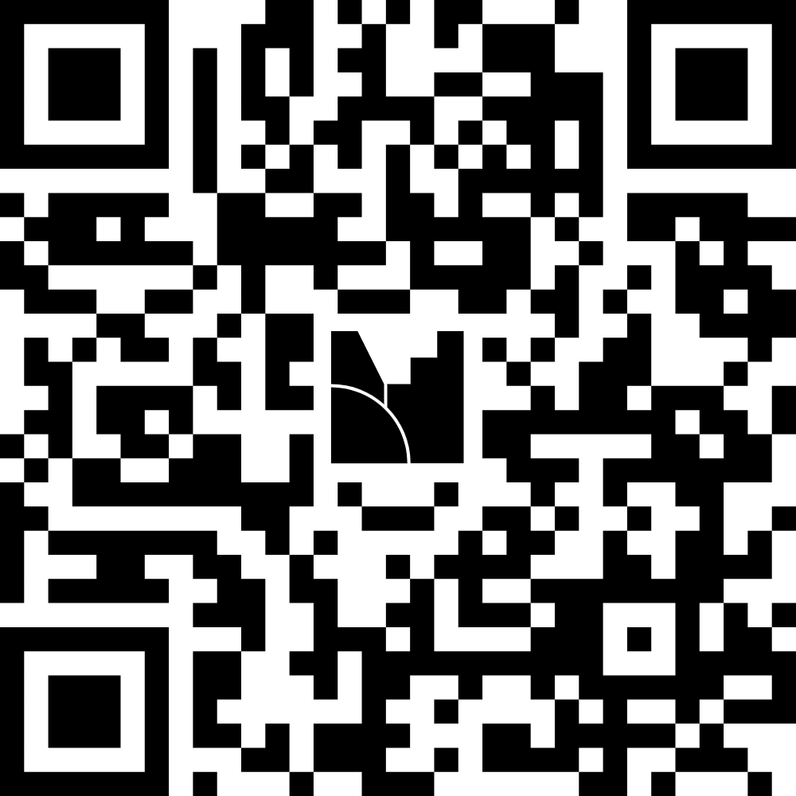
Q&A
What support do you need from your organisation to embed standards 9-12?
What does your organisation do well in relation to standards 9-12?
Standards
9.Environment
10.Things to do on ward 11.Therapeutic support 12.Transparency
https://www.menti.com/alttj2pvkam6

Slide 43
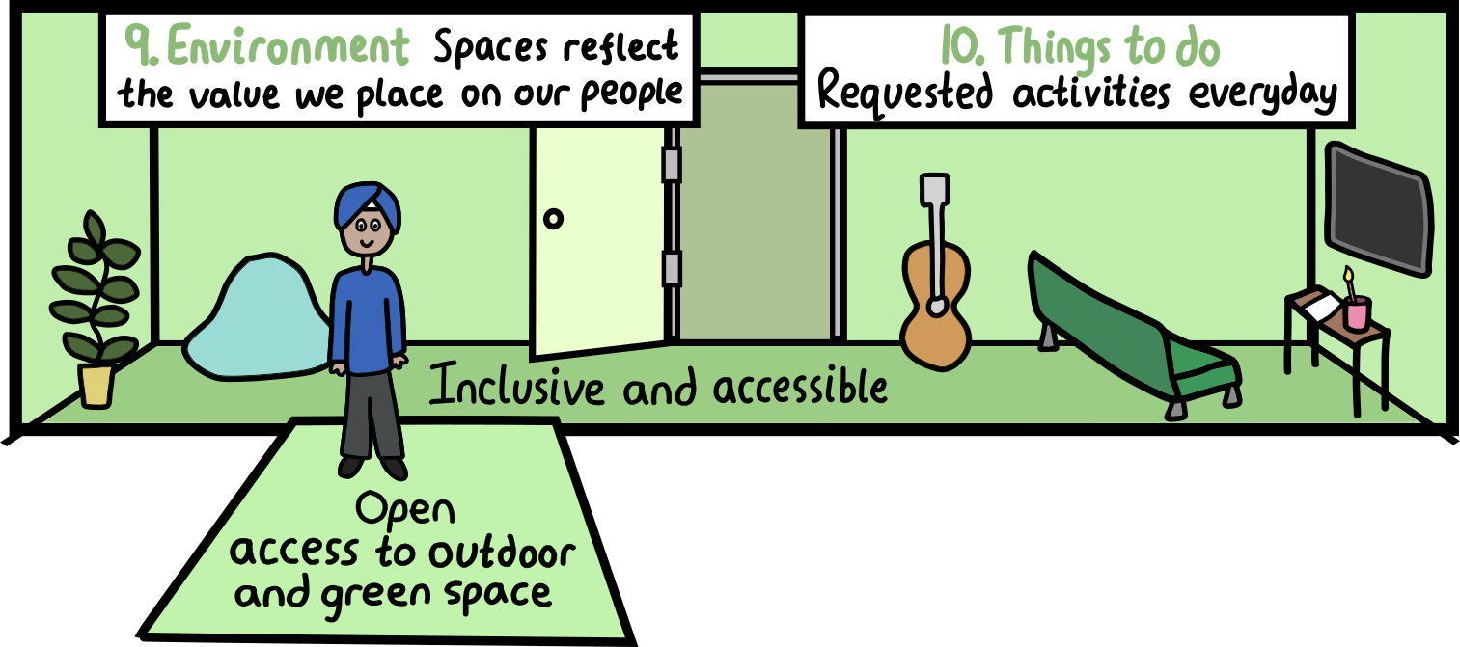
9. Environment
The environment is inclusive and accessible, including through making reasonable adjustments where appropriate
The environment is autism-informed, trauma-informed and sensory friendly
Comfort is prioritised alongside the space being clean and hygienic
To prioritise relationships, there are no locked staff offices on the ward
All people have open access to outdoor and green space
The ward environment and procedures foster a sense of community, for example eating together
The environment has been co-designed with people with lived experience and the needs and preferences of patients are evident

Slide 44
9. Environment
Challenges/barriers
Resource
Infection prevention control myths
Health and safety regulation
Focus on reducing access to means above the therapeutic relationship
Procurement rules meaning furnishings can only be bought from certain suppliers.
Blanket restrictions
Restrictions around heat and light control
Suggestions for organisational change....
Estates to lead a programme of change around sensory friendly environments
IPC- what is possible to make it more homely and soothing
Clarity of process- what can be changed and what cant? Work with CQC to agree.
Investment in adapting environments
Trial and invest in ‘walking office stations’ for ward managers.
Estates to consider options for creating open office spaces
Exec and management visits model sitting with patients, eating together

Slide 45
10. Things to do on the ward
People are supported to spend their time doing activities they enjoy
Patients decide which activities are on offer, including those that are culturally appropriate
Wards collaborate with VCSE and lived experience partners to deliver those activities
Activities support physical wellbeing

Slide 46
10. Things to do on the ward
Challenges
Resource
Creativity/ideas
Not having effective relationships with third sector
Digital poverty/ poor wi-fi access
Suggestions for organisational change....
Commissioning arrangements with VCSE partners to provide activities
Budget for patients and families to spend on activities they decide.
Trust charity to work in partnership with ward teams and experts by experience to target funding into activities and support patients would find most useful
Director of partnerships/coms to work with local VCSE and community organisations to consider how best to enable access to community activities and assets for inpatients

Slide 47
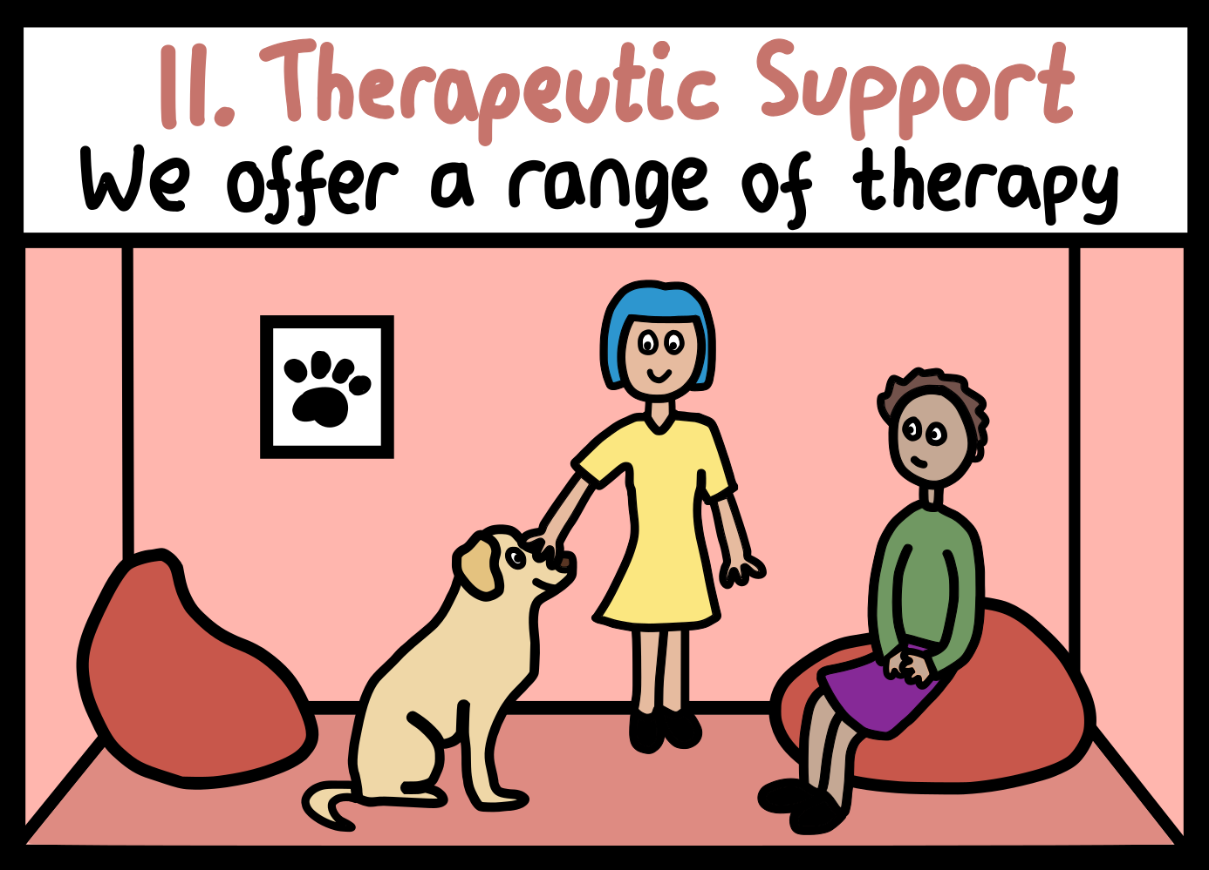
11. Therapeutic support
People have access to culturally sensitive support and treatment that is helpful
People can choose their preferred therapy from a range of options, including trauma-specific therapy
People have access to support around their social needs, including to maintain links with any community-based health and social care services and to plan for transition

Slide 48
11. Therapeutic support
Challenges/barriers
Staff training and competencies
Staff mix
Staff attitudes and value base
Staff time to build relationships and offer therapeutic support
Diagnostic pathways
Worries about starting therapy in hospital
Organisational support for this standard
Staffing mix and investment in therapeutic interventions etc.
Data to understand racialised experience of access to and experience of therapy
Values based recruitment and probatory periods
Staff training and support in compassionate responses to distress, not punitive ones
Consideration of use of PBS and other ‘behavioral approaches’
Commission women’s centre/rape crisis etc. to provide in reach support into ward
Consider work to support access to therapy across community and inpatient pathways

Slide 49
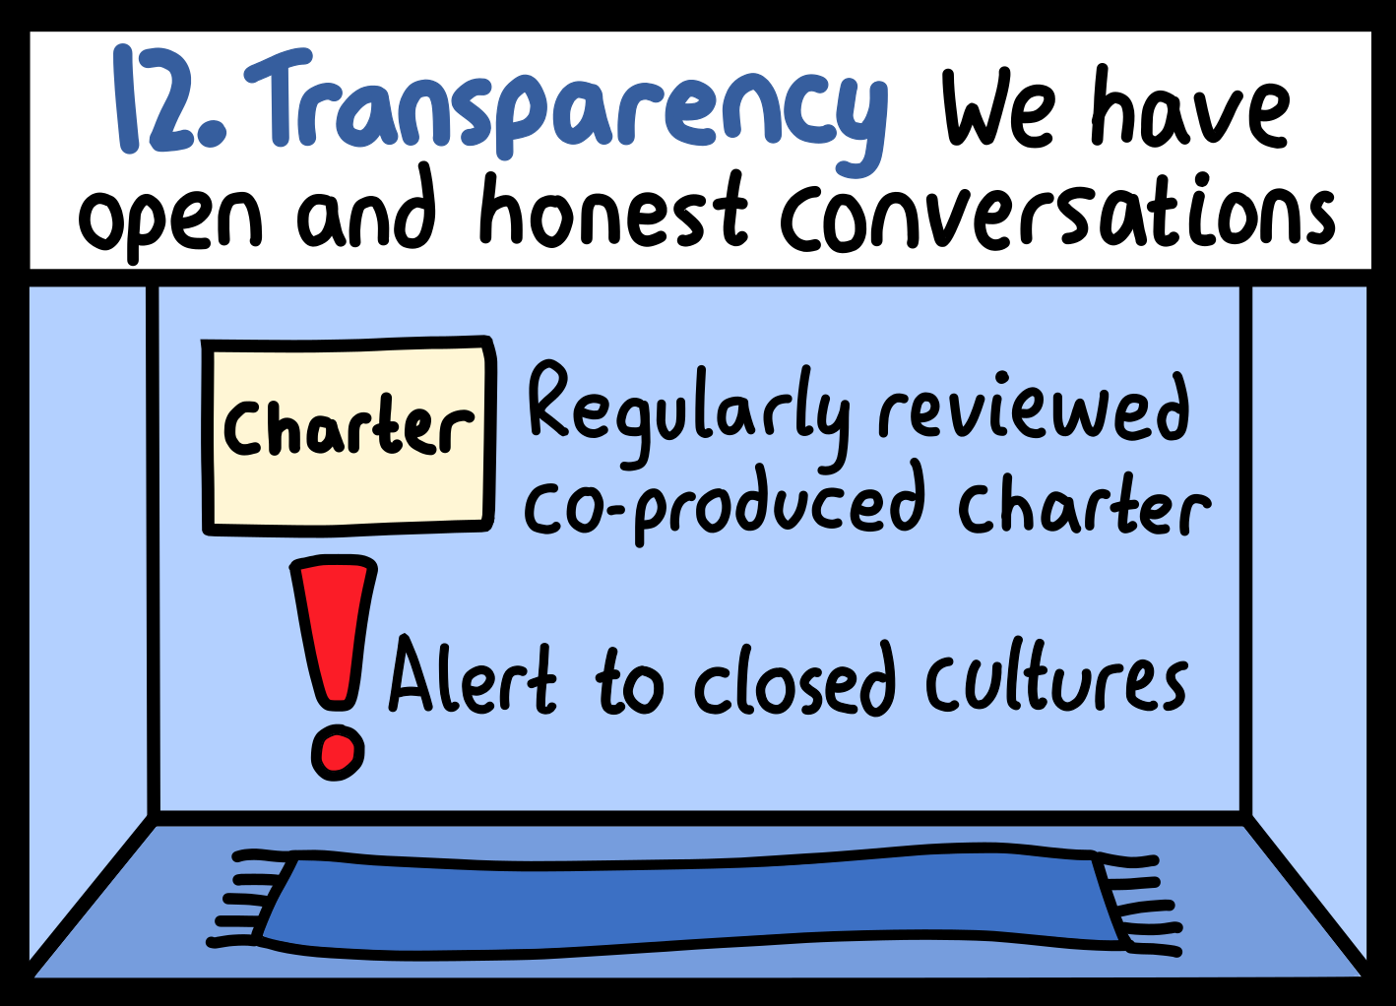
12. Transparency
We are honest with patients about our decision-making
We have a regularly reviewed, co-produced charter that clearly sets out values and expectations
The organisation has a transparent, compassionate, safe and responsive complaints process
We are alert to how closed cultures can develop and take steps to avert this in partnership with people and families
Independent organisations and advocacy are welcomed onto the ward
We are transparent about the names, roles and responsibilities of everyone working on the ward

Slide 50
12. Transparency
Challenges/barriers
Fear of litigation/professional registration/reputation
Fear of not having support of organisation
Fear of the patient
Fear of blame from family
Organisations getting stuck in difficult dynamics with patients and families who are angry and hurt
Organisational support for this standard
Organisation modelling – acknowledging mistakes and genuinely learning from them.
Complaints teamwork with people and families to improve process including duty of candour
Risk factors for closed cultures considered by nursing and governance structures.
Investigations being shaped by patients and/or their families
Robust FTSU and whistleblowing process- including investment in a FTSU guardian for patients
IT/IS departments to support with patient and family feedback tools that can provide real time feedback

Slide 51
Q&A
What support do you need from your organisation to embed standards 9-12?
What does your organisation do well in relation to standards 9-12?
Standards
9.Environment
10.Things to do on ward 11.Therapeutic support 12.Transparency
https://www.menti.com/alttj2pvkam6

Slide 52
Support offer for organisation level-element
Matt Milarski & Emily Cannon
Heads of Quality Improvement, NCCMH

Slide 53

The offer
All organisations were offered either a light-touch or full programme of support.
Both offer 4 virtual learning sessions:
  Anti-racism at organisational level
  Trauma-informed organisations
  Autism-informed organisations
  Embedding lived experience leadership and coproduction in an organisation.
Light-touch offer will follow up an in-person reflective space. With wards involved in Culture of Care and executives receiving coaching.
Full programme will follow up with 5 in-person reflective spaces to embed the sessions above at an organisational-level, and an additional session to sustain and spread learning and successes.
Notes:
Centred around the equity principles.

Slide 54
Full support
Avon and Wiltshire Mental Health Trust
Birmingham and Solihull Mental Health NHS Foundation Trust
Black Country Health Care Foundation Trust
Bradford District Care Trust
Bramley Health
Cambridgeshire and Peterborough NHS Foundation Trust
Central and North West London NHS Foundation Trust
Cornwall Partnership NHS Foundation Trust
Coventry and Warwickshire Partnership NHS Trust
Devon Partnership NHS Trust
Essex University Partnership Trust
Gloucestershire Health and Care NHS Foundation Trust
Greater Manchester Mental Health Trust
Hampshire and IOW NHS Foundation Trust
Herefordshire and Worcestershire Health and Care Trust
Humber Teaching Foundation NHS Trust
Lancashire and south Cumbria foundation trust
Mersey Care NHS Foundation Trust
Norfolk and Suffolk NHS foundation trust
North East London Foundation Trust
Northamptonshire Healthcare NHS Foundation Trust
Nottinghamshire Healthcare Foundation Trust
Priory Woodbourne
Sheffield Health and Social Care
Somerset NHS Foundation Trust
South West Yorkshire Partnership Foundation Trust
Sussex Partnership NHS Foundation Trust
Tees Esk and Wear Valley NHS Foundation Trust
Notes:
Centred around the equity principles.

Slide 55
Light-touch support
Berkshire Healthcare Foundation Trust
Birmingham Women's and Children's NHS Foundation Trust
Cheshire and Wirral Partnership Foundation Trust
Cumbria, Northumberland, Tyne and Wear NHS Foundation Trust
Cygnet
Derbyshire Healthcare NHS Foundation Trust
Dorset Healthcare NHS Trust
Elysium Healthcare
Gateshead Trust
Hertfordshire Partnership Foundation NHS Trust
Kent and Medway NHS and Social Care Partnership Trust
Leeds and York Partnership Foundation Trust
Leicestershire Partnership NHS Trust
Lincolnshire Partnership Foundation Trust
Livewell Southwest
North London Foundation Trust
North Staffordshire Combined Healthcare Trust
Northumbria Healthcare NHS Foundation Trust
Oxford Health NHS Foundation Trust
South London and Maudsley NHS Foundation Trust
St Andrews Healthcare
Surrey and Borders Partnership Trust
West London NHS Trust
Notes:
Centred around the equity principles.

Slide 56
Who to get involved
We would like to bring together the following in each organisation:
    Wards receiving QI support on the programme
    Facilities and estates (hotel services)
    HR (Equality, diversity and inclusion), Recruitment
    Quality improvement, Organisational development
    Information (Planning and performance, Clinical records)
    Nursing and governance (Patient safety, Safeguarding, Infection prevention control)
    Involvement and engagement/coproduction/lived experience
    Communications (Complaints/PALS, Freedom to speak up guardian)
    Finance/contracting
    Clinical leadership (medical, therapies, nursing)
    Operational management (including community services)
    Executive leadership
Notes:
Centred around the equity principles.

Slide 57
Next steps for key contacts
Booking onto the virtual training courses (one per topic) and inviting people and departments listed on the previous slide:
    Co-production 1 = 11th July
    Trauma informed approach 1 = 17th July
    Autism informed approach 1 = 9th September
    Race equity 1 = 26th September
    Co-production 2 = 14th November
    Trauma informed approach 2 = 25th November
    Autism informed approach 2 = 20th January
    Race equity 2 = 30th January
If you’re taking part in the full support:
    Making contact with your paired organisation
    Working with your QI Coach to identify dates for the in-person follow up sessions
    If you’re taking part in the light-touch support, we will be in touch about your in-person session in the coming months
Notes:
Centred around the equity principles.

Slide 58
Q&A
Brendan Stone, Emily Cannon, Matt Milarski & Sal Smith

Slide 59

Upcoming events in 2025
    Dates for your diary
22 September: Lived Experience Network(virtual, 13:00-16:00)
September Events: Learning Network Event (in-person)
22 October: PAR Learning Event (10:00 – 12:30)
30 October: National Learning Session (13:00 – 15:00)
***The calendar of all our events and trainings can be found on our website.

Slide 60


Reminder about training for ward staff
Dialogical and Relational Training Taster Days (DARTT)
16 July 2025 09:30 – 16:30
18 Sept 2025
09:30 – 16:30
Autism Informed
Training
20 August 2025 13:00 – 16:00
23 Oct 2025
13:00 – 16:00
Anti Racism Training
4 Sept 2025 14:00 – 16:00
17 Nov 2025 10:00 – 12:00
Preventing Sexual Harm Training
22 July 2025
10:00 – 12:00
11 Nov 2025
10:30 – 12:30
These training sessions are delivered virtually.
Please visit our website for more information & how to register: www.rcpsych.ac.uk/improving-care/nccmh/culture-of-care-programme/learning-events
Notes:
Multiple sessions put on, if you can’t attend one date, easily able to attend another
Sessions are delivered virtually but visit our website for more info and registration

Slide 61
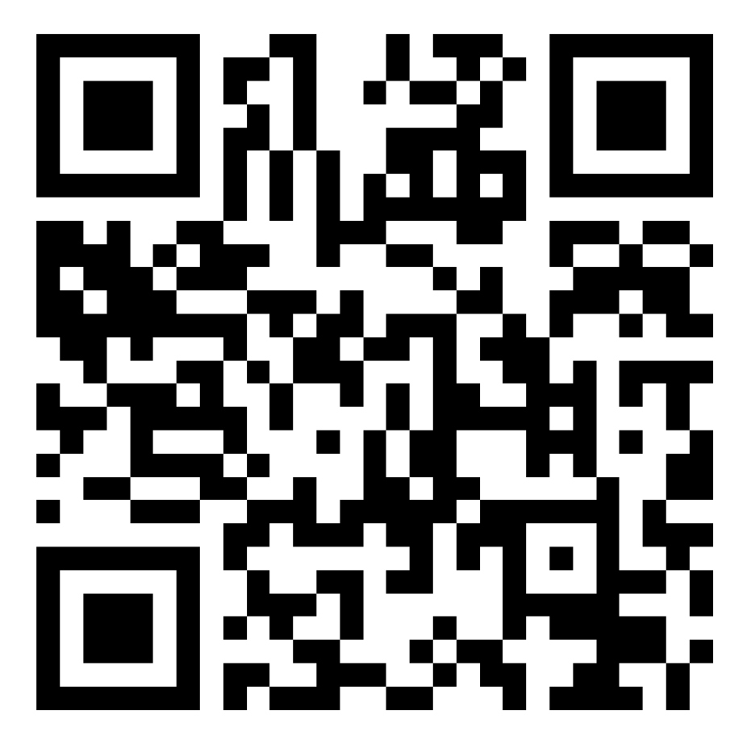
With gratitude
Thank you so much for coming today and for the work you continue to do to influence services and try to improve things for patients and families.
If you could kindly scan the QR code and provide your feedback.

Slide 62
Close

