Slide 1


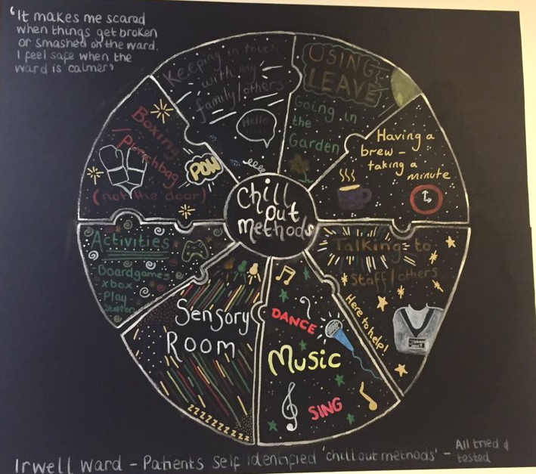
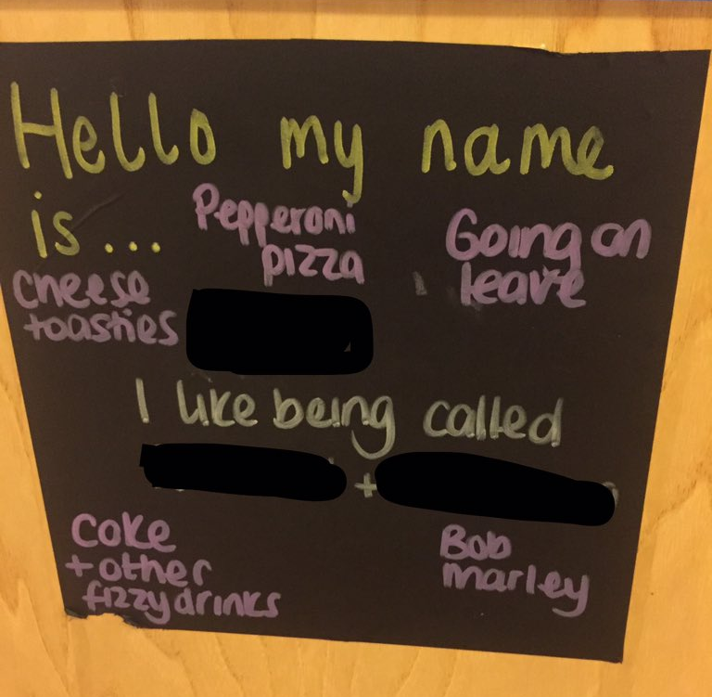
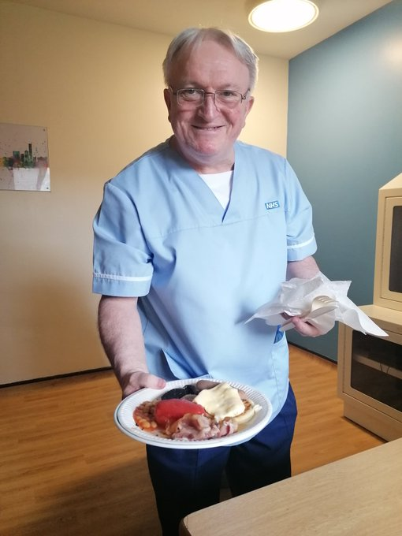
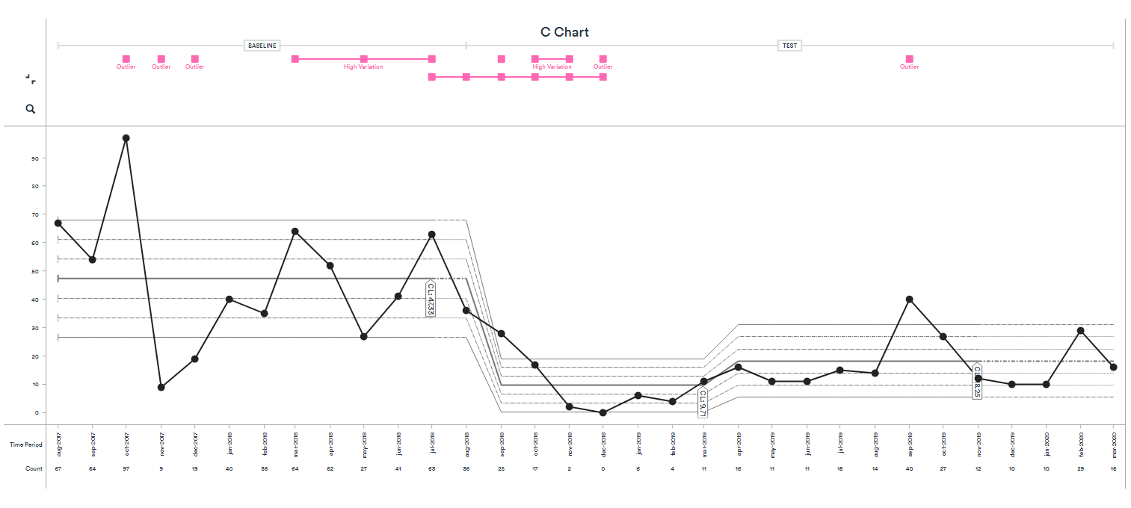
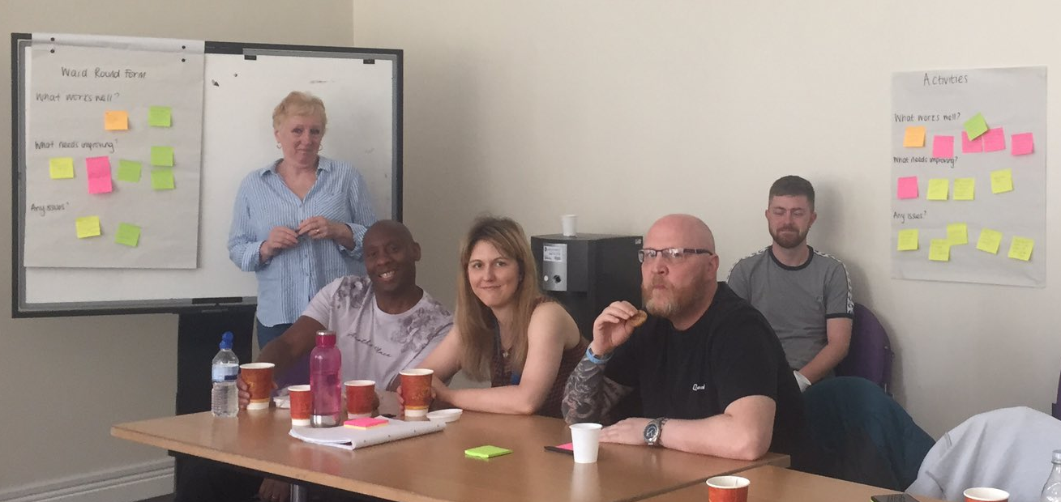
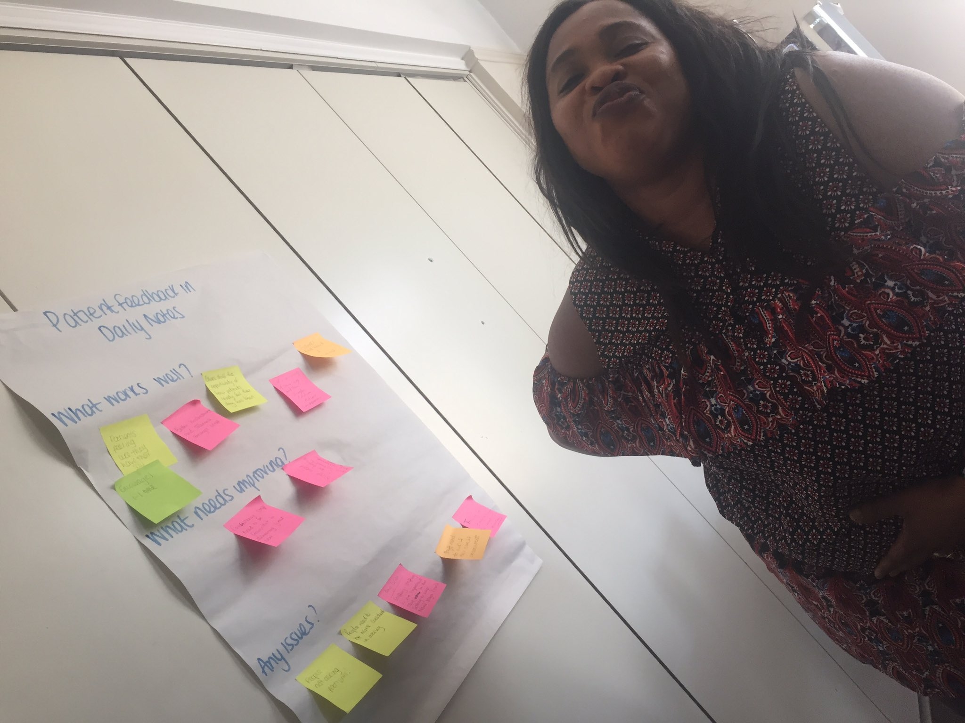
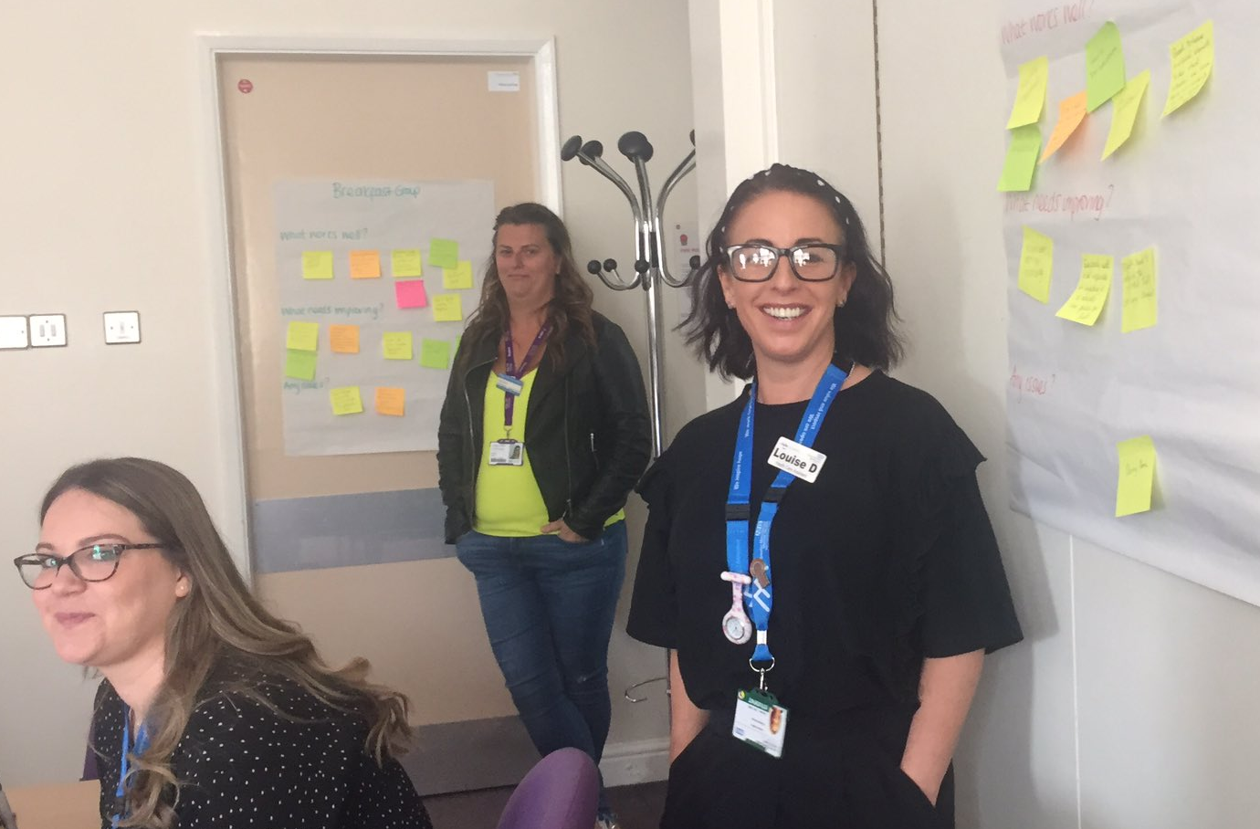
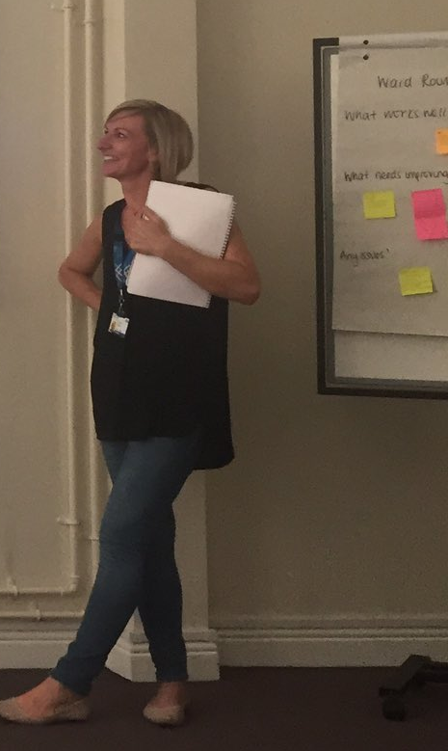
Irwell Ward
Lianne Holland, Sarah Holtom, Louise Dalton, Sharron McGregor, Louise Grange, Ade Crump, Garry Cooke, Kevin McDonnell, Jo Hadfield, Tim McDougall
Reflecting on our project
Summary at the end of the project:
Overall data – 61% reduction
Physical restraint – 70% reduction
Seclusion – 79% reduction
Rapid transquilisation – 76% reduction
Change ideas we have tested include:
Changes we have seen on the ward
- Getting to know you sheets completed on admission. These include triggers and identified Calm Down methods. They are used within Positive Behavioural Support plans, care plans and patient files.
- Adapted observation forms to include Calm Down methods, triggers and early warning signs for agitation/aggression.
- Patients share information about themselves on their bedroom doors e.g. nicknames and activities they enjoy
- Planning forms for patients to complete with staff to prepare for ward rounds
- A Breakfast Group with staff and patients where they have chance to talk about their day and interact with each other in a positive way.
- The garden was refurbished to include outdoor gym equipment and a more relaxing space for patients to spend time outside.
There were early challenges with the change in culture particularly, with staff who had been there a long time. The involvement of patients in the project had a huge impact on the attitude of staff and has led to a sustained change in culture to create a less restrictive and more positive environment.
There have been significant reductions in the use of restrictive interventions and the staff and patients continue to work together to maintain these reductions. Staff and patients have felt empowered to make suggestions on how to improve the ward. This has led to the ward attracting students and nurses from other wards who want to work in an environment committed to the principles of least restrictive practice. There has been a positive impact on staff wellbeing for all staff.
What our patients, staff and carers say
Looking to the future
- Patients have expressed that they feel listened to, appreciate having lots of 1:1 time with staff and have particularly enjoyed the Mutual Help Meeting and Breakfast Groups.
- Carers have been positive about the collaborative plans made with patients which are clear and easy to follow. A family recently fed back that this has helped them when out on leave.
- Staff said that they really appreciate having summarised information about patients' preferences, triggers and warning signs. They feel they are more able to engage patients in activities they enjoy, and the ward is a positive place to work.
- Quote from a patient: “Staff know what I like and what helps me. I don’t like working with people that I don’t know; this makes me scared. Sometimes I don’t want to talk about it, and I want someone to already know these things to make me feel less scared.”
The changes are now fully embedded into everyday practice. Staff are keen to continue using QI approaches to continually improve care on the ward. The Trust is beginning a Breakthrough Series Collaborative with 6 wards where the use of restrictive interventions is higher. Our ward will also be included so that we can share what we’ve learned, and also so that we can access support for ongoing improvement.
We’re really proud of what we’ve achieved and how it has changed things for the better for patients, staff and carers. This gives us the motivation to carry on and to help other wards who are keen to learn from what we’ve achieved.

