Slide 1


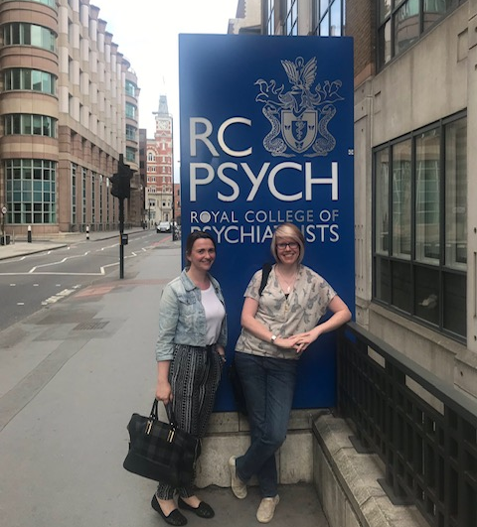
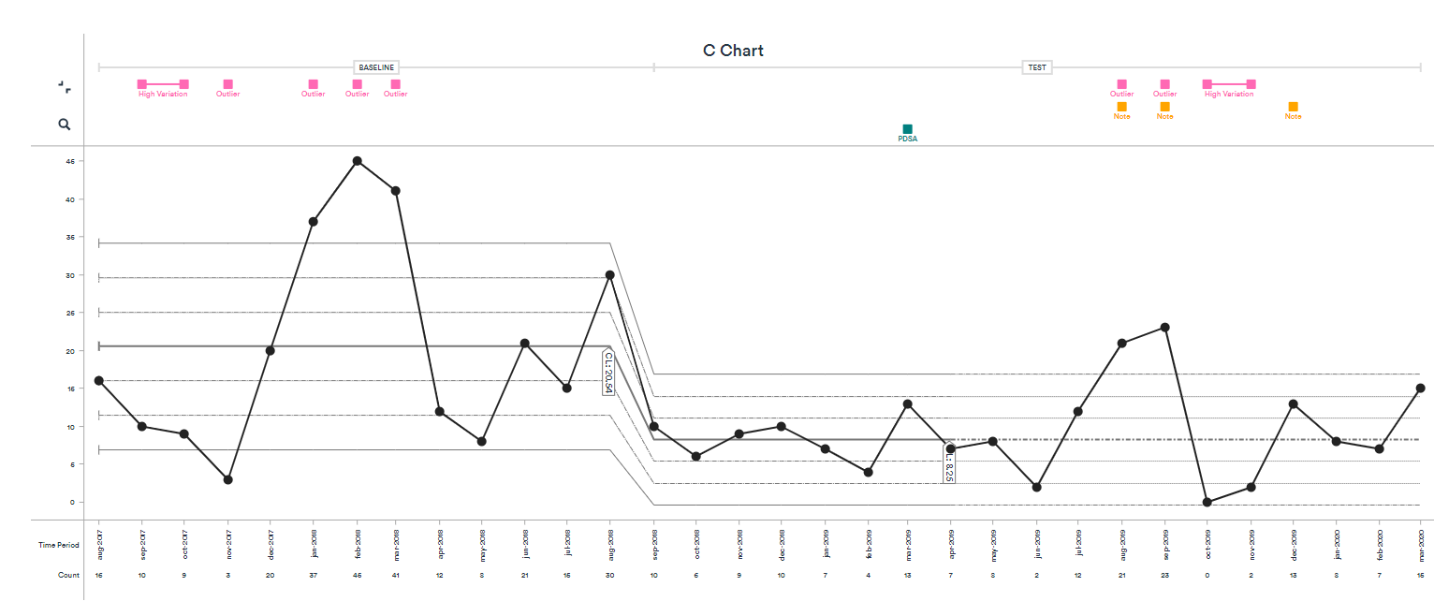
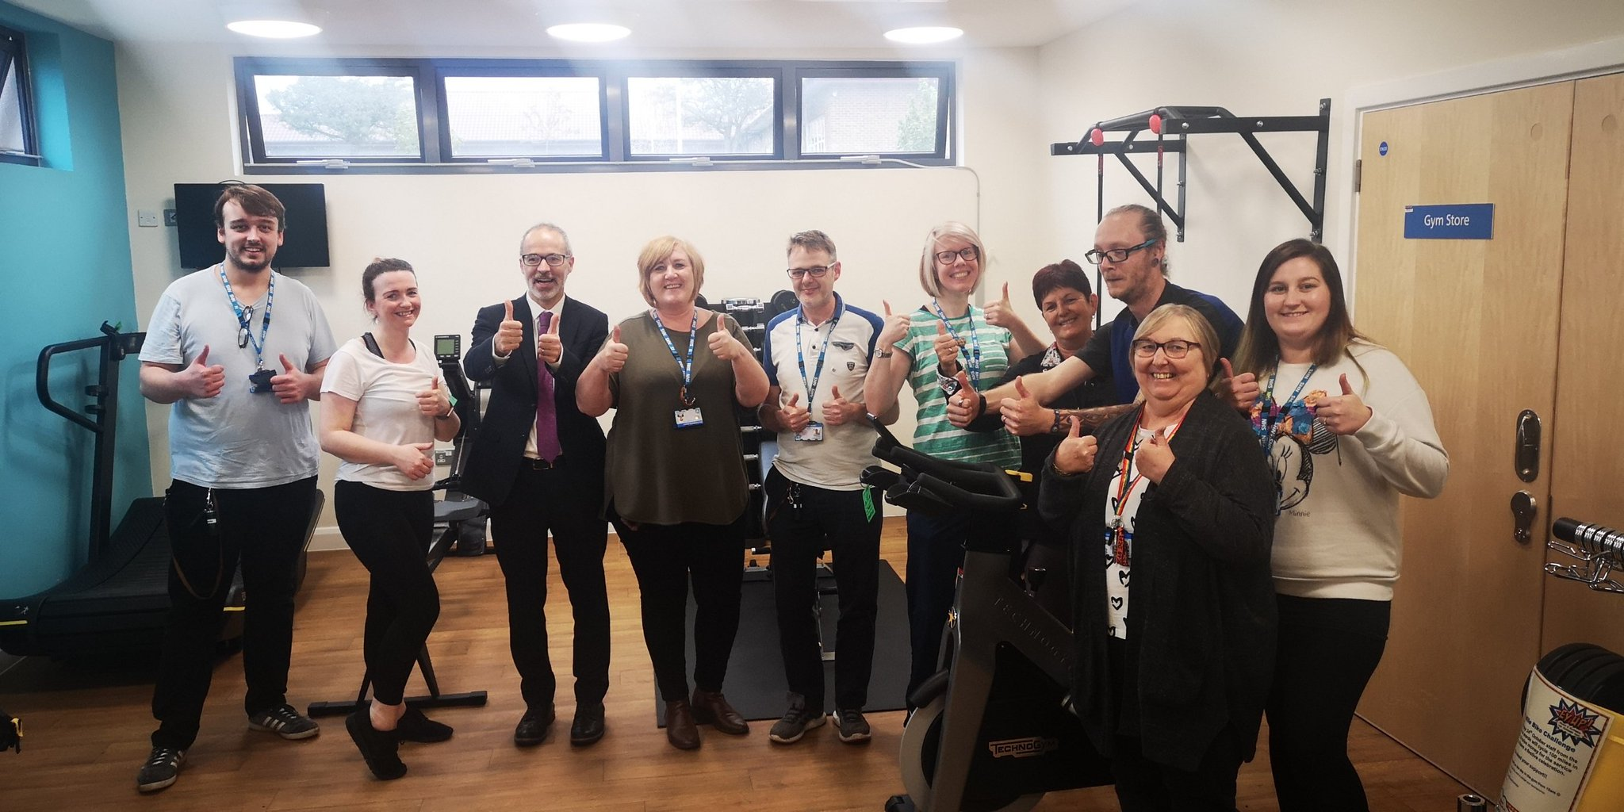
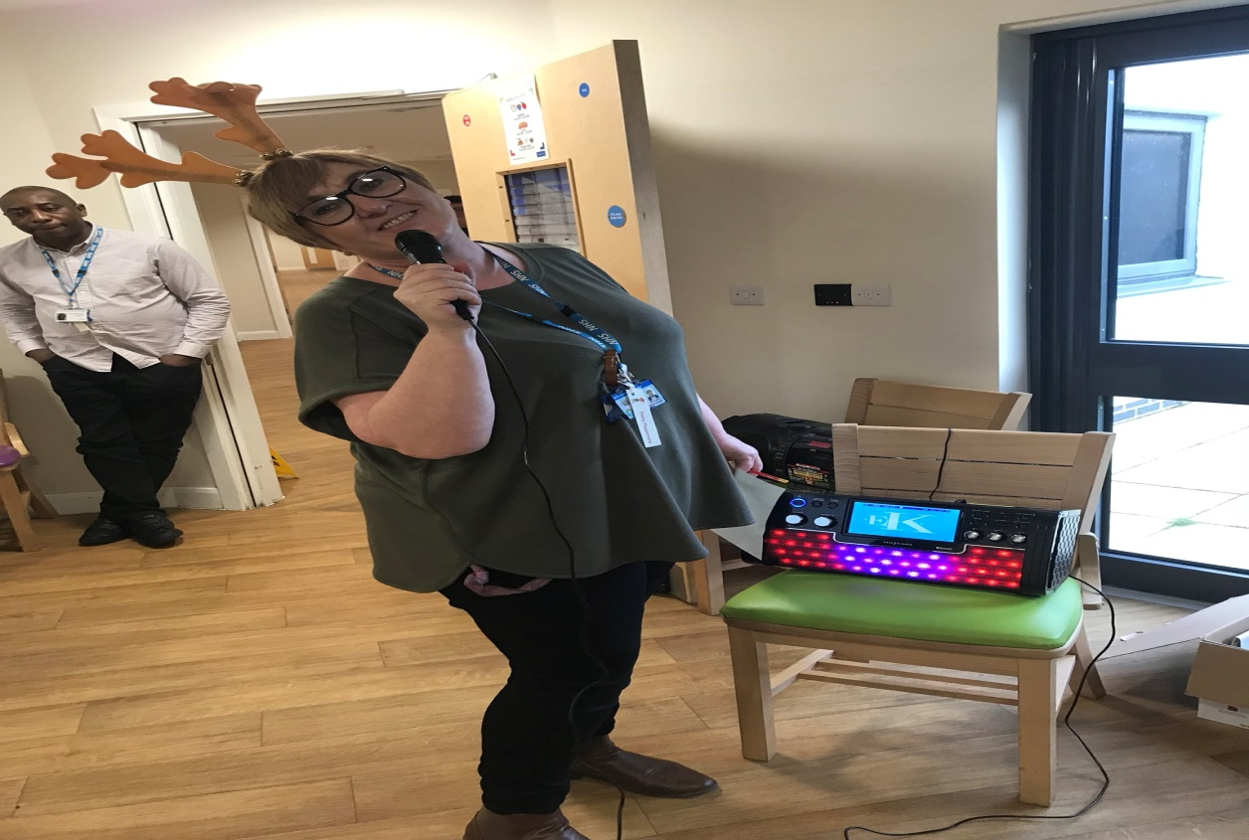
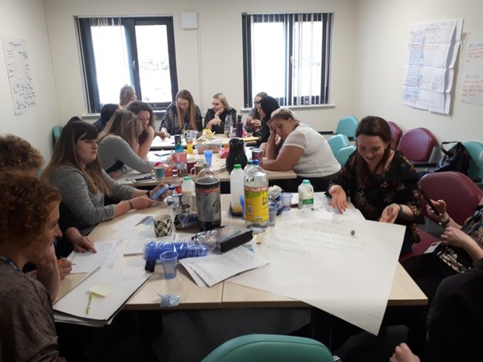
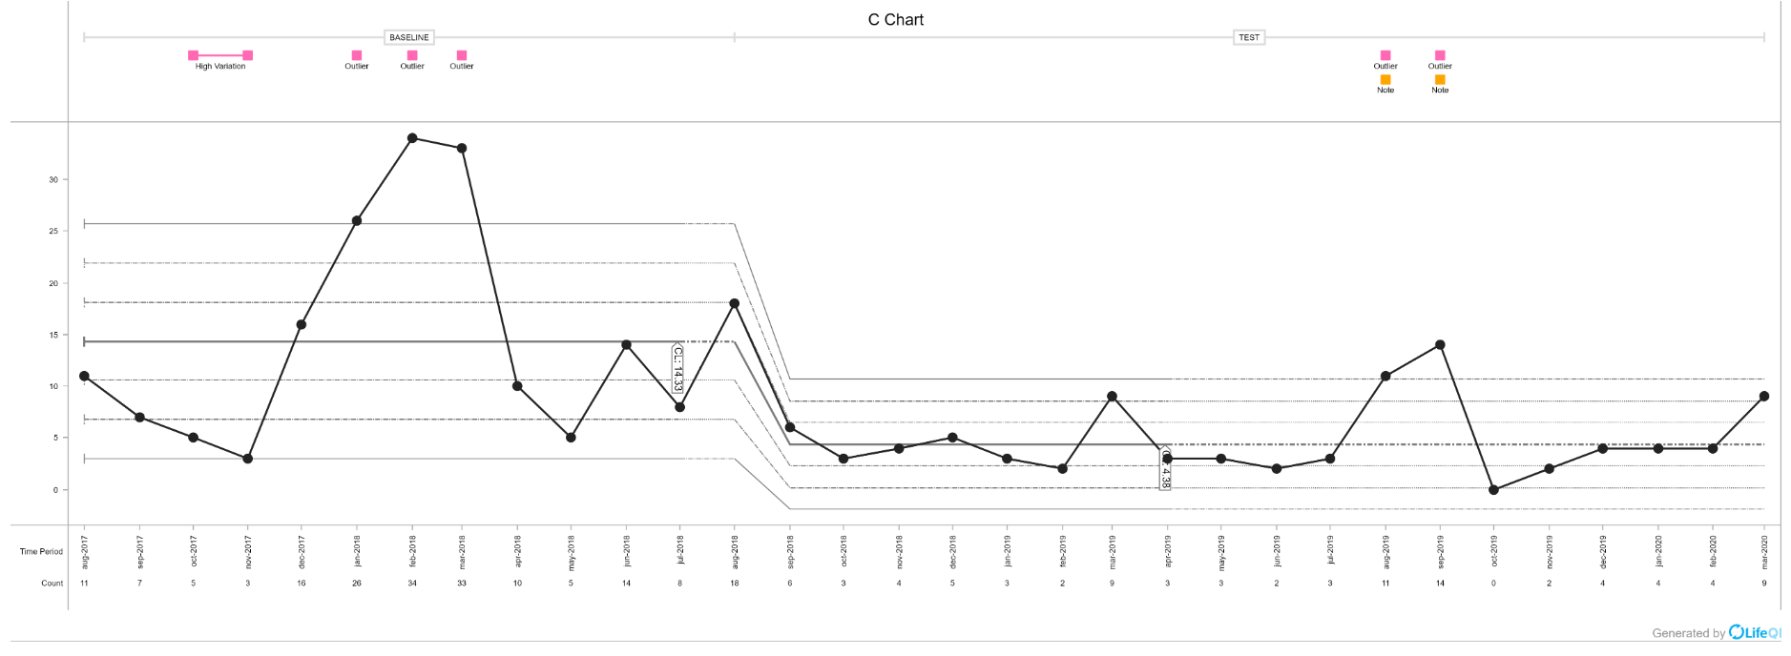
Nostell Ward
James Waplington, Claire Wilkinson, Stephanie Gibson
Reflecting on our project
Overall reduction in restrictive practice across all three measures: 60%
Overall reduction in restraints: 69%
Change ideas we have tested include:
Changes we have seen on the ward
- 24/7 access for patients to make their own hot drinks
-Increased access to leave from the ward
-Increased nurse led activities on the ward and activities being carried out on evenings and weekends
-Collaborative care planning for patients who self harm
-Training for staff on personality disorder and self harm
-Protected 1-1 engagement for staff and service users during shifts
-Unrestricted access to relaxation room and quiet lounge
-Therapy dog visits to the ward
The ward environment has improved dramatically with the impact of the interventions that have been implemented during the collaborative and the ward is a much calmer and more relaxing environment.
We have seen a drastic reduction in the numbers of incidents requiring restrictive interventions.
Using the PDSA format staff and service users have been more empowered to implement the changes they want and to deliver those changes from the ‘bottom up’.
Staff are more positive about coming to work on the ward and that also has a positive effect on the patients who also appear generally to be happier and calmer.
What our patients, staff and carers say
Looking to the future
Staff enjoy having more ‘time to care’ for patients and to engage in a positive and proactive manner. Patients say they enjoy having regular activities and the staff being able to join in.
Both staff members & service users have commented about the change in atmosphere and how the ward is calmer, quieter and more therapeutic.
Service user’s commented that they love staff wearing the yellow landyards ‘It means we don’t have to hang around the office waiting for staff’.
The ward team is supportive - when incidents do happen on the ward staff are quick to hold de-briefs with staff and service users and will work quickly to adapt and implement changes where indicated.
The change ideas implemented have now been embedded into practice. We know this because we have had a number of new staff join the team who have implemented and embraced the RRPI ethos.
Nostell ward holds weekly community meetings where service users and staff are able to voice their views and change ideas to the ward.
Moving forward Nostell ward has been also involved in a research study called Edition which has allowed us to continue being focused on improving our ways of working in regards to de-escalation and restrictive practices.

