Slide 1






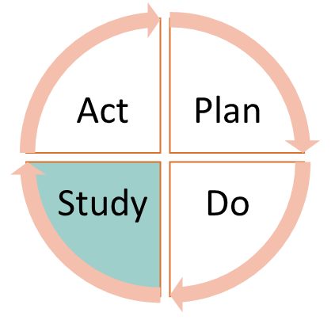


INSERT trust logo
Insert: Ward, ward type, trust, authors/project team members
Insert the change idea you are testing/objective
What did you think would happen?
Who, what, where, when?
What happened?
What data did you collect?
What observations did you make?
Compare the data to your predictions.
Summarise and reflect on what you learned
What modifications did you make? (adapt, adopt or abandon)
What was the next step/revised PDSA?
INSERT high quality team photo/data/other visual representation of your work
What learning can you share with the collaborative about this test of change?
What have you achieved/are you working towards achieving?
What does this mean for staff and service users?
What questions do you have for your next steps?

