Slide 1


Sexual and reproductive health (SRH) for River House
Dr Polly Cohen
Community Sexual and Reproductive Health ST2
Pollyanna.cohen@nhs.net

Slide 2
Intended Learning Outcomes
By the end of this session you will be able to:
Explain the relevance of SRH in the medium secure unit
Describe the symptoms of different STIs
State at least 5 methods of contraception and 2 methods of emergency contraception
Identify patients who need further support with their sexual and reproductive health
Describe where patients can get more advice about contraception, pregnancy decision-making, abortion and sexual health

Slide 3
What we won’t cover
Side effects of psychiatric medication
Psychosexual medicine in depth
Tests and treatments for specific STIs
How to start, insert or switch contraception
How to start PrEP or PEP
…This is what psychiatrists and SRH clinics are for!

Slide 4
Contents
Why is this particularly important on the medium secure unit?
STIs – recap
Questions, questions
Referral pathways

Slide 5
Contents
Why is this particularly important on the medium secure unit?
STIs – recap
Questions, questions
Referral pathways

Slide 6
Why is this particularly important on the medium secure unit?
Higher rates STIs/HIV
Higher rates sexual dysfunction → medication related
Unplanned pregnancy:
Unwanted?
Poor health outcomes?
Social care?
Difficult maternity/labour experience?
If father, possibly unable to see baby?

Slide 7
Why is this particularly important on the medium secure unit?
Higher rates STIs
Higher rates sexual dysfunction medication and diagnosis related:
Decreased libido (sex drive/interest in sex)
ED (erectile dysfunction)
Anorgasmia (inability to orgasm)
Reduced sperm count/ejaculate

Slide 8
Why is this particularly important on the medium secure unit?
Higher rates STIs
Higher rates sexual dysfunction (decreased libido, ED, anorgasmia) → medication related
Psychotropic medication: sexual dysfunction in 30-60% patients
Classical antipsychotics + risperidone
Lots of research on switches to improve sexual dysfunction
…But no good if issues unidentified!
For all genders!

Slide 9
Why is this particularly important on the medium secure unit?
“Well maybe they have put me on this medication which causes these sexual issues so that I can’t reproduce”
Dispel the myth –
psychotropic medications stopping reproduction → not the aim!
Some medications are teratogenic (cause fetal abnormalities) and need to be avoided in pregnancy/avoid conceiving while taking them

Slide 10
Why is this particularly important on the medium secure unit?
“I don’t understand why there’s not conjugal”
National guidance lacking
Sexual relationships may improve healing
What’s your opinion?
“Those of us who have been diagnosed with major mental illness do not cease to be human beings by virtue of that diagnosis. Like all people, we experience the need for love, companionship, solitude, and intimacy. Like all people, we want to feel loved, valued, and desired by others.”
Deegan PE. Human sexuality and mental illness: consumer viewpoints and recovery principles. In: Buckley P, editor. Sexuality and Serious Mental Illness. Amsterdam: Harwood Academic Publishers; (2001). p. 21–34. [Google Scholar]

Slide 11
Contents
Why is this particularly important on the medium secure unit?
STIs – recap – Quiz!
Questions, questions
Referral pathways

Slide 12
True or false?
1. There are more than 7 infections which can be transmitted through sexual contact.

Slide 13
True or false?
1. There are more than 7 infections which can be transmitted through sexual contact.
TRUE

Slide 14
STIs
Gonorrhoea
Hepatitis B & C
Chlamydia
Genital warts
Syphilis
HIV
Pubic lice
Trichomonas
Herpes
Monkeypox
Thrush, BV & Balantitis → may present similarly but not STIs
More info:
https://www.sexwise.org.uk/

Slide 15
True or false?
2. Pain when passing urine, vaginal/penile discharge or itch can all be symptoms of an STI.

Slide 16
True or false?
2. Pain when passing urine, vaginal/penile discharge or itch can all be symptoms of an STI.
TRUE

Slide 17
True or false?
2. Pain when passing urine, vaginal/penile discharge or itch can all be symptoms of an STI.
TRUE
But don’t forget about non-STI causes!
Urinary tract infection
Thrush
Balantitis etc.

Slide 18
True or false?
3. Some STIs can have no symptoms at all (asymptomatic) but won’t cause any serious long-term health consequences.

Slide 19
True or false?
3. Some STIs can have no symptoms at all (asymptomatic) but won’t cause any serious long-term health consequences.
FALSE
Chlamydia, gonorrhoea, HIV, syphilis and hepatitis can all be asymptomatic and affect people’s future fertility, immune system or major organs.
That’s why we advocate for sexual health screening after every new partner.

Slide 20
STIs
What do you test for routinely? (BBV)
Name | Symptoms
Chlamydia | None / discharge / dysuria / abdominal pain / vaginal bleeding
Gonorrhoea | None / discharge / dysuria / abdominal pain / vaginal bleeding
Syphilis | None / ulcer / rash / neurological
HIV | None / flu-like / rash / other infections
Trichomonas | None / discharge / dysuria / abdominal pain / vaginal bleeding
Herpes | Tingling / blisters / dysuria
Genital warts (HPV) | Painless lumps
Monkeypox | Blisters / ulcers / dysuria / rash
Pubic lice | Itch / rash / visible lice/eggs
Hepatitis B / C | None / flu-like / abdominal pain
Routine
screening
More info:
https://www.sexwise.org.uk/

Slide 21
True or false?
4. An STI test 1 week after sex with a new partner will accurately tell you if the patient has an STI.
FALSE
Chlamydia/gonorrhoea: from 2 weeks
HIV: 45 days
Syphilis/hepatitis B/C: from 3 months
(If they have been tested since the last partner and no other risks in between)

Slide 22
Contraception
Contraceptive Injection
Implant
Intrauterine System (IUS)
‘hormonal coil’
Intrauterine Device (IUD)
‘copper coil’
Female Sterilisation (tubal occlusion)
Male Sterilisation (vasectomy)
Combined vaginal Ring
Combined Patch
Combined Pill (COC / CHC)
Progestogen-only Pill
External (‘male’) Condom
Internal (‘female’) Condom
Diaphragm
Cervical Cap
Sponge
Spermicides
Natural Family Planning
Lactational Amenorrhea Method (LAM)
LARC
Long-
Acting
Reversible
Contraception
Less than 6 months postnatal
NO periods
Full-time breastfeeding
More info:
https://www.contraceptionchoices.org/

Slide 23
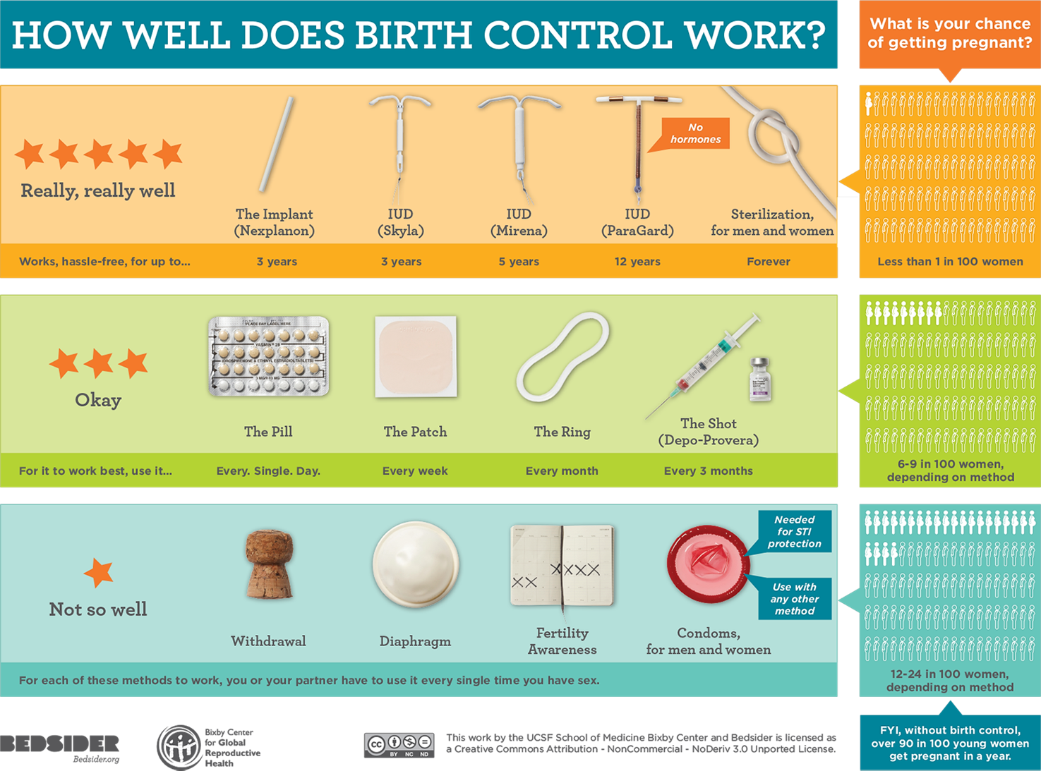

Slide 24
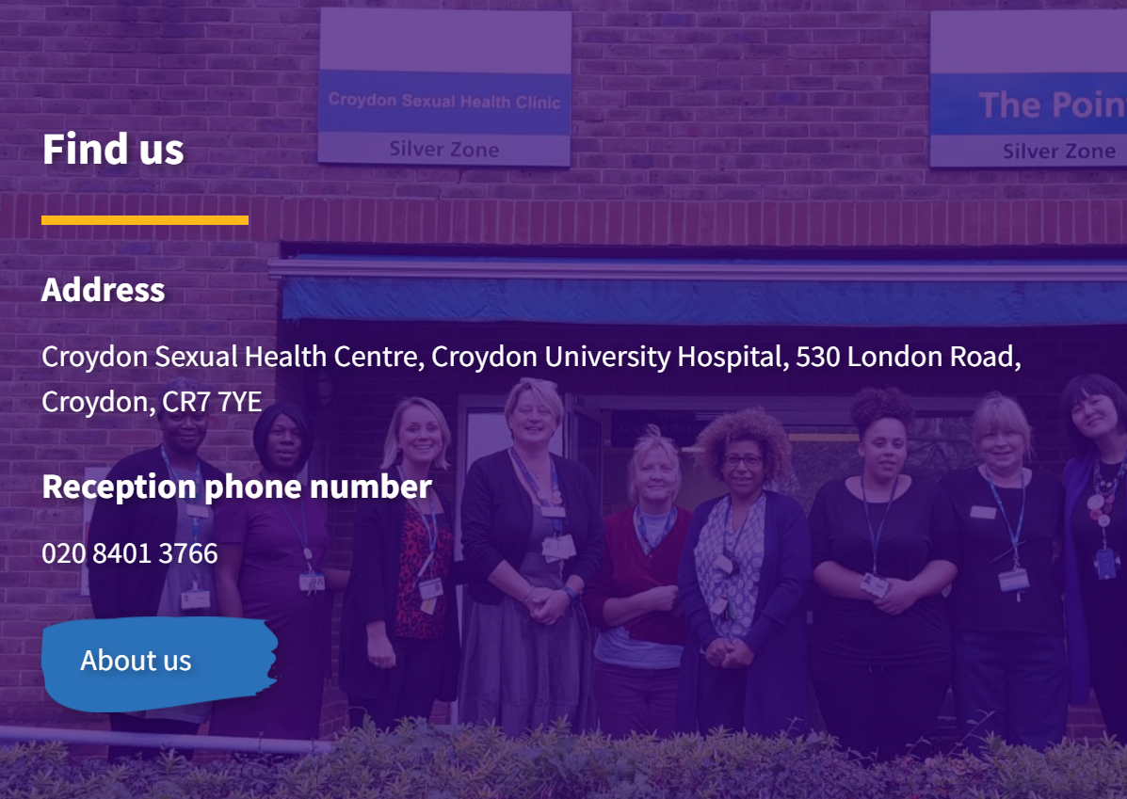
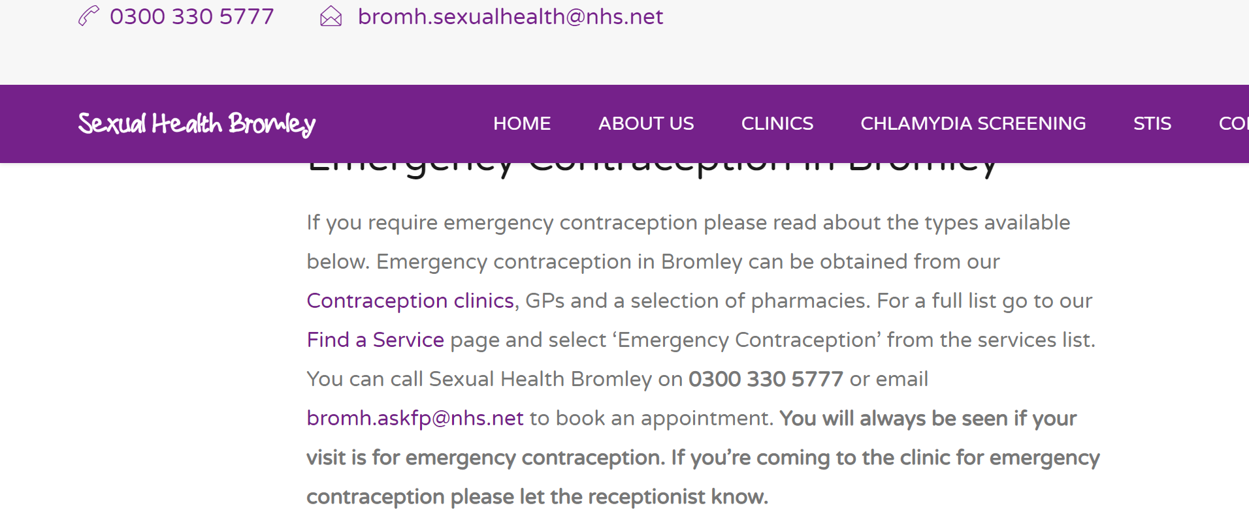
Emergency contraception
The sooner the better (more effective)!
IUD (copper coil)
Up to 5 days after sex or up to 5 days after earliest predicted ovulation
Camberwell Sexual health clinic
Most effective
Can use as ongoing contraception
Emergency Contraceptive Pill
Up to 3 days or 5 days after sex (if no contraindication)
Liaise with Bethlem Pharmacy
More info:
https://www.sexwise.org.uk/contraception/emergency-contraception

Slide 25
True or false?
!
The ‘best’ method is what is right for the individual patient.
A contraceptive choices discussion may consider:
Effectiveness
How methods work
Side effects
(such as bleeding, hormonal side effects) / risks
Contraindications
(such as heart disease, blood clots, breast cancer)

Slide 26
What do we ask in clinic?
Questions you might ask
Questions you might ask
Have you used any contraceptive method(s) in the past?​
What did you like about the method(s)?
What did you dislike about the method(s)?
Why did you stop this method(s)?
What’s important to you in a contraceptive method?
Is there a method you were thinking of using?
Are there two or three methods you’re interested in?
Are there any side-effects you’re particularly worried about?
Are you planning to have a child in the next few years?
What are your periods like?
Have you had experience taking a pill every day? How did that go for you?
Would you like to discuss any non-contraceptive ​benefits of methods?
✓
X
!
?
2 or 3

Slide 27
Contents
Why is this particularly important on the MBU?
Contraception – avoiding jargon
Questions, questions
Referral pathways

Slide 28
Questions from staff
“?”
Discussions about sexual and reproductive health often take place amongst friends on the ward and/or with certain trusted members of staff.
How do you ask patients about sexual health?
How confident do you feel in these discussions?
2 minutes for discussion or reflection.
(at least) 2 staff members to feedback please.

Slide 29
Questions from staff
“?”
How do you ask patients about sexual health?
How confident do you feel in these discussions?
Has SHRINE influenced these discussions?

Slide 30
Asking questions
“?”
Respectful care, avoiding presumptions
Are you sexually active at the moment? I’m wondering if you’re up to date with screening for sexually transmitted infections, have you had sex?
Some patients have infections and don’t have any symptoms. Are you up to date with tests for sexually transmitted infections?
Some patients I speak to have difficulties with sex due to medication or past experience. Do you have difficulties with sex?
Are you planning for a pregnancy? If not, are you using any contraception?
Would you like to discuss this further with a sexual health doctor?

Slide 31
Questions from patients
“?”
What questions, if any, do patients ask you about contraception?
How confident do you feel answering these questions?

Slide 32
Questions from patients
“?”
What questions, if any, do patients ask you about contraception?
How confident do you feel answering these questions?
Let’s talk about this now!

Slide 33
Burning questions for me!
“?”
Any questions about sexual health you’d like clarified?

Slide 34


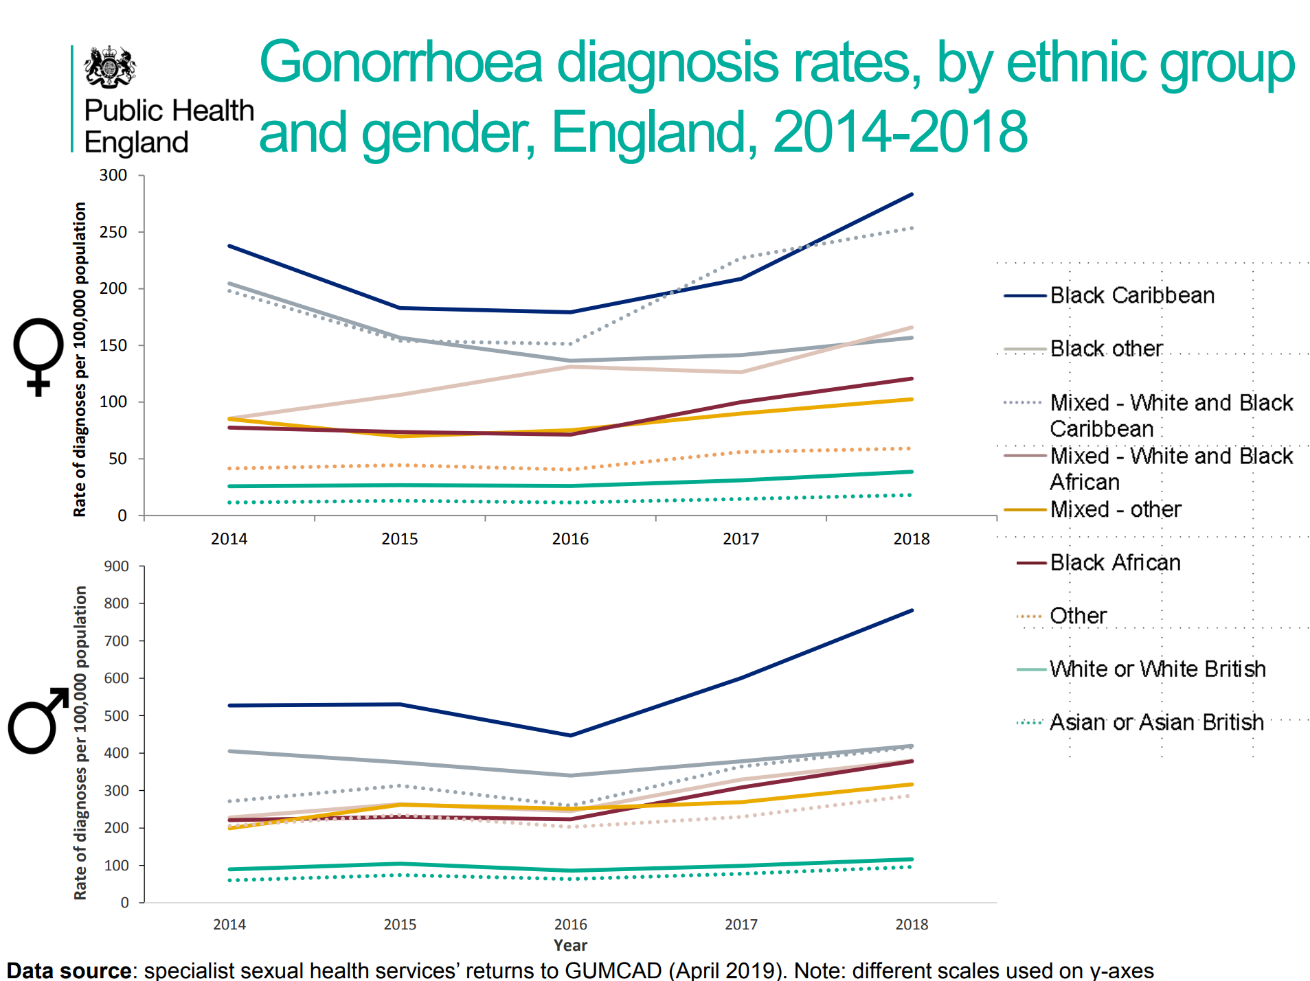
Contraception Choices
https://www.bbc.co.uk/news/av/uk-56765171
https://www.youtube.com/watch?v=-r3sA-XXn6c&t=182s&ab_channel=ContraceptionChoices
More info:
https://www.contraceptionchoices.org/

Slide 35
Contents
Why is this particularly important on the MBU?
Contraception – avoiding jargon
Questions, questions
Referral pathways

Slide 36

Referral pathways
Difficulties with sex – erectile dysfunction,
pain with penetration
Non-specific genital symptoms e.g. itch, discharge,
skin problems
Prolapse ‘feels like something is dragging/coming
out of my vagina’
Smear testing – 3 yearly
Care after sexual violence
Are you sexually active?
If no, ask every 3 months
If yes, when was the last time you had sex?
If in the last 72h → PEP?
If in the last 120h → EC?
Would you like a check up for sexually transmitted infections?
Are you currently having any symptoms?
Such as discharge, pain when urinating, abnormal bleeding, abdominal pain?
If yes, offer symptomatic screen via SHRINE
If no, offer asymptomatic screen via:
Croydon Sexual Health
Please note:
We can discuss contraception/choose a method before patient becomes sexually active again

Slide 37
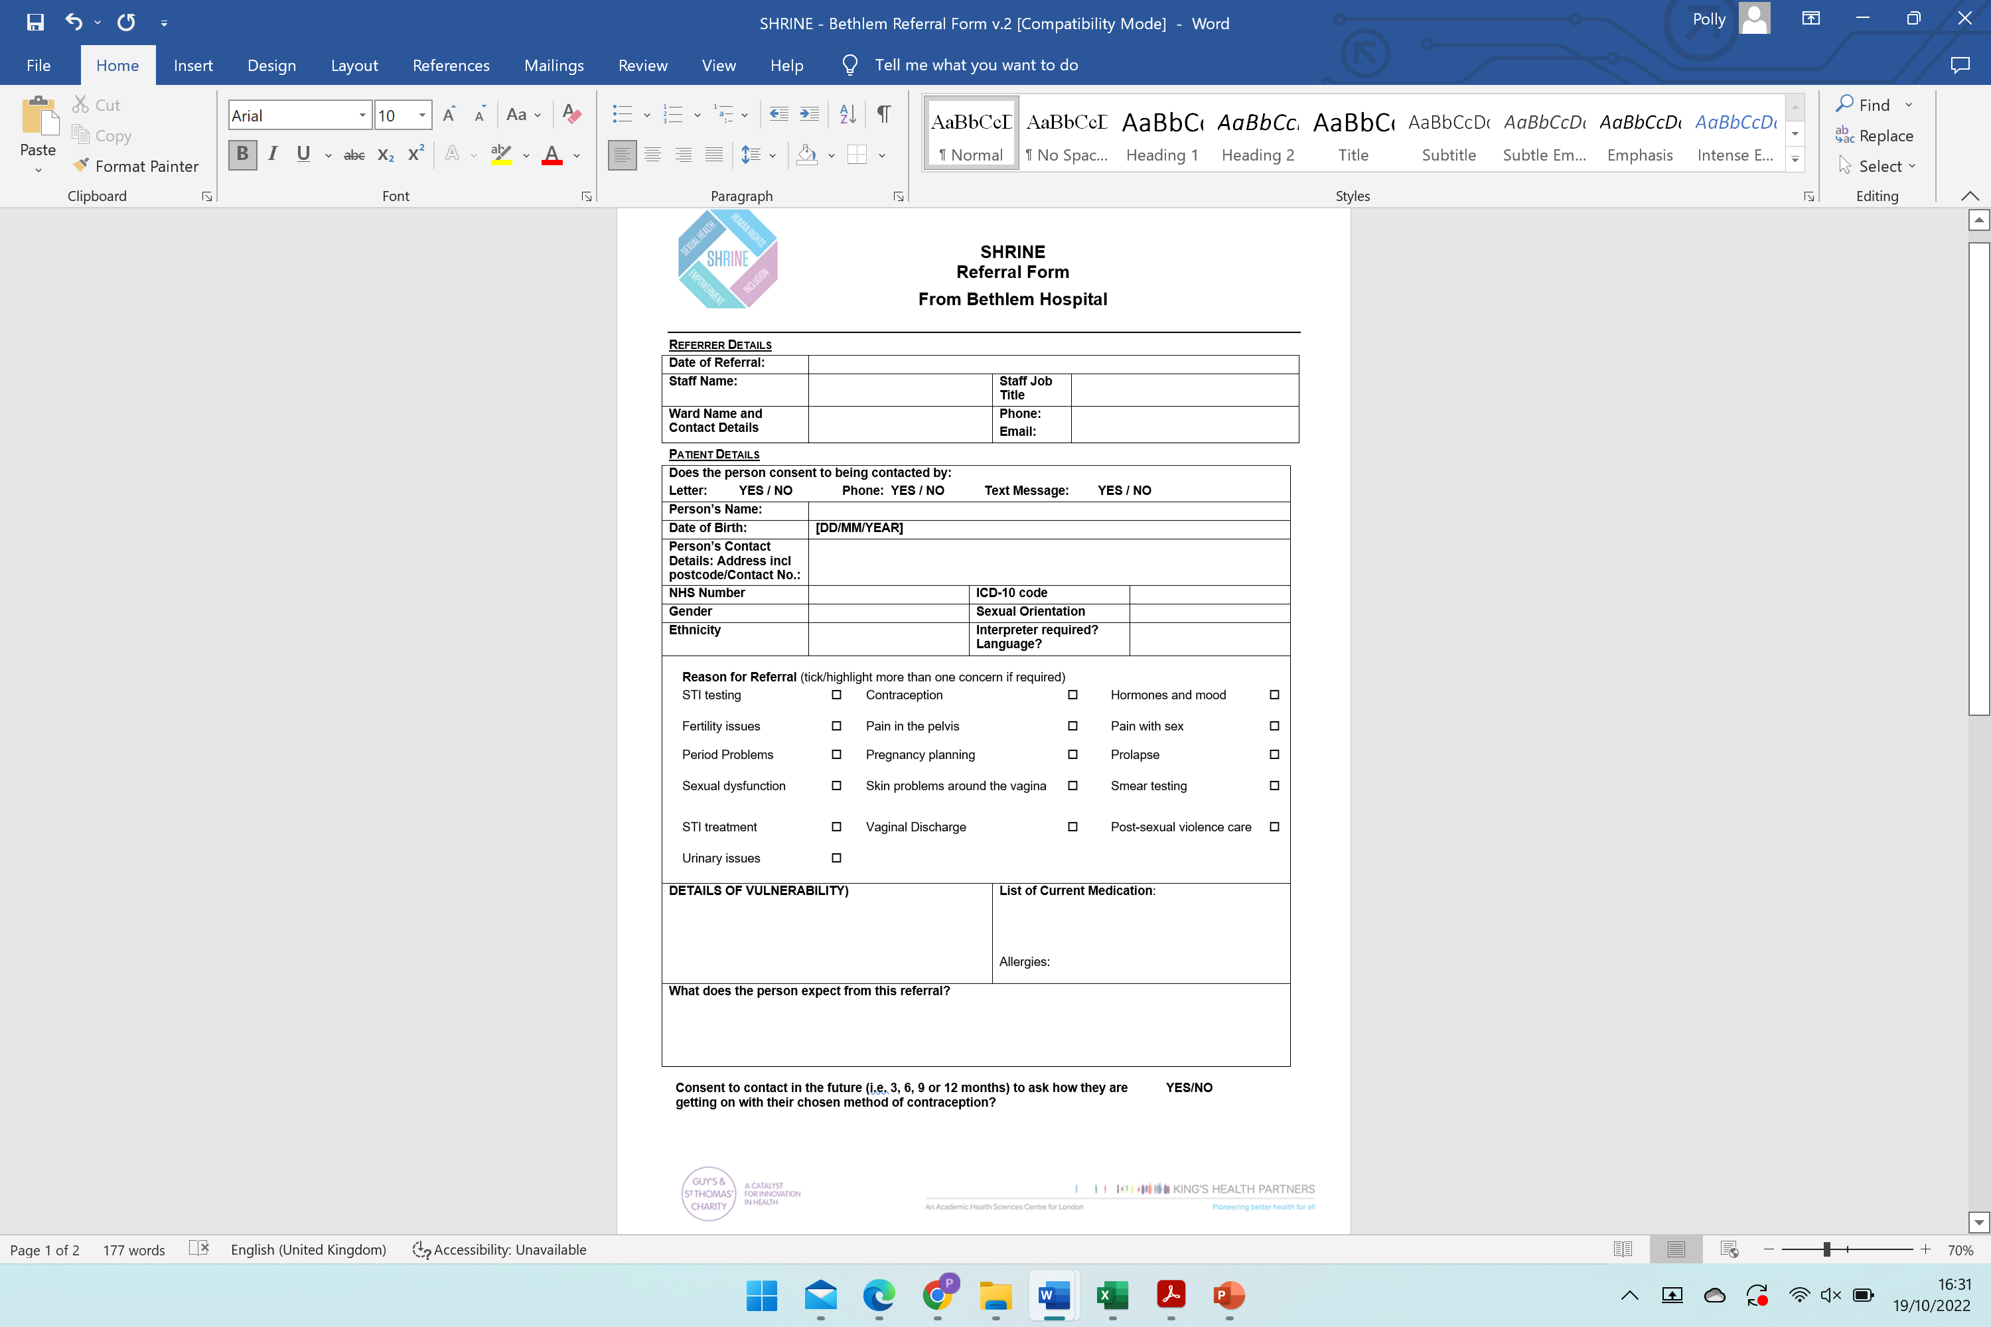
Referral to SHRINE

Slide 38
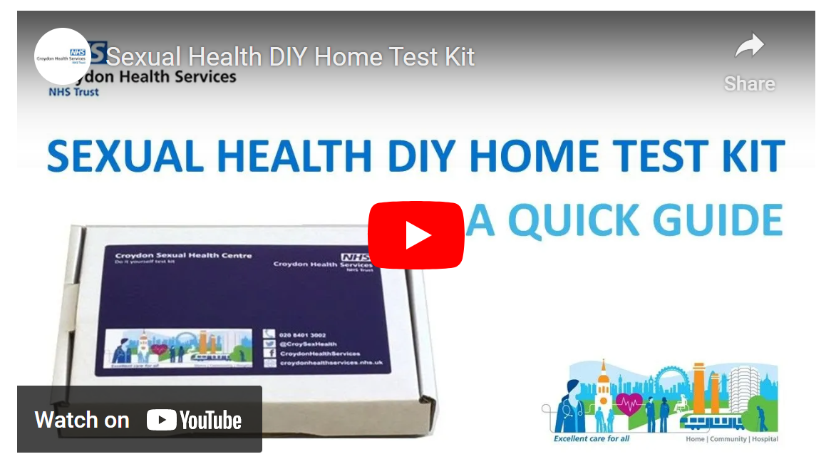
Croydon Sexual Health self-test kit
https://www.croydonsexualhealth.nhs.uk/order-a-self-test-kit/

Slide 39
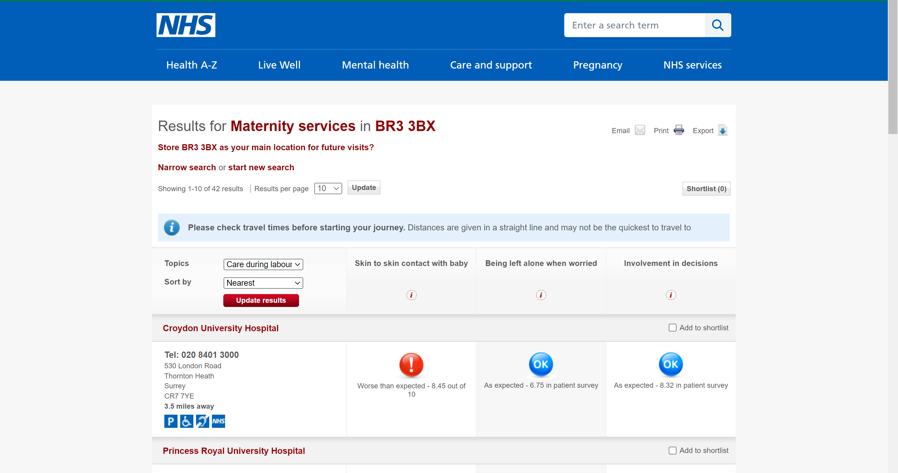
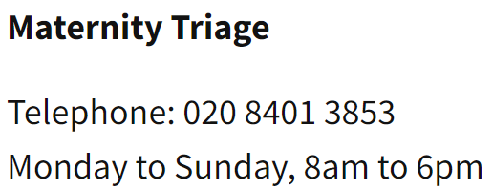

Maternity services
Most self-referral, local unit, safeguarding team
slm-tr.croydonperinatalteam@nhs.net

Slide 40



Abortion services
Decision-making should be in conjunction with the psychiatry team.
BPAS, MSI or NUPAS are the main independent providers (NHS funded).
03457 30 40 30
Bpas.org
0333 004 6666
Nupas.co.uk
0345 300 8090
MSIchoices.org.uk

Slide 41
Key points
Patients with severe mental illness have higher rates of STIs, HIV and unwanted pregnancy
Many psychiatric medications cause sexual dysfunction
Some STIs can be asymptomatic
Many methods of contraception other than the pill and condoms
The most effective methods are implants and IUDs (coils) and you can have them taken out at any time
Use the SHRINE clinic to start a conversation about SRH

Slide 42
Thank you!
Feedback link in the chat or QR below
Dr Polly Cohen
Community Sexual and Reproductive Health ST2
Pollyanna.cohen@nhs.net

