Slide 1


Bethlem Clinic Project (SHRINE) Learning Set 3 21 September 2022

Slide 2
Agenda
Time | Item
14:00 | Welcome and introductions
14:10 | Overview of the SHRINE training offer
14:25 | Data collection
14:35 | Updates from teams
14:55 | Next Steps

Slide 3





Housekeeping
Please can everyone have their camera on.
Please mute your microphone unless you are speaking​.
If you would like to ask a question or make a comment, please use the raise hand function. You can also use the chat.
We will be recording this session and share the link afterwards. If there is anything you would like us to remove from the recording, please let us know.
If you experience any technical difficulties, please email edward.barrett@rcpsych.ac.uk​

Slide 4
Overview of training sessions
Notes:
Polly has extensive experience in delivering training and e-learning
She has lots of experience talking about having difficult conversations with people e.g. about abortion
Opportunity for Q&A at the end of the sessions

Slide 5

Teaching topics
Hi, I’m Polly, an SRH doctor!
Sorry I can’t be there today, but what have I missed which you’d like to hear more about?
Starting the conversation about SRH – When? How? What to say?
Sexually transmitted infections: basics
Identifying risk of pregnancy
Contraception: basics
What can SHRINE offer?

Slide 6
Teaching Styles
Microsoft Teams / Zoom with online quizzing
Live in-person?
  During MDT?
  During set teaching time?
E-learning: videos/quizzes.
Summary sheet hand-outs to be provided.
How would you like to learn? What would work best?

Slide 7
Data collection

Slide 8
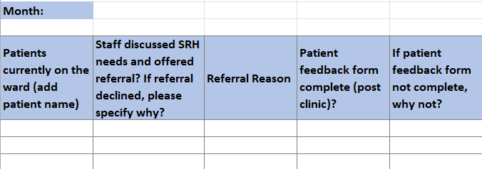
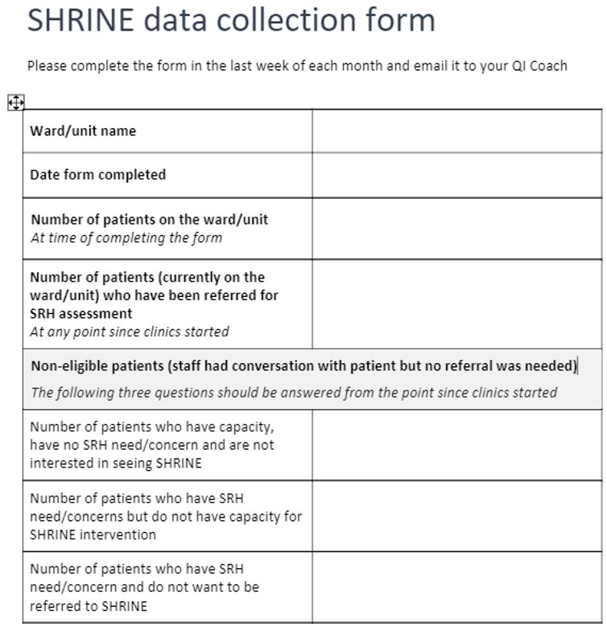
Data collection process
Refer patients to clinics using the SHRINE referral form
Complete the SHRINE monthly totals spreadsheet (This is for your information only, we do not need to see this spreadsheet so there is no need to anonymise the data)
At the end of each month, using the monthly total spreadsheet (above), complete the SHRINE data collection form and return to your QI Coach
When a patient has attended the clinic, ask them to complete the SHRINE patient feedback form
Notes:
- Check if all have received the updated (and simplified) referral form from Elana
- Has anyone started collecting data and using the spreadsheet?
- Are you giving the feedback form to patients who attend clinics?

Slide 9
Update from teams
Have you started doing anything differently since the SRH clinics started (e.g. to encourage patients to attend clinics, to normalise conversations about SRH, etc?)
Anything you are planning to do?
How are you engaging patients and the wider team?
Is there anything else we can do to support you?
Notes:
Give a brief overview of how QI coaches are supporting teams
Share examples of ideas being tested/planned at MBU and Spring Ward

Slide 10
Close and next steps
Notes:
Next session, inviting Rachel from the East London Foundation Trust to talk about a similar QI project her team did at ELFT
Engage with your QI coach
Collect data

