Slide 1
#Just Say Hello:
Community suicide prevention campaign
Chris Pyburn
Public Health Manager
Suffolk County Council

Slide 2
The context
Around 65 people die by suicide each year in Suffolk (this is on par with the England average)
Evidence suggests that each death by suicide affects 60 other people, and six severely (Pitman)
The cost of each death by suicide has been estimated at £1.7m (Knapp et al)
3 in every 4 deaths by suicide affect men and suicide is the most common form of death among under 45 year old men
The majority of deaths by suicide occur in the home
75% of deaths by suicide affect people who have had no contact with mental health services, or even their GP, in the 12 months preceding their death

Slide 3
Building on a history of effective partnership working
Suffolk was among the first in the country to produce a local suicide prevention action plan in 2016
Coordinated work across all health and wellbeing partners, voluntary sector agencies, businesses and others where it contributes to effective suicide prevention
Taking a population focus to plan and prioritise the approach, coupled with a place-based focus where there is specific need for intervention at local level

Slide 4
Refreshing the plan for Suffolk (2022-25)
Priorities in line with the Cross-Government Suicide Prevention Workplan (2019):
Reducing the risk of suicide in high risk groups
Tailor approaches to improve mental health in specific groups
Reduce access to the means of suicide
Provide better information and support to those bereaved or affected by suicide
Support the media in delivering sensitive approaches to suicide and suicidal behaviour
Support research, data collection and monitoring
Reducing rates of self harm as an indicator for suicide risk

Slide 5

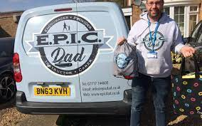
Learning from NHSE funded programme (2019-22)
Community funded projects were very effective at supporting men’s mental health
Supporting community conversations through work with football clubs, barbers, taxi drivers and tattooists

Slide 6
Supporting good mental health and community wellbeing is key to effective upstream suicide prevention

Slide 7
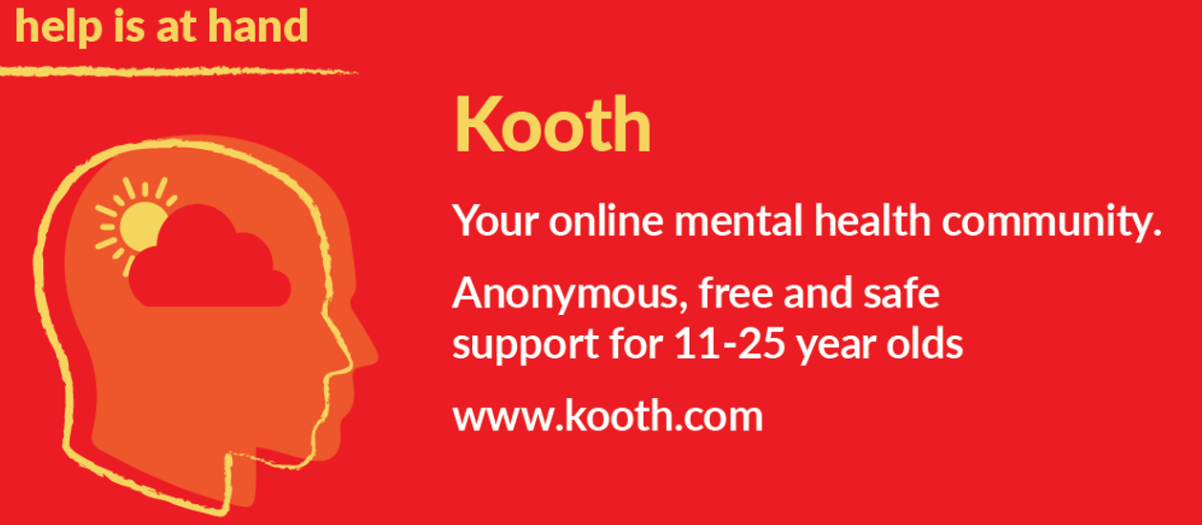
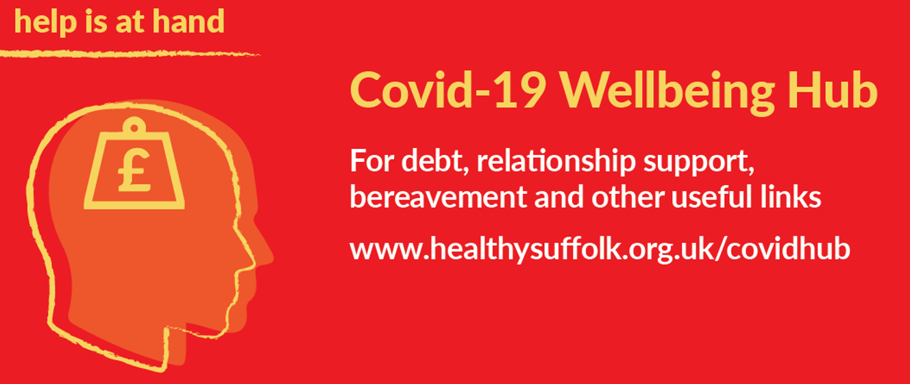
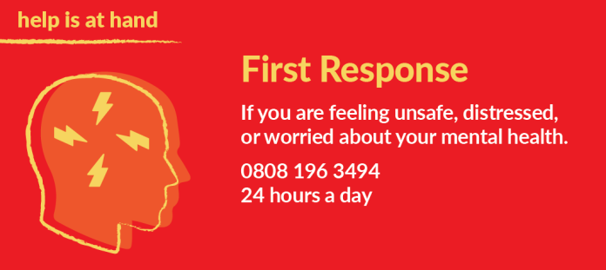
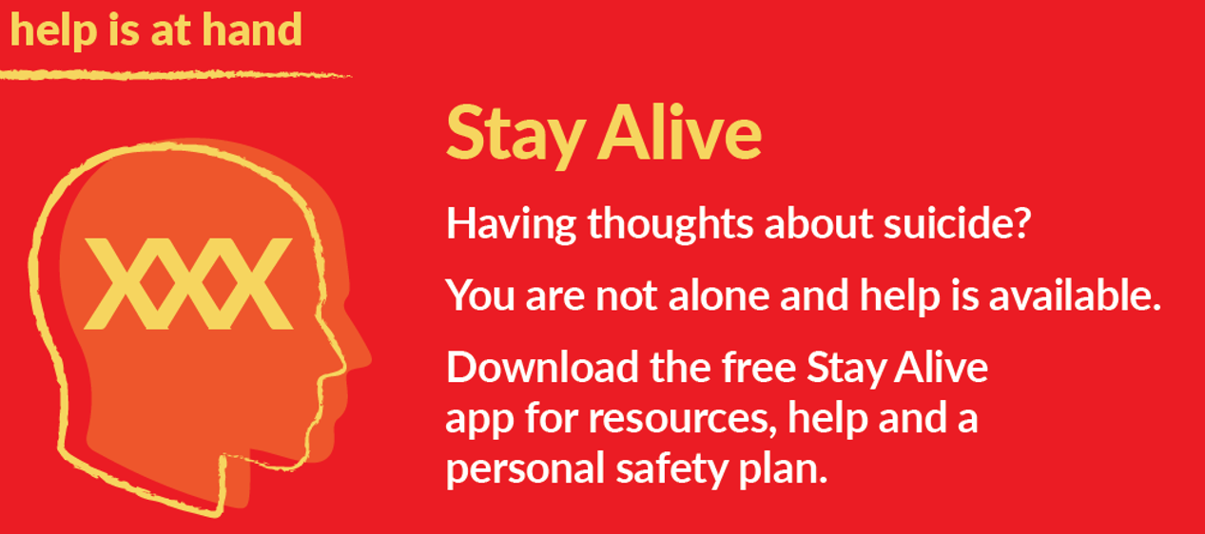
Building awareness of mental health support throughout Covid-19 pandemic

Slide 8
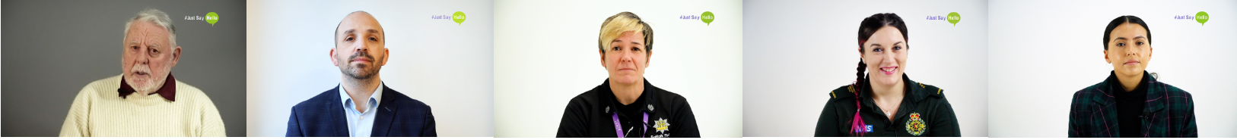
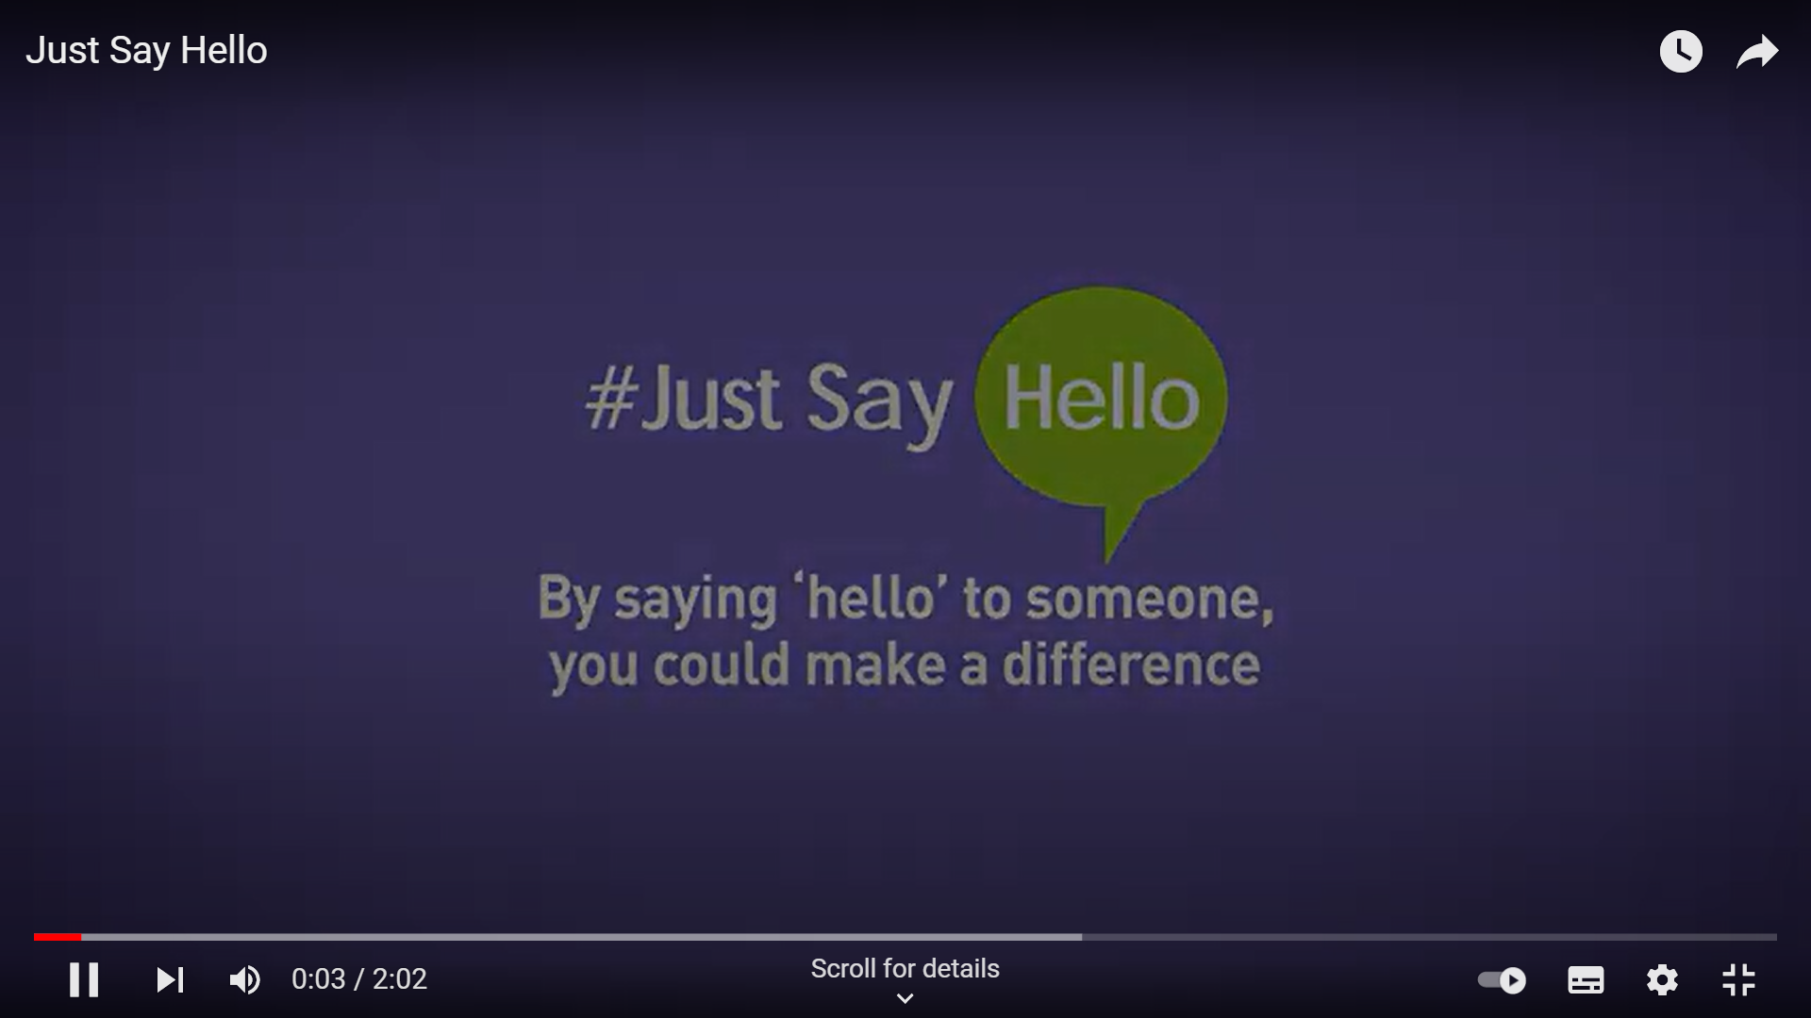
Creating a new film

Slide 9
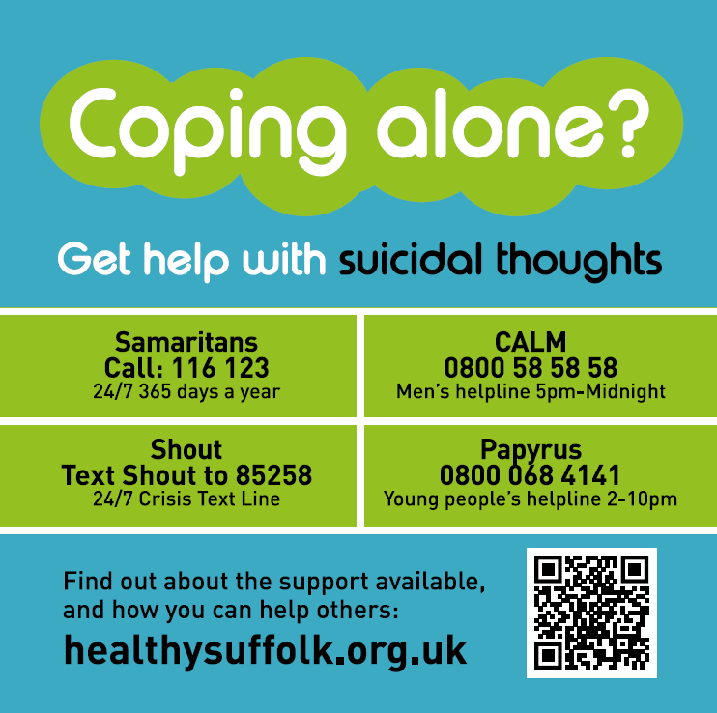
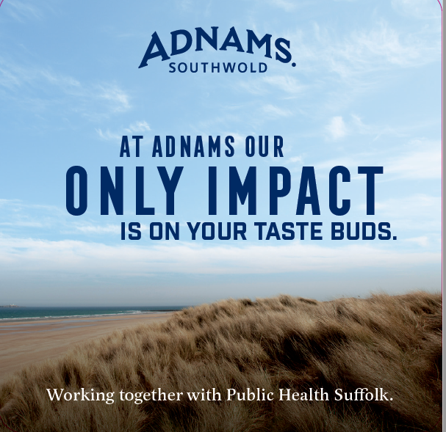
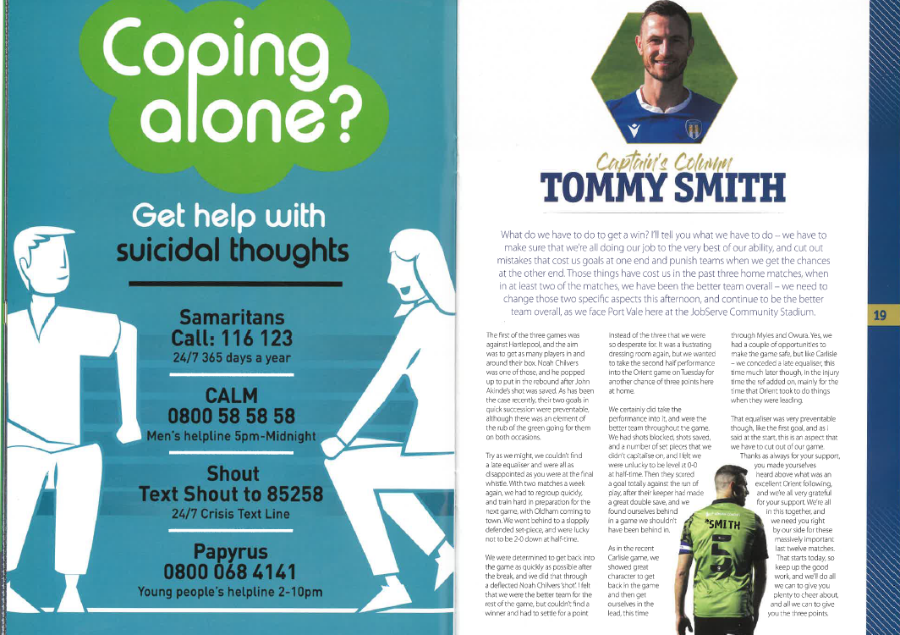
Broadening the reach with other community partners
Working with
Adnams
Greene King
Ipswich Town FC
Colchester FC
Gyms, sports clubs
Men’s community funded projects

Slide 10
Impact of #Just Say Hello and next steps
Almost 600 views on YouTube and widely shared across partner networks
Using the campaign to drive interest in a localised programme for the free Zero Suicide Alliance training
Integrating #Just Say Hello as central campaign message for Suffolk
Continuing to share and promote case study films

Slide 11
For further information
Contact Chris Pyburn, Public Health Manager
01473 263742, chris.pyburn@suffolk.gov.uk
Find the ZSA Zero Suicide Alliance training
Suicide data - Healthy Suffolk
www.healthysuffolk.org.uk

