Slide 1




National Confidential Inquiry into Suicide and Safety in Mental Health
STP Learning Day
Latest findings on self-harm and suicide prevention
June 2022
Professor Nav Kapur

Slide 2
Outline
Data
Young People
Ethnicity
Our annual report

Slide 3
Outline
Data
Young People
Ethnicity
Our annual report

Slide 4
Real-time suicide surveillance in the general population
No rise in the number of suspected suicides
This finding is reflected in ONS findings
Lockdown
Lockdown
UK_SUICIDE (2009-201)
© National Confidential Inquiry into Suicide and Safety in Mental Health. All rights reserved.
Not to be reproduced in whole or part without the permission of the copyright holder.

Slide 5
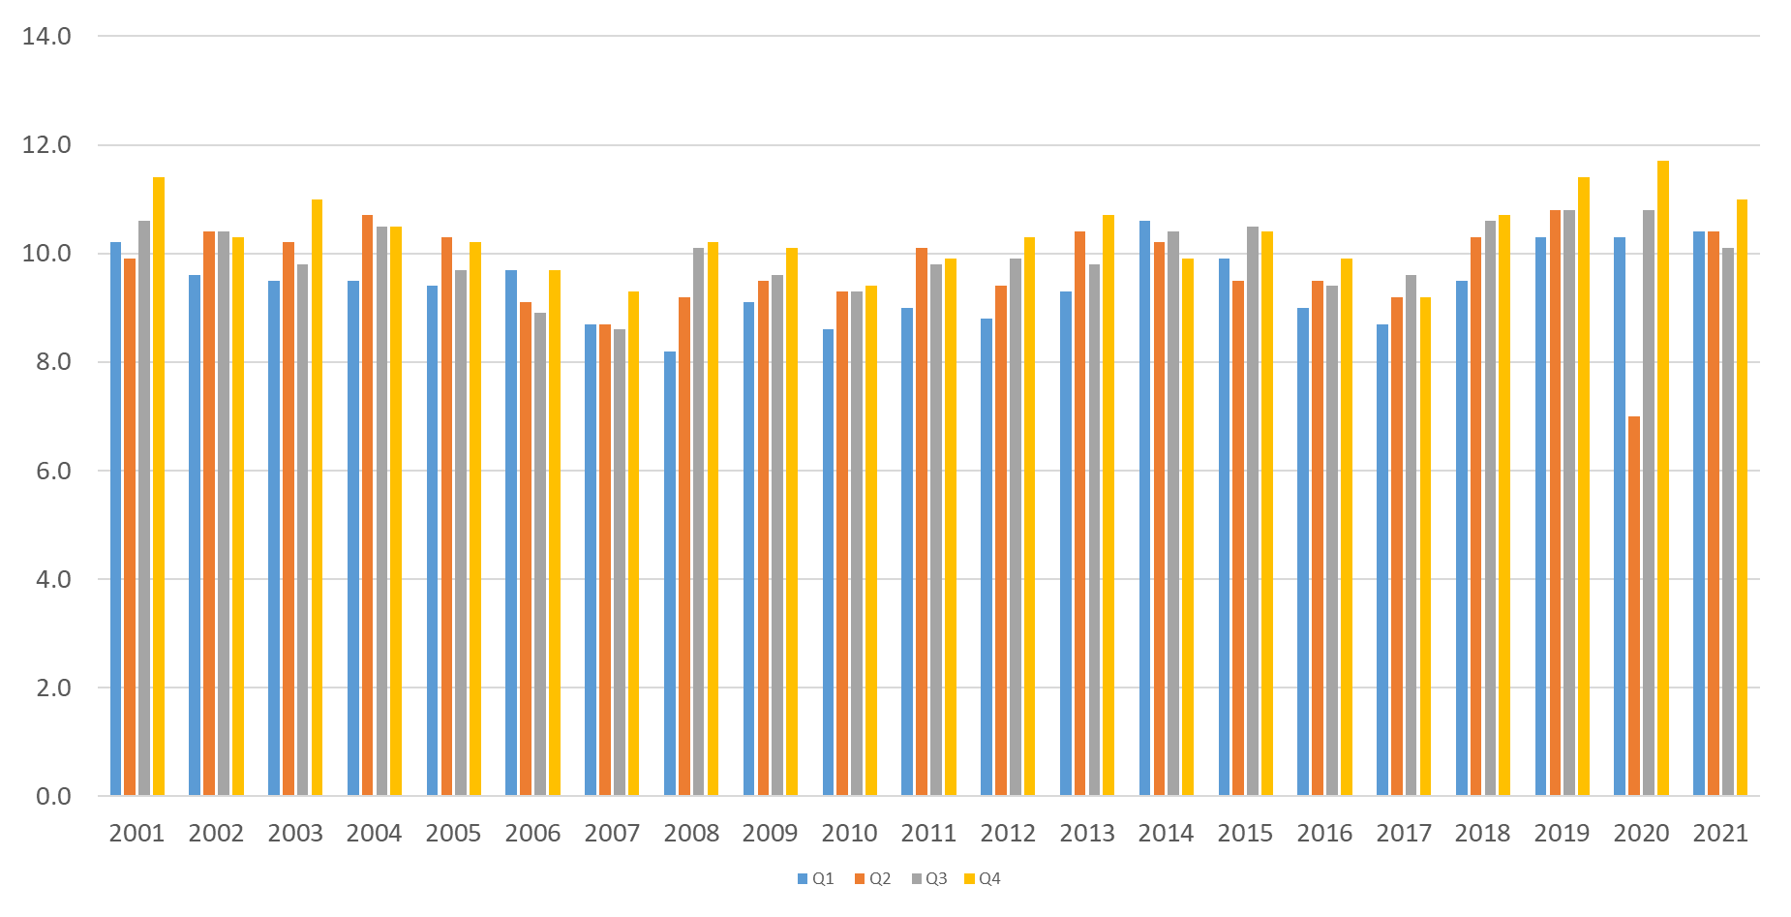
ONS data on suicide (registrations)
https://www.ons.gov.uk/peoplepopulationandcommunity/birthsdeathsandmarriages/deaths/bulletins/quarterlysuicidedeathregistrationsinengland/2001to2020registrationsandquarter1jantomartoquarter4octtodec2021provisionaldata

Slide 6
Suicide in children (ONS)
https://www.ons.gov.uk/peoplepopulationandcommunity/birthsdeathsandmarriages/deaths/adhocs/14550numberofsuicidesinchildrenagedunder18yearsinenglandoccurringbetween2015and2020

Slide 7
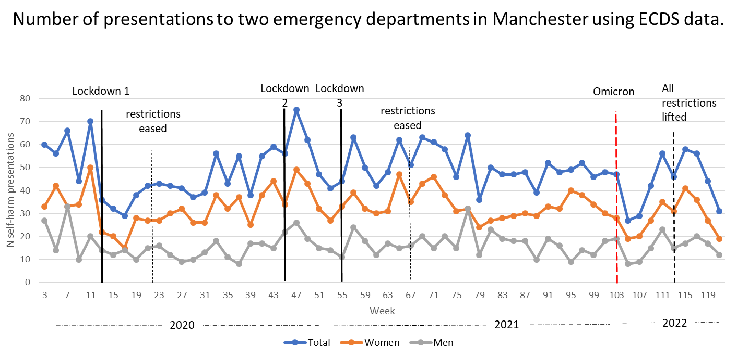
Self-harm (hospital presentations)

Slide 8
Outline
Data
Young People
Ethnicity
Our annual report

Slide 9
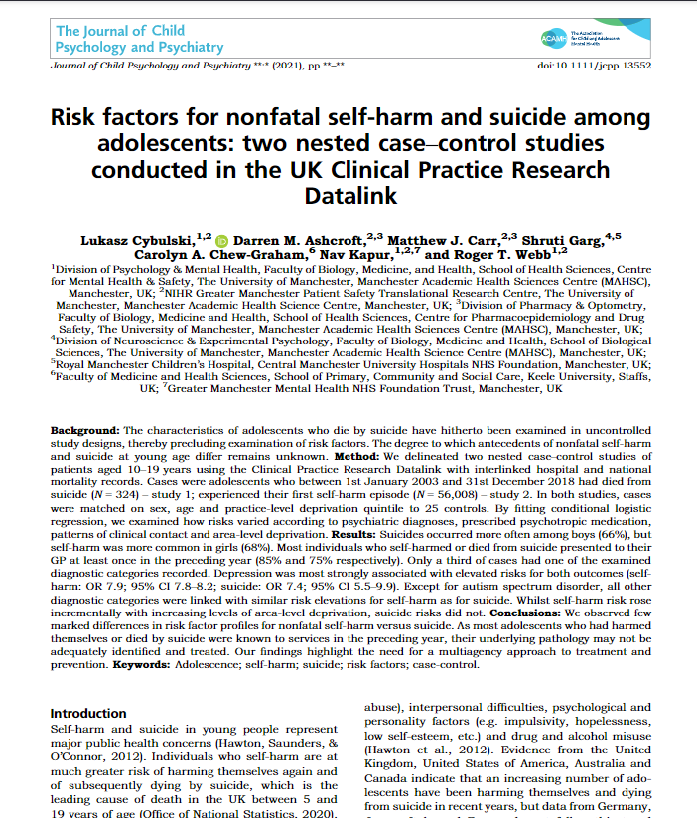
Young people
Most young people who had self-harmed (75%) or died from suicide (85%) had seen their GP in the previous year.
Around 2/3 of young people who had died from suicide had a history of previous self-harm.
Only one third of people had a recorded psychiatric diagnosis before their death or first self-harm event.
Cybulski L, Ashcroft DM, Carr MJ, Garg S, Chew‐Graham CA, Kapur N, Webb RT. Risk factors for nonfatal self‐harm and suicide among adolescents: two nested case–control studies conducted in the UK Clinical Practice Research Datalink. Journal of child psychology and psychiatry. 2021 Dec 4.

Slide 10
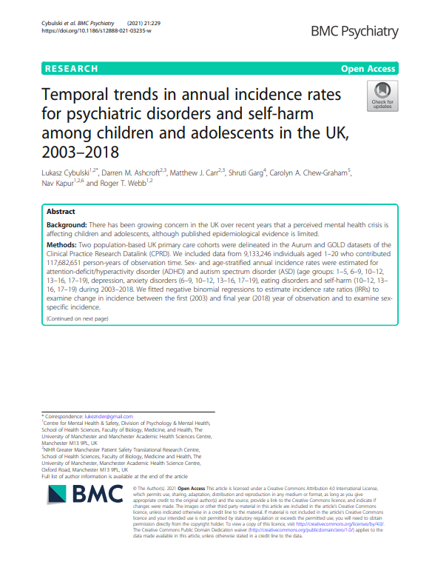
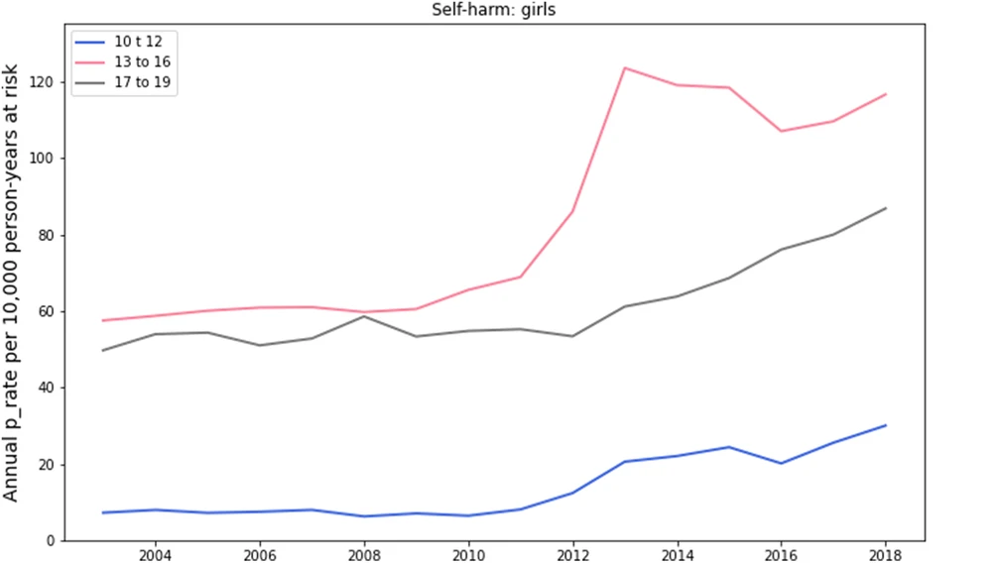
Young people
Cybulski L, Ashcroft DM, Carr MJ, Garg S, Chew-Graham CA, Kapur N, Webb RT. Temporal trends in annual incidence rates for psychiatric disorders and self-harm among children and adolescents in the UK, 2003–2018. BMC psychiatry. 2021 Dec;21(1):1-2.

Slide 11
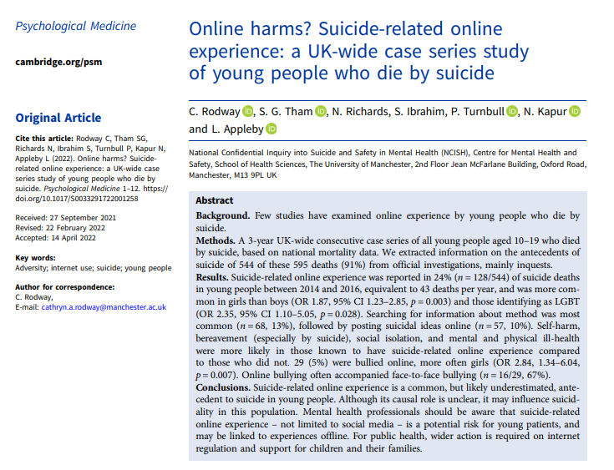
Online harms?
https://www.cambridge.org/core/journals/psychological-medicine/article/online-harms-suiciderelated-online-experience-a-ukwide-case-series-study-of-young-people-who-die-by-suicide/BDF430691070BACDC1A14D12D66677E7

Slide 12
Outline
Data
Young People
Ethnicity
Our annual report

Slide 13
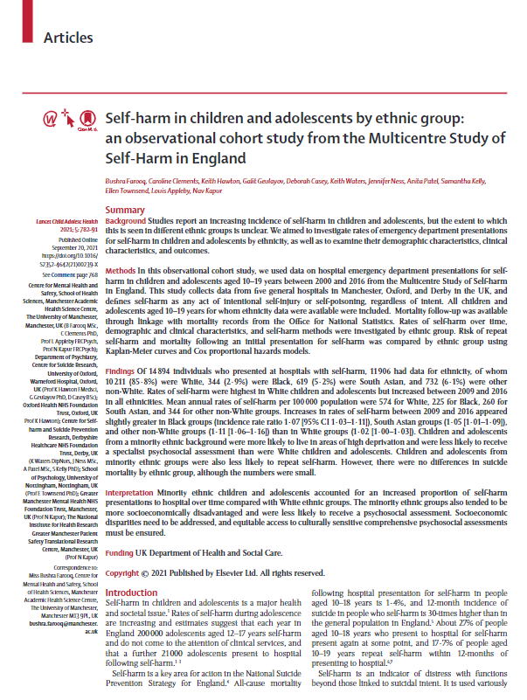
Ethnicity
Young People from ethnic minority groups:
↑ Deprivation
↓psychosocial assessment
↓mental health care
↑ no follow up
↓repetition
Similar incidence of suicide
Farooq B, Clements C, Hawton K, Geulayov G, Casey D, Waters K, Ness J, Patel A, Kelly S, Townsend E, Appleby L. Self-harm in children and adolescents by ethnic group: an observational cohort study from the Multicentre Study of Self-Harm in England. The Lancet Child & Adolescent Health. 2021 Nov 1;5(11):782-91.

Slide 14
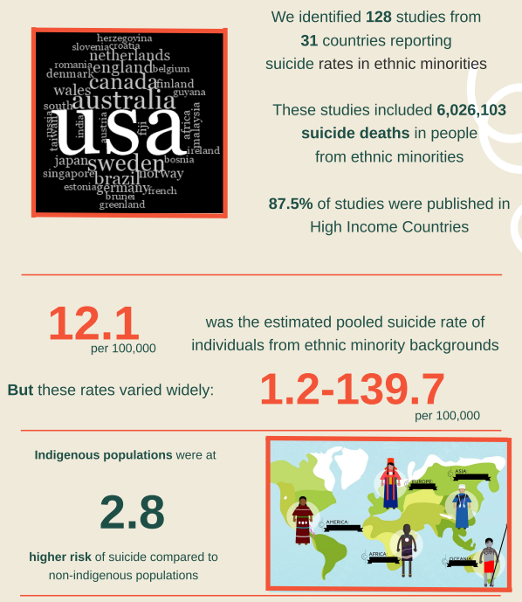
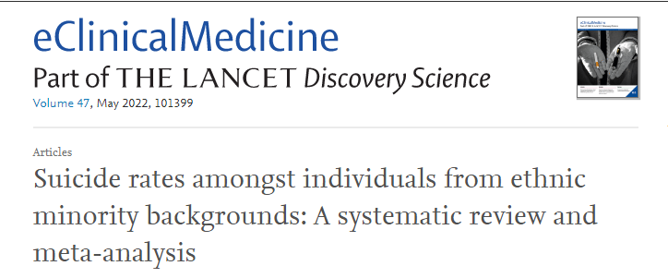

Ethnicity
https://www.sciencedirect.com/science/article/pii/S2589537022001298
https://cpb-eu-w2.wpmucdn.com/blogs.bristol.ac.uk/dist/3/343/files/2022/06/Infographic_finalversion01_06_22.pdf

Slide 15
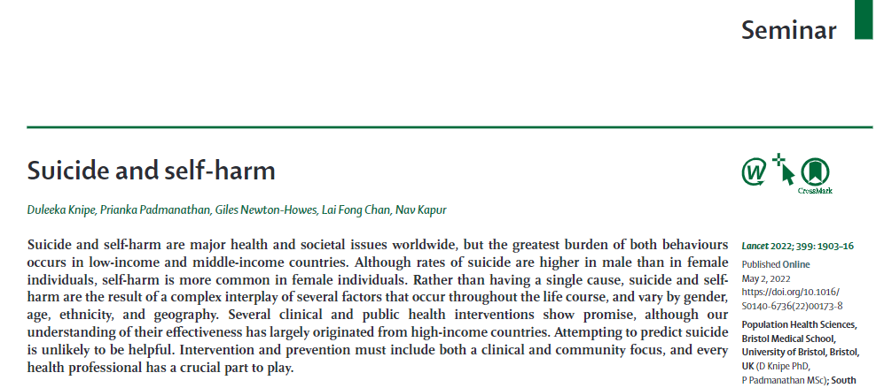
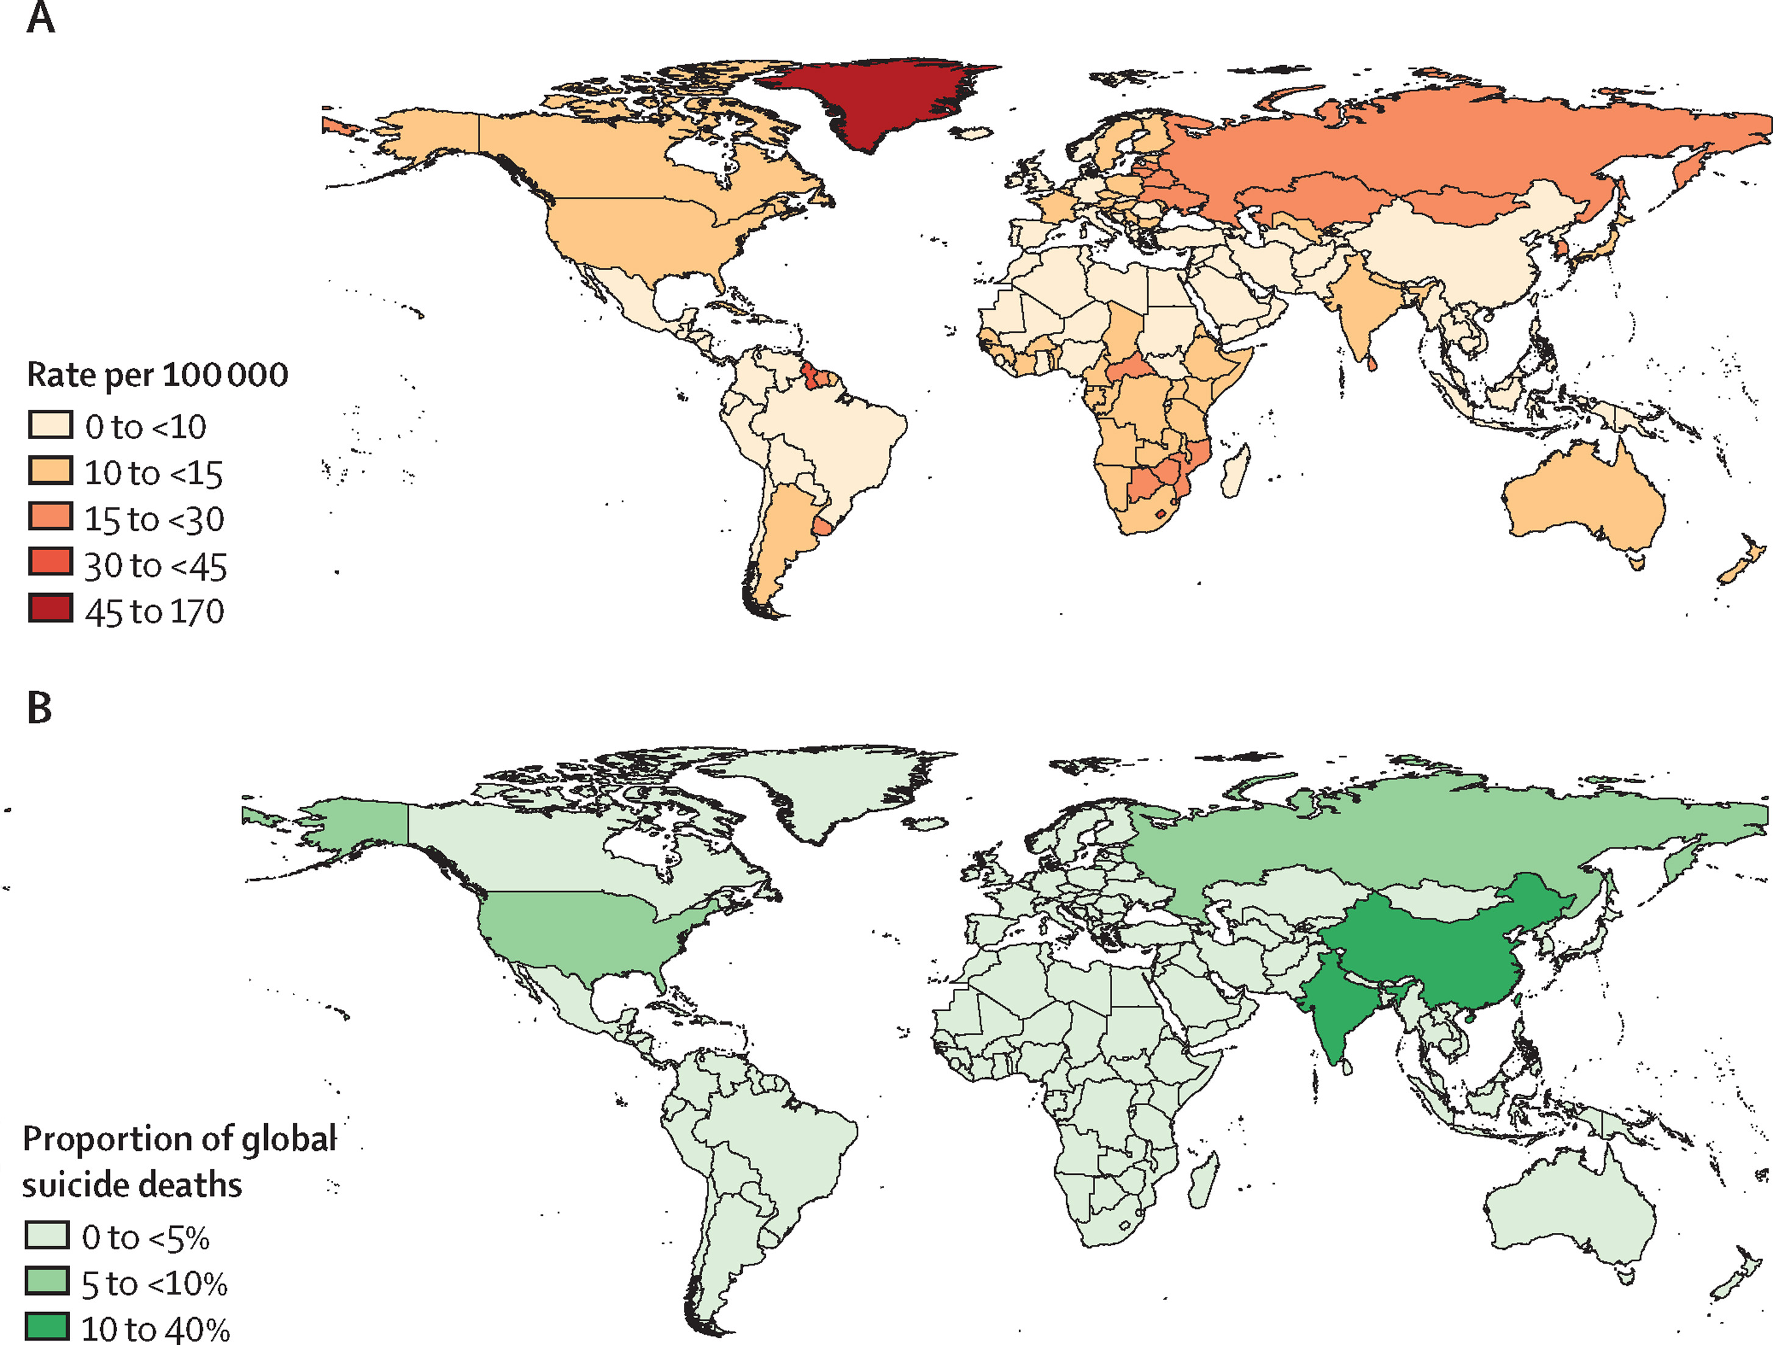

Suicide as a global issue
https://www.sciencedirect.com/science/article/pii/S0140673622001738

Slide 16
Outline
Data
Young People
Ethnicity
Our annual report

Slide 17
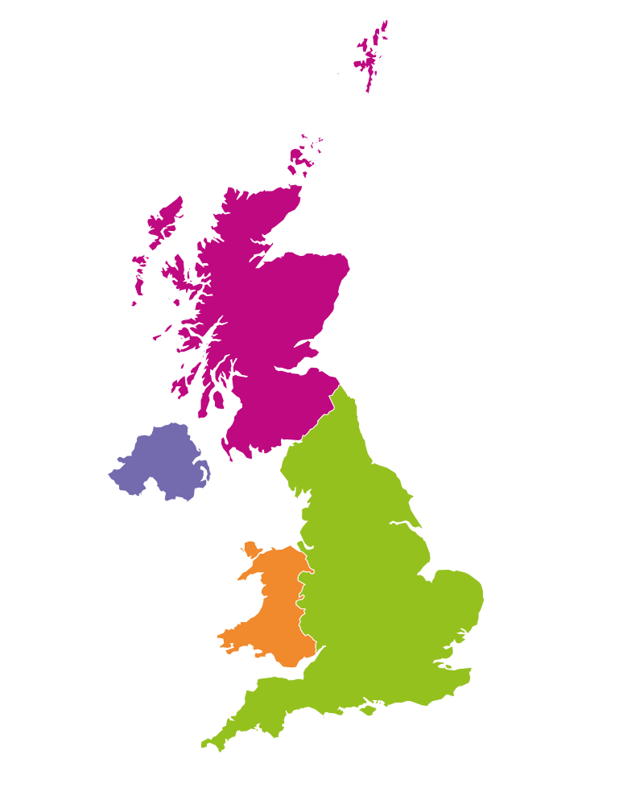
Annual report 2022
Suicide 2009-19
Northern Ireland
2,478 suicide deaths
0,579 (25%) patients
Scotland
8,447 suicide deaths
2,645 (31%) patients
Note: patient data unavailable in Northern Ireland
in 2018
Wales
3,756 suicide deaths
0,836 (22%) patients
England
52,310 suicide deaths
14,208 (27%) patients
UK_SUICIDE (2009-2019)
© National Confidential Inquiry into Suicide and Safety in Mental Health. All rights reserved.
Not to be reproduced in whole or part without the permission of the copyright holder.

Slide 18




  3,345 (18%) patients with recent economic adversity
Often middle-aged (45%) male (74%),
Over half were unemployed (55%) with alcohol (53%) or drug misuse (41%)
Disengagement with services was common, over a quarter (26%) missed their last appointment, non-adherence with medication (15%)
Nearly half were living alone (49%), many were divorced (29%)

Slide 19
  Patients with a history of domestic violence (2015-2019)
149
deaths per year
10% of patient suicides
Notes: *2015 was the start of data collection and is therefore incomplete.
Male and female numbers in 2018 do not total the overall figure due to rounding.
Patient data unavailable in Northern Ireland in 2019.
UK_SUICIDE (2009-2019)
© National Confidential Inquiry into Suicide and Safety in Mental Health. All rights reserved.
Not to be reproduced in whole or part without the permission of the copyright holder.

Slide 20
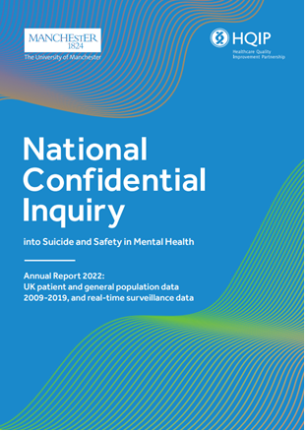
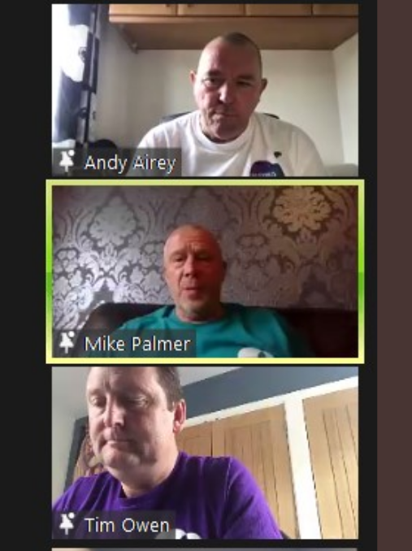
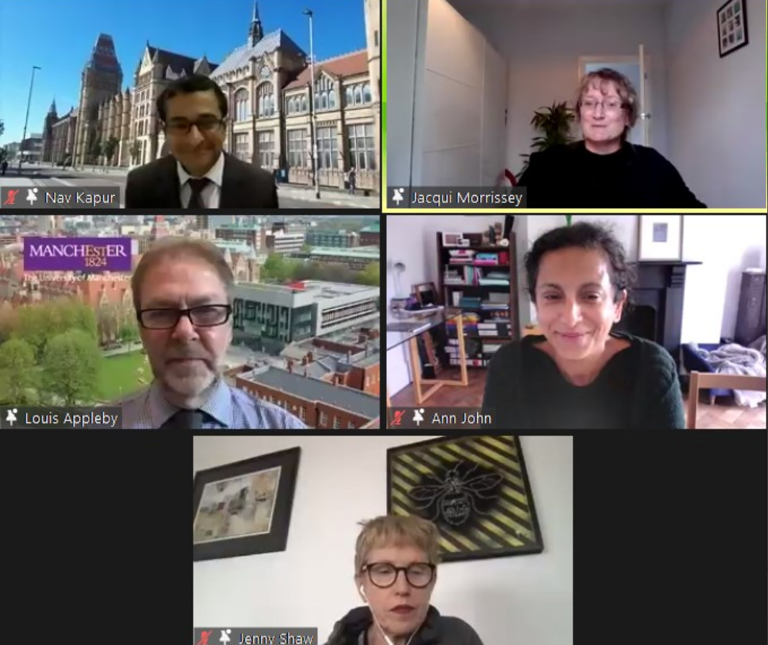
Annual report 2022
https://sites.manchester.ac.uk/ncish/reports/annual-report-2022/
https://sites.manchester.ac.uk/ncish/resources/data-slides/

Slide 21
Outline
Data
Young People
Ethnicity
Our annual report

Slide 22
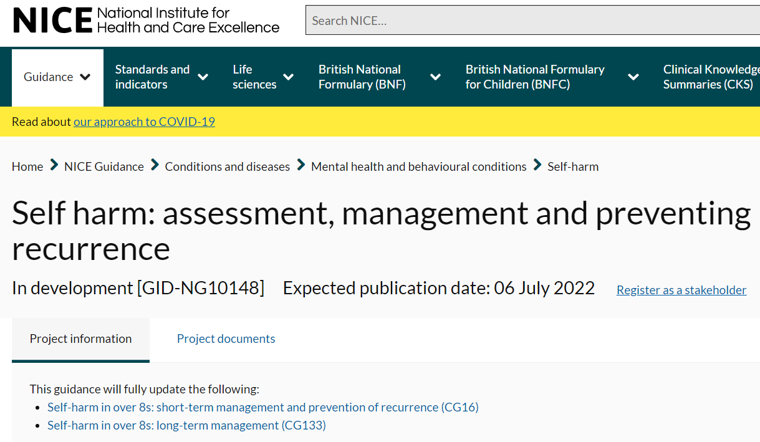
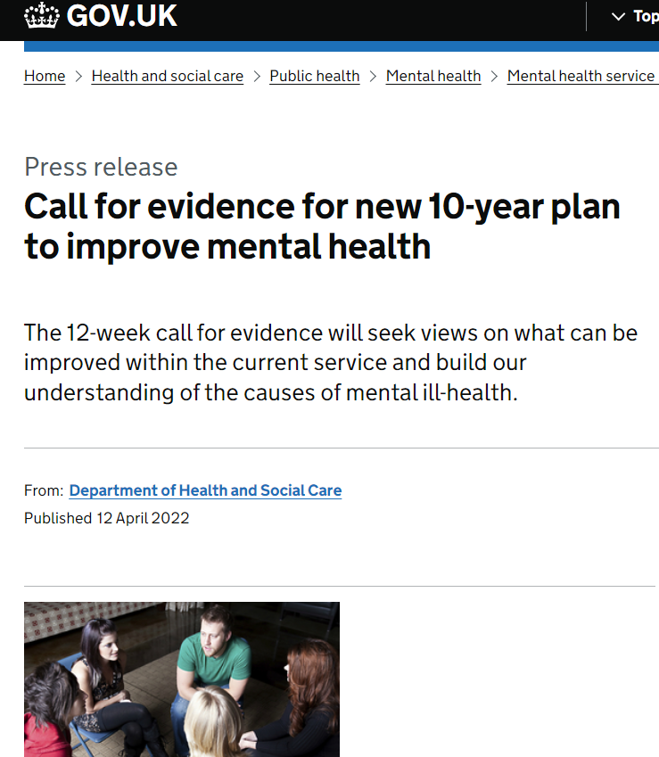
Upcoming….
https://www.nice.org.uk/guidance/indevelopment/gid-ng10148
https://www.gov.uk/government/consultations/mental-health-and-wellbeing-plan-discussion-paper-and-call-for-evidence

Slide 23
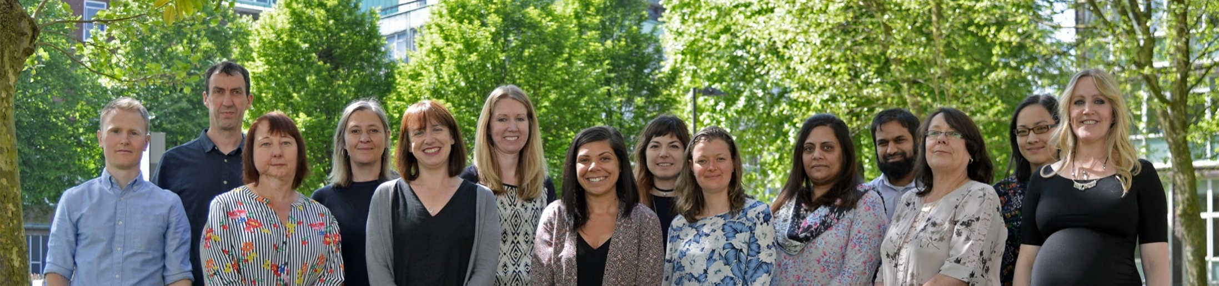
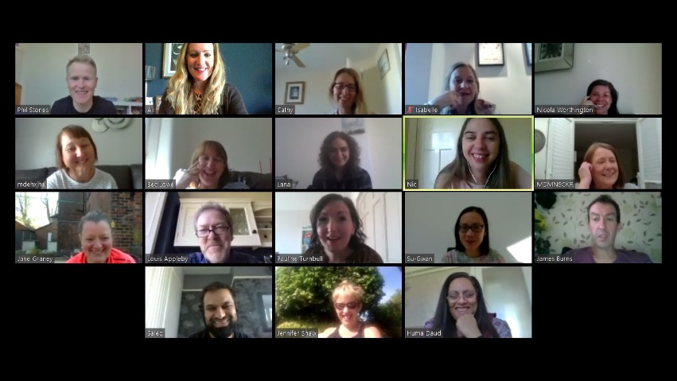








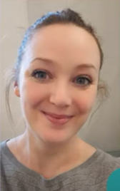



Centre for Mental Health and Safety
@NCISH_UK
@mashproject
@PSTRC_GM

