Slide 1


Learning Set 10: latest findings on suicide prevention
31 May 2023
Professor Louis Appleby
Source: ONS

Slide 2









Suicide Prevention Strategy in 2023
Ethnicity
Domestic violence
Online harms
Updated suicide prevention priorities
Gambling
Economic stresses
Covid impact
Pre-Covid trends, eg CYP
LGBT
Data

Slide 3
Suicide rate, England 1981-2022
Age-standardised suicide rates, England, registered
ASMRs per 100,000 people
Persons
Source: ONS

Slide 4
Suicide rates, date of occurrence, England 2013-2021
Age-standardised suicide rates by sex, England, date of occurrence
ASMRs per 100,000 people
Source: ONS

Slide 5
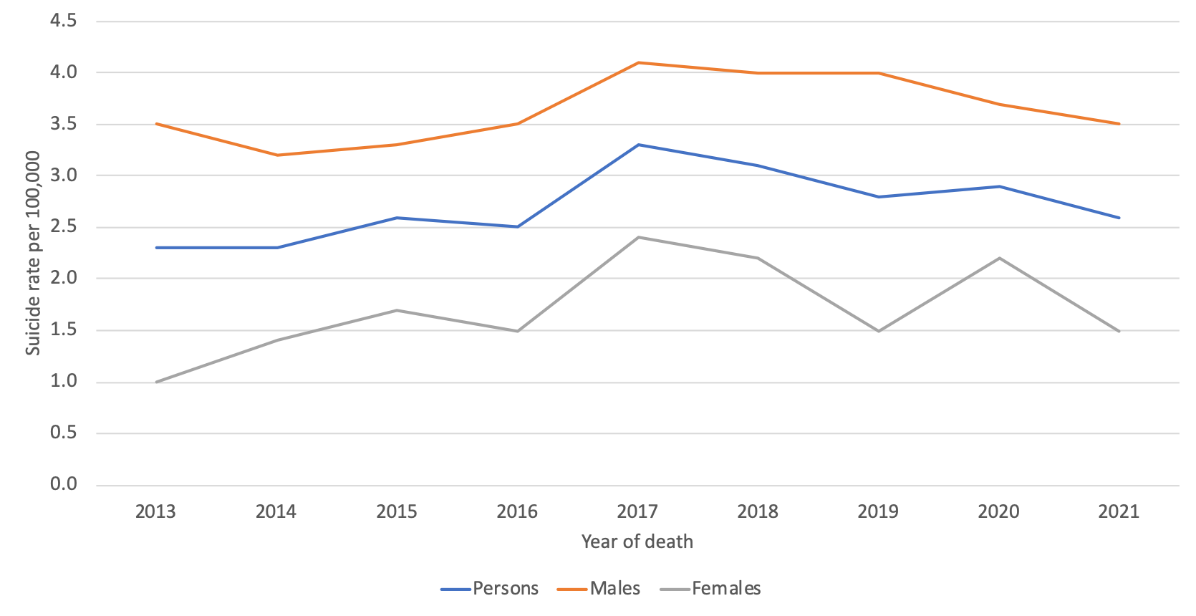
Suicide rates, 10-19 year olds, England
Source: ONS (2023)

Slide 6










Common themes in young suicides: national study
Online risk 24%
Had been in care 8%
Family factors 23%
Isolation 21%
Abuse 11%
Physical health 30%
Bereavement 25%
Alc/drug use 42%
Bullying 19%
LGBT 5%
Academic pressures 32%
Source: NCISH

Slide 7
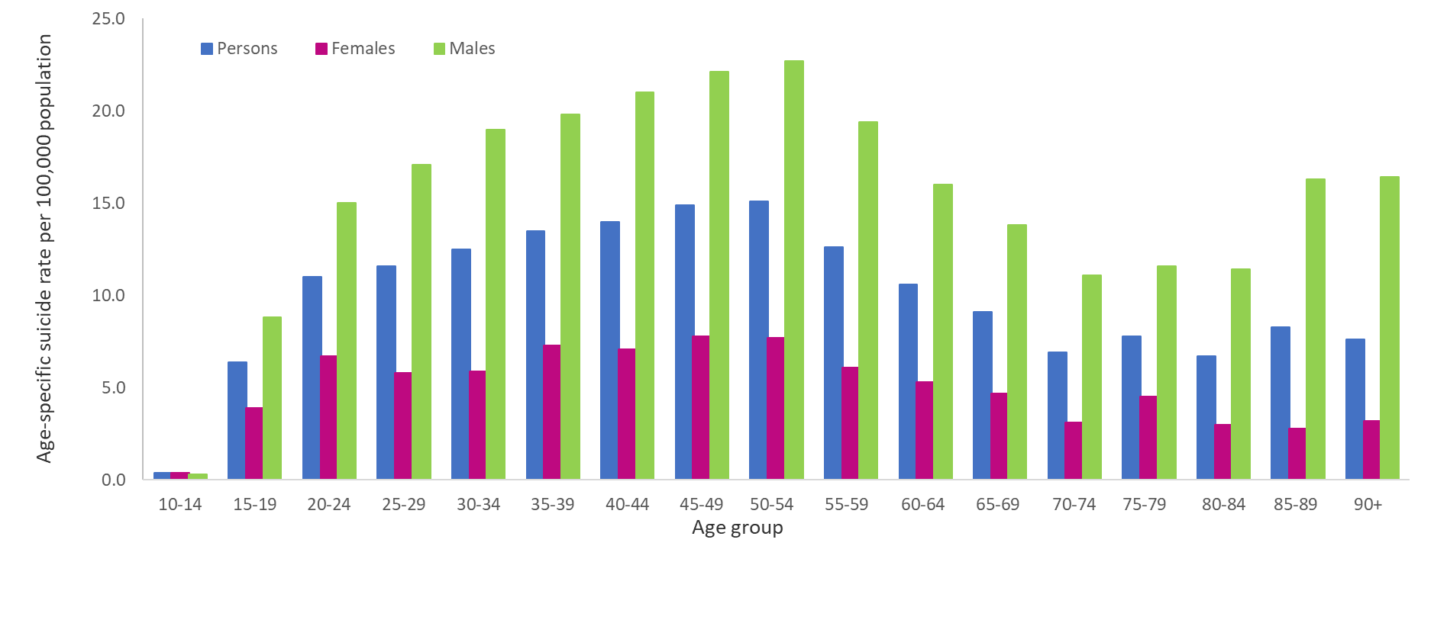
Suicide in age and sex groups
Age-specific suicide rates, 2021, England and Wales
Men aged 40-54 have highest suicide rates
Source: ONS Suicides in England and Wales: 2021 registrations

Slide 8
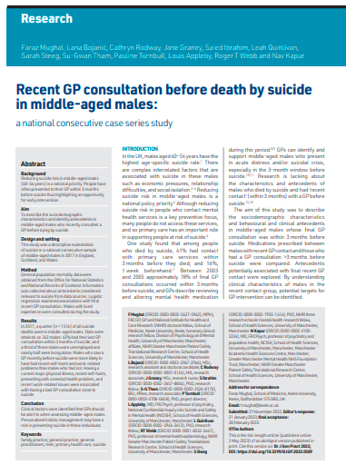
Primary Care – middle-aged men
43% of men saw a GP within 3 months of death
Half of these men had presented with a mental health problem
More likely (than >3 month contact group) to be on psychotropic medication
More likely to have physical illness, recent self-harm, work-related stress
Faraz Mughal, Lana Bojanić, Cathryn Rodway, Jane Graney, Saied Ibrahim, Leah Quinlivan, Sarah Steeg, Su-Gwan Tham, Pauline Turnbull, Louis Appleby, Roger T Webb and Navneet Kapur. Recent GP consultation before death by suicide in middle-aged men: a national consecutive case series study. British Journal of General Practice 8 March 2023; BJGP.2022.0589. DOI: https://doi.org/10.3399/BJGP.2022.0589

Slide 9
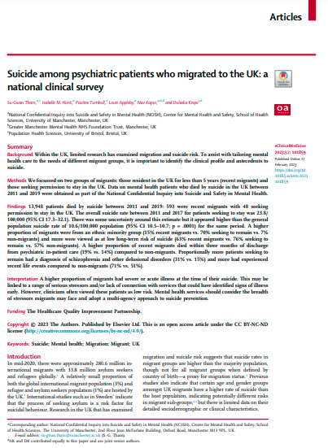
Suicide in patients who migrated to the UK
Those seeking permission to stay:
Higher rates of suicide than general population?
More likely to be:
Younger, unmarried, homeless
From a non-white background
More likely to have experienced:
Relationship, health, legal, or financial problems
More likely to have:
A diagnosis of schizophrenia
Recent hospital admission
Tham, Su-Gwan, Hunt, Isabelle, M., Turnbull, Pauline, Appleby, Louis, Kapur, Nav, Knipe, Duleeka. Suicide among psychiatric patients who migrated to the UK: a national clinical survey. eClinicalMedicine 2023, Volume 57, 101859

Slide 10
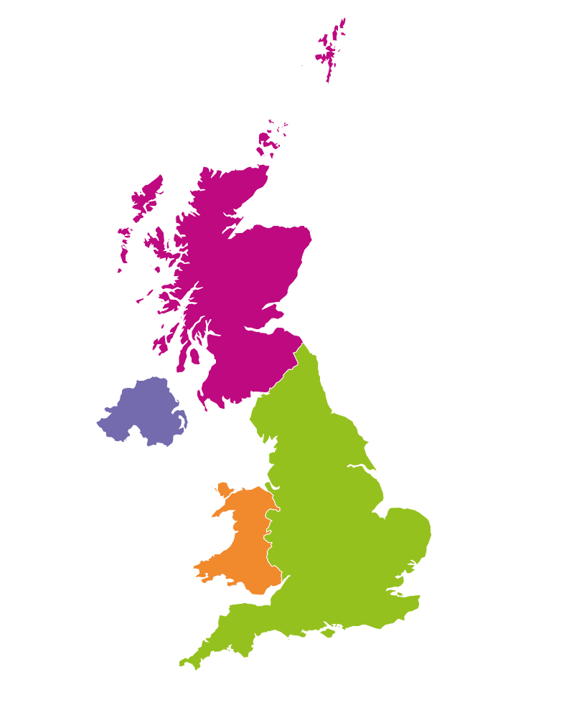
UK suicide numbers 2010-2020
Suicide 2009-19
Northern Ireland
2,541 suicide deaths
547 (24%) patients
Scotland
8,496 suicide deaths
2,646 (31%) patients
Note: patient data unavailable in Northern Ireland
in 2019-2020
Wales
3,874 suicide deaths
845 (22%) patients
England
53,446 suicide deaths
14,365 (27%) patients
UK SUICIDE (2010-2020)
© National Confidential Inquiry into Suicide and Safety in Mental Health. All rights reserved.
Not to be reproduced in whole or part without the permission of the copyright holder.

Slide 11
Patient suicide numbers, UK

Slide 12


  Characteristics of 18,403 patient suicides, 2010-20
High rates of social adversity and isolation, nearly half lived
alone (48%); nearly half were unemployed (48%)
High rates of self-harm (64%), alcohol (48%)/drug (37%) misuse
7% were from an ethnic minority group; 5% were recent migrants to the UK

Slide 13
  Patients with recent economic adversity, 2016-20
Mainly aged 45-64 (44%), male (74%), divorced/separated (30%)
Alcohol/drug misuse common in those unemployed (66%)
Those not unemployed had more depression (39%) and recent illness (35%)

Slide 14
Suicide by people aged under 25
Lower rates of contact (22%)
Autism (13%) and anxiety (10%) common in under 18s
More alcohol and drug use in
18-24 year olds
75% had a history of self-harm

Slide 15
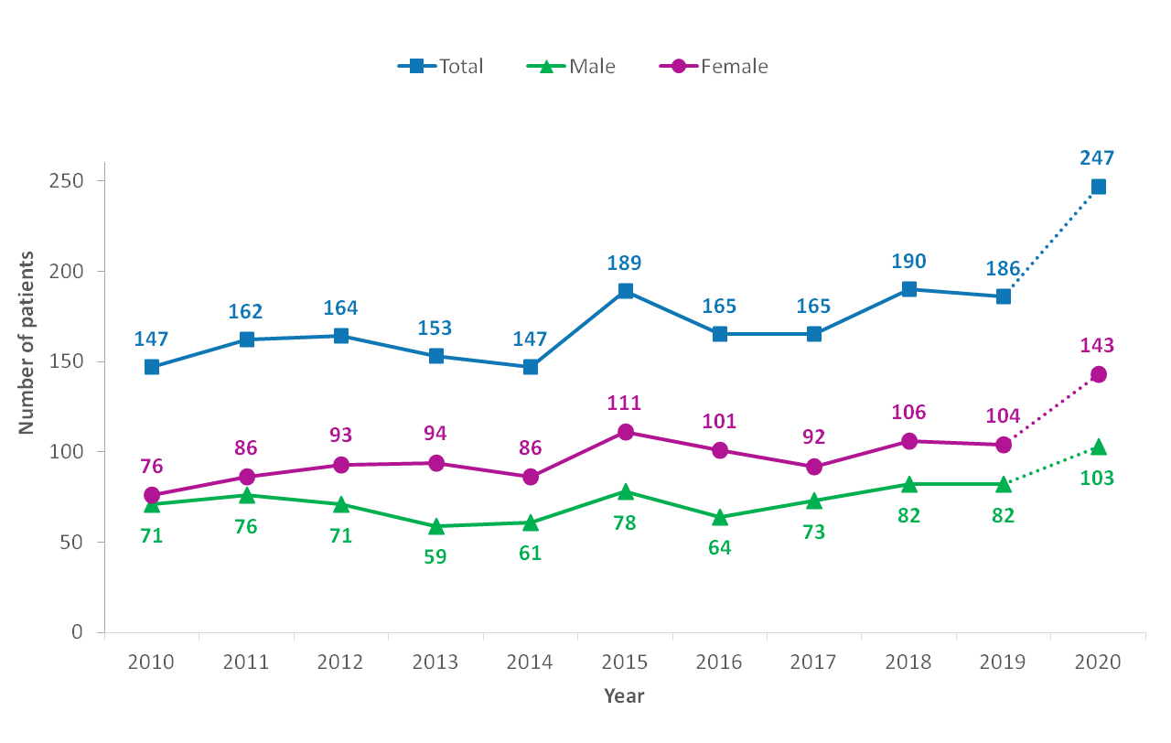
Patients given a diagnosis of personality disorder
Past abuse, self-harm, alcohol and drug misuse common
More had experienced domestic violence; women (41%) and men (12%)

Slide 16
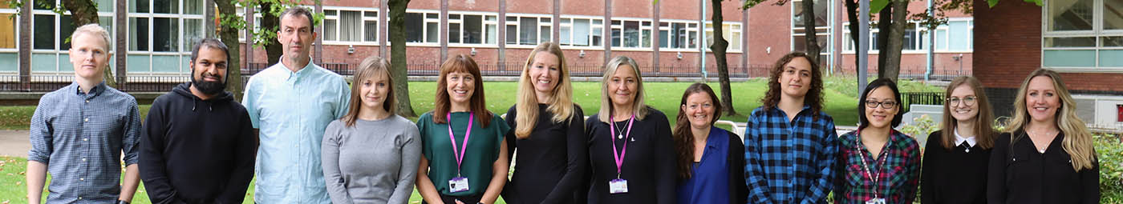






National Confidential Inquiry into Suicide and Safety in Mental Health
www.manchester.ac.uk/ncish @NCISH_UK

