Slide 1

The impact of suicide on the Mind of the Bereaved (inc Frontline workers)
Dr Rachel Gibbons.
Chair of the Royal College of Psychiatrists Working Group on the effect of suicide and homicide on Clinicians, Vice-Chair Psychotherapy Faculty, Co-Chair of the Patient Safety Group
Consultant psychiatrist, psychoanalyst, group analyst

Slide 2

“To help a truly suicidal person you have to approach them with an open heart…
Chaplain of Beachy Head ”

Slide 3

The contact with suicide and what it means
Shocking annihilatory loss
Uncertainty
Fracturing of fragile construct of life
Projected into by the person who has died- suicide acting out
Leads to a fragmentation of the mind
Delusion generated

Slide 4

‘the delusion is found applied like a patch over the place where originally a rent had appeared in the ego's relation to the external world’.
Freud: Neurosis and Psychosis

Slide 5

Pattern of Response
Initially shocked
Within short space of time a delusional narrative is constructed
The bereaved as the protagonist
Obsessional ‘I have made a mistake – I am to blame’
Guilt/shame/humiliation
Important transitional point- sensitive to external response
Gradually more realistic development

Slide 6

Clinicians suffer Disenfranchised grief
There is not enough grief to go round
“I have no right to feel grief because the families grief is so much worse”
“If I ask for any space for my feelings then it will take away, or compete with, the families grief”

Slide 7
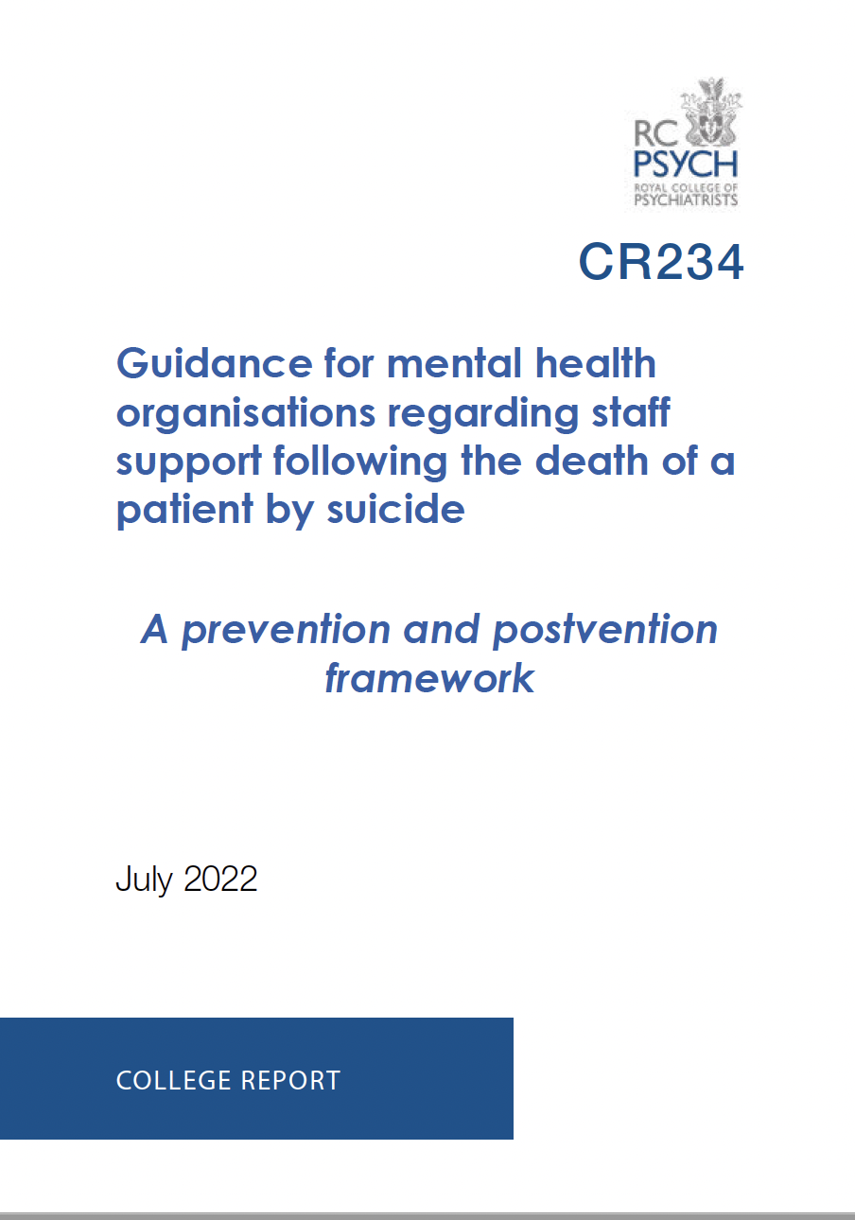

Slide 8
Aims of New Guidance
Recommend evidenced-based and best practice interventions to:
  mitigate the impact of a patient death by suicide
  improve the sustainability of mental health services increase staff wellbeing, progression with training, resilience and retention.
  assist mental health and training organisations in their legal obligation of duty of care for their employees
Increase awareness of the impact that a death of a patient by suicide can have on professionals and to:
  encourage transparent and open dialogue about the impact on staff of working with suicide risk and death.
  facilitate expansion of suicide prevention and awareness training to include preparation for the emotional effects and the processes that follow the death of a patient by suicide.
Help support cultural transformation:
  from one where individual clinicians may feel isolated and personally held responsible following a death, to a systemic understanding about the uncertainty and complex aetiology of suicide and its consequences on staff.
Improve the quality of patient care: by helping staff feel less anxious working with suicidality and in this way maintain their capacity to think clearly and provide safe, high-quality, care.
Increase the possibility of truly learning from these tragic events. To learn takes time, space for reflection and freedom from persecution.

Slide 9
Recommendations
1. Organisational pastoral suicide lead role
2. Pastoral senior management support
3. Support for the processes following the death
4. Buddy systems and other individual support
5. Group psychological support including a organisational suicide group
6. Family liaison officer (FLO), service or similar
7. Training on the effect of patient suicide on clinicians and on the processes that follow
8. Resource availability

