Slide 1


National Confidential Inquiry into Suicide and Safety in Mental Health
STP Learning Day
Latest findings on self-harm and suicide prevention
July 2023
Professor Nav Kapur

Slide 2


Slide 3
Suicide rate England 1981-2022
Age-standardised suicide rates, England, registered
ASMRs per 100,000 people
Persons
Source: ONS

Slide 4
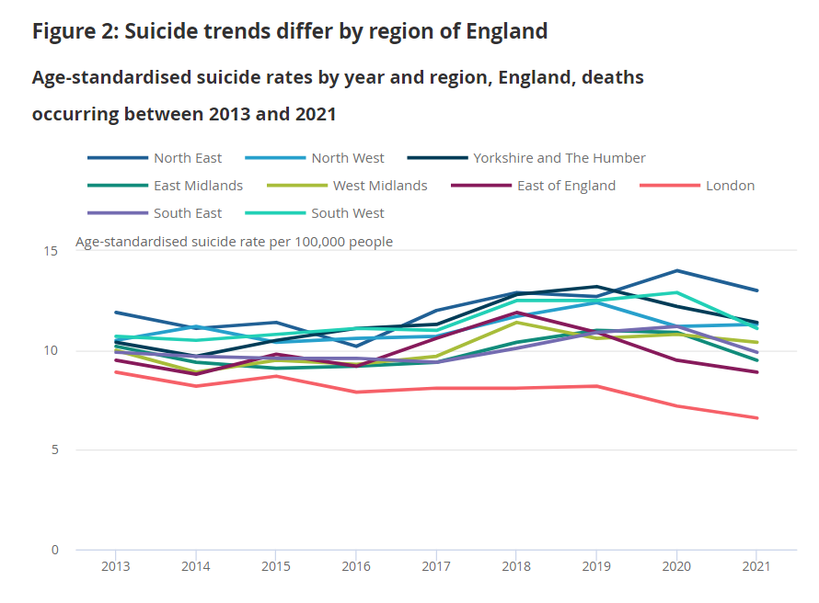
Suicide rates by region
Source: ONS

Slide 5
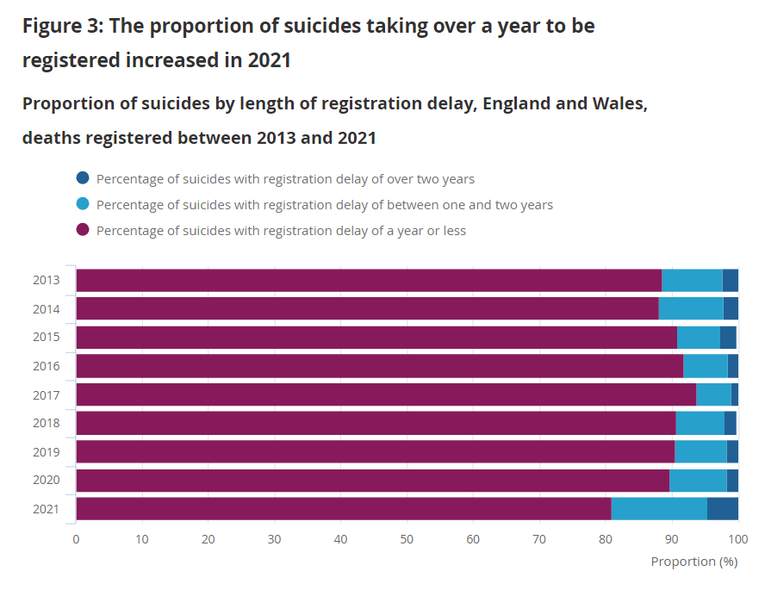
Registration delays
Source: ONS

Slide 6
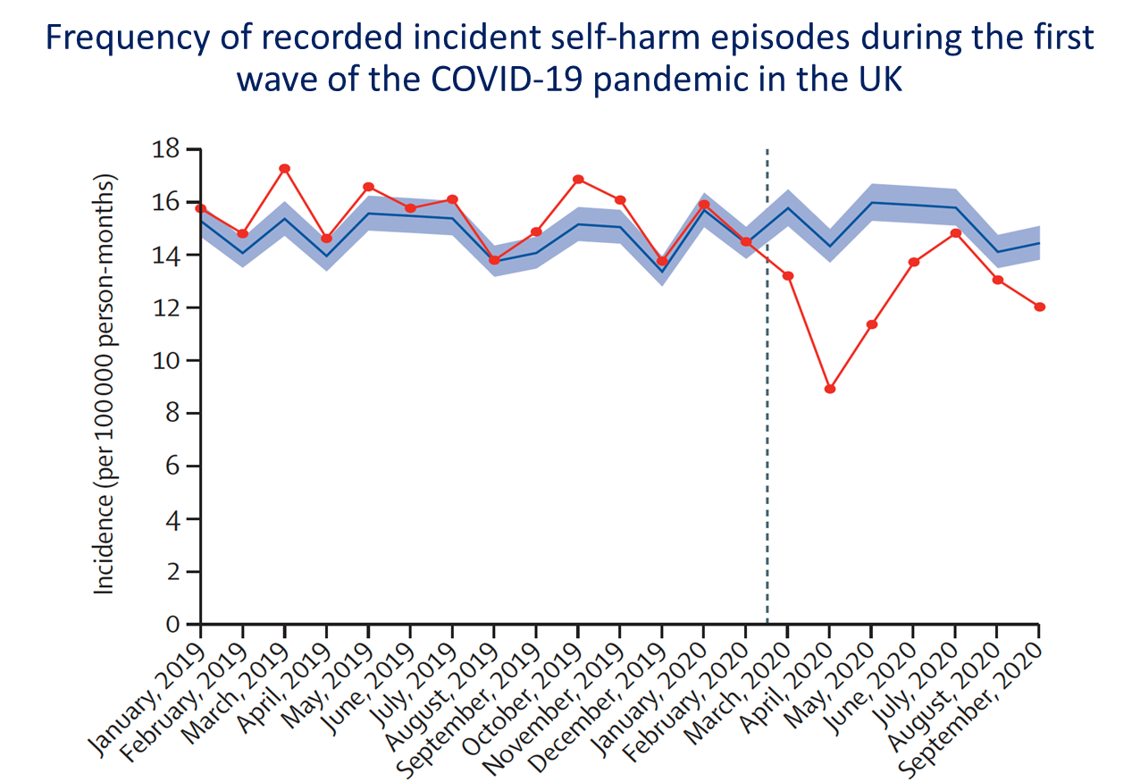
Self-harm in primary care

Slide 7
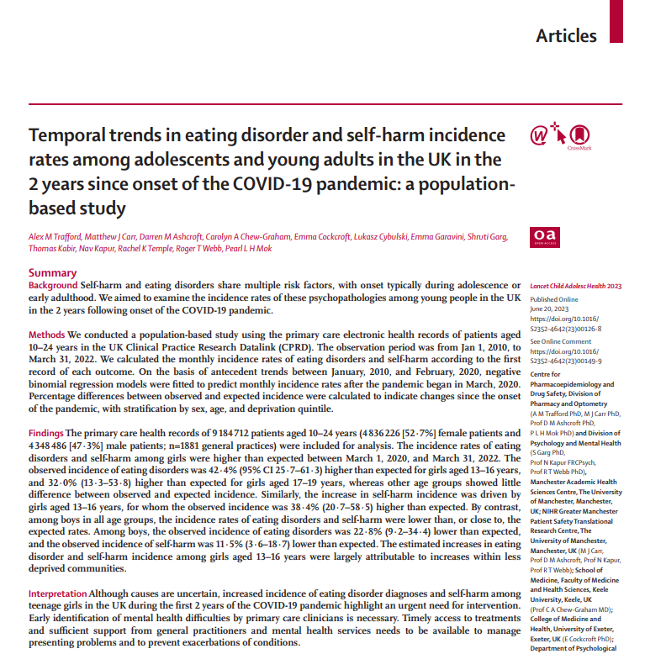
Self-harm in primary care

Slide 8
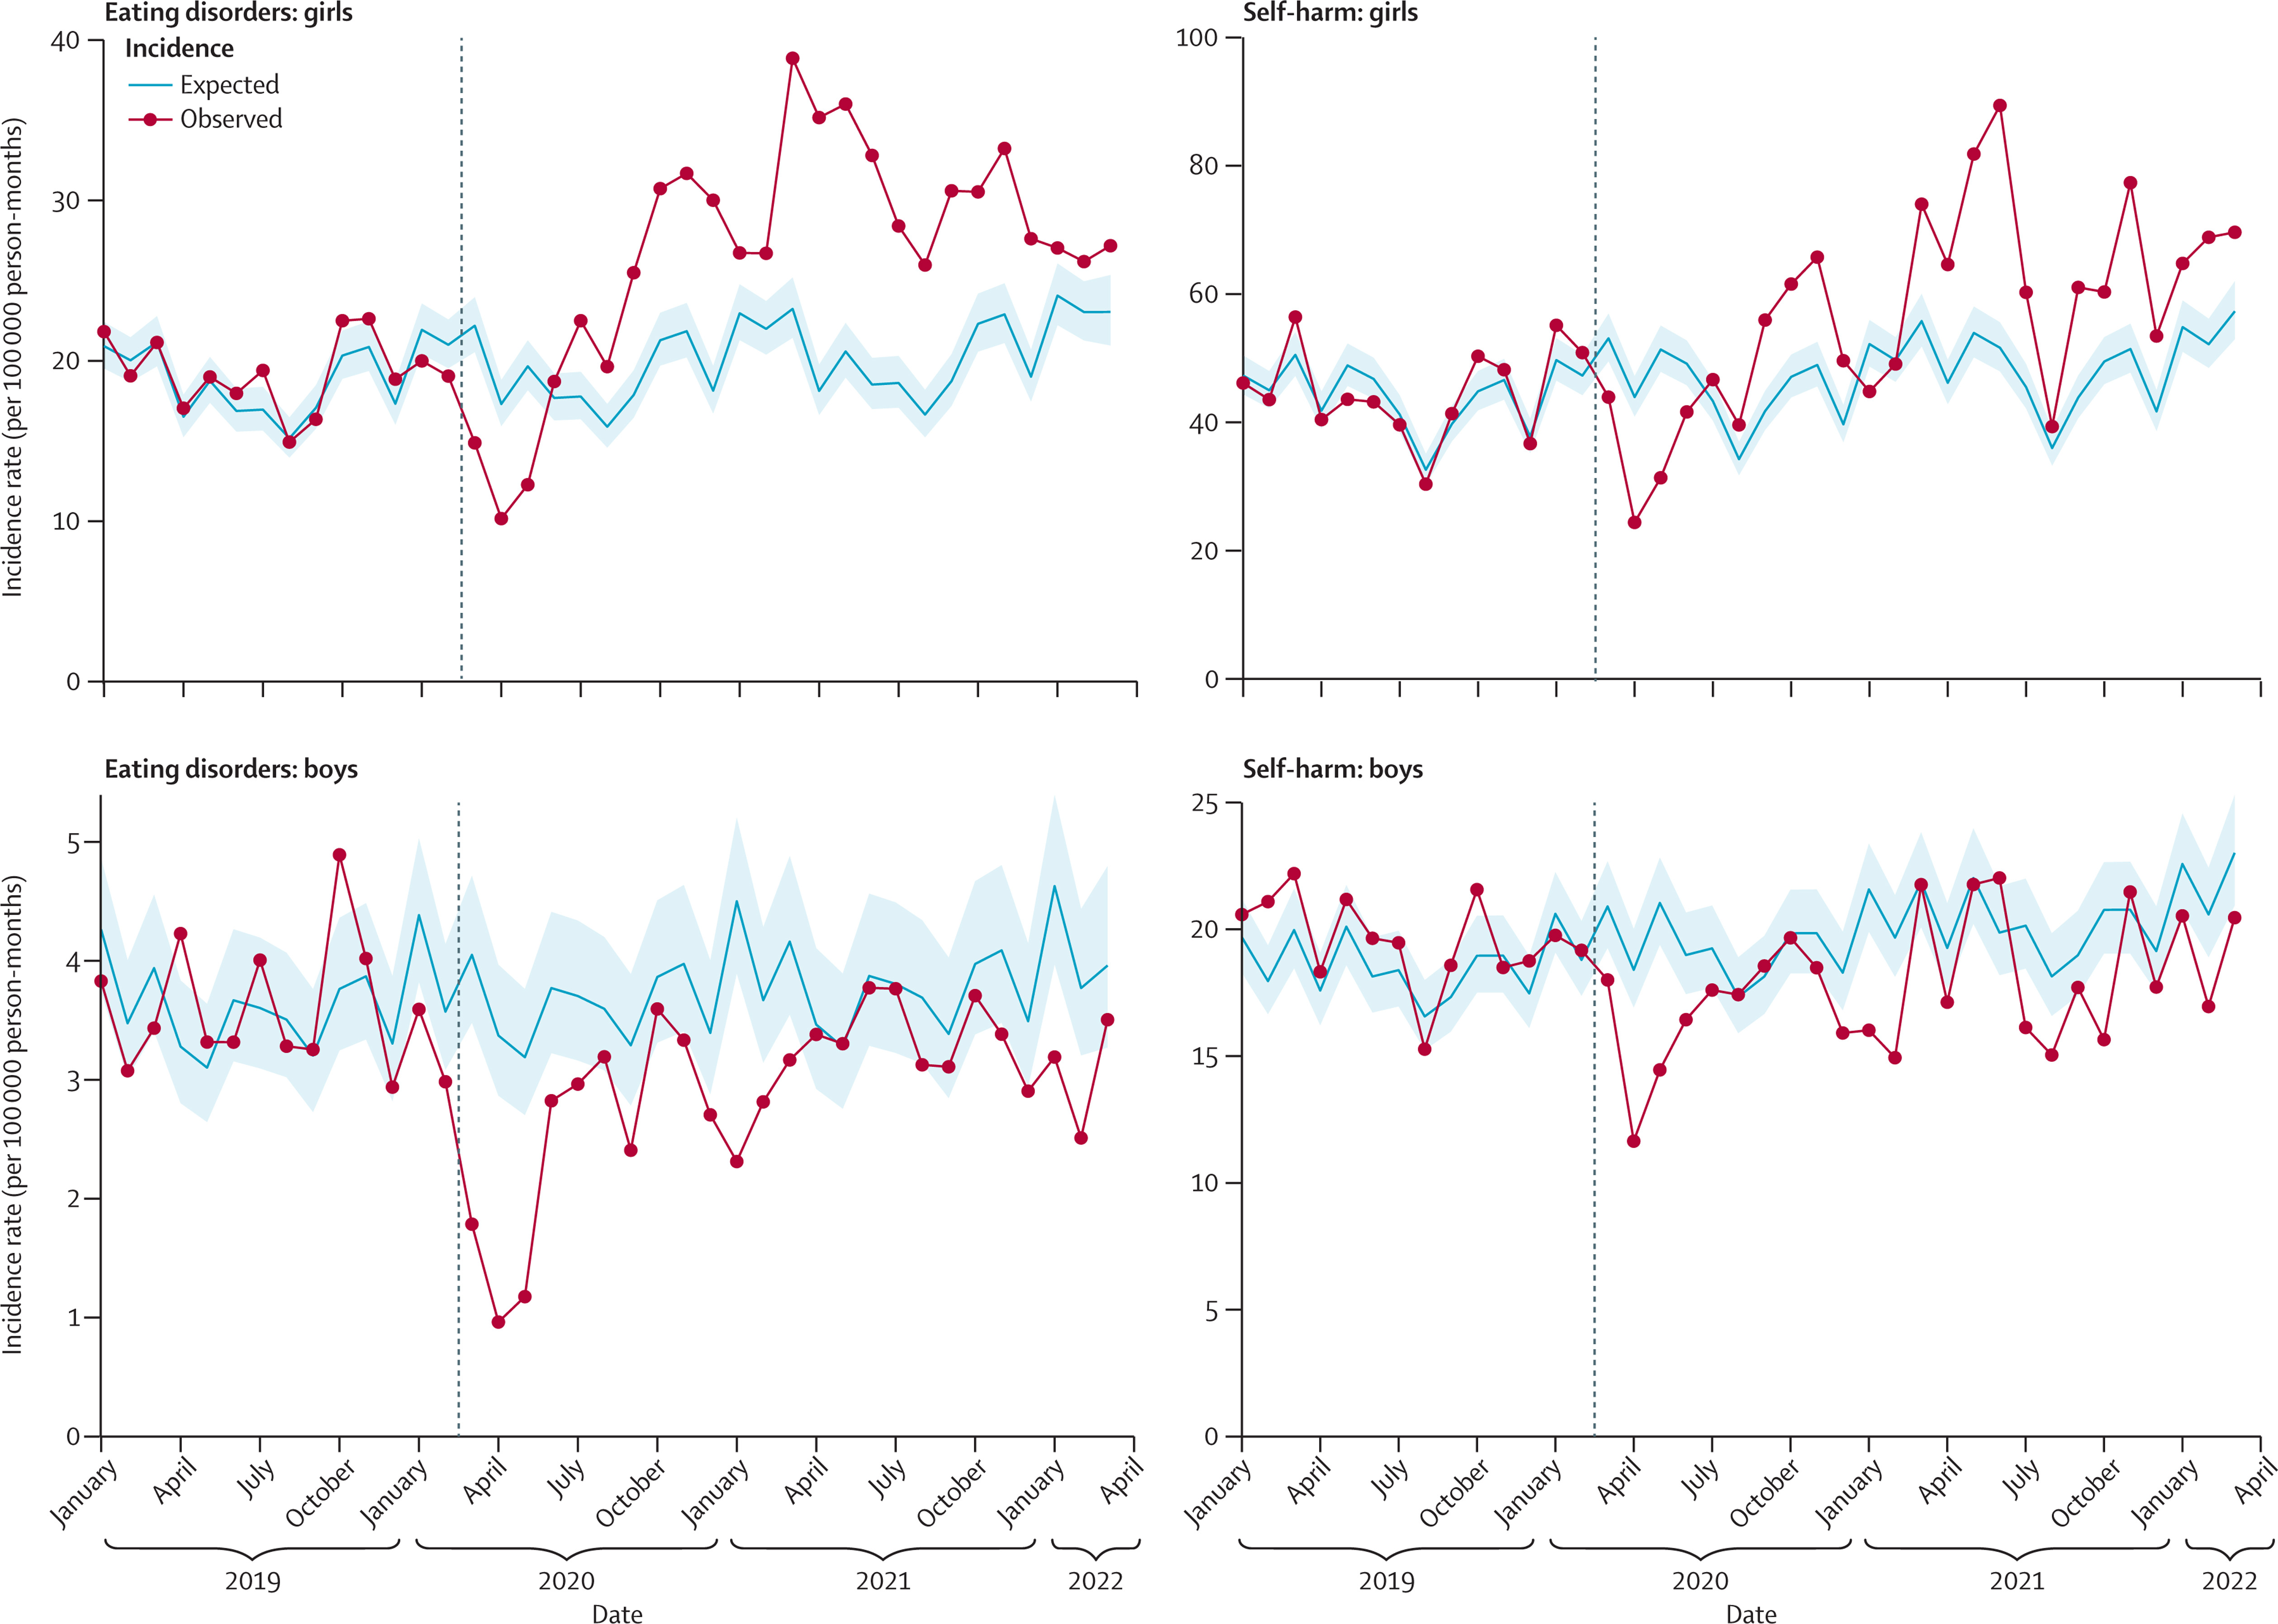

Self-harm in primary care
The Lancet Child & Adolescent Health DOI: (10.1016/S2352-4642(23)00126-8)

Slide 9
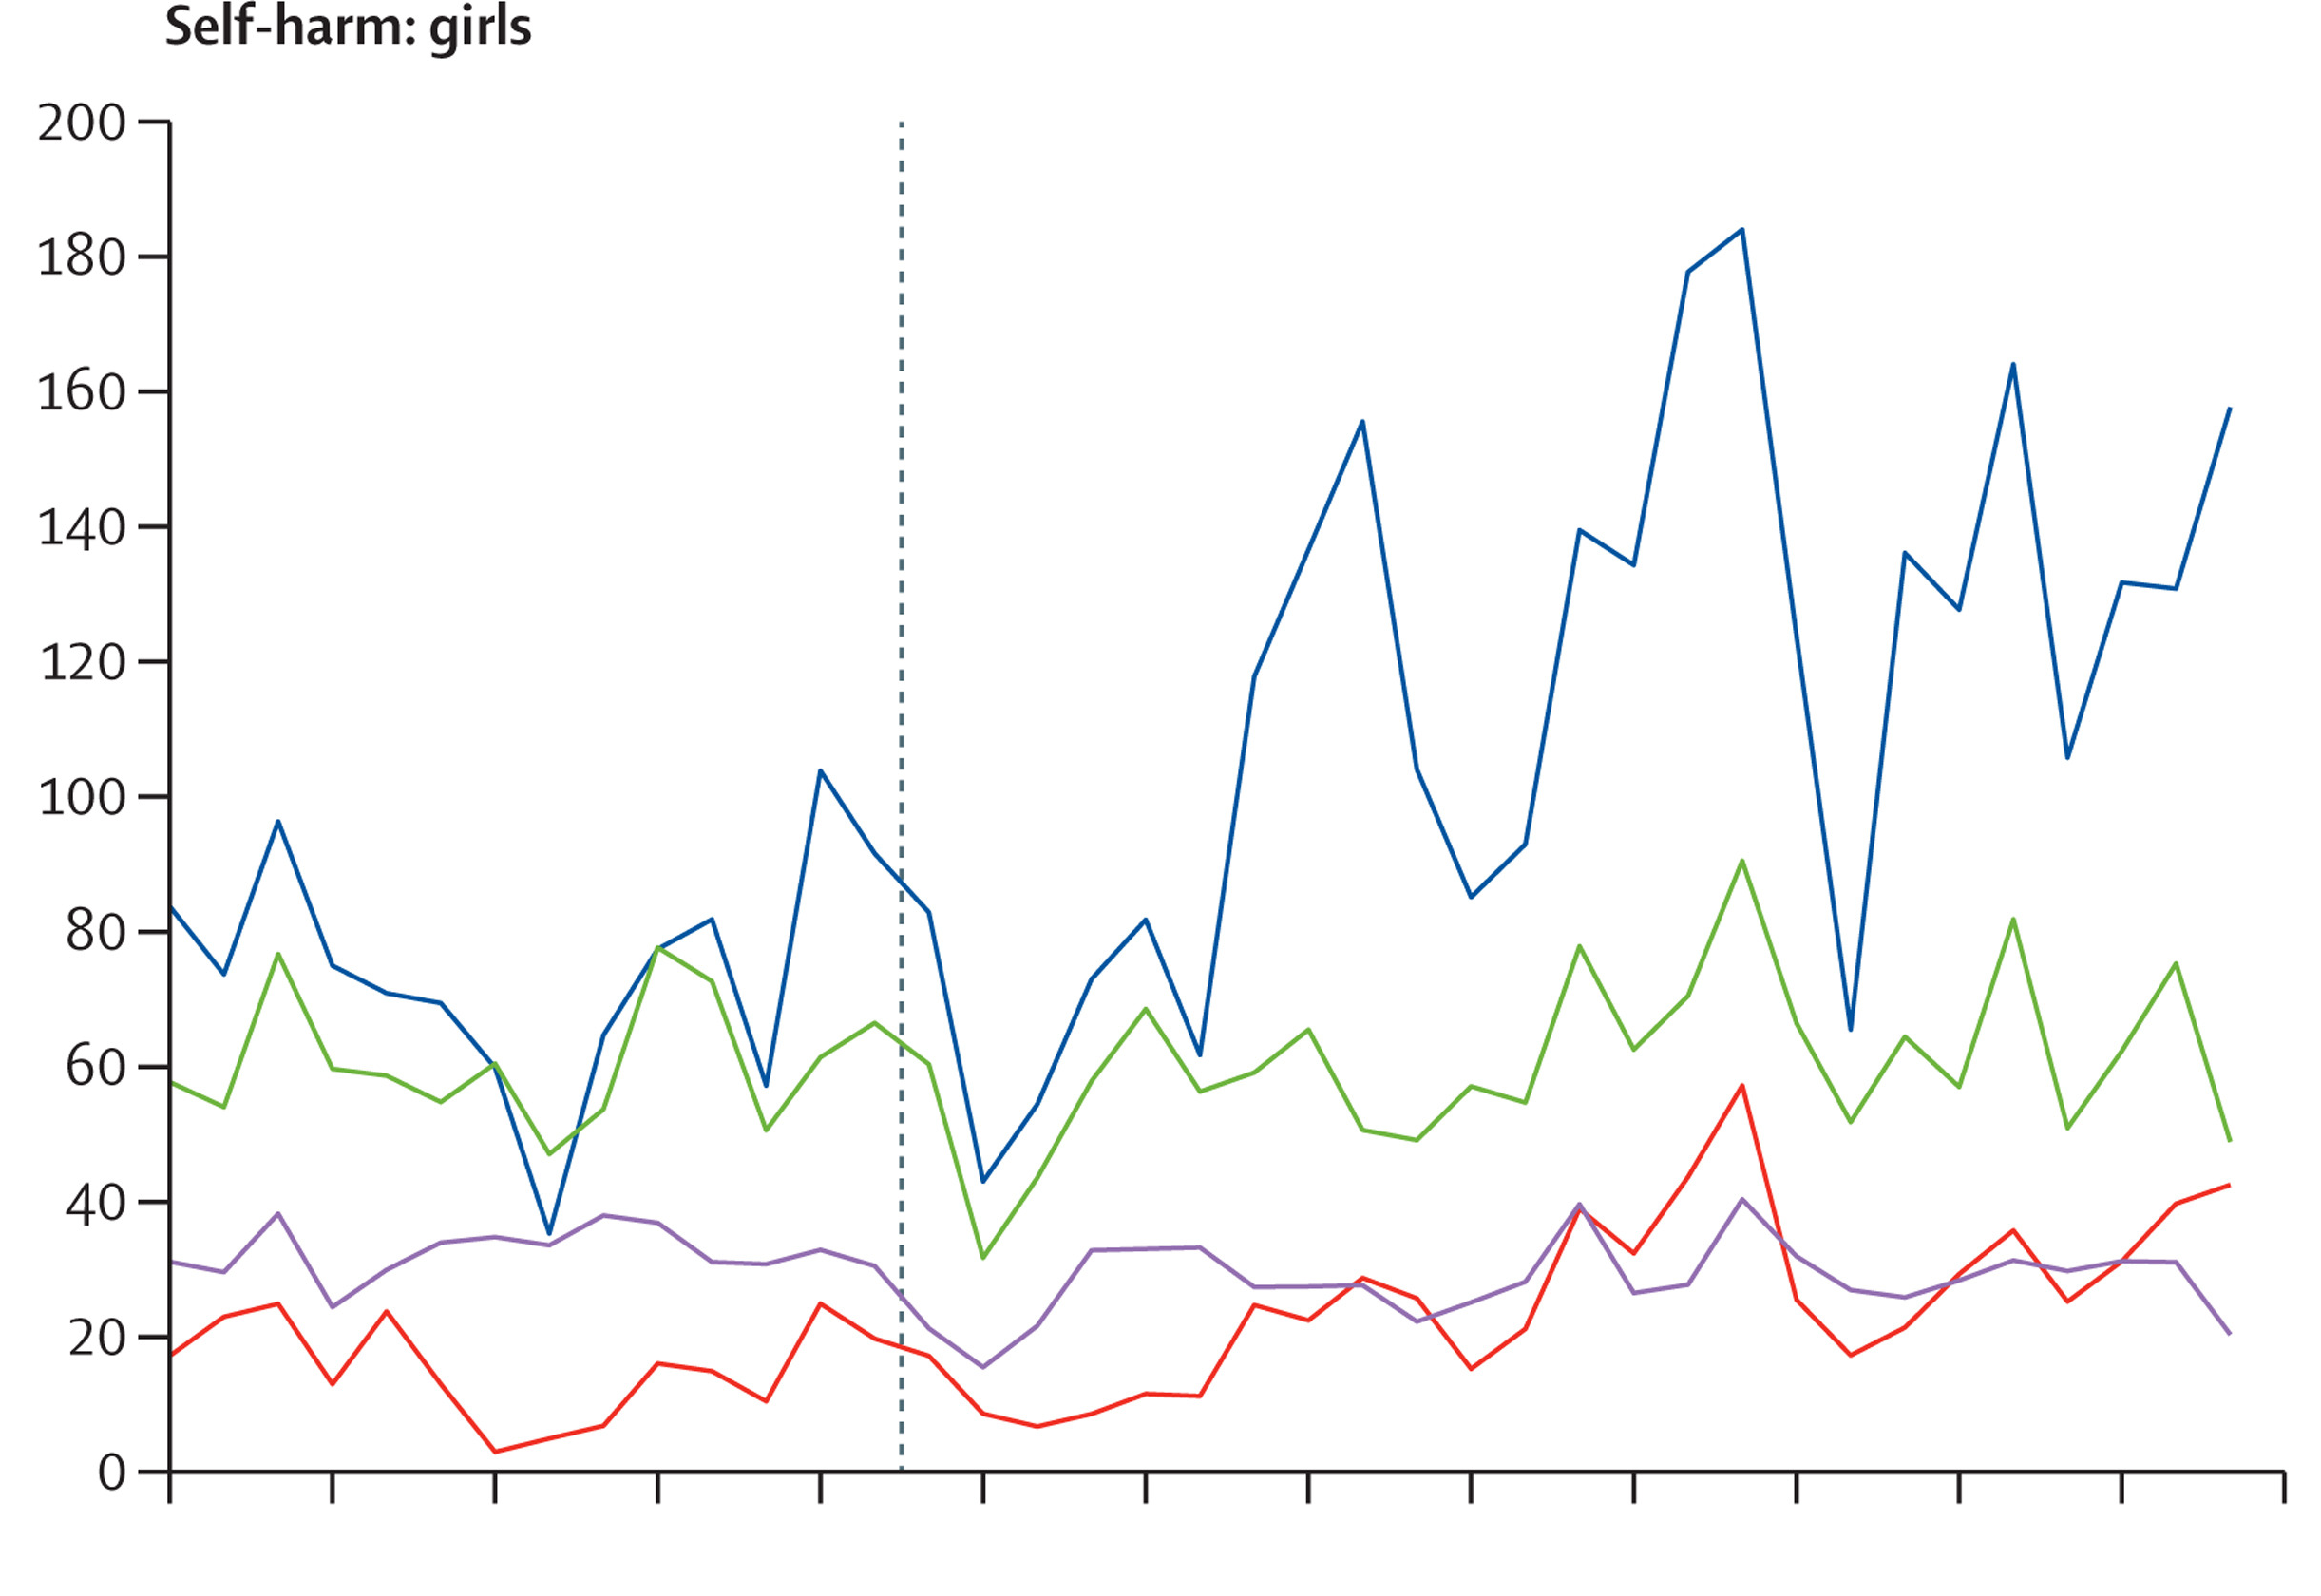
Self-harm in primary care
The Lancet Child & Adolescent Health DOI: (10.1016/S2352-4642(23)00126-8)

Slide 10
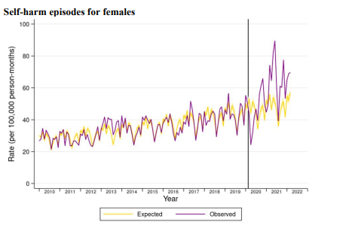
Self-harm in primary care
The Lancet Child & Adolescent Health DOI: (10.1016/S2352-4642(23)00126-8)

Slide 11
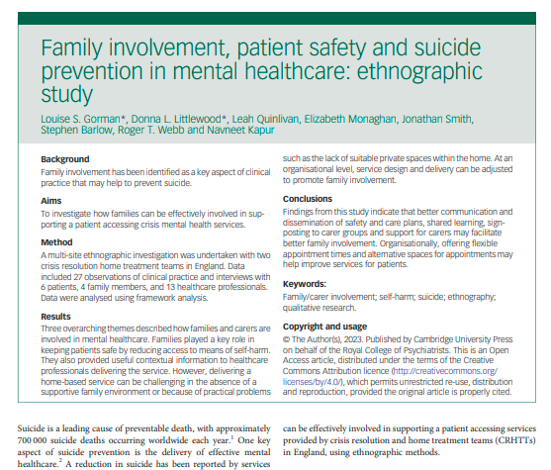
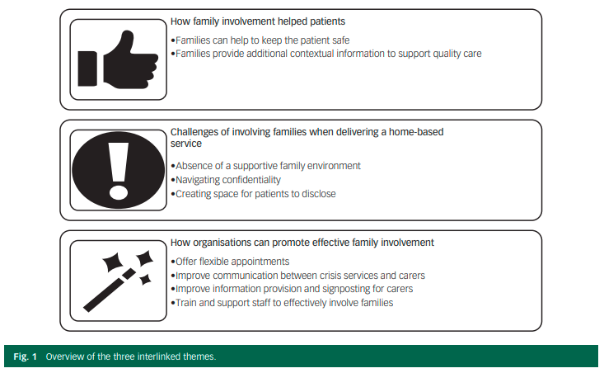
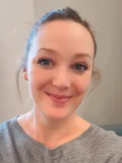

Family involvement
Gorman, L., Littlewood, D., Quinlivan, L., Monaghan, E., Smith, J., Barlow, S., . . . Kapur, N. (2023). Family involvement, patient safety and suicide prevention in mental healthcare: Ethnographic study. BJPsych Open, 9(2), E54. doi:10.1192/bjo.2023.26

Slide 12
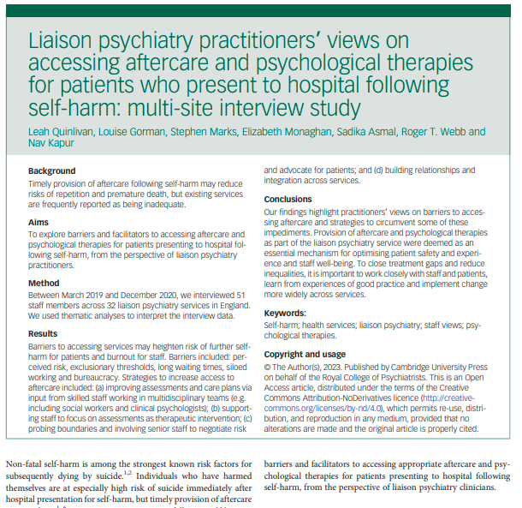
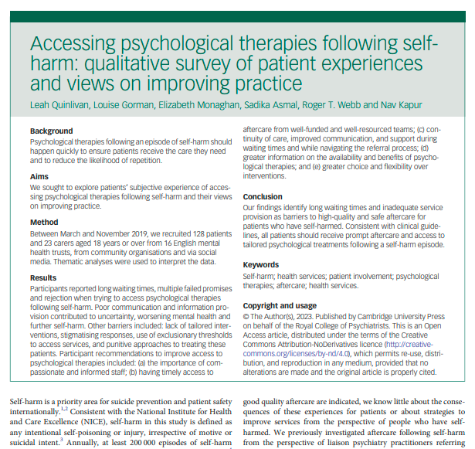

Aftercare for self-harm
Quinlivan, L., Gorman, L., Marks, S., Monaghan, E., Asmal, S., Webb, R., & Kapur, N. (2023). Liaison psychiatry practitioners’ views on accessing aftercare and psychological therapies for patients who present to hospital following self-harm: Multi-site interview study. BJPsych Open, 9(2), E34. doi:10.1192/bjo.2023.2
Quinlivan, L., Gorman, L., Monaghan, E., Asmal, S., Webb, R., & Kapur, N. (2023). Accessing psychological therapies following self-harm: Qualitative survey of patient experiences and views on improving practice. BJPsych Open, 9(3), E62. doi:10.1192/bjo.2023.27

Slide 13









Improving access to psychological therapies: Staff views & strategies
MTDs & skilled staff
Therapeutic assessments
Crafting referral letters
Probing boundaries and advocating for patients
“pull the consultant card”
Building relationships
Open accessible & integrated services
Provision of psychological therapies & follow-up clinics

Slide 14
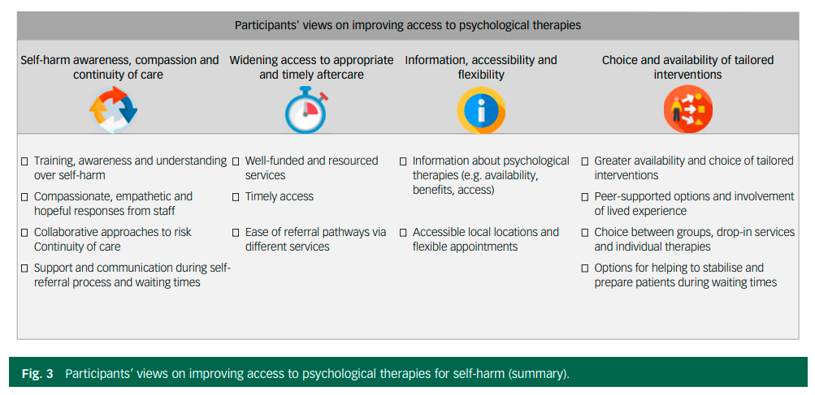
Psychological therapies for self-harm – patient views

Slide 15
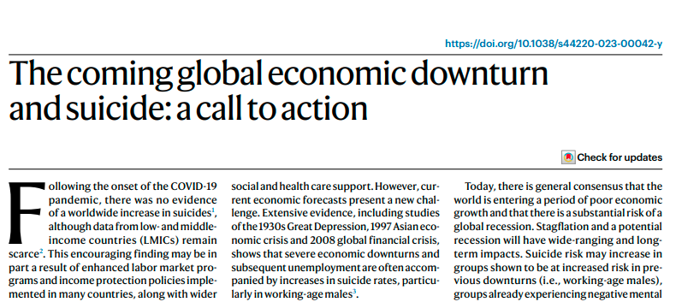

Current and future drivers of suicide
https://www.nature.com/articles/s44220-023-00042-y

Slide 16
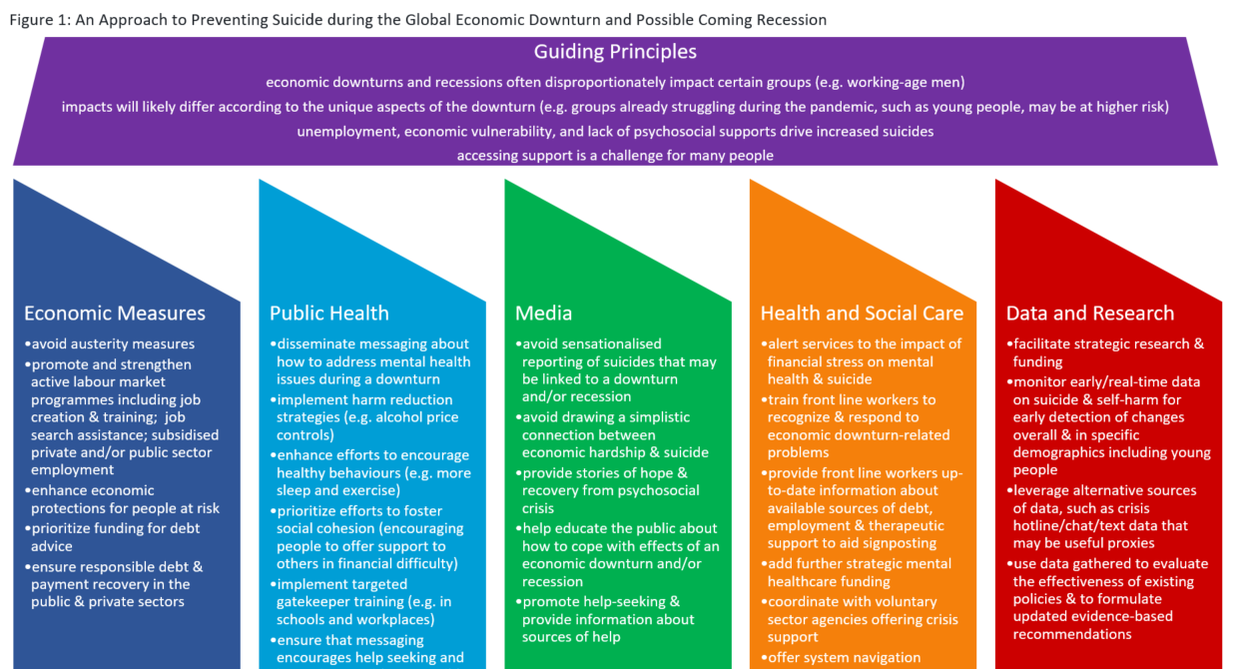

Slide 17
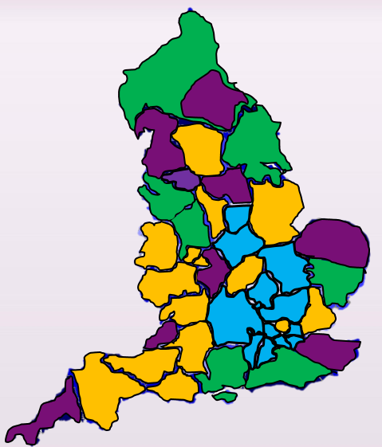
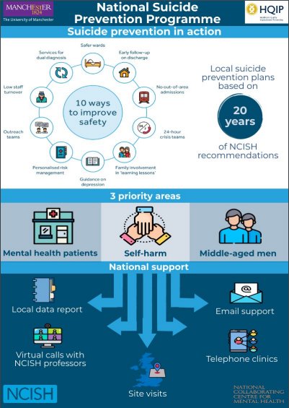
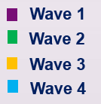
QI for suicide prevention
https://www.rcpsych.ac.uk/improving-care/nccmh/national-suicide-prevention-programme
https://sites.manchester.ac.uk/ncish/research-projects/

Slide 18
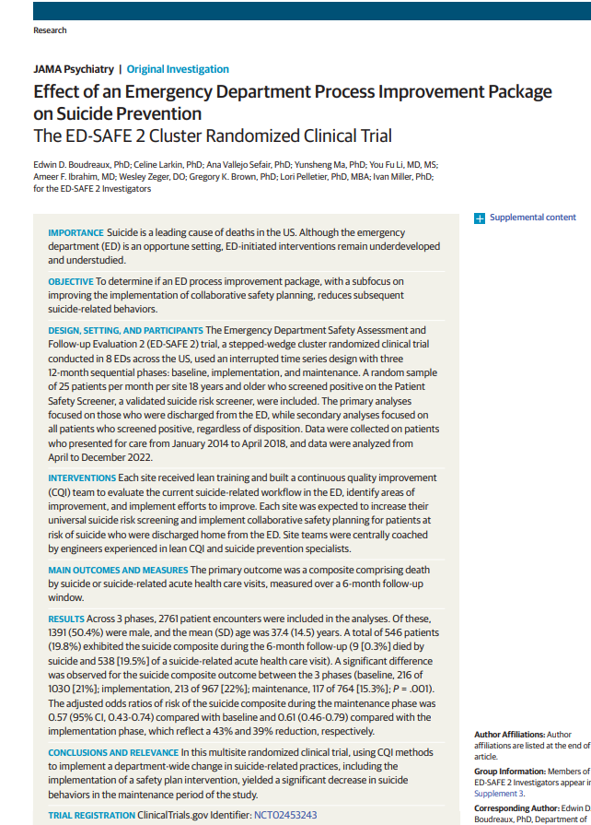
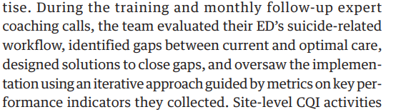
QI for suicide prevention
Site QI lead
MDT (clinicians, managers, IT, patient safety and quality)
Initial one day on site training

Slide 19

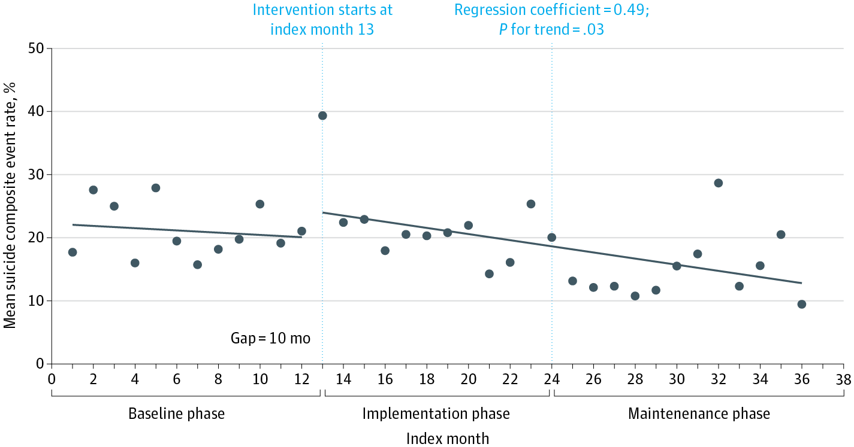
From: Effect of an Emergency Department Process Improvement Package on Suicide Prevention: The ED-SAFE 2 Cluster Randomized Clinical Trial
JAMA Psychiatry. Published online May 17, 2023. doi:10.1001/jamapsychiatry.2023.1304

Slide 20









Suicide Prevention Strategy in 2023
Ethnicity
Domestic violence
Online harms
Updated suicide prevention priorities
Gambling
Economic stresses
Covid impact
Pre-Covid trends, eg CYP
LGBT
Data

Slide 21
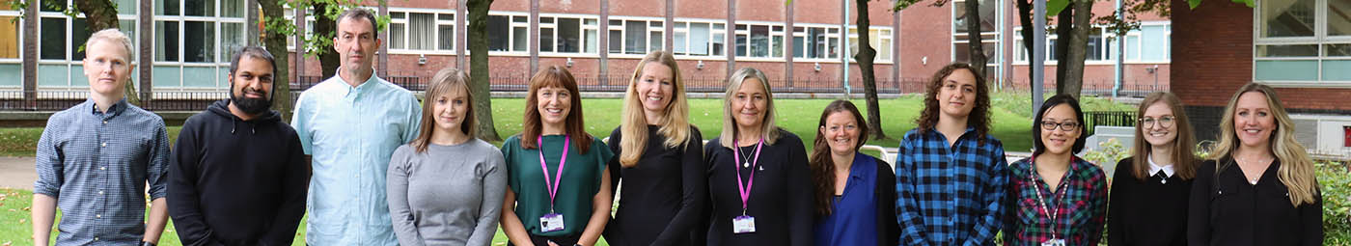




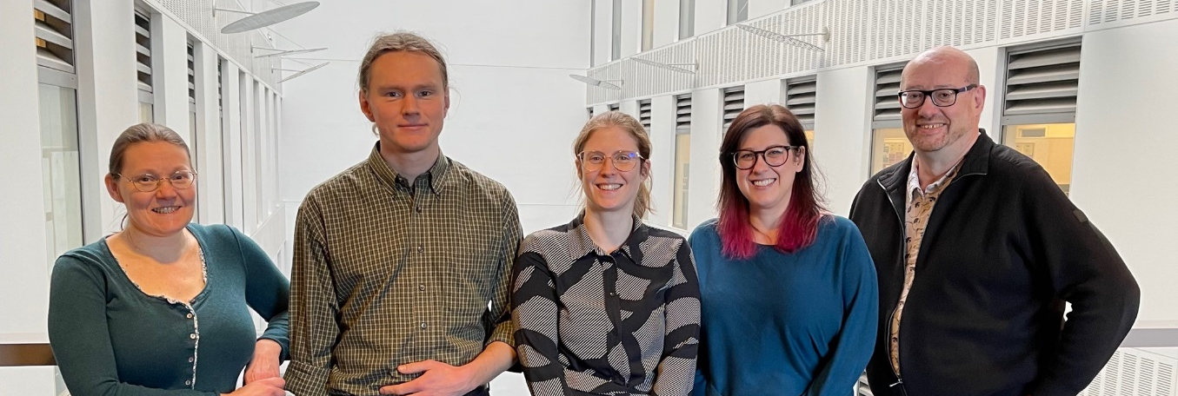

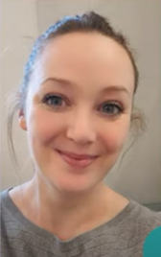





Centre for Mental Health and Safety
@NCISH_UK
@mashproject
@PSTRC_GM

