Slide 1
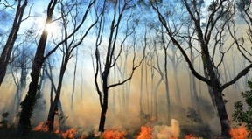
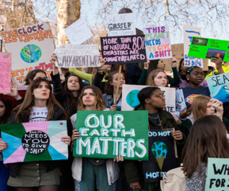



Eco Crisis and CAMHS:
Threat and opportunities
1/3/23
Dr Catriona Mellor, Child and Adolescent Psychiatrist
Oxford Health NHS Foundation Trust, RCPsych Planetary Health and Sustainability Committee
Catriona.mellor@oxfordhealth.nhs.uk

Slide 2
EcoCrisis and CAMHS: threat and opportunities
Main messages and overview
Child and adolescent psychiatry perspective
Difficult stuff
  Collective enquiry and interconnectedness
Scale and complexity of eco crisis is hard to contemplate but impacts us, our patients and our services at multiple levels
  Impacts on mental health and health inequalities
Human relationship with nature, and the biodiversity crisis
Chatbox. Q&A after Dr Pihkala’s talk
Notes:
40 mins
This talk focuses mainly on the ‘what is the problem’ side of things – it is at the start of a day that is designed to move towards more positive and creative solutions focused discussion
First section: how and why we could engage with these issues as child and adolescent psychiatrists.
this is a tough topic. the situation we face is a really difficult one and it is hard to choose to remain focused on it –
Thank you for deciding to be here despite that.
Two themes to highlight that can make this difficult work fulfilling and supportive are
firstly approaching it from the stance of it being a collective enquiry and
secondly holding on to the idea of interconnectedness.
data about the scale and complexity of the eco crisis and the impacts on child mental health.
this topic requires us to zoom in and out in perspective so there will be a bit of that – trying to grasp aspects of the bigger picture at the same time as considering our best response at a local level.
Then touching on the central importance of nature and biodiversity.
Invitation to contribute your thoughts and reflections at 2 specific points during the talk,

Slide 3
Role of child and adolescent psychiatrists
Why and How
Notes:
Before getting into the data around the eco crisis and its impacts on mental health – which makes it directly relevant to us in our work –
spend a few minutes considering the question of why else this is relevant to us as a group. Another part of this section is around the how: how to find the capacity to engage and integrate the learning from today into our work: when we already carry high levels of stress, we are busy, and the eco crisis is so overwhelming. are there ways to make it seem more manageable?

Slide 4
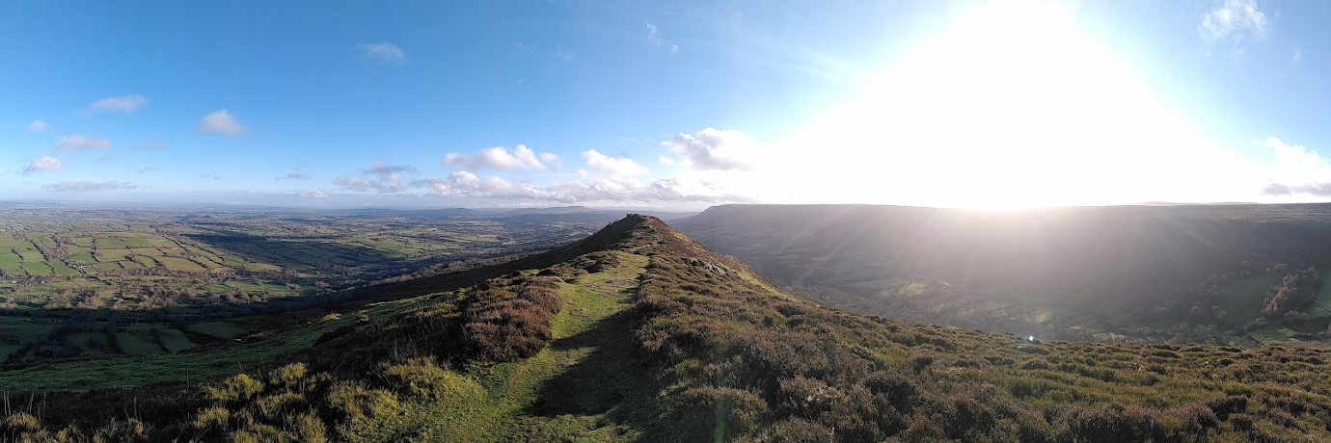
“It really boils down to this: that all life is interrelated.
We are all caught in an inescapable network of mutuality, tied into a single garment of destiny.
Whatever affects one directly, affects all indirectly.”
Dr Martin Luther King 1967
Interconnectedness Systemic Holistic View
mental-physical health planetary-human health nature-climate social justice
Notes:
Interconnectedness:
A systemic, holistic view is really important in understanding the eco-crisis, and in coming up with solutions –
this is one of the areas child and adolescent psychiatrists can contribute to and are good at because of the nature of our work.
just as we know physical health and mental health are inextricably linked,
so are planetary health and human health:
Nature and biodiversity are linked to climate change
and all of these things are linked to social justice.
Other skills we can offer that help us understand the impacts of the eco crisis are that we know how important it is to look upstream of the problems that may present to us in clinic to look at what is generating illness, injury and injustice.
I love this quote about interconnectedness from the wisdom of Dr Martin Luther King,
“It really boils down to this. That all life is interrelated. We are caught in an inescapable network of mutuality, tied into a single garment of destiny. Whatever affects one directly affects all indirectly”.
It’s becoming increasingly clear that a lot of the problems and crises we are facing come from a sense or experience of disconnection – from our own feelings, from other people, from the natural world around us – so it follows that many solutions lie in re-connecting and in operating from a less individualised and less silo-d position.

Slide 5
Collective enquiry
“Avoiding climate breakdown will require cathedral thinking. We must lay the foundation while we may not know exactly how to build the ceiling”
Greta Thunberg
What is the role of Child and Adolescent Psychiatrists in responding to Climate and Ecological Crisis?
Notes:
The second theme is about the importance of tackling the issues around the eco-crises as a collective endeavour that requires lots of people to engage with it together, over a long time scale.
no quick fixes.
feeling alone with the responsibility to make changes can be paralysing and overwhelming, but finding other people to share the task with can be meaningful and life-affirming.
hopefully that is the stance we can take with this question we’re engaging with today around
What is the role of child and adolescent psychiatrists within a climate changing world
Greta Thunberg
“Avoiding climate breakdown will require cathedral thinking. We must lay the foundation while we may not know exactly how to build the ceiling.”
This metaphor refers to the cathedral builders involved in their overwhelmingly enormous task, which was undertaken over generations: An endeavour that would have been impossible for a few of them to tackle. those involved in the beginning, knew it would need a roof that they would never see and didn’t know how to build - but they knew how to do the work required at ground level brick by brick.
Perhaps as CAPs we can come together on days like today to consider our piece of the foundation – which bricks can we collectively lay that are relevant to our work and our skills, and that offer a more stable future.
None of us need to be experts, but there is a space and need for each of us to offer something.

Slide 6

Collective enquiry
How do you see your own role in this?
How can we support each other?
Patients must be able to trust doctors with their lives and health. To justify that trust you must show respect for human life and make sure your practice meets the standards expected of you in four domains:
Knowledge, skills and performance
Safety and quality
Take prompt action if you think that patient safety, dignity or comfort is being compromised. Protect and promote the health of patients and the public.
What is the role of Child and Adolescent Psychiatrist in responding to Climate and Ecological Crisis?
Notes:
The way we each answer these questions could be affected by how we each interpret the duties we’ve signed up to as doctors .
Here are a few points I’ve taken from page one of our GMC guidance:
What responsibility do we feel comes with the influential and privileged position we hold in society – when we know that not enough is being done to prevent climate breakdown and children are looking to people with power and influence to make changes.
As we learn about the unfolding crises how does that link for each of us to how we show respect for human life
how do we assimilate the knowledge from today about the huge and negative impact of the eco crisis on health and embrace this requirement under safety and quality, to protect and promote health, not simply treat disease.

Slide 7
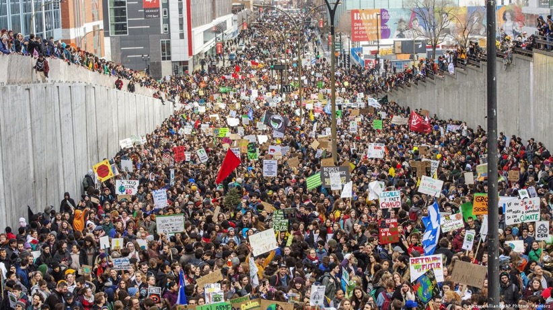
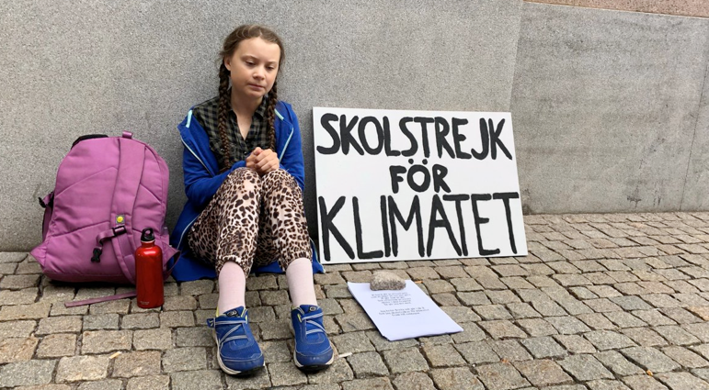
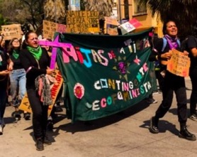



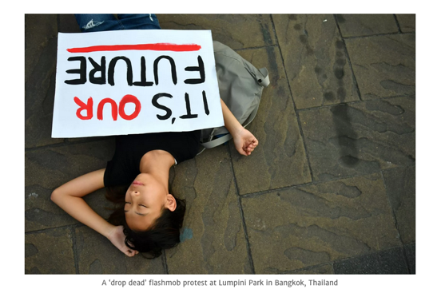
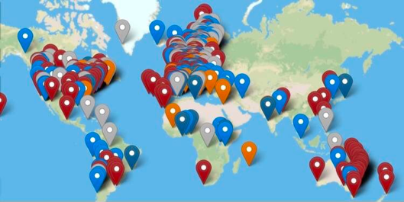
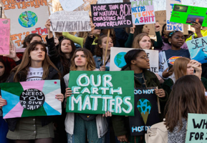
Listen, understand, advocate
“I have always been that girl in the back who doesn’t say anything.
I thought I couldn’t make a difference
because I was too small.”
Notes:
Another thing we do well as child and adolescent psychiatrists is listen to children and young people, understand the context in which they are growing up, advocate for them or support them to be the change they want to see.
Are child and adolescent psychiatrists listening well enough to this generation of children?
5 years ago 15 yo Greta helped millions find their voice by setting off the global youth-led movement Fridays for Future – which led to the worlds biggest environmental protest, nearly 1.5million people in over 100 countries.
So many young peoples’ bodies on the streets bravely showing how they are feeling
including in many parts of the world where it is extremely dangerous to do so,
some young people so despairing they are deciding not to have their own children.
Doesn’t this offer any of us who want to safeguard children and adolescents many questions to answer.
where have we got to that children need to take to the streets to ask adults and decision makers to act on the science to safeguard their futures
How can we show we are willing and available to listen, validate and amplify their messages
How can we push back against narratives that try to silence them – some of the response to these young people has been to criminalise what they are doing, or to dismiss their fears.

Slide 8


Connection
Enjoyment
Calm
Vitality
Love
Nature-based
perspective
Systemic
Professional
Personal
Notes:
And lastly in this first section about the how and why of our involvement in this arena, Before going on to talk about the climate crisis,
I want to mention the potential for us of taking a nature-based perspective. This is one of those paradigm shifts that the climate crisis is ushering in – a re-centering of the importance of the natural world.
This perspective is helpful at a systemic, professional and personal level.
Systemically: It is important that we understand more about our human relationship to nature – which feels like it’s become fractured and destructive. How does nature link in with climate change and health. why is most of the focus currently on the climate crisis, not the equally worrying ecological crisis.
Professionally – through work with our EcoCAMHS group, we have found that nature based insights could have a huge role to play in our service provision
And speaking from a personal perspective, essential for my own wellbeing…..

Slide 9
The climate crisis
“Climate change is fundamentally an issue of human rights and environmental justice that connects the local to the global”
Notes:
Moving on to some data about the climate crisis: first zooming out in perspective a bit, to hold the bigger picture and context in mind, before zooming back in to the impact on mental health.

Slide 10
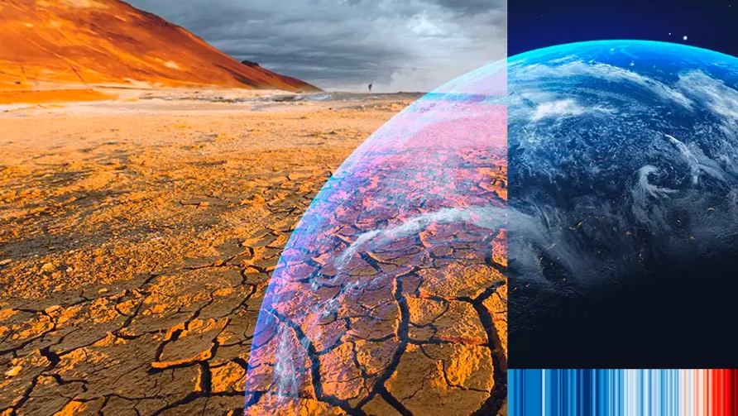
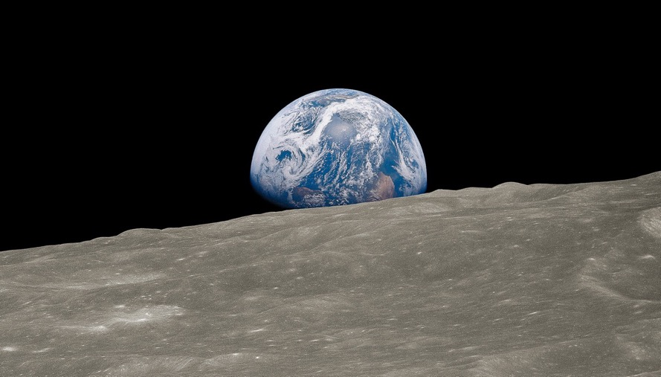
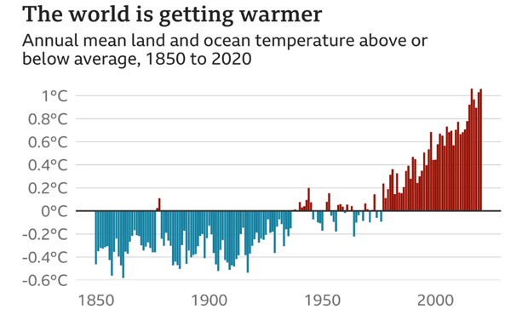
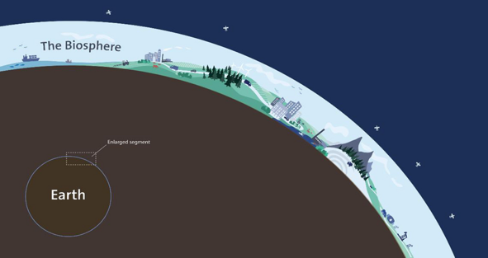


“Climate change is the biggest global health threat of the 21st century”
A Commission on climate change
The Lancet and University College London (UCL) Institute for Global Health 2009
Professor Hawkins, University of Reading
Notes:
This is our planet, the one home we have, photographed from the moon. It’s the only place that we know of in the vast universe that is hospitable for us as a species,
and everything we ever do is carried out just in the biosphere of this planet – the 20km-wide strip around the surface of the earth.
If the earth was an apple this equates to the thickness of its skin.
All human life and existence has taken place in this apple skin like band in the middle of the vast inhospitable space of our solar system.
As we know human activity, through global warming via burning fossil fuels, is threatening this – shriveling and polluting our apple skin.
This clever stripey graphic in the bottom right corner is called the climate stripes and was designed to represent this
the problem of progressive heating of our planet over two centuries,
by showing bars representing global average temperatures
Shades of blue indicate cooler-than-average years, while red shows years that were hotter than average.
This rapid heating is destroying our biosphere.
There is irrefutable evidence now of the impact of this on health, mental health and wellbeing leading this commission to declare:
“Climate change is the biggest global health threat of the 21st century”

Slide 11
Bigger picture
Rates and trends
Injustice
Child rights
Notes:
3 points to make around the bigger picture, this zoomed out perspective, are
The Rate of change
And about how the eco-crisis is also a crisis of inequality and child rights

Slide 12
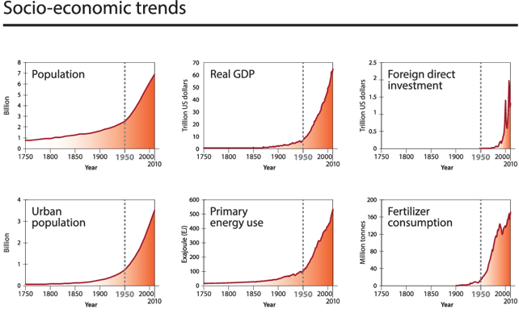
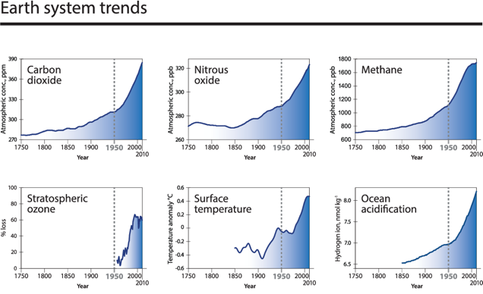
The Great Acceleration
Steffen et al, 2015. International Geosphere-Biosphere Programme, Stockholm Resilience Centre
Notes:
talking about the rate of change we're experiencing.
looking at overall shape of the graphs
These graphs were produced in 2015 to track various parameters since the start of the industrial revolution. there are more grpahs than shown here.
On each x axis we have dates from 1750, with the vertical dotted line marking 1950,
after which point we can see an acceleration in the change being monitored.
These red graphs are representing various markers of human activity including energy use and fertiliser consumption.
Notice that we’re still in that acceleration – we’re not seeing a levelling off. Emissions haven’t peaked yet.
and these blue graphs represent the response of earth systems, for example atmospheric CO2 and surface temperature and ocean acidification.
The levelling off of Ozone showed here is a success story of global cooperation
Unfortunately this is an isolated example and One of the reports main authors stated:
"It is difficult to overestimate the scale and speed of change. In a single lifetime humanity, predominantly via the global economic system, has become a geological force at the planetary-scale,"

Slide 13
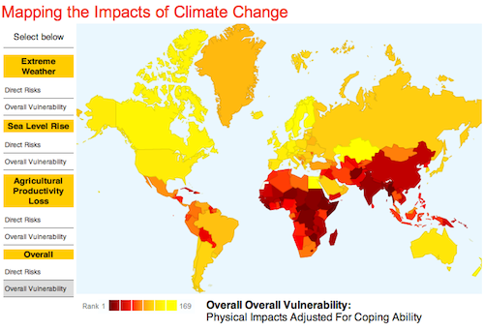
Mapping the Impacts of Climate Change
It aggravates inequalities
Inequalities in health arise because of inequalities in society – in the conditions in which people are born, live, work and age The Marmot Review 2010
increase exposure of disadvantaged groups to the adverse effects of climate change
increase in susceptibility to damage caused by climate change
fewer resources to cope and recover from the damage suffered
Can’t separate out climate, racism, mental health
We feel a huge pressure to correct centuries’ worth of failings
Climate Change and Social inequality Paper. 2017 UN Dept economic and social affairs
Notes:
The second point is about the inextricable link between the climate crisis and inequalities.
And as we know health inequalities arise from other inequalities.
People of colour, people with low-income, and Indigenous communities are being disproportionally impacted by the eco-crisis globally, and within countries like the UK.
The areas and people currently most affected by climate change are those that are least responsible for the crisis but which have been colonized, exploited and historically marginalized.
There are three main channels by which climate change exacerbates inequalities
(a) increased exposure of disadvantaged groups to adverse effects;
(b) increased susceptibility to damage;
and (c) fewer resources to cope and recover from the damage suffered.
EcoCAMHS ran a focus group talking to YP about the climate crisis and how they saw the role of psychiatrists and they spoke to this injustice aspect too:
Can’t separate out climate racism mental health
and
We feel a huge pressure to correct centuries worth of failings

Slide 14
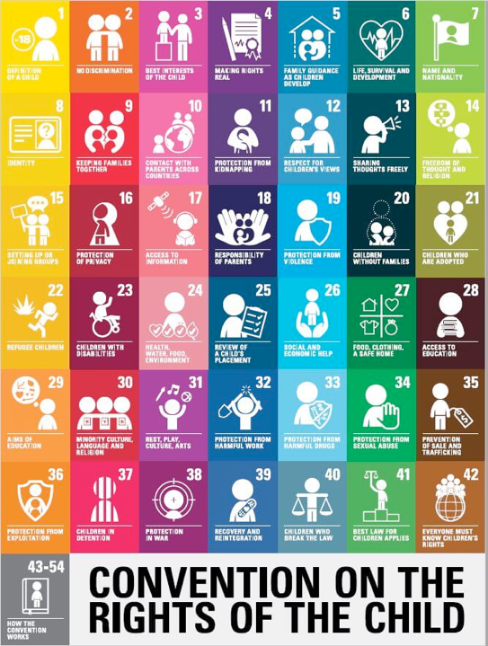
Climate crisis is a child rights crisis
The human right to a clean, healthy and sustainable environment declared by UN General Assembly in July 2022
Right for all not a privilege for some
Notes:
The final point is that the climate and ecological crisis is a human rights crisis.
Last year the UN concluded that access to a clean, healthy and sustainable environment is so fundamental to health that it declared it a human right. However, billions of people do not have this access.
if we look at the Convention on the rights of a child - represented by this graphic - we can see that many of these globally recognised rights are threatened by the climate crisis.
For example
no 6 The right to Life, survival and development
no 24 the right to health water food environment
This is another injustice – intergenerational injustice. Our younger generation, and future generations will suffer a larger burden than us and older generations.

Slide 15
Please use the chat box to share
What words, thoughts or feelings come up for you when you think about the climate crisis?
Notes:
The talk is about to move on to the impact of the climate crisis on mental health. zooming in a bit
Before we do I want to invite you to enter into the CHAT box please –
What words thoughts or feelings are coming up for you when you think about the climate crisis?

Slide 16
Climate crisis: impact on CYP MH

Slide 17



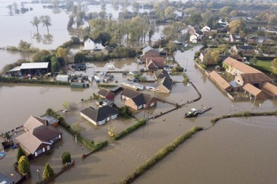

Increased Global Temperatures
Impact of Climate Crisis on Mental Health and Emotional Wellbeing
Vulnerability multiplier
Exacerbates injustice
Indirect
Longer term direct impacts
Immediate direct impacts
Solastalgia, Climate Grief, Eco Anxiety (eco distress)
Witnessing changes to landscape and loss of ecosystems
Awareness of EWE and impacts
Conflict/Violence Forced migration Community breakdown Worsened physical health Lost livelihoods
Disrupted health systems Disrupted food and water
Acute stress, Substance abuse
Suicide
Insomnia, Grief and Loss
Anxiety and Depression
Worsened wellbeing
Fishlake village Yorkshire
Flooded in 2019
Physical injury Loss of life
Loss and Damage to nature, land and infrastructure
Air pollution
Lawrance, E.L., et. al., 2022. The Impact of Climate Change on Mental Health and Emotional Wellbeing
Notes:
The impact on MH
the mechanism behind this is the heating of the planet leading to more frequent and more destructive weather and climate events. For eg floods, wild fires also higher temperatures and drought.
these are all photos from the UK
In this way Climate change has direct and indirect impact on mental health that can play out in the short term and longer term.
An increasing risk in the UK is more frequent and severe flooding. For example, this event in Yorkshire one evening in 2019, where A month’s rainfall fell in a day.
Over 1000 homeowners and families told to evacuate. Overnight, A baby was delivered in hospital but had no home to go to. These are the words of one of the people from an affected village
“One minute I was in town getting the car serviced – and the next minute the phone was buzzing and my neighbours were telling me the [River] Don had broken its banks. Water was rushing towards our house. I called my daughter Amy at home and I told her to get out, fast.
We tried to drive through our village but it was swamped.There was a lot of noise, and debris and telegraph poles were bouncing along at the head of this huge wave of water.
The flood was just pouring through houses. Our neighbours were stood on their drives, totally bewildered. Some people were in their bedclothes clutching valuables. One poor old lady was holding an urn with her husband’s ashes.
If the flooding had begun a few hours later, I think people would have died in their beds. Some bungalows were filled with water to the ceiling”.
The trauma and disruption continued a long term after the event. In this flood alone over 700 houses were deemed unliveable and many people were unable to claim insurance. and of course residents who choose to stay to rebuild are aware it could happen again any year.
Flooding is just one example, but hopefully that example can help us relate to this diagram better.
The immediate impacts of an EWE
could include any of these: eg physical injury and damage to property.
There may be longer term consequences, either linked to the ensuing chaos from the acute event or in other cases, consequences linked to the longer term impacts of climate change such as prolonged drought, sea-level rise, land degradation or a changed growing season.
these factors can lead to increased prevalence of MH Disorders.
in CYP the evidence shows increase risk of PTSD, depression, phobias, panic, sleep and attachment disorders, substance misuse
As well as having psychological impacts that may not reach diagnostic thresholds but could impact development:
This area represented at the top of the pyramid, relates to the impact on us of living with this enormous overarching existential threat
– so whether or not people are caught up in extreme weather events, more and more of us are aware of the risks and may be witnessing distressing changes to our places and ecosystems. there is an acknowledged emotional toll to this:
Reiterating: the climate crisis is inherently unfair and is a vulnerability multiplier.

Slide 18
Forced Migration
79.5million forcibly displaced people in the world by the end of 2019
103million by mid 2022
  (UN High Commission for Refugees)
Stressors at every stage → increased risk PTSD, anxiety, depression, emotional, adjustment and behavioural issues
  Pre-flight: breakdown of social and economic structures, reduced access to education, loss of important relationships
  Flight: uncertainty about food and shelter, separation from parents and carers, risk of violence
  Resettlement: challenges of adapting to new setting; discrimination; complicated legal immigration processes; grief, guilt and anger about loss of homeland, family, possessions
RF: unaccompanied refugees, traumatised parents
Notes:
I want to focus in briefly on two parts of that previous diagram which need whole sessions to themselves really
Forced migration and air pollution
Climate change can directly or indirectly contribute to forced migration but can also trap people in environmentally risky locations. this is already happening but it’s impact will intensify over the next decades
There are Stressors at every stage from pre-flight through flight and into resettlement.
which lead to an increased risk of for eg PTSD, anxiety, depression
Risk factors for developing MH problems in this context include: being an unaccompanied child or having traumatized parents

Slide 19

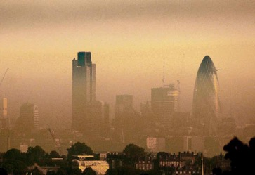
Air pollution
Ella Roberta Adoo
Kissi Debrah
Up to 36,000 deaths each year in the UK, 7mn globally, are caused by air pollution, mainly linked to lung disease
  Particulate matter (PM), Gases, Mould and Chemicals
  Burning fossil fuels, forest fires, waste burning, harmful agricultural practices and many different sources of indoor air pollution
PM2.5 crosses placenta and blood-brain barrier
  vulnerable groups of people such as the young, elderly and those with respiratory problems
  increased risk of infertility, intrauterine growth restriction, prematurity
Early-life exposure to nitrogen oxides was significantly associated with general psychopathology at 18 years of age, representing greater internalizing, externalizing, and thought disorder symptoms
Long-term exposure to even comparatively low levels of air pollution could cause depression and anxiety, according to a study exploring the links between air quality and mental ill-health
Recommendations: legally binding targets based on WHO guidelines, increased public awareness, increased medical professional awareness
Notes:
And to say a little about Air pollution which is very closely linked to the climate crisis.
This is a picture of Ella Roberta Adoo Kissi Debrah who developed asthma age 7 and died in London age 9 of an asthma attack. only after years of campaigning by her mother Rosamund was it clear the role air pollution played in causing then exacerbating her asthma. Ella became the first person in the world to have air pollution listed as a cause of death on her death certificate.
Air pollution, which comes most significantly from burning fossil fuels hence the link to climate change, is causing 13 deaths every minute. and that's Up to 36,000 deaths each year in the UK.
Air pollution comes in the form of Particulate matter (PM), Gases, Mould and Chemicals
Small particulate matter, PM2.5, crosses the placenta and blood-brain barrier causing inflammation and disease.
Certain groups are more vulnerable to the impacts of air pollution
including Children
There is growing evidence of the impact of air pollution on mental health and neurodevelopment
In one study early-life exposure to nitrogen oxides (a gas present in traffic pollution) was significantly associated with general psychopathology at 18 years of age,
In another study there was evidence that long-term exposure to even comparatively low levels of air pollution could cause depression and anxiety
The Coroner involved in the inquest into Ella’s death published a report that recommended:
there should be legally binding targets for max levels of air pollution based on W.H.O guidelines (this is still not the case in the UK),
and increased public and medical awareness. The role of air pollution was never mentioned to Ella or her mum during two years of treatment of her asthma which included over 30 emergency hospital admissions.

Slide 20
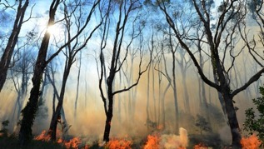
Eco distress
Overarching Threat
Indirect
LT direct
ST direct
Wide range of feelings
  Anger, blame, numbness, hopelessness, fear, hope, avoidance, panic, sadness, grief, guilt, shame, paralysis, optimism
Eco distress, Climate Grief, Solastalgia, Pain for the World, Eco anxiety
Eco-crisis impact
on MH
Compassion
Notes:
Now: the indirect impacts of climate change,
eco emotions and eco anxiety, which for now in the UK is what we are seeing more of – as we are fortunate enough to not be suffering so many direct impacts yet.
to introduce some of the work we’ve done at the College on this,
decided to use eco distress as somewhat of an umbrella term, being sensitive to the need to not pathologise.
As we know the eco crisis we are living through is enormous, devastating, uncertain and beyond our individual control. It's terrifying to consider the implications.
So it makes sense when people describe a complex mix of changing feelings, which can threaten to overwhelm:
Feelings being described include
angry, numb, hopeless and powerless, paralysed, sad, enraged, betrayed, scared, panicky, responsible, guilty, outraged, sometimes optimistic,
sometimes numb
Most of these feelings are aversive: and likely to lead people to turn away from the problem, which could partially explain the levels of insufficient action being taken.
There is debate around the pros and cons of labelling this phenomenon, and if we do what terms to use.
A lot of young people feel the term eco anxiety is helpful for them.
also helpful to see these responses as being an expression of compassion – people showing sensitivity to the harm that is happening and feeling agitated and motivated to do something about it.

Slide 21
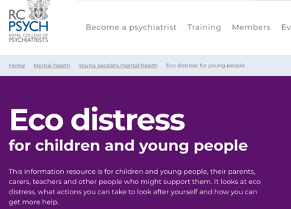

Eco distress
Overarching Threat
Indirect
LT direct
ST direct
Eco-crisis impact
on MH
  1. Systemic not individual
  2. It’s NOT: mental illness or diagnosis
  It’s healthy to be frightened in a crisis
  3. It makes sense and can teach and motivate us
  A final warning call for our species?
Notes:
EcoCAMHS we produced a Fact sheet available on the college webpage that talks through suggested ways of supporting someone with eco distress, which is like guiding people through a process rather than offering a treatment.
The problem and feelings are not going away but can become more manageable with support.
Three messages that I think are helpful to communicate about eco distress:
This distress is a symptom of a systemic problem –this acknowledgment gives us some responsibility to put pressure on the most powerful in our society to tackle the systemic problem that is causing so much distress.
That these responses make sense and it should never be seen as an illness or disorder to be aware and frightened of the climate crisis.
The other thing that can help is to re-frame eco distress as a helpful response: like mentioned on the previous slide. a sign of connection, awareness, compassion and care, which can be a source of motivation that is energising.

Slide 22
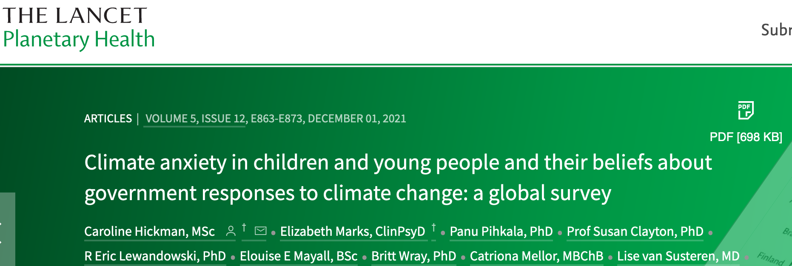
Notes:
Sharing highlights of a piece of research in this field of eco distress. Published at the end of 2021, focusing on climate anxiety:
This research revealed the scale of the problem,

Slide 23
10,000 Children and Young people, aged 16 – 25
Australia
Brazil
Finland
France
India
Nigeria
Philippines
Portugal
UK
USA
Representative samples from each country
Notes:
surveyed 10,000 YP age 16-25 in these 10 countries of Global North and South

Slide 24
45% report negative impact on daily functioning (eating, concentrating, work, school, sleeping, spending time in nature, playing, having fun, relationships).
8 out of 10 children and young people across the world, including UK, worry that climate change is threatening people and the planet
Notes:
The overall stats showed this: if we look at the coloured bar representing level of concern. 8/10 of the 10,000 were moderately to extremely worried about climate change,
and looking at the dark blue bar 45 % agreed these worries were having an impact on their functioning day to day.

Slide 25
Notes:
This is a busy slide showing the breakdown of responses by country. 1000 people per country.
the colour code is the same as previous slide.
Coloured bar showing level of concern and blue bar showing impact on daily function.
These longest blue bars in the centre, showing the largest impact of climate concerns are from the samples in India Nigeria and the Phillipines, countries on the frontline of the crisis.
Looking at The coloured bars concern is high (red orange and yellow) throughout with the highest level of concern about the climate in the Philippines.
This part of the study provided important Push back on the dismissive narrative around before this point that eco anxiety is only a first world problem.

Slide 26
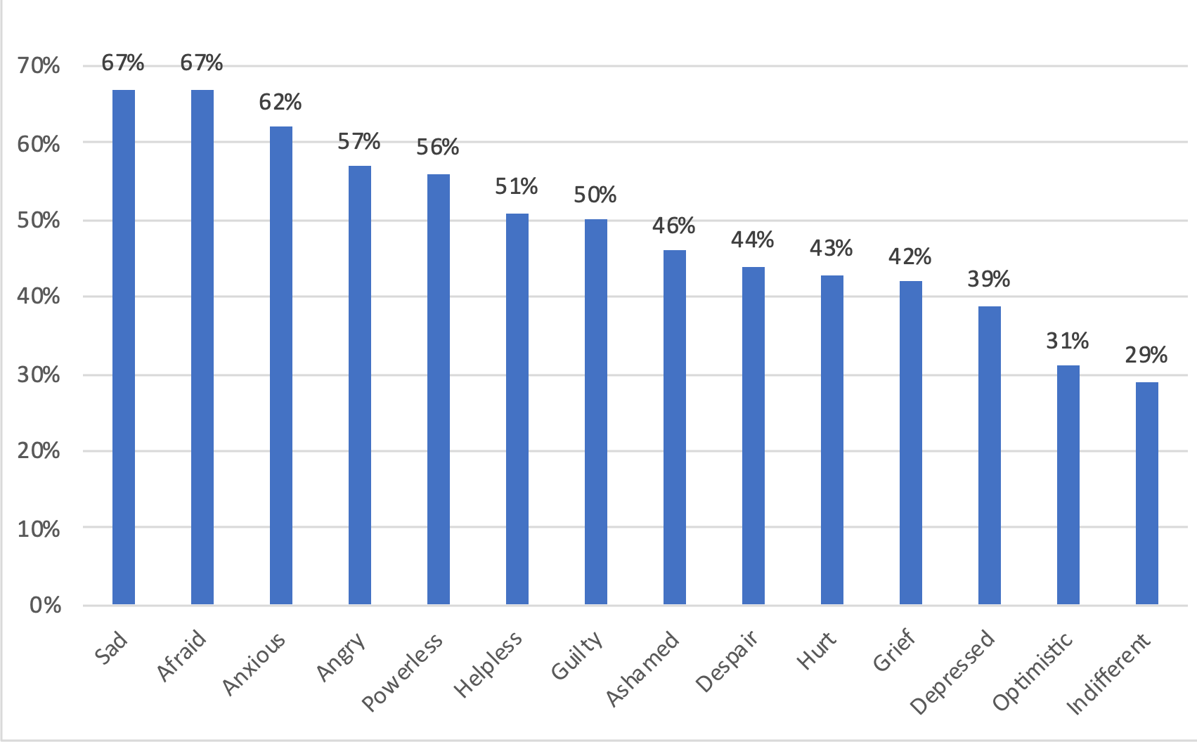
Climate change makes me feel… (% worldwide)
Notes:
The next slides return to the world wide stats - ie from all 10000 yp,
this graph displays what feelings people report having:
we can see 2/3 feeling sad afraid and over 60% feeling anxious

Slide 27
Over half (52%) think that their family’s security will be threatened (e.g. economic, social, physical security)
Notes:
These next statements describe thoughts about the climate crisis
Over Half the sample feared their families security will be threatened

Slide 28
Over half (55%) think that the things they most value will be destroyed
Notes:
And that the things they most value will be destroyed

Slide 29
Three quarters (75%) think that the future is frightening
Notes:
¾ think the future is frightening and

Slide 30
Four out of ten (39%) are hesitant to have children because of climate change
Notes:
4/10 are hesitant to have children because of CC

Slide 31
Over half (56%) think that humanity is doomed
Notes:
Over half of young people surveyed think humanity is doomed

Slide 32
Nearly half (48%) of children and young people have been dismissed or ignored by other people when they try to talk about climate change
Notes:
To add insult to injury nearly half say that they have been dismissed or ignored when they try to talk about CC. This is something that causes harm in itself and is something that can be tackled immediately

Slide 33
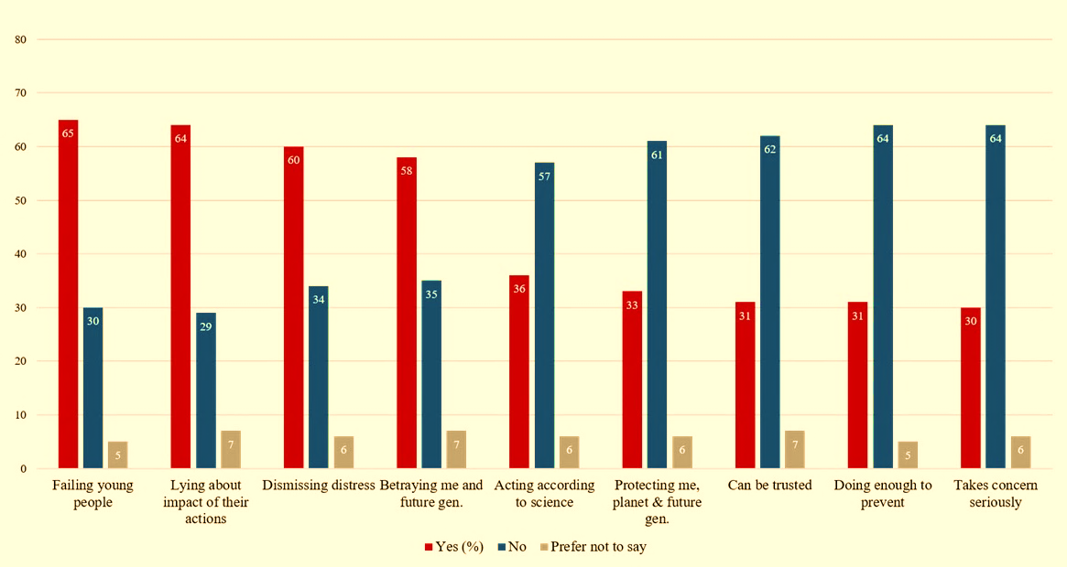
In relation to climate change, I believe that my government / other governments are:
Notes:
One of the most interesting findings was around what YP think about government response. The majority are disappointed.
The first statements are negative beliefs, the latter are positive beliefs, with red indicating yes I agree, blue indicating no.
To pull out a few results
over 60% say that governments are failing young people, can’t be trusted, not taking their concerns seriously and 57% say they are not acting according to science.
analysis of the data showed that overall distress appears to be greater when people believe that government response is inadequate. i.e. climate anxiety is made worse by the feeling of betrayal linked to inaction by powerful players.

Slide 34
There can be hope…
Distress and anxiety associated with:
eco-crisis itself
not being able to talk about it
AND witnessing government inaction
Reassured Valued
Protected Hopeful
Notes:
Importantly this means that when CYP feel that decision makers are taking the problem seriously, they are able to feel reassured, valued, protected and hopeful, despite still being worried about climate change.
In summary the results indicated there are different levels of harm : the distress caused by harm to the planet, distress at not being able to talk about it, and distress at inaction of those in power.

Slide 35
Nature-based perspective
Ecological/biodiversity crisis
Nature connection
Social justice
Climate
Nature
Interconnected
Threat
Opportunity
Our common future is becoming critically dependent on making health and the environment our top priorities
Notes:
In this last section of the talk I want to come back to a nature-based perspective – again looking at threat and opportunity.
Touching on why is the biodiversity crisis - that is the horrifying destruction to our biodiversity, wildlife and ecosystems - as relevant to our health as climate change
But also touching on the opportunity that opens up from this perspective
If we want to thrive in this climate changing world, we need to simultaneously hold in mind intersecting challenges otherwise we could inadvertently make our predicament worse:
Any solution or change we sign up to to tackle the climate crisis needs to also promote social justice and protect nature.
These things are all interconnected.

Slide 36
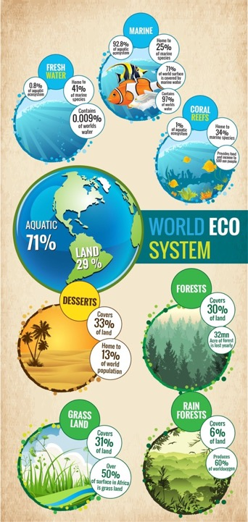
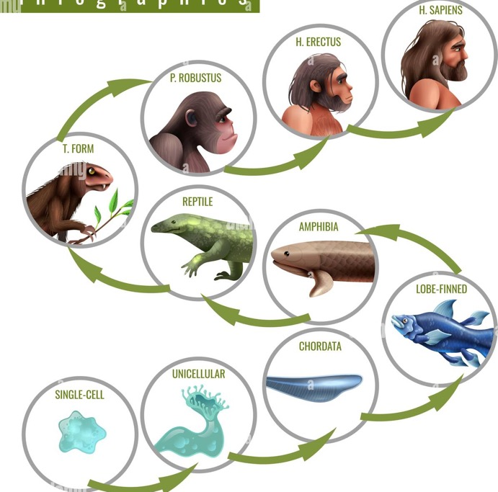
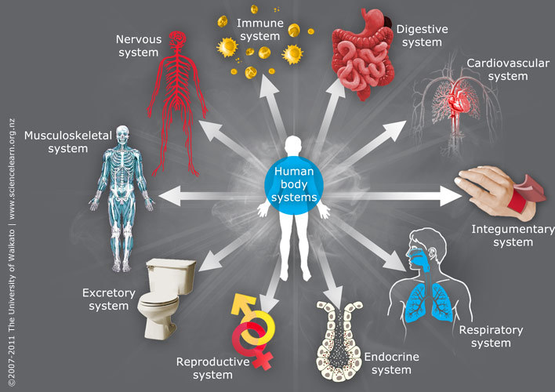
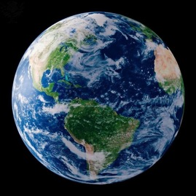
Ecological crisis is a health crisis
Notes:
The ecosystems of our planet have evolved over billions of years to a finely balanced state of rich biodiverse nature and wildlife – our soil, water, plants, animals- all interdependent with each other, as well as with the climate.
We too have evolved, For Hundreds of millions of years, from single cellular organisms, out of the sea, into the complex beings we are today.
Our evolution has been alongside the evolution of these ecosystems which are therefore our life support system – giving us food, water, and regular growing seasons.
It’s this life support system that is being degraded to the point of catastrophic breakdown when we talk about the ecological or biodiversity crisis.
Another way of seeing the link between biodiversity and climate change and the importance of not solely focusing on climate, is to use the metaphor of our planet being like a human body – which as we know is an intricate system of finely balanced sub-systems.
Our body temperature is important to our healthy function, and a fever, even of only a degree or two, makes us very unwell. We could use this as a metaphor for global warming.
But it's not just our temperature regulation that is important. our respiratory system is critical – perhaps like the planet’s forests - and our cardiovascular system too – maybe like our planet’s marine environments.
If we have sepsis from pneumonia it’s no use just treating our high fever – the damage being done to the lungs will continue unless the infection is also treated.
So similarly on a planetary scale it’s no use just focusing on climate change: many of our planet’s systems are impacted by exploitative and destructive human activity – oceans, forests, wildlife, insects – and even if we stopped emissions and global heating tomorrow, our planetary life support system will still be being degraded rapidly.

Slide 37
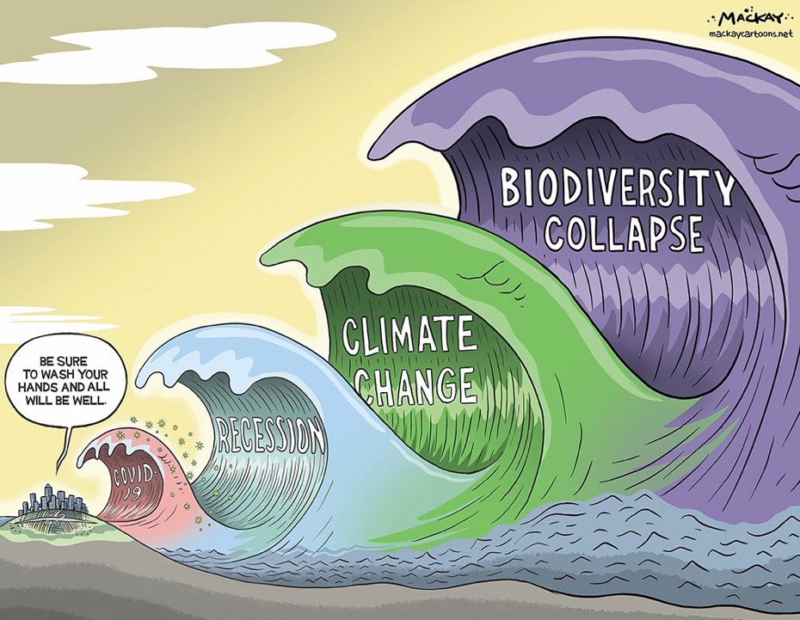
Notes:
all interconnected issues we’re facing at the moment.
This is not to minimise the impacts of covid or recession or to pit the importance of one set of stressors against another.
But it is to try and help understand the scale of these issues are that we’re talking about, and to reiterate the importance of the biodiversity crisis.

Slide 38
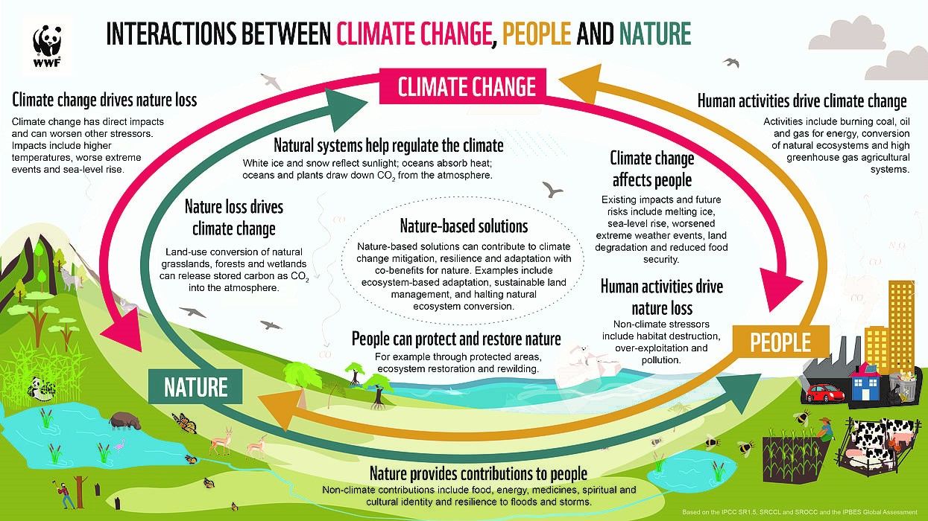
Rejuvenation of green and blue places
How we see our human:nature relationship is closely linked to the climate crisis
Contact and connection with nature confer myriad mental and physical health benefits for CYP and nature-based interventions improve health outcomes
Notes:
This diagram shows how interconnected our human health and behaviour are with nature and climate. if we want to promote health we have to attend to this whole picture.
We’ve seen how human activity drives climate change and climate change negatively impacts people, whilst exacerbating injustices
Climate change drives nature loss which drives climate change in a negative loop
However, restoring natural ecosystems, which we have the capacity to do, is the best technology we have for capturing carbon.
we also know that biodiverse natural spaces positively impact children’s physical and mental health and development and can be a protective factor for mental illness.
There is a huge body of evidence in this realm, and this is one of those areas of enormous potential.
If we were collectively living with this awareness of the importance of our planet’s health - climate and nature – to our own, as a central pillar within our dominant culture I don’t think would be facing the climate crisis or the health crisis that we are.
Our planet has the resources to feed and give energy for the number of people alive, if we know about and respect its limits.

Slide 39






Healthy planet =
Healthy people
Vulnerability and inequality amplifier
Climate justice
“Avoiding climate breakdown will require cathedral thinking. We must lay the foundation while we may not know exactly how to build the ceiling.”
Greta Thunberg
Notes:
How can we use this awareness of how dependent our health is on our planets climate and biodiversity, to inform what our role as health care professionals is,
There are many levels to work at: personal, professional or systemic.
many different bricks in the cathedral walls to lay
The sessions later today will explore this further.
I think the work needs to include identifying and communicating about the negative loop we have got into
with a lot of our health services actually contributing - via their carbon emissions, waste and pollution - to the crisis that is making us unwell.
One reason for identifying the negative loop is that there is so much potential waiting to be unleashed if we can make changes that move us in to a positive loop.
when we collectively and at scale, start to tackle climate change, and rejuvenate and reconnect to nature the positive effect on our health and wellbeing will be huge.

Slide 40





ECObiopsychosocial?
Notes:
One part of the enquiry we’re taking forward in EcoCAMHS is what would an ECObiopsychosocial model of care look like –
what would our practice look like if we integrated the importance of the ecological and our human relationship with nature into our theoretical models, our assessment and formulation, and into sustainable service design.
It’s a really exciting area of growing interest. And I’ve seen transformational change for patients and staff when time outdoors and nature-based interventions are brought into CAMHS care pathways.

Slide 41

Please use the chat box to share
A place that you love and that holds meaning for you
Notes:
final contribution from you.
Can you share in the chat box a place outdoors that you love that holds meaning for you. Just write a few words,
….I’d like to share a a place that is very special to me…
If you can also share - What does it offer you, when do you most need to go there?
– how your place impacts your wellbeing.

Slide 42
Summary
Child and adolescent psychiatry perspective
Difficult stuff
  Collective enquiry and interconnectedness
Scale and complexity of eco-crisis is hard to contemplate but impacts us, our patients and our services at multiple levels
  Impacts on mental health and health inequalities
Human relationship with nature, and the biodiversity crisis

Slide 43
“It really boils down to this: that all life is interrelated.
We are all caught in an inescapable network of mutuality, tied into a single garment of destiny.
Whatever affects one directly, affects all indirectly.”
Dr Martin Luther King 1967
Notes:
a final reminder of the theme of interconnectedness –
perhaps, initially seeing how inextricably linked the crises we’re facing are can be overwhelming,
but ultimately I believe seeing these links can help:
helps guide change that tackles several problems at once rather than inadvertently exacerbating other problems,
helps us see why even small actions can be transformative
and also why it’s so important that we approach this sort of work shoulder to shoulder with others and with a sense of support and connection .

Slide 44

Thank you

Slide 45
Resources for eco distress
Eco distress Fact sheet, Royal College Psychiatrists: https://www.rcpsych.ac.uk/mental-health/parents-and-young-people/young-people/eco-distress---for-young-people
Climate Psychology Alliance resources: https://www.climatepsychologyalliance.org/support
Active Hope online: https://www.activehope.info/free-training
Gen Dread and All We Can Save: Resources for working with climate emotions. https://www.allwecansave.earth/emotions
Don’t look up - https://dontlookup.count-us-in.com/step-detail/be-kind-to-your-mind

Slide 46
Lawrance, E.L., Thompson, R., Newberry Le Vay, J., Page, L., Jennings, N., (2022). The Impact of Climate Change on Mental Health and Emotional Wellbeing: A Narrative Review of Current Evidence, and its Implications. International Review of Psychiatry 34, 443–498
Hickman C. & Marks E., Pihkala P., Clayton S., Lewandowski E., Mayal E., Wray B., Mellor C., van Susteren L. (2021) A global survey of climate anxiety in children and young people and their beliefs about government responses to climate change. Pre-print, Lancet Planetary Health
Pihkala, P. The Process of Eco-Anxiety and Ecological Grief: A Narrative Review and a New Proposal. Sustainability (2022), 14, 16628. https://doi.org/10.3390/su142416628
Mental Health and Our Changing Climate, American Psychological Association, Climate for Health, EcoAmerica: https://www.apa.org/news/press/releases/mental-health-climate-change.pdf
Our Planet’s Climate and Ecological Emergency. Royal College Psychiatrists Position Statement (2021). Mental Health impacts and Psychological dimensions. https://www.rcpsych.ac.uk/docs/default-source/improving-care/better-mh-policy/position-statements/position-statement-ps03-21-climate-and-ecological-emergencies-2021.pdf?sfvrsn=281fb719_8
Clemens V, von Hirschhausen E, Fegert JM. (2020) Report of the IPCC: implications for the mental health policy of children and adolescents in Europe – a scoping review. European Child & Adolescent Psychiatry. https://doi.org/10.1007/s00787-020-01615-3
Hayes K, Blashki G, Wiseman J, Burke S, Reifels L. (2018) Climate change and mental health: risks, impacts and priority actions. Int Journal of Mental Health Systems 12:28
Burke S, Sanson A, Van Hoorn J. (2018) The Psychological Effects of Climate Change on Children. Current Psychiatry Reports 20:35
Diffenbaugh N & Burke M (2019). Global warming has increased global economic inequality. PNAS 116 (20)
REFERENCES
Climate anxiety and MH impacts of eco crisis
Climate anxiety and Mental Health impacts of Eco Crisis

Slide 47
Richardson M, Sheffield D, Harvery C, Petronzi D (2015). The Impact of Children’s connection to Nature. A report for the RSPB, available from https://www.rspb.org.uk/globalassets/downloads/documents/positions/education/the-impact-of-childrens-connection-to-nature.pdf
Bratman G, Anderson C, Berman M, Cochran B, de Vries S, Flanders J, Folke C, Frumkin H et al (2019) Nature and mental health: an ecosystem service perspective. Sci Advan 5: eaax0903
Engemann K, Pedersen C, Arge L, Tsirogiannis C, Mortensen P, Svenning J (2019). Residential green space in childhood is associated with lower risk of psychiatric disorders from adolescence into adulthood. Proceedings of the National Academy of Sciences 116 (11)
Rook G. (2013) Regulation of the immune system by biodiversity from the natural environment; an ecosystem essential to health. PNAS 10 (46)
Cooley, S., Jones, C., Kurtz, A., and Robertson, N. (2020) ‘Into the Wild: a meta-synthesis of talking therapy in natural outdoor spaces. Clinical Psychology Review 77:101841
Roszak T., Gomes, M and Kanner, A (1995) Ecopsychology: Restoring the Earth, Healing the Mind. Crown Publishers
Richardson, M., & Hamlin I., (2021) Nature engagement for human and nature’s well-being during the Corona pandemic. Journal of Public Mental Health 20 (2)
Lumber, R., Richardson, M., Sheffield, D. (2017) Beyond knowing nature: Contact, emotion, compassion, meaning and beauty are pathways to nature connection. PLoS ONE 12(5):e0177186.
Lovell, R (2014) Natural England Access to Evidence Notes. Links between natural environments and Mental Health (EIN018) http://publications.naturalengland.org.uk/category/6159558569361408
REFERENCES
Nature and Health

Slide 49
Impact on CYP MH
Reduction in blood pressure, cortisol levels and stress
improved sleep, attention, pro-social behaviours, self-regulation under pressures, academic performance, ADHD symptoms, memory, competence, self-discipline, language and communication skills functioning (Frumkin et al., 2017; Seers et al., 2022a)
Being in natural spaces
Growing up near green space
Nature connection
Lower levels of emotional and behavioural problems, in particular inattentive and hyperactive domains (Vanaken and Danckaerts, 2018)
Lower risk of psychiatric disorders from adolescence into adulthood (Engemann et al., 2019)
Improved physical activity, immune function, overall cognitive development, self-esteem, self-efficacy, resilience, academic performance, and lower rates of obesity (Seers et al., 2022a)
Lower levels of anxiety, distress, hyperactivity, peer and emotional difficulties and psychosomatic symptoms (Seers et al., 2022b).

Slide 50
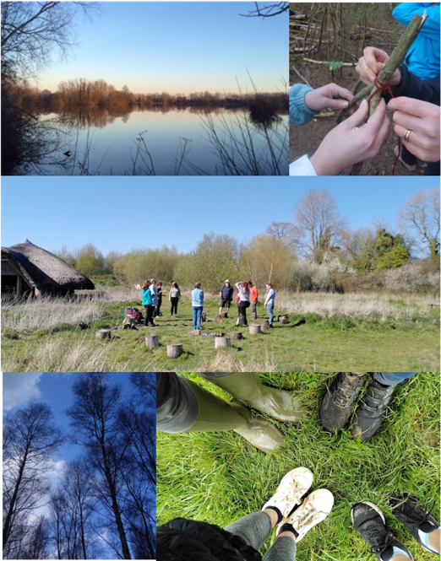
FAMILIES IN THE WILD - multi family ecotherapy woodland intervention
That evening was the first time he’s fallen asleep easily for months
We never get a chance to enjoy ourselves like this as a family
WILD WALKS
It felt like freedom
Coming into the trees was like a big hug
It relaxed me so when I got back to the ward my anxiety was less
NATUREWELL - training for staff
I didn’t realise how much I would get out of it and how much I need to take time out for myself

Slide 51
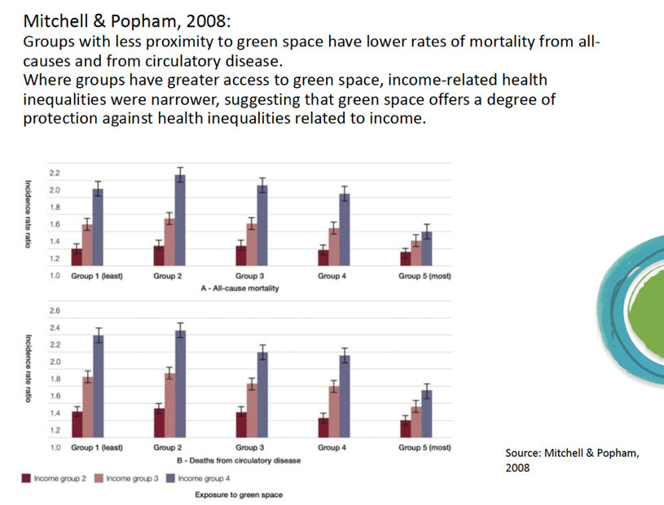
Inequalities and green space
In urban areas the most affluent 20% of wards have FIVE times the amount of green space per person than the most deprived 10% of wards CABE Space 2010
Monitoring visits to green and blue space in urban areas shows that people who are older, from lower socioeconomic groups or from minority ethnic backgrounds are more likely to be infrequent visitors
For people growing up in the most disadvantaged neighbourhoods, access to green space in childhood is linked to lower anxiety in old age Pearce et al, 2018

Slide 52
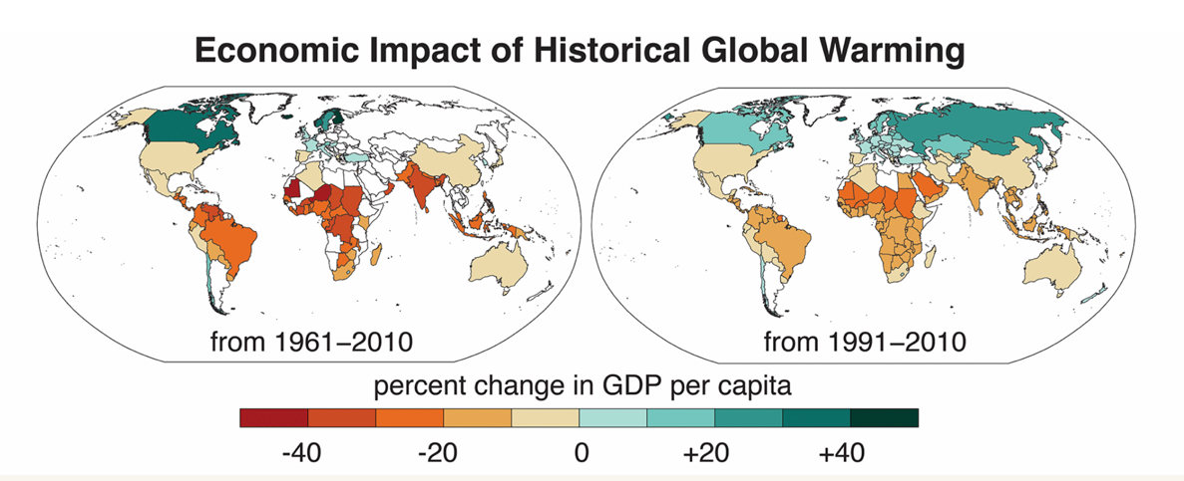
Diffenbaugh & Burke, 2019

Slide 53
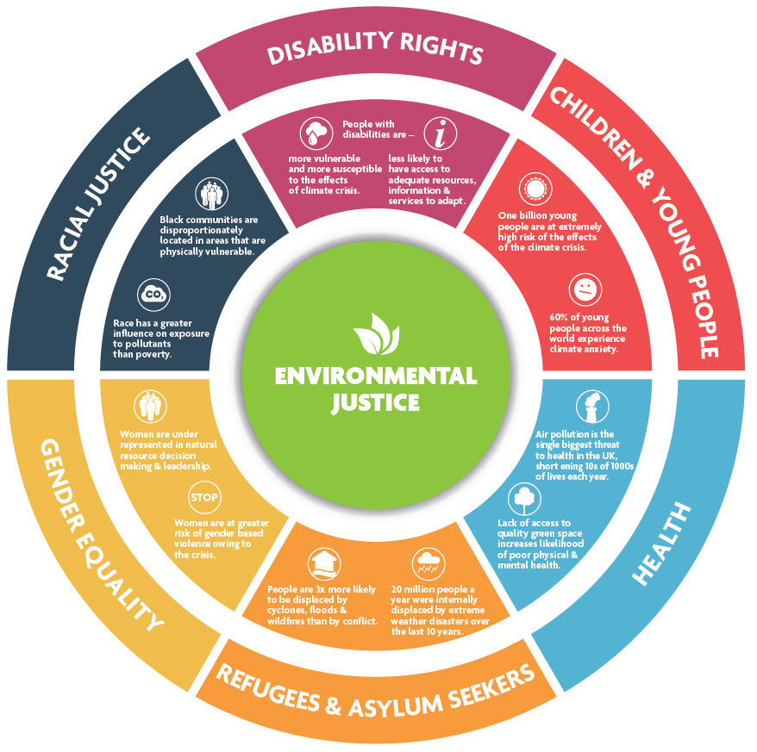
Notes:
https://cloresocialleadership.org.uk/page/Environmental_Justice_Social_Justice_4
This wheel brings together a body of inarguable evidence, with references, to show the connection between social justice issues and the environmental and climate crisis. There are six issues featured here. It is not an exhaustive list, but the overall effect is clear: the climate crisis is a social justice issue.
Examples include:
Women are at greater risk of gender-based violence owing to the effects of the climate crisis.
Race has a greater influence on exposure to pollutants than poverty.
People with disabilities are more vulnerable and more susceptible to the effects of the climate crisis, and
Less likely to have adequate access to information, resources and services to adapt.
This model provides a snapshot of just some of the intersections identified by the group during our research, we recognise that there will be many more, that beneficiaries may intersect across multiple issues and also that these will change over time.

Slide 54
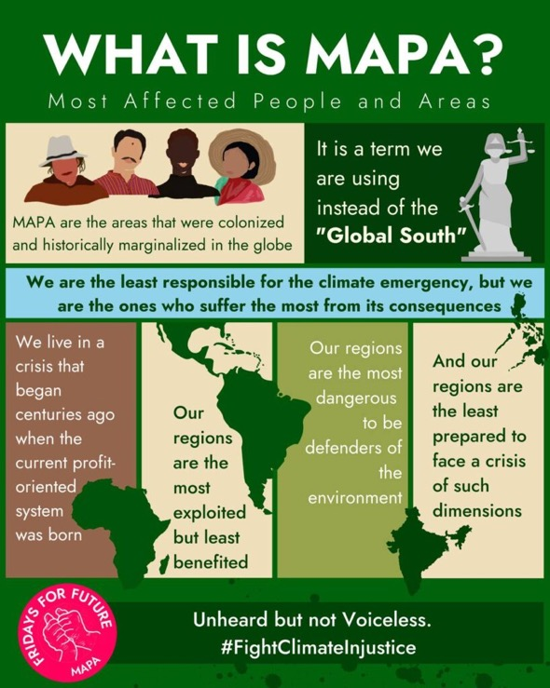

Slide 55

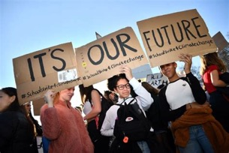


EcoCAMHS
June 2019 Presentation
CAPFEC
24/7/19 1st meeting
Jan 2023
40 members, 6 in core team, 2 youth advocates
SCOPE
MH impacts of CEE on CYP
and
Nature’s Role in CAMHS

Slide 56
Support for eco distress cultivating resilience and optimism
Advocate for systemic action
Validate the emotional experience
  Is a massive intervention. Promote intentional self-care
This is Collective and Systemic
  Link people to groups that value internal and external activism
  Taking action helps and is vital: start small, shared responsibility, stay involved as it evolves
Buffer the pain: cultivate connection to what makes life feel good and meaningful
  Nature, creativity, sport, religious/spiritual practice, friends, music
Awareness and Acceptance
Emotional support and community
Taking action towards a better future

Slide 57

CLIMATE CHANGE
It is not a scientific problem waiting for a technical solution
  It is a paradigmatic challenge to an economic system driven by fossil fuels and consuming life styles
    Separation of human – nature, othering of nature/peoples as resources for exploitation and growth
  It’s an urgent, frightening, systemic problem involving environment, culture and politics.
It challenges all of us in modern societies both personally and politically.
  It engenders fear, denial and despair amongst individuals
  It engenders evasion, indifference and duplicity amongst the powerful
  It forces uncomfortable dilemmas about justice, nature and equality into consciousness.
= Culture (not Climate) Change Work

Slide 58
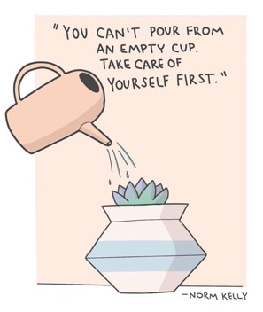
Drastic, Just, Climate Action by those in power
Zero Carbon, Nature Positive
Developing a response to emotional and mental health burden of these crises
Awareness, education, impact, policy
Co creation of effective locally relevant interventions
Ensure research and investment directed at most affected communities
Support for eco distress
Children, Young People, Parents, Teachers, Ourselves, Anyone
Feel, Think, Breathe, Understand, Act
Join with others for emotional support as well as action
MHCP RESPONSE TO MH IMPACTS OF CEE

Slide 59
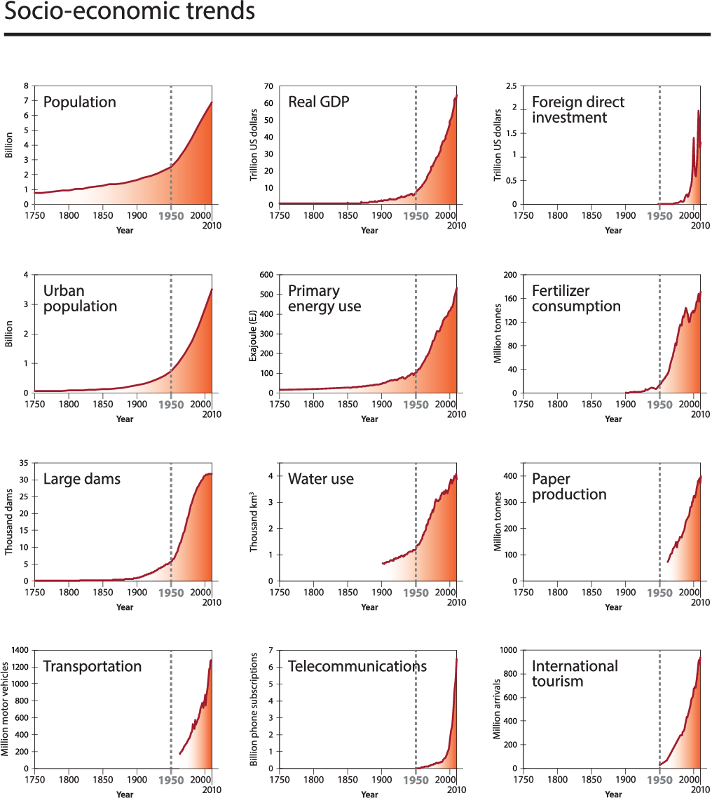
Notes:
Figure 1. Trends from 1750 to 2010 in globally aggregated indicators for socio-economic development. (1) Global population data according to the HYDE (History Database of the Global Environment, 2013) database. Data before 1950 are modelled. Data are plotted as decadal points. (2) Global real GDP (Gross Domestic Product) in year 2010 US dollars. Data are a combination of Maddison for the years 1750 to 2003 and Shane for 1969–2010. Overlapping years from Shane data are used to adjust Maddison data to 2010 US dollars. (3) Global foreign direct investment in current (accessed 2013) US dollars based on two data sets: IMF (International Monetary Fund) from 1948 to 1969 and UNCTAD (United Nations Conference on Trade and Development) from 1970 to 2010. (4) Global urban population data according to the HYDE database. Data before 1950 are modelled. Data are plotted as decadal points. (5) World primary energy use. 1850 to present based on Grubler et al. (2012), 1750–1849 data are based on global

Slide 60
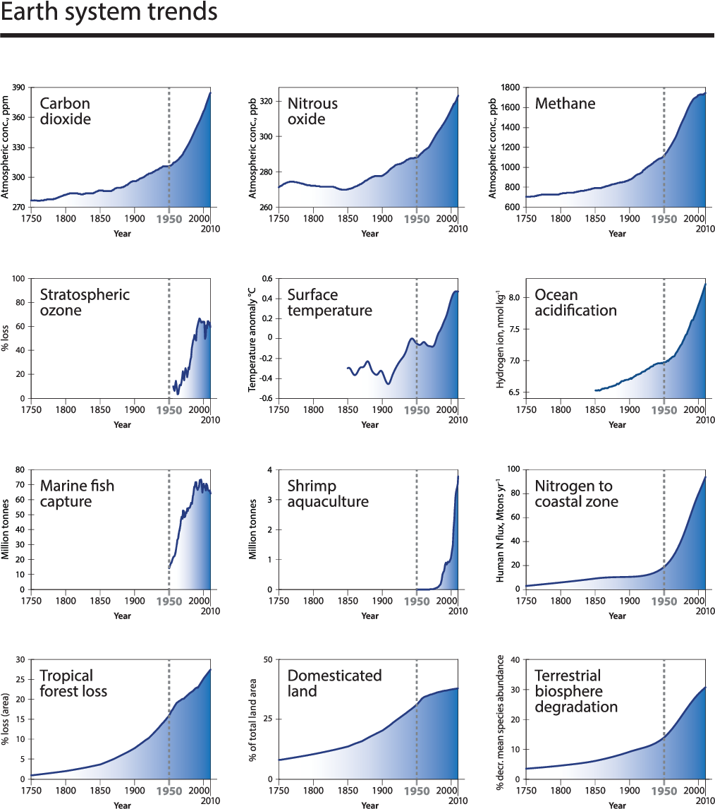
Notes:
Figure 3. Trends from 1750 to 2010 in indicators for the structure and functioning of the Earth System. (1) Carbon dioxide from firn and ice core records (Law Dome, Antarctica) and Cape Grim, Australia (deseasonalised flask and instrumental records); spline fit. (2) Nitrous oxide from firn and ice core records (Law Dome, Antarctica) and Cape Grim, Australia (deseasonalised flask and instrumental records); spline fit. (3) Methane from firn and ice core records (Law Dome, Antarctica) and Cape Grim, Australia (deseasonalised flask and instrumental records); spline fit. (4) Maximum percentage total column ozone decline (2-year moving average) over Halley, Antarctica during October, using 305 DU, the average October total column ozone for the first decade of measurements, as a baseline. (5) Global surface temperature anomaly (HadCRUT4: combined land and ocean observations, relative to 1961–1990, 20 yr Gaussian smoothed). (6) Ocean acidification expressed as global mean surface ocean hydrogen ion

