Slide 1
Suicide and the COVID-19 Pandemic
David J Hall
RCPsychiS Suicide Prevention lead

Slide 2
What is the likely effect of the pandemic on suicide rates?
Reduction in wartime (world cups even)?
National unity- ‘all in this together’
Durkheim- Anomie and Synnomie
However…
‘There is unequivocal evidence that economic recessions are associated with increases in the incidence of suicide…’ (International Handbook of Suicide Prevention)
Inequalities magnify risk
The timing and extent of this likely rise is unclear
Mitigation may be possible

Slide 3
Suicide Prevention Action Plan 2018
‘Every life matters’
20% reduction in suicide by 2022
(from 2017 baseline)

Slide 4
SUICIDE PREVENTION ACTION PLAN:
NATIONAL SUICIDE PREVENTION LEADERSHIP GROUP
Establishing the National Suicide Prevention Leadership Group and supporting the development of local action plans.
Creating and implementing refreshed mental health and suicide prevention training by May 2019.
A coordinated approach to public awareness about suicide prevention.
Timely and effective support for those affected by suicide.
Improved crisis support services for people in distress.
Use of digital innovation to improve suicide prevention.
Targeted preventative activity for at-risk groups.
Ensuring the needs of children and young people are reflected across all of the actions.
Ensuring that data, evidence and guidance is used to maximise impact in and improve service planning and delivery.
Developing appropriate reviews into all deaths by suicide.
Full Suicide Prevention Action Plan can be found here - https://www.gov.scot/publications/scotlands-suicide-prevention-action-plan-life-matters/

Slide 5
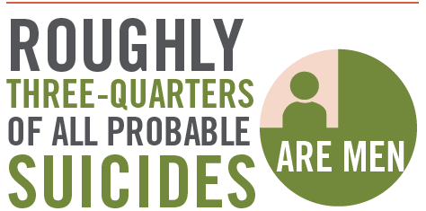
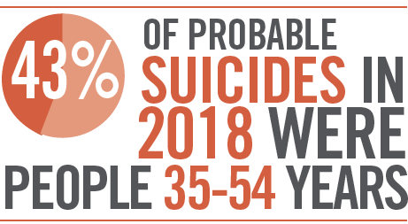
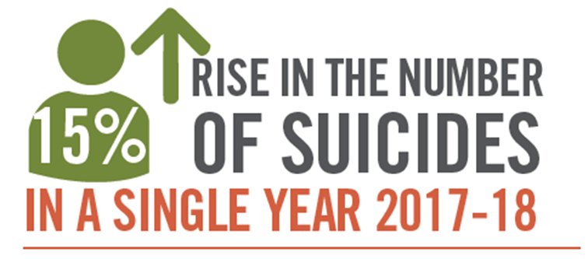
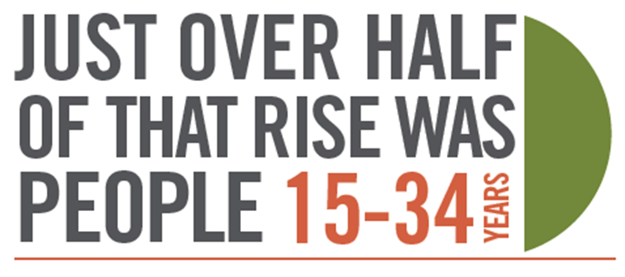
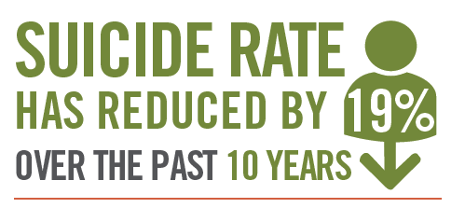

Where were we before the pandemic?
In 2018, there were 784 probable deaths by suicide in Scotland – an increase from 680 in 2017.
Suicide deaths were almost three times more likely among those living in the most deprived areas, than among those living in the least deprived.
The suicide rate in the 15-24 age group increased from 10 to 15 (per 100,000) from 2017 to 2018
“a single year of data should not be over-interpreted”
The highest rate of suicide occurs in the 35-44 age group for males.
The highest rate of suicide occurs in the 45-54 age group for females.

Slide 6
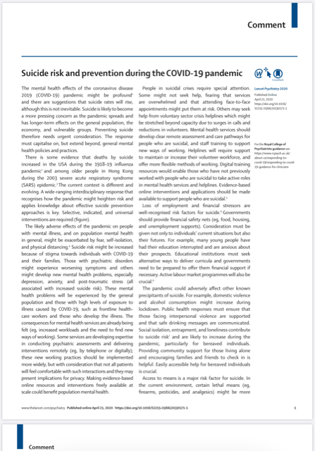
Suicide risk and prevention during the COVID-19 pandemic
Lancet Psychiatry 2020 Published Online April 21, 2020 https://doi.org/10.1016/ S2215-0366(20)30171-1

Slide 7
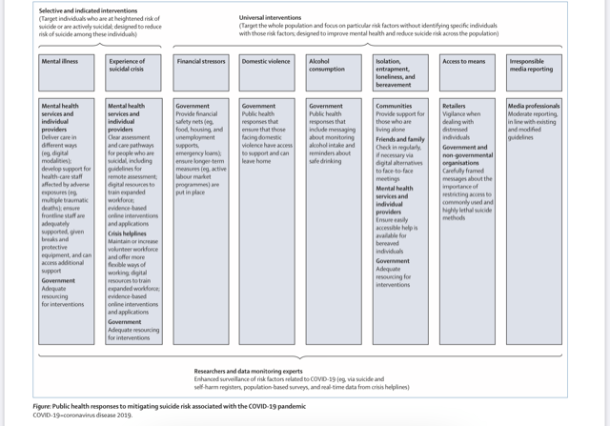

Slide 8
Potential areas for universal intervention
Financial stressors
Domestic violence
Alcohol consumption
Isolation, entrapment, loneliness and bereavement
Access to means
Irresponsible media reporting

Slide 9
Potential areas for selected and indicated interventions
Mental illness- services and providers
Experience of suicidal crisis- mental health services and providers
Crisis helplines
Government resources and initiatives

Slide 10
What do we need to do?
Prepare
Innovate
Prioritise
Collaborate
Reflect
Learn
#MHimprove

