Slide 1
IMPACT OF COVID-19 PANDEMIC ON VULNERABLE CHILDREN & YOUNG PEOPLE
ASPEP
ASSOCIATION OF SCOTTISH PRINCIPAL
EDUCATIONAL PSYCHOLOGISTS
Morven Graham
Principal Educational Psychologist, Stirling Council
&
ASPEP Secretary

Slide 2

Definition of Vulnerable Children and Young People:
at risk of significant harm, with a child protection plan
looked after at home, or away from home
‘on the edge of care’, where families would benefit from additional support
with additional support needs, where there are one or more factors which require significant or co-ordinated support
affected by disability
where they and/or their parents are experiencing poor physical or mental health
experiencing adversities including domestic abuse and bereavement
requiring support at times of key transitions
Scottish Government - 2020

Slide 3
What do we know about children’s experiences of lockdown?
For example:
Children’s Parliament – ‘How are you doing?’ A survey for 8-14 year olds – almost 4,000 responses in April 2020
Scottish Youth Parliament, Youthlink Scotland and Young Scot – ‘Lockdown Lowdown’ survey – 2400 young people across Scotland
Young Minds - 2036 young people with a history of mental health problems

Slide 4
What do we know about parent/carers experiences?
Small-scale research study by the University of Sussex (August 2020)
502 parent/carers of children with additional support needs across the UK (primarily England)
Most reported that their children felt less stressed and anxious,
Main impact on social communication and interaction,
48% reported their children were positive about returning to school to see friends,
Some found schools very supportive during lockdown,
Other parent/carers felt isolated, lonely, had less supports and reported increased strain on relationships
Education and COVID-19: perspectives from parent/carers of children with SEND (Dr J Shepherd & Dr C L Hancock, University of Sussex, August 2020)

Slide 5
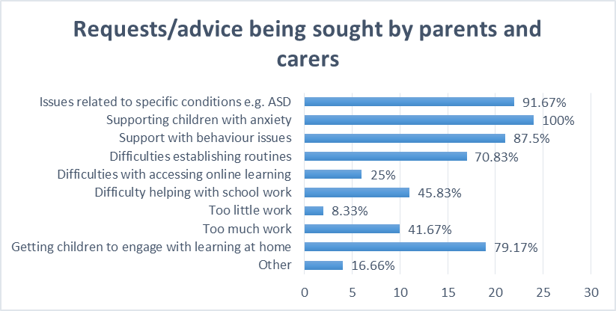
ASPEP Survey – May 2020
Notes:
Survey to EP Services across Scotland

Slide 6
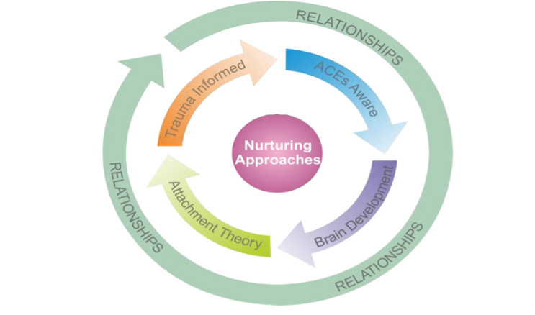
Reconnection and Recovery
Nurture, Adverse Childhood Experiences and Trauma Informed Practice: Making the links between these approaches – Education Scotland, 2018
Notes:
An example of how EP Services are supporting the recovery phase based on universal approaches as well as targeted approaches, with an emphasis on the importance of relationships and regulation.

Slide 7

Key Considerations
Staff & Parent/Carer Wellbeing – ‘an emotionally regulated adult can help to calm an emotionally dysregulated child however an emotionally dysregulated adult cannot help to calm an emotionally dysregulated child’ (B Perry, 2020)
Getting it Right for Every Child approach – child centred; focus on wellbeing; importance of partnerships; assessment & planning
National MH priorities – school counselling funds; community mental health supports & services; CAMHS service specification; suicide prevention; perinatal mental health

