Slide 1
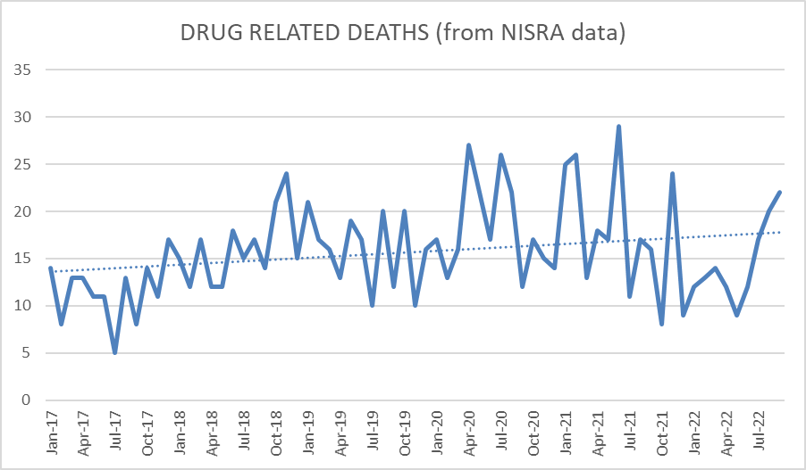
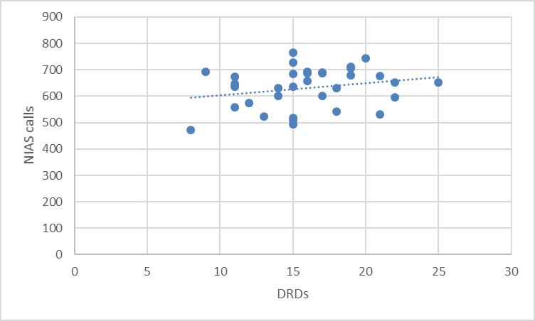
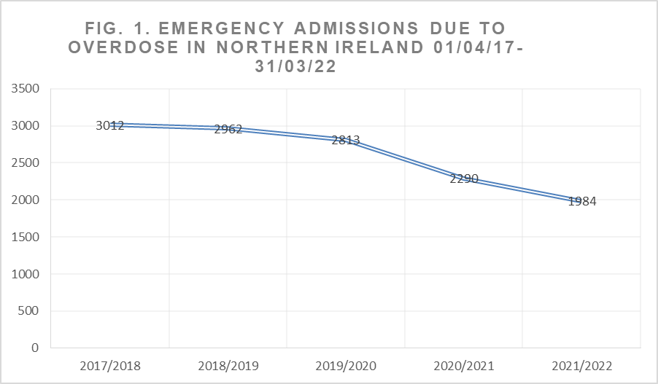
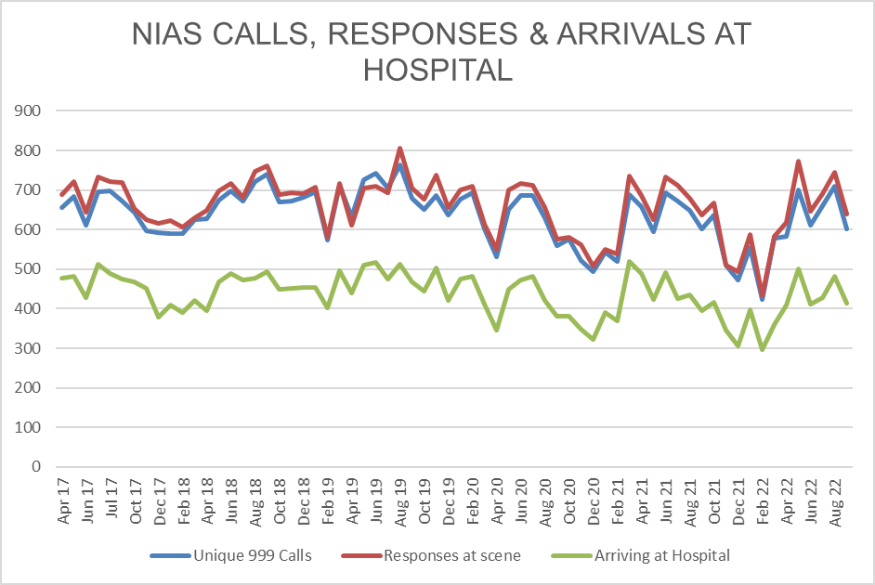
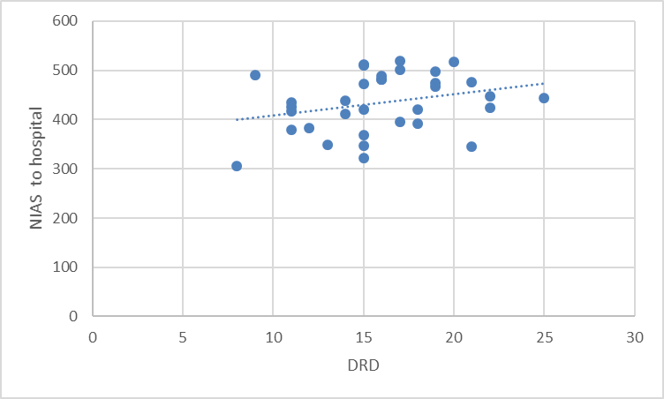
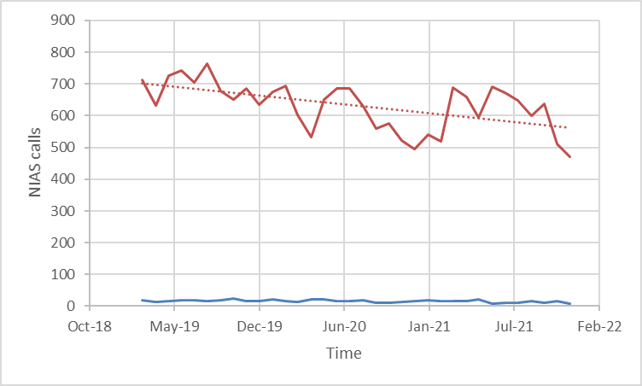
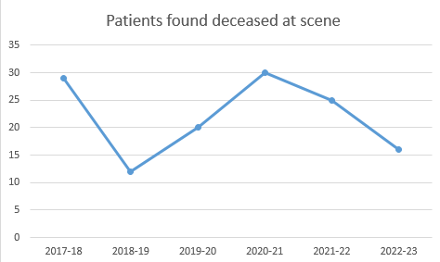
The impact of the Covid-19 pandemic on drug overdose ambulance call-outs, and drug-related deaths in Northern Ireland
Dr. Zarah Fleming & Dr. Donna Mullen
Introduction & Background
The Covid-19 pandemic impacted all health services. For people who use drugs, there was decreased access to scheduled care including inpatient detoxification, face-to-face reviews and reduced supervision of Opioid Substitution Therapy. It was expected that this could have led to increased presentations for unscheduled care, and an increase in drug-related deaths (DRDs). In Northern Ireland a Drug-Related Death is recorded by the Northern Ireland Statistics and Research Agency (NISRA) when the underlying cause of death recorded on the death certificate is drug poisoning, drug abuse or drug dependence. Pre-pandemic DRDs had already been increasing in Northern Ireland. In 2019 there were 191 DRDs recorded and Drug-related deaths accounted for 10.1 deaths per 100,000 people. The rate of death relating to drug misuse had more than doubled over the previous 10 years from 3.2 deaths per 100,000 population in 2009 to 8.7 deaths per 100,000 population in 2019. (NISRA, 2021).
In response to this worrying trend a DRD taskforce has been established. The taskforce has been collecting & collating baseline data from all available sources in an attempt to determine any patterns in DRDs, to recommend strategies for prevention and to improve communication between services. From initial NHS data collected for the taskforce it appeared hospital admissions throughout Northern Ireland for treatment of drug overdoses decreased in 2020 and have continued to decline (Fig1.).
Fig. 1: emergency admissions due to overdose, Northern Ireland 01/04/17- 31/03/22.
NISRA data for DRDs plotted against a timeline of the pandemic showed a potential link between early Covid-19 restrictions and DRDs but the relationship between later variations in restrictions was less clear (fig.2). Recorded monthly rates varied widely and was possible the perceived effect was due to normal fluctuation (fig.3)
Fig. 2: Drug-related deaths in NI Jan 2019 – Dec 2021 by month, with Covid-19 timeline mapped.
Method
Data was obtained from NIAS pertaining to overdose call-outs, calls managed at scene and transfers to hospital. This was analysed against NISRA DRD from data each month for the period between March 2019 & December 2021 using Pearson’s correlation co-efficient to determine strength and significance of the relationship between each group & DRDs.
Results
Following analysis a weak correlation was found between number of 999 calls and DRD (0.23), and between number arriving at hospital and DRD (0.28) these were not statistically significant. Again, weak correlation was found between number of NIAS responses at scene and DRD (0.21) but these were not statistically significant either (p value >0.0.5)
Fig. 3: Number of drug-related deaths in Northern Ireland by month, January 2017 – July 2022
Fig. 4: Numbers of 999 calls which fit the “overdose/poisoning” criteria, responses at scene, and patients arriving at hospital by month, April 2017 – August 2022
Fig. 5: NIAS calls & DRDs March 2019- December 2021
Discussion
The weak correlation between all subsets of NIAS callouts and DRDs suggests other factors, rather than availability of emergency services influence the likelihood of poor outcomes following overdose.
30 patients found deceased on arrival by NIAS in 2020/21 compared to 20, 12 in the previous two years initially led us to believe a reluctance to attend hospital due to fear surrounding Covid had influenced numbers of DRDs. However, numbers refusing to attend hospital after 999 call decreased.
Although raw data in the initial months of the lockdown suggested a possible change in practice or accessibility of emergency services leading to reduced access to hospital, NIAS data collected relating to callouts suggests their practice did not change as much as anticipated during the pandemic. It is likely that other factors within the hospitals themselves, such as bed availability or patient willingness to remain in hospital may have impacted more on the numbers of patients admitted and that these factors have continued to affect numbers admitted since.
Fig. 7: Pearson’s correlation coefficient 0.237254 indication a weak association between increased calls to NIAS relating to OD & DRDs.
Fig. 8: Pearson’s correlation coefficient 0.287939322 indicating possible stronger association between need for transfer to hospital & DRDs.
Conclusions
It is reassuring that access to NIAS & emergency paramedic care does not appear to have contributed to an increase in DRDs during or since the Covid-19 pandemic. The physiology of contracting Covid may have made respiratory depression and therefore DRD more likely.
However the sustained trend of reducing admissions to hospital following overdose is unexplained. It is possible that there has been a change in practice within the hospitals or emergency departments affecting management of patients following transfer to hospital. In the context of increasing drug deaths in Northern Ireland this and other possible factors influencing poor outcomes warrants urgent further investigation & research to produce recommendations for service improvements.
Fig. 6: Numbers of patients found deceased at scene by NIAS, 2017 - 2023
References
Drug-Related and Drug-Misuse Deaths 2009-2019. Northern Ireland Statistics & Research Agency, 2021. https://www.nisra.gov.uk/publications/drug-related-and-drug-misuse-deaths-2009-2019
Timeline of the Covid pandemic in Northern Ireland 2020. Timeline of the COVID-19 pandemic in Northern Ireland (2020) - Wikipedia
Timeline of the Covid pandemic in Northern Ireland 2021. Timeline of the COVID-19 pandemic in Northern Ireland (2021) - Wikipedia
Acknowledgements
Michael Bradley @ Performance Management & Service Improvement, SPPG.
Tracy Keenan and Chris Clarke @ Northern Ireland Ambulance service,
Deborah Lyness & Carly Gordon @ Northern Ireland Statistics and Research Agency.
Notes:
1

