Slide 1
Alcohol misuse in Older adults
Tier 1

Slide 2
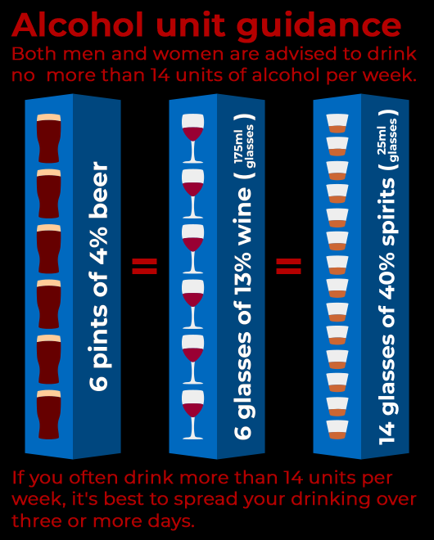
What is normal?
Weekly limits can be misleading.
If just a quarter of the recommended weekly amount is drunk over a matter of hours, this is more likely to be harmful.

Slide 3
Harmful drinking and alcohol dependence
Harmful drinking is defined as a pattern of alcohol consumption causing health problems directly related to alcohol.
Alcohol dependence is characterised by craving, tolerance, a preoccupation with alcohol, and continued drinking in spite of harmful consequences
Older adults tend to drink less alcohol than younger adults
However, 1 in 5 older men and 1 in 10 older women drink enough to harm themselves
These figures have increased by 40 percent in men and 100 percent in women over the past 20 years

Slide 4
Effects of ageing
As people get older, their bodies change.
Older adults:
lose muscle
gain fat
break down alcohol more slowly
Older adults become more sensitive to the effects of alcohol
Even if older adults drink the same amount of alcohol as when they were younger it is likely to affect them adversely

Slide 5
Impact of alcohol on older adults
Health problems can make an older adults more susceptible to the side effects of alcohol
Alcohol can damage nearly every part of the body
Alcohol can also :
add to the effect of some medications, e.g. painkillers or sleeping tablets.
reduce the effect of others, e.g. medication to thin the blood (warfarin)

Slide 6
Alcohol can impact on their Physical health
Older adults who drink alcohol can experience
Stomach ulcers and bleeding
Liver damage,
Heart problems,
Cancers of mouth, stomach and liver,
Malnutrition
Falls and accidents as they can have problems with their balance
Blackouts and fits
Brain bleeds after a minor fall and injury
Impaired sleep
Increased attendances to acute hospitals

Slide 7
Alcohol can impact on their Mental health
Older adults who drink alcohol can experience:
Anxiety
Depression
Hearing voices and seeing things especially if they are experiencing withdrawal symptoms
Confusion
Dementia
Concurrent misuse of illegal drugs/ benzodiazepines

Slide 8
What are some of the triggers for older adults to drink too much ?
Possible triggers:
Bereavement
Difficulty getting around and social isolation can lead to boredom and depression
Physical illnesses including pain. Some people might use alcohol to make these difficulties more bearable
Self-medication using alcohol to manage untreated mental illness such as anxiety.
About a third of older adults with drinking problems (mainly women) develop them for the first time in later life.

Slide 9
What signs might suggest the person is drinking too much?
Empty bottles of alcohol in the flat
If you find the person is drinking in the morning or after they wake up
Excessive sweating or shaking
Other people being concerned about the amount the person is drinking
Physical and mental health problems as listed in the previous slides

Slide 10
What should you do?
If you think that the person has an alcohol problem, encourage them to talk to their GP.
If necessary, their GP can:
Arrange the most appropriate blood tests
Refer to NHS alcohol team
Refer to a mental health team
Refer for talking therapy

Slide 11
Resources
Addaction
Supports individuals and families with the ultimate aim of abstinence. Email: info@addaction.org.uk.
Alcoholics Anonymous
National helpline: 0845 769 7555
MPC_05_03 Alcohol and Other Addictive Drugs | MPC_05_03 Alcohol and Other Addictive Drugs (mindedforfamilies.org.uk)
This is an easy to access website for older adults and their families which has good advice about symptoms and strategies to reduce alcohol and substance misuse in older adults

