Slide 1
Delirium in older adults
Tier 2

Slide 2
Delirium
Delirium is a clinical syndrome
Concurrent disturbances of
Consciousness and attention
Perception
Thinking
Memory
Psychomotor behavior
Emotion
Sleep-wake cycle.

Slide 3
Course of delirium
Delirium is usually transient
It can present with fluctuating intensity
Most cases recover within 4 weeks or less
However, some may take up to 6 months
Delirium may be superimposed on, or progress into, dementia (ICD-10, 1992)
Delirium is associated with increased length of hospital stay, functional decline, increased morbidity and mortality, increased rates of institutionalisation

Slide 4
Types of delirium
Hyperactive - most easily recognized type. This may include restlessness (for example pacing), agitation, rapid mood changes or hallucinations, and refusal to cooperate with care.
Hypoactive - may include inactivity or reduced motor activity, sluggishness, abnormal drowsiness, or seeming to be in a daze. This is often missed
Mixed - both hyperactive and hypoactive signs and symptoms. The person may quickly switch back and forth from hyperactive to hypoactive states.

Slide 5
Symptoms of delirium
Acute onset
Fluctuating course
Inattention
Reduced awareness
Altered alertness
Altered consciousness & a change in cognition
Disrupted sleep pattern
Hallucinations – usually visual
Fleeting delusions
Labile affect
Orientation – variably impaired
Memory – short term memory impairment

Slide 6
Causes
Causes of delirium are often complex and multifactorial.
D - Drugs including: opioids, anticholinergics, steroids, benzodiazepines, antidepressants, sedatives, dehydration, detox, deficiencies, discomfort (pain), dementia
E - Electrolytes (sodium, glucose, Calcium ), elimination abnormalities, environment
L - Lungs (hypoxia), liver, lack of sleep,
I - Infection, iatrogenic events, infarction (cardiac, cerebral)
R - Restricted movement / mobility, renal failure / removal of alcohol
I - Injury, impaired sensory input, intoxication
U - UTI, unfamiliar environment
M - Metabolic abnormalities (glucose, thyroid), metastasis (brain), medications
COVID can cause delirium in older adults

Slide 7
Predisposing Factors
Factors that have been identified as predisposing a patient to develop a delirium include:
Advanced age
Cognitive impairment
Severe illness
Depression
Dehydration
Sensory impairment
Functional impairment
Physical health conditions – stroke, neurological diseases, chronic renal or hepatic diseases

Slide 8
Precipitating Factors
Events related to either hospitalisation or associated treatments can precipitate the development of delirium:
Surgical procedures – high incidence due to multiple insults to the body
Infection
Electrolyte imbalance
Disruption to sleep cycle
Change in medication regimes / multiple medications / medication errors
Pain
Unfamiliar environment
Poor nutrition / hydration
Constipation
Drug / alcohol withdrawal

Slide 9
Pathophysiology
Delirium = acute medical condition.
Pathophysiology is poorly understood.
Likely related to multiple physiological mechanisms that affect neurotransmission, inflammation and stress responses.
Disease and / or trauma leads to a physical stress response.
Stress response overwhelms the individual due to deranged neurotransmitter release and uptake.

Slide 10
Diagnosis
Clinical assessment is key
Consider using Confusion Assessment Method (CAM) as a screening tool or 4AT
Get an accurate history from someone who knows the patient

Slide 11
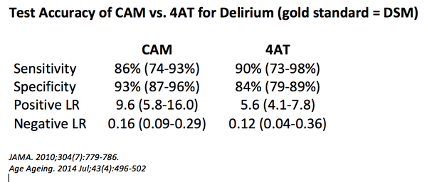
3+ – possible delirium + cog impairment
1-3 – possible cognitive impairment
0 – delirium unlikely

Slide 12
Management
Identify the underlying cause and treat appropriately.
Manage the symptoms of delirium whilst the cause is found.
Prevent injury and delirium complications — falls, wandering, harming self or others, skin breakdown, aspiration.
Address predisposing & precipitating factors as appropriate

Slide 13
Management
Address any infections and pain
Encourage fluids and food
Ensure glasses, hearing aids etc. are accessible and in working order
Attention to the environment is essential
Quiet area or side room; limit staff changes
Adequate lighting, minimise noise, provide a clock the patient can see
Gentle repeated reorientation and avoid confrontation
Try to maintain normal sleep-wake cycle
EXPLANATION is KEY
Explain cause and likely course to patient, relatives and carers
Address anxiety; patients with delirium are often frightened
Explain the organic cause of behaviour and symptoms.

Slide 14
Management
Non-pharmacological measures to manage symptoms should be tried first
Combative and physically dangerous patients may however require urgent reassessment
Appropriate use of medications e.g. antipsychotics may be needed but should be used for the least time possible
Sedatives can prolong the duration of delirium and should be avoided if possible

Slide 15
Delirium resources
HEE NE > PG Dean > Faculty of Patient Safety > Delirium Project
This link has link to animated videos on delirium awareness and
on being delirium ready.
Patient video (europeandeliriumassociation.org) This is the link
to powerful video of what it is like to experience delirium.
Leaflet for relatives and carers : https://www.rcpsych.ac.uk/mental-health/problems-disorders/delirium

