Slide 1
Psychosis in older adults
Tier 3

Slide 2
Psychosis
What is psychosis?
‘Some loss of contact with reality’. This might involve hallucinations or delusions’ (NHS)
Hallucinations – hearing voices/ seeing things/ sensation that someone is touching them/ experiencing smells that are not there
Delusions- unshakeable belief in something untrue
‘When you perceive or interpret reality in a very different way from people around you. You might be said to 'lose touch' with reality.’ (MIND)

Slide 3
Symptoms of Psychosis
Variable experiences depending upon the person and can include:
  Hallucinations
  Delusions
  Disordered or confused thoughts
  Disorganised behaviours
  Negative symptoms (reduction in motivation ,interest and or verbal expression)
The person is usually unaware that the experiences are not real

Slide 4
Psychosis in older adults
Psychosis in older adults is:
Common
Has varied aetiology
Older adults with psychosis have varied presentations
Prognosis is different to younger adults with psychosis
Associated morbidity and mortality is high
Higher rate of adverse effects from treatment

Slide 5
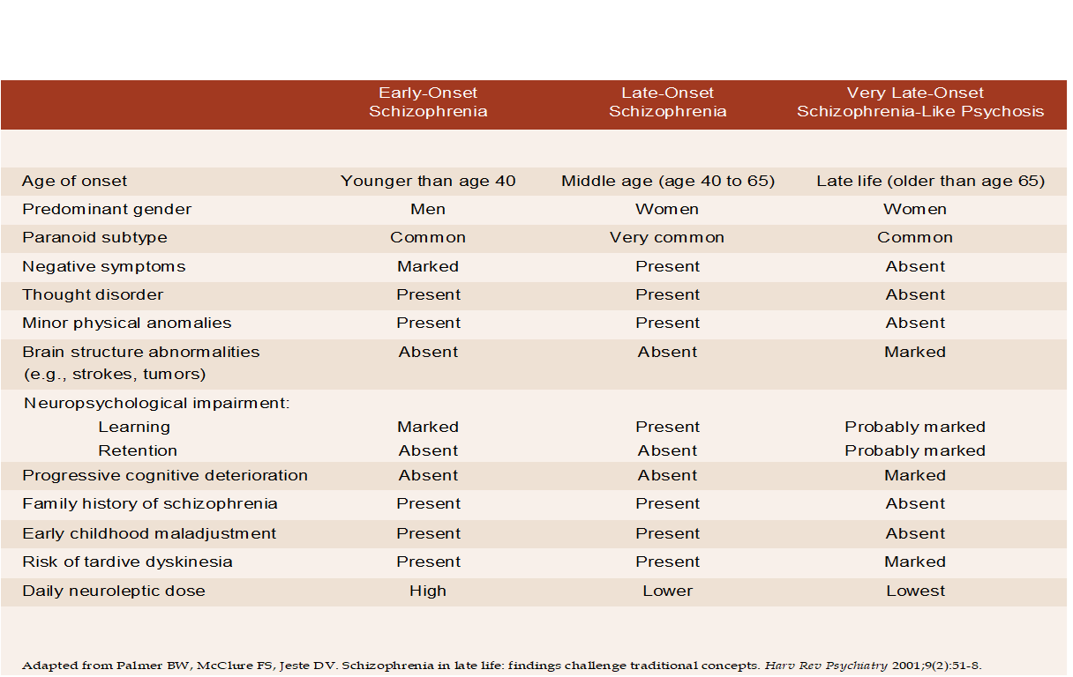
A comparison of the defining characteristics Early-Onset Schizophrenia, Late-Onset Disease, and Very Late-Onset Schizophrenia-Like Psychosis

Slide 6
Causes of psychosis in older adults
Secondary to Medical or ‘Organic’ causes:
  Delirium
  Neuropsychiatric conditions (e.g. stroke, MS, epilepsy, encephalitis)
  Certain prescribed medications
  Alcohol and drug misuse/ withdrawals
  Dementia
    Alzheimer’s
    Lewy body
    Vascular
Primary psychiatric causes
  Schizophrenia
  Very-late onset schizophrenia like psychosis (VLOSLP)
  Delusional disorder
  Schizoaffective
  Depression
  Bipolar affective disorder

Slide 7
Other conditions causing psychosis
Older adults with Delirium have high rates of psychosis (42%) visual>auditory hallucinations
Older adults with depression have higher rates of psychosis, delusions>hallucinations.
Older adults with dementia have high rate of psychosis AD (41%) VD (15%) LBD (up to 78%)
Older adults have higher incidence of secondary psychosis

Slide 8
Assessment
Assessment of psychosis in older adults
Is it new onset or consistent with past mental health presentation
Rule out Delirium and other physical causes
  Medical history including prescription medications
  Investigations: FBC, U&E, CRP, LFT, VIT B12, Urine dip, CXR, CT / MRI head
Assess for dementia and Primary Psychiatric causes
  Careful history taking
  Collateral information
  Mental state examination
  Functional assessments
  Cognitive assessments

Slide 9
Very late Onset Schizophrenia like Psychosis (VLOSP)
More likely to have
  Persecutory and misidentification delusions
  Partition delusions
  3rd person, running commentary and accusatory or abusive auditory hallucinations
  Visual, tactile and olfactory hallucinations
Less likely to have
  Formal thought disorder
  Affective flattening or blunting
  Family history
  VLOSLP tends to occurs more in Females than Males and they often have hearing impairment
It is worth encouraging them to have treatment with low dose of atypical antipsychotics as it can be effective and improve their quality of life

Slide 10
Treatment
Following treatment considerations should be kept in mind when treating psychosis in older adults
Typical antipsychotics: high rate of Extra pyramidal side effects
Atypical antipsychotic: high rate of metabolic disturbance and anticholinergic burden
All antipsychotics increase risk of stroke and cardiac arrhythmias which can lead to sudden death
Individual risk benefit analysis
Typically ½ starting dose for adults
Gradual titration
Use lowest doses and regular reviews

Slide 11
Take home points
Psychosis can occur in older adults
Take a detailed history
Make sure you exclude a physical health cause for the symptoms
Think about VLOSLP as a possible diagnosis
Antipsychotics can work very well in these patients
Low dose and slow titration is necessary, with early reviews
Use of antipsychotics can however increase physical health risks such as strokes and cardiac arrhythmias leading to death

Slide 12
References and Resources
https://www.ncbi.nlm.nih.gov/pmc/articles/PMC181181/
MPC_04_04 Other People Tell Me I'm Seeing Things | Other People Tell Me I'm Seeing Things (mindedforfamilies.org.uk)
This is an easy to access website for older adults and their families which has good advice about symptoms and treatment of hallucinations in older adults

