Slide 1
Psychological First Aid
30.3.2022
Ukraine Psychosocial response
Dr Peter Hughes - Psychiatrist -Royal College of Psychiatrists
Vitalii Klymchuk –Coordinator Community Mental Health Services Development (“Mental Health for Ukraine Project” by GFA Consulting Group)

Slide 2

Acknowledgement to PFA Guide
WHO/WORLD VISION INTERNATIONAL/WAR TRAUMA FOUNDATION (ARQ International)

Slide 3
Royal College of Psychiatrists
Around 40 conflicts in world
College has had responses in Syria, Iraq and ready to respond to any request
Ukraine situation led to most recent request
Royal College of Psychiatrists is supporting DEC for donations

Slide 4
Objective
Background –Ukraine
Orientation to PFA
Basic principles
Orientation to Ukrainian context

Slide 5
Specific Objectives
What PFA is and is not
Place of PFA in overall response
Key resilience factors
Who, when and where of PFA
Frequent needs of survivors
Action principles : Prepare, Look, Listen and Link
Good communication skills
People who likely need special attention
Caring for yourself and your team members

Slide 6
Webinar
90 minutes
Questions in chat or anytime
PFA training can be a few hours to days –experientials
Question/Comments in Chat and at end
Session recorded and can be translated for training purposes

Slide 8
Ukraine Psychosocial response
(PFA component)
- context
- PFA implementation

Slide 9
CONTEXT – general MH situation before the spring 2022
One in three Ukrainians is experiencing at least one mental health disorder in their lifetime
The most common mental disorders in Ukraine include alcohol disorders, mood disorders, and anxiety disorders
The overall prevalence of depression has been found to be higher in Ukraine compared to Western European countries. 6.31% of the population in Ukraine, compared to the EU average of 5.02%
In the East regions 8.2% of respondents struggle with symptoms of PTSD, whilst 12.7% of respondents showed indications of excessive alcohol abuse.
Treatment gap of 75% among IDPs with common mental disorders such as depression, anxiety, and Post-Traumatic Stress Disorder (PTSD).
Suicide rate – in the 20 countries with the highest rate.
https://www.tandfonline.com/doi/full/10.1080/20016689.2020.1843288

Slide 10

CONTEXT – people`s stories
https://thepsychologist.bps.org.uk/letters-ukraine
Notes:
https://thepsychologist.bps.org.uk/letters-ukraine

Slide 11
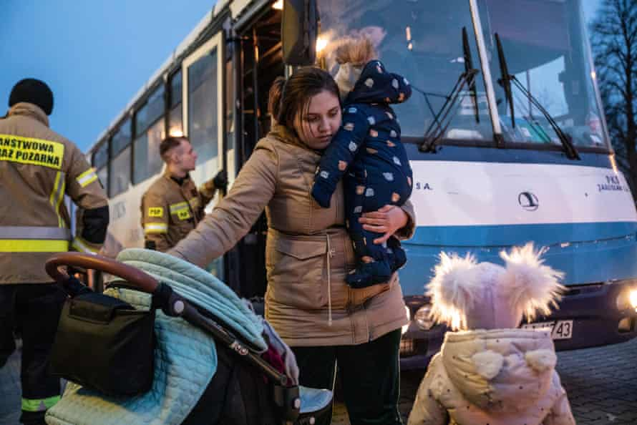
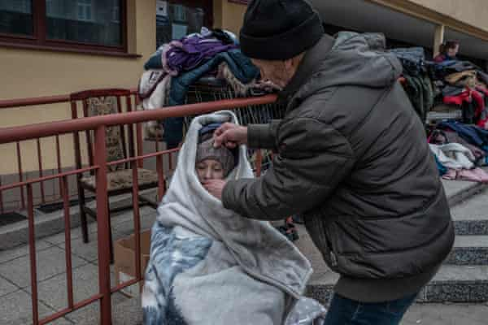
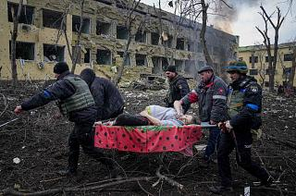
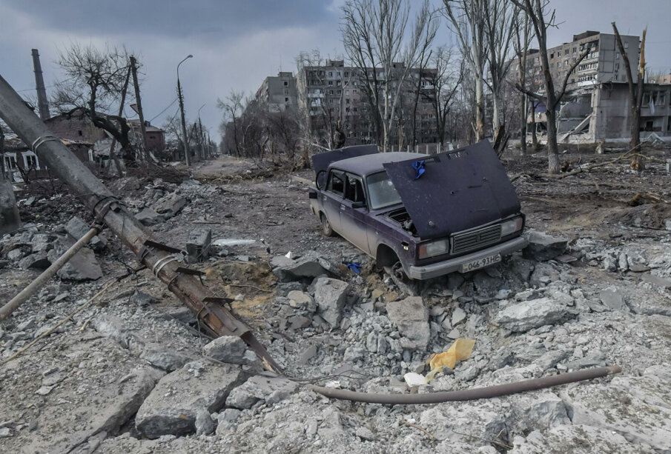
https://www.theguardian.com/global-development/2022/mar/15/ukraine-child-mental-health-crisis
Notes:
https://thepsychologist.bps.org.uk/letters-ukraine
Nothing but reality
I’m from suburban Kyiv, one of the ‘hot spots’. Not the hottest one, but Russian helicopters which were flying above my yard on the first day of the war was good enough reason to leave.
Now me, my three kids (4, 11, and 16 years old), my husband, my two cats, and my dog are safe in Lviv. We’re volunteering here now and my husband is going back to Kyiv to help there. My parents stayed in Kyiv, they refused to leave their home. Every time I call them, they say, “Everything is ok, don’t worry, explosions are not that loud, and take care of the kids and yourself”.
…
It’s hard to write something beyond the facts. What I can write about feelings? As a CBT therapist, I used to teach people to name their feelings. But it doesn’t work now. We’re feeling something more, something that can’t be named and can’t be classified. You knew everything from the news – our shock, our grief, our helplessness, our courage, our braveness, our fear, our kindness, our guilt, our compassion, our hate, our humor, and our rage. Could you imagine that you feel all the feelings, literally all, at the same time and in the strongest way? Could you imagine that everyone near you feels the same? Could you imagine that all this happens in the dangerous, unknown, and extremely unstable world?
Olga Kukharuk
PhD in Psychology, Researcher at the Institute of Social and Political Psychology of the National Academy of Pedagogical Sciences of Ukraine, CBT therapist

Slide 12
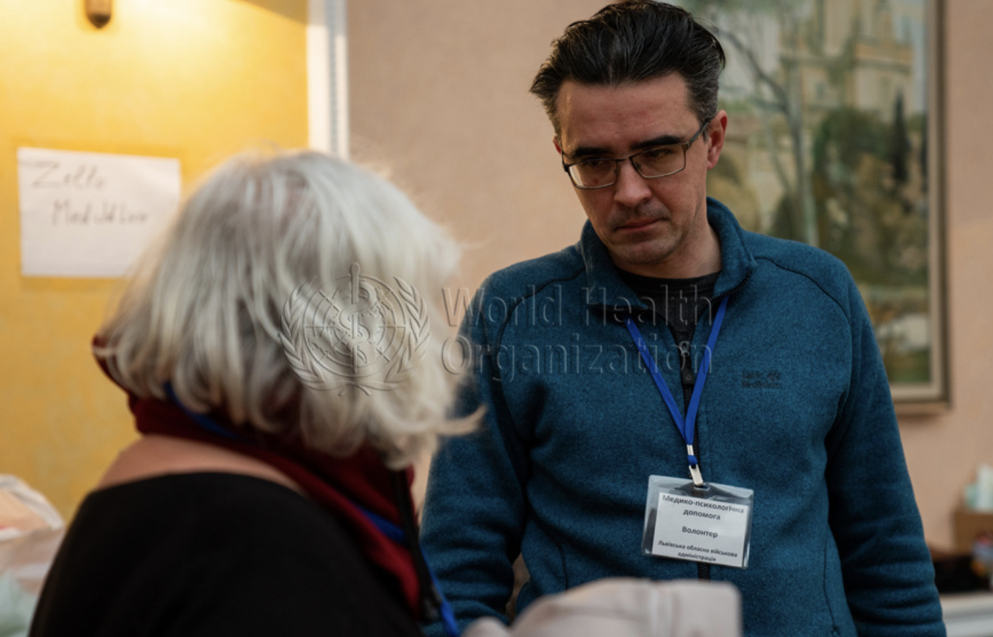
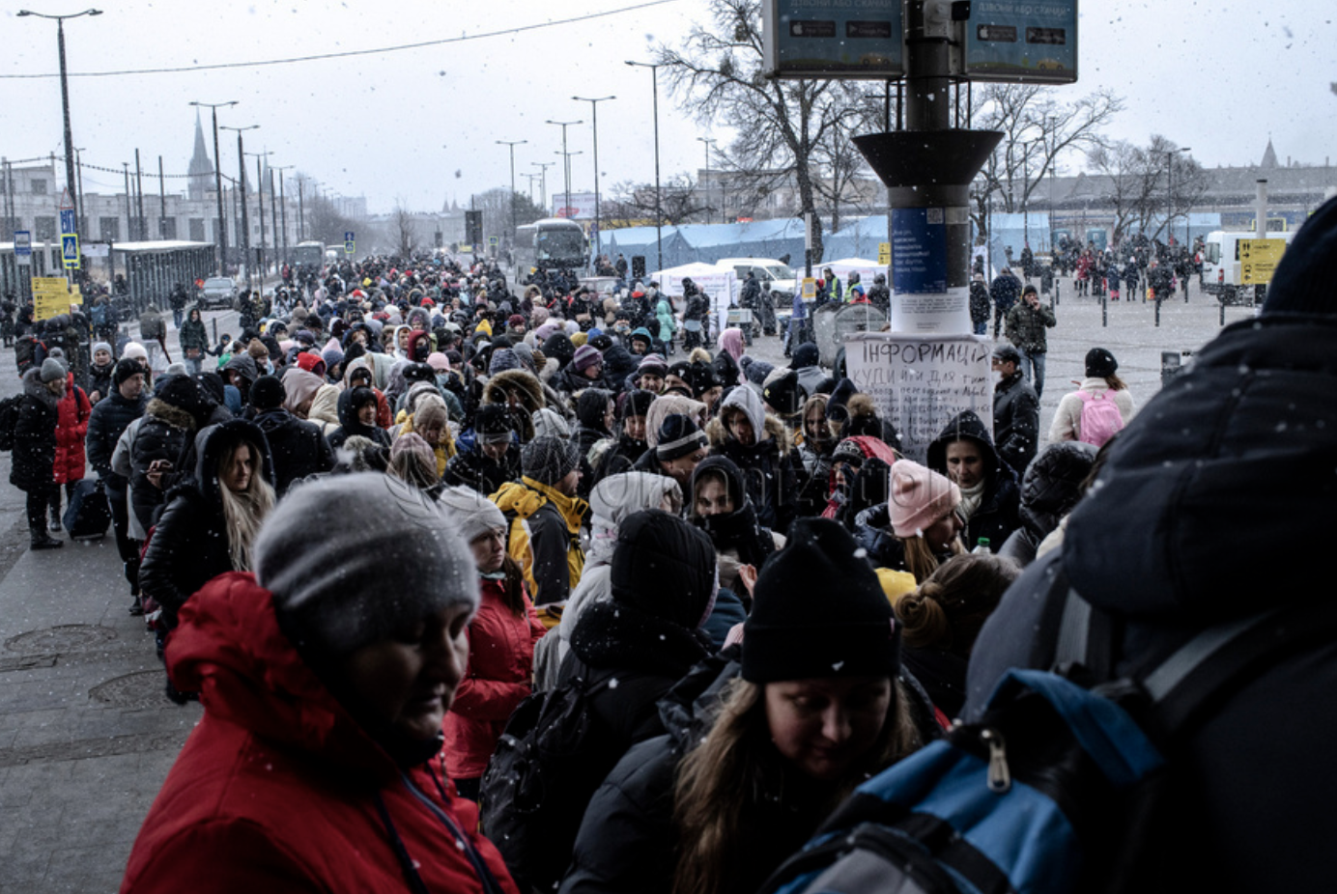
Orest Suvalo, coordinates MHPSS support in the transition points Lviv Oblast and provides PFA and psychiatric assistance as the Lviv railway station
https://photos.euro.who.int/galleries/285/ukraine-assistance-to-ukrainians-in-lviv-march-202

Slide 13
CONTEXT – numbers, 28.03.2022
nearly 10.3 million people and counting have been forcibly displaced within Ukraine and neighbouring countries
around 45 % of people are worried about getting enough food
more than 918,700 users across some 1,435 settlements in Ukraine remain without electricity
6 million people either have limited or no access to safe water
the civilian toll of the ongoing military offensive stands at 2,975 – including 1,151 killed
73 confirmed attacks on health care facilities, 659 educational institutions have been damaged and another 74 completely destroyed to date
US$565 billion in damages and losses
https://reliefweb.int/report/ukraine/ukraine-humanitarian-impact-situation-report-1200-pm-eet-28-march-2022

Slide 14
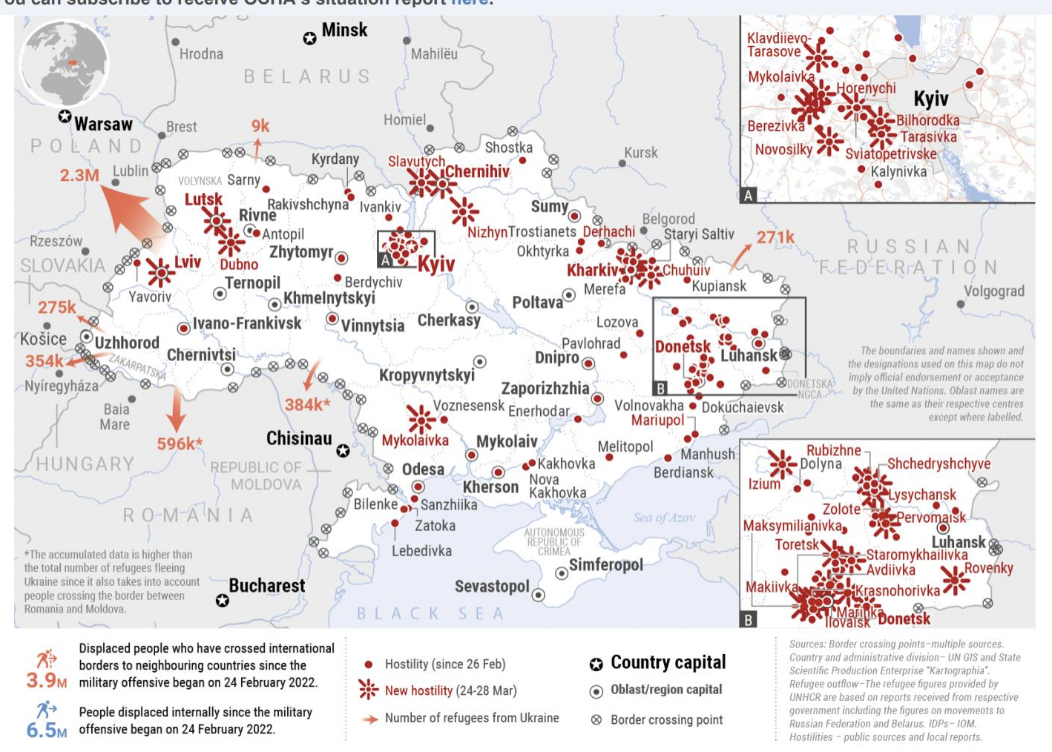
https://reliefweb.int/sites/reliefweb.int/files/resources/2022-03-28_Ukraine%20SitRep%20Humanitarian%20Impact.pdf

Slide 15


PFA in Ukraine
NGO Proliska + MH4U Project = fast and targeted PFA orientation for the first-contact workers and volunteers
2 hours intro + 2 hours advanced training, online

Slide 16
20 PFA courses in one month
345 volunteers and first-line professionals trained
~4000 people during 1 day can receive PFA
~80 000 people in 1 month can receive PFA
Date
9 March
10 March
11 March
12 March
14 March
15 March
16 March
17 March
18 March
21 March
22 March
23 March
24 March
25 March
28 March
29 March
31 March
4 March
6 March
8 March

Slide 17
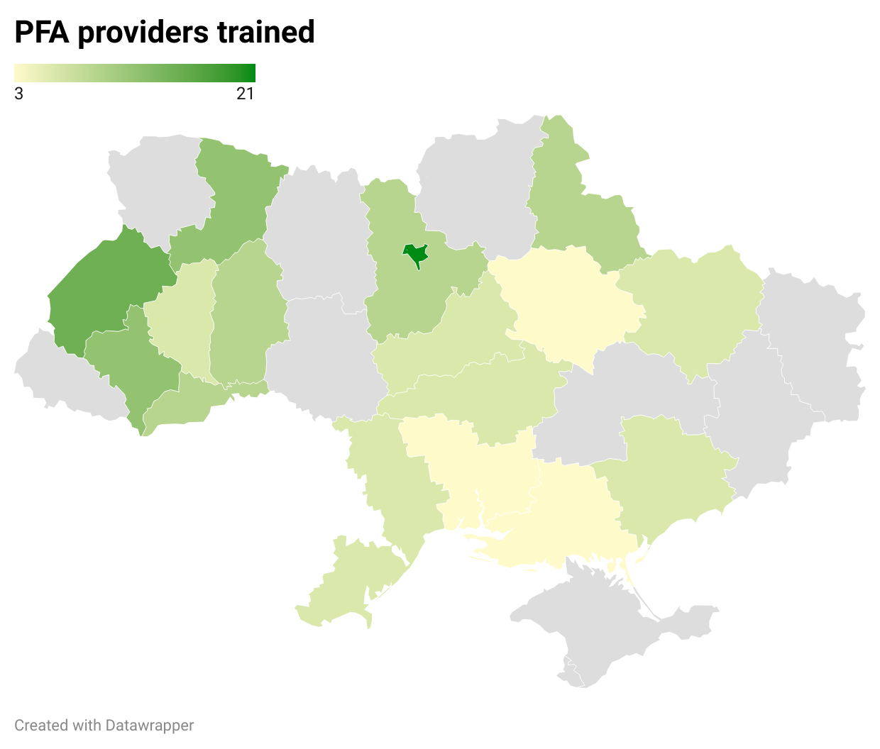

Slide 18
Donate to NGO Proliska
https://proliska.org/en/donate-for-mission/
Supported by Vitalii Klymchuk

Slide 19
Psychological First Aid

Slide 20
Psychological First Aid
Supporting People in the Aftermath of Crisis events

Slide 21
Psychological First Aid
Framework that respects
Dignity
Culture
Abilities

Slide 22
Psychological First Aid
Covers social and psychological support

Slide 23
Psychological First Aid
Endorsed internationally
Including IASC and SPHERE Project
Replaces critical incident debriefing
Can be adapted locally

Slide 24
Psychological First Aid
What comes to mind with term Psychological First Aid?

Slide 25
Psychological First Aid
What it is not –
Trauma therapy
Victim coordination centre etc.
Something only professionals can do
It is not professional counselling
Not critical incident debriefing
It is not about pressuring people to tell you their feelings or reactions to an event

Slide 26
Psychological First Aid
What it is
Humane
Supportive
Practical

Slide 27
Psychological First Aid
Context of Covid 19 Pandemic
-Covid safety is paramount
-increase of anxiety and depression and mental health problems in adolescents

Slide 28
Psychological First Aid
Basic principles
Not everyone needs help –resilience
Not usually about medication
Not about PTSD –if present refer on
If people overwhelmed and not coping need specialist help
Remember children, vulnerable groups, women
Remember protection/Safeguarding/Human rights
In stress there is an increase in substance abuse and gender based violence

Slide 29
Examples:
The place of PFA in overall mental health and psychosocial response
Mental health care by mental health specialists (psychiatric nurse, psychologist, psychiatrist etc)
Specialised
services
Basic mental health care by PHC doctors
Basic emotional and practical support by community workers
(Psychological First Aid)
Focused (person-to-person) non-specialised supports
Activating social networks
Communal traditional supports
Supportive child-friendly spaces
Community and family supports
Strengthening community and family supports
Advocacy for basic services that are safe, socially appropriate and protect dignity
Basic services and security
Social considerations in basic services and security
Notes:
29

Slide 30
Psychological First Aid
First step is self care
How do I take care of myself and my family
What do I do that helps me overcome stressful situations

Slide 31
Psychological First Aid-responses to stress
Reactions can be very different
Stress
Physical symptoms
Emotional symptoms
Cognitive/thinking symptoms
Behavioral symptoms

Slide 32
Psychological First Aid-resilience factors
Only a small number of people will need help
People do better over long term
  if they feel safe, connected to others, calm and hopeful
  Have access to social, physical and emotional support
  Regain a sense of control by being able to help themselves

Slide 33
Psychological First Aid-Who?
Very distressed people exposed to serious stressful event
All ages
Not everyone but those who want support

Slide 34
Psychological First Aid-who needs more specialised help
People with serious life –threatening injuries
People so upset they cannot care for themselves or their children
People who may hurt themselves
People who may hurt or endanger the lives of others

Slide 35
Psychological First Aid-When ?
Whenever the need is –immediate, days or weeks after stressor

Slide 36
Psychological First Aid-Where ? (Covid)
Where ever it is safe enough to do so
Where there is a private, confidential space

Slide 37
Frequent needs after emergency
Basic needs –shelter, food, water and sanitation
Health services for injuries or help with chronic conditions
Information on what has happened, services available, information about family
Contact with their families
Being able to connect to own religion and culture
Being involved in important decisions

Slide 38
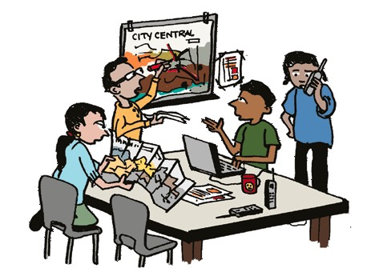
Prepare | Learn about the crisis event. Learn about available services and supports. Learn about safety and security concerns.
Crisis situations
can be chaotic
Often require
urgent action
Wherever possible BEFORE you enter a crisis site, try to obtain accurate information
so you can be safe and effective.

Slide 39
Wherever possible, before you enter a crisis site, try to learn about…
The Crisis Event | What happened? Where? When? How many and who are affected?
Available Services | Who is providing for basic needs (emergency medical care, food, shelter)? When & where can people access services? Who is helping, including community members?
Safety & Security | Is the crisis over or ongoing (aftershocks, fighting)? What dangers may be in the environment? Are there places to avoid due to insecurity or because it is not permitted to be there?

Slide 40
Psychological First Aid-Prepare
Keep yourself safe
Get as much information as possible –resources and accurate information on what has happened
Work in pairs ideally
Coordinate what you are doing with others

Slide 41

PFA Action Principles
Prepare
-------------------
Look Listen Link

Slide 42

PFA Action Principles
Prepare | Learn about the crisis event. Learn about available services and supports. Learn about safety and security concerns.
Look | Observe for safety. Observe for people with obvious urgent basic needs. Observe for people with serious distress reactions.
Listen | Make contact with people who may need support. Ask about people’s needs and concerns. Listen to people and help them feel calm.
Link | Help people address basic needs and access services. Help people cope with problems. Give information. Connect people with loved ones and social support.
Notes:
What you need - comes through in preparation and also in the action steps.
-as much information as you can gather about the event, who is affected, etc.
-to know you are safe
-to know what your agency can provide in terms of support, communication, etc.
What people may need is also clear when you look at the steps: helping to feel calm, urgent basic needs, information, social support, etc…

Slide 43
Psychological First Aid-Look
Covid
Look for safety
Look for injuries or those that need specialist help
Look for people who are upset, anxious or in shock or unable to care for themselves
Look for people who need special assistance, separated children, immobile, elderly
Children who are separated
Look for those at risk of sexual and gender based violence

Slide 44
Psychological First Aid-look
Look for what might be helpful in area
Crisis situations can change quickly
And be calm yourself, be safe

Slide 45
Look | Observe for safety. Observe for people with obvious urgent basic needs. Observe for people with serious distress reactions.
Safety | What dangers can you observe? Can you be there without harm to yourself or others? | If you’re not certain about safety…DO NOT GO! Seek help from others. Communicate from a safe distance.
People with obvious urgent basic needs | Is anyone critically injured Does anyone need rescue? Obvious needs (torn clothing…)? Who may need help to access services or to be protected? Who else is available to help? | Know your role. Try to obtain help for people who need special assistance. Refer critically injured people for care.
People with serious distress | How many & where are they? Is anyone extremely upset, immobile, not responding to others or in shock? | Consider who may benefit from PFA and how best to help.

Slide 46
Psychological First Aid-Look –people who need special attention
Children and adolescents (especially separated)
People with health conditions, pregnancy, breast feeding, disabilities
People at risk of discrimination or violence –women, ethnic, religion, mental illness, lgbt

Slide 47
Distress Reactions to Crisis
Physical symptoms (shaking, headaches, fatigue, loss of appetite, aches & pains)
Anxiety, fear
Weeping, grief and sadness
Guilt, shame (for having survived, or for not saving others)
Elation for having survived
Being on guard, jumpy
Anger, irritability
Immobile, withdrawn
Disoriented - not knowing one’s name, where one is from or what happened.
Not responding to others, not speaking at all
Feeling confused, emotionally numb, feeling unreal or in a daze
Unable to care for oneself or one’s children (not eating or drinking, not able to make simple decisions)
Notes:
Serious or long-lasting distress:
Try to make sure they are not left alone.
Try to keep them safe until the reaction passes or until you can find help from health personnel, local leaders or other community members in the area.

Slide 48
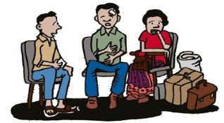
Helping people in distress
Most people recover well over time, especially if they can restore basic needs and receive support (PFA).
Those with severe or long-lasting distress may require more support.
Try to make sure they are not left alone.
Try to keep them safe until the reaction passes or you can find help from others.

Slide 49
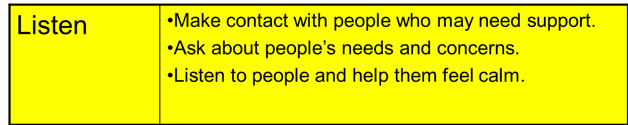

Psychological First Aid

Slide 50

Make contact | Approach respectfully Introduce yourself by name & organization Ask if you can provide help, find safe/quiet place Help person feel comfortable (water, blanket) Try to keep them safe
Ask about needs & concerns | Although some needs are obvious, always ask Find out person’s priorities - what is most important to them.
Listen & help people feel calm | Stay close to the person Do not pressure them to talk Listen in case they want to talk If very distressed, help them feel calm & make sure they are not alone

Slide 51

Help People Feel Calm
Keep your tone of voice soft and calm
Maintain some eye contact
Reassure them they are safe and that you are there to help
If someone feels “unreal”, help them make contact with:
  Themselves (feel feet on the floor, tap hands on lap)
  Their surroundings (notice things around them)
  Their breath (focus on breath & breathe slowly)
Notes:
These techniques are about helping people to get in touch with themselves and their surroundings…to “ground” themselves.

Slide 52
R
Introduce yourself by name and agency.
Ask the affected person their name and if you can help them.
Protect them from harm by moving to a safer place to talk
Offer some comfort (i.e., water) if you can.
Listen and stay near without forcing talk.
Ask for their needs and concerns, and help them feel calm.
Reflect ways in which they have acted appropriately (i.e., keeping themselves safe) and encouraging good coping strategies.
Acknowledge their worry over possible losses of those around them.
Offer to help connect them with loved ones or other supports.

Slide 53
Psychological first aid
Listen | Make contact with people who may need support. Ask about people’s needs and concerns. Listen to people and help them feel calm.
Listen with compassion by using your:
Eyes - giving the person your undivided attention
Ears - hearing carefully their concerns
Heart - with caring and showing respect

Slide 54
Good Communication:
Things to Say and Do
TALK LESS, LISTEN MORE!
Try to find a quiet place to talk and minimize outside distractions
Stay near the person but keep an appropriate distance depending on their age, gender and culture
Let them know you hear them, for example, nod your head and say…”hmmmm.”
Be patient and calm
Provide factual information IF you have it. Be honest about what you know and what you don’t know. “I don’t know but I will try to find out about that for you.”
Give information in a way the person can understand - keep it simple.
Acknowledge how they are feeling, and any losses or important events they share with you, such as loss of home or death of a loved one. “I’m so sorry…”
Respect privacy. Keep the person’s story confidential, especially when they disclose very private events.
Acknowledge the person’s strengths and how they have helped themselves.

Slide 55
Good Communication:
Things NOT to Say and Do
Don’t pressure someone to tell their story
Don’t interrupt or rush someone’s story
Don’t give your opinions of the person’s situation, just listen.
Don’t touch the person if you’re not sure it is appropriate to do so.
Don’t judge what they have or haven’t done, or how they are feeling. Don’t say…”You shouldn’t feel that way.” or “You should feel lucky you survived.”
Don’t make up things you don’t know.
Don’t use too technical terms.
Don’t tell them someone’s else’s story
Don’t talk about your own troubles
Don’t give false promises or false reassurances
Don’t feel you have to try to solve all the person’s problems for them
Don’t take away the person’s strength and sense of being able to care for themselves

Slide 56


Psychological First Aid

Slide 57
Psychological First Aid
Link | Help people address basic needs and access services. Help people cope with problems. Give information. Connect people with loved ones and social support.
Help people to help themselves and
regain control of their situation.
Notes:
People may feel isolated, powerless in a crisis. Unable to access usual supports, daily life disrupted, suddenly living in stressful conditions.
Linking is about helping people to begin meeting their needs and gathering their resources to cope.

Slide 58
Link - basic needs
What needs do they request?
What services are available?
Don’t overlook the needs of vulnerable or marginalized people
Follow-up if you promise to do so
Notes:
Try to help them access the needs THEY request - head scarf?
Learn what they feel is important - things for caring for children?
Make sure vulnerable & marginalized people are looked after & can access available services.
Follow-up if you promise to do so.

Slide 59
Link - help people cope with problems
Distressed people may feel
overwhelmed with worries…
Help them prioritize urgent needs (what to do first)
Help them identify supports in their life
Give practical suggestions how they can meet their needs (i.e., registering for food aid)
Help them remember how they coped in the past and what helps them to feel better

Slide 60
Positive coping strategies (adjust for culture)
Help people use their natural coping mechanisms to regain a sense of control:
  Get enough rest
  Eat as regularly as possible and drink water
  Talk and spend time with family and friends
  Discuss problems with someone you trust
  Relax: walk, sing, pray, play with children
  Exercise
  Avoid alcohol or drugs, caffeine, nicotine
  Bathe and attend to personal hygiene
  Find safe ways to help others

Slide 61
Link - give information
Find accurate information before helping
Keep updated
Make sure people are informed where & how to access services - especially vulnerable people
Say ONLY what you know - Don’t make up information
Keep messages simple & accurate, repeat often
Give same info to groups to decrease rumors
Explain source & reliability of info you give
Let them know when/where you will update them
Notes:
Hard to find accurate information - what are reliable sources?

Slide 62
Link - social support
Very important to recovery
Keep families together & children with caregivers
Help people contact friends and loved ones
Give access to religious support
Affected people may be able to help each other - bring them together
Make sure people know about how to access services (especially vulnerable people)
Notes:
Religious support - people’s faith may be challenged, made stronger or somehow changed. Allow people to question. Don’t affirm or reject beliefs or religious interpretations of the crisis. Don’t impose your beliefs.

Slide 63
Ending your assistance
Use your best judgment of person’s needs and YOUR own needs.
Explain you are leaving and, if possible, introduce them to someone else who can help.
If you linked them with services, be sure they have contact details and know what to expect.
No matter what your experience, say goodbye in a good way, wish them well.

Slide 64
Recap: Ethical Guidelines
Do’s
Be honest and trustworthy
Respect a person’s right to make their own decisions
Be aware of and set aside your own biases and prejudices
Make it clear to people that even if they refuse help now, they can still access help in the future
Respect privacy and keep the person’s story confidential, as appropriate
Behave appropriately according to the person’s culture, age and gender
Don’ts
Don’t exploit your relationship as a helper
Don’t ask the person for any money or favor for helping them
Don’t make false promises or give false information
Don’t exaggerate your skills
Don’t force help on people, and don’t be intrusive or pushy
Don’t pressure people to tell you their story
Don’t share the person’s story with others
Don’t judge the person for their actions or feelings

Slide 65
Starting and ending with care for ourselves
Remember what you wrote…
How do I take care of myself?
How does my team take care of each other?
Be responsible to yourself and
others by paying attention to
self-care on a daily basis

Slide 66
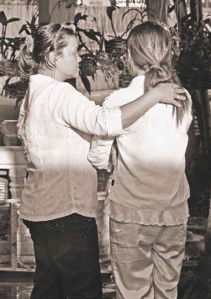
Practice self and team care
Before:
  Are you ready to help?
During:
  How can you stay physically and emotionally healthy?
  How can you support colleagues and they support you?
After:
  How can you take time to rest, recover and reflect?
Notes:
Readiness - make honest assessment - look at your personal needs and condition (life stresses, family demands…)
Pitfall: feeling you have to solve everyone’s needs for them.
Needs are overwhelming and resources may be scarce - not possible.
You are there temporarily, so your actions should be about helping people to begin helping themselves. Help them to regain control.
Don’t assume just b/c they have been through a distressing event, that they are helpless.

Slide 67
Seek help when you…
Have upsetting thoughts or memories about the crisis event
Feel very nervous or extremely sad
Have trouble sleeping
Drink a lot of alcohol or take drugs to cope with your experience
Consult a professional if these difficulties persist more than one month

Slide 68
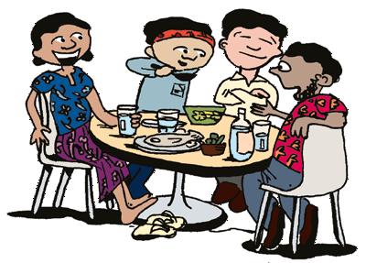
Team support
It is best for helpers to be connected with an agency or group to ensure safety and good coordination.
Tips for peer support or “buddies”:
  Use good listening skills
  Show concern and empathy
  Be respectful
  Don’t blame or judge
  Have clear boundaries
  Be available when needed
  Help your colleague regain control and help themselves
  Maintain confidentiality
  Appreciate each other
Notes:
Team support very important
Supporting colleagues: buddy system, working in pairs/teams whenever possible. Can be very helpful for many reasons - safety, your own support, coordination and being better able to manage contexts where several people need help.

Slide 69
Psychological First Aid –for children
https://www.futurelearn.com/courses/psychological-first-aid-for-children-and-young-people

Slide 70
References
Bisson, J.K. & Lewis, C. (2009) Systematic Review of Psychological First Aid, Commissioned by WHO.
Inter-Agency Standing Committee (IASC) (2007) IASC Guidelines on Mental Health and Psychosocial Support in Emergency Settings. Geneva: IASC.
The Sphere Project (2011) Humanitarian Charter and Minimum Standards in Disaster Response. Geneva: The Sphere Project.
TENTS Project Partners. The TENTS Guidelines for psychosocial care following disasters and major incidents.
Hobfoll S, Watson P, Bell C, Bryant R, Brymer M, Friedman M, et al. (2007) Five essential elements of immediate and mid-term mass trauma intervention: Empirical evidence. Psychiatry 70 (4): 283-315.

Slide 71
Psychological First Aid
Thank you
Supporting the mental wellbeing of those suffering in conflicts around the world
Dr Peter Hughes dppmh@Hotmail.com
Vitalii Klymchuk

