Slide 1
mhGAP HIG
Webinar
5.4.2022
Ukraine Psychosocial response
Royal College of Psychiatrists
Dr Peter Hughes Psychiatrist -Royal College of Psychiatrists
Vitalii Klymchuk –Coordinator Community (“Mental Health for Ukraine Project” by GFA Consulting Group)

Slide 2

mhGAP Humanitarian Intervention Guide (mhGAP-HIG)
Acknowledgement WHO and UNHCR

Slide 3
Webinar
90 minutes
Questions in chat or anytime
mhGAP training can be a split into 2 -3 or more days
Question/Comments in Chat and at end
Session recorded and can be translated for training purposes

Slide 4

mhGAP-HIG https://www.who.int/publications/i/item/9789241548922

Slide 5
Objective-mhGAP orientation
Orientation to mhGAP
Background mhGAP HIG
mhGAP HIG
Psychosocial treatments

Slide 6
mhGAP-Background in Ukraine

Slide 7
MH in Ukraine in brief (before the 24 February 2022)
at least one disorder in lifetime
have a current disorder
experienced an episode in the past year
Age, education, and living in the Eastern region of Ukraine were significant risk factors across disorders
≈33%
≈ 18%
≈ 10%
Bromet, Evelyn J., et al. "Epidemiology of psychiatric and alcohol disorders in Ukraine." Social psychiatry and psychiatric epidemiology 40.9 (2005): 681-690.

Slide 8
have a symptoms of the anxiety disorder
have a symptoms of the depression
have a symptoms of the anxiety disorder
have a symptoms of the depression
≈ 20%
≈ 25%
≈ 15%
≈ 12%
GP
IDPs
Survey was designed by the University of Birmingham (Dr Irina Kuznetsova, Dr Jon Catling, Dr John Round) and conducted by SocioInform in August-September 2018. Report in progress

Slide 9
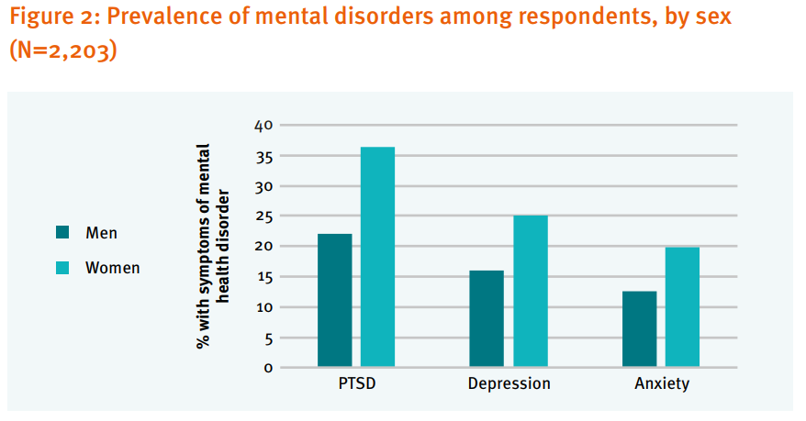
IDPs
Roberts, B., Makhashvilie, N., and Javakhishvilie, J. 2016. The burden of mental disorders and access to services among internally displaced persons in Ukraine. The International Alert; GIP-Tbilisi; London School of Hygiene and Tropical Medicine.

Slide 10
Female
Male
≈ 35%
≈ 23%
Children, 10-15, PTSD symptoms
Klymchuk V., Gorbunova V. Prevalence of the PTSD symptoms in Ukrainian children: the brief report on the research findings. Problems of Political Psychology. – Vol. 6 (20), 2018. – P. 162-170.

Slide 11
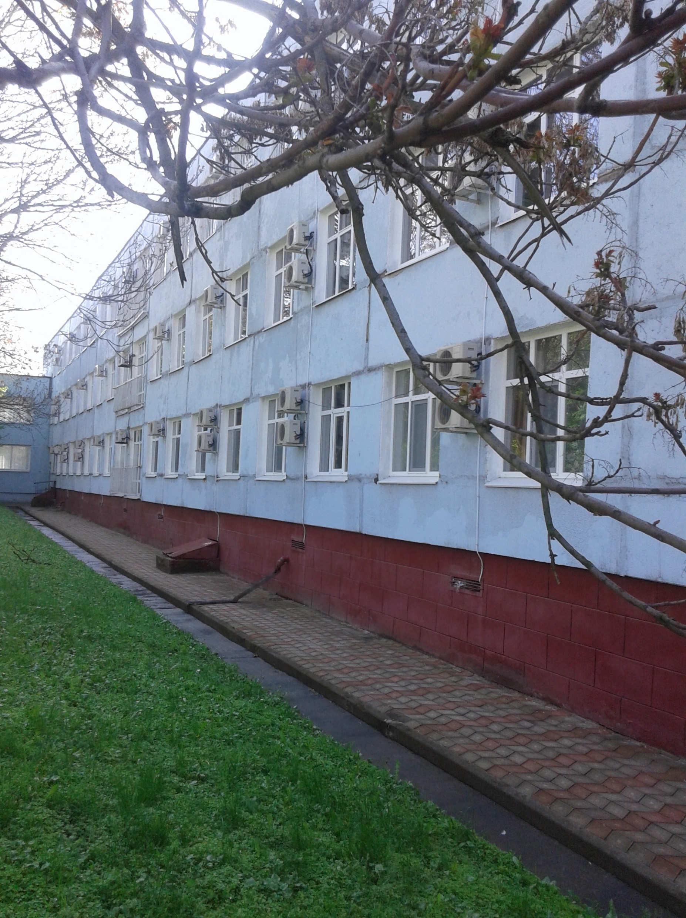
What kind of services people use?
1,7 mln of people were registered in the psychiatric clinics and dispensers
3,8 %
Психічне здоров’я населення України. Аналітично-статистичний довідник 2013–2015
рр. / Український НДІ соціальної і судової психіатрії та наркології МОЗ України; Центр мед. статистики МОЗ України. – Кіровоград: Поліум, 2016. – 80 с.

Slide 12
Here is the gap…
One year prevalence of the mental disorders
18 %
Admission to the psychiatric clinics
3,8%

Slide 13
Here is the gap…
One year prevalence of the mental disorders
18 %
Admission to the psychiatric clinics
3,8%
≈ 6 400 000
Ukrainian YEARLY do not obtain necessary support (by conservative calculations)k

Slide 14
Here is the gap…
One year prevalence of the mental disorders
18 %
Admission to the psychiatric clinics
3,8%
Do not have any support in the communities…
≈ 6.4 mln
≈ 1.7 mln

Slide 15

Service users` opinion…
«Typical medication treatment with no explanation of problems (factors, what cause the relapse), without resources for patient`s support in outpatient settings and no providing explanations and recommendations to relatives»
Patient with bipolar disorder
Low qualification of the professionals
lack of continuity of treatment
48%
26%

Slide 16
mhGAP implementation
WHO Ukraine
MdM
MsF
MH4U
Proliska
Academy of Family Medicine
World Bank Ukraine
National mhGAP Coordination group
2017
MH Concept note
2017-2021
Development of the MH Action Plan and approving it by Government
Making the cases and mhGAP Implementation in the East of Ukraine (mhGAP + mhGAP HIG)
2022
2nd ToT in mhGAP
Plans to cover 50% of family doctors in Lugansk oblast
Community-based care, integration of MH in the healthcare and social care
Plan to change the legislation to allow family doctors to assess MH state and make incentives for those who are working with MH
2014-2015
Revolution of Dignity, Russian invasion
Rising attention to MH (veterans, IDPs)

Slide 17
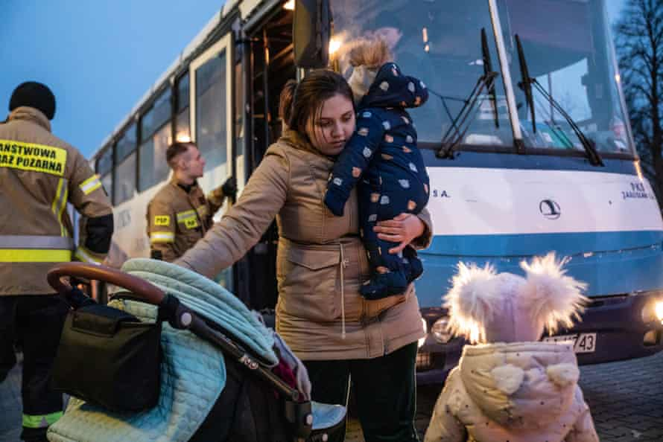
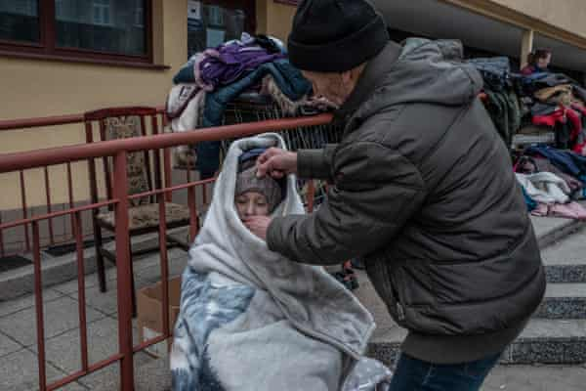
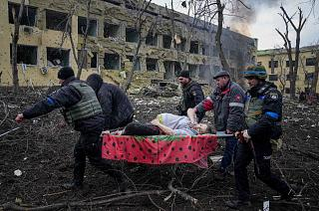
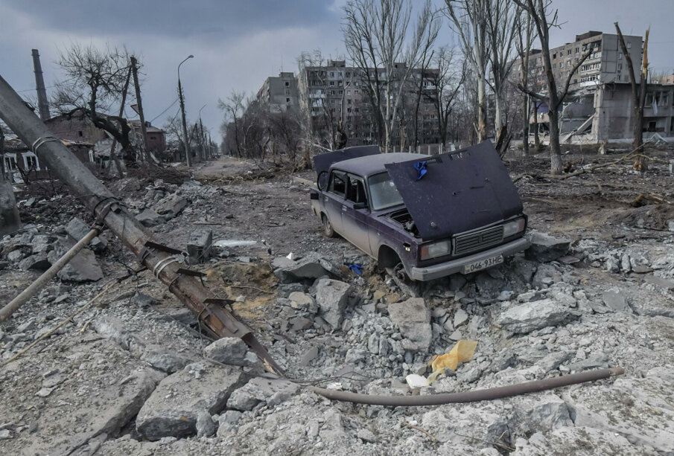
https://www.theguardian.com/global-development/2022/mar/15/ukraine-child-mental-health-crisis
Notes:
https://thepsychologist.bps.org.uk/letters-ukraine
Nothing but reality
I’m from suburban Kyiv, one of the ‘hot spots’. Not the hottest one, but Russian helicopters which were flying above my yard on the first day of the war was good enough reason to leave.
Now me, my three kids (4, 11, and 16 years old), my husband, my two cats, and my dog are safe in Lviv. We’re volunteering here now and my husband is going back to Kyiv to help there. My parents stayed in Kyiv, they refused to leave their home. Every time I call them, they say, “Everything is ok, don’t worry, explosions are not that loud, and take care of the kids and yourself”.
…
It’s hard to write something beyond the facts. What I can write about feelings? As a CBT therapist, I used to teach people to name their feelings. But it doesn’t work now. We’re feeling something more, something that can’t be named and can’t be classified. You knew everything from the news – our shock, our grief, our helplessness, our courage, our braveness, our fear, our kindness, our guilt, our compassion, our hate, our humor, and our rage. Could you imagine that you feel all the feelings, literally all, at the same time and in the strongest way? Could you imagine that everyone near you feels the same? Could you imagine that all this happens in the dangerous, unknown, and extremely unstable world?
Olga Kukharuk
PhD in Psychology, Researcher at the Institute of Social and Political Psychology of the National Academy of Pedagogical Sciences of Ukraine, CBT therapist

Slide 18
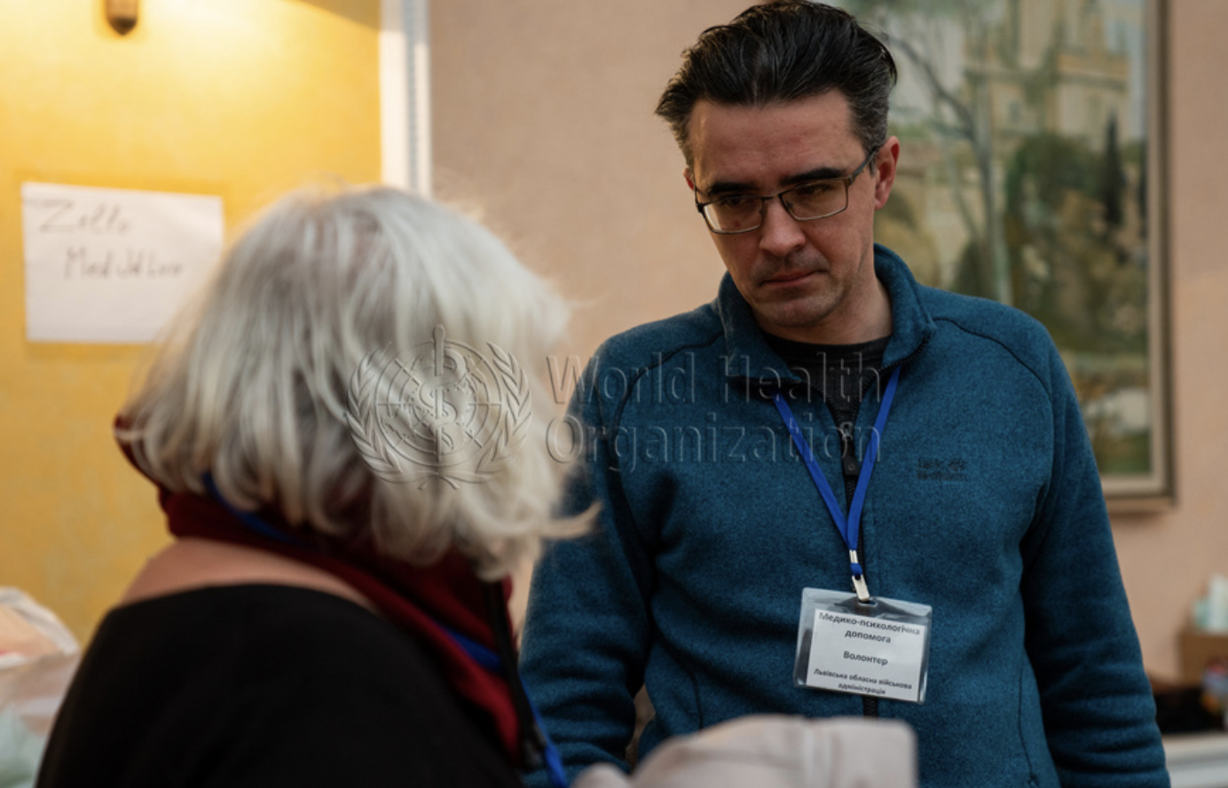
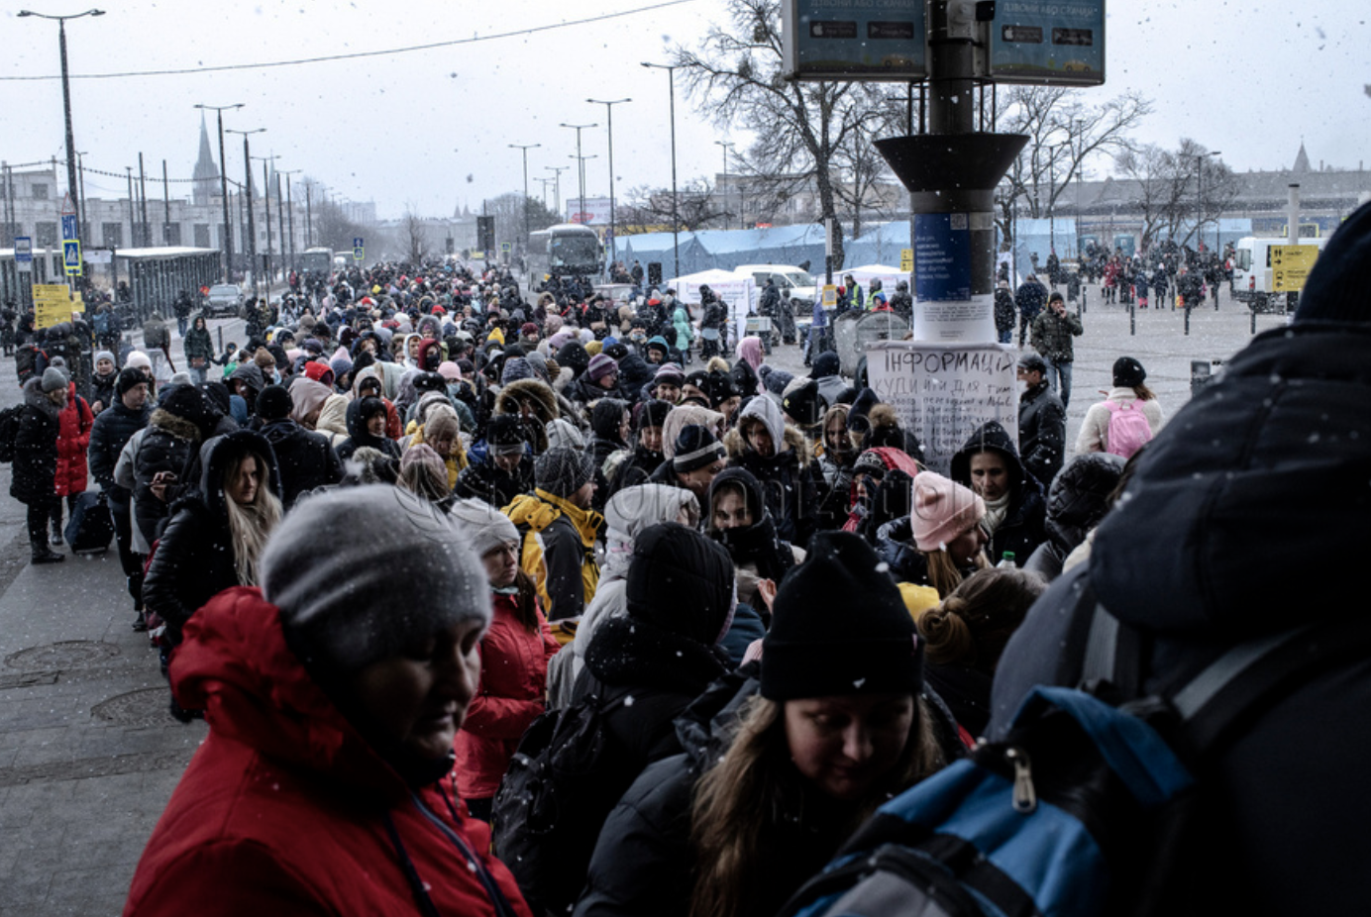
Orest Suvalo, coordinates MHPSS support in the transition points Lviv Oblast and provides PFA and psychiatric assistance as the Lviv railway station
https://photos.euro.who.int/galleries/285/ukraine-assistance-to-ukrainians-in-lviv-march-202

Slide 19
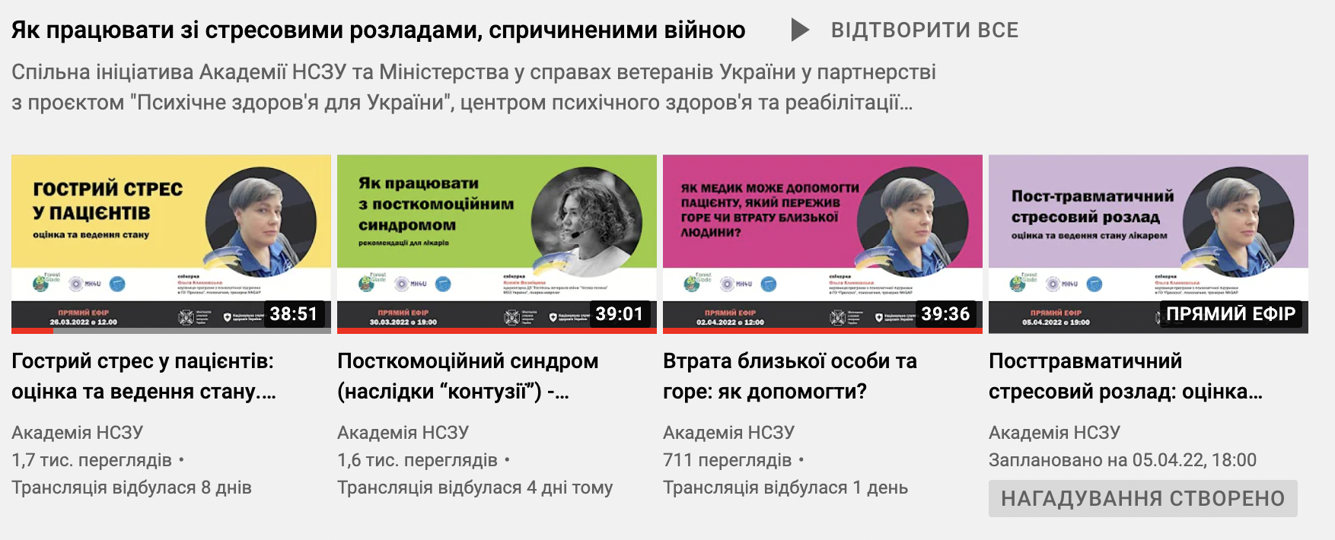

https://www.youtube.com/channel/UCjNc_c-4lz-NSkQH3EBMKbQ

Slide 20
NEXT STEPS after the mhGAP HIG Promotion:
Deliver mhGAP HIG Orientation Training (online, 1 day)
Start to deliver mhGAP HIG in a full mode (3 days offline)

Slide 22
Challenges in humanitarian emergencies
Urgency and scarce resources
Limited training time
Limited access to specialists
Limited access to medication

Slide 23
mhGAP HIG
For those people affected by disasters that need more help
To be used in humanitarian emergencies –so shorter than mhGAP and focus on conditions common to emergencies
For use when resources stretched
Derived from longer mhGAP IG (implementation Guide)

Slide 24
Examples:
The place of mhGAP HIG in overall mental health and psychosocial response
Mental health care by mental health specialists (psychiatric nurse, psychologist, psychiatrist etc) mhGAP HIG can be used
Specialised
services
mental health care by PHC doctors
Basic emotional and practical support by community workers
(mhGAP HIG)
Focused (person-to-person) non-specialised supports
Activating social networks
Communal traditional supports
Supportive child-friendly spaces
Community and family supports
Strengthening community and family supports
Advocacy for basic services that are safe, socially appropriate and protect dignity
Basic services and security
Social considerations in basic services and security
Notes:
24

Slide 25
mhGAP HIG –Humanitarian emergencies
1 in 11 people have significant mental health disorder
20% have mental health problems

Slide 26
mhGAP HIG –Humanitarian emergencies
Common mental health problems are depression, anxiety, stress, grief conditions, bedwetting, behavioural problems, ptsd
Substance abuse
Gender based violence
relapse triggered of pre –existing conditions –psychosis, depression, epilepsy

Slide 27
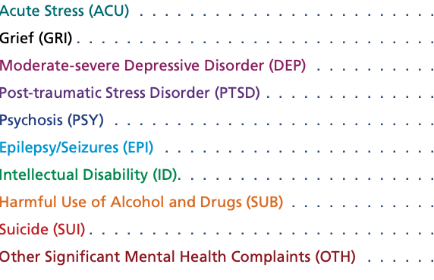
mhGAP HIG –Humanitarian emergencies

Slide 28
mhGAP HIG
Simple, practical tool that aims to support general health facilities in areas affected by humanitarian emergencies in assessing and managing mental, neurological and substance use conditions
Consistent with Inter-agency standing Committee (IASC) guidelines on Mental Health and Psychosocial Support in Emergency Settings and the UNHCR Operational Guidance for Mental Health and Psychosocial Support in Refugee Operations

Slide 29
mhGAP HIG
The Mental Health Gap Action Programme (mhGAP) – a WHO programme to address gaps in care for people with mental health problems
For general physicians, nurses, midwives, clinical officers
Also associated tools in mhGAP

Slide 30
mhGAP HIG-contents
Advice for clinic managers
General principles of Care
Specific modules
UNHCR –Health Information System
Glossary

Slide 31
mhGAP HIG-General Principles of Care
Principles of Communication
Principles of Assessment
Principles of Management
Principles of Reducing Stress and Strengthening Social Support
Principles of Protection of Human Rights
Principles of attention to Overall Well-being

Slide 32
mhGAP HIG-Communication (GPOC)
Right environment
Respectful
Principles of PFA
Patient is involved/directs care
Listening and explaining
Language
Non judgmental
Translators

Slide 33
mhGAP HIG –assessment (GPOC)
Physical
Mental
Social
Be alert for suicide, vulnerable groups, protection and when specialist emergency care needed e.g. withdrawal states

Slide 34
mhGAP HIG –Management (GPOC)
Physical
Mental
Social
Be alert for suicide, protection and when specialist emergency care needed e.g. withdrawal states
Vulnerable groups

Slide 35
mhGAP HIG –Management (GPOC)
Participatory
Explain
Involve family /carers
Follow-up

Slide 36
mhGAP HIG –Management (GPOC)
Basic psychosocial support
Listen –don’t pressure to speak
Ask –about person’s needs
Help –meet their needs
Protect –from further harm

Slide 37
mhGAP HIG –Principles of Reducing Stress and Strengthening Social Support (GPOC)
Assess social support
Stresses
Positive coping methods
Problem solving
Protection
Breathing exercises and other relaxation
PFA
Carer support
”hand technique”

Slide 38
mhGAP HIG
Hand technique
-Social mobilisation
-stress reduction
-strengthening social support
-behavioural activation
- Cognitive and message of hope

Slide 39
                HAND TECHNIQUE Each line of palm represents 2 activities that the person does that sed used to give pleasure (behavioural activiation) each line of wrist represents 2 sayings that help give hope
Each finger
Represents
Someone or organization
Or resource to approach
(Social mobilization)

Slide 40
mhGAP HIG –Management (GPOC)
Stress reduction –breathing exercises

Slide 41
mhGAP HIG –Management (GPOC)
Problem solving

Slide 42
mhGAP HIG –Principles of Protection of Human rights
People with severe MNS conditions are at higher risk of human rights violations –including housing, family life, access to health
PFA
Social and community approach
Respect and dignity

Slide 43
mhGAP HIG –Principles of Attention to Overall Well-being
Meet all of basic needs – water, food, sanitation, shelter etc
Promote activities –child friendly spaces etc.
Physical health, vaccinations, family planning etc
NCD care
Elderly care

Slide 44
mhGAP HIG –Specific modules
Each module
General description and context
Assessment questions
Management plan
  Basic psychosocial support
  Reduce stress and strengthen social support
  Psychoeducation
  Manage concurrent conditions
  Follow up

Slide 45
mhGAP HIG –Acute stress
Sleep
Bedwetting
Hyperventilation
Dissociative symptoms (conversion disorders, pseudoseizures)
Follow up

Slide 46
mhGAP HIG –Acute stress/grief
Basic psychosocial support
  Listen
  Ask
  Help
  protect
Psychoeducation
Reducing stress and strengthen social support
Culture appropriate interventions
Resume usual activities

Slide 47
mhGAP HIG – Depression
Common condition
Assess and distinguish from stress and grief
Typical presenting complaints of moderate –severe depressive disorder
  Low energy, fatigue, sleep problems
  Multiple persistent physical symptoms with no clear causes
  Persistent sadness or depressed mood, anxiety
  Little interest in or pleasure from activities

Slide 48
mhGAP HIG – Depression
3 assessment questions
Does the person have moderate-severe depressive disorder?
Are there other possible explanations for the symptoms
Is there a concurrent mental, neurological and substance use (MNS) condition requires management

Slide 49
mhGAP HIG – Depression –Management
Psychoeducation- explain, do activities, suicide aware
Address current psychosocial stressors
Strengthen social supports
Stress management
Pharmacology
Follow-up
Specific treatments if available
  Problem solving
  Interpersonal therapy
  CBT
  Behavioural activation
Pharmacology
Follow-up

Slide 50
mhGAP HIG – PTSD
Non specific
Sleep problems
Irritability, persistent anxious or depressed mood
Multiple persistent physical causes with no clear physical cause

Slide 51
mhGAP HIG – PTSD
Specific
  Re-experiencing symptoms
  Avoidance behaviours
  Heightened sense of current threat /Hyperarousal
  Difficulty with daily functioning
  1 month after a significant event

Slide 52
mhGAP HIG – PTSD-Management
Psychoeducation –include resume activities
Reduce stress
Strengthen social support
Refer to protection agency if victim of severe human rights violations
Antidepressants
Follow-up
If available specialist CBT with trauma focus and EMDR

Slide 53
mhGAP HIG – Substance use
Typical presenting complaints
Appearing to be under the influence of alcohol or drugs
Recent injury
Signs of intravenous drug use
Requests for sleeping tablets of painkillers

Slide 54
mhGAP HIG – Substance use-Management
Manage harmful effects
Motivational conversation
Strategies to stop or reduce substance
Reduce stress
Strengthen social support
Follow up

Slide 55
mhGAP HIG – Suicide
Mental disorder, acute emotional distress and hopelessness common in humanitarian settings
May lead to suicide or feelings of self harm
Asking about suicide often reduces the person’s anxiety around suicidal thoughts, helps make people feel understood and opens opportunities to discuss problems further

Slide 56
mhGAP HIG – Suicide
Typical symptoms
Feeling extremely upset or distressed
Profound hopelessness or sadness
Past attempts of self harm

Slide 57
mhGAP HIG – Suicide
Important to have good communication on suicide

Slide 58
mhGAP HIG – Suicide –Management
Medical management
Reduce stress
Strengthen social support
Stop means of self harm
Not to leave person alone
Follow-up

Slide 59
mhGAP HIG – OTH
Other significant Mental Health Complaints
Physical health problems with physical cause
Mood and behavioural problems that do not meet criteria of other conditions like moderate depression
Significant if impair daily functioning or when person seeks help for them

Slide 60
mhGAP HIG – OTH
Other significant Mental Health Complaints –Management
Psychosocial support/psychoeducation, acitivites
Reduce stress
Strengthen social supports

Slide 61
mhGAP HIG – OTH
Other significant Mental Health Complaints –Management
Adolescents
Give more time
Activities/education

Slide 62
mhGAP HIG – other modules
Psychosis
Epilepsy/Seizures
Intellectual Disability

Slide 63
mhGAP HIG – other tools
Thinking healthy
Problem solving +
Group Interpersonal therapy
Doing what matters in times of stress
https://www.who.int/publications/i/item/WHO-MSD-MER-15.1

Slide 64
Thank you
Dr Peter Hughes dppmh@Hotmail.com
Vitalii Klymchuk

