Slide 1
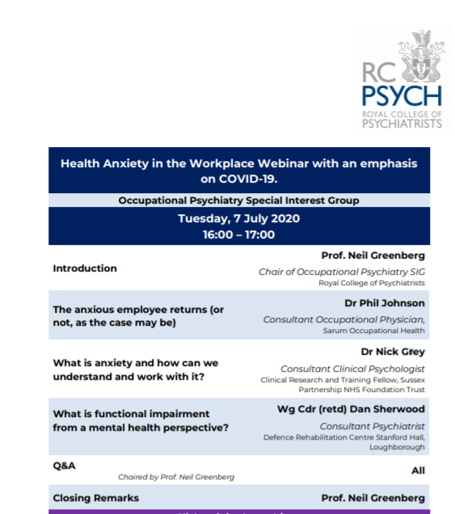





Slide 2
The anxious employee returns
(or not, as the case may be)

Slide 3
Dr Philip Johnson
Independent Consultant Occupational Physician
Sarum Occupational Health

Slide 4
We live in interesting times
There is no “rule book”
Our reliance upon “evidence” is limited – not a lot of it about
It is difficult to determine “correct” from “incorrect” (or right from wrong…)
Uncertainty is a powerful cause of anxiety
Anxiety may be “understandable”
  Or may be something else

Slide 5
Return to work after…
Why do we distinguish?
  Leave
  Maternity
  Illness
  Bereavement
  Sabbatical
  Unemployment
  Furlough
  Cannot get into work and cannot manage to be “furloughed”

Slide 6
Any return is an obstacle
Even two weeks of leave results in a rebound effect
Some are lucky enough to enjoy their work – but most are not…
Concerns do not improve with absence

Slide 7
What are the key variables in a return?
Health Status
  Covid-related – not for today
  Pre-exisiting – may be anxiety-related
  Situational – matters of the moment
Period of absence
  We know that minimising length of absence will improve the chance of successful return
  Not negotiable in the current situation
The Situation That Presents
  The major variable

Slide 8
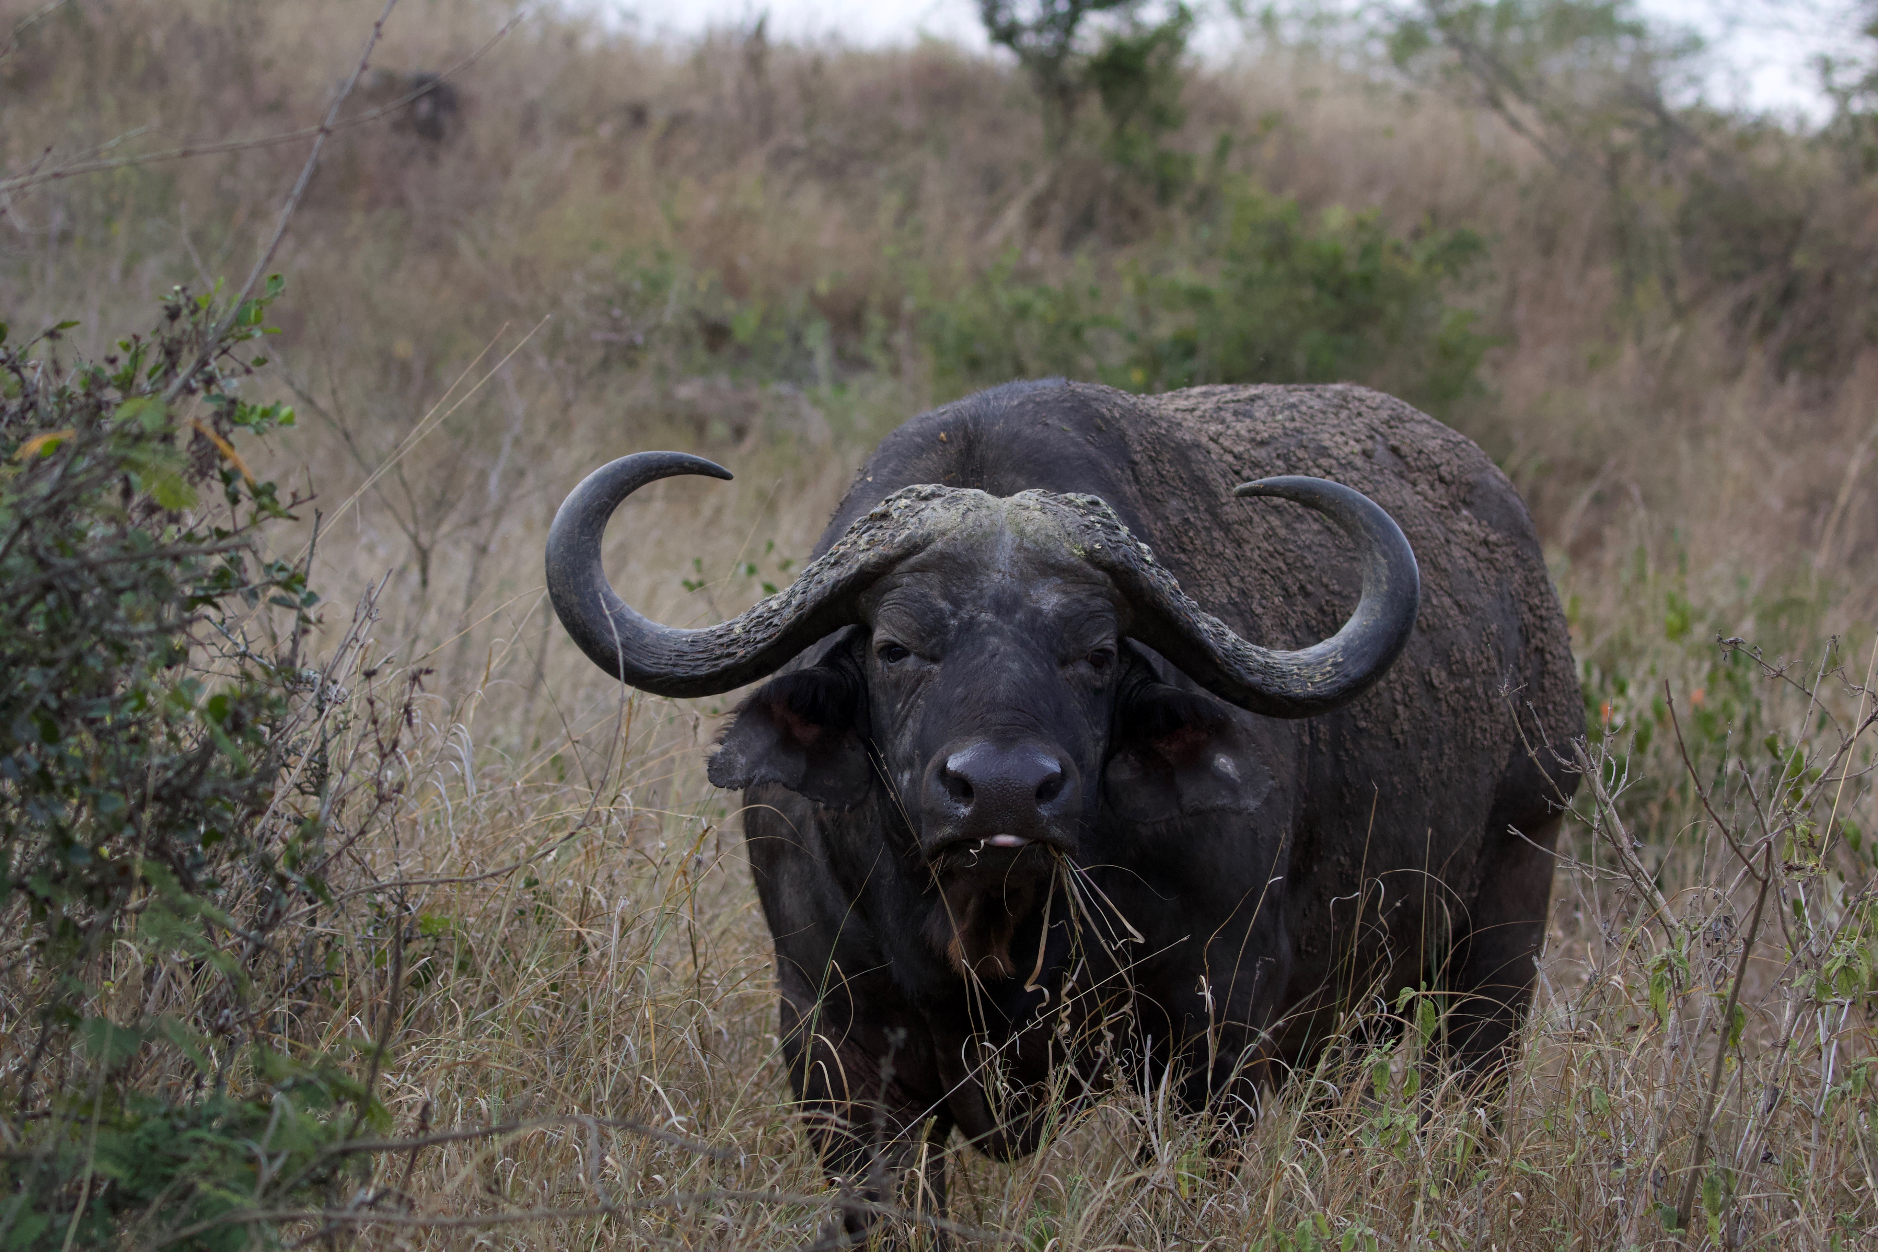
Workplace Situations
Anticipation – what awaits in the office

Slide 9
Problems have not all arisen from Covid-19
Previous poor absence history
Attendance issues
Performance problems
Interpersonal factors
Few (if any) will have been improved by 16 weeks away from work!

Slide 10
Covid-19 issues
Many reasons arising:
  I am shielding – my medical condition
  My partner, mother, cat is shielding
  I do not trust my colleagues to behave safely
  “They” are not providing correct masks
  I have a disability…
Risk assessment process
Covid Age assessments

Slide 11
Covid-19 issues - continued
Pressures of home
Working from Home – the advantages of this are a very “middle class” benefit
  Small space
  Neighbours
  Family on furlough (up late watching Box Sets!)
  Extra meals
  …
Job security/work concerns
The need is to Understand the issue
– not the stated reason…

Slide 12
I Don’t Feel Safe at Work!
Employment Rights Act Section 44 (an employee may withdraw from and refuse to return to an unsafe workplace)
  Question of perception
  Where this is borne out of anxiety rather than reason, the employee (and employer) may be in a difficult situation
Assessment should include a consideration of whether the reaction is reflection of an underlying problem

Slide 13
The problem with anxiety
How long have you got?
Individual’s perspective
  No expectation of “insight” – the individual may not see the “issues”
Lack of understanding
  No concept of
Lack of willingness to accept/address issues
Looking for “The Cause”

Slide 14
I don’t need treatment…
I need
  My manager
  My boss
  My colleagues
  My ex
  My mother
  [Please insert comment]
to stop causing all of this trouble for me

Slide 15
How to manage the anxious return?
Understand
  What is causing the problem for the individual at this time – expert advice as needed!
Define
  The issues – ideally with agreement of the individual
Address
  The problems as they present
Adjust
  Temporary adjustments can assist in building confidence
Review
  Ensure that there is adequate review built into the process, again this is a reassurance for all involved

Slide 16
Who is anxious here?
“Anxiety” may be the issue for the individual/employee/worker
There is a degree of concern for the employer (manager/HR/ “Boss”) – need to provide “safe” environment
In short, everyone is worried…

Slide 17
Who are we advising?
Employee/worker
  What can YOU do about YOUR situation?
  What can I advise about YOUR circumstances?
Managers/HR
  What can YOU [HR etc.] do about THE situation?
  Individuals/teams – what considerations and adjustments will make a difference
Organisations/C-Suite
  What SHOULD WE [C-Suite/”CMO”] DO to HELP THEM make it happen

Slide 18
Understanding
Necessary to be able to discern:
  The nature of the anxiety
  The actual cause
  How to make progress
Without an understanding of the situation it will be impossible to offer any meaningful advice

Slide 19
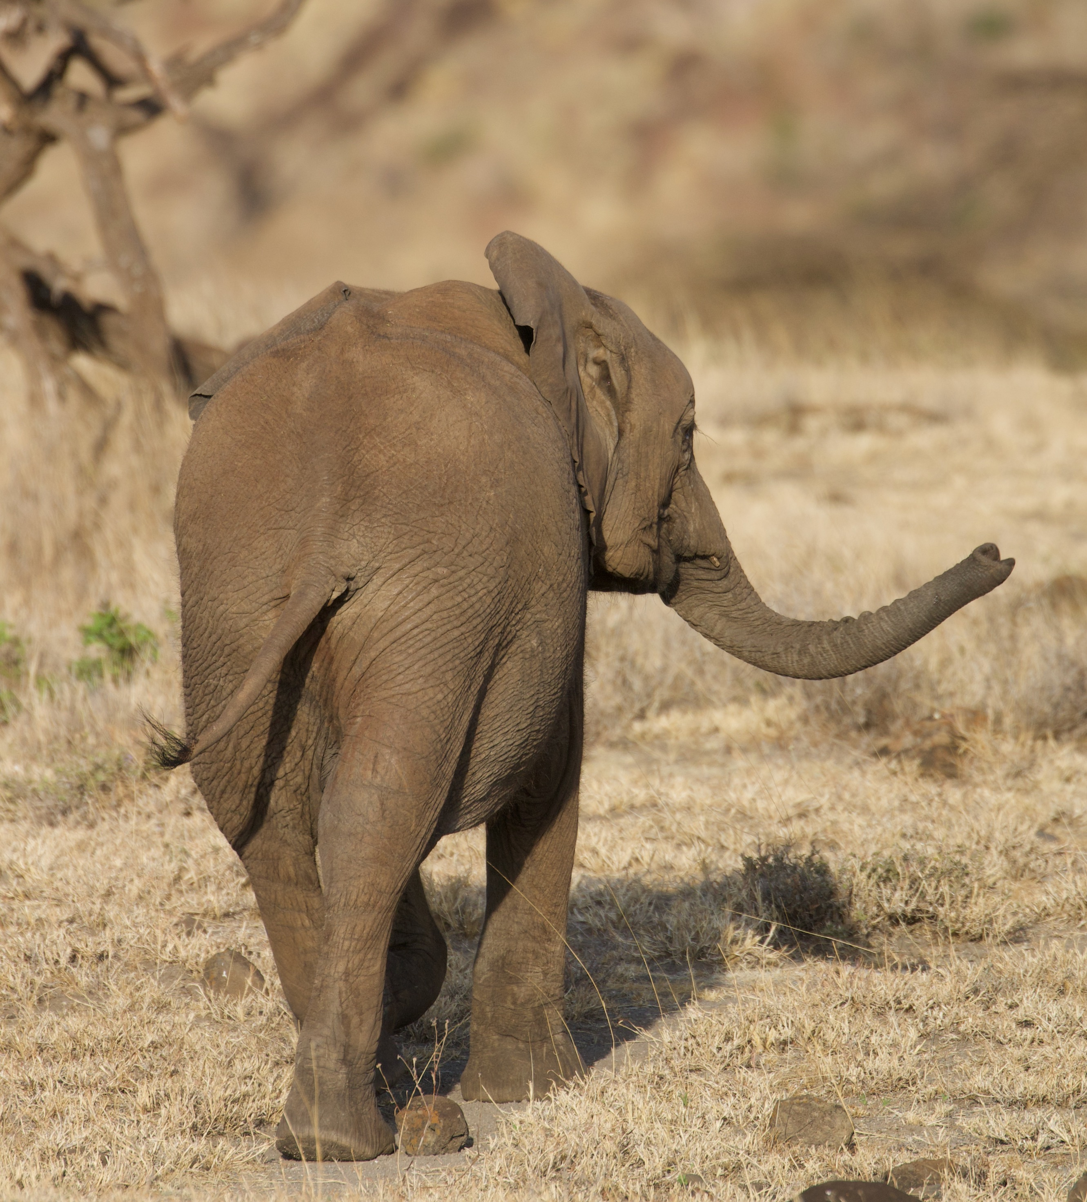
Contentment – the achievable goal?

Slide 20
Anxiety: how we can understand it and work with it
Dr Nick Grey
Consultant Clinical Psychologist
Joint Clinical Lead for the Psychology Support Programme for Covid-19 (NHSE)
July 2020
@nickdgrey

Slide 21
Outline
Understanding people’s anxiety
Acute stress, worry, and chronic anxiety (disorder)
What we can do to help
Health anxiety and ‘death anxiety’
Acknowledgements
Paul Salkovskis, Joy McGuire, Alison Croft, David Clark, Anke Ehlers

Slide 22



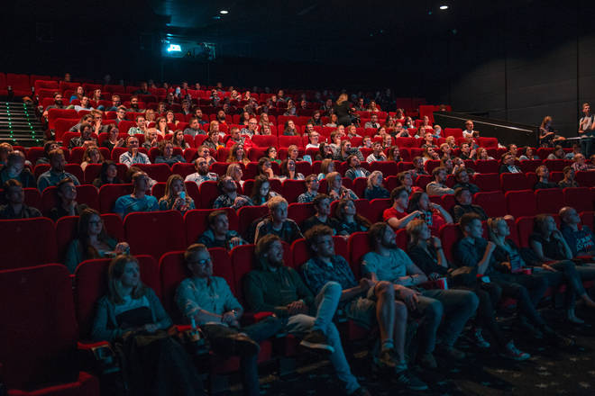

Slide 23
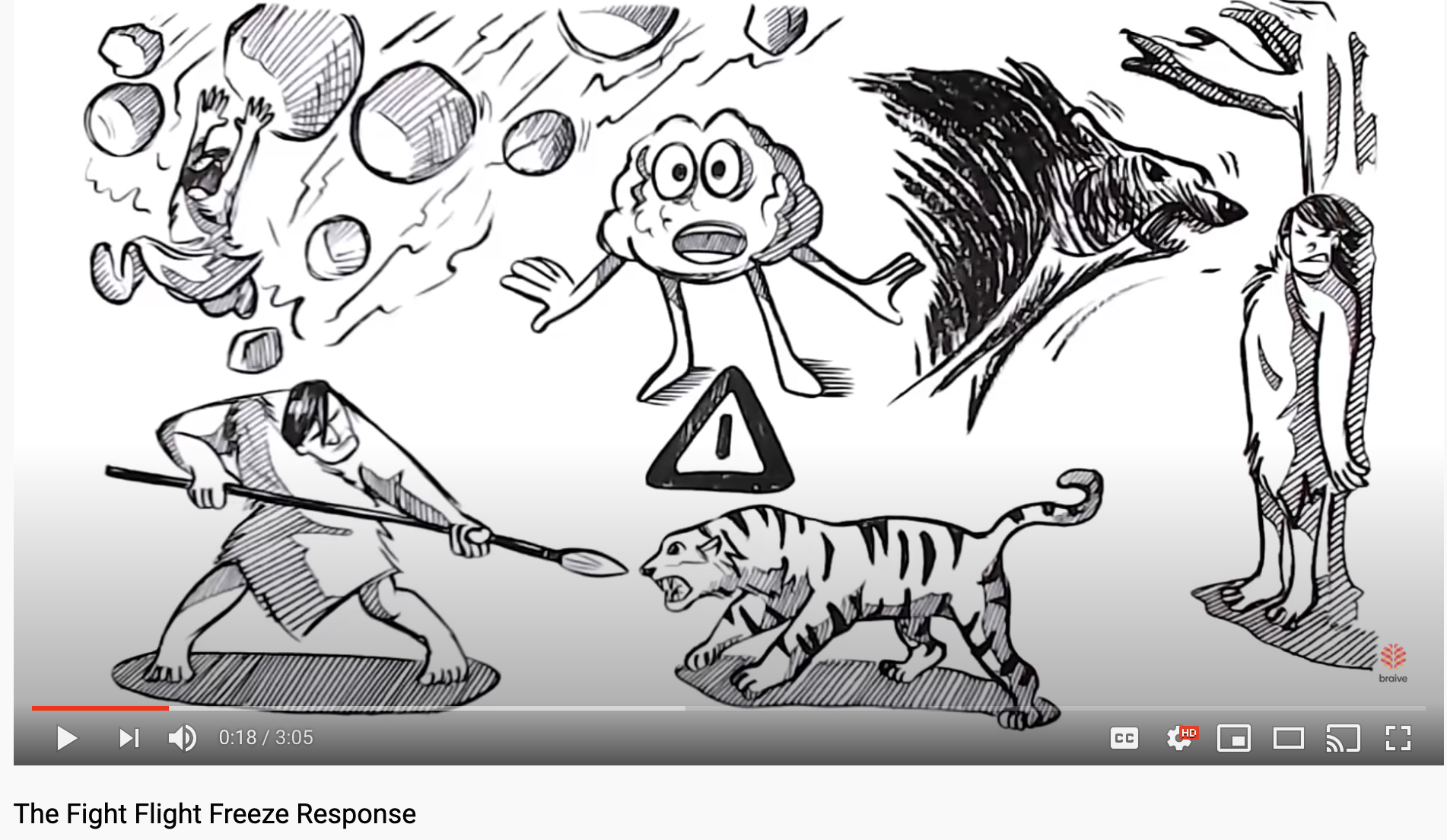
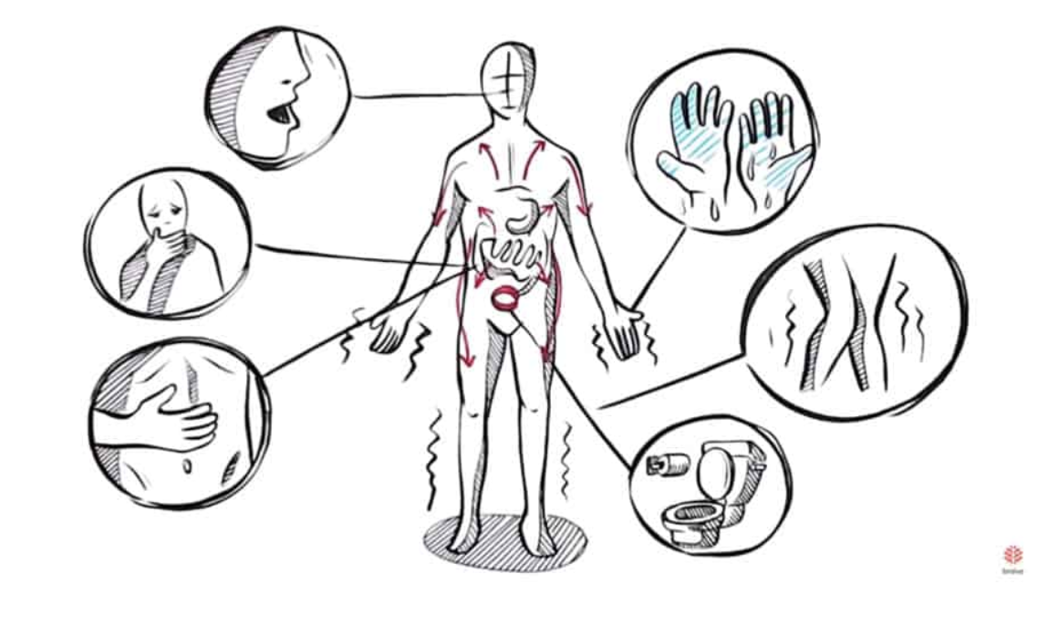
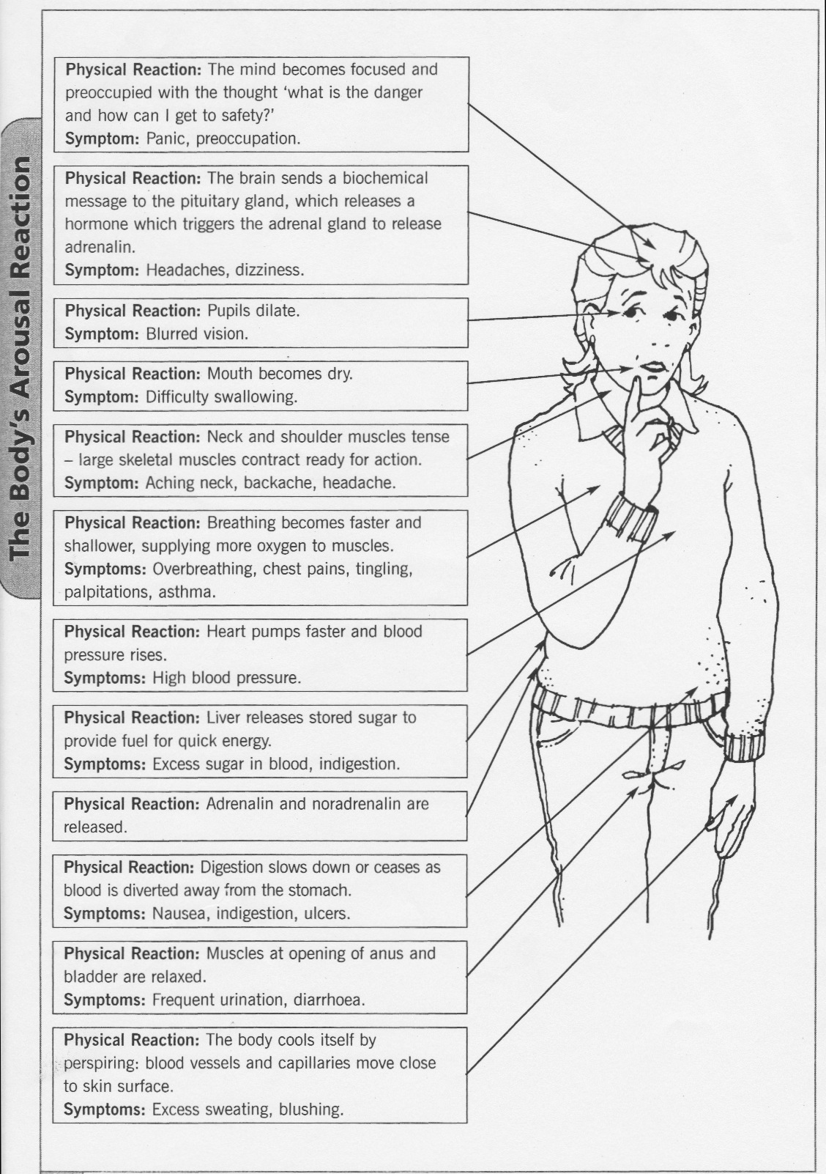
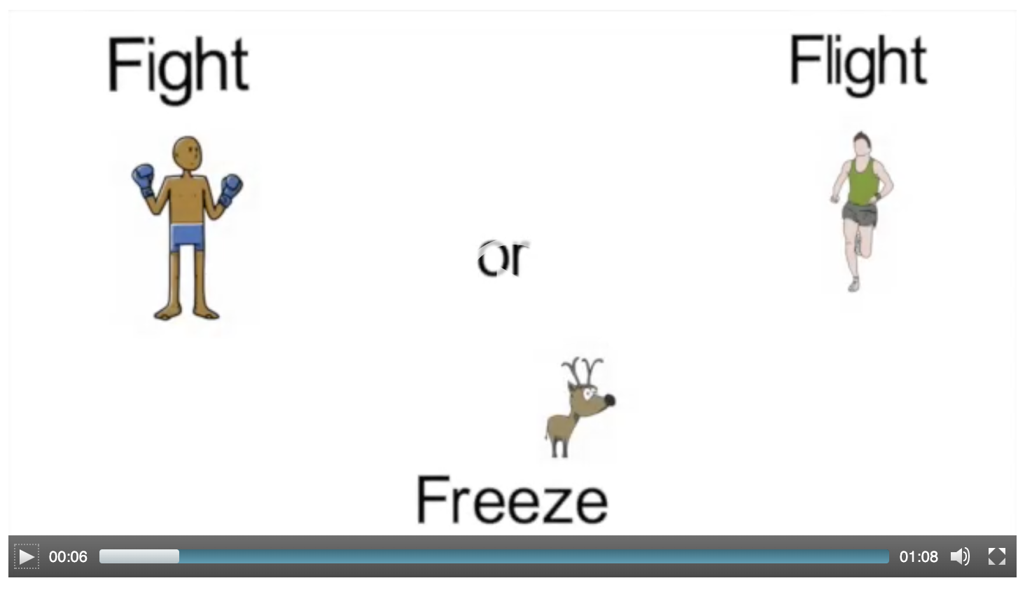

Slide 24


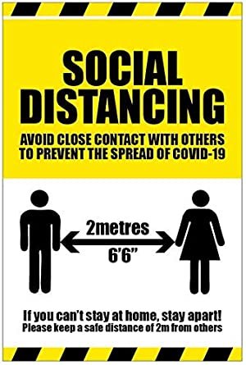


Slide 25
We are all living with risk
Take no risks
Take lots of risks
Where were you on this scale before the COVID-19?
Where are you now?
Where would your partner or a good friend be?
Where would you like to be?

Slide 26
Anxiety and threat
Anxiety is proportional to the perception of danger; that is
perceived
likelihood
it will happen
perceived
“awfulness”
if it did
X
___________________________
  +
perceived
coping ability
when it does
perceived
rescue
factors

Slide 27
Anxiety and threat
perceived
likelihood
it will happen
perceived
“awfulness”
if it did
X
___________________________
Everyone will think I am stupid and incompetent
I won’t be able to speak up at the meeting
perceived
coping ability
when it does
perceived
rescue
factors
  +
I won’t know what to do next
Others won’t help me out

Slide 28
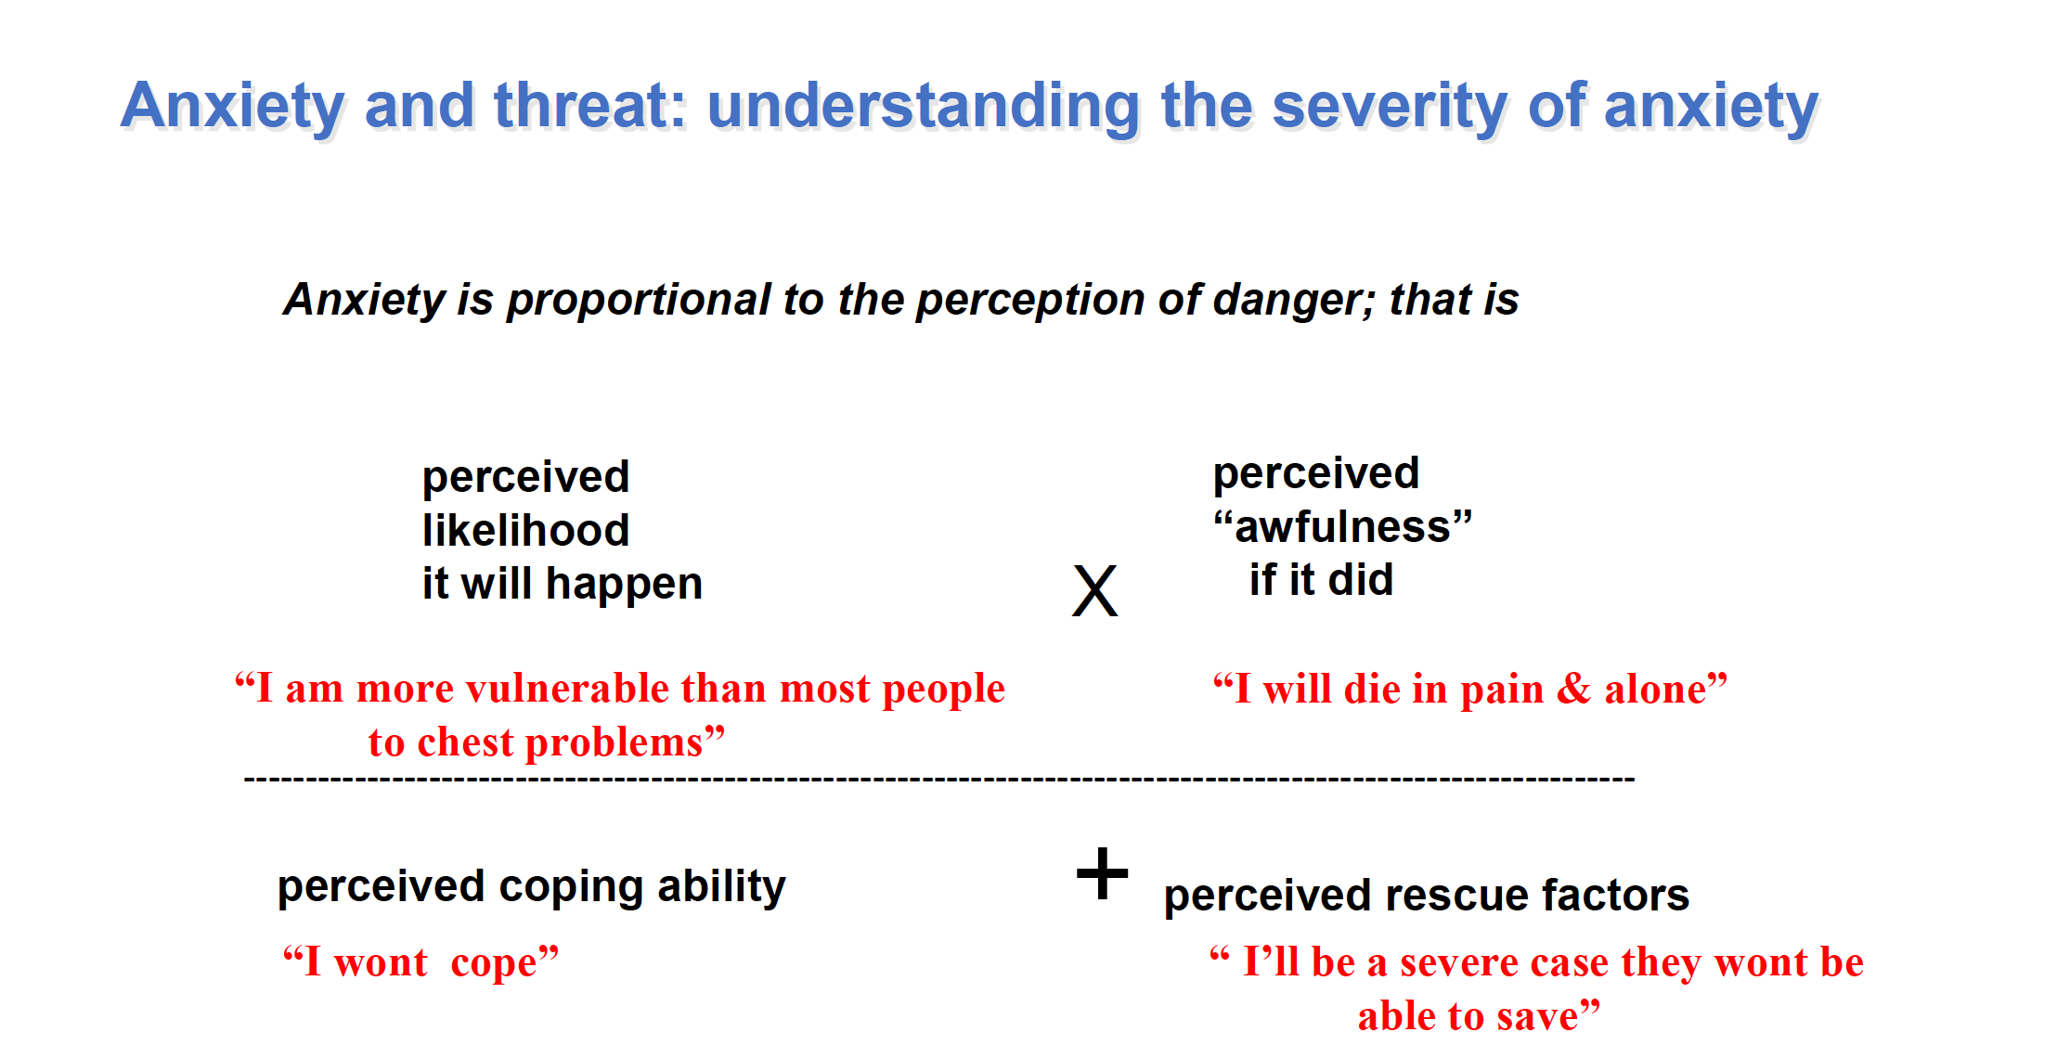
Salkovskis et al (2020)

Slide 29
Acute stress, worry and chronic anxiety (disorder)
Worry is a normal process
Anxiety is a normal human experience
Traumatic stress symptoms are normal
Most people recover from traumatic/very stressful experiences naturally
How long have they lasted?
How much do they interfere?
How upsetting are they?
Are they improving, worsening, or static?
Worry - chronic anxiety still a continuum!

Slide 30
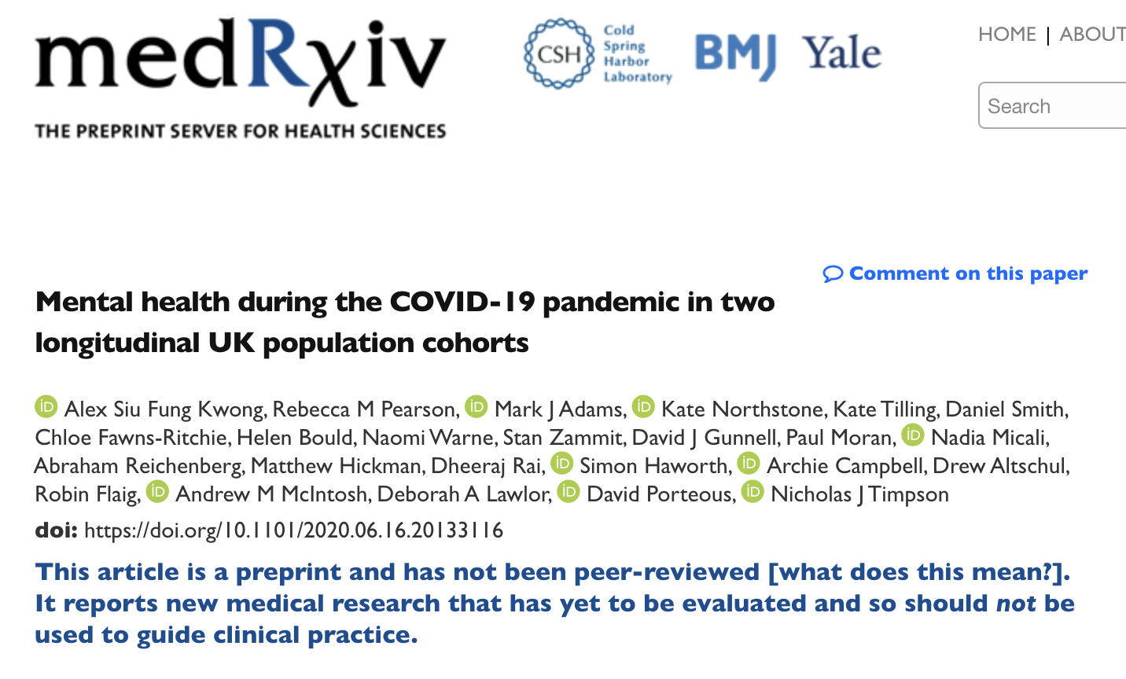
www.medrxiv.org/content/10.1101/2020.06.16.20133116v1

Slide 31
COVID-19 surveys April/May 2020 nested within longitudinal population cohorts
  Avon Longitudinal Study of Parents and Children
  Generation Scotland: Scottish Family Health Study
Anxiety higher, wellbeing lower, similar depression
Probable anxiety disorder 24% during COVID-19 vs 13% pre-pandemic
Depression and anxiety were greater in
  younger populations
  women
  those with pre-existing mental and physical health conditions
  those living alone
  those with socio-economic adversity
  No evidence for elevated risk in key workers or health care workers.
  No reporting of ethnicity

Slide 32
Is it depression?
Worry and anxiety almost always present in depression
Worry and rumination two sides of same coin
Is it PTSD?
Often missed
People may not disclose without prompting
Nature of the trauma memory makes the world seem more dangerous
Re-experiencing symptoms key
  Sense of nowness
  Awake and/or asleep

Slide 33
Treatment
Specific anxiety disorders need to be offered psychological interventions
CBT recommended by NICE across all anxiety problems
Understand (formulation)
Get summaries and feedback from patient (as prone to misinterpretation)
Address the threat / meanings
Change the maintaining processes
Provide information (normalisation)
Overcoming avoidance
Notes:
Avoidance is culturally sanctioned right now

Slide 34
Formulation is the less threatening understanding
anxiety
memories
attention
Worry processes
threat appraisal / meaning
reassurance
checking
physical sensations
Avoidance
(Mental) events, stimuli, situations
Notes:
Understanding people’s worst fears
Understanding the maintaining processes

Slide 35
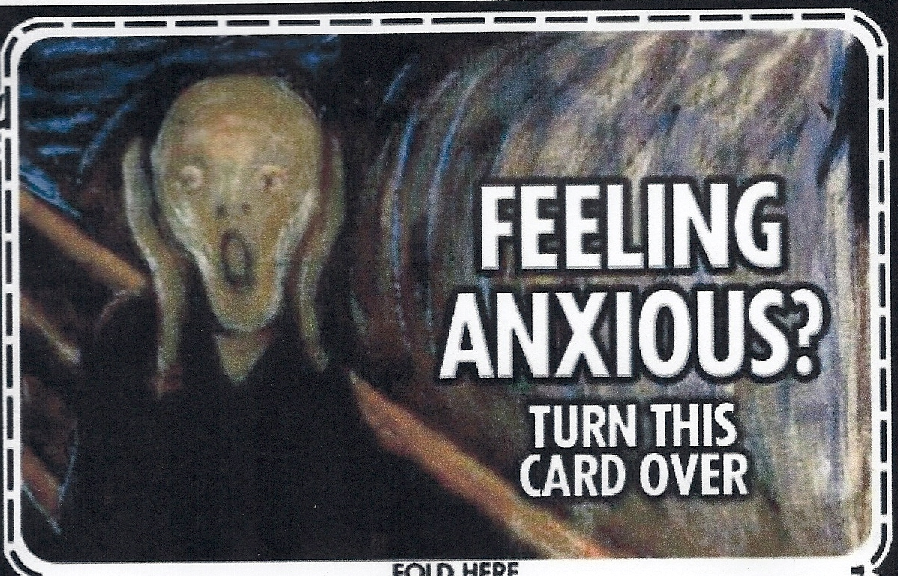

Slide 36
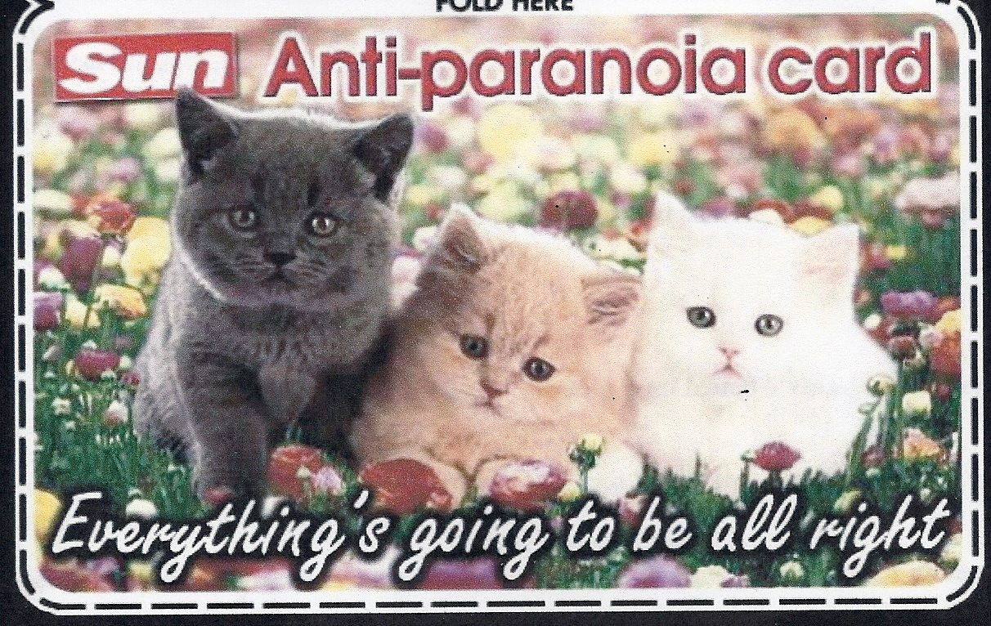
X
Normalisation and provide information, not reassurance, for chronic anxiety problems

Slide 37
Health Anxiety
“Disease Phobia”
  strong with Covid-19 situation
“Disease Conviction”
  limited by time scales.
Misinterpretation
  of the meaning of symptoms (most likely to result here in Panic)
  misinterpretation of the meaning of medical information (from health professionals and the media)
Reassurance seeking from health professionals and the web sometimes very extreme
Patients able to elicit not only reassurance, but also multiple (expensive) unnecessary referrals and investigations

Slide 38
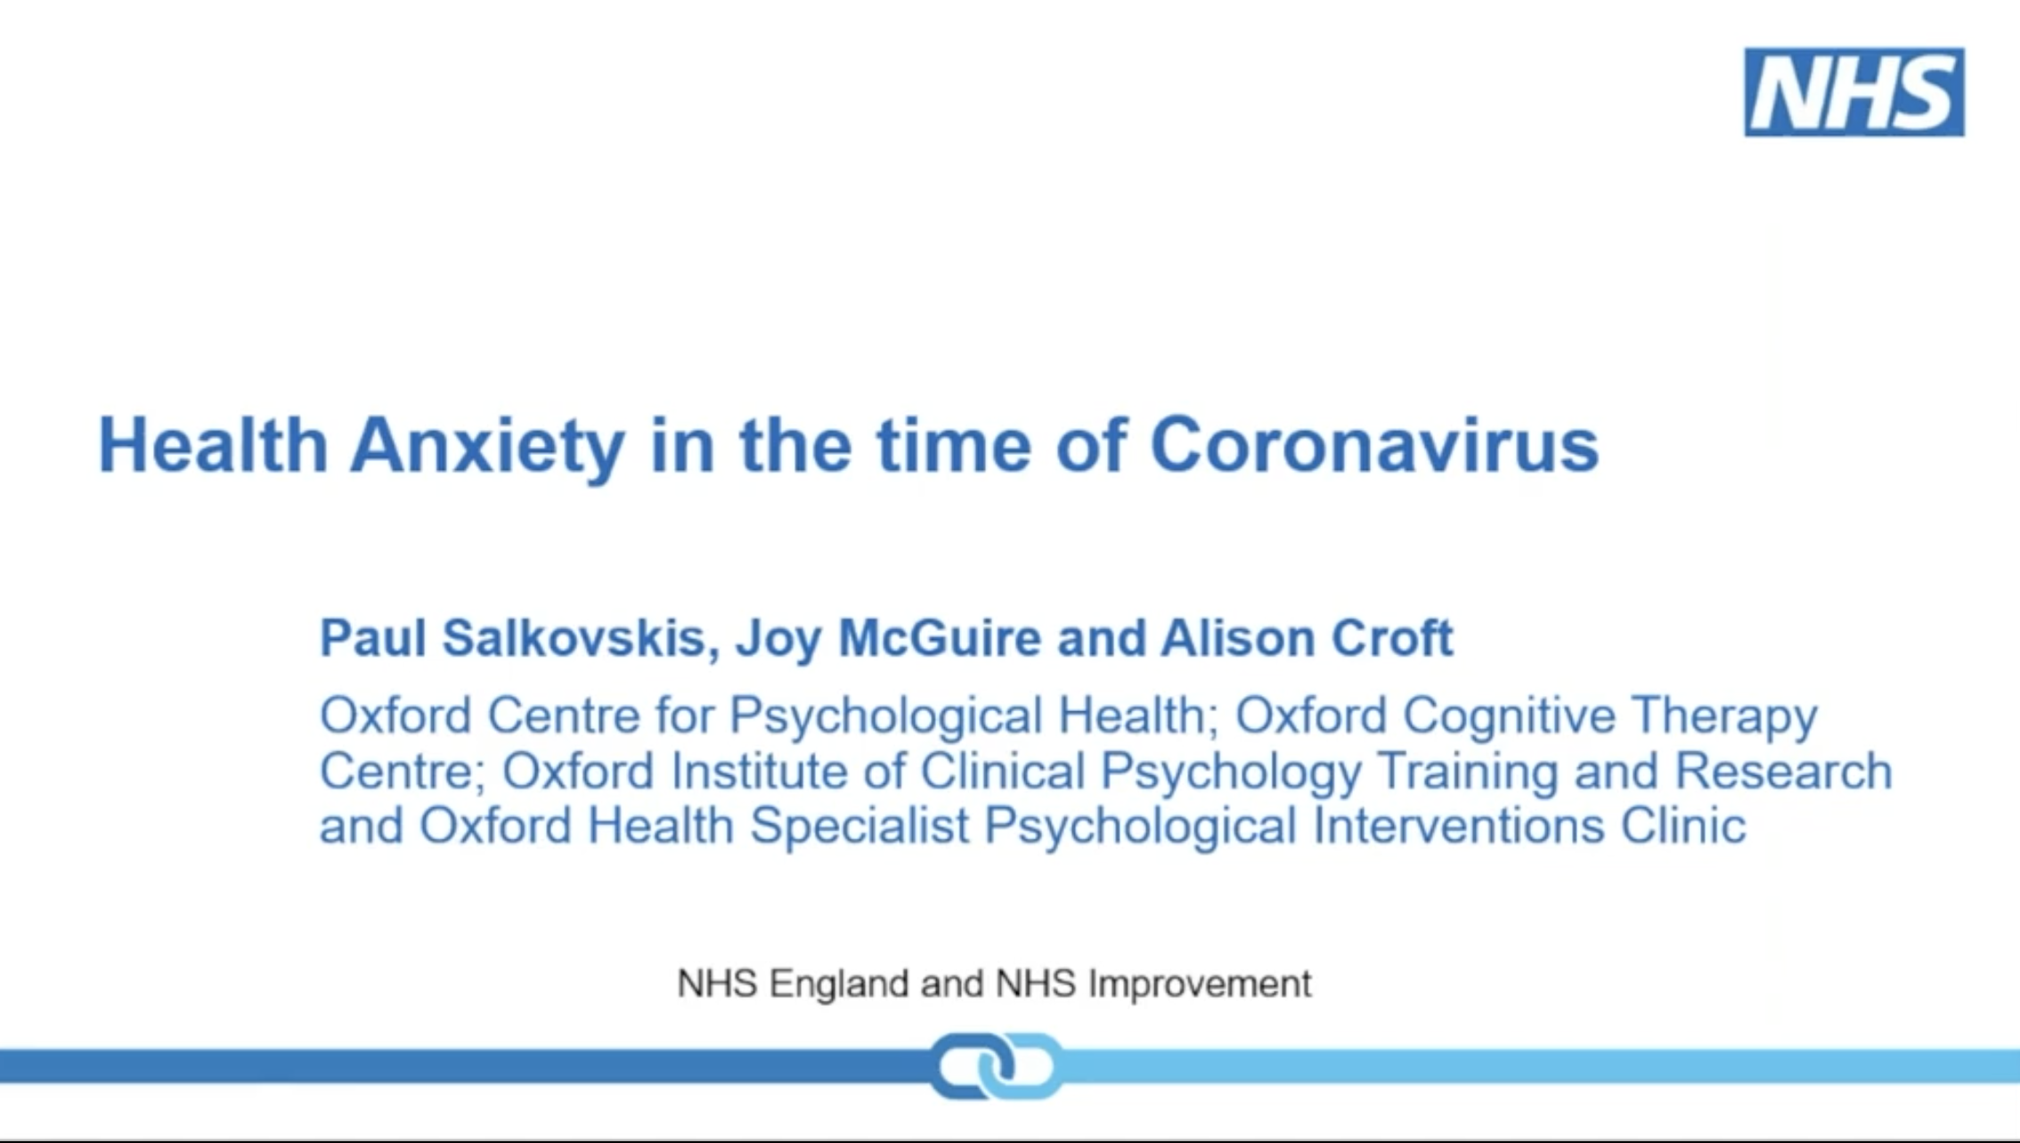
www.babcp.com/Therapists/IAPT-Webinars.aspx

Slide 39
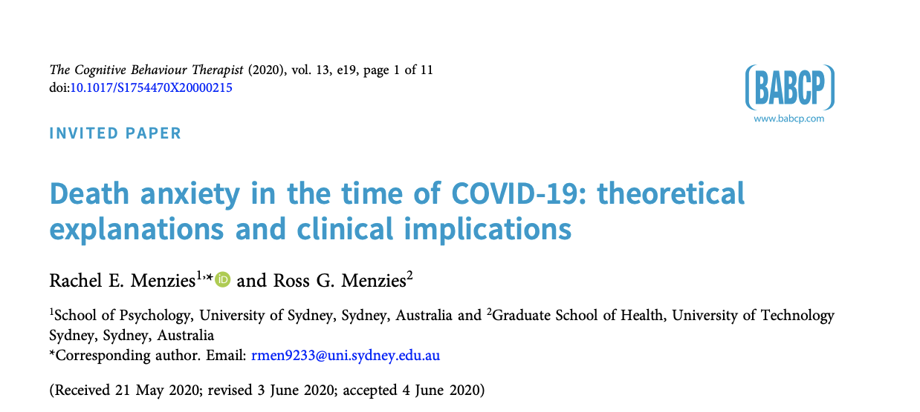
Terror Management Theory (TMT; Becker, 1973)
Two buffers in order to allay this fear:
  Cultural worldviews
  Self-esteem
Reminders of death (e.g pandemic) produce increases in attempts
  to avoid a physical death (such as by wearing protective gear or self-isolating)
  to ensure a symbolic immortality (such as by bolstering one’s cultural worldviews, and aggressing against those that threaten them).
Notes:
our awareness of our own death produces a crippling terror
Cultural worldviews involve shared symbolic concepts of the world, including identifying with cultural values or endorsing belief systems, such as the belief in an afterlife. Sharing these cultural worldviews is thought to offer a sense of ‘symbolic immortality’, by giving an individual a sense of permanence and meaning in the face of death. Secondly, self-esteem, gained through fulfilling the expectations of our cultural worldview, is also said to buffer death anxiety, by making one feel like a valuable member of their culture, who will be remembered after death (Greenberg, 2012).

Slide 40
Death anxiety
Transdiagnostic, underlying range of mental health conditions
Specific worries or thoughts about death
  dying process itself (e.g., pain or loss of cognitive capacities),
  the feared death of a loved one
  fears concerning eternal punishment in the afterlife
  uncertainty surrounding life after death, or non-existence itself
Focus on addressing the cost of death, rather than likelihood
CBT treatments aimed at overcoming avoidance are most effective
Notes:
Panic disorder
Health anxiety
OCD

Slide 41
Avoidance
Avoidance is a key symptom of anxiety (and traumatic stress)
So distressed staff may be staying away from work
Staff who don’t turn up to work should be asked if it is related to worry / stress /psychological problems

Slide 42
Advice (for us all!)
Rely on trusted sources of information (e.g. NHS) about the pandemic and what to do.
  Recognise that people with anxiety will misinterpret this so ask for their understanding
Limit exposure to the news and media reporting.
Stick to what is known rather than speculation
Differentiate acute stress responses from chronic problems
Psychological interventions most available in IAPT services

Slide 43





Ways to access support during COVID-19
Send the text ‘FRONTLINE’ to 85258 to start a conversation
Listening Line - For all NHS Staff – call
0300 131 7000 07:00-23:00
Bereavement and loss support call
0300 3034434 07:00-23:00
Help
now
On-line
www.people.nhs.uk
Self guided mental heath support
Common rooms
Emotional support
A range of materials to support you and your teams perform under this pressure.
Webinars
Access to the latest information and support
Meet other professionals in a safe and guided space. Get support and share your experiences.
https://www.practitionerhealth.nhs.uk/upcoming-events
http://horizonsnhs.com/
caring4nhspeople/
https://www.practitioner
health.nhs.uk/
Apps
Silvercloud
https://nhs.silvercloudhealth.com/signup/
use the code NHS2020
Free access to psychological support – use your nhs.net email address to download

Slide 44






nick.grey@sussexpartnership.nhs.uk
www.researchgate.net/profile/Nick_Grey
@nickdgrey

Slide 45
Functional impairment associated with COVID-related anxiety symptoms
Dr Daniel Sherwood, Consultant Liaison Psychiatrist, Defence Medical Rehabilitation Centre, Stanford Hall

Slide 46
Who is vulnerable to anxiety associated with COVID-19?
People who have recovered from Covid-19 infection (any severity)
People who have had a traumatic experience linked to the pandemic
People who are medically vulnerable to the effects of Covid-19
People with increased vulnerability to anxiety symptoms in general
The (understandably) worried well

Slide 47
Anxiety symptoms can affect one’s ability to:
Work effectively
Work independently
Work with others
Work safely
Work at all

Slide 48
To work effectively one needs to:
Make good decisions
Prioritise tasks and utilise time management strategies
Have sufficient stamina to respond to the rigours of a full shift

Slide 49
To work independently one needs to:
Work effectively
Tolerate being temporarily removed from sources of support such as peer group or supervision.

Slide 50
To work with others one needs to:
Tolerate frustration
Relinquish some control over one’s working pattern
Tolerate noise

Slide 51
To work safely one needs to:
Work effectively
Work predictably
Unpredictable episodes of panic

Slide 52
To work at all, one needs to:
Work effectively
Work predictably
Leave the house (if required to)
Feel well enough

Slide 53
General considerations when assessing fitness to work
Environment
Level of stress attached to the role
Level of supervision and peer support
Safety critical tasks
Individual vulnerability to worsening symptoms of physical or mental illness
The impact of the individual’s illness upon the rest of the team
The individual’s insight into their diagnosis

Slide 54

Questions?
@rcpsychOHSIG
@profngreenberg
@nickdgrey

